Slide 1
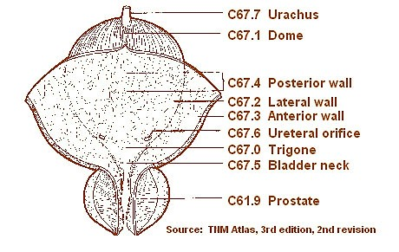
Update on the pathological diagnosis of urothelial lesions
Andreas C. Lazaris, Pathologist
Notes:
The pathology reports can present some differences on the basis of the surgical specimens: for example, report on transurethral resection (TUR) specimens supplies the main information that determines subsequent patient management, such as re-TUR or radical treatment, while report on cystectomy may have an effect on further adjuvant chemo/radiotherapy or appropriate surveillance.
Currently, histological evaluation remains the gold standard for classifying and diagnosing urothelial tract tumors, which is underlined in the recent WHO classification. Surgical pathology is able to relatively rapidly provide crucial data for the treatment of bladder cancer, such as stage, grade, lymphovascular invasion, carcinoma in situ and histological subtypes with known prognostic impacts (e.g. micropapillary carcinoma).
The urologist should indicate:
• demographic information and clinical history of the patient, bladder cytology if present, whether it is the first presentation of the tumor and if not, details of previous resection;
• the cystoscopic appearance of bladder mucosa and indicate number, size, location of the tumor/s, the morphological features of the lesion: papillary, solid, or ulcerate;
• the state of remaining mucosa if further biopsies were performed;
• if previous radiotherapy to the bladder or to adjacent organ were performed;
• if after the first transurethral resection of bladder tumor (TURBT) local treatments, such as bacillus Calmette-Guérin (BCG) or Mitomycin C intravesical instillation, were performed.
En bloc resection is an emerging surgical technique that provides a circumferential incision of the bladder mucosa at a safety margin of few millimeters from the lesion. This technique allows removing the whole tumor and part of the underlying detrusor muscle. Several energy sources are used for this surgical technique, such as monopolar or bipolar current, Holmium and Thulium laser, and hydrodissection. Recent studies have demonstrated that “en bloc” resection of bladder tumor (ERBT) should be considered feasible for bladder tumor size of ≤ 3 cm. This surgical technique, compared with traditional TUR, provides an intact tumor specimen containing detrusor muscle that allows pathologist to make accurate histopathological evaluation. In this type of specimen evaluation of circumferential and deep resection margins must be performed.
“En bloc” resection of bladder tumor surgical practice is not yet widely used while TUR remains the surgical procedure more used for non-muscle invasive bladder tumors and for large tumors that can be removed in fragments. The TUR specimens should be weighted in aggregate and processed completely, especially for TUR specimens up to 10 g. When papillary neoplasms are recognizable in these specimens, the number of tissue chips, that shows the lesion and gross tumor size should be recorded and, at least 1 cassette block per cm of tumor, up to 10 blocks, should be sampled initially.
In case of cystectomy, the urologist should provide further information, such as:
• information about previous surgical treatments, location, and pathological diagnosis of bladder lesion/s;
• cystoscopic appearance of the bladder mucosa;
• tomographic scan or MRI of the bladder (if performed) to better compare them with macroscopic appearance of the specimen;
• information concerning neoadjuvant chemotherapy, location, number, and size of the lesion/s presents in bladder before therapy to avoid the difficulties in identifying the tumor/s.

Slide 2
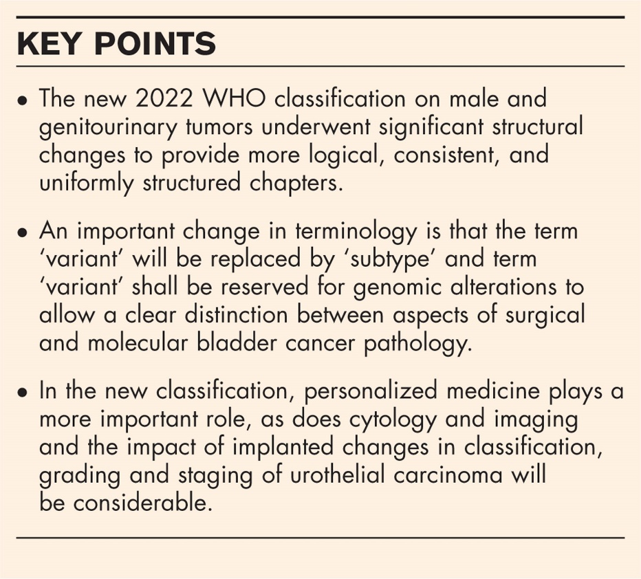
Summary of important changes in the WHO 2022 classification for urothelial carcinoma
Structural changes similar to other 5th edition WHO handbooks.
New subchapters for rare entities and divergent differentiation have been added. New subchapters have been written about Littré gland carcinomas of the urethra, skene gland carcinomas of the urethra and Cowper gland adenocarcinoma of the urethra. These cases are exceptional and are problematic for the diagnosis, as the literature is particularly sparse.
Important changes in terminology: The terms ‘urothelial hyperplasia’ and ‘urothelial proliferation of unknown malignant potential’ will not be addressed and are now thought to be benign. The morphology term ‘variant’ is replaced by ‘subtype’. The term ‘variant’ shall be reserved for genomic alterations.
Cause and pathogenesis discussions include a concise summary of major molecular findings of the last years.
Changes in the classification of neuroendocrine tumors based on 2017 IARC consensus conference
The new WHO 2022 encourages pathologists to perform substaging of pT1 urothelial carcinomas and suggests different methods for this.

Slide 3
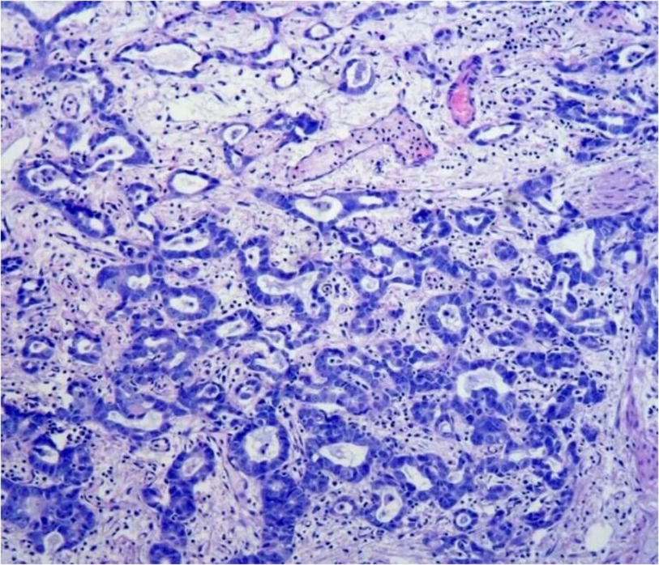
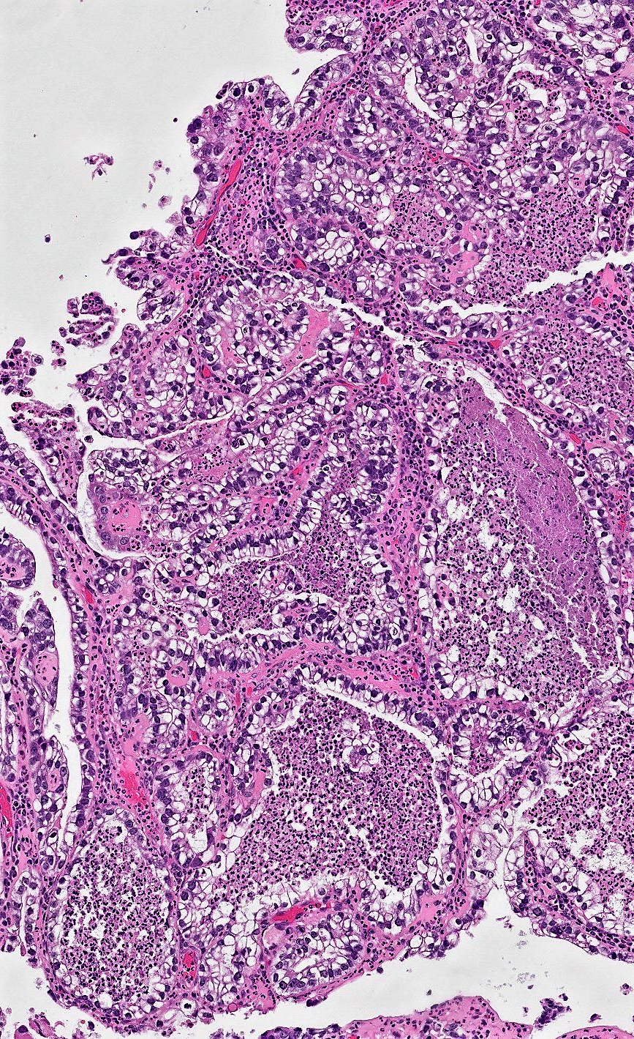
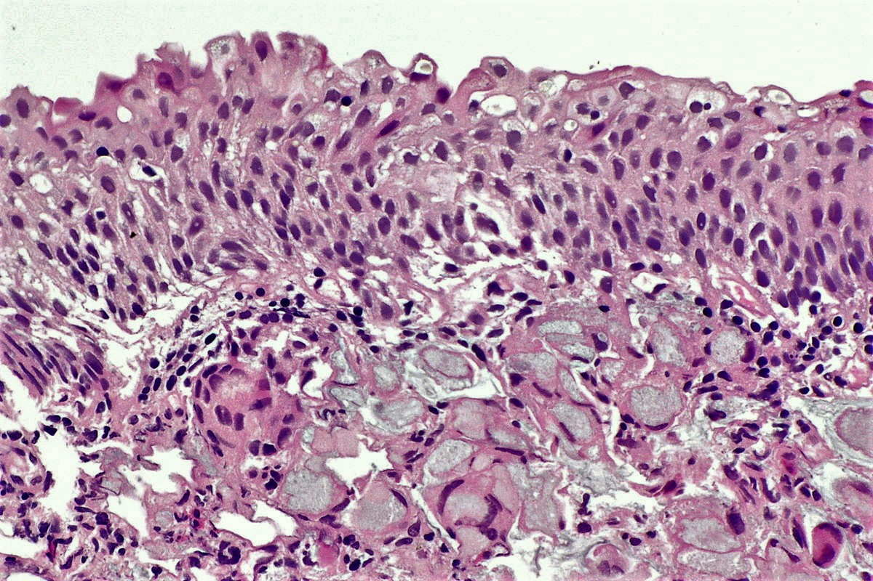
UROTHELIAL CARCINOMAS TERMINOLOGY
Müllerian
differentiation
Tubular subtype
Signet ring-cell / plasmacytoid carcinoma
Notes:
Importantly, the term ‘variant’ in the context of morphology will be replaced by ‘subtype’. The term ‘variant’ shall be reserved for genomic alterations. This allows a clear distinction between aspects of surgical and molecular bladder cancer pathology.
Regarding divergent differentiation: in addition to squamous, glandular and trophoblastic differentiation, Müllerian differentiation – which was present but less visible in the previous edition – has now received its own subchapter. Flat/cuboidal neoplastic cells with abundant clear/eosinophilic cytoplasm and frequent hobnailing, papillae may have hyalinized cores, myxoid stroma can be seen.
Urothelial carcinoma with (true) glandular differentiation which tumor has intratumoral tubular or enteric gland-spaced shape structures.
For the microcystic urothelial carcinoma a new subtype/name has been added, which is the tubular subtype.
The signet ring-cell carcinoma is still considered to be included within the plasmacytoid urothelial carcinoma. Regarding signet ring-cell carcinomas, attention must be paid not to classify it as a signet ring cell adenocarcinoma with mucin production, which is a different subtype and belongs to the adenocarcinomas.
It is important to mention that the interobserver variability in case of rare subtypes is rather high.

Slide 4
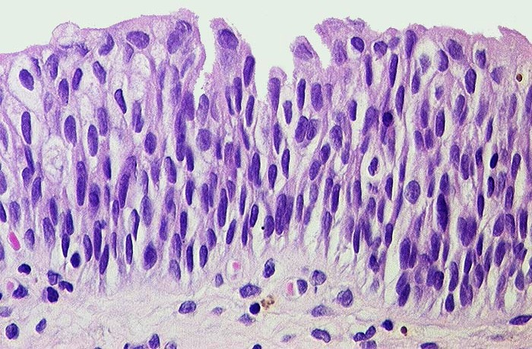
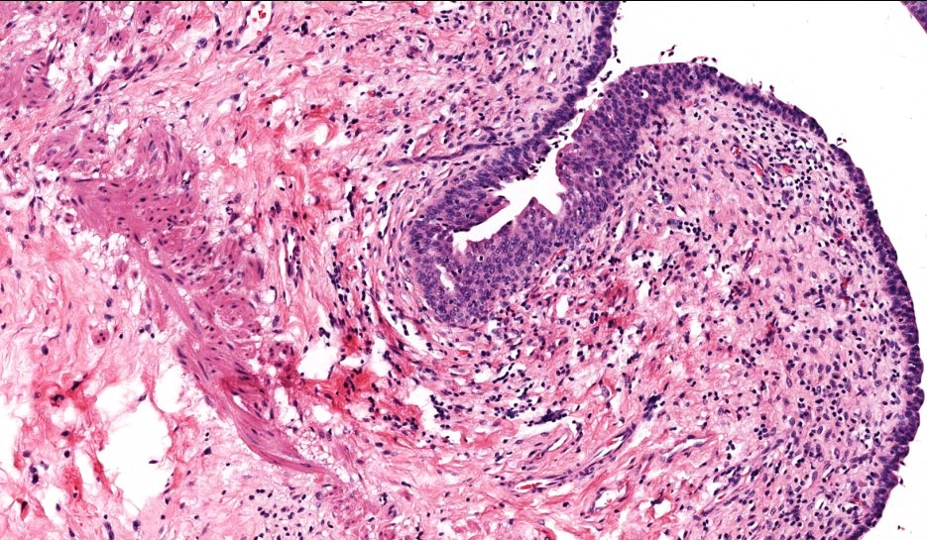
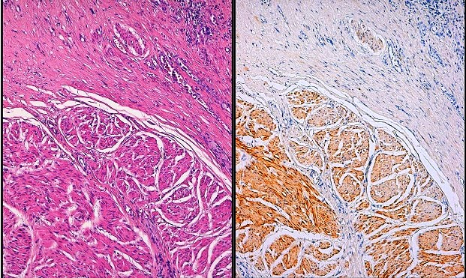
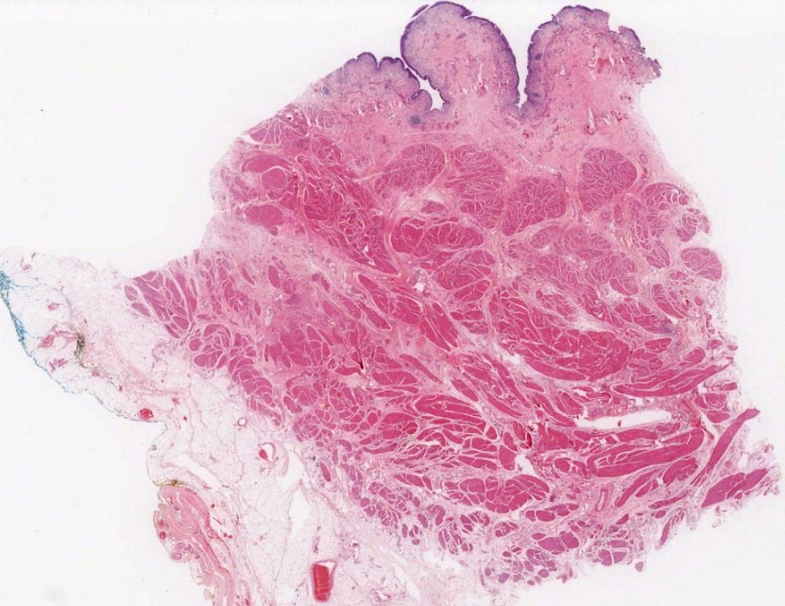
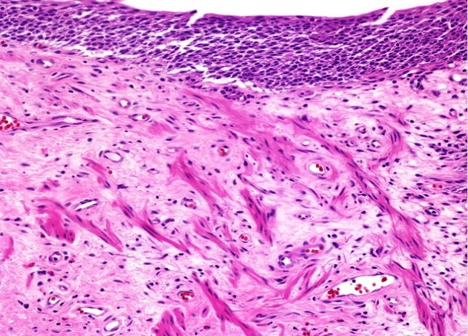
Normal histology: Bladder layers are mucosa (urothelium, lamina propria, discontinuous muscularis mucosa), muscularis propria, adventitia, serosa / peritoneum at dome; no submucosa is present.
One challenge is the different structure of the bladder according to the anatomic location, where TURB was performed. The muscularis mucosae is often not identifiable at the trigone, the detrusor muscle on the other hand can be extremely thick in this area because of the insertion of the ureters. Therefore, lack of information on biopsy or TURB location may influence staging outcome. The differentiation of muscularis mucosae and muscularis propria is also often considered a common challenge in certain situations. Correct staging is also often challenging after multiple resections, which leads to hypertrophy, different orientation, or even desmoplastic reaction of lamina propria and/or muscularis mucosae. Other factors which might influence staging are thermal or crush artifacts, as well as necrosis, especially if extensive.
Smoothelin antibody, a marker of terminally differentiated smooth muscle, is useful in distinguishing muscularis propria (positive) from muscularis mucosa (negative). It can be used only in the presence of muscularis propria as an internal positive control.
Normal bladder wall section shows a weak smoothelin staining in the muscularis mucosae and a strong and patchy smoothelin staining in the muscularis propria. The smoothelin intensity in the muscularis propria is stronger than in the muscularis mucosae.
Notes:
UROTHELIUM
5 - 7 cell layers thick in contracted bladder, 2 - 3 cells thick in distended bladder; lines renal pelvis, ureters, bladder, most of urethra but not distal urethra.
Superficial urothelium (umbrella cell layer) is single layer of umbrella cells, which are large and elliptical with abundant eosinophilic cytoplasm and often binucleation or prominent nucleoli.
Intermediate urothelial cells are cuboidal to low columnar with well defined borders and amphophilic cytoplasm rich in glycogen; nuclei are regularly arranged, ovoid with long axis at right angles (90 degrees) to surface; chromatin is finely granular; have small nucleoli; usually no mitotic figures.
Basal urothelial cells are more cylindrical, can be flat when bladder wall is stretched; some have longitudinal nuclear grooves; lie on continuous basal lamina.
LAMINA PROPRIA
Located between the mucosal basement membrane and the muscularis propria, is thinner at the trigone and bladder neck.
Contains loose to dense connective tissue, variably sized blood vessels that may be close to epithelium, lymphatics, variable adipose tissue.
Discontinuous muscular mucosa (wisps of smooth muscle), usually associated with intermediate sized arteries and veins; only 5% of bladders have well developed, continuous muscularis mucosa. The smooth muscle bundles of muscularis mucosa in the lamina propria are associated with a rich capillary network and medium-sized blood vessels.
Occasionally muscularis mucosa is hyperplastic (more common in women) and may resemble muscularis propria.
Adipose tissue often is present within deep lamina propria, usually as small localized aggregates and is always found within muscularis propria (superficial and deep); beware of inappropriate staging of tumors as pT3 due to tumor infiltration of adipose tissue, particularly in TURBT specimens.
MUSCULARIS PROPRIA
Consists of inner longitudinal, circular and outer longitudinal layers of thick muscle bundles, may also contain adipose tissue between muscle fascicles, paraganglia.
Muscle layers are distinct only near bladder neck and in the remaining areas the longitudinal and circular layers mix freely without definite orientation.

Slide 5
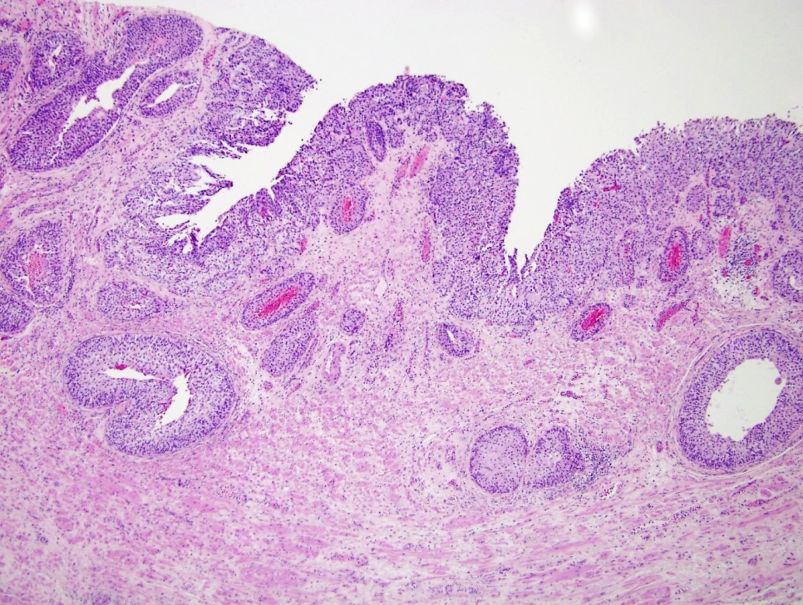
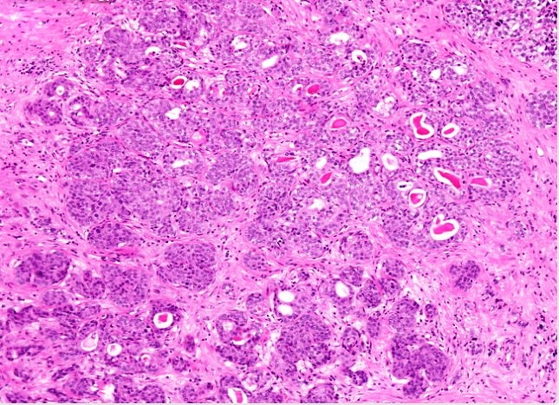
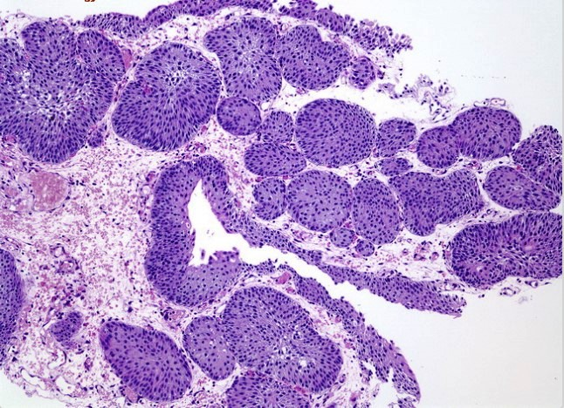
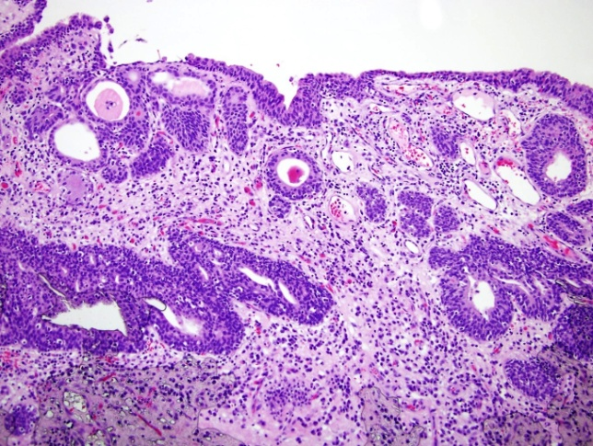
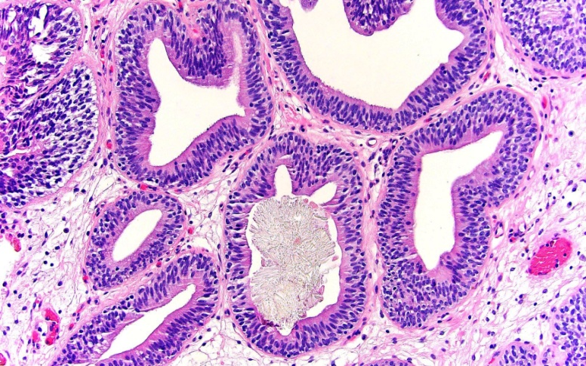
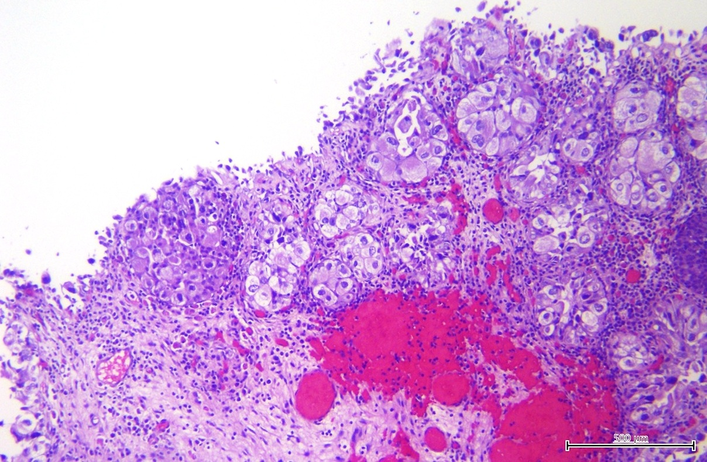
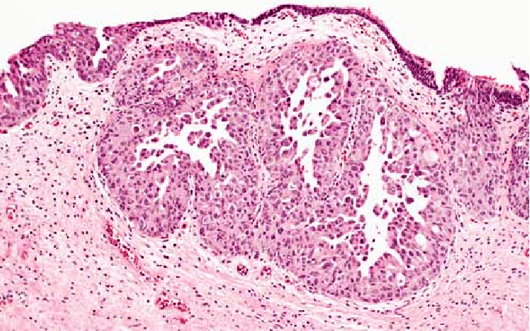
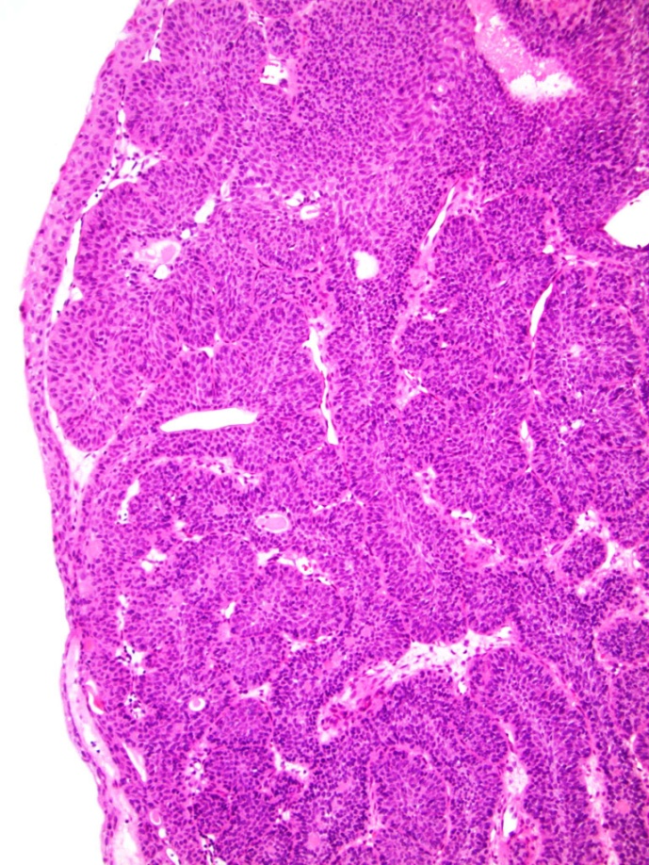
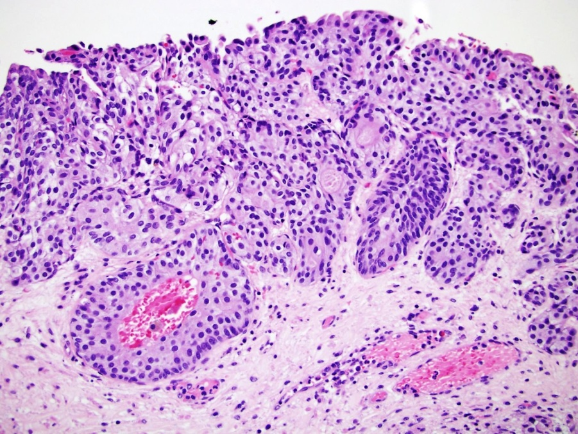
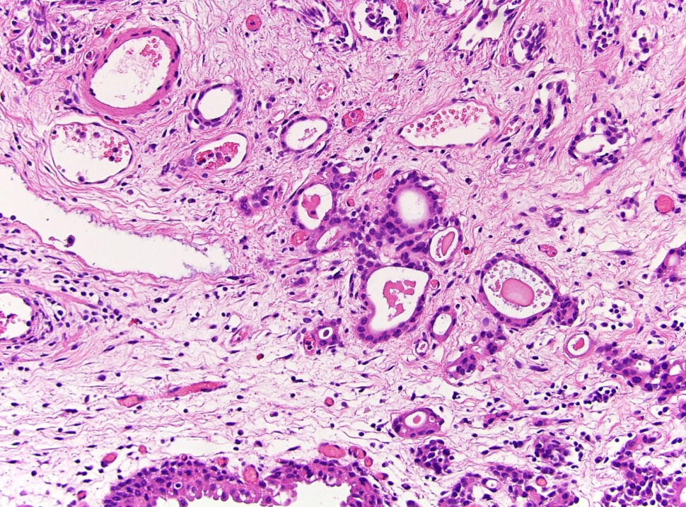
Smoothly or relatively smoothly contoured urothelial structures within the lamina propria: reactive, inflammatory, benign, malignant non-invasive, malignant invasive.
Nested subtype
of invasive
urothelial carcinoma
Cystitis cystica
Cystitis glandularis
Von Brunn nests
Inverted urothelial papilloma
Urothelial carcinoma in situ involving von Brunn nests
Microcystic subtype of invasive urothelial carcinoma: Variably sized cysts and tubules infiltrating lamina propria (and muscularis propria).
Urothelial carcinoma involving von Brunn’s nests
Notes:
Von Brunn nests represent a commonly encountered reactive change and consist of urothelial mucosa budding of solid rounded nests into superficial lamina propria. Von Brunn nests are usually quite large, superficially located, regular in shape and spacing, and lack cytologic atypia. In the first image, note the relatively uniform size and shape of the nests and the lack of cytologic atypia. Von Brunn nests hyperplasia (florid cases of Brunn nests) lacks glandular type epithelium and cystic changes.
Irregularity in size and shape, deep location within the lamina propria, and cytologic atypia should raise the concern for nested subtype of urothelial carcinoma. Florid cases of Brunn nests may mimic nested subtype of urothelial carcinoma but there is no muscle invasion.
Relatively round and evenly spaced with uniform linear border at base versus nested carcinoma, which has anastomosing, smaller, irregularly sized nests lacking orientation to overlying urothelium and more irregular projections into stroma and muscle invasion.
2. Cystitis cystica: Superficial nests of urothelial mucosa with cystic change in the background of chronic inflammation.
3. Cystitis glandularis: Nests of urothelial mucosa with luminal columnar cells, not necessarily of goblet cell type (and calcium oxalate crystals in the 3rd image).
4. Inverted urothelial papilloma: Architectural complexity; trabecular / corded pattern. Smooth or dome shaped surface with monotonous cells growing in an endophytic pattern without the presence of lamina propria invasion. Periphery of the lesion demonstrates a pushing border. Has cytoarchitectural organization within nests. Cells maintain peripheral palisading.
5. Urothelial carcinoma involving von Brunn’s nests: more atypia and mitotic activity, often papillary component. The smooth regular contour of basement membrane, however, is preserved. Definite stromal invasion is not seen.
6. Urothelial carcinoma in situ involving von Brunn nests: Prominent cytologic atypia, increased mitoses and apoptotic debris. Surface urothelium with carcinoma in situ. Transurothelial CK20 immunopositivity.
7. Nested subtype of invasive urothelial carcinoma: Irregularly sized nests projecting into underlying stroma with a von Brunn-like appearance; overlying urothelium is unremarkable. Cytologically bland nests of low to intermediate grade urothelium lacking polarity and with occasional tubular lumens, forming irregular projections into underlying stroma.
8. Microcystic subtype of invasive urothelial carcinoma: Greater cytologic atypia than reactive lesions; higher proliferation rate. Formation of microcysts which may mimic cystitis cystica in small specimens. Cytologic atypia can be minimal. Microcysts, macrocysts and tubules lined by either simple cuboidal, multilayered or flattened epithelial cells with a cytologically bland appearance similar to the nested subtype; some containing eosinophilic secretions and necrotic material. The infiltrativegrowth pattern is diagnostically useful in recognizing this lesion as malignant. Other than mimicking a benign entity like cystitis cystica, this variant has no specific clinical significance.

Slide 6
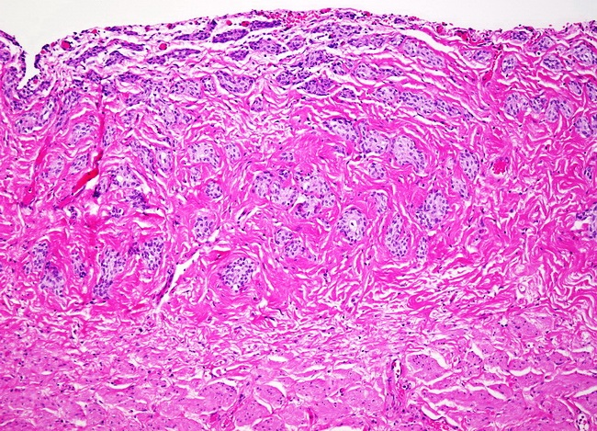
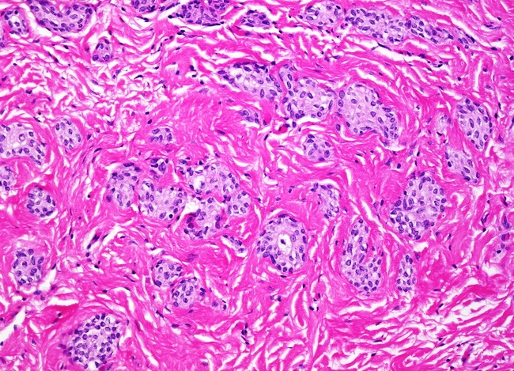
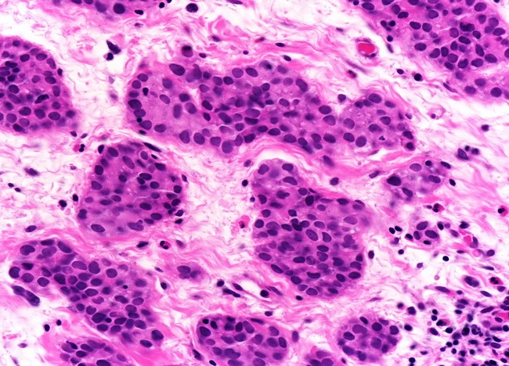
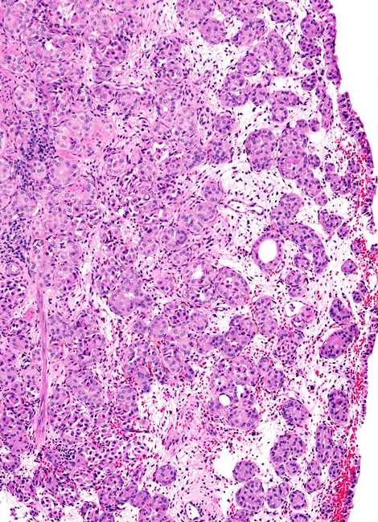
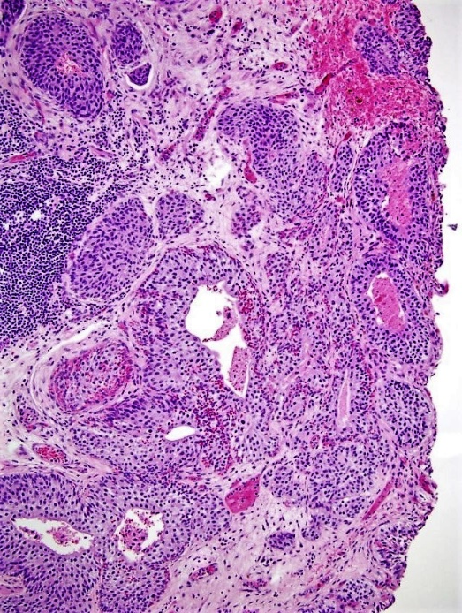
Florid von Brunn Nests
Nested subtype of urothelial (invasive) carcinoma
Notes:
Florid Brunn Nests: Some bladder specimens show exuberant Brunn nests which may mimic nested variant of urothelial carcinoma. This image shows small solid clusters of urothelial cells lacking cytologic atypia scattered throughout the lamina propria. However, note the linear, non-infiltrative base. The nests stop just short of muscularis propria. High power view (upper right image) highlights the lack of cytologic atypia. The linear arrangement of these nests in the lamina propria just beneath the urothelial surface, the complete lack of cytologic atypia, and sparing of muscularis propria were helpful diagnostic features in distinguishing them from the nested variant of urothelial carcinoma.
The nested subtype of (invasive) urothelial carcinoma consists of small, discrete nests with bland morphology distributed irregularly in the lamina propria. The overlying urothelium is usually unremarkable. In the deeper aspects of the tumor, the nests may anastomose or become confluent and exhibit greater cytolgic atypia. The size of nests is often -not always (as the upper images show)- much smaller than von Brunn's nests of normal urothelium. Higher magnification view of the superficial nests of nested variant of urothelial carcinoma (lower right image). The nuclei show only minimal enlargement and prominent nucleoli are not seen. Mitotic activity is not increased. The small size of these nests, anastomosis and confluence of some of the nests, and irregular extension into the lamina propria set them apart from ordinary von Brunn's nests.
The nested subtype variant is a tumor with deceptively benign appearance that mimics von Brunn's nests and can be confused with von Brunn's nest hyperplasia if not invading the detrusor muscle. The tumor growth pattern varies from solid expansive to infiltrative nests without nuclear atypia that is observed most frequently in the deeper part of the tumor.

Slide 7
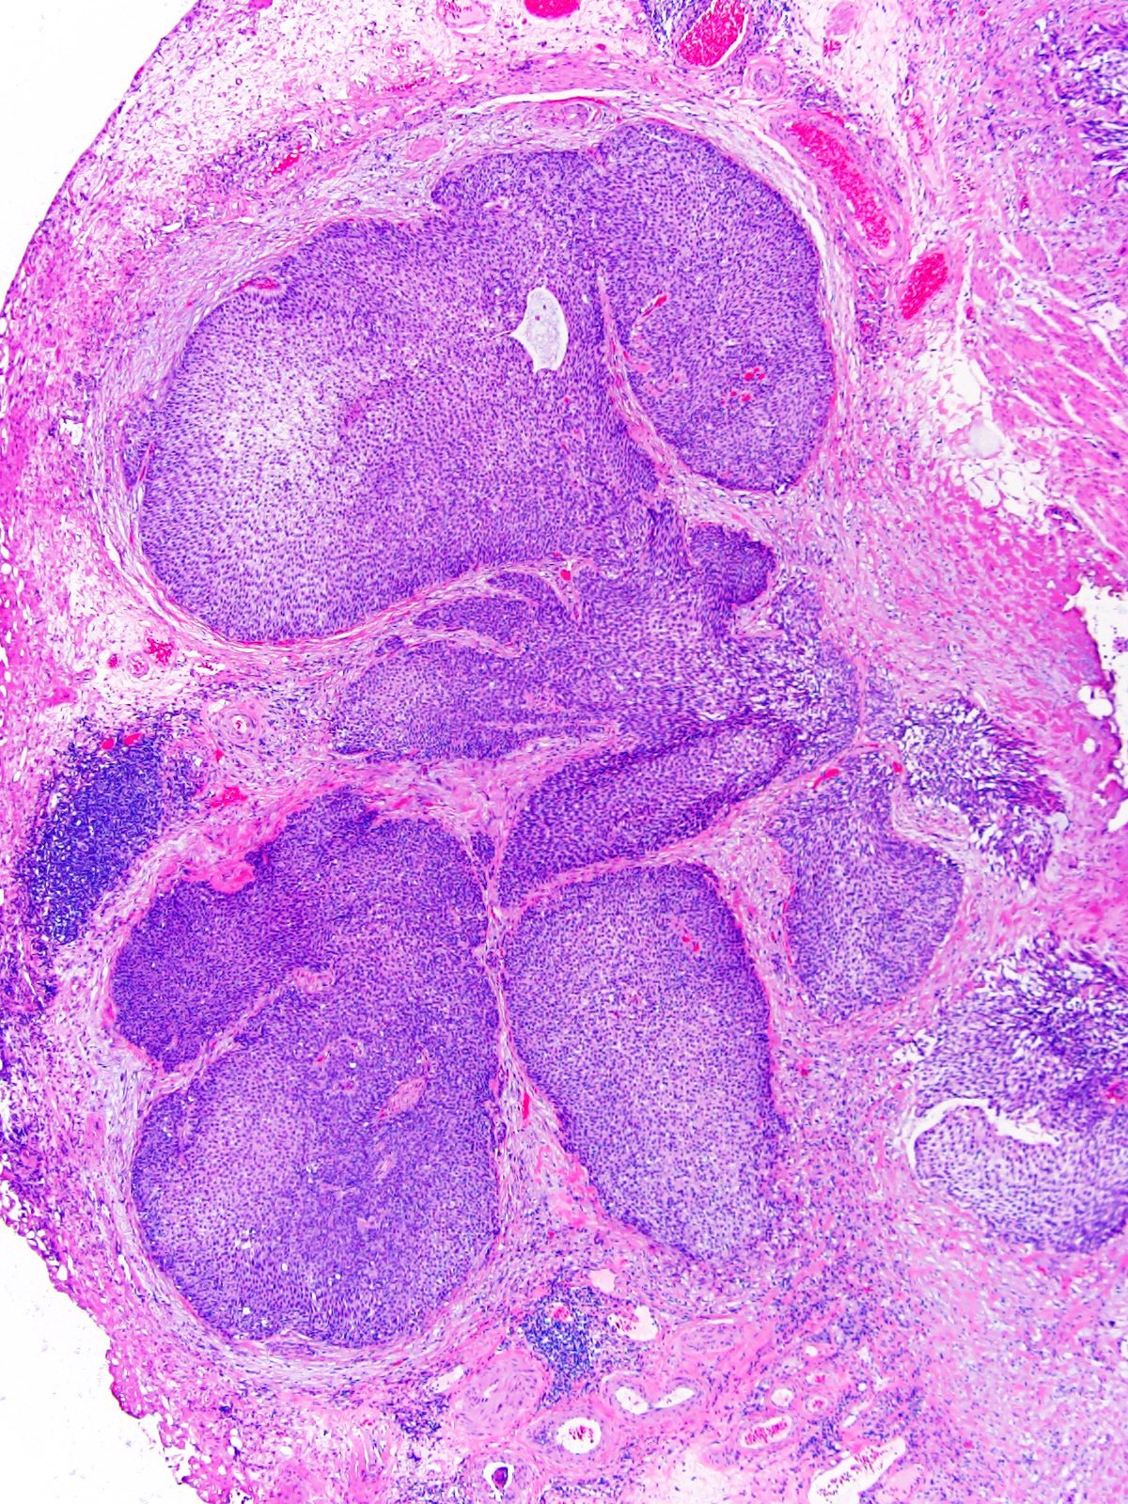
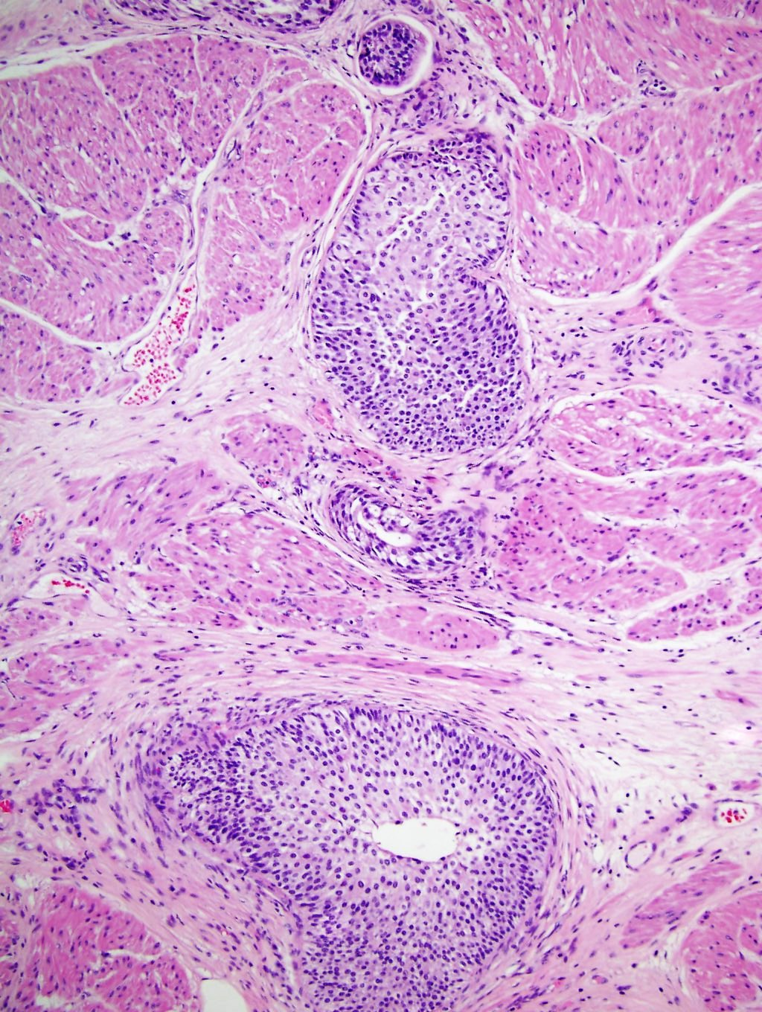
Large nested subtype of urothelial (invasive) carcinoma
Anastomosing, irregular, large nested and inverted growth of cytologically bland urothelium with desmoplastic stromal reaction. Deeply invasive nests of cytologically bland urothelium in muscularis propria.
Notes:
The large nested urothelial carcinoma was in the 2016 edition included within the nested subtype, this is not clearly stated in the WHO classification.
Nested and large nested UC display nests of cells, characteristically with deceptively mild pleomorphism and only slightly increased nuclear-cytoplasmic ratio. Also in this subtype, there seem to be differences between pure and mixed forms; pure large nested carcinoma has been shown to have a predominantly luminal-papillary phenotype with higher rate of FGFR3 mutations than mixed large nested subtype.

Slide 8
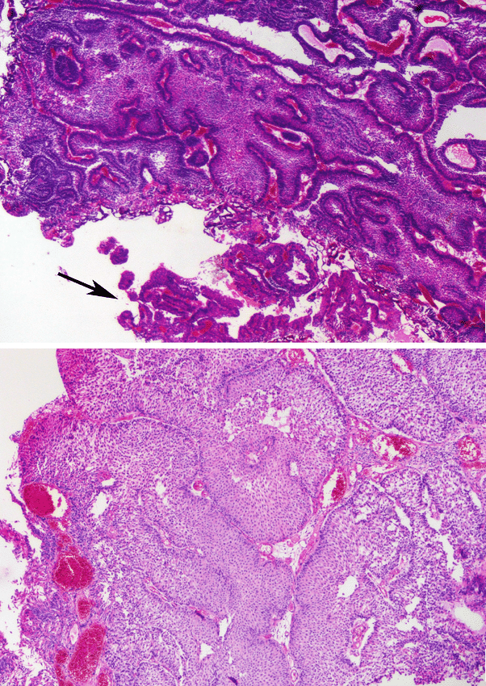
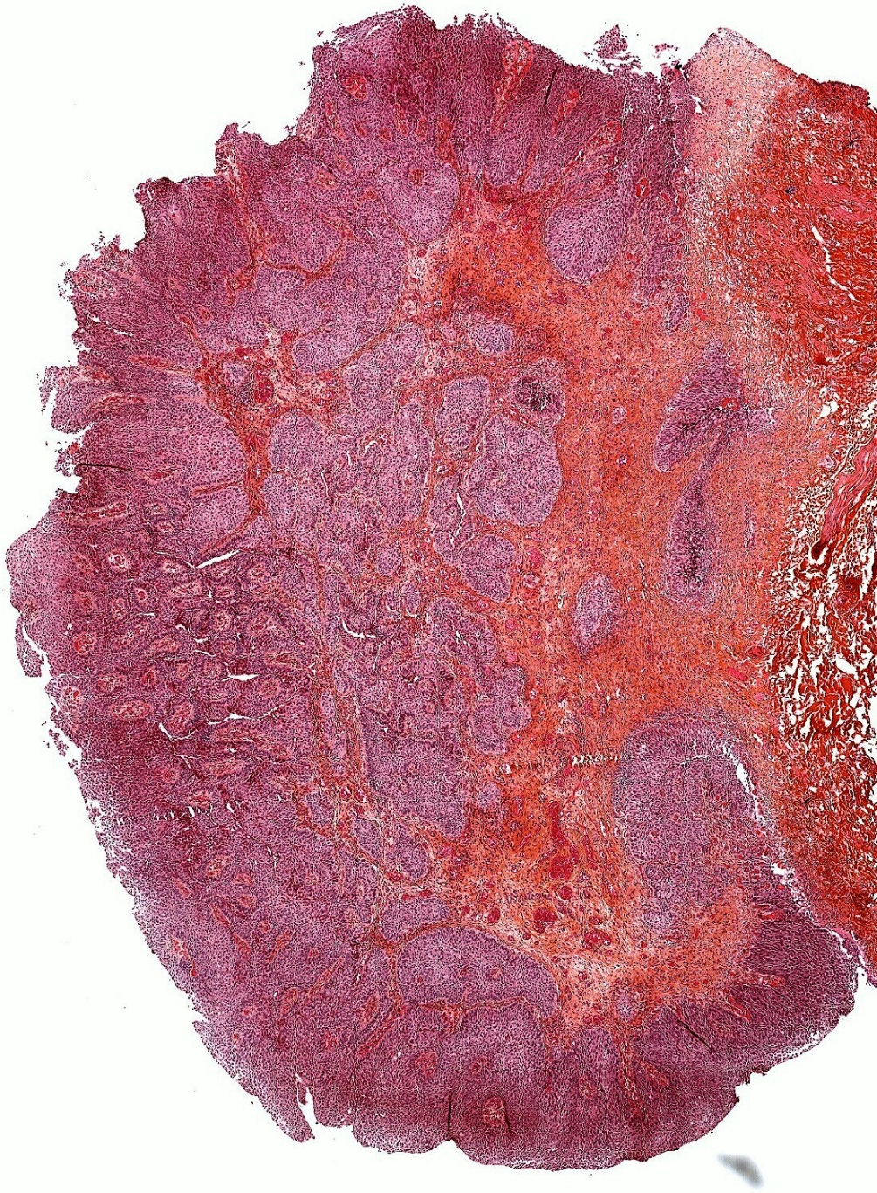
Three examples of non-invasive, low-grade papillary urothelial carcinoma with an inverted pattern. Accompanying small exophytic component is indicated by an arrow.
Notes:
It can be very challenging to diagnose, grade and stage inverted tumours, especially with the differential diagnosis of an invasive tumour with ‘pushing borders’. Tangential sectioning must be excluded before diagnosing an inverted lesion; if a lesion is predominantly or exclusively inverted, this should be underlined in the pathology report. Exclusively inverted lesions (with exception of the inverted papilloma) are rare.
The new blue book pays much attention to inverted lesions, which shall be graded by the same criteria as exophytic tumors. It can be extremely challenging to grade and stage inverted tumors; ‘pushing borders’, tangential cutting, muscularis mucosae hyperplasia or demoplastic stroma of the lamina propria must be excluded. Noninvasive inverted lesions are probably among the most difficult cases in regard to staging.

Slide 9
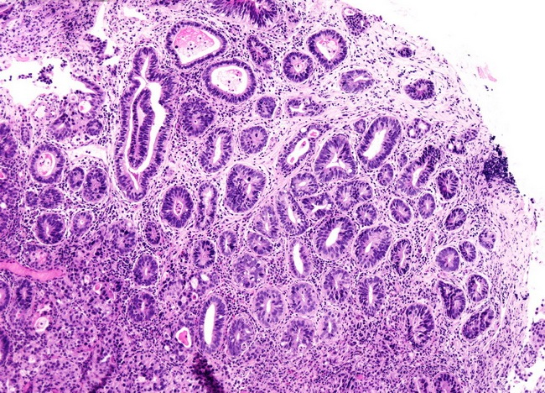
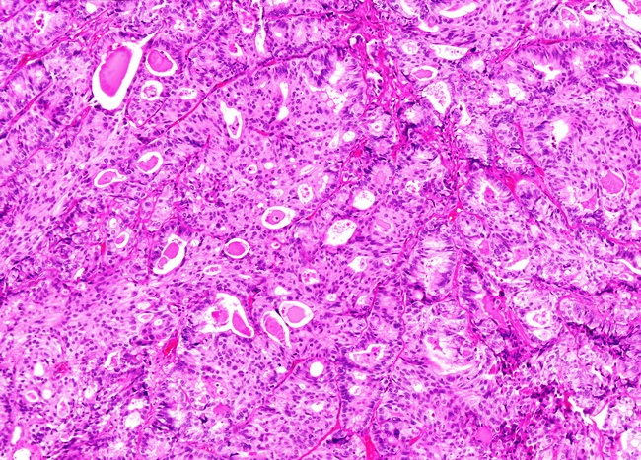
Microcystic / tubular/ glandular/ glandular-like features of urothelial carcinomas ( not adenocarcinomas )
Glandular differentiation may be seen in about 18% of urothelial carcinomas. Such foci may show gland-like luminal spaces (shown here, right image) or fully developed adenocarcinoma – i.e., true glandular differentiation-, often with intestinal morphology. The presence of glandular differentiation does not appear to have any prognostic significance, once stage is accounted for.
The left case showed a focus with microcystically distended or tubular features adjacent to conventional urothelial carcinoma in a transurethral resection specimen. It bears resemblance to cystitis glandularis but has greater cytologic atypia. The glandular and tubular structures are variably sized and show architectural distortion and deep irregular infiltration often including the muscularis propria. The microcystic subtype has a new ‘sibling’, the tubular subtype.

Slide 10
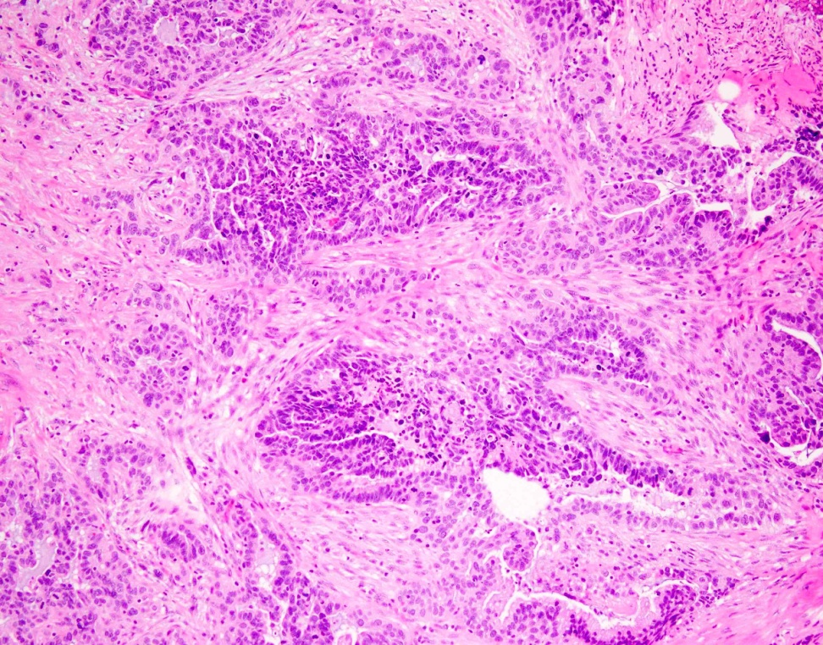
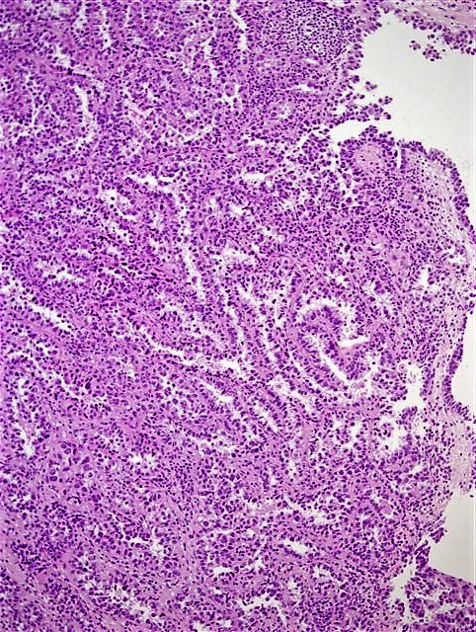
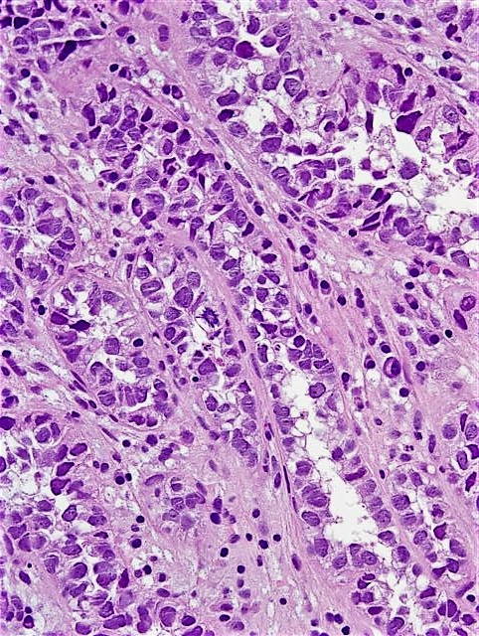
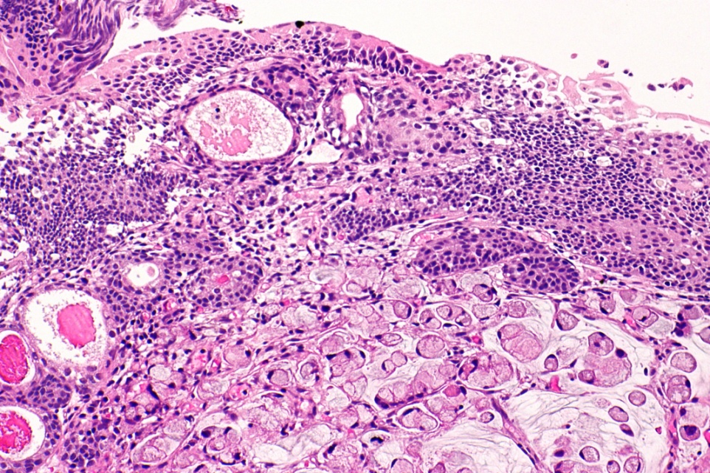
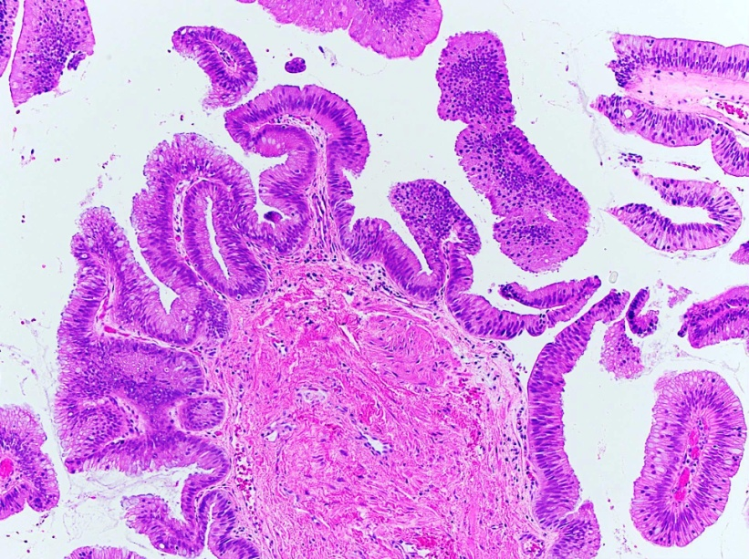
Glandular, non urothelial neoplasms
Invasive adenocarcinoma, NOS, with desmoplastic reaction
Pure clear cell (adeno)carcinoma
Isolated villous adenoma of the urinary bladder
Signet ring cell adenocarcinoma of the urinary bladder
Notes:
Invasive adenocarcinoma, NOS, with desmoplastic reaction.
Differential diagnosis
Urothelial carcinoma with predominantly glandular features / differentiation:
Glandular differentiation in urothelial carcinoma is second most common after squamous differentiation.
Composed of glands with columnar epithelium, often of enteric type and mucin production with typical urothelial carcinoma components present. However, typical urothelial carcinoma components, such as invasive or noninvasive urothelial carcinoma, are present.
Examine the tumor specimen carefully to rule out any urothelial component.
Pure clear cell (adeno)carcinoma. Either arises from Müllerian elements in the bladder (endometriosis), represents a peculiar variant of vesical adenocarcinoma of non Müllerian derivation, or represents a peculiar morphologic expression of urothelial carcinoma, with glandular differentiation often uncertain.
Often papillary or tubulocystic.
Flat or cuboidal neoplastic cells have abundant clear or eosinophilic cytoplasm with glycogen and frequent hobnailing.
Pleomorphic cells and brisk mitotic activity; variable necrosis.
Resembles urothelial carcinoma more than adenocarcinoma.
The papillae sometimes have hyalinized cores.
Myxoid stroma may be seen.
Signet ring cell adenocarcinoma of the urinary bladder, (mucin-positive).
Isolated villous adenoma of the urinary bladder.

Slide 11
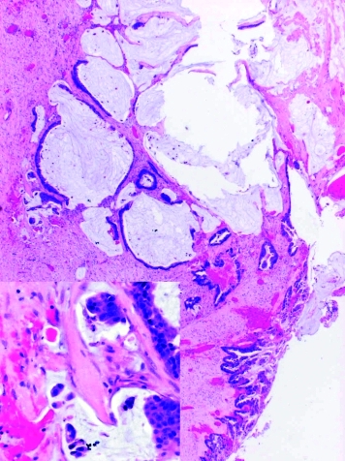
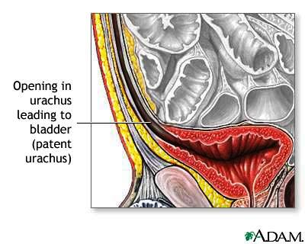
The urachal carcinoma has been updated with new molecular findings, and allows a good overview on this rare topic. Represents 10-30% of bladder adenocarcinomas, 0.3% of all bladder cancers.
Criteria for urachal origin of adenocarcinoma:
Centered in anterior wall or dome of bladder.
Predominant invasion of muscularis or deeper tissues with sharp demarcation between tumor and surface bladder urothelium.
Surface urothelium is free of glandular or polypoid proliferation (i.e. invasion is from outside in).
No carcinoma in situ or glandular metaplasia other than (possibly) cystitis glandularis is present.
The presence of urachal remnants is helpful but not always identifiable.
No primary adenocarcinoma elsewhere.
Haematoxylin and eosin stain (higher magnification inset) showing foci of invasion into the stroma of mucinous cystadenocarcinoma with mucin extravasation.

Slide 12
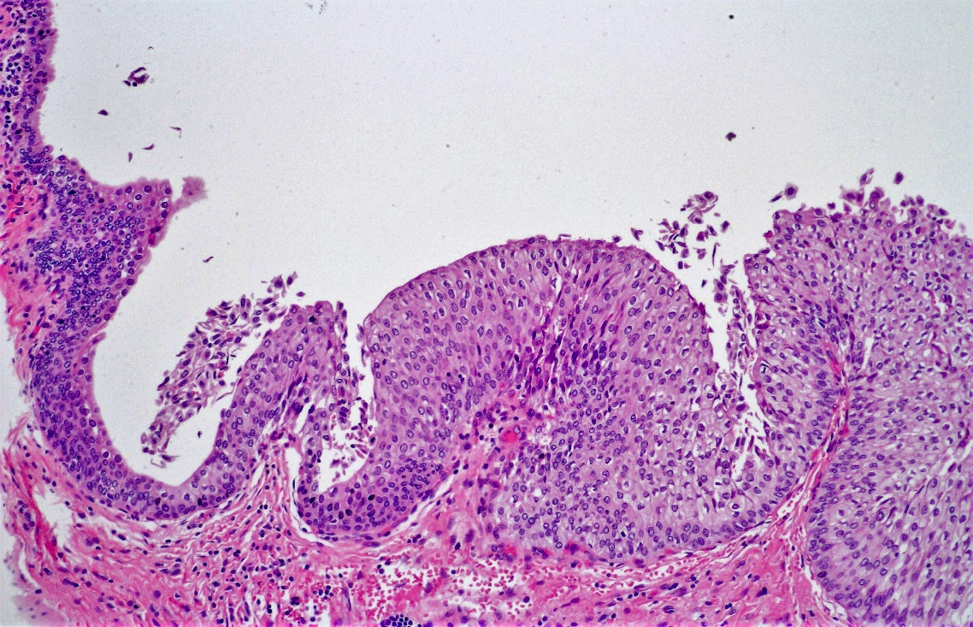
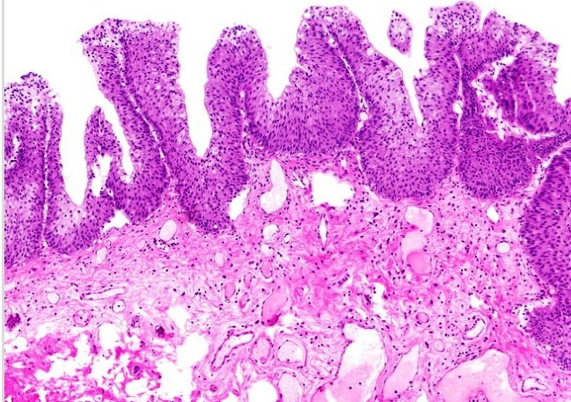
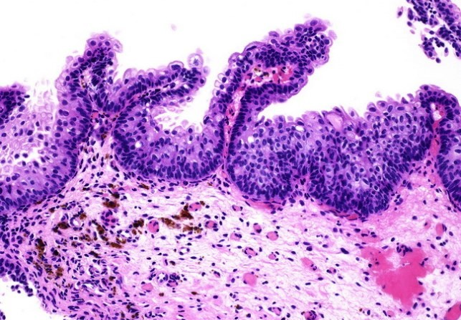
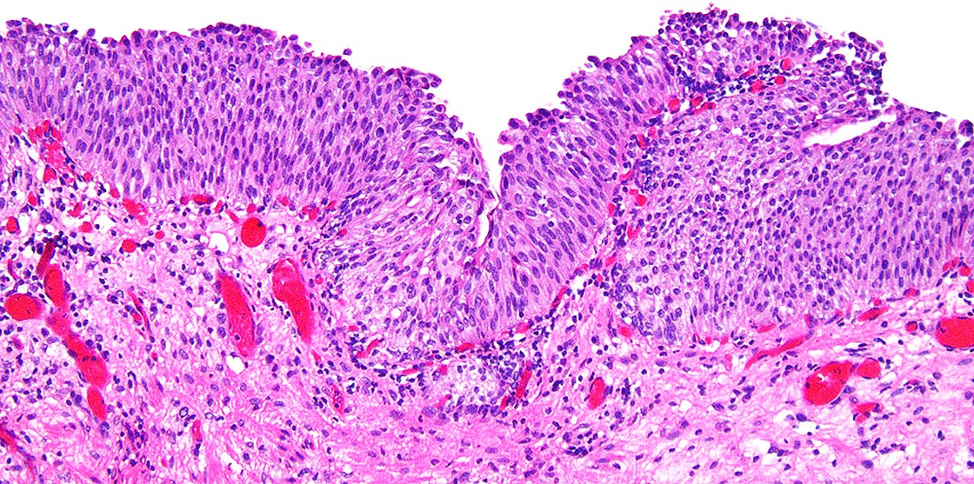
The new WHO 2022 will not address the terminology of ‘hyperplasia’ or ‘urothelial proliferation of unknown malignant potential’ as mentioned in the WHO 2004 and 2016. These lesions (corresponding to what was earlier called flat hyperplasia) are thought to be benign. They can exhibit discrete papillary aspects without true fibrovascular cores and without branching and may be considered shoulder lesions in the context of pTa tumors. GUPS suggest to replace the term ‘hyperplasia’ with ‘atypical urothelial proliferation (AUP)-flat’ in case of a flat lesion, or alternatively, if some papillary formations without fibrovascular cores are present, to call it ‘AUP-tented’.
The transition zone between normal ureteral urothelium and a shoulder lesion: formerly known as “urothelial proliferation of unknown malignant potential (UPUMP)” and now proposedly termed “atypical urothelial proliferation (tented)”.
No true, too delicate fibrovascular cores

Slide 13
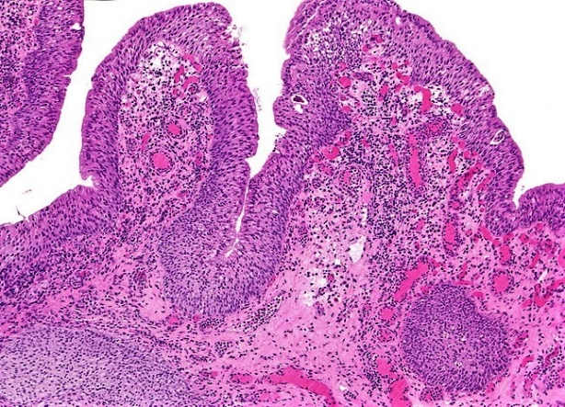
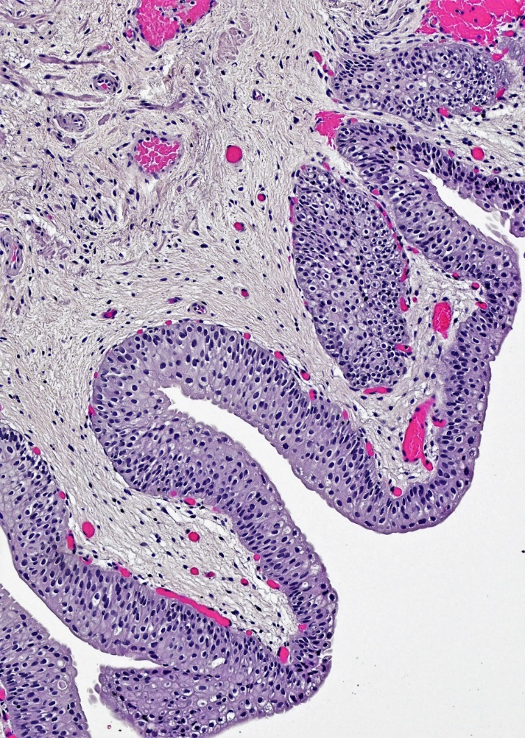
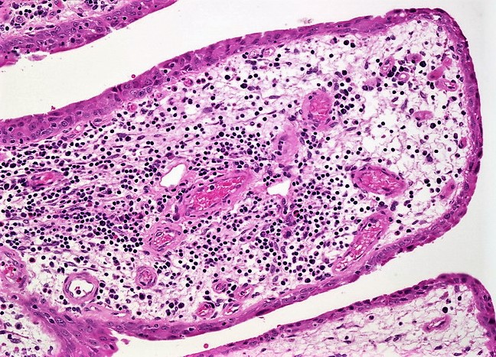
Polypoid / papillary cystitis Broad and possibly narrow based, finger-like papillae covered by normal urothelial cells with a superficial layer of undulating umbrella cells. There is no evidence of urothelial atypia. No mitotic figures or loss of cellular polarity is noted. In addition, the lamina propria is edematous and occasional chronic inflammatory cells are seen. The stroma may be fibrotic and contain evident chronic inflammatory infiltrate. The overlying urothelium is normal. Isolated fronds in a case of papillary/polypoid cystitis may be difficult to distinguish from urothelial carcinoma. Features favoring papillary cystitis include inflamed background, normal urothelial thickness lacking significant atypia, and non-branching broad-based fronds. High power view of one of the broad-based papillary fronds showing inflammatory infiltrate and a few delicate blood vessels. The overlying urothelium shows reactive atypia.

Slide 14
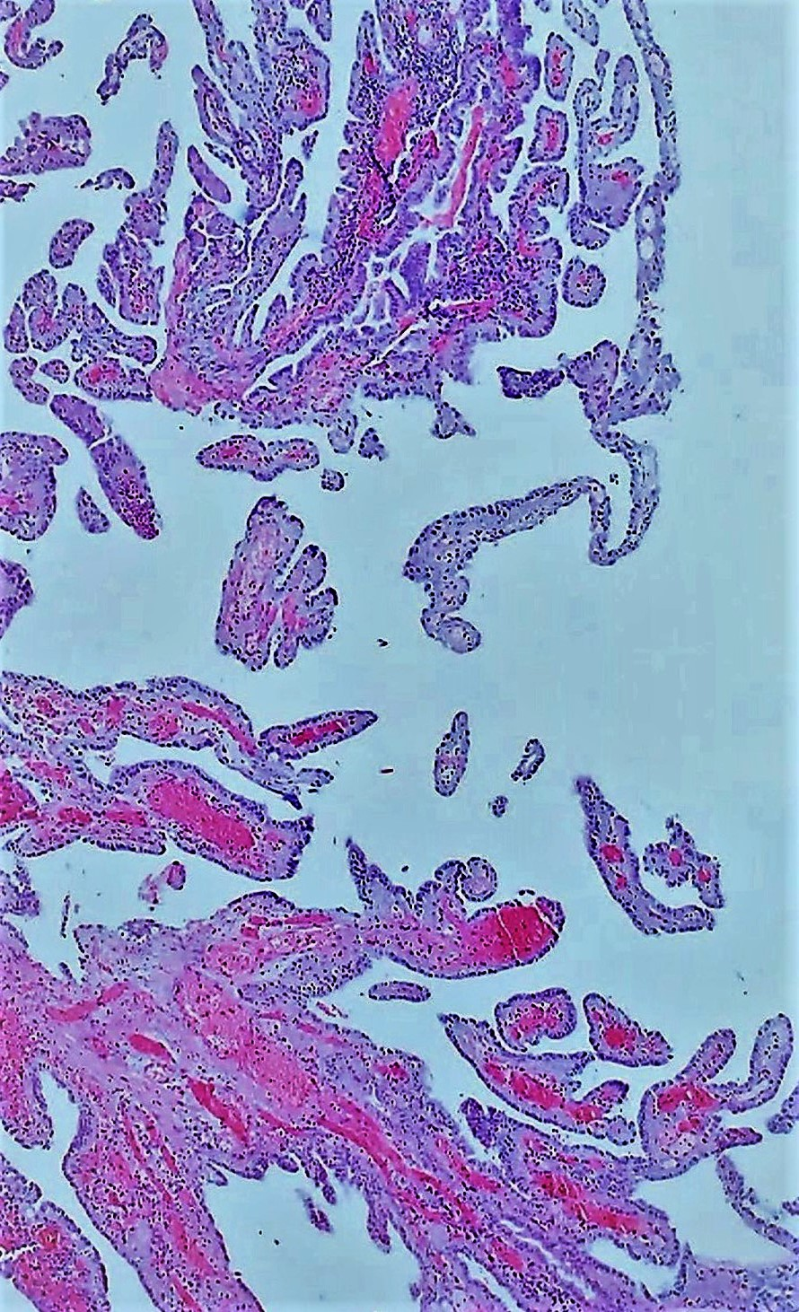
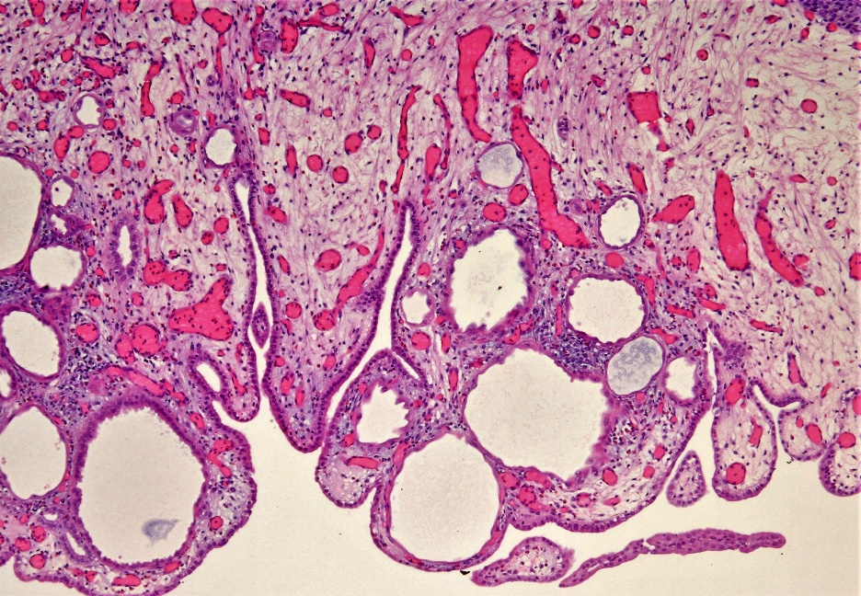
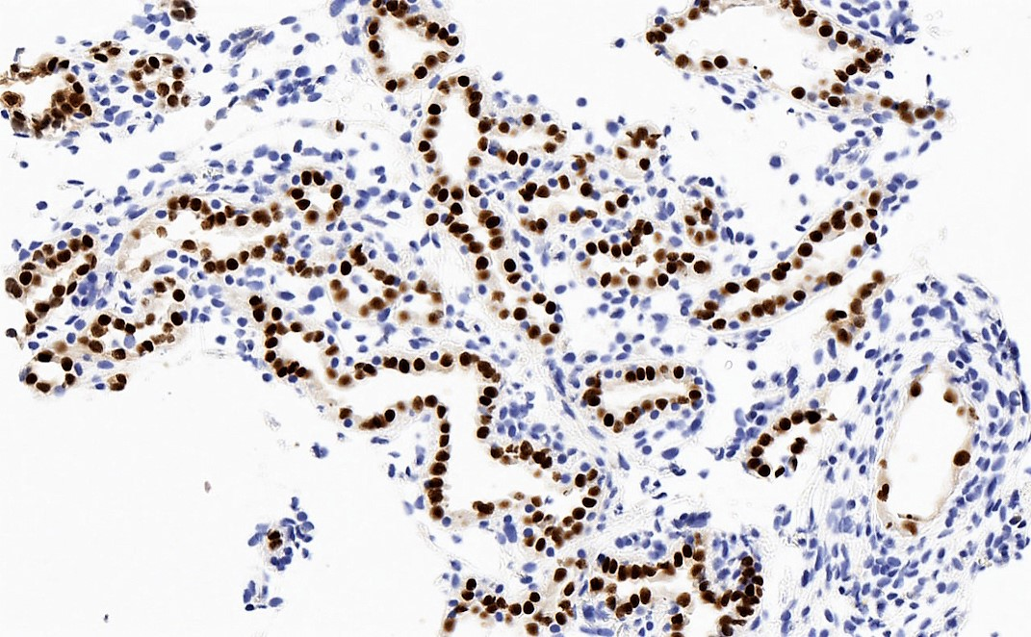
Nephrogenic metaplasia Nonneoplastic reactive metaplastic lesion with tubular, glandular, papillary or cystic architecture and surrounded (at least focally) by thick basement membrane. Most cases confined to lamina propria. May mimic urothelial carcinoma, clear cell or prostatic adenocarcinoma.
Pax8
Notes:
Florid papillary pattern of nephrogenic adenoma mimicking papillary urothelial neoplasm.
"Nephrogenic adenoma, misnomer! ✅metaplastic reactive change ✅tubulocystic, papillary, polypoid ✅cuboidal/hobnailed cells with eosinophilic cytoplasm & smudged nuclei, no prominent nucleoli ✅thickened hyalinized basement membranes around tubules ✅limited to lamina propria, no stromal reaction
Nephrogenic adenoma with nuclear PAX8 positivity.
Differential diagnosis
Clear cell adenocarcinoma
Commonly seen in women
Solid growth pattern with clear cells, marked atypia, complex hyalinized papillae
Muscularis propria invasion+, necrosis+
High mitotic rate
Morphology is still the cornerstone
IHC: CAIX+, PAX8 variable, high Ki67
Papillary urothelial carcinoma:
Multilayered urothelial cells with variable atypia
IHC: p63+, Uroplakin 2+, GATA3+
Urothelial carcinoma nested / microcystic variant:
Small, crowded, tightly packed, multilayered, irregular nests with bland cytology and without any associated stromal changes
Usually deeply infiltrative
IHC: p63+, Uroplakin 2+, GATA3+
Prostatic adenocarcinoma:
Diffuse nucleolar prominence
More atypia
Infiltration in between normal prostatic glands
IHC: PSA+, NKX3.1+, CK7-, PAX8-

Slide 15
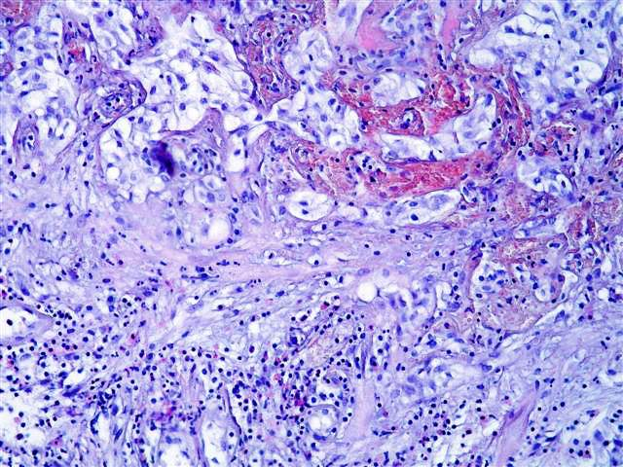
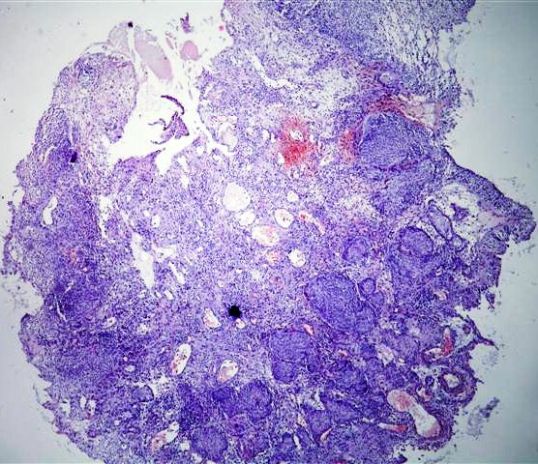
Pseudocarcinomatous epithelial hyperplasia Rare reactive condition that resembles carcinoma, initially described postradiation. Also associated with ischemia and chronic radiation.
Postradiation changes may also
mimic intraurothelial neoplasia.
Mitotic figures are absent, though.
Notes:
Microscopic description of pseudocarcinomatous epithelial hyperplasia
Downward proliferation of urothelial pseudoinvasive nests with focal squamous metaplasia but without atypia.
Nests wrap around vessels with fibrin deposition and congestion.
May have retraction artifact.
These nests, especially because of their irregular shape, can resemble invasive carcinoma; however, morphology is not typical of early invasive urothelial carcinoma.
Frequently hemorrhage, thickened vessels and other radiation-associated vascular changes are present.
Fibrin deposition, fibrin thrombi, fibrosis, inflammation, hemosiderin, ulceration, edema and vascular congestion.
No mitotic figures.
Radiation therapy: causes endothelial swelling and necrosis, mural thickening and hyalinization with late luminal narrowing; also pseudoinfiltrative epithelial cords and nests extending into lamina propria and wrapping around dilated blood vessels containing fibrin; radiation fibroblasts with cytoplasmic or nuclear vacuoles and prominent nucleoli, stromal edema, extravasated red blood cells, destruction of bladder tumor papillae.

Slide 16
Urothelial dysplasia The diagnosis of dysplasia is based on morphologic features. Microscopic features of urothelial dysplasia are similar to the wrapping of a low-grade papillary urothelial carcinoma of the right figure but detected on flat urothelium. In the insert, a high magnification of covering urothelium.
Notes:
The use of immunohistochemical panel (CK20/p53/CD44) has potential utility but has limitations. In dysplastic urothelium, cytokeratin 20 stains superficial and intermediate cell layers, CD44 stains basal and intermediate cell layers, and p53 expression is increased compared to normal urothelium. However, the immunostaining may be misleading especially in the post-treatment atypia and in the differential diagnosis between carcinoma in situ and dysplasia.
The main differential diagnoses include reactive epithelium, hyperplasia, and carcinoma in situ.
Reactive atypia may be a difficult differential diagnosis, especially in therapy-related atypia. The presence of regular and smooth nuclei and visible nucleoli and vacuolization of the cytoplasm are consistent with reactive atypia.
The presence of nuclei with regular borders, small nucleoli, an increased number of cell layers, and the lack of mitoses may be indicative of urothelial hyperplasia.
The presence of features of moderate-severe anisonucleosis, pleomorphic cells with nuclei with irregular borders, hyperchromatic nuclei without polarization, and mitotic figures with a stromal microvascolar proliferation is suggestive for urothelial carcinoma in situ.

Slide 17
Carcinoma in situ Flat lesion composed of cells in mid to upper epithelium with high cytologic grade. By definition, no invasion into lamina propria. On sub-analysis of studies restricted to patients with organ confined bladder cancer at radical cystectomy (RC), concomitant CIS was associated with worse recurrence-free survival and greater cancer-specific mortality.
Notes:
Note: high grade non-invasive papillary lesions are NOT designated as carcinoma in situ to avoid confusion.
Microscopic (histologic) description
Flat lesion composed of cells with large, irregular, hyperchromatic nuclei, prominent nuclear pleomorphism, high N/C ratio, mitotic figures in mid to upper epithelium.
Atypia may not be full thickness.
Epithelium is often denuded.
Nuclear size is 5x that of lymphocytes versus 2x lymphocytes for normal urothelium.
Also (but less important) loss of polarity, nuclear crowding, irregular thickness of urothelium.
Cells are not cohesive, leading to shedding into urine.
Occasionally present in prostatic ducts, spreads by intramucosal extension.
Large cells with prominent pleomorphism, large cells without severe pleomorphism, small cell, clinging (single layer of atypical cells on denuded urothelium), cancerization of urothelium (pagetoid, undermining or overriding).
Pattern need not be included in surgical pathology report.
Microinvasion (2 mm or less) demonstrates invasive cells with retraction artifact mimicking vascular invasion (77% of cases of microinvasion).
Also nests or irregular cords, rarely invades as isolated single cells with or without desmoplasia.
Differential diagnosis
Denuding cystitis: cells may look malignant.
Denuded urothelium:
Extensively denuded epithelium is often seen in CIS ("clinging CIS" or "denuding cystitis").
However residual malignant cells required for diagnosis.
Deeper sectioning of tissue block or examination of von Brunn nests may be helpful if epithelium is denuded.
Dysplasia: less severe atypia although distinction may be difficult. It must be underlined that ‘dysplasia’ is not a synonym of ‘intraepithelial neoplasia’. Dysplasia shows changes thought to be neoplastic, but insufficient to be termed ‘carcinoma in situ’. The ‘dysplasia’ issue is discussed in the subchapter of carcinoma in situ, the latter being high grade by definition. Nevertheless, dysplasia is thought to represent a potential precursor to carcinoma in situ.
Post-topical therapy for high grade urothelial carcinoma: still has capillaries.
Radiation effect: cells still cohesive, may have distinctive nuclear borders, may resemble pagetoid variant of CIS.
Reactive atypia: less pleomorphic nuclei than CIS, (usually) preserved polarization, regular nuclear contours, regular chromatin pattern; patchy CK20 in umbrella cells only, p53 weak/negative, CD44 diffusely or focally positive vs.
CIS which is intensely CK20+ (81%), p53+ (57%), CD44- (100%).

Slide 18
Atypia in flat urothelium Intraurothelial abcedation and slight atypia of the urothelium, corresponding to reactive atypia (left image). Typical aspect of a carcinoma in situ, loss of polarity, cytonuclear atypia (right image).

Slide 19
Urothelial papilloma Low power view of a urothelial papilloma with discrete papillary structures, hierarchical branching but without fusion. Urothelial papilloma showing slender fibrovascular cores and the transversally sectioned papillary structures appear to float on the surface. A high power view where the lining urothelium appears normal with prominent umbrella cell layer, showing vacuolization. There should be no marked cytologic atypia, increased thickness of the urothelium or increased mitotic / apoptotic figures.

Slide 20
Papillomas Papilloma with typically vacuolated umbrella cells and minimal branching (left image). Endophytic growth of urothelium, covered by normal urothelium (inverted papilloma, right image). Papillomas obviously do not require grading or staging.

Slide 21
Papilloma
PUNLMP
Predominantly exophytic tumor.
Discrete papillary structures with central fibrovascular cores with hierarchical branching pattern but without fusion.
Papillae appear to float above urothelial surface due to transverse sectioning of branching papillae.
Papillae usually slender with scant stroma around fibrovascular cores.
May have large papillae with marked stromal edema or cystitis cystica-like invaginations.
Papillary structures are lined by urothelium of normal thickness and cytology; often with prominent umbrella cells layer.
Umbrella cells may show cytoplasmic vacuolization and degenerative type atypia.
Increased thickness of papillary structures with slender fibrovascular cores.
Ordered layering (streaming) of uniform nuclei with preserved polarity.
Inconspicuous nucleoli.
No variation in nuclear size, contour or shape.
No nuclear hyperchromasia.
Minimal mitotic activity confined to basal layers.
Presence of umbrella cell layer.

Slide 22
Grading papillary urothelial carcinomas under the microscope. Histological tumor grade is a crucial parameter especially for non-invasive papillary urothelial tumor to guide the choice of therapy. It is well-known that papillary urothelial carcinoma can present grade heterogeneity that has been reported in 3–43% of papillary urothelial lesions.
High grade
Low grade
Papillary structures of variable thickness with fibrovascular cores.
Disordered layering with loss of polarity.
Variably enlarged nuclei and nuclear crowding.
Variation in nuclear size, contour or shape.
Nuclear hyperchromasia may be present.
Mitotic activity may extend to upper layers.
Umbrella cell layer generally indiscernible.
Increased thickness of papillary structures with slender fibrovascular cores.
Ordered layering of somewhat enlarged nuclei with variation in polarity.
Mild variation in nuclear size, contour or shape.
Limited mitotic activity may extend to suprabasal layers.
Presence of umbrella cell layer.

Slide 23
Grading papillary urothelial tumors Low grade papillary urothelial carcinoma can be distinguished from high grade papillary urothelial carcinoma predominantly by variation in nuclear size.
Notes:
The WHO maintains a three tiered grading scheme for noninvasive papillary lesions, as in previous classifications, first seen in 1998. This comprises papillary urothelial neoplasia of low malignant potential (PUNLMP) and low-grade and high-grade papillary noninvasive (pTa) lesions. The distinction of low-grade and high-grade pTa tumors reflects our current understanding of bladder carcinogenesis, with the dichotomous hyperplasia/pTa low-grade and the dysplasia-carcinoma in situ/invasive pT1-4 sequences. Low-grade tumors do not benefit from intravesical therapies. Any high-grade bladder cancer currently requires intravesical therapy. In summary, the classification of PUNLMP, pTa low-grade and high-grade divides bladder tumors into clinically relevant categories.
Papillary urothelial neoplasm of unknown malignant potential (PUNLMP) characterized by papillary structure with central slender fibrovascular core and lined by a layer of urothelial cells of increased thickness. The small nuclei lack atypia and show nuclear streaming as a consequence of vertical polarization. An attenuated umbrella cell layer covers the papillary structure (objective 20x).
Low grade papillary urothelial carcinoma with papillary formations and central fibrovascular core. The thickness of the urothelial lining is variable and nuclei are slightly enlarged but remain polarized with some variation in nuclear density. An umbrella cell layer can be appreciated (objective 20x).
High grade urothelial carcinoma displaying disordered lining of the papillary structure with variation in nuclear size, cytonuclear atypia and lack of umbrella cell differentiation.
An important issue in grading is the handling of heterogeneous tumors with both LG and HG aspects. According to various studies, 5–40% of urothelial carcinomas display grade heterogeneity. The fifth edition approach is very pragmatic: all papillary lesions with more than a 5% HG area are considered HG, while all papillary lesions with less than 5% are considered LG, in which case the comment ‘low grade tumour with less than 5% high grade component’ may be added.

Slide 24
PUNLMP
Notes:
PUNLMP
Neoplastic proliferation of the urothelium in a papillary configuration, with no invasion through the basement membrane.
Thickened urothelium or increased cellularity, without marked cytological atypia.
Epithelial lining of fibrovascular cores is thicker than normal urothelium.
No nuclear atypia or hyperchromatic nuclei in neoplastic urothelial cells.
Maybe exophytic papillary or endophytic papillary (inverted).
Exclusion criteria is prior history of urothelial carcinoma.
PUNLMP is distinguished by urothelium that is thicker than that of urothelial papilloma. In contrast to noninvasive low-grade papillary urothelial carcinoma. PUNLMP has a proliferation of monotonous, bland-appearing cells and lacks the scattered cells with enlarged hyperchromatic nuclei seen in carcinoma.
Exophytic intraluminal urothelial papillary neoplasm.
Papillary exophytic urothelial neoplasm with orderly maturation and no mitoses or hyperchromatic nuclei.
Preserved polarity and hypercellularity. Preserved polarity and a basal layer.
No atypia or mitoses.
Differential diagnosis
Noninvasive papillary urothelial carcinoma, low grade:
At least scattered atypical / hyperchromatic nuclei in a neoplastic urothelium with somehow preserved polarity in low magnification.
More than rare mitoses should favor urothelial carcinoma.
Urothelial papilloma
No atypia in the urothelial lining of delicate fibrovascular cores, limited to 6 - 7 layers of urothelial cells.
Branched but not fused papillae.
Polypoid / papillary cystitis
Edematous or fibrotic stroma with broad base cores of papillary outlines.
Reactive epithelial changes may be present.
(Urothelial hyperplasia, urothelial proliferation of unknown malignant potential) or atypical urothelial proliferation (flat or tented):
No true, too delicate, non branching fibrovascular cores.

Slide 25
Evidently Inverted Urothelial Neoplasm of LMP
Notes:
This tumor shows an exophytic papillary component with true fibrovascular cores as well as an endophytic, inverted papilloma-like component. The lamina propria shows anastomosing cords and nests of urothelial cells without destructive stromal invasion. There is no cytologic atypia.
Such cases may be classified as (predominantly) inverted urothelial neoplasm of low malignant potential, although the current WHO/ISUP Classification does not address this category.
Even at this magnification, peripheral palisading of basaloid cells can be appreciated in the anastomosing nests in the lamina propria. The tumor was composed of roughly equal proportions of exophytic and endophytic components. The urothelial cells have bland morphology and mitotic activity is not increased.
Inverted papillary urothelial neoplasm of low malignant potential (Inverted PUNLMP, lower images). Inverted PUNLMP demonstrates inverted (endophytic) growth and resembles inverted papilloma, but in contrast, shows expanded and rounded cords and nests, composed of architecturally and cytologically bland urothelial cells. Inverted PUNLMP may also lack central streaming and peripheral palisading, as typically seen in inverted papilloma.

Slide 26
Noninvasive (pTa) papillary urothelial carcinoma, low grade
Notes:
Noninvasive papillary urothelial carcinoma, low grade
Neoplastic proliferation of the urothelium in a papillary configuration, with no invasion through the basement membrane.
Low grade architectural and cytologic abnormality, absence of high grade features, such as irregular nuclei with frequent, prominent nucleoli and mitoses, pleomorphism.
Essential features
Noninvasive papillary urothelial neoplasm with low grade cytoarchitectural abnormality.
Loss of polarity evident in medium magnification, rare mitoses, subtle variation in nuclear size but no significant pleomorphism.
Immunohistochemistry not helpful for diagnosis.
Hematuria common presentation.
Disease related death and progression is rare but recurrence common.
Transurethral resection, bladder. Low power of early low grade, noninvasive papillary urothelial carcinoma shows fibrovascular cores lined by neoplastic urothelium.
Bladder; low grade, noninvasive papillary carcinoma. High power of papilla with mild architectural disorder, mitotic figures and mild nuclear pleomorphism.
Low grade noninvasive papillary carcinoma with endophytic component.
Noninvasive papillary urothelial carcinoma, low grade (pTa): predominantly orderly at low power with mild but definitive cytologic atypia with regard to polarity, nuclear size, shape and chromatin texture.
Differential diagnosis
Papillary urothelial neoplasm of low malignant potential (PUNLMP):
Similar appearance at low and intermediate power
No architectural or cytologic abnormalities (lacks variation in nuclear size / shape and polarity is maintained)
Noninvasive papillary urothelial carcinoma, high grade:
High grade features present, although may be focal
Nucleomegaly, nuclear pleomorphism, irregular nuclear contours and clumped chromatin
Mitoses readily identifiable
Polypoid cystitis:
Edematous or fibrotic papillary cores.
Broad base papillary excrescences
Reactive epithelial changes may be present.
Urothelial papilloma:
Papillary lesions with normal, nondysplastic urothelium.
No cytologic atypia.
Inverted papilloma:
Endophytic growth pattern of urothelium into lamina propria.
Degenerative atypia may be present.

Slide 27
Noninvasive (pTa) papillary urothelial carcinoma, high grade
Notes:
Noninvasive papillary urothelial carcinoma, high grade
Definition / general
Neoplastic proliferation of the urothelium with a papillary configuration and no invasion beyond the basement membrane.
Moderate to marked architectural and cytologic atypia.
Essential features
Noninvasive papillary urothelial neoplasm with moderate to marked cytoarchitectural abnormality.
Complex solid to fused papillary architecture, nuclear atypia, pleomorphism (may be focal), crowded and overlapping cells, brisk mitotic activity.
Immunohistochemistry not required for diagnosis.
Commonly presents with hematuria.
High rate of progression to invasion.
High grade noninvasive papillary urothelial carcinoma demonstrating complex papillae (low power).
High power showing cells with irregular nuclear contours, hyperchromasia and mitoses.
Noninvasive papillary urothelial carcinoma, high grade (pTa): disordered architecture and cytologic pleomorphism.
Differential diagnosis
Low grade urothelial carcinoma:
Cells more uniform and appear quite orderly on low power.
Chromatin evenly distributed.
Mitoses may be present but usually confined to lower half of urothelium.
Prominent umbrella cells present.
Papillary polypoid cystitis:
Broad based papillary fronds with edematous or fibrous stroma.
No complex branching papillary structures.
Reactive urothelial atypia may be present.
Papillary nephrogenic adenoma:
Single layer of cuboidal cells lining papillae.
Other patterns present: tubular, tubulocystic, diffuse, solid.
Positive for PAX2, PAX8, AMACR expression.
Prostatic type polyp:
Papillary architecture lined by both urothelial and prostatic cells.
PSA and PAP expression in secretory cells.

Slide 28
Required and recommended features to report in bladder specimens. Comperat et al. World Journal of Urology 2022 40: 915-927.
Tumor stage and grade are the most effective predictors of BCG response, which underlines the important role of pathology in BCG treatment.
The presence of any urothelial component (including pTis) within a malignant lesion invokes the diagnosis of urothelial carcinoma. As notable exception, any quantity of neuroendocrine component yields the diagnosis of a neuroendocrine tumor and dictates its according management. Only “pure” squamous cell carcinoma (SCC), adenocarcinoma (AC), or Mullerian carcinoma should be designated as such.
The presence of subtypes and/or divergent differentiation is important for several reasons: first, reporting the relative amount of subtypes (as percentage) in a sample enables clinicians to treat patients according to the latest results of the literature regarding prognostic or therapeutic implications.

Slide 29
Invasive urothelial carcinoma with lymphovascular invasion.
Lymphovascular invasion (LVI) should be part of all urothelial carcinoma (UC) reporting, especially in T1 tumours, and could provide additional information for treatment decisions regarding adjuvant therapy after radical cystectomy (RC). LVI detection can be difficult using hematoxylin and eosin-stained section, so immunohistochemistry technique (CD31, CD34, and D240) can be necessary but conflicting data exist on immunohistochemical staining for diagnosis of LVI in bladder cancer, so this technique should be used only in selected equivocal cases.

Slide 30
Staging bladder carcinoma
Despite frequent stromal (fibrotic stroma 41%) and epithelial (poorly preserved chromatin 5%) changes post-NAC (neoadjuvant chemotherapy), multivariate analysis showed that only pTN stage and margin status, but not tumor regression grade, predicted progression and cancer related death. Thus, the “traditional” histological parameters in radical cystectomy (RC) remain the best predictors of disease course post-NAC.
Notes:
Tumor characteristics can make difficult the interpretation of the staging, such as some urothelial carcinoma subtypes (e.g., nested type or micropapillary) or CIS spread into von Brunn's nest as well as the involvement of muscle fibers by invasive tumor.
Bladder wall. Black arrows in the right image indicate the vascular plexus (VP) and the muscularis mucosae (MM); these divide the lamina propria in two parts and represent the landmark to subclassified T1 tumors. In fact, the muscularis mucosae (MM) contained in the lamina propria can represent a confounding element to a correct diagnosis because the smooth muscles fibers constitute both MM and MP. In addition, the MM is not a complete layer in bladder and can be hyperplastic especially in the dome and the lamina propria is thinner in the bladder trigone and neck regions where, on the contrary, the MP is both thicker and more superficial in the latter regions.
A still not entirely resolved problem in staging is substaging of T1 tumors. It was suggested in the WHO 2016 to perform substaging of T1 tumors, as this affects prognosis according to extent of invasion. Nevertheless, no specific method was suggested by the WHO. There is still agreement that evaluating tumor extension of T1 carcinoma in a TURB has prognostic value. The recent classification suggests several methods to report this. On the one hand, there is micrometric measurement, which contrasts microscopic against extensive invasion. Microscopic corresponds to one high power field of invasion versus extensive, which is either more than one high power field, multifocal invasion or both. Another method is based on histo-anatomical limits, where the muscularis mucosae or/and the plexus vascularis are landmarks for a 2-tiered or 3-tiered system.
At cystectomy, it is highly relevant to substratify pT2N0 UC. Substaging (T2a, inner detrusor layer versus T2b, outer detrusor layer) should not be performed in a TURB/biopsy specimen, as this determination can only be reliably preformed in a cystectomy.
The staging of pT2b (deep muscle invasion) versus pT3a (fat invasion) tumors may be problematic as there is no often no clear histological distinction between the two, especially if the tumor is surrounded by desmoplastic stroma. The junction between the outer layer of the muscularis propria and the peri-vesical fat is badly defined.
Acquired diverticula may still contain sparse detrusor muscle, while in congenital diverticula detrusor muscle is absent in the affected portion of the bladder wall. In case of absent detrusor muscle, respective tumors cannot be designated T2 stage, and pathologists can report only Ta-1 and T3–4 stages.

Slide 31
Invasive urothelial carcinoma, high grade with nests of microinvasive tumor under the papillae seen in the center of the image (pT1).
Invasive urothelial carcinoma, high grade with abundant tumor in the lamina propria (pT1). The lamina propria contains large vessels.
Invasive urothelial carcinoma, high grade invading the large muscle bundles of the muscularis propria (pT2).
Invasive urothelial carcinoma, high grade invading the wispy muscularis mucosae of the lamina propria (pT1).

Slide 32
One way to distinguish between pT1 tumors is to measure the maximum extent of invasion at any direction. Using a size-based approach, van Rhijn et al. established a clinically significant threshold of invasion at 1 high-power field (HPF 40x) and divided their cohort of T1 invasive bladder tumors into pT1m (microinvasive) and pT1e (extensively invasive).
Notes:
Lamina propria invasion in a high-grade papillary urothelial carcinoma: T1m/ROL1 substaging (T1 < 0.5 mm, left image).
Lamina propria invasion in a high-grade papillary urothelial carcinoma: T1e/ROL1 substaging (the focus is contained within one x 200 field, although it is larger than one x400 field, upper right image).
Multiple foci of lamina propria invasion in a high-grade papillary urothelial carcinoma: T1e/ROL2 substaging (multifocality of invasion cumulatively amounting to more than 1 mm, i.e. > 200x field, lower right image).
Defining cutoffs for pT1 substaging has proved challenging.
The most widely applied are histopathological parameters based on invasion of the muscularis mucosae - i.e. within the lamina propria above the muscularis mucosae (T1a), within the muscularis mucosae (T1b), and beyond the muscularis mucosae (T1c); or, more simply, above or into vs beyond the muscularis mucosae (T1 a/b). The main weakness of this anatomy-based system lies in that it suffers from a limited feasibility of application and a poor reproducibility.
ROL substaging was thus defined as follows: ROL1 < 1 PF (objective 20x, ocular 10x/field 22, diameter 1.1 mm) of invasion, approximately corresponding to invasion of the lamina propria 1 mm thick or less; ROL2: > 1 PF (objective 20x), approximately corresponding to invasion of the lamina propria more than 1 mm thick, or multifocal invasion with foci cumulatively amounting to invasion of the lamina propria more than 1 mm thick.

Slide 33
Gross aspect of pT3b bladder cancer. The growth of the tumor (white) from the bladder lumen into the perivesicular adipose tissue is macroscopically visible and, therefore, qualifies as pT3b.
pT3a urothelial carcinoma.
Tumor invades into perivesical adipose tissue. Microscopic finding.
Perineural invasion is present. The prognostic significance of perineural invasion is uncertain.
In multivariate analysis, both urethral and soft tissue margins were independent factors for recurrence, but only soft tissue margins affected cancer-specific survival. It is worth noting that some tumor subtypes (i.e. plasmacytoid) very frequently have positive margins upon resection. Frozen sections of the ureteral margins at cystectomy are a reliable examination with a sensitivity and specificity of approximately 75% and 99%, and are positive in around 9% of cases.
Notes:
Assessment of perivesical fat invasion (pT2 vs pT3a/b) can be challenging and leads to some degree of interobserver variability, even among experts, due to the poorly demarcated junction between the perivesical fat and the outer layer of the MP, which typically presents as haphazardly separated muscle bundles.
Determination of perivesical fat invasion may be compounded by extensive desmoplasia and fibrosis surrounding an invasive carcinoma and requires generous sampling and close examination.
Tumors with grossly visible fat invasion are considered pT3b.

Slide 34
Invasion into adjacent structures is designated pT4. In contrast to prostatic invasion via the bladder wall or the perivesical fat (pT4), subepithelial or stromal invasion of the prostate via the urethra is staged via the urethral staging system and is designated pT1 or pT2, respectively.
Notes:
High-grade urothelial carcinoma in a prostate needle biopsy. About 50% of these patients don't have a prior or concurrent history of urothelial carcinoma. The tumor is not confined to the prostatic ducts and acini and is invading the stroma. When faced with a high-grade carcinoma in a prostate needle biopsy, the features favoring urothelial carcinoma include: tumor growing in nests; marked nuclear pleomorphism with giant tumor nuclei; dense eosinophilic cytoplasm; squamous differentiation; necrosis; positivity for p63 and HMWCK; negativity for prostatic markers. The prognosis in such cases is poor.
This image shows intraductal urothelial carcinoma within prostatic ducts in a patient with a high-grade bladder tumor. These patient usually have carcinoma-in-situ of the prostatic urethra and the tumor appears to spread first into more centrally located prostatic ducts. Highly pleomorphic tumor cells have insinuated themselves between the basement membrane and the ductal epithelium which appears lifted off from its place.

Slide 35
For both TURB and RC, reporting the presence and percentage of any subtype or differentiation present in a urinary bladder specimen, and the percentage of squamous, true glandular, trophoblastic, Mullerian and neuroendocrine differentiation is recommended.
Notes:
Pathology can explore and describe aspects of morphologically observed tumor heterogeneity in biopsy, TURB or cystectomy and lymphadenectomy specimens.
If the tumor metastasizes, it would be helpful to know if the primary had any unusual morphologic features, such as divergent squamous or glandular differentiation.
It is essential to report the histological type and percentage of NE carcinoma component in the mixed forms.
Neuroendocrine tumors, such as small cell neuroendocrine carcinoma or large cell neuroendocrine carcinoma, are an exception to the general rule, because regardless of the quantity of this component, it is recommended reporting all cases with a neuroendocrine carcinoma component as neuroendocrine tumor. These neuroendocrine tumors express immunohistochemical markers, such as synaptophysin, chromogranin, and CD56.
Distinction between well differentiated neuroendocrine tumors (formerly carcinoids and paraganglioma, each described in a separate subchapter) and neuroendocrine carcinomas (NEC). The latter includes small-cell and large-cell neuroendocrine carcinoma as well as what is referred to as mixed NEC, which contain significant amounts of both neuroendocrine and non neuroendocrine components. It is extremely important to report these carcinomas correctly, including the type and percentage of different components in the mixed forms. Mixed NEC represent around 50% carcinomas with NEC components, and this is important prognostic information with a major management impact. The report must clearly inform the clinician that there is an aggressive tumor component. The clinician will be able to consider the potential role of neoadjuvant/adjuvant chemotherapy in this specific case.

Slide 36
Urothelial carcinoma – invasive with trophoblastic differentiation Urothelial carcinoma with focal or diffuse trophoblastic / (here) syncytiotrophoblastic morphology or beta hCG immunoreactivity. Carries a worse prognosis compared to conventional urothelial carcinoma Multinucleated giant cells admixed with urothelial carcinoma is the most commonly encountered pattern. Beta hCG immunohistochemical stain highlights cells with trophoblastic differentiation (including cyto- and syncytio- trophoblastic elements).Reporting the presence of this element is recommended.
hCG
GATA3
Notes:
Large multinucleated giant cells admixed within urothelial carcinoma.
Strong staining of hCG in large multinucleated cells and some mononuclear cells that cannot be distinguished from urothelial carcinoma, NOS based on morphology.
GATA3 immunohistochemical stain highlights both urothelial carcinoma, NOS and trophoblastic components.
Differential diagnosis
Urothelial carcinoma with osteoclast-like giant cells
Giant cells are positive for CD68 and negative for beta hCG
Urothelial carcinoma with pleomorphic giant cells:
Giant cells are highly pleomorphic and can be uni- or multinucleated
Giant cells are negative for beta hCG

Slide 37
Significant UC subtypes
Micropapillary UC
Plasmacytoid UC:
Single infiltrating cells
with or without cytoplasmic lumina or vacuoles. Frequent positive surgical margins in areas that are not grossly evident, such as the soft tissue around ureters (frozen sections evaluation).
Notes:
All lesions with divergent differentiation or morphological subtypes besides purely urothelial carcinomas are, by definition, considered HG lesions, even those which display LG features, such as the nested carcinoma (which appears LG).
Micropapillary UC (MPUC) is attributed in the presence of micropapillary architecture, reminiscent of the configuration seen in ovarian papillary serous tumors. Typical micropapillary UC infiltrating the lamina propria. Retraction artefact around the tumor cells may mimic lymphovascular invasion. The evidence regarding the oncological outcome of MPUC and benefit of neoadjuvant chemotherapy is conflicting. Transcriptomic analysis of 43 MPUC showed that they were almost all of the luminal subtype. Micropapillary subtype is frequently mixed with conventional urothelial carcinoma or other variant, and some studies suggest that any amount of micropapillary variant, even <10% is significant in urothelial carcinoma and should be reported.
The plasmacytoid UC is very rare and has potential surgical implications, since local control is challenging due to its reported invasion along tissue planes and fascial sheets/peritoneal surfaces. The data on treatment of plasmacytoid UC are based on small case series and the benefit of neoadjuvant chemotherapy is unclear. Plasmacytoid UC with discohesive tumor cells resembling plasma cells with infiltrative growth between connective tissue and muscle fibres. Bladder wall from cystectomy specimen with plasmacytoid urothelial carcinoma with both signet ring cell and classic plasmacytoid morphologies. The signet ring-cell carcinoma without extracellular mucin is still grouped together with the plasmacytoid subtype in the updated classification.
Plasmacytoid/diffuse variant is characterized by individual cells that look like plasma cells and single cells with cytoplasmic vacuoles can be present. This tumor shows no extracellular mucin production and displays a diffusely infiltrative growth pattern with minimal stromal reaction, and frequent peritoneal carcinomatosis. Plasmacytoid carcinoma typically express urothelial markers, such as p63 and GATA3 and CD138, a plasma-cell marker. Diagnosis of plasmacytoid variant is important in the first TUR specimens, because an immediate cystectomy should be considered in early invasive tumors (i.e., pT1) while advanced disease appears to be chemotherapy responsive.

Slide 38
(A) Urothelial carcinoma with squamous divergent differentiation. (B) Bladder neuroendocrine tumor; the inset shows positive immunohistochemistry staining for synaptophysin of the tumor. (C) Plasmacytoid urothelial carcinoma. (D) Micropapillary urothelial carcinoma.

Slide 39
Sarcomatoid urothelial carcinoma Spindled to epithelioid cells with pleomorphic nuclei, abundant mitotic figures and apoptosis in a myxomatous background forming a vaguely fascicular growth pattern (20x).
Notes:
Sarcomatoid urothelial carcinoma is an aggressive variant of urothelial carcinoma characterized by both epithelial and mesenchymal malignant differentiation, and undifferentiated high-grade spindle cell sarcoma is the mesenchymal component observed most frequently. Heterologous malignant elements may be present (e.g., osteosarcoma, chondrosarcoma, rhabdomyosarcoma, and leiomyosarcoma). In sarcomatoid urothelial carcinoma, the two components, carcinomatous and sarcomatous, are present in variable amount, but in the most cases sarcomatous component represents >50%. This variant may show prominent myxoid and sclerosing stroma, and that makes the diagnosis challenging.
High molecular-weight cytokeratin is the marker most frequently expressed in the sarcomatous component. Moreover, immunohistochemical expression of urothelial differentiation markers, such as p63 and GATA3, although focal, can be useful for the diagnosis of this subtype.

Slide 40
Key points
Regarding grading of non-invasive papillary lesions, the WHO maintains the clinically relevant categories, namely papillary urothelial neoplasia of low malignant potential (PUNLMP), papillary non-invasive (pTa) LG and pTa HG.
Grade heterogeneity. Distinct areas of low and high grade urothelial carcinoma. Clear demarcation of separate areas. Reporting: By convention, the highest grade is reported if comprising > 5% of the carcinoma. If < 5% of high grade, a comment on its presence is made.
Substaging of T1 tumors. One method contrasts microscopic versus extensive invasion, where microscopic invasion corresponds to no more than one high-power field of invasive growth, and extensively corresponds to more than one high-power field and/or multifocal growth. Some authors consider the microscopic approaches (1 high power field/more than 1 high power field) to be the easiest because they are potentially applicable in all specimens (i.e. even when muscularis mucosae cannot be identified). Regardless of the method used, an assessment of the depth and/ or extent of lamina propria invasion in pT1 cases should be provided in the pathological report.
Such morphological findings as LVI, and concomitant CIS, especially if abundant, uni- or multifocal cannot be represented in molecular classifications.
For both TURB and RC, reporting the presence and percentage of any subtype or differentiation present in a urinary bladder specimen, and the percentage of squamous, glandular, trophoblastic, Mullerian and neuroendocrine differentiation is recommended.
Urachal carcinomas are diagnosed only on the basis of strict clinicopathologic correlation and not on histology alone (lesion located within, and absence of diffuse intestinal metaplasia/cystitis glandularis outside of, bladder dome or anterior wall, epicenter in bladder wall or perivesical tissue, absence of known primary elsewhere).

Slide 41
Spring is by your side. Don't pass by.

