Slide 1
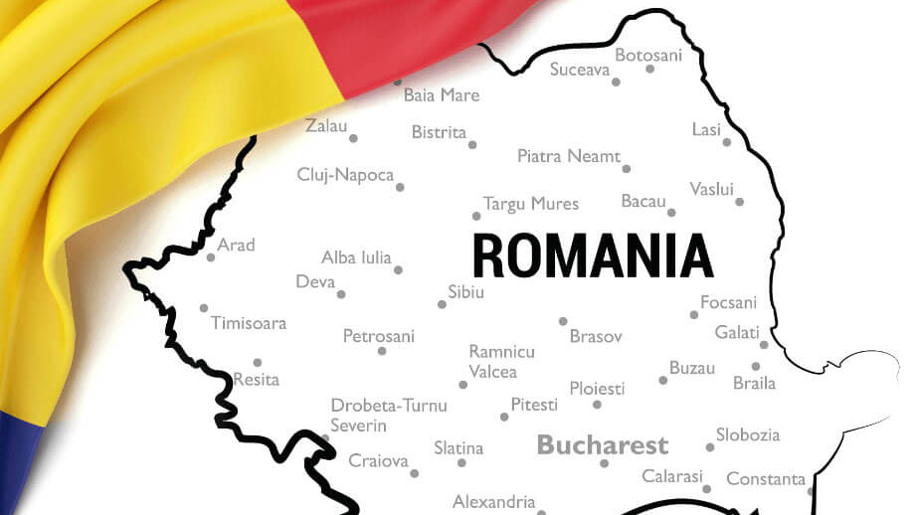
Romania
Mihai Marcovici, MSc
CIVIS Student, NKUA
Media and Communication Department

Slide 2
table of contents
General information about Romania
History facts – How the country was shaped through time
Communist period
The road to EU and NATO
Post communist times
EU budget and trade
Ukraine war
Euroscepticism

Slide 3
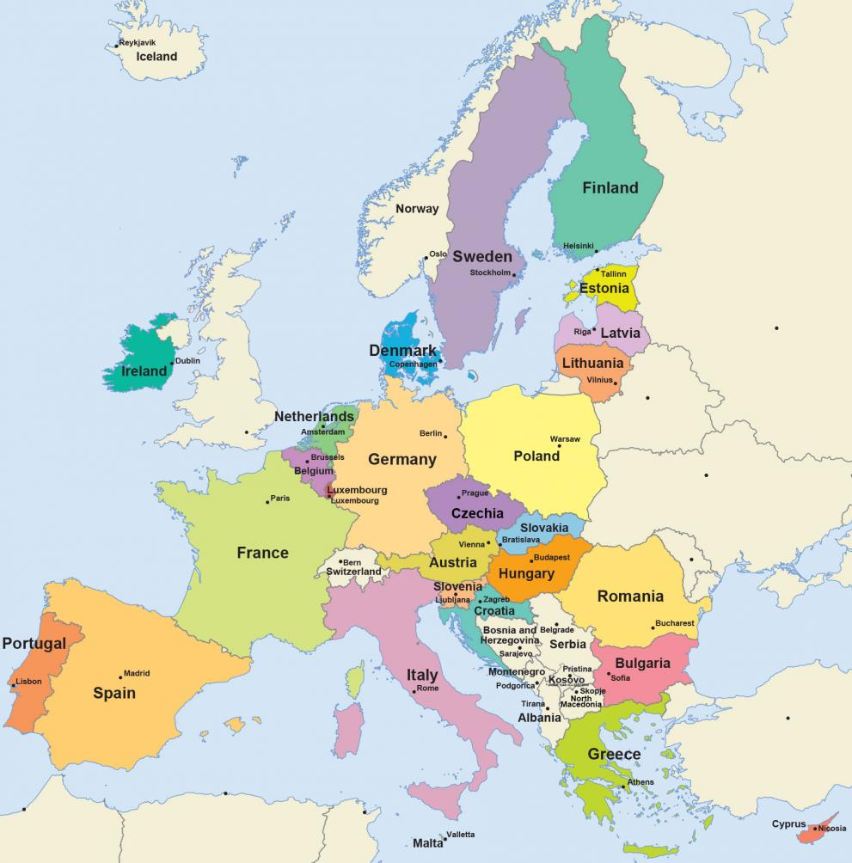
General info About romania
Romania is a European Union member country located at the crossroads of Central and Southeastern Europe, on the northeastern part of the Balkan Peninsula, bordering with Bulgaria, Ukraine, Moldova, Hungary, and Serbia.
The capital and largest city of Romania is Bucharest, the official language is Romanian, has a population of 19,759,110 million, and the local currency is Romanian Leu (RON).
EU membership since 2007
NATO member since 2004
Not a Schengen and Eurozone Country

Slide 4
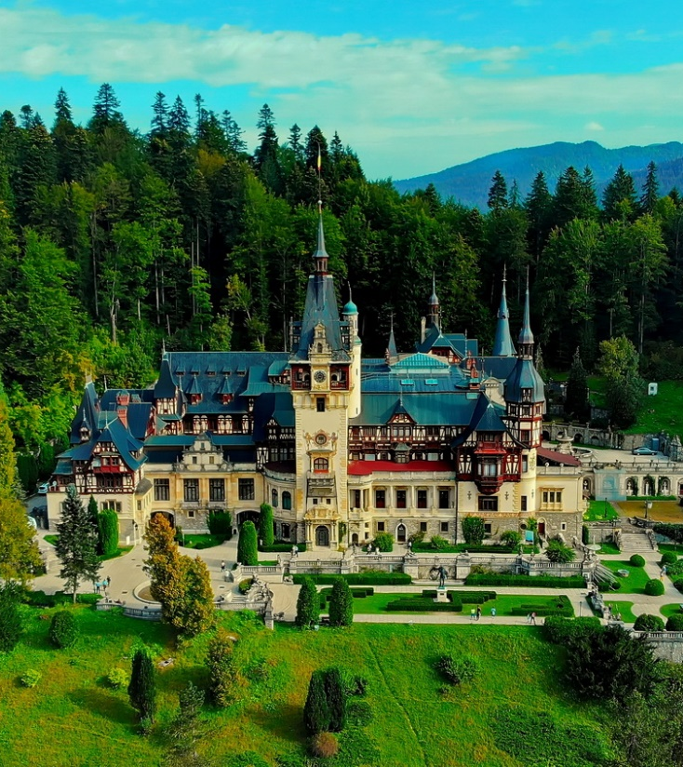
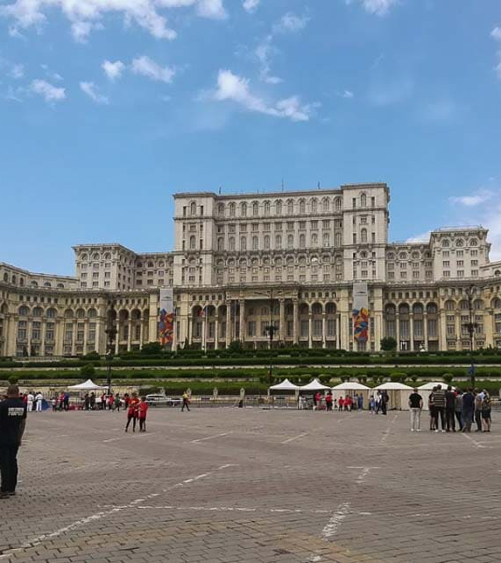
Did you know…
The Parliament Palace in Romania’s capital of Bucharest is the second largest building in the world, behind only the Pentagon.
Peles Castle in Sinaia was the first European castle entirely lit by electrical current and in 1889, Timisoara became the first in Europe to have electric street lighting.
The first ever perfect 10 awarded in the Olympic Games went to Romanian gymnast Nadia Comaneci in Montreal, Canada in 1976.
Romanian Engineer Traian Vuia, build and fly the first(plane) “heavier-than-air” in 1906

Slide 5
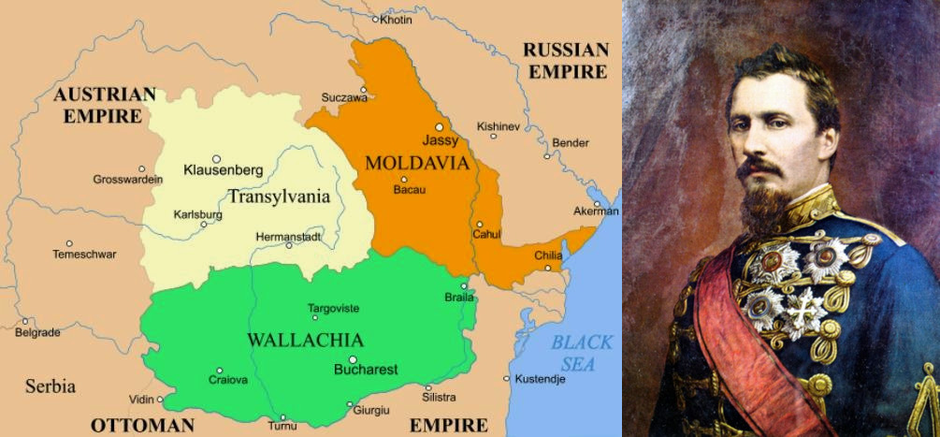
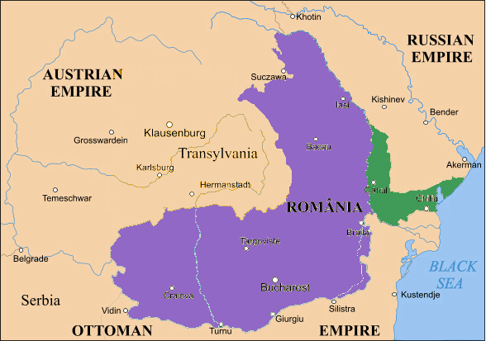
About Romania
Before first unification
The name of the country was adopted during the rule of Alexandru Ioan Cuza on 24th of January 1862.
The name was adopted to strengthen the national identity, following the unification on Moldova and Wallachia
After unification 1859

Slide 6
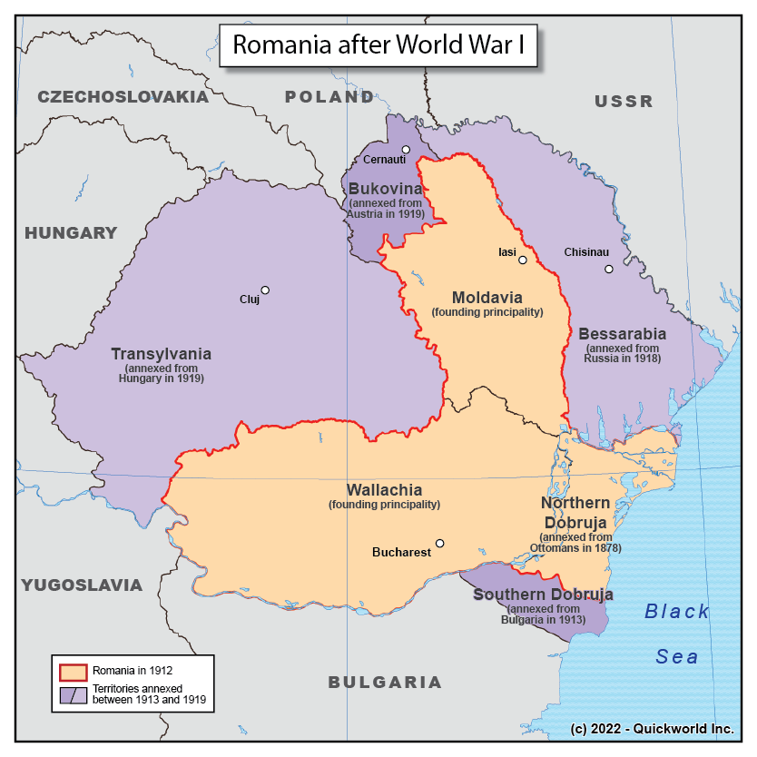
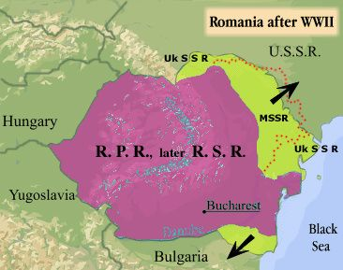
Country shaping by the 1st ans 2nd world war
After the First World War and disintegration of Austro-Hungarian Empire, Transylvania was annexed to Romania
In 1940 Romania was forced to cede back Transylvania back to Hungary
In February 1947 during the Treaty of Paris Romania regained Northern Transylvania, but the territories of Basarabia (now State of Moldova) and Northern Bukovina became part of the Soviet Union

Slide 7
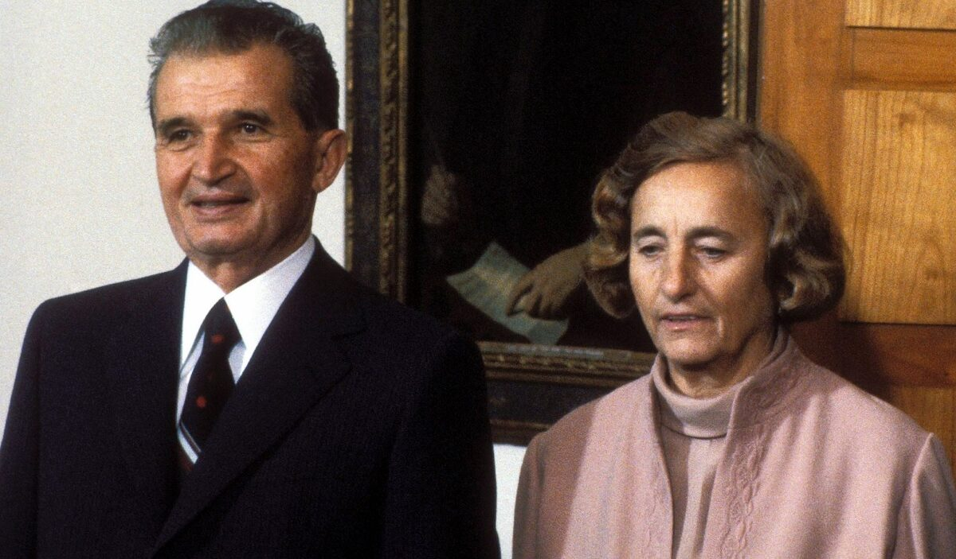
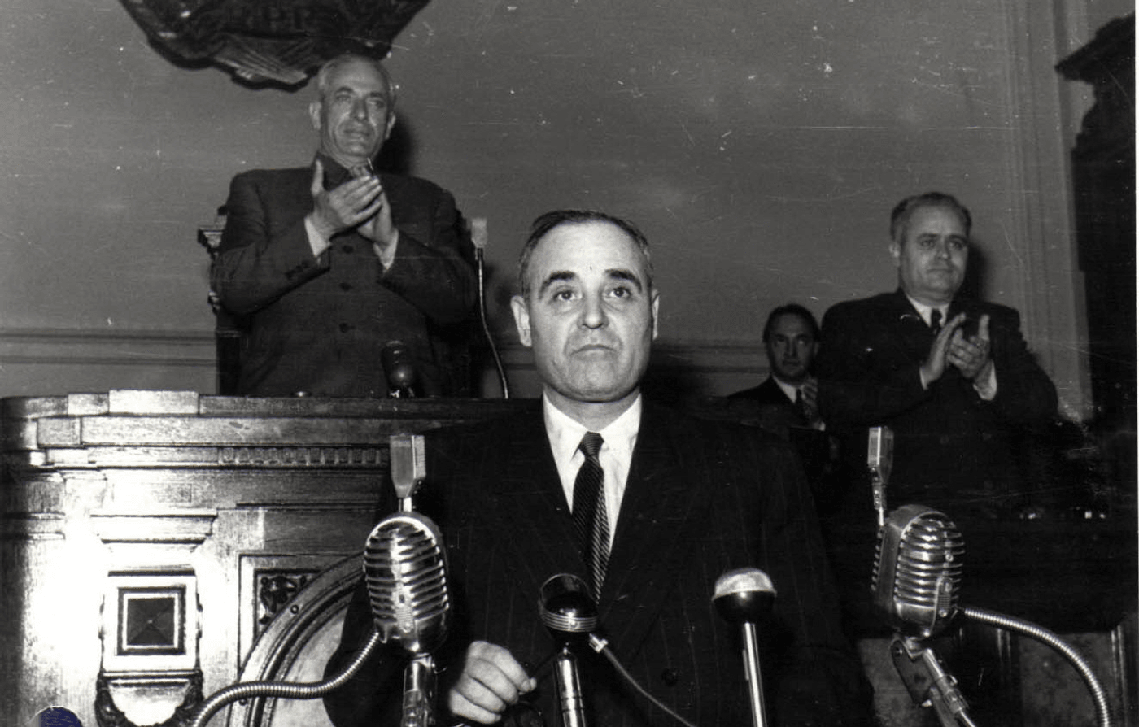
Romania and the communist period
Nicolae Ceausescu and his wife
After the end of World War II in Romania communists come into power starting with Gheorghe Gheorghiu-Dej and succeeded by Nicolae Ceaușescu's rule until December 1989.
Under communist rulers Gheorghe Gheorghiu-Dej and Nicolae Ceaușescu, Romania had experienced :
collectivization of agriculture and industrialization campaigns.
aggressions from national security forces, called “Securitate”
Gheorghe Gheorghiu Dej

Slide 8
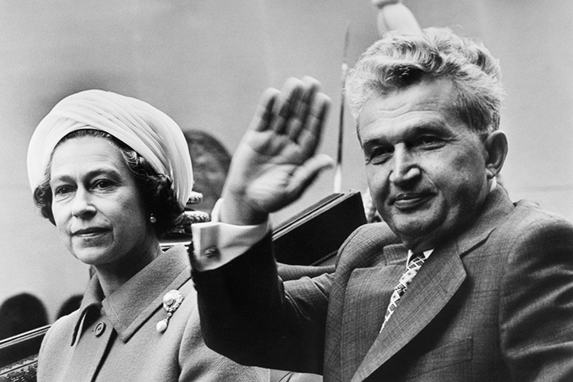
Romania one party state
During his regime, Nicolae Ceausescu stopped every political party opposition and there was only the Romanian Communist Party(PCR).
Ceaușescu distanced Romania from Soviet influence and his refusal to participate in the Warsaw Pact invasion of Czechoslovakia in 1968 proved his commitment to not participate in other states international affairs.
Ceaușescu approached to Germany and USA and refused to categorize Israel as an aggressor during the Six Day War

Slide 9
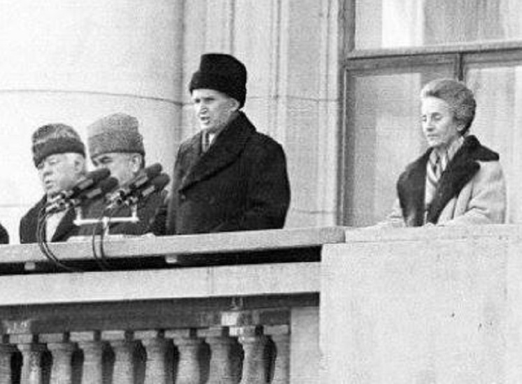
Romanian Revolution and downfall of communism
The revolution started in 16 of December 1989 in the city of Timișoara and immediately after in Bucharest and across the country
On 22nd of December 1989, Nicolae Ceaușescu address to the people in Bucharest in order to regain control, but the speech backfired, and the crowd turned against him later
They were arrested and trial and on Christmas day on December 1989, Nicolae and Elena Ceaușescu were executed by firing squad
The number of victims of the Romanian Revolution was 1166 people

Slide 10
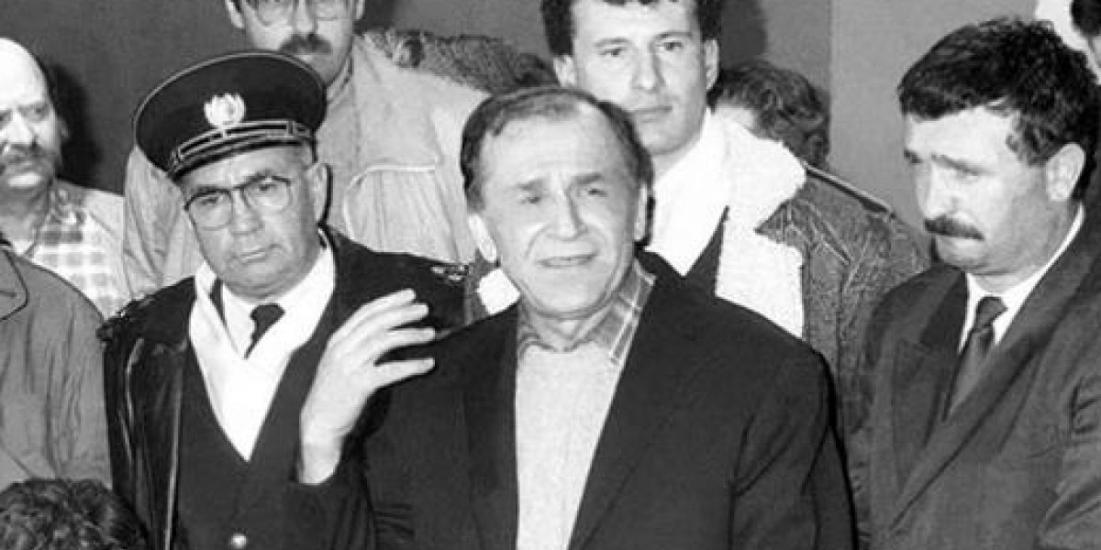
After the revolution
Immediately after the Romanian Revolution from December 1989, temporary, the power of the state was taken by Ion Iliescu and the political party named National Salvation Front ( FSN)
The first elections were held on March 1990 and Ion Iliescu won the elections having the support of the communist electorate, having 2 years term mandate
In 1991 through Referendum is adopted the Romanian Constitution
In 1992 he won again the Presidential elections for a 4year term

Slide 11
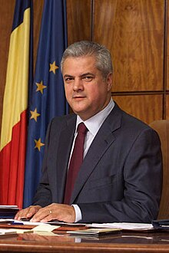
Romania road to democracy and EU
An important victory of human rights and sexual minorities was in 22 of June 2001 when the Article 200 who was incriminating and punishing the same-sex relationships was cancelled by the former Prime Minister Adrian Nastase.
This was one of the conditions for EU ascension
Formel Romanian Prime Minister Adrian Nastase

Slide 12
Romania road to democracy and EU
During the next period European Councils of Copenhagen ,of Thessaloniki ,Bruxelles reconfirm the support of the EU member states towards the conclusion of the negotiations in 2004, the signing of the Accession Treaty as soon as possible in 2005 and the effective accession in January 2007.
25 of April 2005, at Luxemburg, Romania signed the Accession Treaty
Regarding the financial support from the Phare programme and other pre-accession instruments focused for the Accession Partnership priorities Romania received funds through PHARE, Sapard and ISPA programmes.
Officially joined EU in 2007

Slide 13
Why Romania chooses to join NATO?
After the dissolution of Soviet Union, President Ion Iliescu changed his agenda regarding the external policies affairs and started to get closer to the West for economic and defence benefits
Romania was the first former communist state to formally apply to join the Partnership for Peace programme launched in January 1994.
In the spring of 1999 NATO’s upstanding movement against Serbia NATO requested and attained military installations from Romania (as well as Bulgaria) in its drive against Slobodan Milošević and his actions in Kosovo.
Along with Romania, Bulgaria denied Russia authorization to over-fly its airspace to support and supply the regime of Slobodan Milošević.

Slide 14
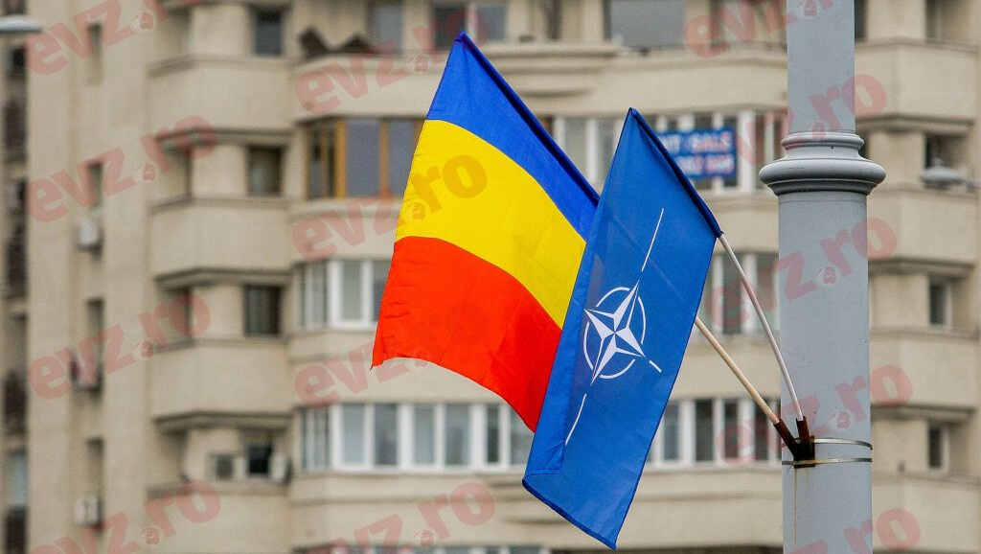
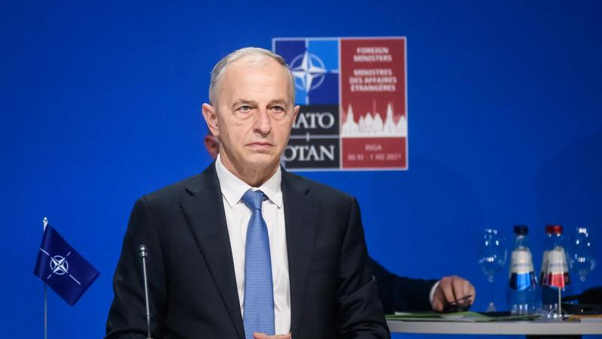
Why Romania chooses to join NATO?
In regards with the events from 11 of September 2001, Romania and Bulgaria stated that them will help United States with the terrorism fight and having a strategic position at the Black Sea
In 2004 Romania signs the full membership with NATO
In October 2019 Mr. Mircea Geoană was appointed NATO Deputy Secretary General being the first Deputy Secretary General from Romania, and the first from any of the countries that joined the Alliance after the end of the Cold War.

Slide 15
Current political situation
Romania is a semi-presidential republic with a president as the head of state and a prime minister as the head of government.
The president of Romania is Klaus Werner Iohannis, now at the second term. The Prime Minister Marcel Ciolacu, is member of the Social Democrat Party.
The parliament of the country is formed by two chambers, Chamber of Deputies, and the Senate.
-The actual president and parliament face re-election this year in November.

Slide 16
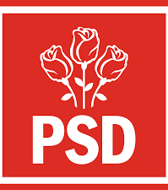
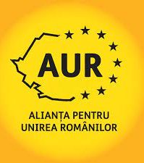
Parliament structure
Social Democrat
106 members
Liberal Party
76 members
Save Romania Union
41 members
Alliance for Romanians Unification
32 members
Hungarian Democrat Union
20 members
+ 53 members from Minorities and Independents
PSD + PNL forms the Government coalition and the rest of the are in opposition.
The coalition had each 2 years mandate for the PM, this raising concerns about the political ability to solve country issues.

Slide 17
Critical Romanian events
An important event that happened since Romania joined EU is the Same-sex Referendum for changing the article 48 from the Constitution on 6th and 7th of October 2018 .
They wanted to change “spouses” into “man and a woman” in order to future block the same sex marriages
The 2 days referendum didn’t pass, because the voting presence was 20.4% and the necessary for passing through is 30%.
Currently in Romania is not allowed same sex marriages but the relationship between same sex couples are not against the law.
Source: https://www.nytimes.com/2018/10/07/world/europe/romania-referendum-marriage.html

Slide 18
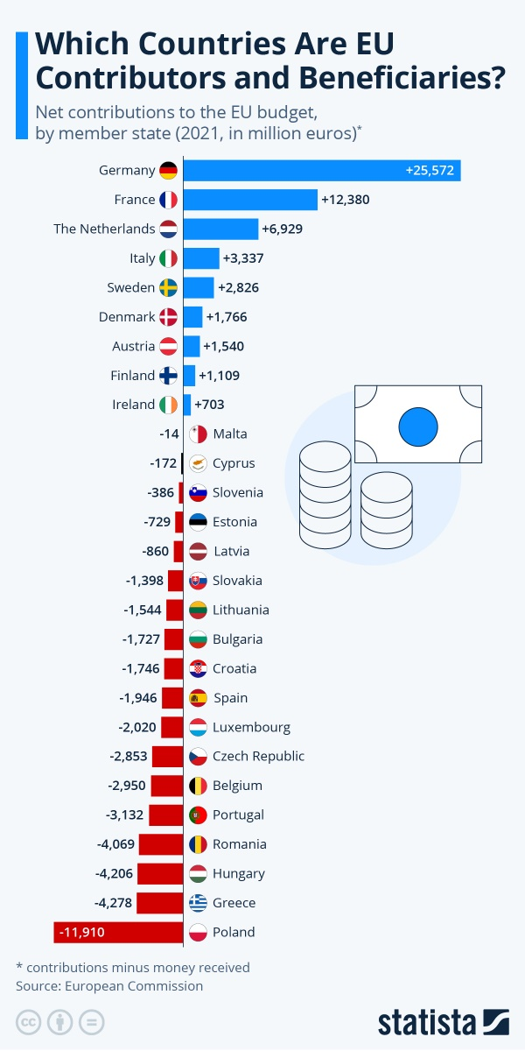
Eu budget and romania
Romania is a net beneficiary of the EU budget. This means that Romania receives more money from the EU than it pays in contributions. As example, in 2021, Romania received €11.9 billion from the EU budget, while it paid €7.7 billion in contributions. This means that Romania had a net benefit of €4.2 billion from the EU budget.
Romania is a beneficiary of the EU budget for several reasons. These include:
Country low GDP per capita - Romania has one of the lowest GDP per capita in the EU, and this makes it eligible for a large amount of EU funding. In Romania GDP per capita is 76 versus 100 of the European Union
Country need for infrastructure investment - Romania's infrastructure needs significant investment, and the EU budget can provide assistance with this.
Its commitment to reform - Romania has made significant progress in recent years with economic reforms, and the EU budget is helping to support this process. For instance, the unemployment rate in 2021 and 2022 decreased at 5.6% ( EU average 6.2%) source : https://ec.europa.eu/eurostat/databrowser/view/tps00203/default/table

Slide 19
Trade and economics
Romania is not part of Eurozone and Schengen Area ( expected in March 2024).
The most important sectors of Romania’s economy in 2020 were industry (21.7%), wholesale and retail trade, transport, accommodation and food services (19.7%) and public administration, defence, education, human health and social work activities (16.5%).
Intra-EU trade accounts for 74% of Romania’s exports (Germany 23%, Italy 11% and France 7%), while outside the EU 3% go to Turkey and the United Kingdom.
In terms of imports, 74% come from EU Member States (Germany 21%, Italy 9% and Hungary 7%), while outside the EU 6% come from China and 4% from Turkey.
Source : https://european-union.europa.eu/principles-countries-history/country-profiles/romania_en

Slide 20
Romania and Ukraine war
Romania has a significant historical connection with Ukraine, particularly in regions that were once part of historical Romania but are now situated in present-day Ukraine.
As of February 24, 2023 , more than 2.46 million border crossings from Ukraine and the Republic of Moldova to Romania were registered.
As of December 27, 2022, a total of 106,542 refugees from Ukraine are present in the country and 101,641 refugees registered for temporary protection in Romania, according to Romanian Government data. Women and children make up 80% of the refugee population.

Slide 21
Romania and Ukraine war
Regarding the position of the country towards Russia, there were applied all the sanction imposed together with European Union
One of other taken by the country authorities is closure of the Russian Centre for Culture and Science by reasons of Russian propaganda in the country.
A survey done by INSCOP Research ( Survey Company in Romania ) showed that :
A majority of respondents (75.2%) consider Russia to be mainly to blame for the war
79.2% agree with the sanctions against Russia by the EU and the USA - 59.4% fully and 19.8% somewhat.

Slide 22
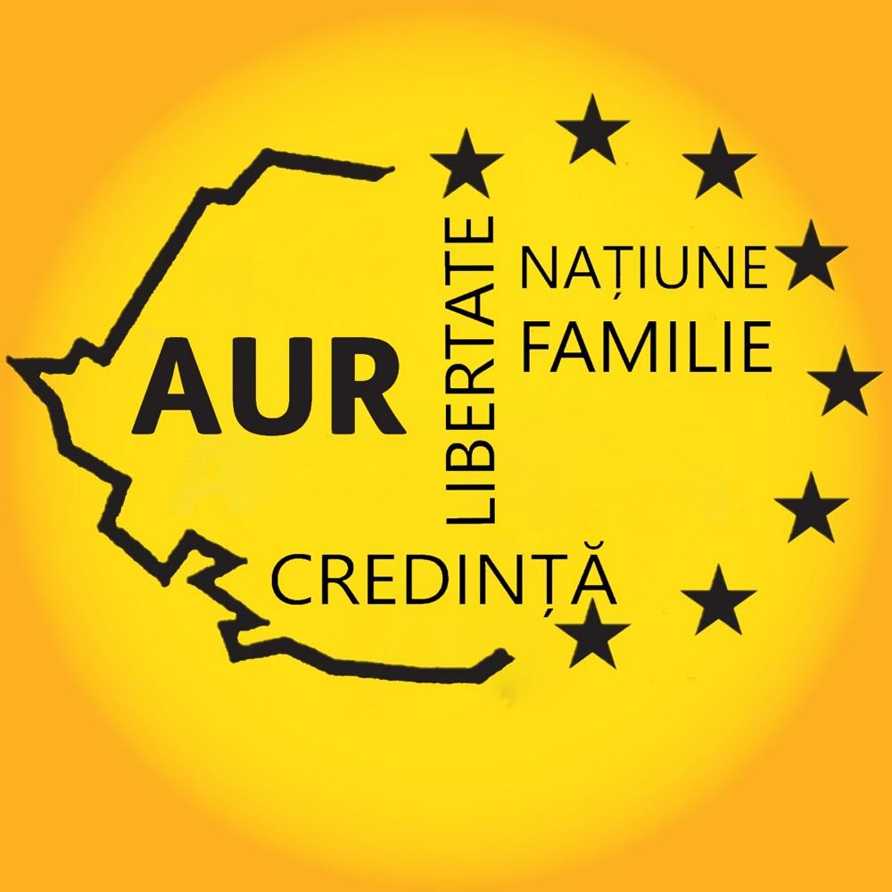
EUROSCEPTICISM IN ROMANIA
Both before and after their country’s accession to the EU, Romanian citizens’ level of trust in the EU remained well over that of the average numbers in other EU countries.
A 2023 poll found that only 48% of Romanians believe that Romania should remain a member of the EU, while 40% believe that Romania should leave the EU.
The situation changed with the last elections in 2020 when the Alliance for the Union of Romanians (AUR), a far-right populist party has gained significant sympathy, gaining 32 seats in the Parliament.
The party's platform being characterized by strong opposition to the European Union (EU) policies, focusing on national identity, and populist rhetoric.

Slide 23
EUROSCEPTICISM IN ROMANIA
Factors Contributing to AUR's Euroscepticism
Dissatisfaction with the EU's economic performance saying that the EU has not done enough to help Romania recover from the economic crisis.
Some Romanians feel that the EU is too focused on issues such as LGBTQAI+ rights and immigration, which they believe are not in Romania's interests.
Some Romanians believe that the EU is trying to impose its values on Romania and that Romanian sovereignty is being undermined and here the discussions are mainly about migration.

Slide 24
Bibliography
Adrian Otovescu, F. P. (2020). The Romanian community in Chernivtsi: Historical landmarks and current issues. Revista Universitara de Sociologie , 194-195.
Bachman, R. D. (1991). In R. D. Bachman, Romania, a country study. Washington, D.C: Library of Congress.
Buchholz, K. (2023, 06 27). Which Countries are EU Contributors and Beneficiaries? Retrieved from Statista: https://www.statista.com/chart/18794/net-contributors-to-eu-budget/
Carmen Valică, E. T. (2023, 12 17). Ei au murit pentru libertate în 1989. Comunismul a început, a continuat și s-a sfârșit cu sânge. Retrieved from Europa Libera: https://romania.europalibera.org/a/revolutia-romana-1989/32730871.html
EUR-LEX, Acces to European Union Law. (2007, 01 23). The Accession Partnership with Romania. Retrieved from EUR-LEX, Acces to European Union Law: https://eur-lex.europa.eu/EN/legal-content/summary/the-accession-partnership-with-romania.html
European Commission . (n.d.). Mircea Geoana. Retrieved from European Commission: https://commission.europa.eu/persons/mircea-geoana_en
European Commission. (2022, 07 25). EU Cohesion Policy: €31.5 billion for Romania's economic, social and territorial cohesion, competitiveness and green and digital transition in 2021-2027. Retrieved from European Commission: https://ec.europa.eu/commission/presscorner/detail/en/ip_22_4662
European Public Prosecutors Office. (n.d.). The independent public prosecution office of the EU. Retrieved from European Public Prosecutors Office: https://www.eppo.europa.eu/ro/node/42

Slide 25
Bibliografy
Eurostat. (2023, 11 28). Population change - Demographic balance and crude rates at national level. Retrieved from Eurostat: https://ec.europa.eu/eurostat/databrowser/view/DEMO_GIND__custom_7127262/default/table
GALLAGHER, T. (2009). NATO, the EU and Romania’s strategy of duplicity. In T. GALLAGHER, Romania and the European Union (pp. 132-152). Manchester: Manchester University Press.
Gavin Bowd, M. A. (2019). Peak Dictatorship: Ceauşescu's State Visit to Great Britain, June 1978. The Slavonic and East European Review , Vol. 97, No. 4 , 711-737.
GHIŞA, D. A. (2021, 02 08). Romania and the System of Treaties of Versailles. Retrieved from Pulsul Geostrategic: https://www.pulsulgeostrategic.ro/en/materiale/material/196
Lindley-French, J. (2007). A World Gone Mad: 9/11 and Iraq. In J. Lindley-French, The North Atlantic Treaty (pp. 16-17). Abingdon: Routledge Global Institutions.
Lucie Steinzova, S. G. (2019, 01 16). The Man Who Saved Romanian Churches From Destruction. Retrieved from Radio Free Europe, Radio Liberty: https://www.rferl.org/a/romania-bucharest-architecture/29697331.html
OECD. (2009). Talent Abroad: A Review of Romanian Emigrants . Paris: OECD Publishing.
Pietroşel, A. (2021, 06 21). 20 years since the repeal of Article 200 of the Criminal Code. Retrieved from Radio France International: https://www.rfi.ro/social-135238-20-de-ani-de-la-abrogarea-articolului-200-din-codul-penal
Stemp, A. (2023, 07 15). Reliving revolutionary days in Timisoara. Retrieved from Budapest Times: https://www.budapesttimes.hu/travel/reliving-revolutionary-days-in-timisoara/
Tismaneanu, V. (1998). Communism and post-communism in Romania: Challenges to democratic transition. The National Council for Eurasian and East European research, 1-32.

