Slide 1
Portugal in the EU
by Aris Georgakopoulos

Slide 2
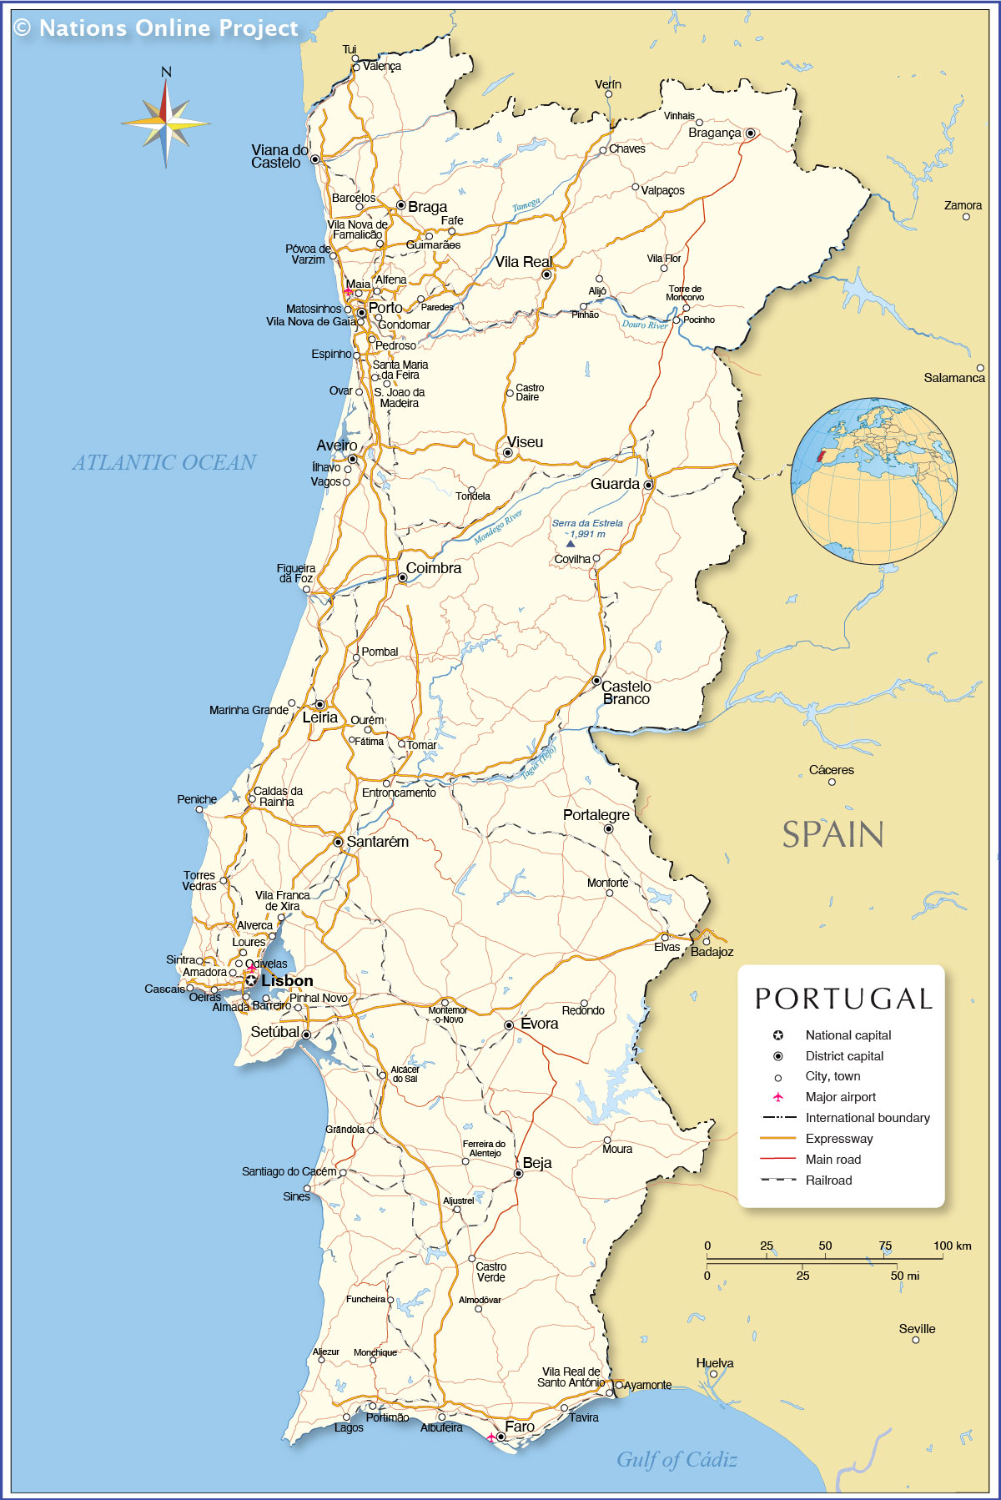
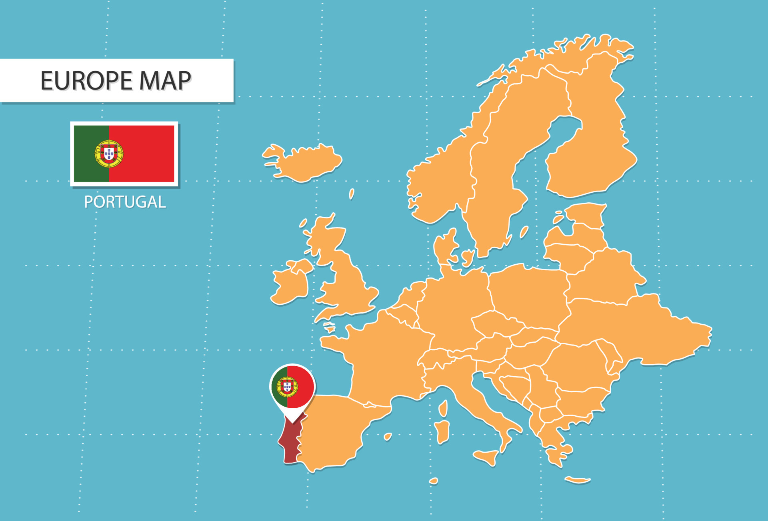
Portugal on the map
Population: 10.3m (12th in EU)
Size: 92k sq km (12th in EU)

Slide 3
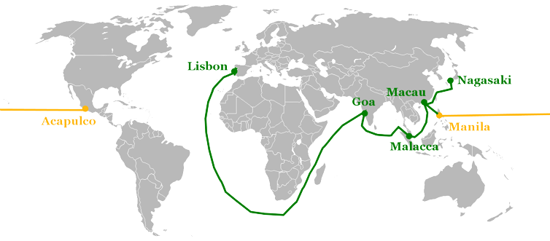
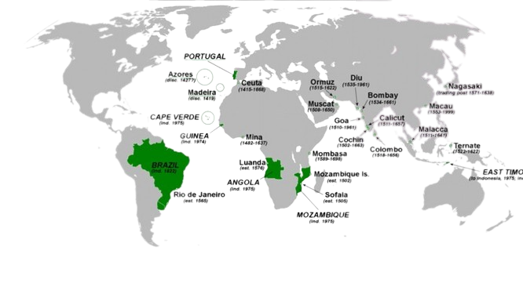
Portuguese History
Portuguese Empire (1415 – 1999)
Size: 4m sq km (1815)
Brazil Independence: 1822
Mozambique-Angola: 1975
Treaty of Tordesillas (1494)
Treaty of perpetual friendship (1386)

Slide 4
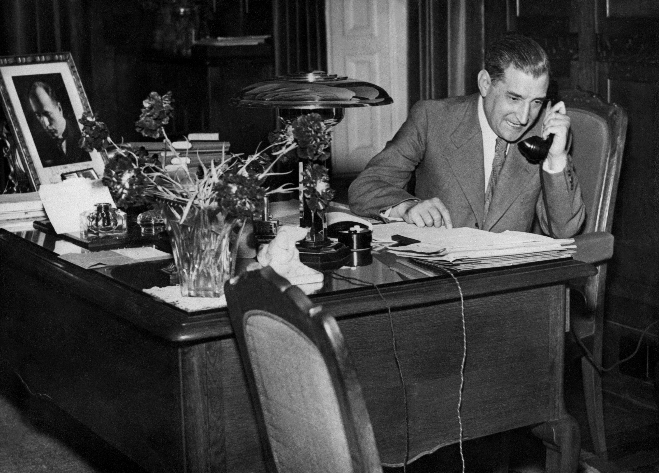
Portuguese History
Abolition of the Monarchy (1910)
38 prime ministers in 16 years
Participation in WW1
Estado Novo Dictatorship (1933 – 1974)
Censorship
Isolation
Anti decolonization

Slide 5
1986 enlargement
1976 beginning of process
1981 Greece joins the EEC
“The EEC is not a club for the rich”
1986 Enlargement

Slide 6
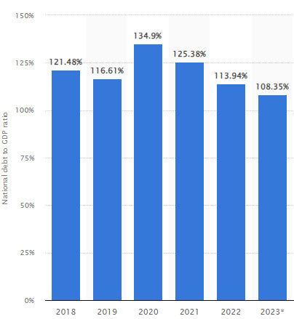
Portuguese Economy
GDP: 242B€
15th in the EU
GDP per capita: 19k€
Eu average: 29k€
20th in the EU
Unemployment: 6%
EU average: 6.8%

Slide 7
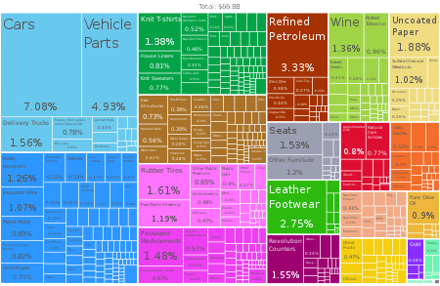
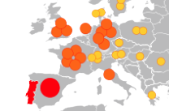
Portuguese Economy
Exports: 71% towards EU
(Spain 25%, France 14%, Germany 12%)
Imports: 75% towards EU
(Spain 33%, Germany 13%, France 7%)
Portugal is the 5th largest net beneficiary from the EU budget (3B€ in 2021)

Slide 8
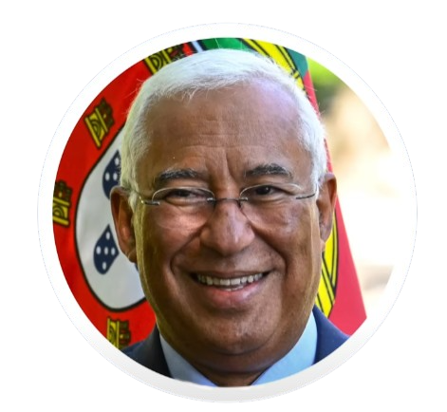
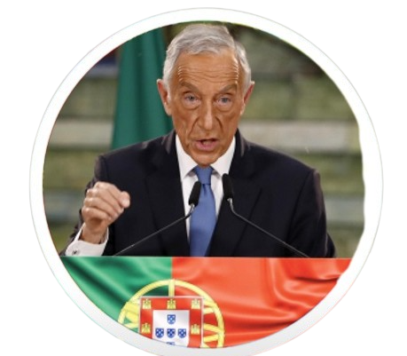
Portuguese Political System
Marcelo De Sousa Antonio Costa
(President)
(Prime Minister)

Slide 9
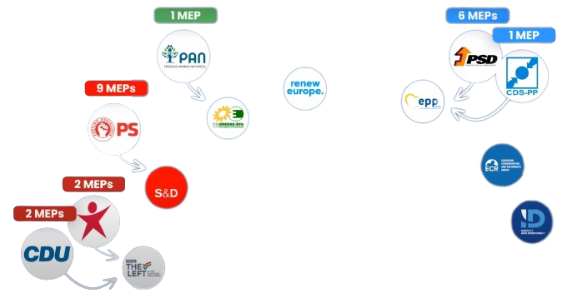
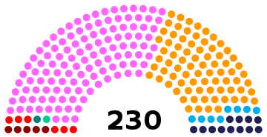
Portuguese Political System
2022 legislative election
Socialist Party: 120/230 seats
Social Democrats: 77/230
Chega: 12/230
21 MEPs
Socialists & Democrats: 9 MEPs
EPP: 7 MEPs
The Left: 4 MEPs

Slide 10
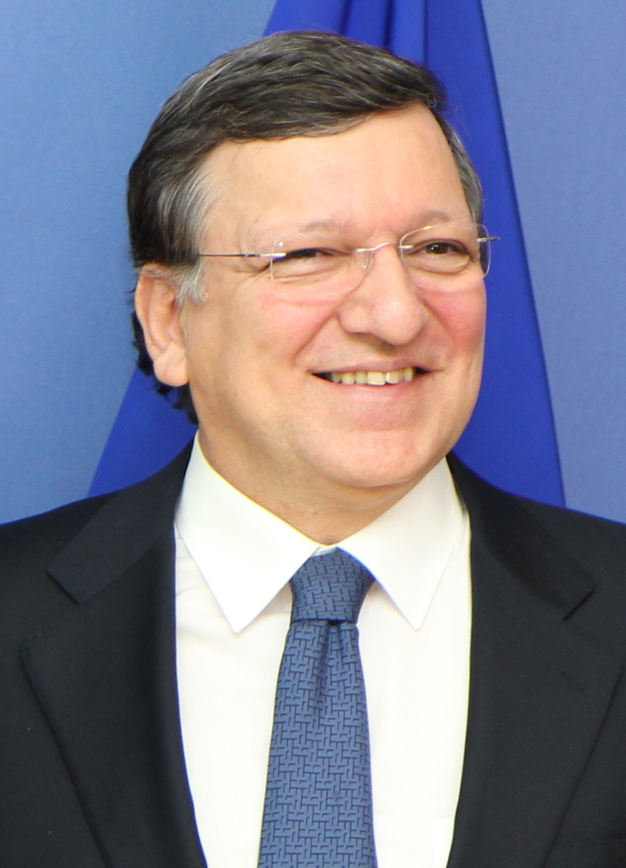
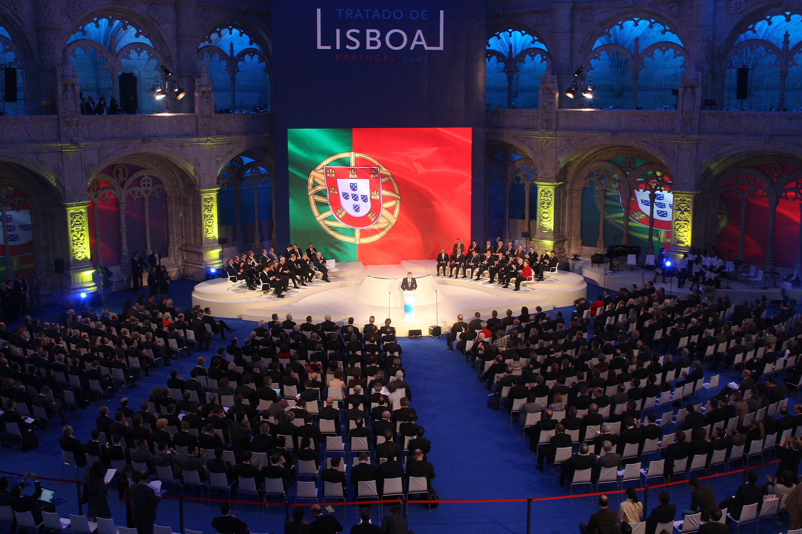
Portugal in the EU
Jose Manuel Barroso
(President of the Commission)
(2004 – 2014)
Treaty of Lisbon 2007

Slide 11
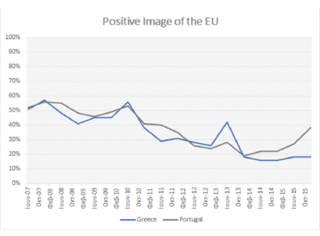
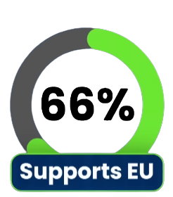
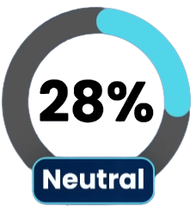
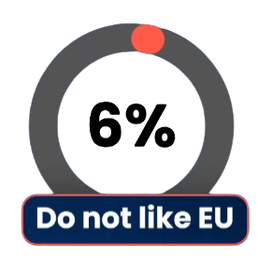
Euroscepticism in Portugal
Eurobarometer 2023
Eurosceptic parties
17%
Soft Euroscepticism 12 seats
Hard Euroscepticism 6 seats
Soft Euroscepticism 5 seats
Believe Portugal could face a future outside the EU
27%
Peak of Euroscepticism after the 2011 bailout
Big reduction after 2015
Feel the EU is going in the wrong direction

Slide 12
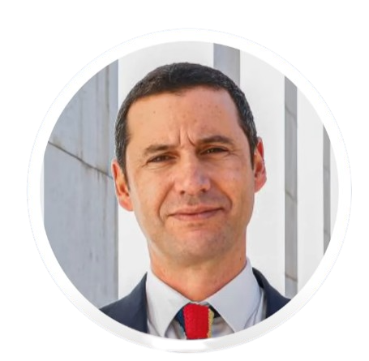
Corruption Scandal
3rd Scandal
1st Scandal
State Airline
500k€ illegal payout to junior minister
TAP CEO and the Finance Minister fired by Costa
2nd Scandal
Corruption and bribery involving EU funded projects
Antonio Costa resigns (7th of November)
Snap elections called for March 4th 2024
Since 2022 elections 10 ministers have been either fired or left their post.
Accused of witness tampering
Attempted to resign in May 2023
President didn’t dissolve parliament
Joao Galamba
(Minister of Infrastructure)

Slide 13
Thank you for your attention!

