Slide 1
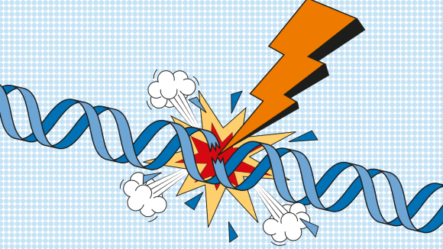
DNA repair mechanisms
Clinical relevance and therapeutic targeting
Kostas A. Papavassiliou MD, PhD
Harvard University
October 2023

Slide 3
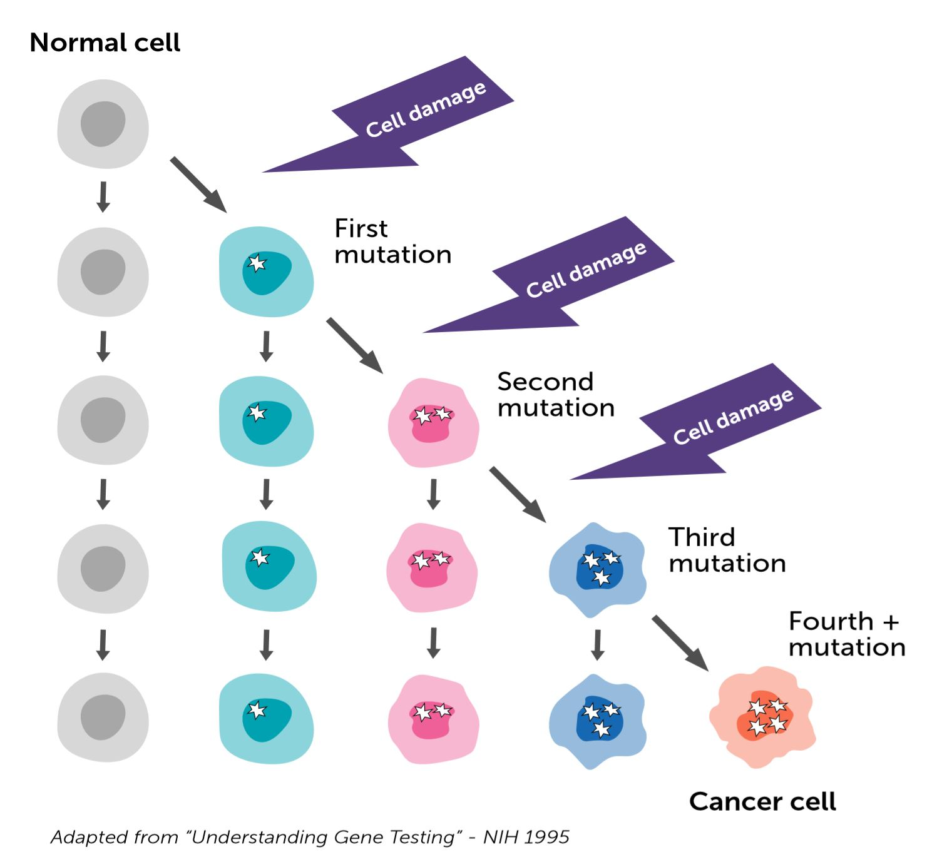
Significance of DNA repair
Consider the effects of unrepaired DNA damage…
If replicated and transmitted to future cell generations, it becomes permanent → mutation (substitution, insertion, deletion, silent)
In mammals, strong correlation between accumulation of mutations and cancer

Slide 4
Significance of DNA repair
During a 24-hour period, the mammalian cell genome accumulates many thousands of lesions
DNA repair makes sure that <1/1000 becomes a mutation
If DNA repair systems were absent, life would be impossible!
Number & diversity of DNA repair systems reflects both importance of DNA repair to cell survival and diverse sources of DNA damage

Slide 5
DNA repair systems

Slide 6
DNA repair systems
Divided into 2 general mechanisms:
Direct: MGMT
Indirect: BER, NER, MMR, HR, NHEJ

Slide 7
Direct DNA repair
O⁶-methylguanine forms in the presence of alkylating agents & tends to pair with thymine rather than cytosine during replication
If not repaired, this leads from a G·C to A·T mutation after replication

Slide 8
O6-methylguanine-DNA methyltransferase (MGMT)
MGMT acts by removing alkyl adducts from the O6 position of guanine, thus antagonizing the lethal effects of alkylating agents
During the repair process, the methyl moiety of the O6-methylguanine adduct is transferred to the MGMT protein, which subsequently undergoes irreversible inhibition
Notes:
MGMT acts by removing alkyl adducts from the O⁶ position of guanine at DNA level, thus antagonizing the lethal effects of alkylating agents. During the repair process, the methyl moiety of the O⁶-methylguanine adduct is transferred to the MGMT protein, which subsequently undergoes irreversible inhibition.

Slide 9
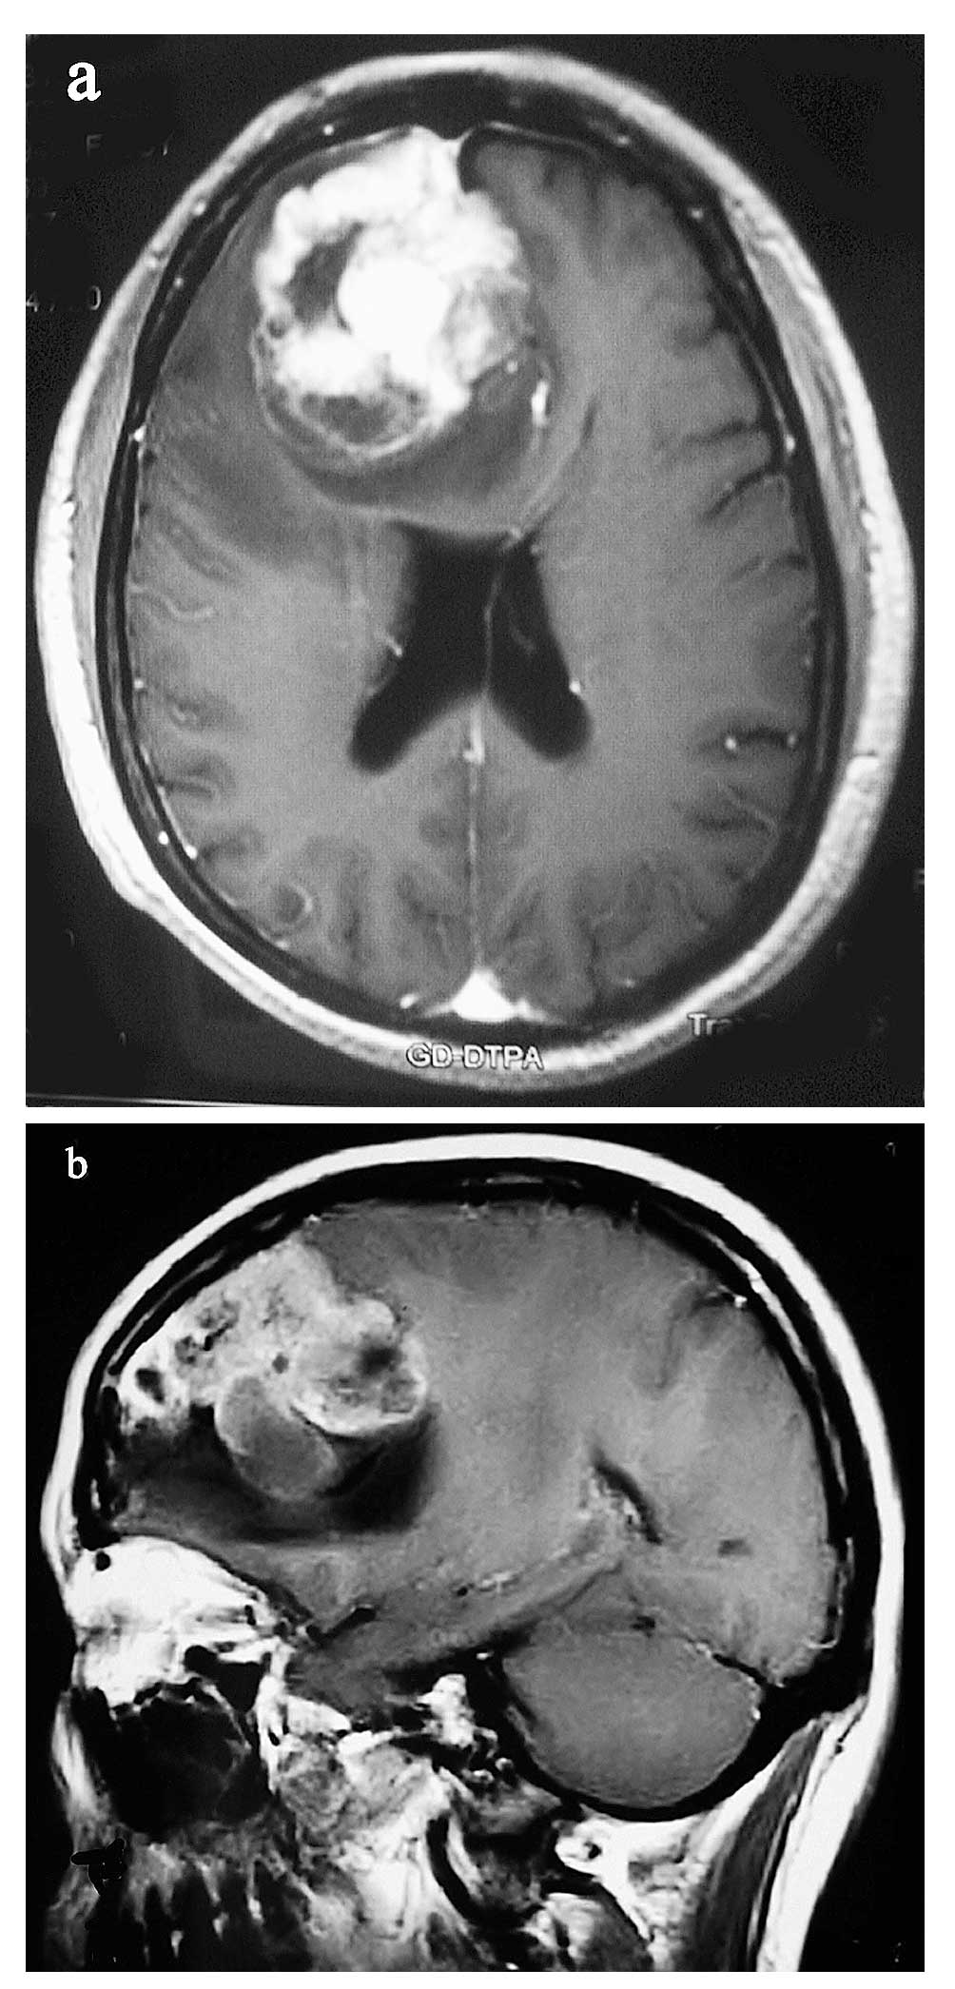
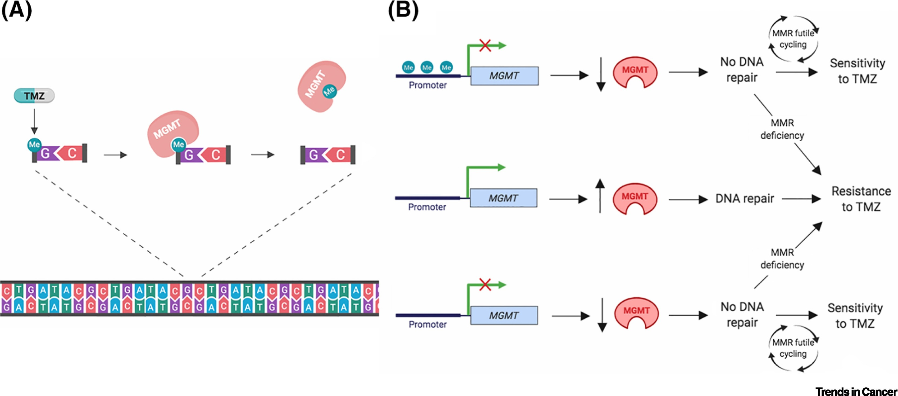
MGMT and Glioblastoma
MGMT gene promoter methylation in ~50% of GBMs
‘Stupp trial’ firstly associated MGMT methylation status with response to TMZ
MGMT as a prognostic biomarker
MGMT as a predictive biomarker
Notes:
In the ‘Stupp trial’ MGMT gene promoter methylation was found to be the strongest predictor of survival regardless of whether GBM patients were treated with TMZ plus radiotherapy or radiotherapy alone

Slide 10
Indirect DNA repair
Base-excision repair (BER)
Nucleaotide-excision repair (NER)
Mismatch repair (MMR)
Homologous recombination (HR)
Non-homologous end joining (NHEJ)

Slide 12
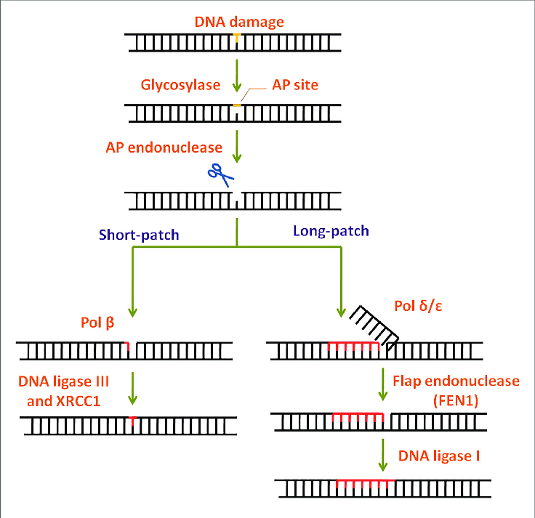
BER
Base-specific glycosylase (DNA glycosylase) recognizes and removes damaged bases (e.g., deaminated or oxidated), creating an AP site (apurinic/apyrimidinic)
AP endonuclease cuts the DNA backbone on the 5′ end of the AP site
AP lyase cuts the DNA backbone on the 3′ end of the AP site
DNA polymerase-β refills the gap
Ligase reseals the strand.

Slide 14
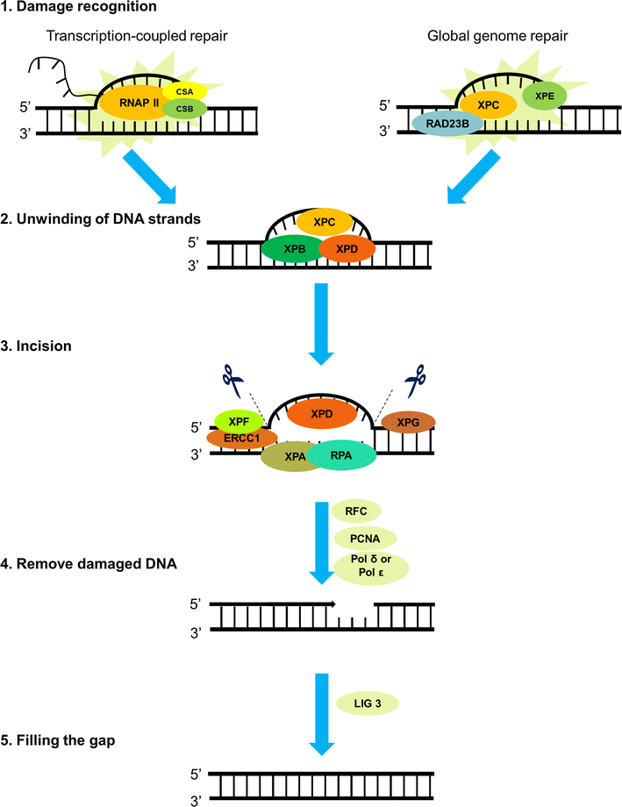
NER
Specific endonucleases recognize the damaged area (e.g., pyrimidine dimers that distort the DNA helix) of nucleotides (typically a 12–24 bp section)
Oligonucleotide containing the damaged region is excised by endonuclease
DNA polymerase refills the resulting gap
Ligase reseals the strand

Slide 15
Diseases associated with defective NER
Xeroderma pigmentosum
Cockayne syndrome

Slide 16
Xeroderma pigmentosum
Rare, autosomal-recessive, hereditary skin disease caused by defective DNA repair mechanisms (i.e., nucleotide excision repair – XP repair proteins XPA, XPB, XPC, XPD, XPE, XPF, XPG)
Minimal UV radiation has carcinogenic effects and can lead to severe skin damage in affected individuals
Prevalence: 1:1,000,000 in the US
♂ = ♀

Slide 17
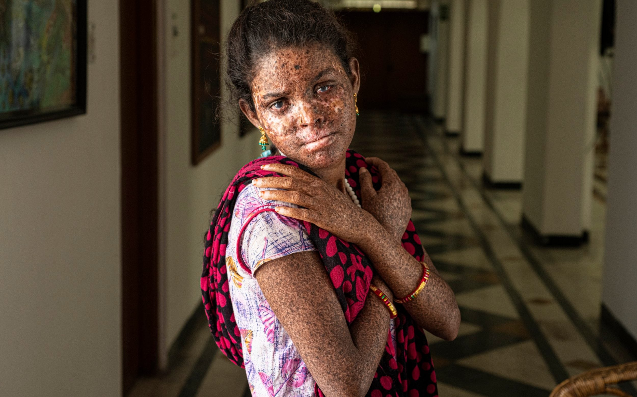
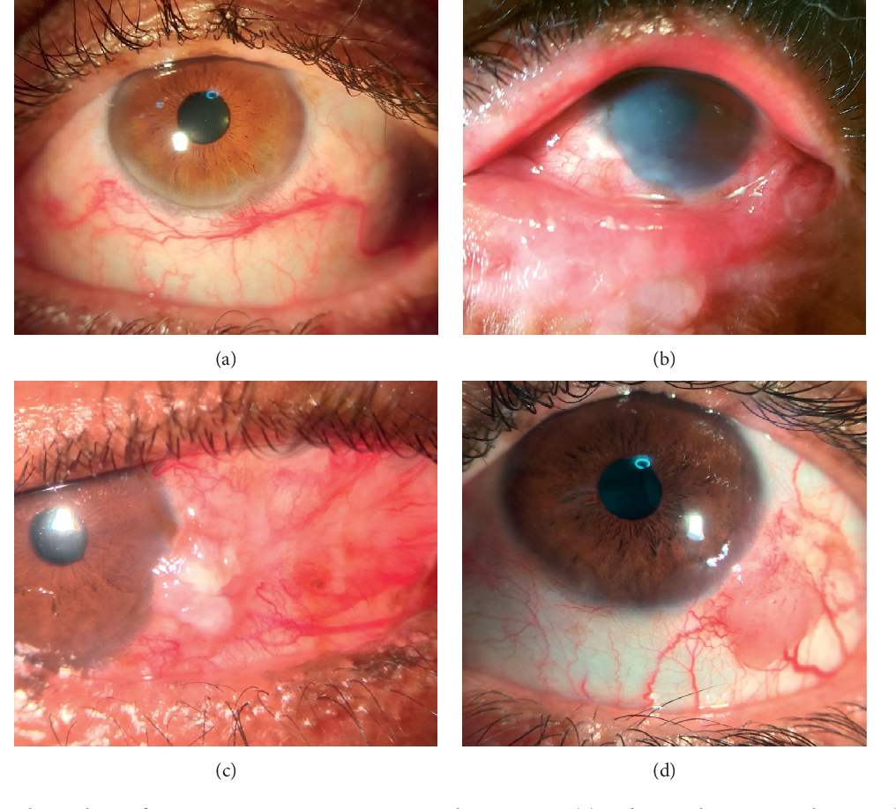
Xeroderma pigmentosum
Cutaneous manifestations
Slow healing, blistering burns after minimal exposure to sunlight in 50% of affected individuals
Solar lentigos, xerosis, poikiloderma, telangiectasia due to repeated exposure to sunlight
Multiple precancerous lesions (actinic keratoses) develop during early childhood.
Ocular manifestations
Photophobia and dry eyes
Atrophy of eyelids, loss of eyelashes
Keratitis, corneal opacification, loss of vision
Progressive neurodegeneration (∼ 25% of cases): cognitive impairment, sensorineural hearing loss, ataxia, spasticity, decreased deep tendon reflexes

Slide 18
Xeroderma pigmentosum
Diagnosis
Primarily based on history and clinical findings
Confirmatory genetic testing
Management
UV protection: limit exposure of skin and eyes to sunlight (e.g., protective clothing, high SPF sunscreen, UV-protective eyewear)
Vitamin D supplementation
Frequent skin cancer screening and ophthalmic exams
Systemic retinoids: non-melanoma skin cancer prophylaxis
Complications
Skin cancer (basal cell carcinoma, squamous cell carcinoma, melanoma) at a young age (< 20 years)
Malignant tumors of the eyes and eyelids
Prognosis: severely limited life expectancy

Slide 22
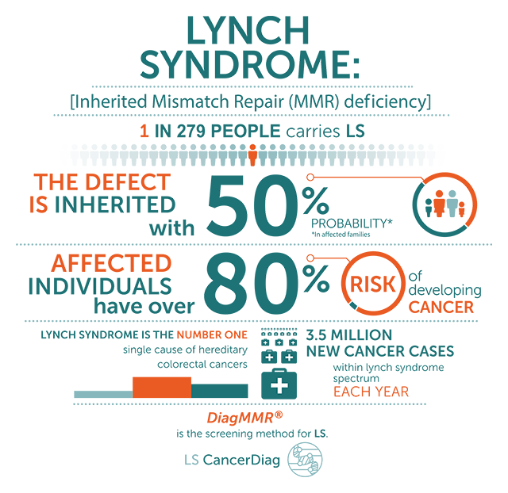
Hereditary nonpolyposis colorectal cancer (HNPCC) or Lynch syndrome

Slide 23
Homologous recombination (HR)

Slide 24
Homologous recombination (HR)
Repair by exchanging homologous segments between two DNA molecules (sister chromatids)
The error can be repaired using the complementary strand from the intact sister chromatid
Requires a (nearly) identical sequence (such as the complementary strand) to serve as a template for repair
No DNA is lost in the process

Slide 25
Diseases associated with defective HR
Breast/ovarian cancer (due to BRCA1 & BRCA2 mutations – tumor suppressor genes)
Fanconi anemia - hereditary form of aplastic anemia caused by an autosomal recessive defect in interstrand cross-link repair (e.g., by homologous end joining); associated with short stature, café-au-lait spots, thumb and forearm malformations, and an increased incidence of acute myeloid leukemia and myelodysplastic syndromes

Slide 26
Nonhomologous end joining (NHEJ)

Slide 27
NHEJ
DNA that has undergone a double-stranded break is repaired via DNA ligase IV
Short homologous sequences called microhomologies comprise the single-stranded tails of the DNA ends to be joined
Repair is usually accurate if microhomologies are compatible
Nonhomologous end joining is itself prone to errors and mutagenic defects because no error-free template is available
Some DNA may be lost or translocated in the process

Slide 28
Diseases associated with NHEJ
Ataxia-telangiectasia
Incidence is 1:100,000
Autosomal recessive inheritance
Pathophysiology - ATM gene mutation → defective dsDNA break repair → accumulation of mutations → tumor development and immunodeficiency (combined B and T cell immunodeficiency)

Slide 29
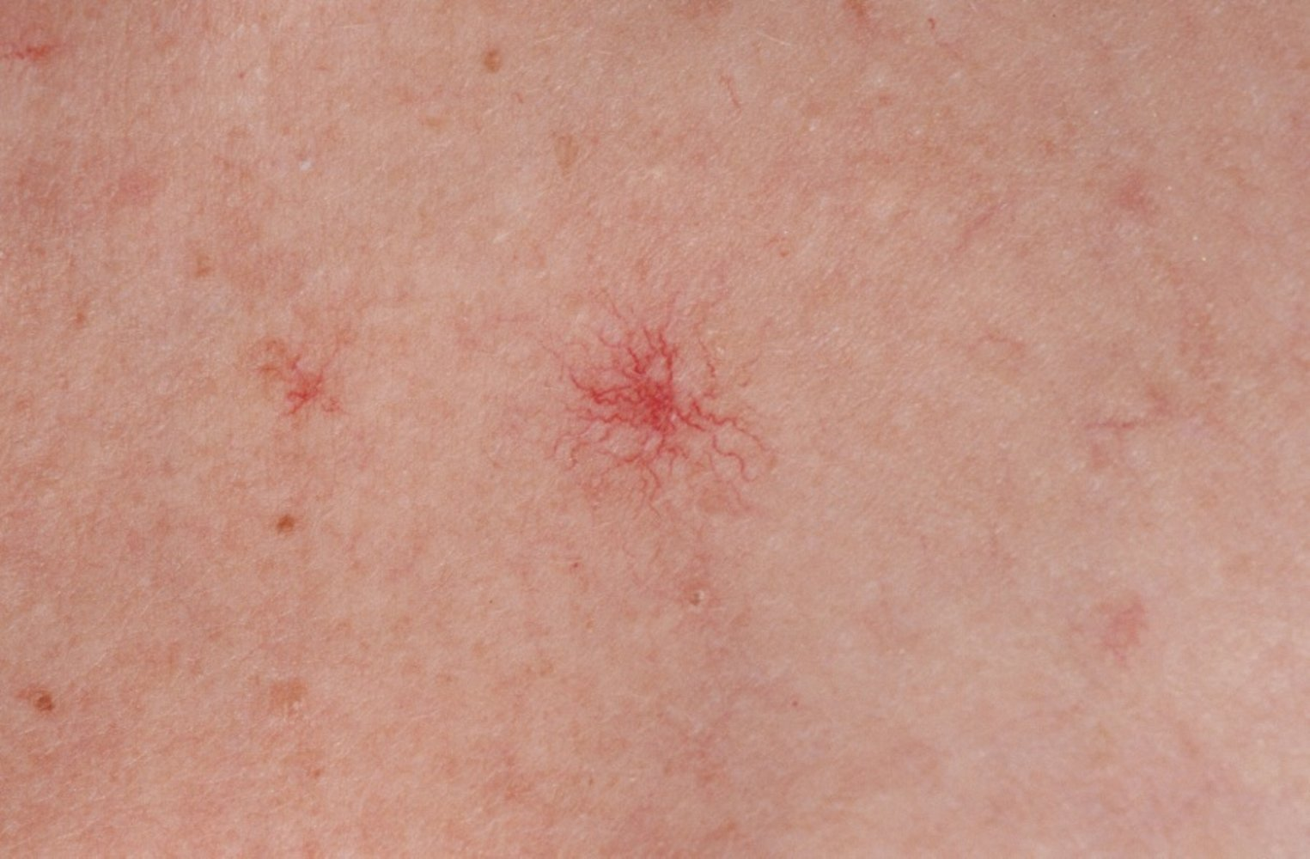
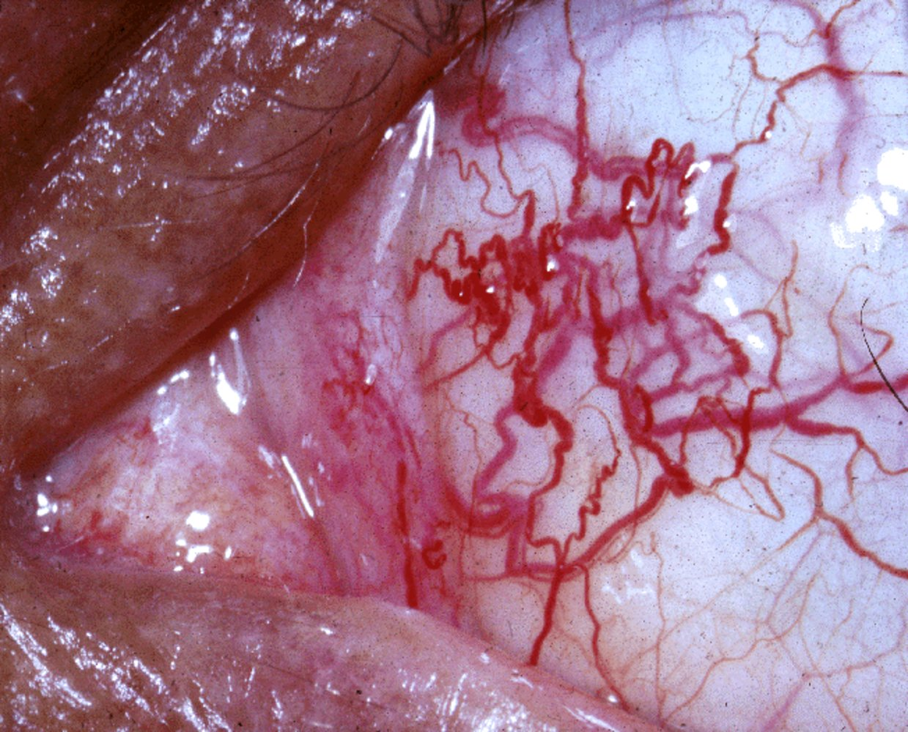
Ataxia-telangiectasia
Neurological features
Cerebellar involvement - age of onset 6–18 months, atrophy of the cerebellar vermis and hemispheres
Symptoms: Truncal swaying, Gait ataxia, Dyssynergia, Muscle hypotonia, Sudden falls
Movement abnormalities: Chorea, Athetosis, Dystonia, Myoclonic jerks
Eye involvement: Oculomotor apraxia, Nystagmus, Strabismus
Spider angiomas: telangiectasia that mainly involves the conjunctiva and face
Immunodeficiency (B and T cell deficiency) - Manifests with recurrent sinopulmonary infections, commonly associated with IgA deficiency (e.g., mucosal infection, transfusion-related anaphylaxis), ↑ AFP
Increased risk of malignancy - Lymphoma, Leukemia,Gastric carcinoma

Slide 30
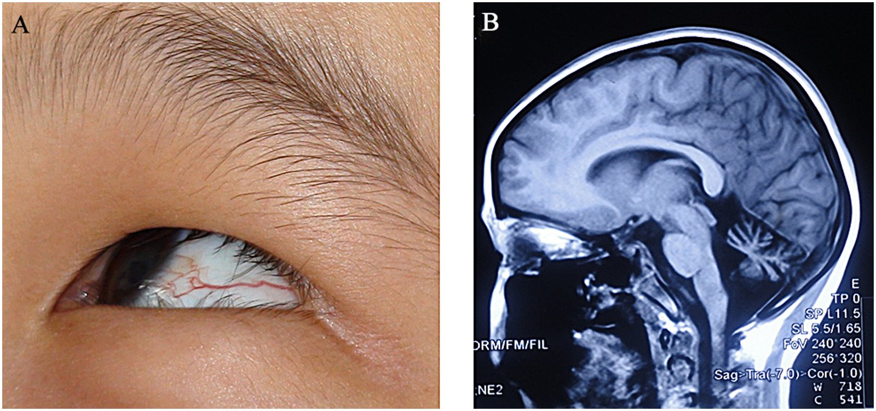
Ataxia-telangiectasia
Diagnostics
Serology
↑ AFP
↓ IgA, IgG, and IgE
Lymphopenia
Genetic testing: mutation of ATM gene
Contrast MRI: may show cerebellar atrophy

