Slide 1
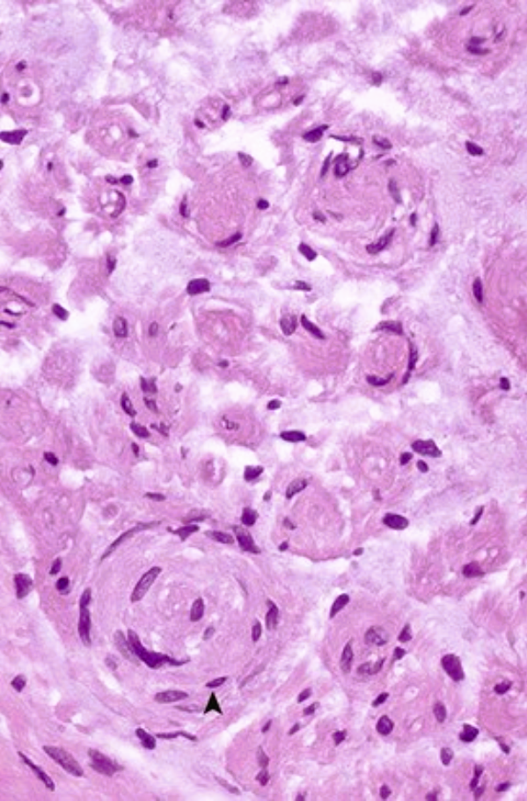
A 50-year-old woman with a 2-year history of waxing and waning symmetric motor and sensory loss in her extremities undergoes a sural nerve biopsy with the microscopic appearance shown.
What is your diagnosis?
What would happen to denervated muscle?
Name an acute neuropathy with ascending paralysis.
This is chronic inflammatory demyelinating polyneuropathy.
There is recurrent demyelination and remyelination with an “onion bulb” appearance as a result of layering by Schwann cells (▴) in response to injury.
There would be denervation atrophy followed by type grouping with re-enervation; subsequent reinjury would lead to group atrophy.
Guillain-Barré syndrome is an acute inflammatory neuropathy that often follows an influenza-like infection.

Slide 2
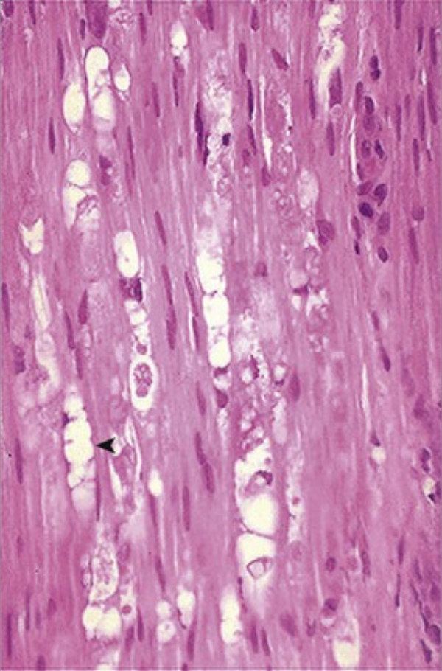
After a fracture of the fibular neck, a 25-year-old man has a loss of motor function to his foot extensors. The microscopic appearance of the common peroneal nerve distal to this site would appear as shown.
What is your diagnosis?
How can recovery occur?
This patient has Wallerian degeneration. The nerve distal to the injury has vacuoles (◂) that are filled with axonal and myelin fragments.
Recovery depends on the extent of nerve injury. Neurapraxia is conduction loss without axonal or myelin sheath damage; functional recovery occurs quickly (one's foot “falling asleep” is a simple example). Axonotmesis is axonal loss without damage to the nerve sheath; Wallerian degeneration occurs, but the regrowing axon has an intact path to follow. Neurotmesis is the disruption or transection of the entire nerve so that regrowth cannot occur unless the cut ends are carefully realigned.

Slide 3
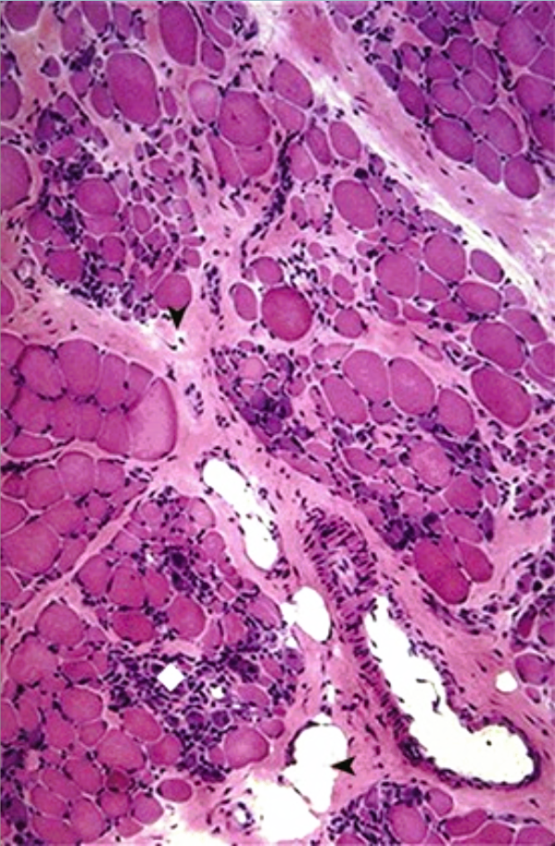
A 6-year-old boy with progressive diffuse weakness can no longer rise from a sitting position unassisted. On examination, his calves are prominent. His serum creatine kinase level is 2270 U/L (nl ≤235 U/L). The microscopic appearance of his gastrocnemius biopsy specimen is shown.
What is your diagnosis?
What protein is absent?
What is the inheritance pattern?
What complications can be anticipated?
This patient has Duchenne muscular dystrophy.
Dystrophin is absent; it is responsible for linking sarcomeric contraction to the extracellular matrix.
This is an X-linked disorder; one third to one half of cases represent new spontaneous mutations. Female carriers may exhibit mild weakness and some elevation in their creatine kinase levels; they also may develop dilated cardiomyopathy later in life.
Muscle with inflammation (♦) is progressively replaced by fat (◂) and fibrous connective tissue (▾). Death from progressive muscular weakness, which eventually affects the diaphragm and the myocardium, often occurs by age 20.

Slide 4
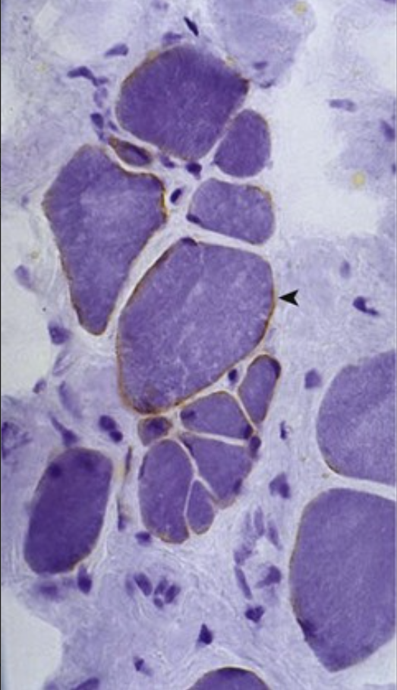
A 33-year-old man has had increasing muscular weakness for 13 years. On examination, he has primarily proximal weakness with associated atrophy. His serum creatine kinase level is elevated. The microscopic appearance of his muscle biopsy specimen with immunohistochemical staining for dystrophin is shown.
What is your diagnosis?
Why did the weakness have its onset during adulthood?
This patient has Becker muscular dystrophy. Note the variations in the size of the muscle fibers and the markedly diminished dystrophin (◂).
This is a different mutation of the dystrophin gene than that seen with Duchenne muscular dystrophy; there is diminished (or dysfunctional) dystrophin, but it is not absent. The onset of the disease is delayed into adult life, and symptoms typically progress more slowly. Additional myopathic changes seen in striated muscle include the degeneration and regeneration of muscle fibers.

Slide 5
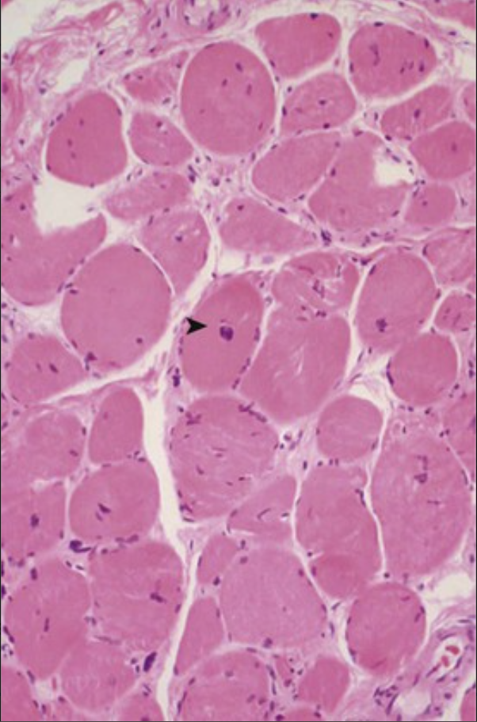
A 40-year-old man with a 25-year history of difficulty ambulating has more recently developed hand weakness and marked atrophy of his facial and neck muscles. He has dilated cardiomyopathy and congestive heart failure. The microscopic appearance of his deltoid muscle biopsy specimen is shown.
What is your diagnosis?
What is the genetic basis of this patient's disease?
What other complications could he develop?
This patient has myotonic dystrophy. There is variation in fiber size, with multiple central nuclei (▸).
There is a CTG triple nucleotide repeat expansion in the gene that encodes for dystrophia myotonica–protein kinase (DMPK); expanding numbers of triple repeats lead to diminished mRNA production and decreased protein.
Visual difficulty with cataracts occurs in nearly every case. Gonadal atrophy and frontal balding are frequent. Glucose intolerance occurs, and some patients develop dementia.

Slide 6
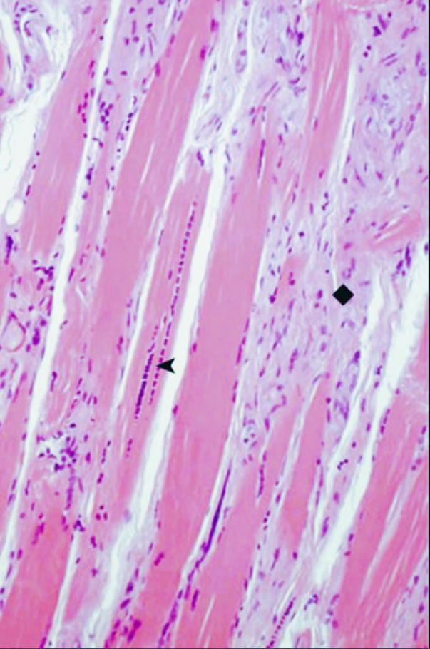
A 34-year-old man with a 25-year history of progressive muscle weakness involving the hands, arms, shoulder girdle, neck, and face has a persistently elevated serum creatine kinase level. The microscopic appearance of his deltoid muscle biopsy specimen is shown.
What is your diagnosis?
Why are individuals in his family affected at an earlier age and more severely in successive generations?
This patient has myotonic dystrophy. Chains of central nuclei (◂) are seen in this longitudinal section, with fibrous replacement (♦) of the muscle fibers.
There is ongoing expansion of the CTG triple nucleotide repeats in successive generations. This is the result of a genetic process called anticipation.

Slide 7
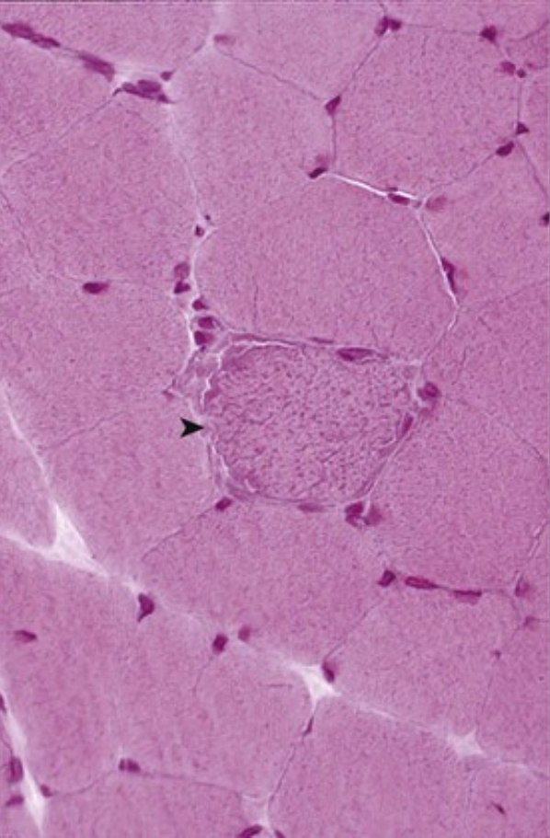
A 10-year-old girl with a history of exercise intolerance develops headaches and vomiting followed by a generalized tonic-clonic seizure and hemiplegia. Evaluation in the emergency department reveals elevated serum lactate and creatine kinase levels, and cerebral MRI shows areas of remote infarction. The girl's muscle biopsy specimen is shown.
What is your diagnosis?
What is the genetic basis of this disease
What type of headache is commonly seen?
This myopathy has features of mitochondrial encephalopathy with lactic acidosis and stroke-like episodes (MELAS). The histology is confirmatory, showing a ragged red fiber with subsarcolemmal aggregates (▸) of mitochondria. With electron microscopy, these often show characteristic paracrystalline “parking lot” inclusions in the cristae.
Typically, mutations in mitochondrial DNA (mtDNA) cause this condition. The mitochondrial genome is a small circular DNA strand that codes for 22 mitochondrial-specific tRNAs; 2 rRNA species; and many of the proteins involved in oxidative phosphorylation (20% of the mitochondrial oxidative phosphorylation proteins are coded by mtDNA). Mutations lead to inefficient ATP synthesis.
Migraine headache is common among these patients.

Slide 8
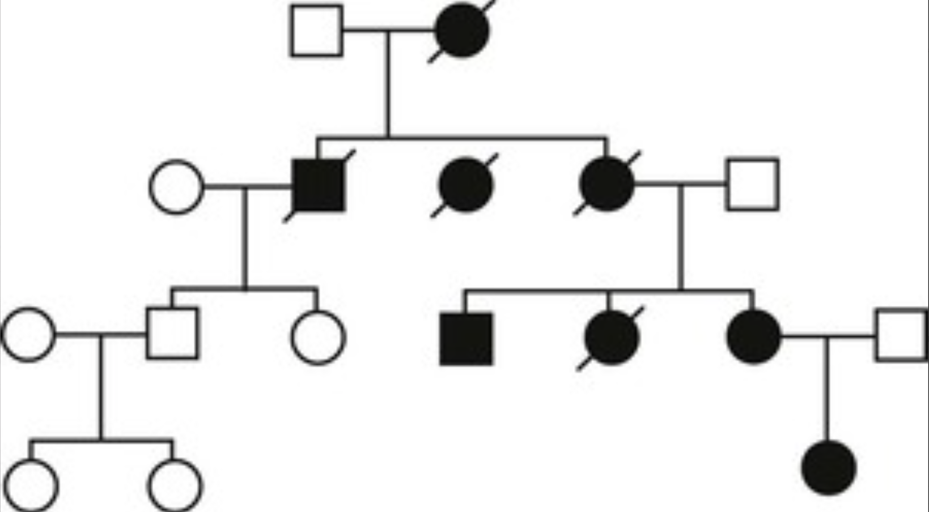
A 3-year-old child with lifelong failure to thrive now presents with learning disabilities, hearing problems, external ophthalmoplegia, and weakness with hypotonia. The pedigree of other affected family members is shown.
What is your diagnosis?
Describe the inheritance pattern.
What is the mutation rate of mitochondrial DNA (mtDNA) as compared with nuclear DNA?
This patient has mitochondrial myopathy.
The disorder has a maternal pattern of inheritance, because mtDNA is passed to offspring only via mitochondria provided by the ovum. All embryonic mitochondria are maternal in origin.
mtDNA has a higher mutation rate than nuclear DNA.

Slide 9
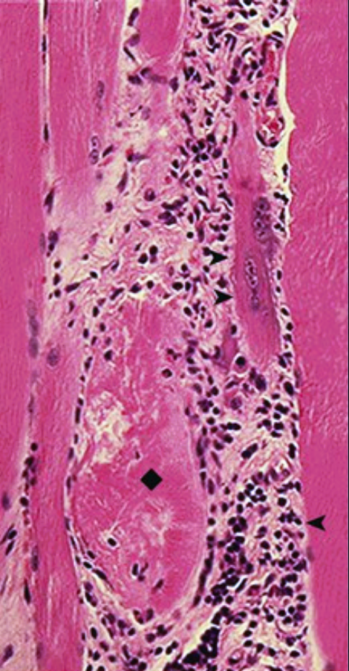
A 41-year-old woman has had progressive proximal muscular weakness for 4 years. She now has difficulty climbing stairs or lifting objects. Her fine muscle movement and deep tendon reflexes are not affected. Her serum creatine kinase level is elevated, and her muscle biopsy specimen is shown.
What is your diagnosis?
What is the pathogenesis for this disease?
What autoantibody may be present?
What would a skin rash indicate?
This patient has polymyositis. There is marked lymphocytic infiltration (◂) with necrosis (♦) as well as the regeneration (▸) of muscle fibers.
With polymyositis, there are cytotoxic CD8+ T lymphocytes that can cause myocyte killing.
Anti-histidyl-t-RNA-synthetase (Jo1) may be present, in addition to antinuclear antibody. Although the anti-tRNA synthetase antibodies are specific, they do not have a clear-cut causal role in the disease.
Skin involvement with a violaceous rash suggests dermatomyositis.

Slide 10
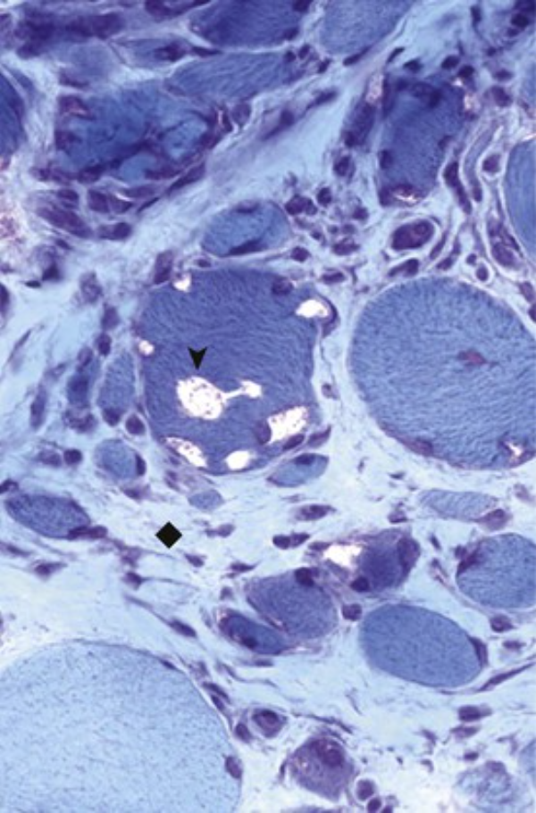
A 57-year-old woman presents with a 5-year history of progressive asymmetric muscular weakness involving distal muscle groups, including the knee extensors and the wrist flexors. Her trichrome-stained muscle biopsy specimen is shown.
What is your diagnosis?
What can be seen with electron microscopy?
What is the pathogenesis?
The patient has inclusion body myositis. Note the “rimmed vacuoles” (▾) within the muscle fibers. There is variation in fiber size and fibrous replacement (♦), which is typical for a myopathic disease.
Filamentous inclusions that contain amyloid and hyperphosphorylated tau proteins are seen.
Intracellular β-amyloid deposits, amyloid fibrils, and hyperphosphorylated tau suggest an aging phenomenon. Although CD8+ T cells are found in the lesions, the lack of response to immunosuppressive therapy suggests that this condition is not autoimmune in origin. Hereditary forms of this disease are also described.

