Slide 1
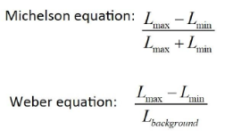
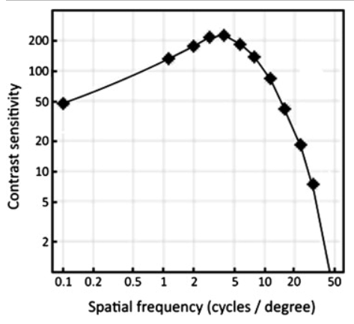
Contrast Sensitivity Measurement Methods
Ονοματεπώνυμο: Έλενα Μαραγκού
Contrast threshold: the smallest notable amount of difference in lightness and darkness, between an object and its background
Contrast sensitivity: the sensitivity to this difference in luminance
Contrast sensitivity= 1/ contrast threshold
frequently, cs is articulated in log units
While the background luminance remains constant, is better to use the Weber principle
In case that both light and dark components change, should be used the Michelson procedure
The contrast sensitivity function represents the relationship between contrast sensitivity and spatial frequency
e.g.: The human eye’s ability to discriminate between objects and or lines of similar contrast is higher at the middle spatial frequencies (3 to 6 cycles per degree [cpd]) and reduced at the low and high frequencies. For 3 to 6 cpd, a contrast of 0.5% can be detected in normal patients, whereas at 30 cpd, 100% black and white contrast is required

Slide 2
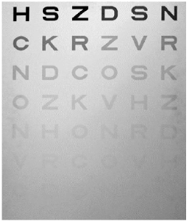
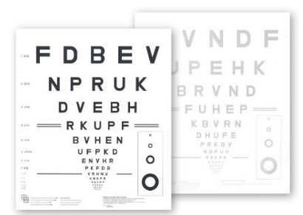
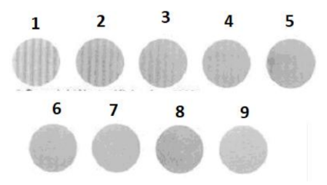
Pelli- Robson: From left to right, the contrast of each letter will decrease. The patient starts from the top of the chart and reads each row until they can no longer see any letter against the white background
Bailey- Lovie Chart: the charts standardized the task so that the size is the only significant variable from one row to the next. The between- letter and between- row spacing is equal to letter size. The charts come as a set of two panels each with a high contrast chart one side and low contrast chart (18% Weber or 10% Michelson) on the other. The difference in the number of letters read on the high and low contrast charts provides a measure of the slope of the CSF.
To evaluate the entire range of spatial vision, Sinusoidal Grating Patterns are typically used as stimuli and the luminance of grating is varied from 0.5% to 90% contrast. Contrast sensitivity determines the lowest contrast level, which can be detected by patient for a given size of grating pattern. The different size gratings are called spatial frequencies

Slide 3
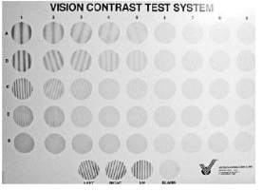
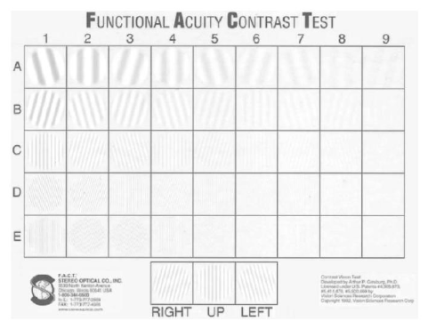
Visual Contrast Sensitivity: This test involves the presentation of series of images of decreasing contrast to the test subject and the recording of the contrast levels where patterns, shapes, or objects can or cannot be identified. The results of the test can be used as an aid in the diagnosis of visual system dysfunction.
Fig.: The VCS sine- wave grating chart tests five spatial frequencies (sizes) and nine levels of contrasts
Functional Acuity Contrast Test (FACT): This includes a chart of sine- wave grating with five spatial frequencies and nine levels of contrast that can be tested. The contrast of the grating changes in the row and decreases from left to right. The spatial frequency increases from top to bottom and the test is performed at the distance of 10 feet. The patient sees the grating in each row like A, B, C and D and then reports the orientation right, up, or left. The last grating for each spatial frequency is then plotted for CS curve

Slide 4
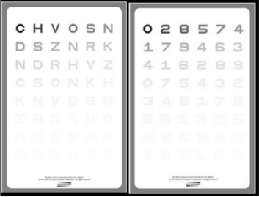
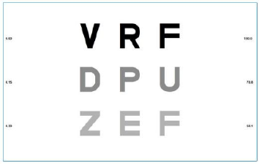
Medication Adherence Report Scale (MARS) test: evaluates visual acuity using low contrast targets. It is the contrast and not the letter or numeral size that reduces from the beginning to the end of the chart.
Contrast Sensitivity Test Chart 2000: patients are required to read triplets of letters decreasing contrast and the minimum contrast required for patient to read 2 out of 3 letters is recorded as contrast sensitivity
Freiburg Visual Acuity and Contrast Test (FrACT): employs advanced computer graphics to present Landolt Cs over the full range of visual acuity.
https://www.researchgate.net/publication/355394042_Contrast_Sensitivity_Measurement_Tests_and_Methods
https://www.ncbi.nlm.nih.gov/books/NBK580542/
https://pubmed.ncbi.nlm.nih.gov/17219125/

