Slide 1
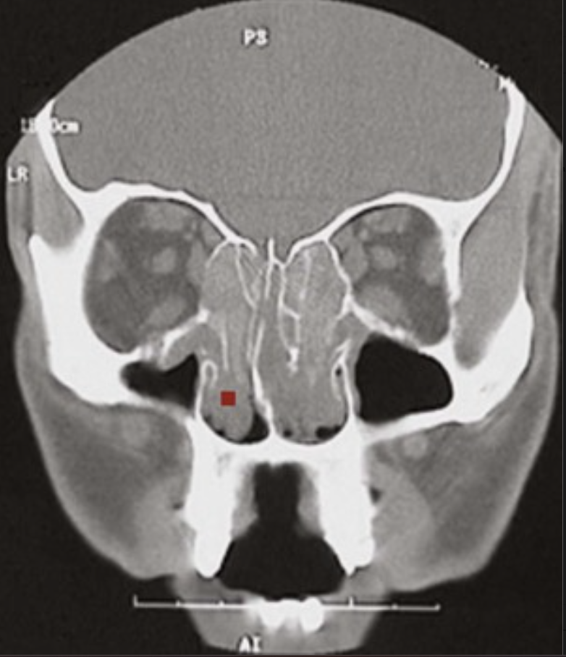
A 27-year-old man has a 20-year history of severe “hay fever” and difficulty breathing through his nose. For the past 8 months, he has had complete nasal blockage. His head CT scan is shown.
Explain this radiologic appearance.
What type of hypersensitivity response is this?
What is the underlying immunologic lesion
that leads to such hypersensitivity responses?
There is soft-tissue density (▪) in the nasal cavities instead of dark air density; this is consistent with inflammatory nasal polyps.
These are likely to be caused by type I hypersensitivity or allergy.
Individuals with type I hypersensitivity develop IgE isotype antibodies to certain antigens (called allergens). Their immune systems are tipped toward the generation of TH2-type helper lymphocytes, which are characterized by their production of cytokines such as interleukin-4 (IL-4); these in turn induce B cells to shift to IgE production.

Slide 2
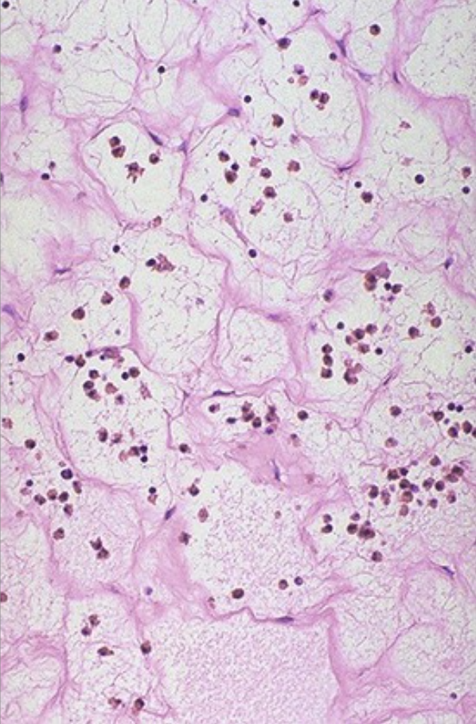
A 30-year-old woman has seasonal and cat-related asthma and urticaria. A work-up for recurrent sinus infections revealed multiple nasal mucosal polyps, which were resected. The histology of these is shown.
Describe the findings.
How do mast cells contribute to this lesion?
The “allergic” polyps covered by pseudostratified ciliated columnar epithelium (not shown) are filled with markedly edematous loose connective tissue that contains inflammatory infiltrates, including eosinophils and plasma cells.
Allergen cross-linking of IgE bound to mast cell Fc receptors causes degranulation with the release of stored biogenic amines (e.g., histamine), thereby leading to vasodilation, increased vascular permeability, bronchial smooth muscle contraction, and mucous gland secretion. Leukotrienes, platelet-activating factor, and cytokines produced by mast cells have similar effects and lead to eosinophil recruitment.

Slide 3
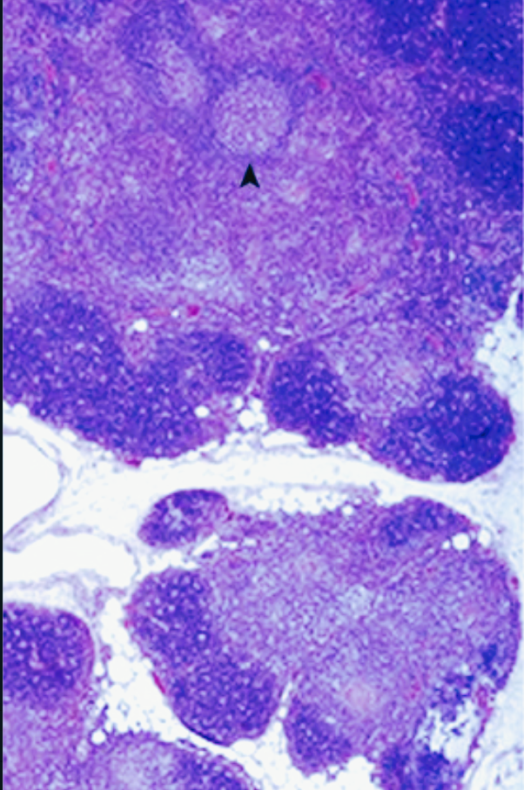
A 33-year-old woman has increasing weakness for 1 year. On examination, she has 5/5 muscle strength in all extremities that diminishes to 4/5 after repetitive movement. She also notices increasing ptosis and occasional diplopia, which is worse at the end of the day. On chest CT scan, a mediastinal mass is found and resected, with the histology shown.
What is the tissue, and what is the pathology?
What is the immunologic mechanism
underlying her symptoms?
How is this disease treated?
The thymus shows prominent thymic hyperplasia with lymphoid follicles (▴). Of patients with myasthenia gravis, 65% have thymic hyperplasia; another 15% have a thymoma. In either case, thymic resection generally yields improvement.
Type II hypersensitivity (antibody against a fixed tissue antigen) is the underlying immunologic mechanism. In this case, acetylcholine receptor antibodies block or down-modulate neuromuscular junction acetylcholine receptors. Consequently, nervous impulses are not translated into muscle contractions.
Besides thymectomy, patients can receive oral therapies such as corticosteroids to suppress the immune response and cholinesterase inhibitors to increase the local effective levels of acetylcholine.

Slide 4
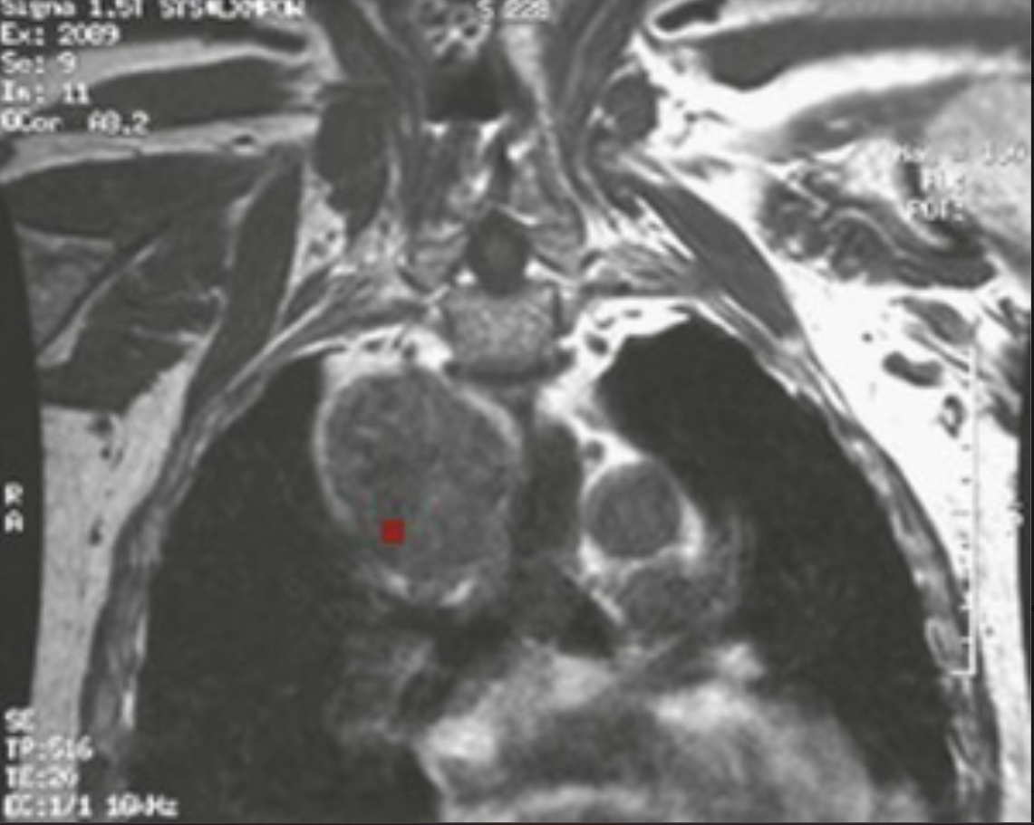
A 29-year-old man with diffuse muscle weakness improves symptomatically with edrophonium administration. He later develops acute respiratory distress that requires intubation and emergent plasmapheresis. An MRI of the patient's chest at that time reveals the lesion shown.
What is the lesion in his chest?
Why is plasmapheresis effective?
What paraneoplastic syndrome with muscular weakness
involves autoantibodies that target
motor end plate calcium channels?
Coronal chest MRI shows a large anterior mediastinal mass (▪) that likely represents a thymoma, which is seen in about 15% of patients with myasthenia gravis.
Emergent plasmapheresis removes the acetylcholine receptor antibodies and improves the function of the neuromuscular junction.
Lambert-Eaton myasthenic syndrome, typically with small cell lung cancer.

Slide 5
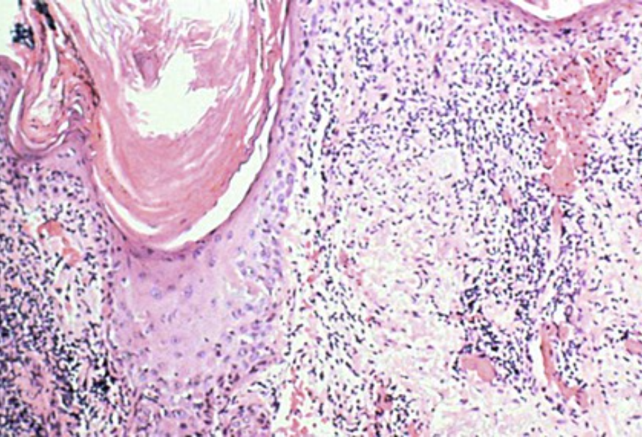
With any prolonged time outdoors, a 23-year-old woman develops a skin rash with raised scaly erythema that is apparent only in sun-exposed areas. She is otherwise healthy. A biopsy specimen of lesion skin reveals the microscopic appearance shown.
Describe the appearance.
Explain the immunologic mechanism.
A photosensitive rash with no other organ findings is highly suggestive of discoid lupus erythematosus.
This is a type III hypersensitivity reaction; antibody-antigen complexes can accumulate at basement membrane interfaces, such as skin (rash), glomerular capillaries (glomerulonephritis), or mesothelial surfaces lining body cavities (serositis) or within any arterial wall (vasculitis). Symptoms are referable to the site of immune complex deposition, with subsequent complement activation and the recruitment of Fc receptor–bearing cells.

Slide 6
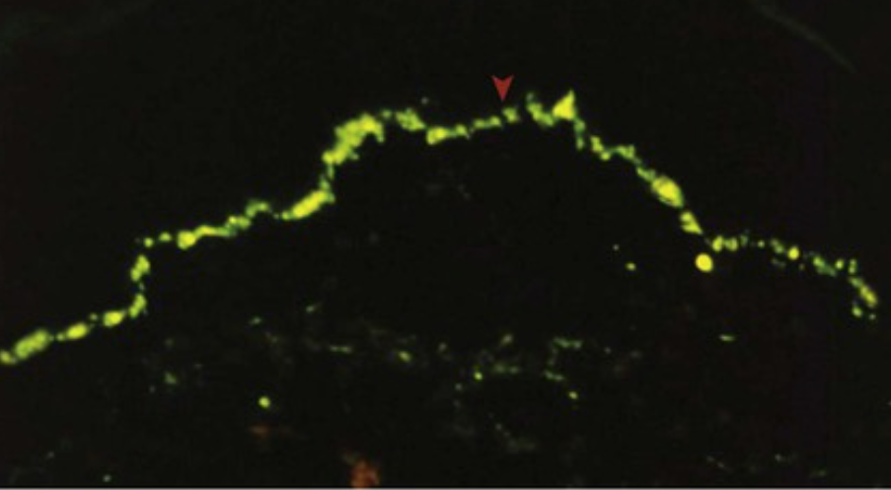
Laboratory testing shows that the patient from Side A has a positive antinuclear antibody (ANA) titer. Anti-Smith and anti–double-stranded DNA (ds-DNA) antibodies are negative, and antihistone antibody titer is negative as well.
Explain the immunofluorescence pattern shown from the patient's skin biopsy specimen (adjacent normal-appearing skin shows no such changes).
Explain the laboratory findings.
What is the prognosis?
There is immune complex deposition along the dermal–epidermal junction basement membrane (▸); this is a so-called positive “lupus band test.” In patients with systemic lupus erythematosus (SLE)—as opposed to discoid lupus erythematosus (DLE)—grossly normal-appearing skin also has such immune complex deposition.
About one third of patients with DLE have a positive ANA. Anti-Smith and anti–ds-DNA antibodies are seen more often with SLE. Antihistone antibodies are typical for drug-induced lupus.
About 5% to 10% of patients with DLE eventually develop systemic manifestations.

Slide 7
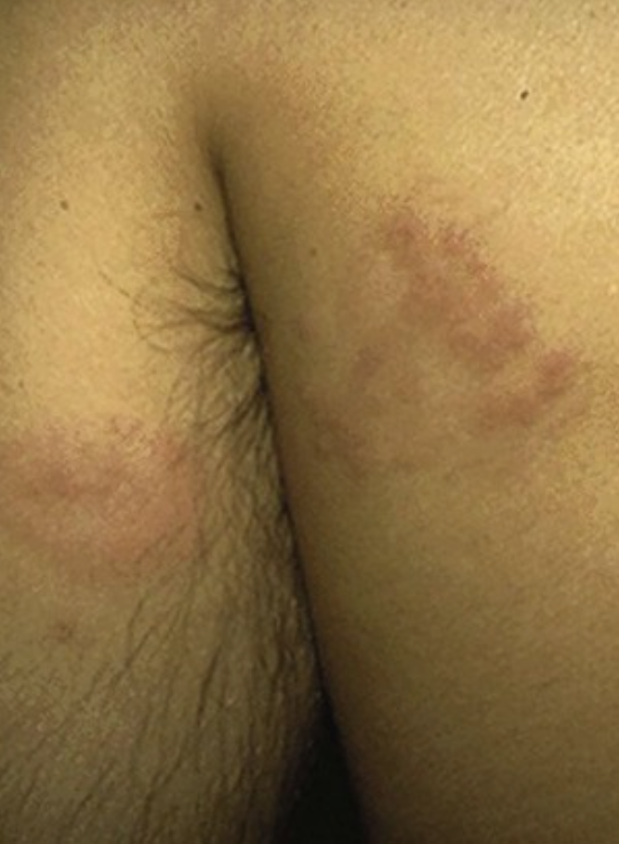
A 39-year-old man applied a deodorant, and 30 hours later he noted the appearance shown.
What is a likely explanation for these lesions?
Explain the immunologic mechanism.
Name other diseases with similar basic immune pathogenesis.
Contact dermatitis resulted from exposure to substances in the antiperspirant that complex with host proteins to elicit a type IV (delayed-type) hypersensitivity response. Similar responses occur to compounds such as urushiol in poison ivy.
Cutaneous macrophages and dendritic cells take up and process conjugated proteins, thereby presenting modified peptides to circulating memory CD4+ T lymphocytes that recognize antigens from prior exposures. T-cell activation produces a TH1 response that is dominated by interferon-γ.
Type IV hypersensitivity underlies the pathogenesis of type I diabetes mellitus, scleroderma, and inflammatory bowel disease, among others; it has also been implicated in multiple sclerosis and rheumatoid arthritis.

Slide 8
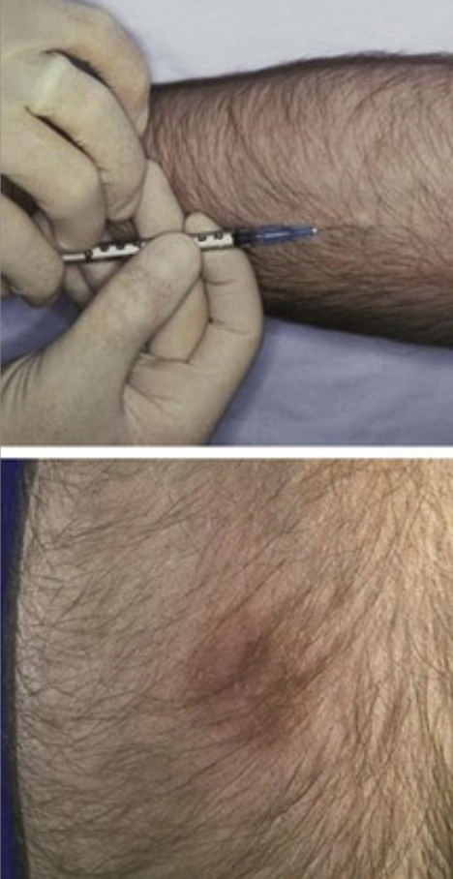
A 28-year-old man from India has a tuberculin skin test placed (upper panel), despite his objections that he was previously immunized with BCG. Two days later, the reaction with induration shown here is noted (lower panel).
Why did this reaction occur?
What cells and cytokines are most important?
Circulating memory T cells recognize processed fragments of the BCG vaccine, which is made from a bile-attenuated strain of tuberculosis. As a result of this patient's prior vaccination, the tuberculin skin test cannot distinguish a prior “authentic” tuberculosis exposure.
The CD4+ cells elaborate interferon-γ that activates macrophages, which elaborate IL-12; this in turn induces more interferon-γ production by the CD4+ cells (paracrine effect). Activated T cells also produce IL-2, which promotes T-cell proliferation. The production of T cells and macrophage tumor necrosis factor increases endothelial adhesion molecule expression to attract more leukocytes.

Slide 9
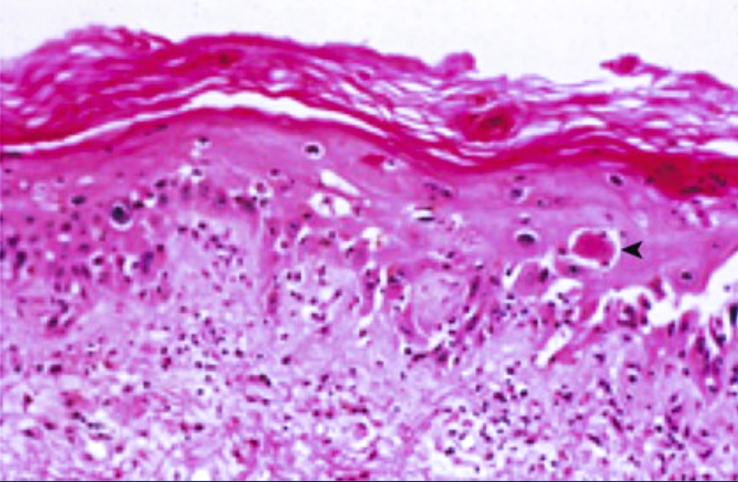
A 52-year-old woman with acute myelogenous leukemia undergoes an allogeneic bone marrow stem cell transplantation with a five of six HLA antigen match. A month after engraftment, she develops jaundice, watery diarrhea, and a scaling rash. Her skin biopsy specimen is shown.
What complication has occurred?
Explain the immunologic mechanism.
The patient has graft-versus-host disease (GVHD); the donor lymphocytes recognize the host major histocompatibility complex (MHC) as being foreign. Biliary, cutaneous, and bowel epithelium seem to be most susceptible to this reaction, so the development of jaundice, rash, and diarrhea is typical for acute GVHD. Note a modest number of chronic inflammatory cells with dyskeratosis and prominent keratinocyte apoptosis (▾); chronic GVHD of the skin eventually leads to significant dermal fibrosis.
Donor lymphocytes cause direct cytotoxicity (cytotoxic T lymphocytes), cytokine-mediated injury, and heightened host natural killer cell damage.

Slide 10
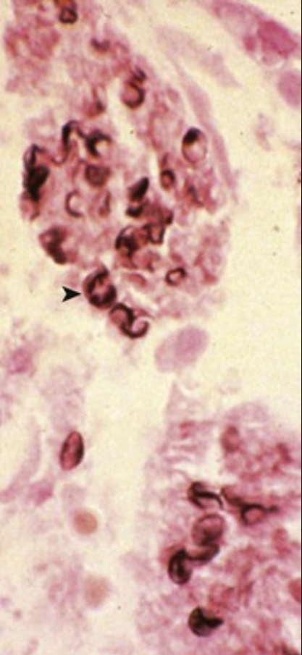
Over the next 6 months, the patient described on Side A develops recurrent respiratory and urinary tract infections. Cytomegalovirus and adenovirus are cultured from her lungs, and bronchoalveolar lavage (BAL) reveals the organisms shown by silver staining. The patient's leukemia does not recur.
What is the organism shown?
Why does the patient have recurrent infections?
What helped to prevent the recurrence of leukemia?
This is Pneumocystis jiroveci. The cup-shaped or boat-shaped organisms (▸) frequently elicit little inflammation; these forms can persist long after an active infection has been cleared. BAL has high sensitivity for the detection of active infection.
Immunodeficiency can occur secondary to myeloablative therapy before transplant or as a result of GVHD through the donor cell destruction of host lymphocytes in tissues such as lymph node and spleen.
The antigen mismatch had the one advantage of producing a “graft-versus-leukemia” response.

Slide 11
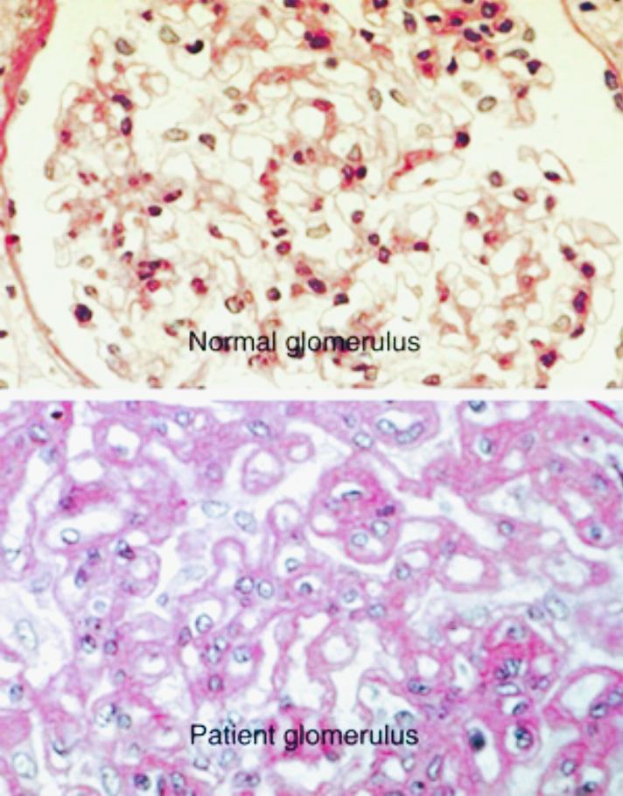
A 33-year-old woman has had increasing fatigue, pleuritic chest pain, and a malar rash for 7 months, and she now has dark urine. Her serum creatinine level is 3.7 mg/dL (nl ≤ 1.2 mg/dL). A urinalysis shows RBC casts. Her renal biopsy specimen is shown; for comparison, a similar magnification of a normal glomerulus is also shown.
Explain this patient's renal disease.
What is the likely diagnosis?
What antibody studies would be confirmatory for the diagnosis?
This patient has membranous glomerulonephritis with “wire loop” thickening of the glomerular capillaries caused by immune complex deposition. Antigen–antibody deposition activates complement and recruits Fc-receptor–bearing leukocytes, thereby causing decreased filtration (elevated creatinine) and hematuria (dark urine caused by the presence of RBC casts).
Systemic lupus erythematosus (SLE)
Anti-Smith and anti-ds-DNA antibodies are most specific for SLE, but these are not highly sensitive. There is overlap among autoimmune diseases, and so the SS-A antibodies most typical of Sjögren syndrome are also present in 50% of patients with SLE.

Slide 12
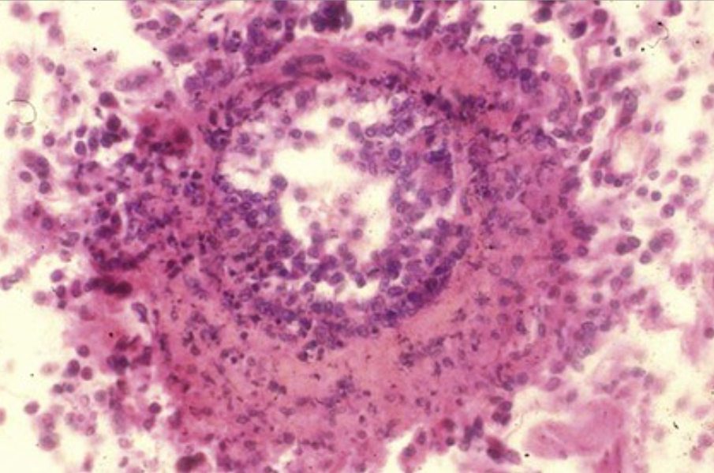
A 55-year-old woman has a 2-year history of joint pain, Raynaud syndrome, and a skin rash in a sun-exposed distribution. She develops recurrent pericardial effusions and tamponade, which prompts a pericardiectomy. An artery from her pericardial specimen is shown.
What is the pathology shown here?
How does this explain the patient's pericardial disease?
Note the necrotizing vasculitis (transmural leukocyte invasion) and fibrinoid necrosis (hyaline protein deposition in the vessel wall), which are characteristic of immune complex–induced vasculitis. The patient's history is strongly suggestive of SLE.
Such severe vessel inflammation leads to increased vascular permeability, with protein and cellular exudation; there is probably also a component of thrombosis and infarction. Recurrent bouts lead to fibrinopurulent pericardial effusions, organization of the exudates, and pericardial thickening and scarring.

Slide 13
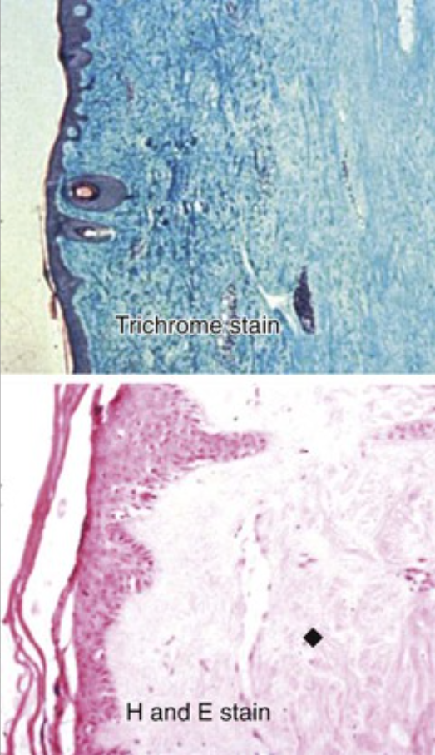
A 42-year-old woman has difficulty swallowing. She also notes that her fingers are cyanotic and painful with cold exposure. Her skin is diffusely thickened, with diminished hair. Her skin biopsy specimen is shown.
What is shown in her skin biopsy specimen?
Explain the immunologic mechanism.
Explain her cold sensitivity.
Note the extensive dermal fibrosis (♦). Similar esophageal collagen deposition explains the patient's dysphagia.
A CD4+ lymphocyte-mediated delayed-type hypersensitivity response is directed against vascular wall antigens. Chronic vascular inflammation with cytokine production (e.g., transforming growth factor-β) and superimposed thrombotic and ischemic injury have led to chronic fibrosis in multiple tissues.
Raynaud phenomenon is due to increased vasomotor tone (vasospasm) that is frequently triggered by cold exposure.

Slide 14
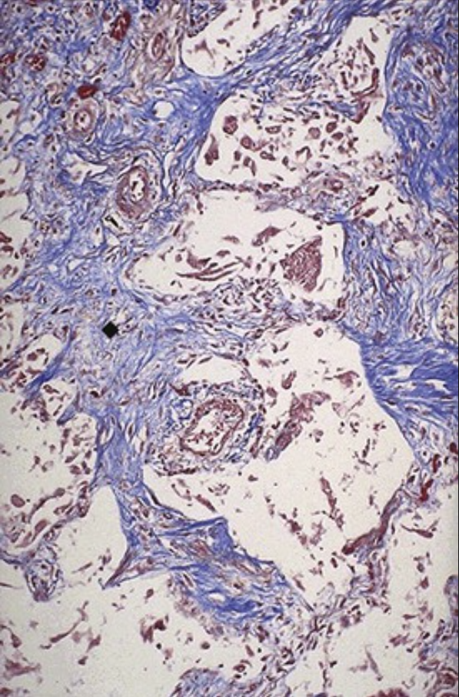
Over the next 3 years, the patient from Side A develops a nonproductive cough with increasing dyspnea. On examination, her blood pressure is 260/150 mm Hg. A lung biopsy is performed, and the specimen is shown with trichrome stain.
Describe the pulmonary findings from the patient's biopsy specimen.
What renal findings do you expect?
What laboratory findings would be expected?
She has extensive interstitial fibrosis (“honeycomb” lung [♦]) with restrictive lung disease.
Renal hyperplastic arteriolosclerotic narrowing leads to diminished perfusion with activation of the renin–angiotensin system. A vicious cycle ensues that can culminate in malignant hypertension.
Autoantibodies that are classically associated with scleroderma will likely be found. These include generic antinuclear antibody, anti–DNA topoisomerase I (in diffuse scleroderma), and anticentromeric antibody (most specific for CREST syndrome [calcinosis, Raynaud phenomenon, esophageal dysmotility, syndactyly, and telangiectasias]).

Slide 15
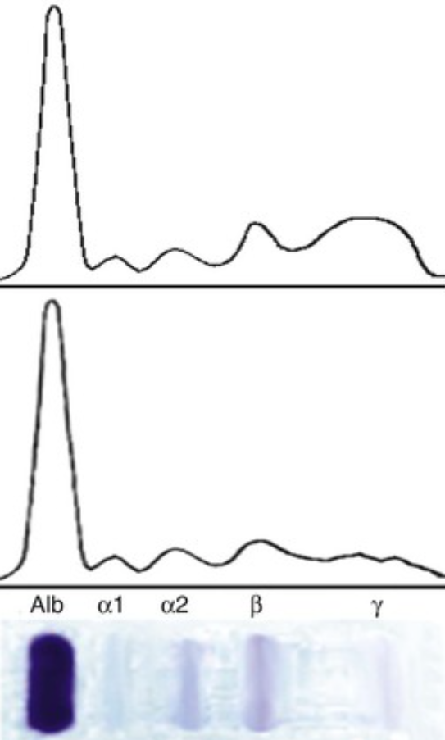
Although he is well developed and well nourished, a 9-month-old boy has a 3-month history of recurrent bouts of otitis media, sinusitis, bronchopneumonia, and gastroenteritis. His serum protein electrophoresis (SPEP) is shown and compared with a normal SPEP at the top.
What is the likely diagnosis?
What is the genetic deficit? What are the molecular and cellular consequences?
What organisms will likely be found in this infant's respiratory tract? What organisms will likely be found in his gastrointestinal tract?
Why did the infections begin only 3 months ago?
The SPEP confirms agammaglobulinemia of Bruton as a result of the depressed levels of all serum immunoglobulins.
The BTK gene on the X chromosome encodes Bruton tyrosine kinase, which is required for B-cell antigen receptor signaling that drives pre–B cell maturation into immunoglobulin-producing cells. Although there is a normal number of T cells, mature B cells are absent.
The lack of circulating antibody leads to recurrent respiratory bacterial infections with Haemophilus influenzae, Streptococcus pneumoniae, and Staphylococcus aureus. In the gastrointestinal tract, Giardia lamblia and enteroviruses are common pathogens.
Maternally acquired antibody protection is depleted after about 6 months.

Slide 16
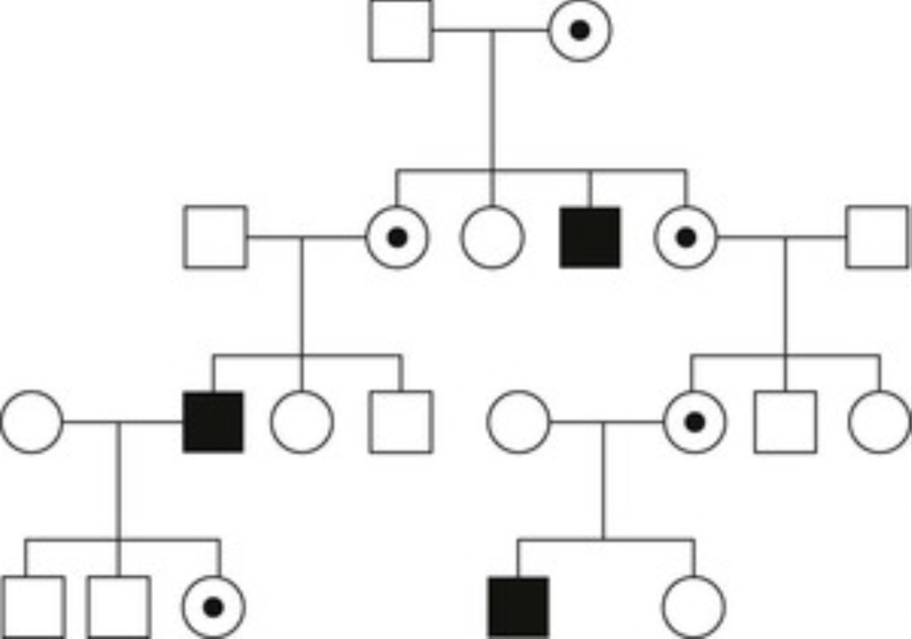
Over the next 2 years, the boy described on Side A develops arthritis; treatment with replacement immunoglobulins relieves the symptoms. The family pedigree is shown.
Why is intravenous immunoglobulin therapy helpful?
What is the inheritance pattern?
Under what circumstances could females be affected?
Intravenous immunoglobulin therapy provides needed antibodies; presumably, the arthritis has an infectious etiology (e.g., Mycoplasma) that clears with therapeutic antibodies.
This is an X-linked recessive pattern. Females are typically carriers of the disease, but they are not affected.
Females can manifest an X-linked disease if both parents carry the abnormal gene. Alternatively, “random X inactivation” in a female carrier can lead to most of the X chromosomes with a functional gene being inactivated.

Slide 17
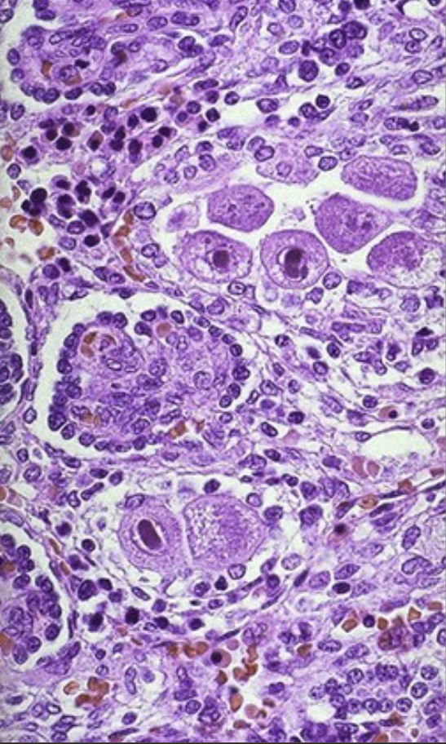
A 3-week-old boy has failure to thrive, severe diaper rash, and oral thrush. He subsequently develops Pneumocystis pneumonia and a bout of severe diarrhea with Pseudomonas aeruginosa. A brother died of overwhelming infections at the age of 4 months; two sisters are alive and well at the ages of 5 and 7 years. The microscopic appearance of the boy's kidney is shown.
What is wrong with the kidney?
What is the likely overarching diagnosis of this infant?
What is the most common cause of this disease?
This is cytomegalovirus (CMV). Note the prominent large intranuclear inclusions and the minimal inflammatory response.
Severe combined immunodeficiency (SCID) results from severe T-cell depletion; B cells are also affected because helper T cells are involved in their maturation.
The most common form of SCID (50% to 60% of patients) is X-linked, which results from a mutation of the common gc chain used by multiple cytokine receptors.

Slide 18
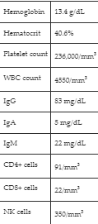
An infant girl has a history of multiple fungal, viral, and bacterial infections. Despite the recurrent infections, her lymph nodes are poorly developed. Her laboratory findings are shown. She dies after a severe viral pneumonitis. At autopsy, a small anterior mediastinal structure was sampled.
What was the small mediastinal structure?
What is the likely diagnosis of this patient? What is this disease's most common autosomal-recessive form?
Interpret these laboratory findings.
The patient's thymus was sampled. Hassall corpuscles are present, but virtually no thymocytes are found.
The patient likely has severe combined immunodeficiency syndrome (SCID). The most common form of autosomal-recessive SCID results from adenine deaminase deficiency with the accumulation of intracellular metabolites that are toxic to lymphocytes.
The total peripheral lymphocyte count is reduced, mainly from a lack of T cells. Secondary B-cell impairment leads to markedly diminished immunoglobulin levels.

Slide 19
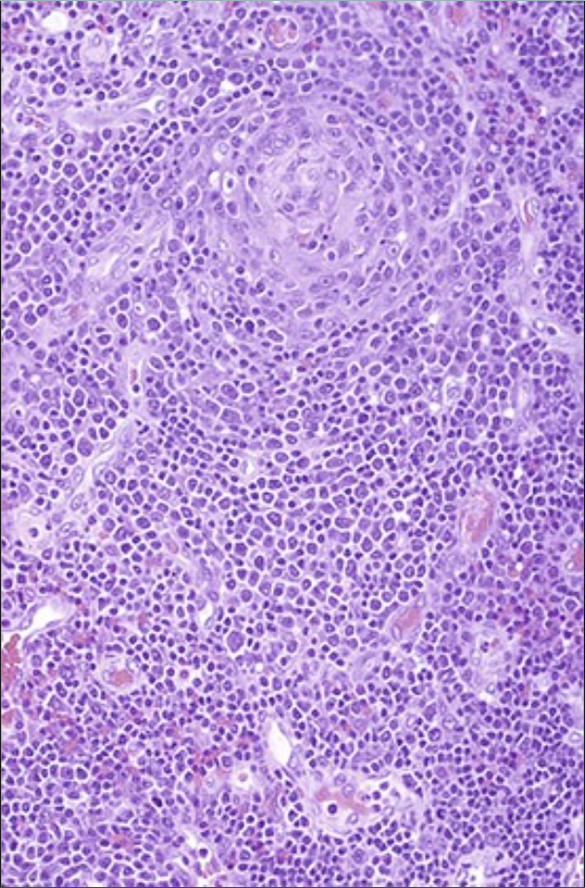
The 25-year-old sexual partner of an intravenous drug abuser has a 2-week history of fever, pharyngitis, arthralgia, myalgia, and headache. Examination reveals generalized tender lymphadenopathy and a diffuse erythematous rash. Her lymph node biopsy specimen is shown.
What is happening at this stage in this node?
What cells are targeted by this infection? Is the CD4+ count at this point high, low, or normal?
How could the infection be diagnosed?
At this early stage of HIV infection, a host polyclonal B-cell response leads to marked follicular hyperplasia and lymphadenopathy. With time and CD4 “exhaustion,” the lymph node architecture involutes (folliculolysis).
The major target is the CD4+ lymphocyte, although antigen-presenting cells (e.g., dendritic cells, macrophages) are persistent viral reservoirs. During the early stages, CD4+ counts are relatively normal. However, as HIV infection progresses toward clinical AIDS, CD4+ counts decrease.
HIV infection is screened for with the use of an enzyme immunoassay test (EIA) and confirmed by Western blot.

Slide 20
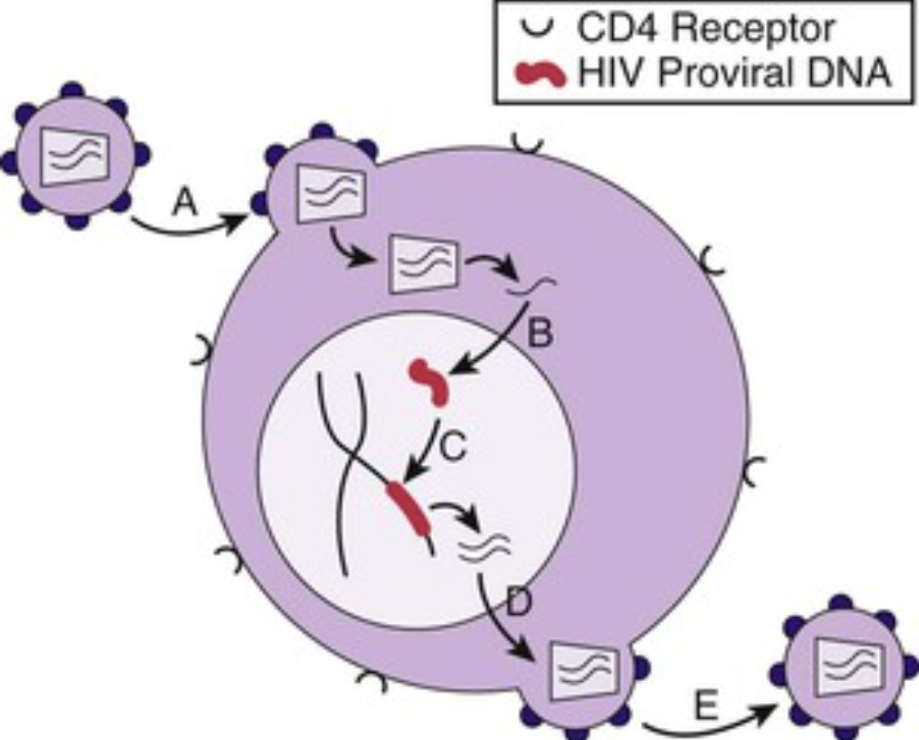
A 41-year-old man has a CD4+ lymphocyte count of 138/mm3 (normal, 490 to 1740/mm3). The schematic shows potential therapeutic targets (A–E).
What laboratory test best assesses anti-HIV drug efficacy?
Which labeled HIV targets currently have drug therapy?
How long is therapy expected to be effective?
The HIV1-RNA viral load test gives an indication of the effectiveness of antiretroviral therapy (ART).
Enfuvirtide works at point A to block the fusion of HIV to cell-surface receptors. Reverse transcriptase inhibitors work at point B. Protease inhibitors work at point E. Integrase (point C) inhibitors are in development.
ART suppresses viral replication for years, thereby converting HIV infection into a chronic disease.

Slide 21
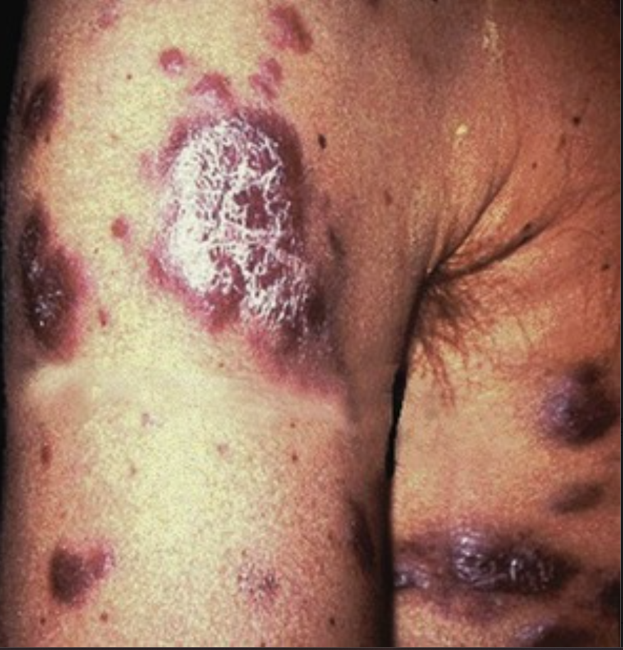
Over the last 6 months, a 31-year-old man with a 10-year history of HIV infection has experienced chronic watery diarrhea, the loss of 10% of his body mass, and oral thrush. He has the skin lesions shown.
What is your diagnosis?
What has likely happened to his HIV1-RNA and CD4+ cell counts?
What would be the significance of similar lesions in an HIV-negative geriatric man from Eastern Europe?
These are nodules of Kaposi sarcoma.
The HIV1-RNA viral load is increased, and the CD4+ cell count decreases as HIV infection progresses to clinical AIDS.
This would most likely represent the classic, endemic form of Kaposi sarcoma; it is less aggressive than AIDS-associated Kaposi sarcoma (only 10% of patients have visceral involvement).

Slide 22
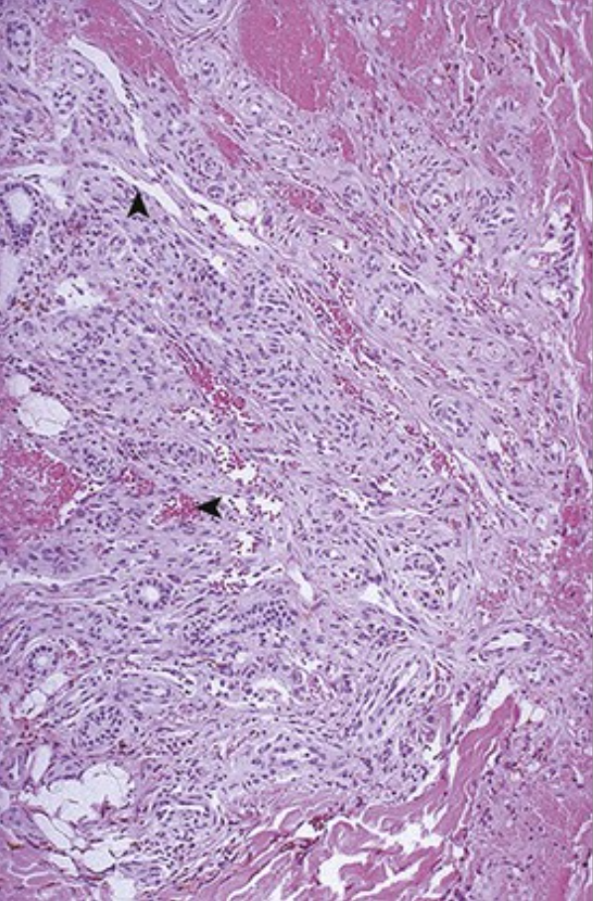
A 42-year-old man with history of Pneumocystis pneumonia has recently developed multiple lower-extremity pink-red macules that are up to 1 cm in size. The microscopic appearance of one lesion is shown; note the irregular slitlike vascular channels (▴) and hemorrhage (◂). Human herpesvirus-8 (HHV-8) can be shown in the lesions by polymerase chain reaction.
What is your diagnosis?
What underlying disease and risk factor could he have?
How does HHV-8 contribute to these lesions?
What noncutaneous sites are most affected by the African endemic form of this disease?
Kaposi sarcoma
This patient could have AIDS. He is likely to engage in sex with other men, because HHV-8 is much more prevalent among HIV-positive homosexuals than other populations that are at risk for HIV.
HHV-8, which is also called Kaposi sarcoma–associated herpesvirus (KSHV), infects endothelial cells, which results in the increased expression of p53 inhibitors and cyclin D. This drives cellular proliferation while reducing apoptosis.
This aggressive form of Kaposi sarcoma involves the lymph nodes.

Slide 23
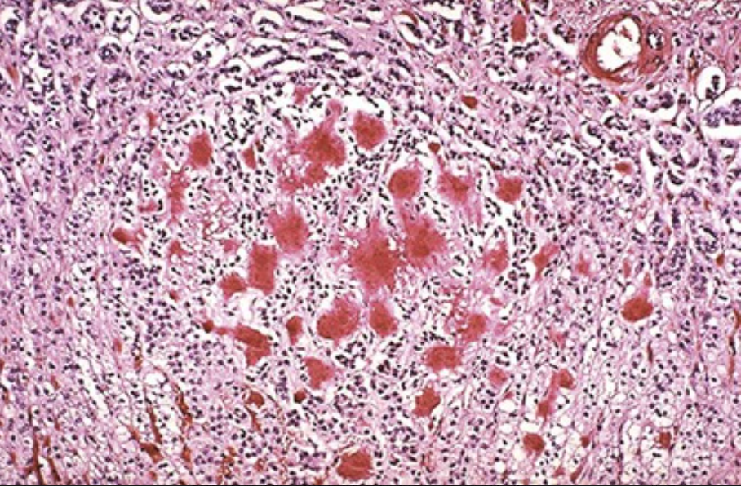
A 58-year-old man has increasing fatigue, back pain, and bilateral carpal tunnel syndrome. His work-up reveals the following: serum creatinine, 3 mg/dL (normal, ≤ 1.2 mg/dL); urea nitrogen, 28 mg/dL (normal, 7 to 30 mg/dL); total protein, 9.4 g/dL (normal, 6 to 8.5 g/dL); and albumin, 4.4 g/dL (normal, 3.5 to 5 g/dL). A radiograph of the spine shows multiple lytic lesions. After this patient's sudden arrhythmic death, autopsy shows that his adrenal gland contains the amorphous hyaline material seen here with a Congo red stain.
What is a bone marrow biopsy specimen likely to show?
What would serum protein electrophoresis show?
What is shown by the Congo red stain?
Multiple myeloma is a clonal proliferation of plasma cells secreting a single immunoglobulin, with hypergammaglobulinemia. The patient's back pain relates to osteolysis from plasma cell accumulation and the production of osteoclast activating factors.
Protein electrophoresis shows a gamma globulin M-spike.
Excessive myeloma light chains form AL-type amyloid that is deposited in many organs, including the adrenals. Renal light-chain deposition accounts for renal failure.

Slide 24
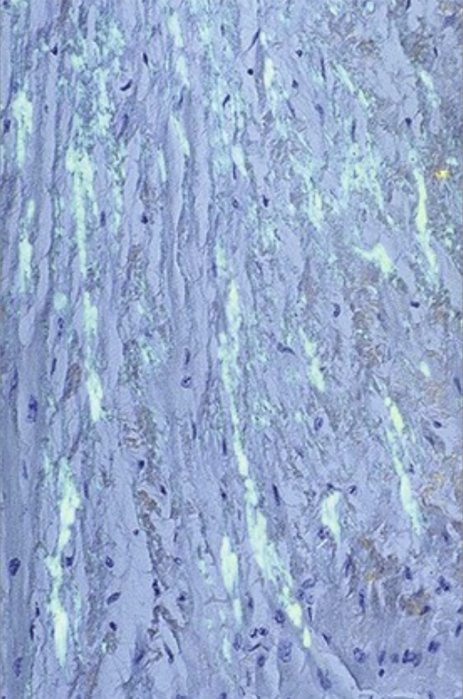
A 60-year-old woman who has had severe rheumatoid arthritis for 30 years has worsening congestive heart failure. Echocardiography shows restrictive changes with diminished ventricular wall motion and ejection fraction. Her endomyocardial biopsy specimen is shown with Congo red stain viewed with polarized light.
What is her diagnosis, and why did she develop it?
What protein would likely form these deposits in an elderly patient with isolated cardiac arrhythmia?
About 3% of patients with rheumatoid arthritis patients have reactive systemic amyloidosis, with deposition of AA-type amyloid. This occurs mainly in the heart but also in other organs.
Localized cardiac amyloidosis involves mutated transthyretin (TTR) protein forming amyloid (although normal transthyretin or atrial natriuretic peptide can also deposit as isolated cardiac amyloid).

Slide 25
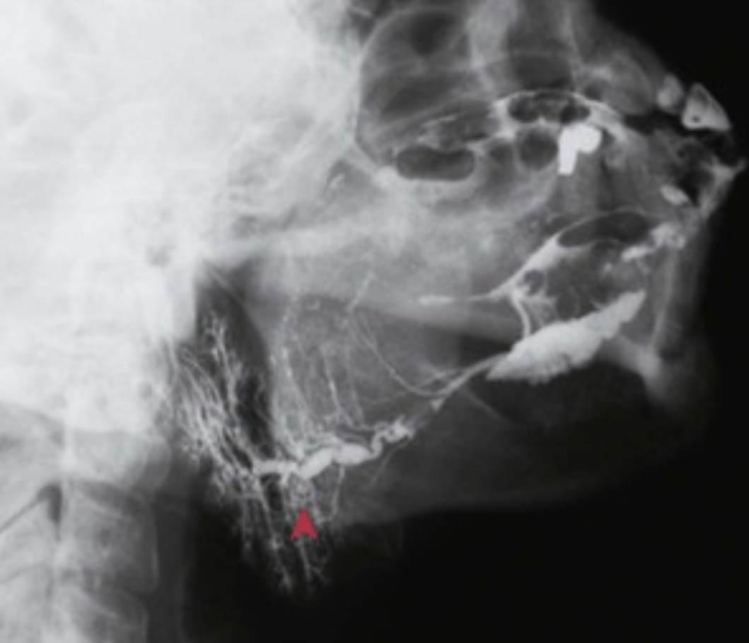
A 55-year-old woman presents with blurred vision and ocular burning and itching. Review of systems uncovers that she also has difficulty swallowing solid foods because of a dry mouth. Physical examination reveals keratoconjunctivitis. Her submandibular sialogram is shown.
What is your diagnosis?
What autoantibodies are likely to be present?
What microscopic findings would you expect from a
biopsy specimen of her submandibular gland?
This patient has sicca syndrome (reduced lacrimal and salivary secretions), most likely secondary to Sjögren syndrome. Note the dilation (▴) and irregular filling of the submandibular gland ducts scarred by this inflammatory process.
The most specific serologic assays involve autoantibodies directed against ribonucleoproteins designated SS-A (Ro) and SS-B (La); more generic antinuclear antibodies (ANAs) and rheumatoid factor (RF, which is an IgG against IgM) are also often present.
The sialogram shows ectatic (dilated) ducts. Inflammation directed against the salivary gland has caused fibrosis and atrophy with more proximal duct dilation.

Slide 26
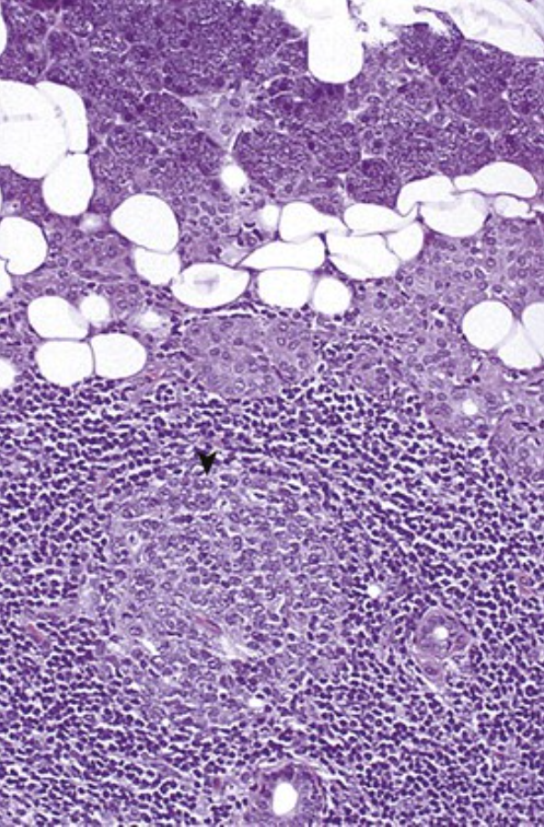
A 59-year-old woman with a 9-year history of hand and foot arthritis now has parotid gland enlargement with xerostomia, frequent epistaxis (as a result of mucosal dryness), and bronchitis. Her salivary gland biopsy specimen is shown.
Describe the findings and the likely diagnosis.
What malignancy is this patient at increased risk of developing
There is chronic inflammation with a lymphoid follicle (▾) that has a prominent germinal center. The lack of salivary and nasal secretions is typical for Sjögren syndrome. More than half of such patients also have rheumatoid arthritis, which accounts for this patient's hand and foot symptoms.
An initial polyclonal lymphoid proliferation in patients with Sjögren syndrome may give rise to an oligoclonal/monoclonal population that eventually becomes a full-blown non-Hodgkin lymphoma.

Slide 27
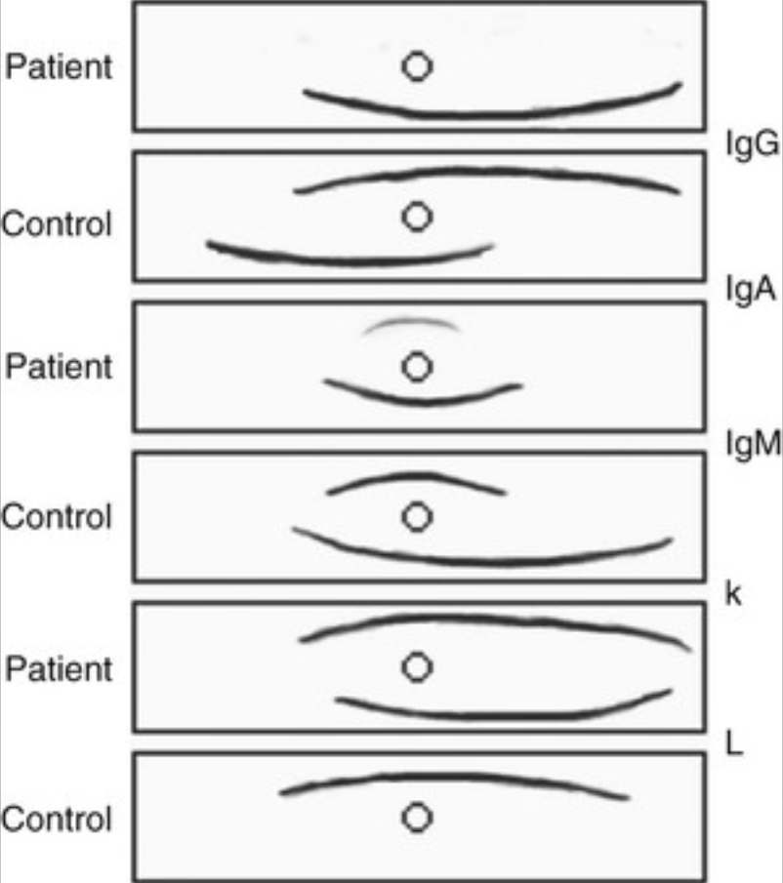
A 12-year-old boy has a 2-year history of multiple respiratory tract infections and watery diarrhea. He just recovered from a Streptococcus pneumoniae pneumonia, and he now has Giardia lamblia cysts in his stool. His hematocrit, platelet, and white blood counts are all normal, and he has normal levels of circulating T and B cells. His serum immunoelectrophoresis is shown.
What is your diagnosis?
What are the underlying immune abnormalities?
What future complications could this patient have?
This is likely isolated IgA deficiency, but it could also represent common variable immunodeficiency (CVID).
There can be failure of B-cell maturation into plasma cells, excessive T-cell suppression, T-cell or B-cell autoantibodies, or defective T helper cell function.
The same deficient mucosal IgA-mediated immunity that leads to recurrent respiratory and gastrointestinal infections may also fail to neutralize extrinsic antigens, which promotes allergic disorders and autoimmune diseases. Lymphomas and gastric carcinoma are more likely to occur.

Slide 28
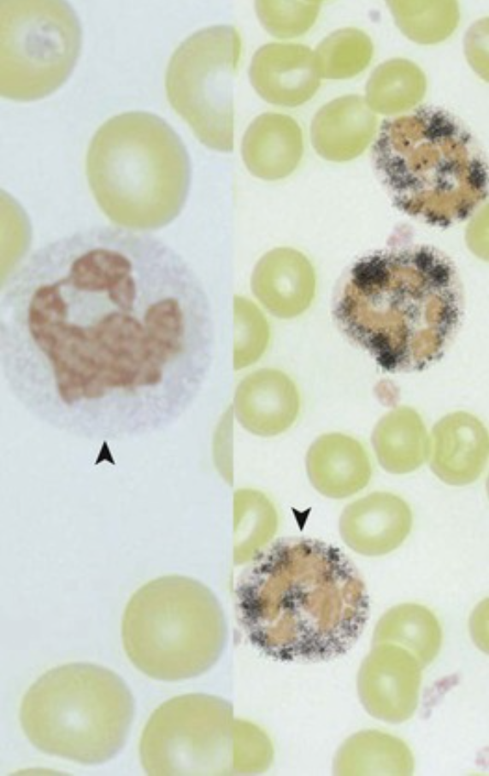
A 7-month-old boy presents with failure to thrive and diffuse lymphadenopathy. Stool cultures grow Serratia; a lymph node biopsy specimen shows macrophage hyperplasia, and cultures grow Aspergillus. A neck abscess exhibits granulomatous inflammation and Staphylococcus aureus. A nitroblue tetrazolium test of the patient's neutrophils (▴) is compared with control neutrophils (▾).
What does this test show?
What is your diagnosis?
Normal neutrophils at the right exhibit multiple dark granules (azurophilic granules), whereas the patient's neutrophils do not.
The patient has chronic granulomatous disease (CGD). This is a disorder of leukocyte function that results from the mutations of genes of the NADPH oxidase system, thereby leading to defective bactericidal activity. Two thirds of cases are X-linked, and one third are autosomal recessive.

