Slide 1
Prostate large glands pattern
HIPON IMAGES ON PROSTATE PATHOLOGY
Andreas C. Lazaris

Slide 2
Seminal vesicles/ejaculatory duct epithelium
The epithelium of these normal structures may be mistaken as neoplastic. The majority of cells is tall and contains hyperchromatic large pleomorphic nuclei (blue arrows) and gold-brown lipochrome pigment (lipofuscin) in the cytoplasm ( thin brown arrows).
The presence of this pigment and the absence of mitoses are quite helpful to exclude the possibility of neoplasia (i.e., PIN or cancer). In the absence of the pigment, monoclonal PSA antibody immunonegative staining will confirm the different histogenesis of these structures.

Slide 3
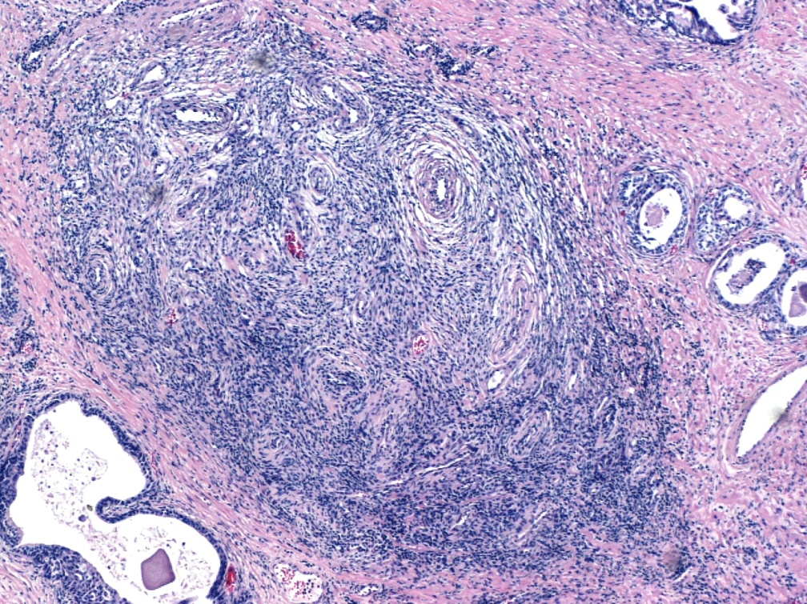
Benign nodular prostate hyperplasia
Nonencapsulated nodule of benign, hyperplastic , irregularly shaped prostate glands with a double cell layer and focal pseudostratification of secretory cells
Papillary infoldings and papillae with fibrovascular cores( thin arrows) in the lumen of medium to large-sized glands. [On the contrary, adenosis ( atypical adenomatous hyperplasia) is a small glandular proliferation ].
Corpora amylacea (amyloid bodies, pink circles) are much more common in benign prostate glands than in cancerous prostate glands.
Hyperplastic stromal component (blue asterisk) composed of fibroblasts and smooth muscle cells.

Slide 4
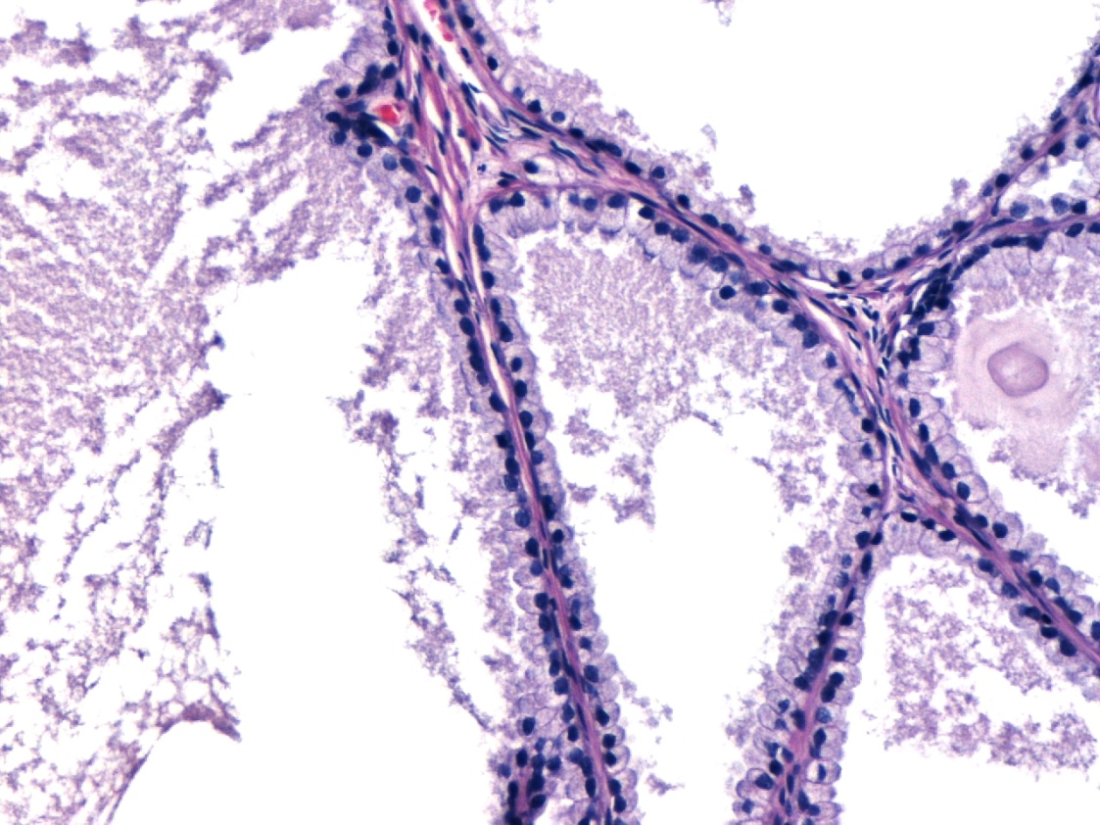
Benign nodular prostate hyperplasia
Hyperplastic nodule composed of cystically dilated large glands of non-atrophic type (lack of basophilia).
In this case, smooth luminal borders and pink amorphous secretions are noticed ; sometimes a closer inspection is necessary to rule out the presence of enlarged nuclei and numerous nucleoli and thus exclude the possibility of pseudohyperplastic carcinoma, an unusual variant of acinar adenocarcinoma. To diagnose cancer , basal cells should be totally absent ; as always, racemase (AMACR) positivity will be taken into account as an indicator of cancer only if benign glands in the section we examine, are AMACR-immunonegative .

Slide 5
Evident basophilia in two large sized glands with PIN (blue asterisks); glands with PIN show papillary projections/infoldings similar to adjacent, non basophilic benign prostate glands (yellow asterisks). The architecture is that of benign glands (yellow asterisks) but nuclear atypia makes the glands basophilic, so they attract our attention. PIN is a lesion of the peripheral zone and thus it is frequently encountered in needle-biopsy material, like acinar adenocarcinoma.

Slide 6
Nuclear atypia in high grade (HG) PIN. Loss of polarity ,numerous visible eccentric nucleoli (thin black arrows) and quite uniform atypia in acinar cells (cuboidal cells with round nuclei) close to the basement membrane. At least some basal cells (green arrows) are present in PIN. Note that acinar cells towards the centre (yellow arrows) exhibit nuclei with more benign morphology compared to the basally orientated acinar cells by which PIN grading is made; this maturation phenomenon can be observed in HG PIN. This phenomenon along with the uniform atypia of acinar cells discriminates HG PIN from intraductal carcinoma of the prostate.

Slide 7
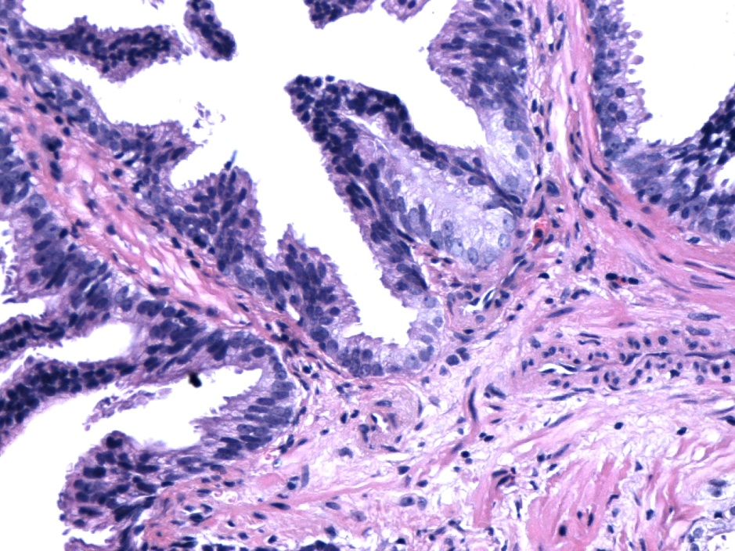
High grade (HG) PIN
Focally to diffusely detected, visible nucleoli (thin black arrows).
Some degree of nuclear enlargement of acinar cells, orientated basally, vertically to the basement membrane .
Maturation phenomenon (yellow arrows).
The commonest architectural pattern of PIN is the tufted one (grey arrows); other patterns (i.e., flat, micropapillary, cribriform, inverted) , however, frequently co-exist (flat and micropapillary patterns, pink and purple arrows, respectively).
As a rule, in PIN central comedonecrosis is totally absent or very limited and focal, in contrast to Gleason pattern 5 acinar and ductal prostate adenocarcinomas .

Slide 8
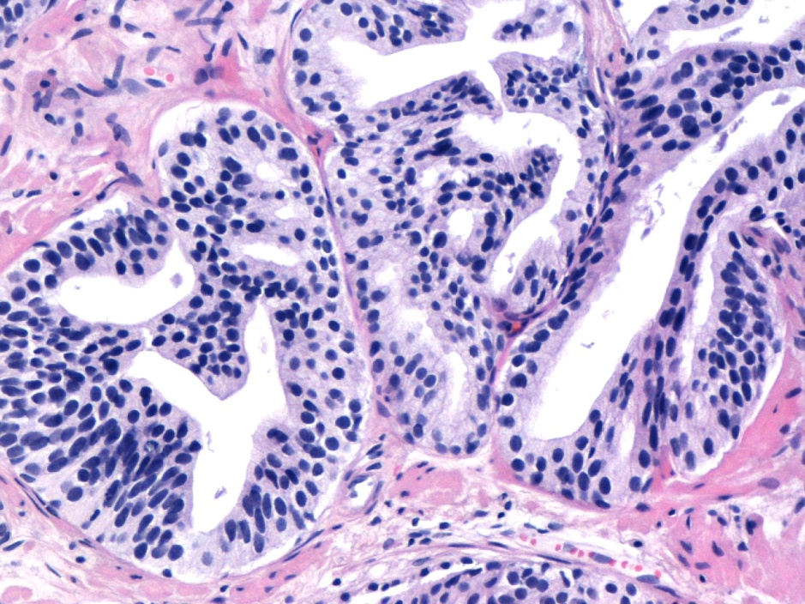
High Grade Prostatic Intraepithelial neoplasia (HG PIN) High degree of crowding/stratification (blue arrows).Complex architecture with bridges and cribriform formations (red arrows). PIN is usually detected in single glands or small groups of glands with a lobular configuration . When numerous large glands are too crowded and back-to-back, immunodetection of basal cells will rule out a PIN-like acinar adenocarcinoma. If basal cells are not at all detected in a sufficient number of glands, the diagnosis of cancer can be made .

Slide 9
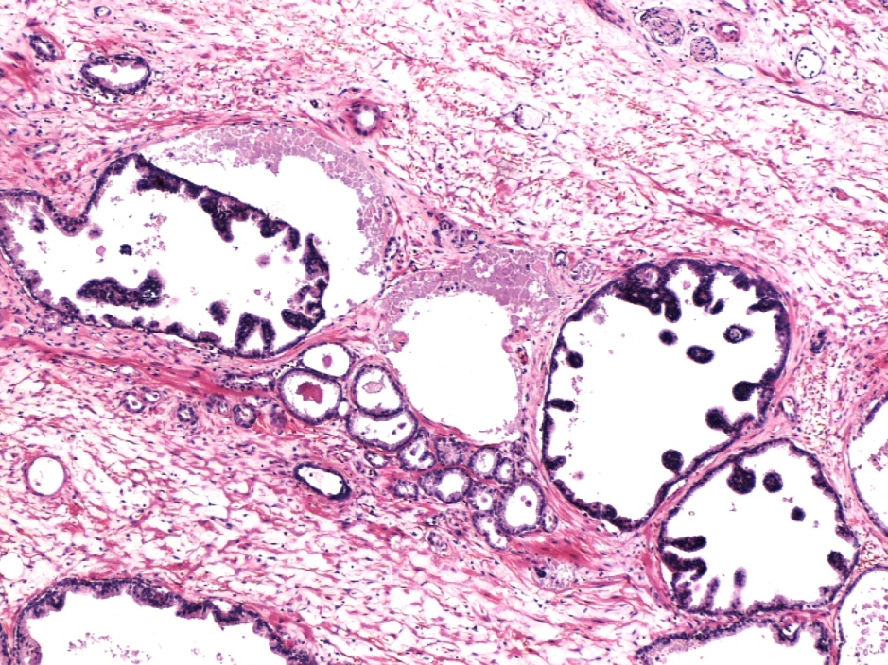
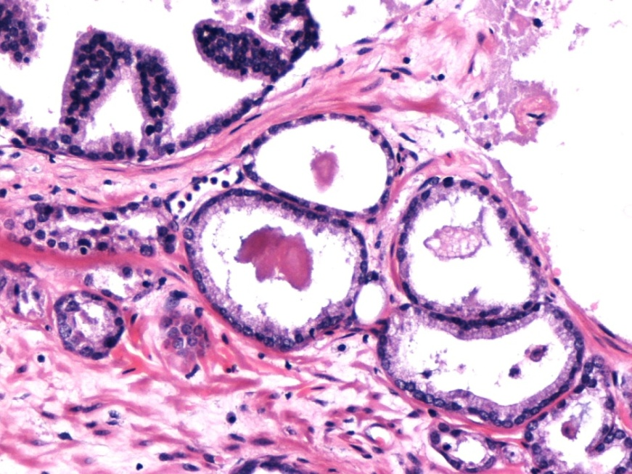
Development of prostate acinar adenocarcinoma (small sized cancerous glands) adjacent to HG PIN of the micropapillary type (purple arrows)
It is possible to diagnose PIN in the absence of prominent nucleoli, based on nuclear pleomorphism , marked hyperchromasia (as in this case, purple arrows) and/or mitotic figures .
Glands of cancer (red arrows) bud from HG PIN. Their number and their considerable distance from HG PIN foci are sufficient to make a diagnosis of acinar adenocarcinoma, since these small glands are unlikely to represent outpouchings of HG PIN .

Slide 10
Immunohistochemistry results at the previous lesion. PIN and adjacent carcinoma of Gleason pattern 3.
Remnants of basal cell layer are observable in PIN glands
( dark brown arrows) and their outpouchings ( orange arrows) , while, in this case, an adequate number of glands is completely immunonegative for the basal cell immunomarker ( cancerous glands, red asterisks)
Racemase (AMACR) is strongly expressed both in HG PIN glands (dark brown arrows) and in cancerous glands (red asterisks); so, it is of no use in the diagnosis of acinar adenocarcinoma adjacent to HG PIN .
Racemase
34βE12 CK

Slide 11
HG PIN (dark brown arrow) and adjacent atypical glands (orange arrows) (PIN-ATYP). Immunohistochemistry is not particularly useful . Racemase is expressed with a specific staining pattern both in PIN focus and in adjacent atypical small glands. Basal cells are identified both in HG PIN focus and in a small gland nearby; diagnosis of cancer could not be made even if the small gland of the left image (orange arrow) completely lacked basal cells. Remember that in order to diagnose cancer a sufficient number of glands (at least 3) should be completely devoid of basal cells.
34βE12 CK
Racemase

Slide 12
Conventional (acinar) adenocarcinoma of the prostate with merging cancerous glands resulting in cribriform architecture. Atypical acinar cell morphology. Perineural invasion (blue asterisk), pathognomonic of cancer .

Slide 13
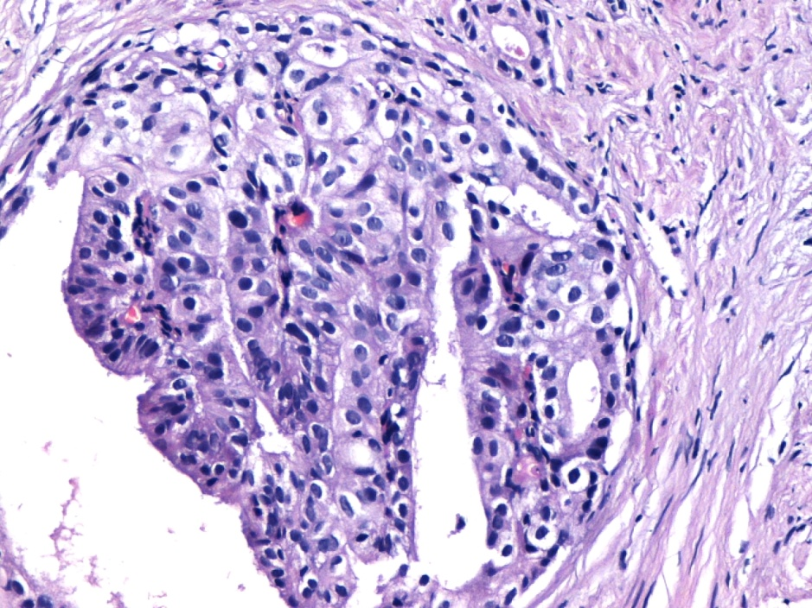
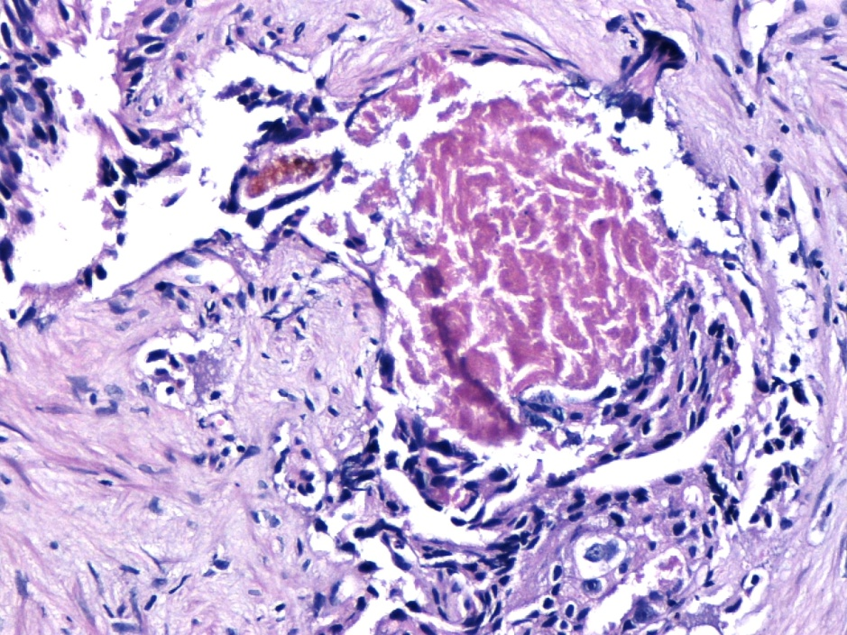
Conventional (acinar) adenocarcinoma of the prostate with cribriform architecture
Note the regular round to oval nuclei of the acinar cell cribriform pattern ( acinar-cell type as opposed to the tall columnar cells with large elongated hyperchromatic nuclei making up the cribriform ductal adenocarcinoma we are going to examine next).
Complete loss of basal cell layer favors the diagnosis of prostate carcinoma .
The cribriform glands with irregular infiltrating borders of Gleason pattern 4 must be distinguished from cribriform Gleason pattern 3, in which the cribriform glands have regular borders (blue arrows). In cribriform pattern 3 , the cribriform proliferations are rather small, rounded and not crowded together. Only rounded, well-circumscribed glands having the same size as normal glands as well as evenly spaced lumina and cellular bridges of uniform thickness are considered in Gleason pattern 3 category. Small infiltrating glands of Gleason pattern 3 (red arrows) almost always accompany cribriform pattern 3 .
(Central) comedonecrosis(pink asterisk) is classified as pattern 5 .

Slide 14
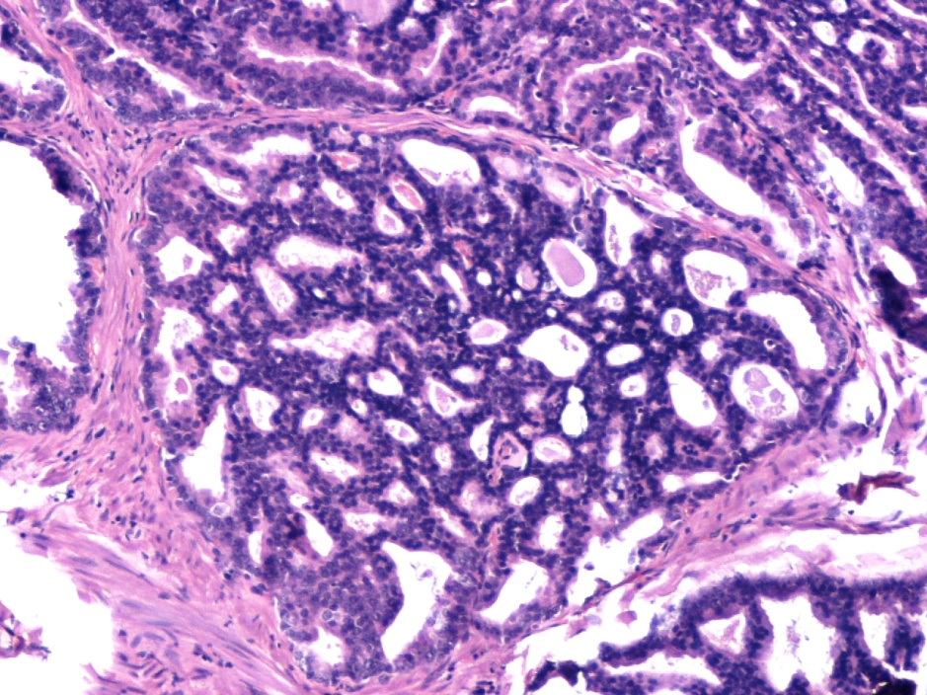
Cribriform pattern of high grade prostate acinar adenocarcinoma (Gleason pattern 4)
As the majority of acinar adenocarcinomas, this is lesion of the peripheral zone of the prostate, frequently accompanied by small sized infiltrating glands.
Complete lack of basal cells.
The cribriform glands of pattern 4 are either large cribriform glands , including cribriform sheets, or smaller cribriform glands with irregular infiltrating borders.
It is generally important to be able to separate pattern 3 from pattern 4 because this separation usually distinguishes Gleason score 6 from Gleason score 7 , the latter having a significantly worse prognosis . There is a trend toward interpreting most infiltrating cribriform patterns as pattern 4; in routine practice, cribriform pattern 3 is rarely , if ever, diagnosed.

Slide 15
Prostate ductal adenocarcinoma
Prostate adenocarcinoma characterized by tall columnar cells (resembling prostatic ductal cells) with high grade nuclei is defined as ductal adenocarcinoma; (on the contrary, acinar adenocarcinoma is composed of cuboidal cells, characteristic of protate acini).
Classified as Gleason pattern 4 ; when comedonecrosis is present: Gleason pattern 5.
Most are distributed around the prostatic urethra.
The assessment of invasion is occasionally difficult when the tumour mass invades in an expansile manner. However, ductal adenocarcinoma is commonly intermingled with usual acinar cancer; ductal adenocarcinomas admixed with Gleason pattern 3 is considered more aggressive than Gleason score 7 purely acinar cancer, if the ductal component equals or exceeds 10% of the tumour mass.
Ductal adenocarcinoma cells are always positive for PSA and PSAP; this is particularly helpful in the differential diagnosis of urothelial or colon carcinoma involving the prostate. Urothelial cells are PSA (-), (unless they show glandular metaplasia).

Slide 16
Prostate ductal adenocarcinoma. Too large glandular structures of various sizes with distorted and complex architecture (red asterisks). Papillary architecture (red arrows). In the papillary pattern of ductal adenocarcinoma , the papillae are supported by a fibrovascular core; this core is absent in the papillae of PIN.

Slide 17
Ductal adenocarcinoma of the prostate. Solid papillary (red arrows pointing to vascular cores of the papillae which in this case appear solid) combined with cribriform-like architecture (blue arrows).

Slide 18
Atypical ductal –cell morphology.
Ductal adenocarcinomas spreading along primary or secondary prostatic ducts, frequently retain basal cells in a discontinuous or continuous manner, as evidenced by 34βE12 immunoreactivity. It is noteworthy that these carcinomas should be regarded as ductal adenocarcinomas since they progress as invasive ductal adenocarcinomas.
Distinction from PIN is indeed important and depends on the fact that ductal adenocarcinomas with preserved basal cells are architecturally more complex than PIN and cytologically different [predominance of rather tall columnar cells with elongated nuclei (thin black arrows) instead of round to oval nuclei of the acinar type, atypical mitoses (thin red arrow) ].
Apart from HG PIN, which is the precursor lesion to invasive prostate acinar adenocarcinoma, it is well known that invasive acinar adenocarcinoma has the capacity to spread along ducts and acini and form a cribriform pattern with preservation of basal cells; in this case, carcinoma cells retain the cytologic characteristics of acinar cells (i.e., cuboidal cells with round nuclei) and only seldom acquire the columnar cell features with increased cytologic anaplasia of ductal adenocarcinoma. The diffusely , markedly malignant , less uniform (than observed in PIN) nuclear morphology and the too complex architecture in such intraductal carcinomas with atypical acinar–cell type morphology should rule out the diagnosis of HG PIN. This is the lesion which truly corresponds to “intraductal prostate carcinoma ” and is almost always associated with neighboring invasive carcinoma.

Slide 19
IMPORTANT MESSAGE The diagnosis of “intraductal” prostate carcinoma depends on the type of cell morphology.
An intraductal lesion (retaining basal cells) and exhibiting atypical ductal-cell morphology is distinct from that of atypical acinar-cell morphology.
The former is characteristic of ductal adenocarcinoma , irrespective of the presence or absence of basal cells.
The latter is characteristic
either of HG PIN (which is the precursor of acinar adenocarcinoma)
or , when atypical morphology is beyond what is acceptable for a HG PIN diagnosis, of intraductal spread of an (already invasive) neighboring acinar adenocarcinoma ( intraductal carcinoma of the prostate, a late event in the evolution of prostate neoplasia).
We can understand the critical importance of seperating HG PIN from intraductal carcinoma of the prostate in needle biopsy. The most common criteria associated with the latter are: 1. expanded, yet circumscribed intraductal foci with dense cribriform (more solid than cribriform) to solid masses with too complex architecture, with or without comedonecrosis and 2. marked, non uniform, nuclear atypia (enlargement, hyperchromasia and pleomorphism),well beyond that of HG PIN, and mitotic figures .

Slide 20
Urothelial carcinoma involving prostatic periurethreal ducts. Remaining amyloid bodies are observed in some ducts (pink circle). Basal cells may be identified. Considerable nuclear pleomorphism and overlapping as well as increased mitotic rate are hallmarks of high grade urothelial cancer.
Differential diagnosis includes HG PIN , ductal adenocarcinoma or intraductal carcinoma of the prostate.
Immunohistochemistry is quite helpful since common urothelial carcinoma expresses CK 34βE12 , CK7 , CK20, p63, uroplakin and thrombomodulin and is simultaneously immunonegative for prostate tissue immunomarkers ( eg. PSA , PSMA).

Slide 21
Urothelial carcinoma involving prostatic periurethreal ducts (black asterisks). In contrast to epithelial cells and secretions of adjacent atrophic prostate glands which serve as an internal positive control for anti-PSA immunostain (pink arrows), urothelial carcinoma is PSA-immunonegative.
PSA immunostaining

