Slide 1
Identification of tumor subtypes with prognostic/predictive significance in genitourinary pathology
2nd International SPCA Congress and 16th National Congress of SPCA
SYMPOSIUM - Saturday 21.4.2018 Histology-based Prognostic Markers Besides Tumors Grade and Stage
Prof. Dr med. Andreas C. Lazaris, Histopathologist
First Department of Pathology, School of Medicine,
The National and Kapodistrian University of Athens, Greece.

Slide 2
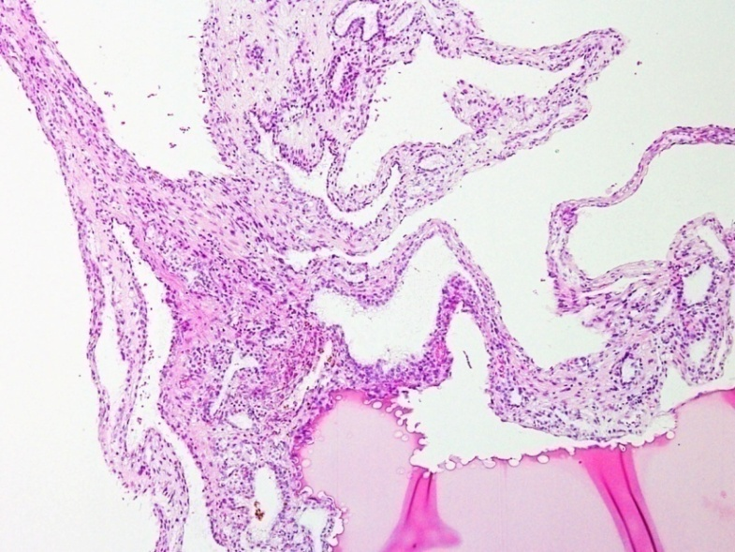
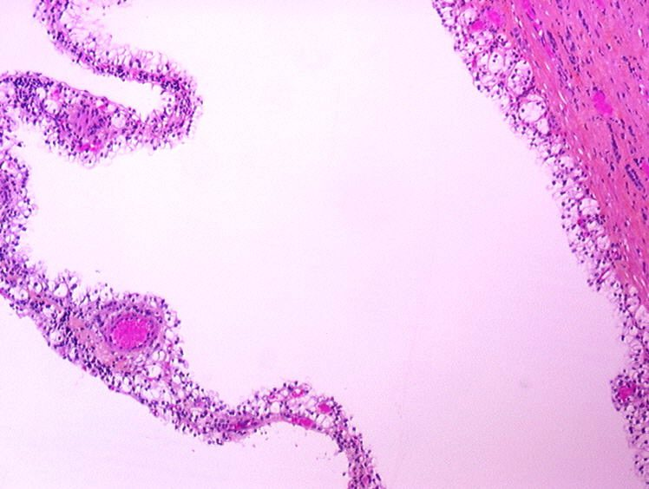
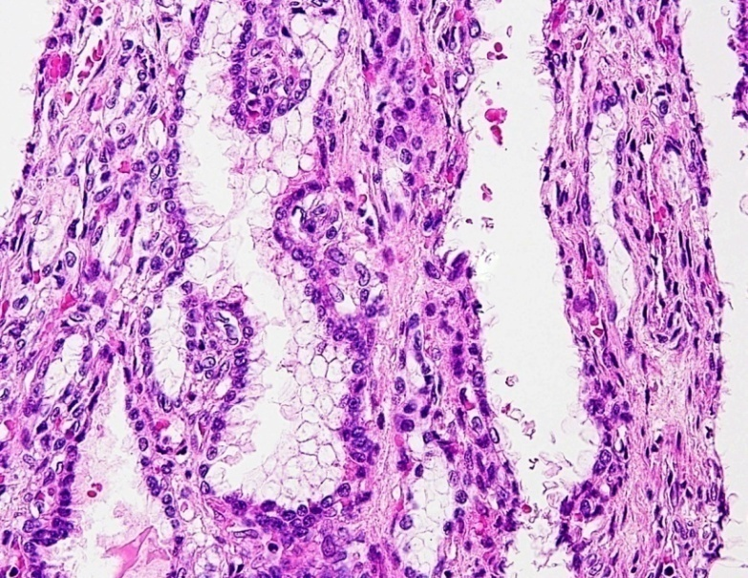
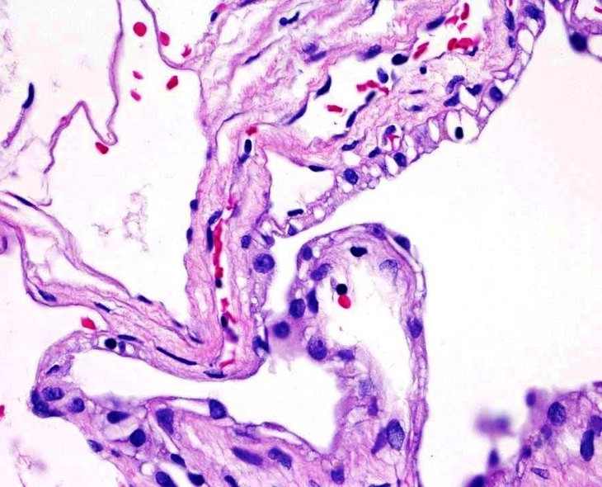
A multilocular cystic renal neoplasm of low malignant potential is defined as a neoplasm with a fibrous pseudocapsule and composed entirely of numerous cysts, the septa of which are thin and contain individual or groups of clear cells without expansile growth; clear cells have low grade nuclei; briefly, a multicystic growth with no expansile growth/solid nodules.

Slide 3
Clear cell Renal Cell Carcinoma (CC RCC) with extensive cystic changes
RCCs with cystic change have expansile clear cell nodules in their cyst walls or papillary excrescences covered by clear cells, no matter how extensive the cystic change. No prognostic advantage of such tumors, in contrast to multilocular cystic renal neoplasm of low malignant potential.

Slide 4
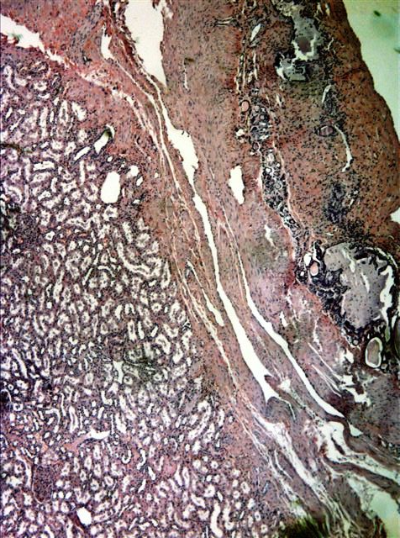
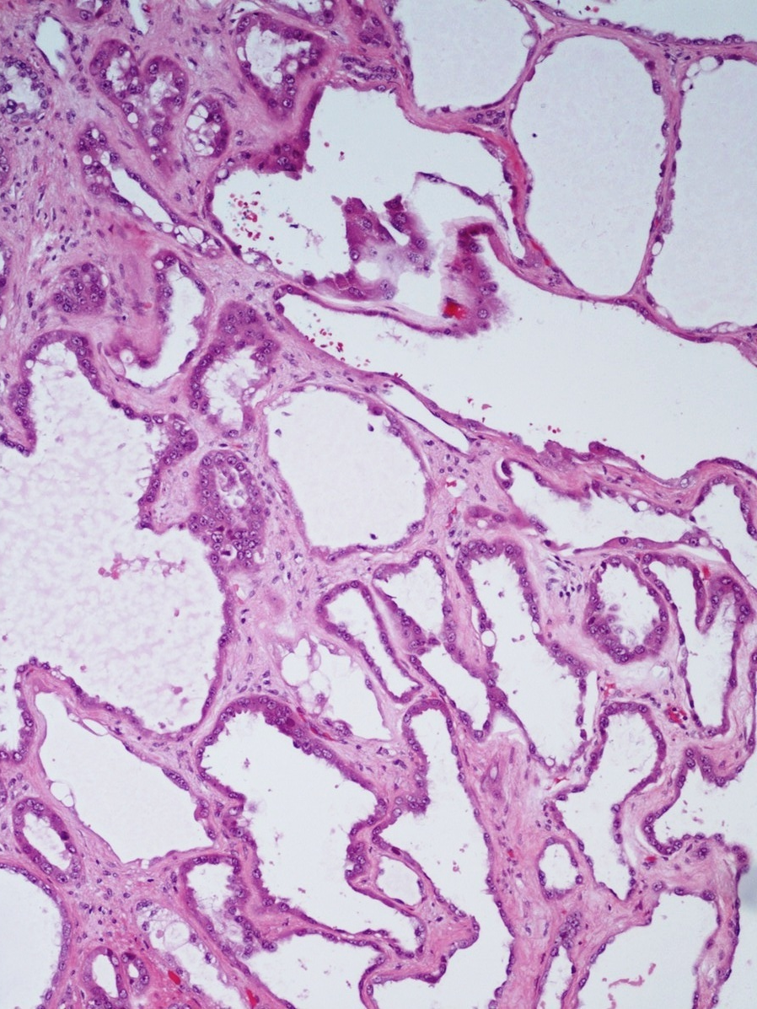
Tubulocystic RCC. Tubulocystic RCC is an uncommon cystic renal epithelial malignancy of WHO / ISUP grade not higher than 3 and indolent behavior, composed of small to intermediate-sized tubules admixed with larger cysts; its cytoplasmic features include abundant, oncocytoma-like aspects.

Slide 5
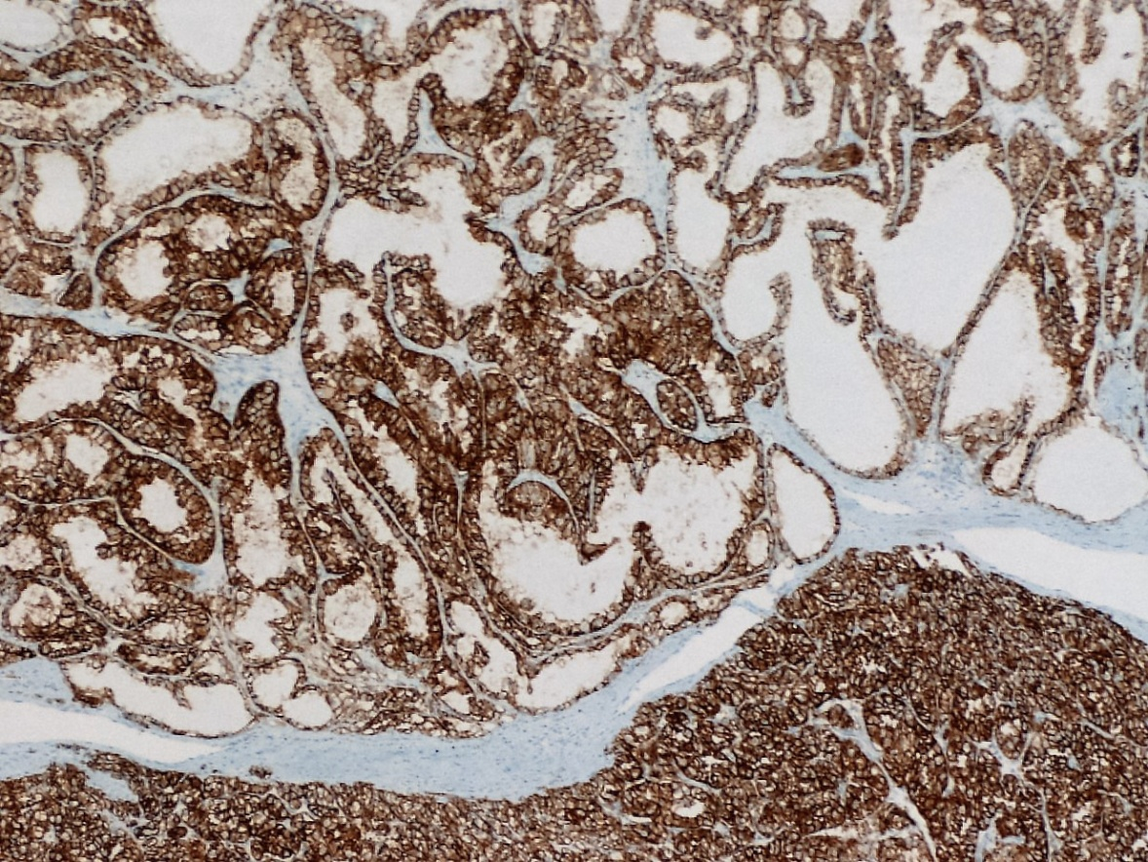
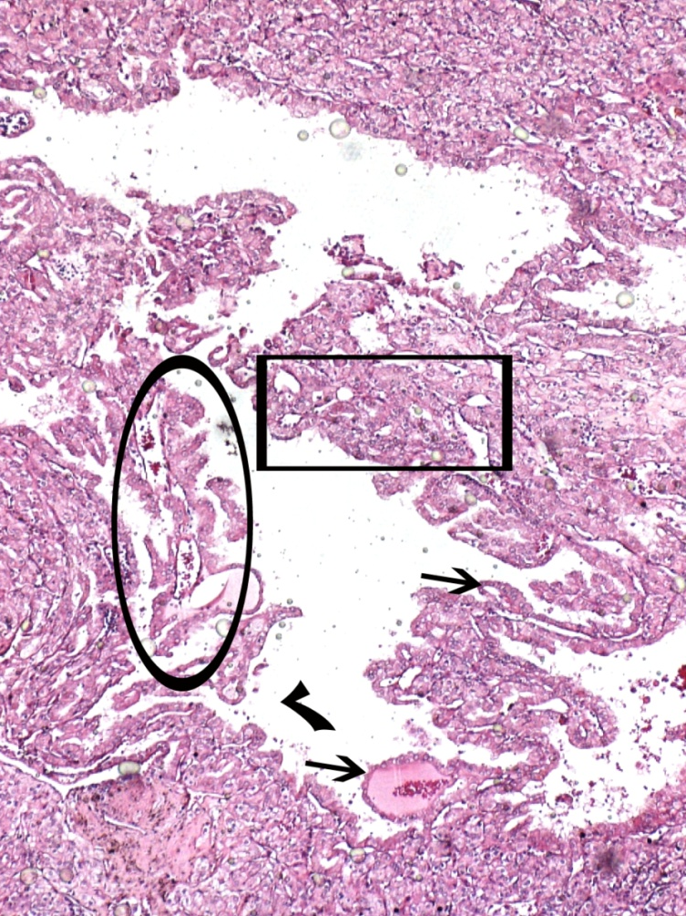
(Conventional) CC RCC with granular cytoplasm and/or focal papillary architecture
Clear cell cytology is not absolutely necessary for the diagnosis of a clear cell RCC. More than 50% granular eosinophilic features may predict poor response to IL-2 therapy. Clear cell RCCs with > 40% eosinophilic component may have worse clinical outcome.
In contrast to the eosinophilic variant of chromophobe subtype of RCC, the eosinophilic component of conventional “clear cell” subtype of RCC lacks KIT (CD117) immunoreactivity.
A pseudopapillary (ellipse) and tubular (square frame) pattern of tumor cells growth is possible in clear cell RCCs. Papillary structures should be small and account for an insignificant proportion of the overall architecture of a clear cell RCC.
Complete cytoplasmic membrane CAIX immunostaining pattern confirms that this is a (pure) clear cell RCC.

Slide 6
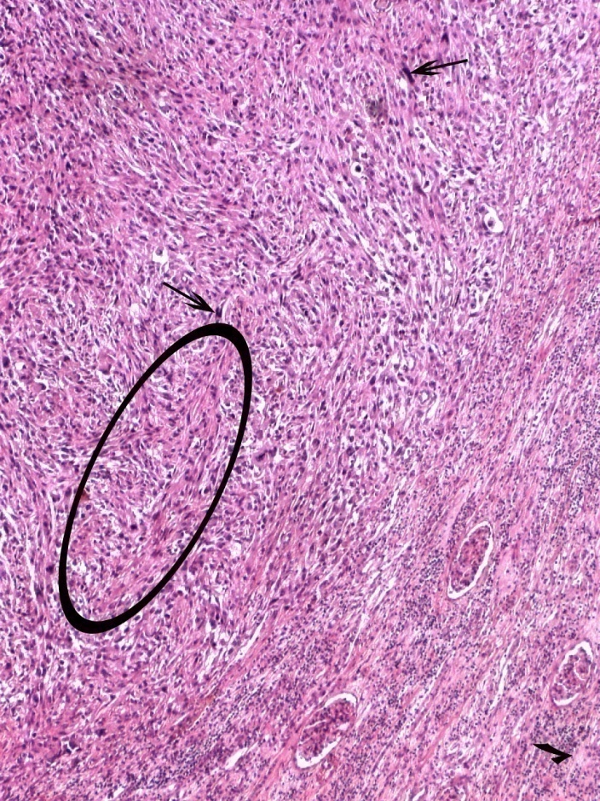
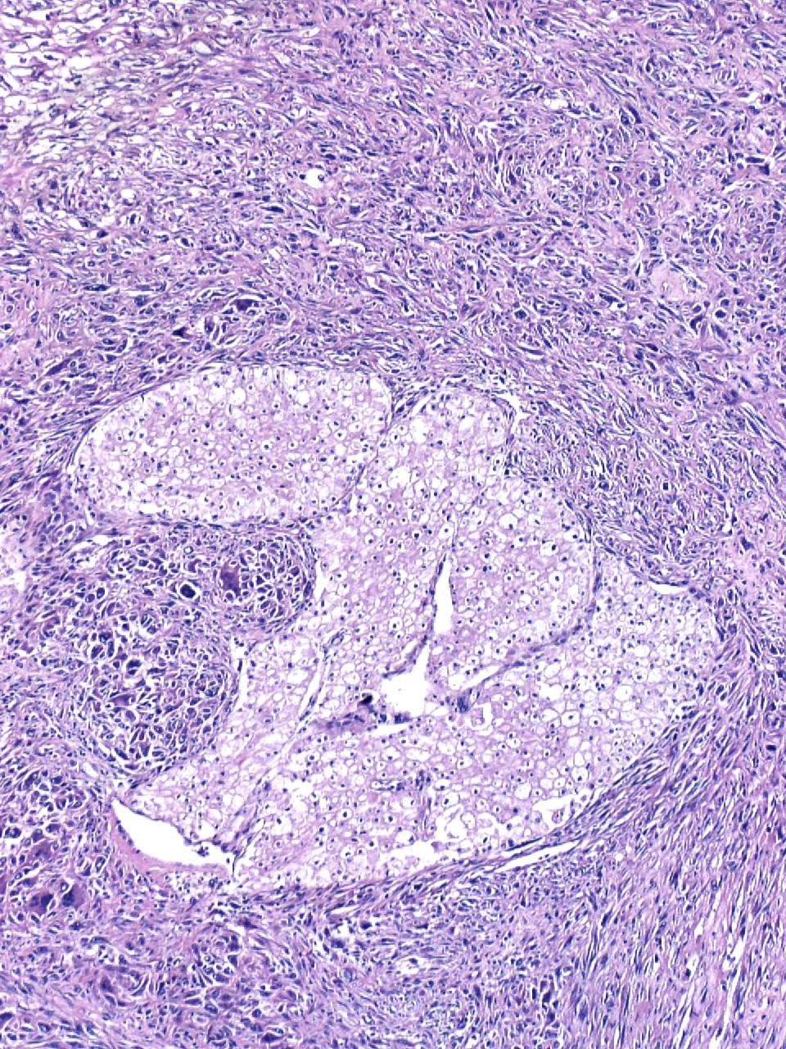
Sarcomatoid and rhabdoid (de)differentiation has higher rates of tumor recurrence and metastasis and should be reported when observed within a RCC parenchyma. Sarcomatoid RCC is not recognized as a distinct histologic subtype, but the common pathway of transformation of all different subtypes of renal cell carcinoma. Irregular, high grade nuclei, mitotic activity (thin arrow) and focal rhabdoid cytology (thick arrows) in the tumor area on the right. Discohesive rhabdoid cells with densely acidophilic, globular cytoplasm (thick arrows), not to be confused with rhabdoid tumors of the kidney. CAIX , Pax8, RCC marker and CD10 immunopositivity in the sarcomatoid component confirms the renal cell origin.

Slide 7
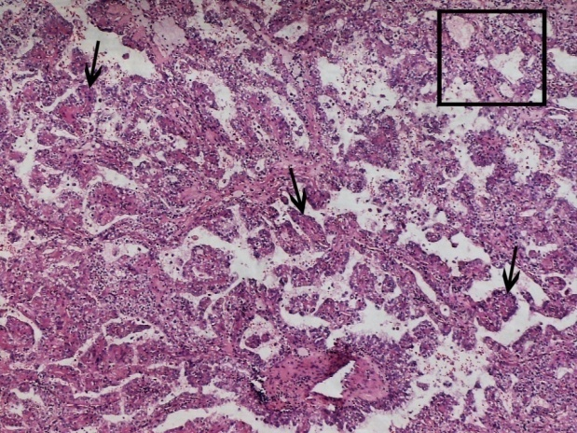
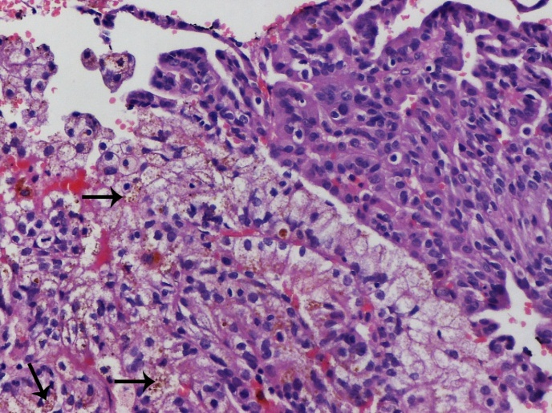
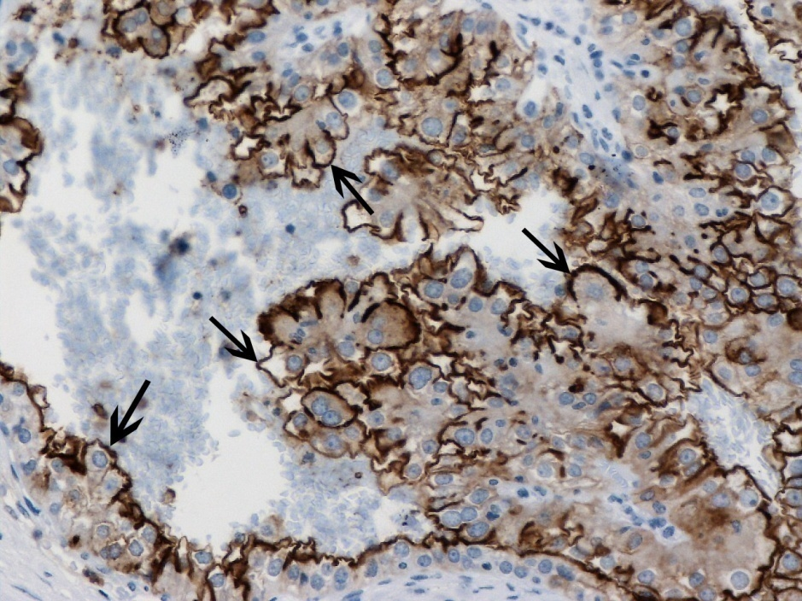
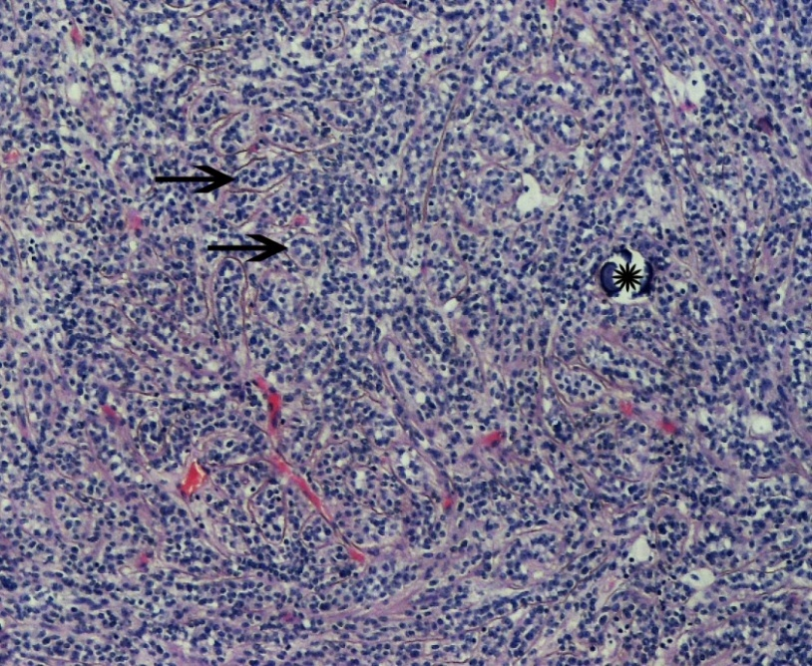
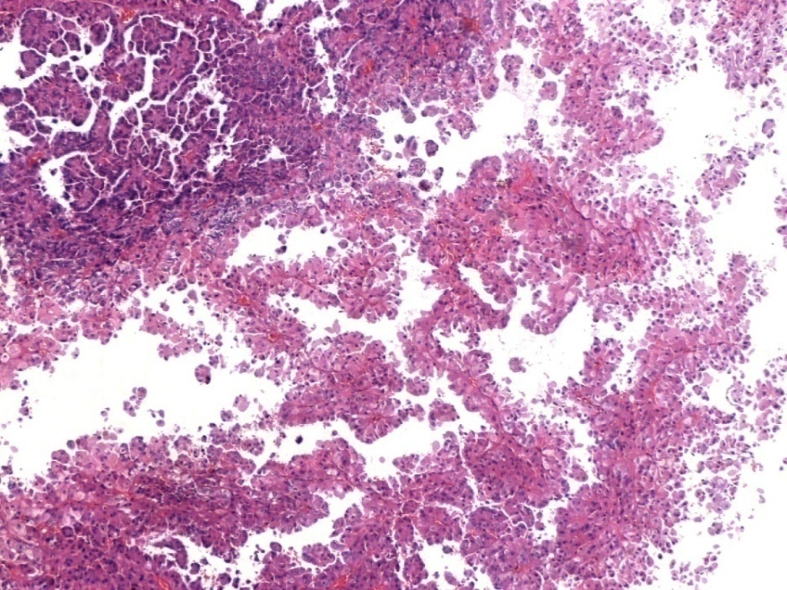
Papillary (P) RCC,type 1 in particular,is associated with a more favorable outcome than are CC RCC, collecting duct carcinoma and hereditary leiomyomatosis and RCC . Identification of true fibrovascular cores is the key to the diagnosis of a papillary RCC . Clear-appearing cells usually exhibit variable granularity and often fine hemosiderin. A solid pattern due to tightly compact growth of papillae is possible. Type 2 papillary RCCs characteristically exhibit nuclear pseudostratification in the single layers covering the papillae; cells are larger and contain abundant, eosinophilic cytoplasm. Oncocytic P RCCs are supposed to behave like type 1 PRCCs. Luminal membranous CD10 immunostaining is often observed.
CD10

Slide 8
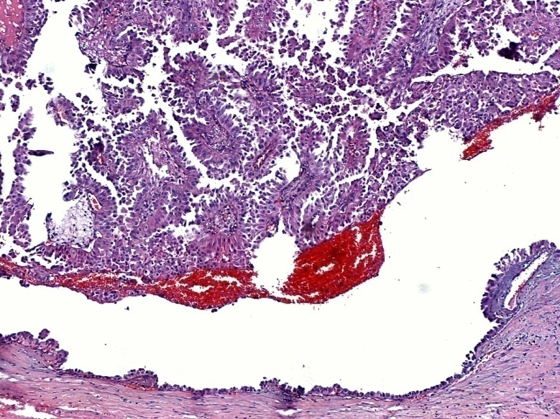
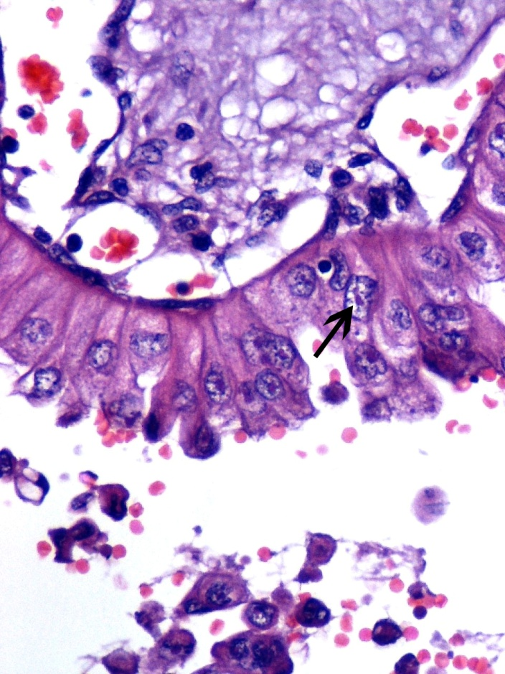
Hereditary leiomyomatosis and renal cell carcinoma-associated
renal cell carcinoma with papillary features.
Often prominent papillary architecture. Rare multifocality. Thick papillae covered by large cells with eosinophilic cytoplasm in a single unilateral cystic renal mass with solid enhancing components. Abundant eosinophilic cytoplasm. Nuclei contain prominent inclusion-like nucleoli with characteristic perinucleolar clearing. Clinical correlation with leiomyomas of the skin and uterus is also important. Poor prognosis with a tendency to early widespread dissemination.

Slide 9
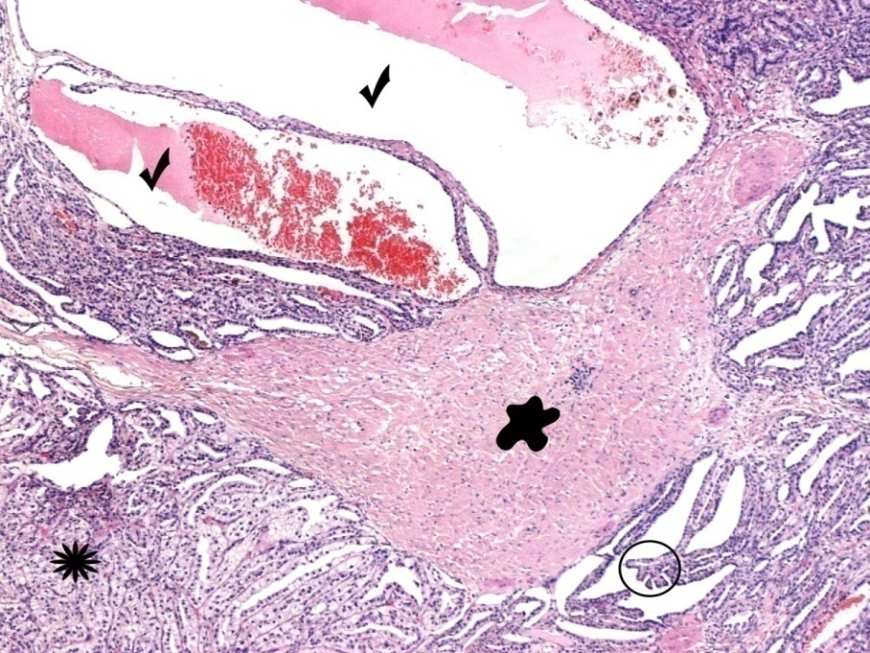
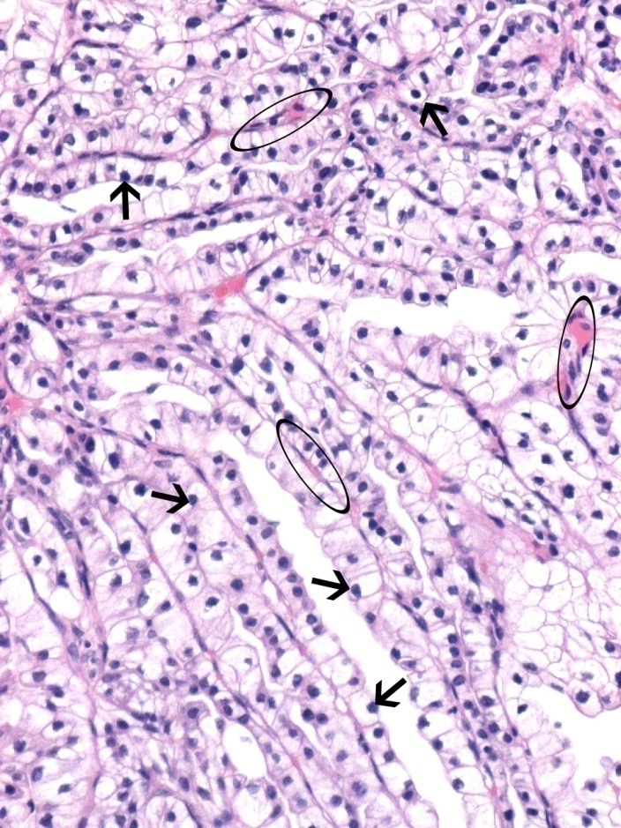
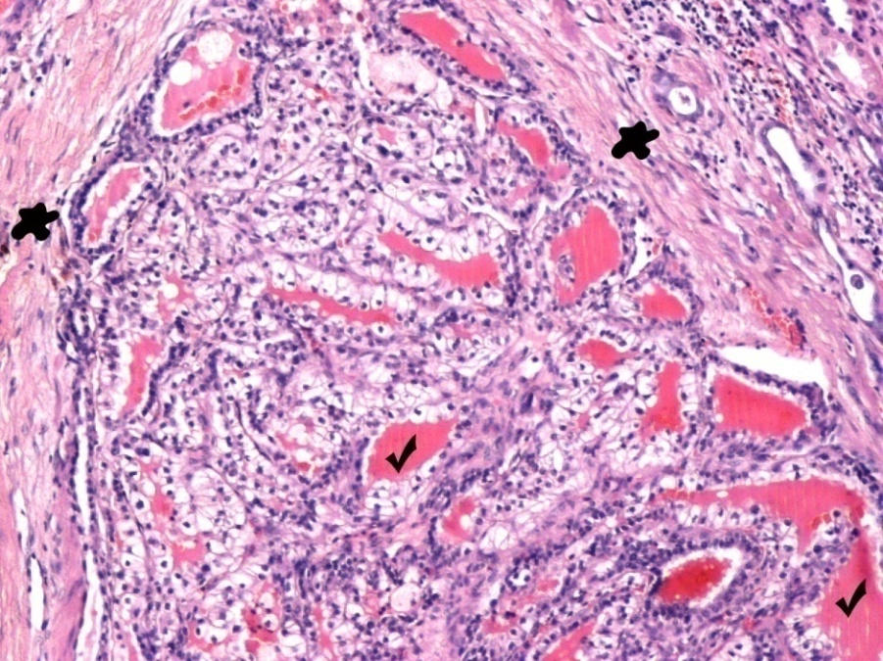
Clear Cell Papillary Renal Cell Carcinoma CC P RCC. Linear nuclei arrangement away from the basal aspect. No local recurrence or metastasis has been documented for such cases.

Slide 10
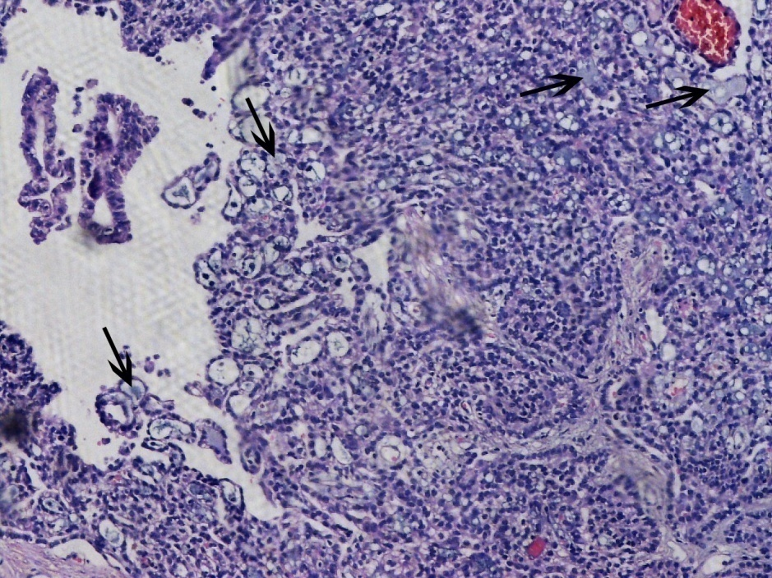
Mucinous tubular and spindle cell carcinoma. Most such tumors have an indolent course. Anastomosing tubular or cord-like formations merging with bland spindle cells. Regular and smooth luminal surfaces, irregular luminal outlines. Myxoid or mucinous stroma with a bubbly appearance (arrows).

Slide 11
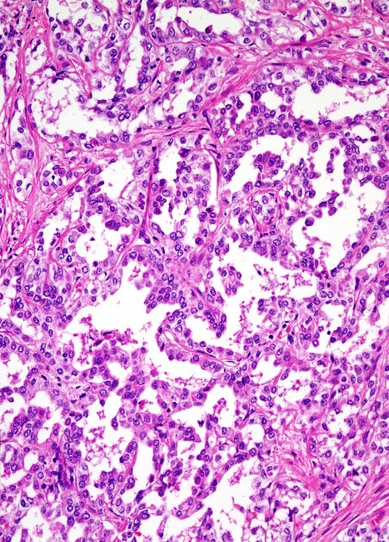
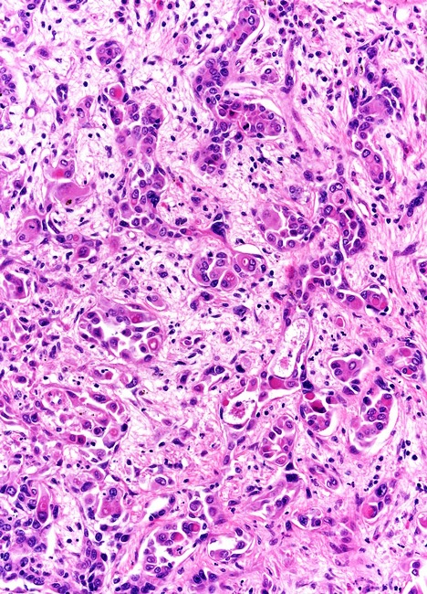
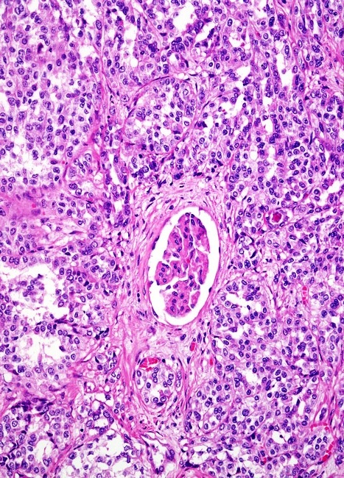
Collecting duct carcinoma, an adverse prognostic factor in itself.
Collecting duct carcinoma with papillary features can be distinguished from papillary RCC by the central, medullary location in the kidney of the main portion of the tumor, prominent multinodular growth pattern, sheet-like areas, infiltrating tubules and border, high-grade, typically hobnail features, intracytoplasmic and luminal mucin, pronounced desmoplastic and inflammatory stroma, associated epithelial dysplasia in collecting ducts adjacent to the tumor, and CEA and HMWCK immunoreactivity.

Slide 12
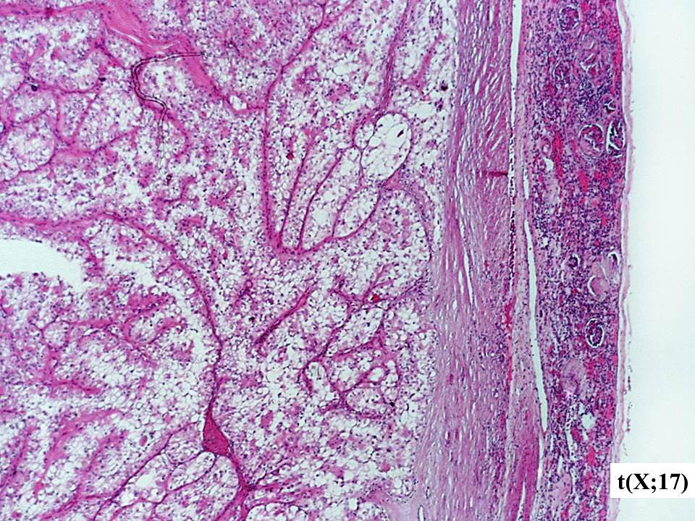
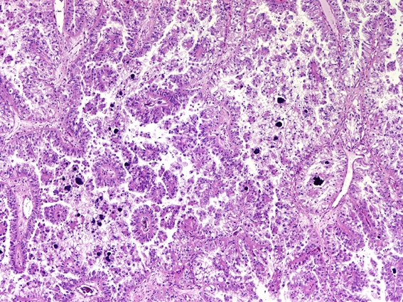
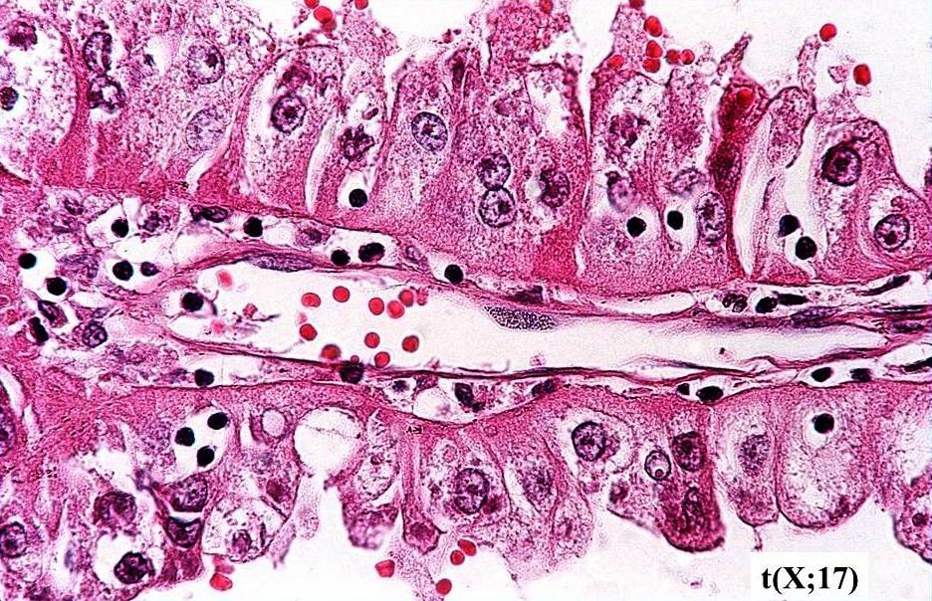
RCC associated with MiT family translocation. This tumor often affects children and young adults. Often papillary architecture with intermingled solid or nested areas; both clear and eosinophilic cells showing voluminous cytoplasm. Unlike most RCCs, MiT family translocation RCCs lack or underexpress epithelial immunohistochemical markers such as pancytokeratin; antibodies for specific gene fusions are necessary for the diagnosis of MiT family translocation RCCs. Survival for patients with Xp11 translocation RCCs is similar to that for patients with CC RCC and significantly worse than that for patients with papillary RCCS.

Slide 13
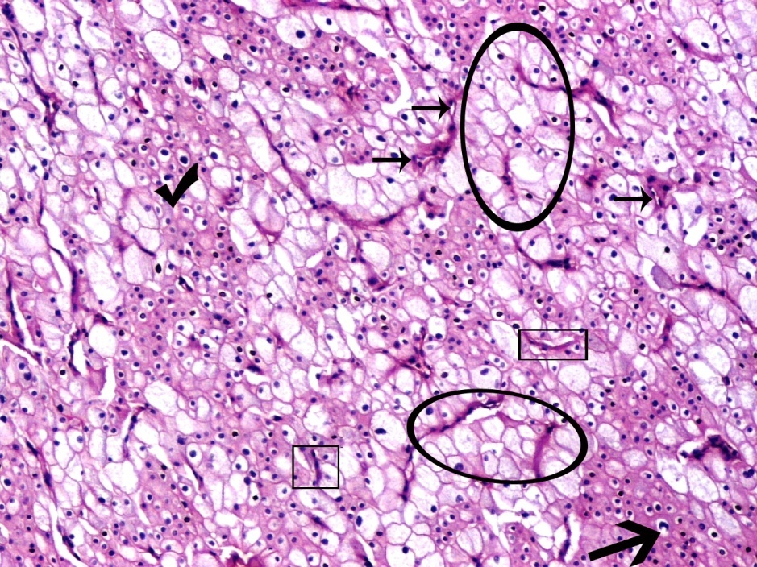
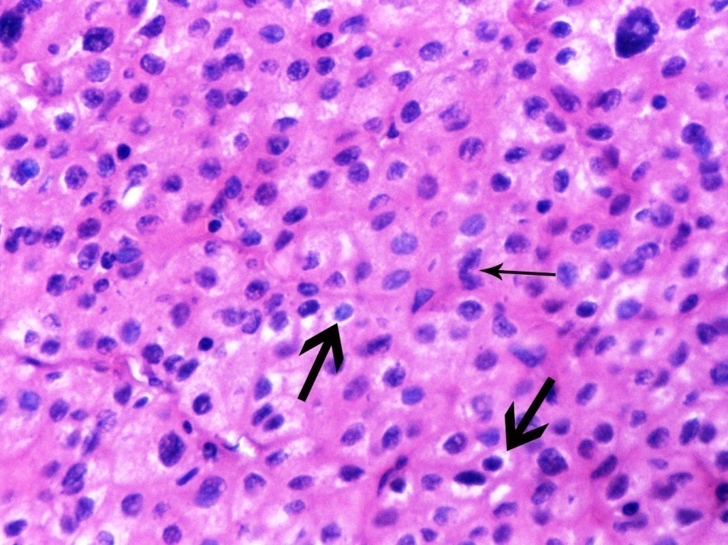
Chromophobe RCC
-Seperation between chromophobe and clear cell RCC is essential because of relatively indolent clinical behavior and significantly better prognosis of chromophobe RCC.
Sharply outlined plant-like cell membranes, voluminous, reticular, translucent to pale acidophilic cytoplasm and ‘raisinoid’ nuclei with perinuclear haloes favor the diagnosis of chromophobe RCC. The nuclei of both classic and eosinophilic types of chromophobe RCC tend to be similar.
The WHO/ISUP nuclear/nucleolar grading is not appropriate for chromophobe RCC.

Slide 14
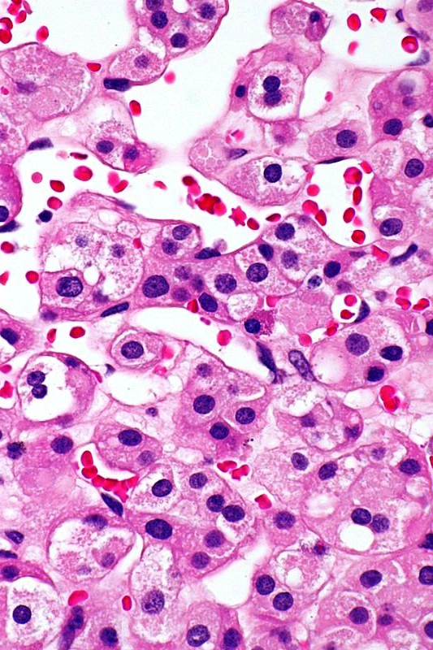
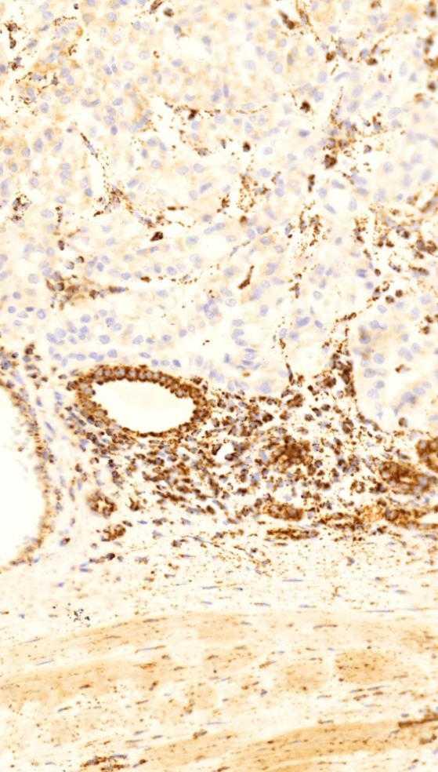
Chromophobe RCC should be distinguished from succinate dehydrogenase-deficient RCC, a rare tumor composed of vacuolated eosinophilic to clear cells with cytoplasmic vacuoles or flocculent inclusions, and defined by the loss of immunohistochemical expression of SDHB-a marker of dysfunction of mitochondrial complex II. Seventy five per cent of cases are uniformly low-grade, lack coagulative necrosis and have a favorable prognosis.
SDHB

Slide 15
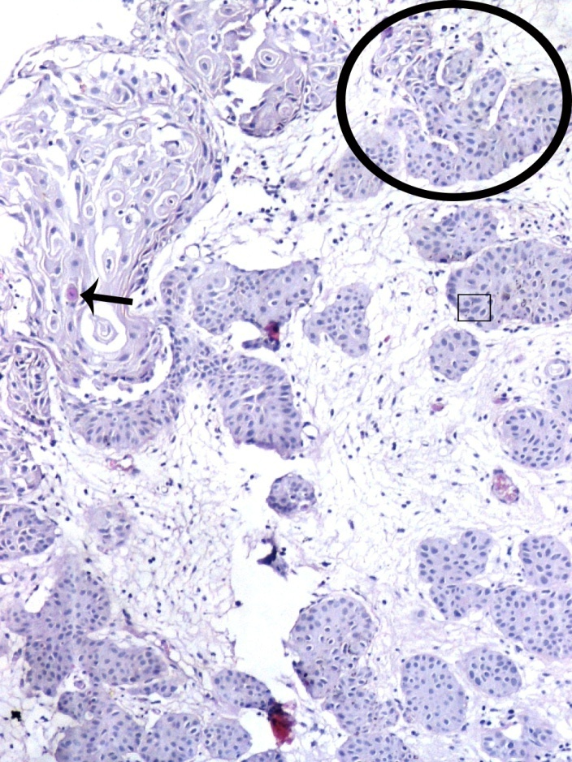
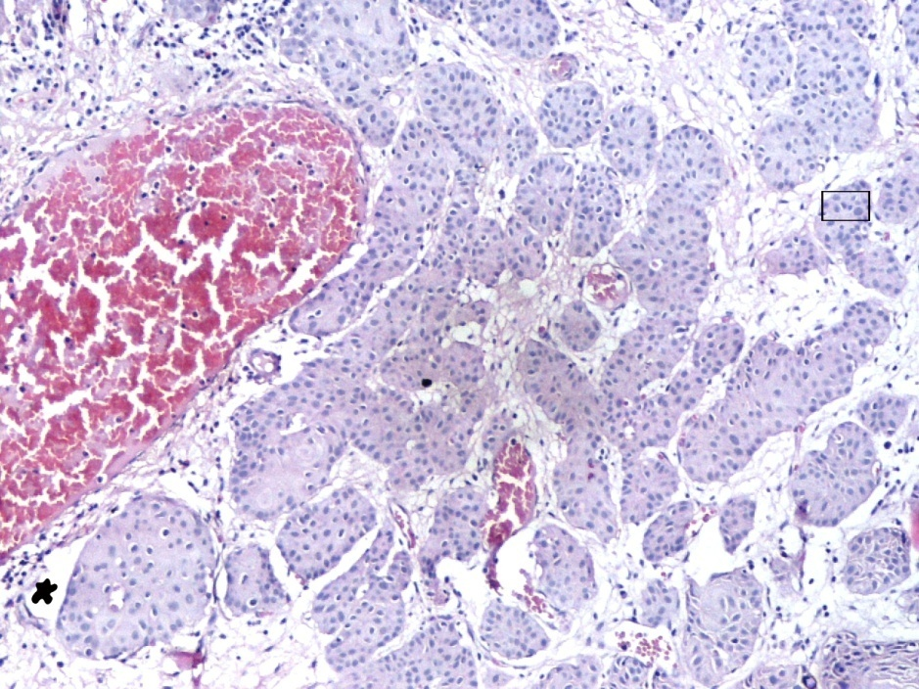
Urothelial carcinoma with an invasive nested type component. The nested type is a rare bladder tumor in which neoplastic urothelial cells are arranged in irregular and confluent small nests (ellipse) and abortive tubules composed of urothelial cells infiltrating the lamina propria or muscularis propria, usually without surface involvement. Tumor nests often have some degree of complex anastomosis, at least focally (ellipse). Most of the neoplastic cells are only slightly atypical but scattered anaplastic elements are found in every case (square frame). There is often more atypia and focal anaplasia with increasing depth of invasion. They tend to present with high-stage disease.

Slide 16
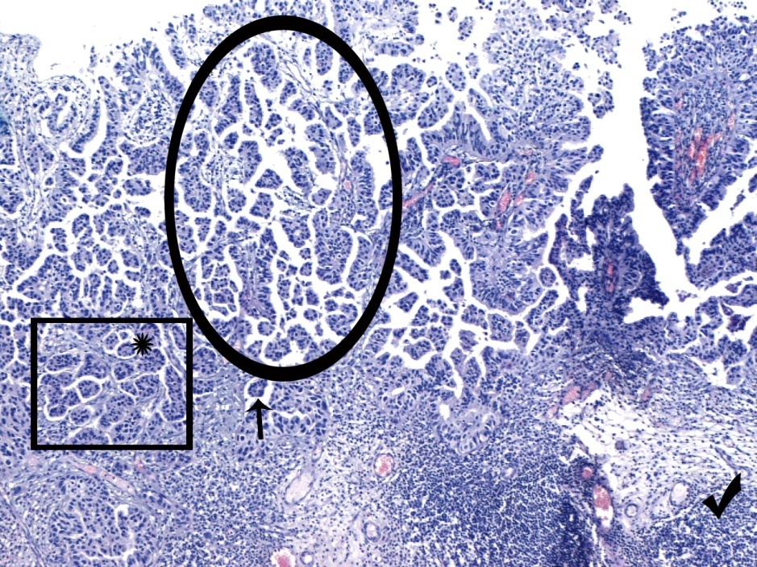
Micropapillary variant of bladder urothelial carcinoma, associated with increased risk of mortality. Delicate papillae, 1-4 cell layers thick, sometimes with thin stromal cores and numerous secondary micropapillae (hierarchical branching). There is a high association of the micropapillary variant of urothelial carcinoma with muscle invasive disease. Surrounding retraction artifact is prominent in this site of detrusor muscle invasion by small nests and micropapillae of malignant urothelial cells and should not be over-interpreted as vascular invasion; of course, this stromal retraction is immunohistochemically negative for CD31, CD34, and for D2-40.
Superficial
component
is not enough for the diagnosis of this variant
Invasive
component

Slide 17
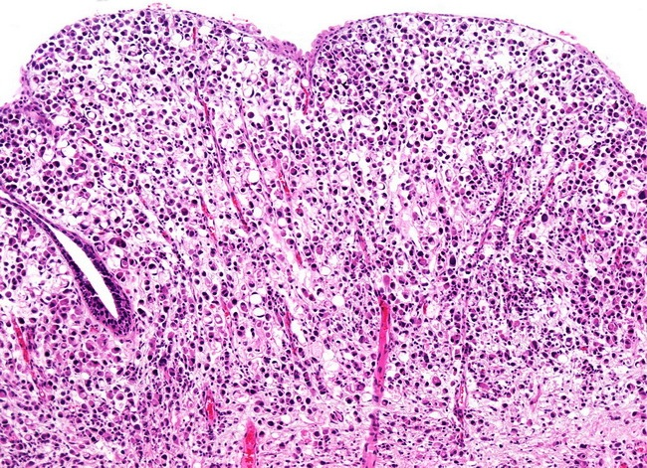
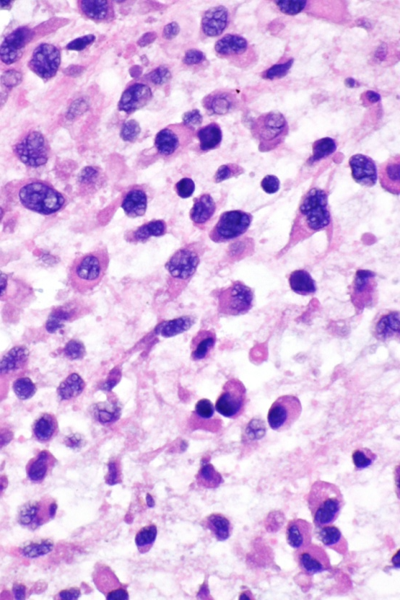
Plasmacytoid variant of urothelial carcinoma, composed of discohesive cells (frequently E-cadherin-immunonegative) that resemble plasma cells and/or monocytes and express cytokeratins, urothelial markers, and, apart from CD138(!), no other lymphoid markers. Advanced stage, high risk for peritoneal spread and positive margins at cystectomy, higher rates of recurrence and death by comparison to usual urothelial carcinoma.

Slide 18
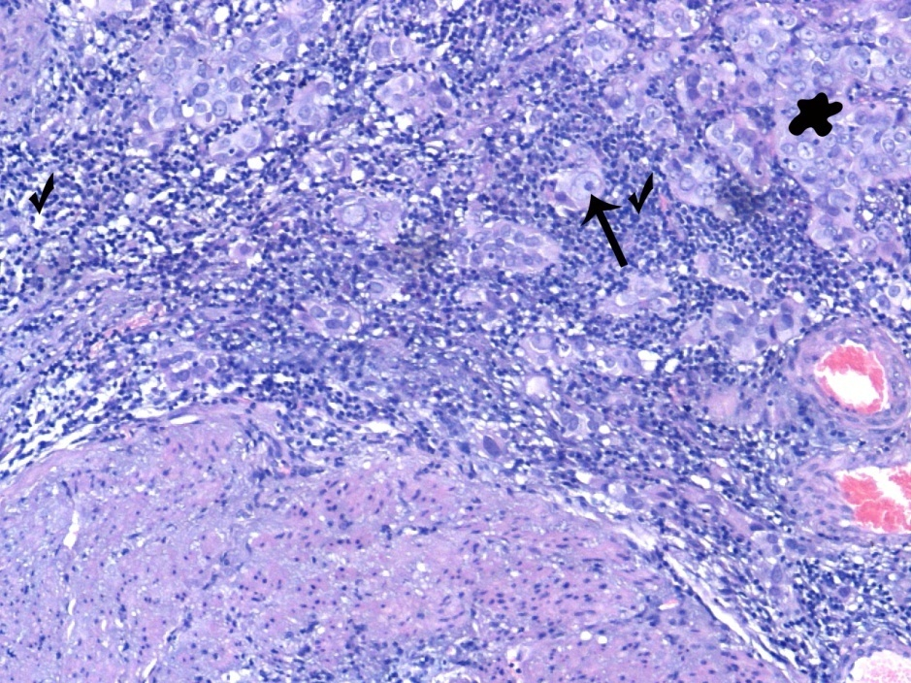
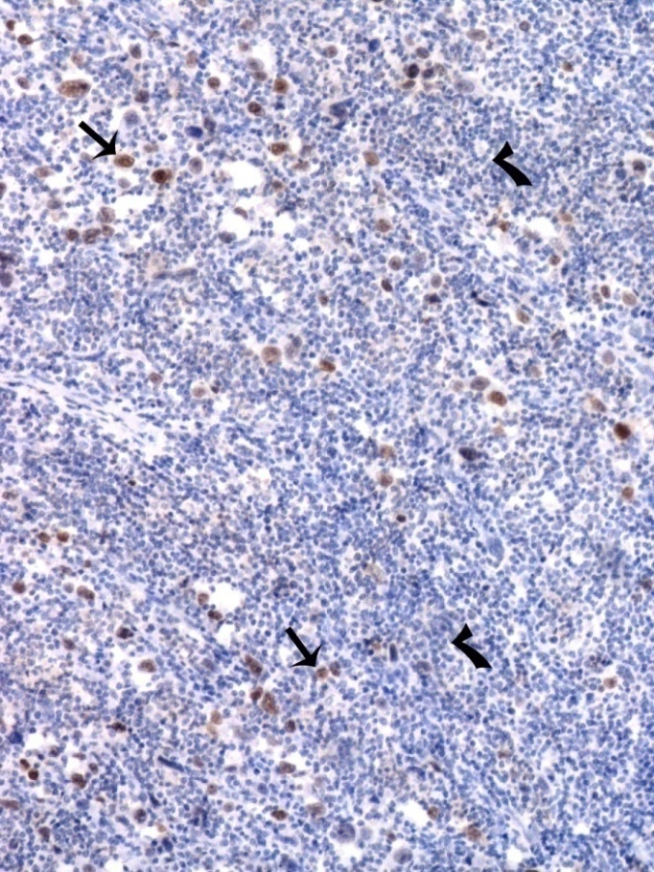
Lymphoepithelioma-like carcinoma of the bladder Undifferentiated tumor cells with indistinct, poorly defined cytoplasmic borders, in syncytial sheets (blob), nests or cords, often with minimal cytoplasm, large pleomorphic nuclei with prominent nucleoli, numerous mitoses, and the background consisting of a prominent lymphoid infiltrate. When lymphoepithelioma-like carcinomas occur in a pure form, they are more responsive to systemic chemotherapy than typical urothelial carcinoma, providing the potential to salvage bladder function. The lymphoepithelioma-like component should be >50% for the diagnosis of lymphoepithelioma-like carcinoma; however, the often co-existing urothelial carcinoma and urothelial carcinoma in situ makes the outcome similar to that of conventional urothelial carcinoma.

Slide 19
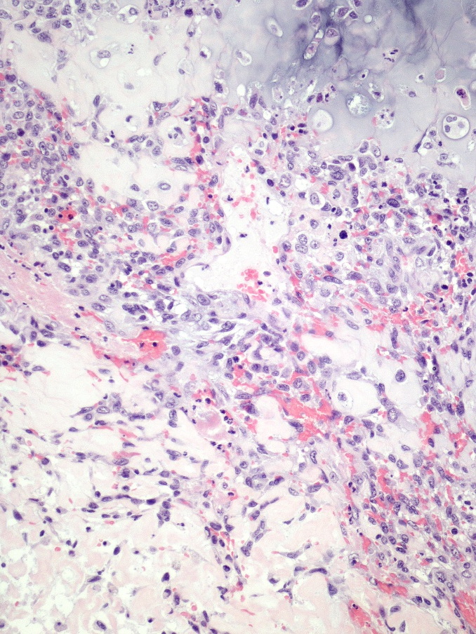
Osteosarcomas and chondrosarcomas are rare in the bladder and, when present, should prompt search for a carcinomatous component so that the diagnosis of sarcomatoid urothelial carcinoma is established. Nodal and visceral metastases are often present at diagnosis.

Slide 20
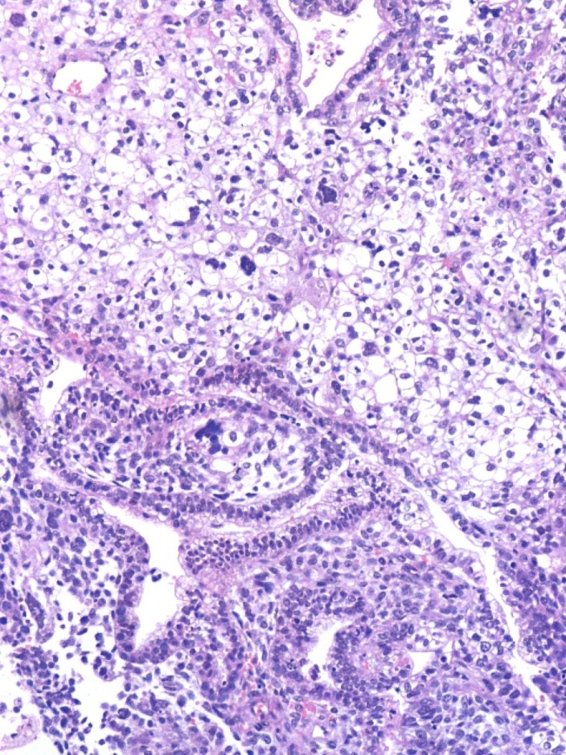
Clear cell carcinoma of the urinary bladder here with a tubulocystic pattern. Admixture of cells with clear or eosinophilic cytoplasm. Mixture of architectural patterns is common. High-stage such tumors are typically associated with a poor outcome; low-stage clear cell carcinomas, particularly with exophytic growth, may have a favorable outcome, if treated aggressively.

Slide 21
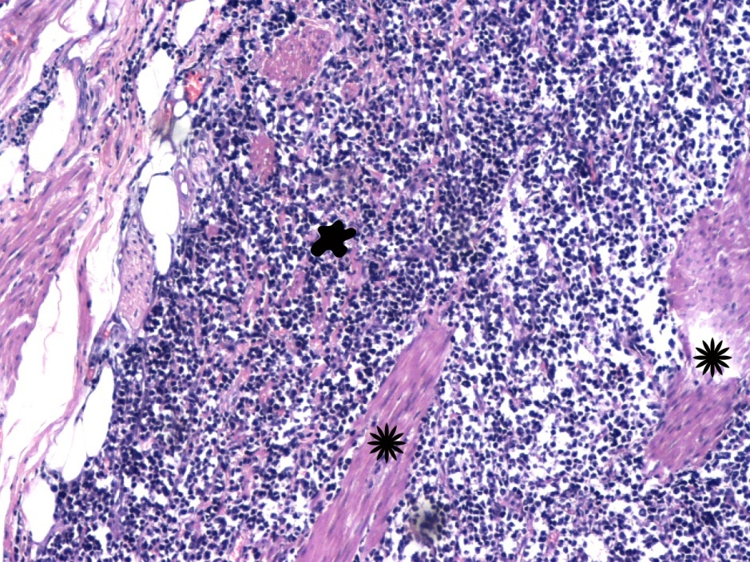
This highly aggressive, small-cell carcinoma is a malignant neuroendocrine neoplasm derived from the urothelium that mimics its pulmonary counterpart. Even a focal small cell component within a conventional urothelial carcinoma, should be reported.

Slide 22
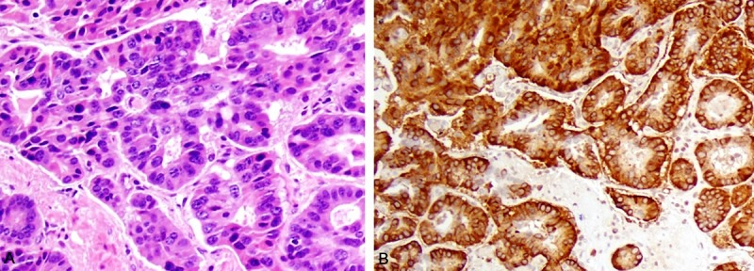
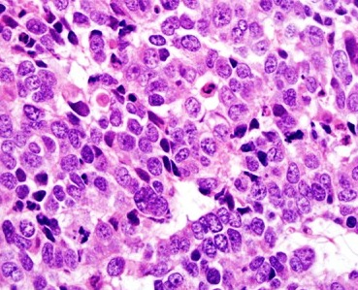
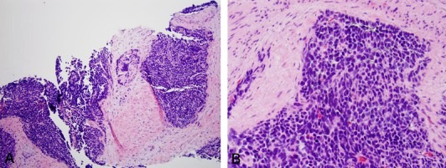
Basophilic areas of neuroendocrine differentiation within the prostatic acinar adenocarcinoma. Their presence is clinically evaluated by the oncologist for the patients’ treatment. Such areas can range from “carcinoid (when well-differentiated) to small cell or large cell (when poorly differentiated, lower images)” appearance, as distinct components (not just scattered cells) usually within an associated, conventional, intermediate to high grade, prostate acinar adenocarcinoma (upper images).

Slide 23
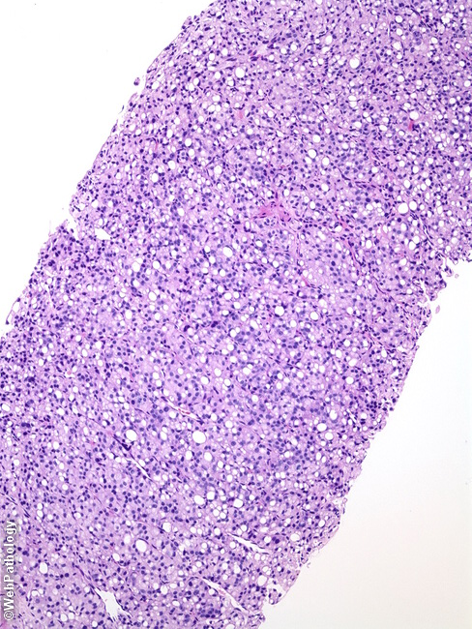
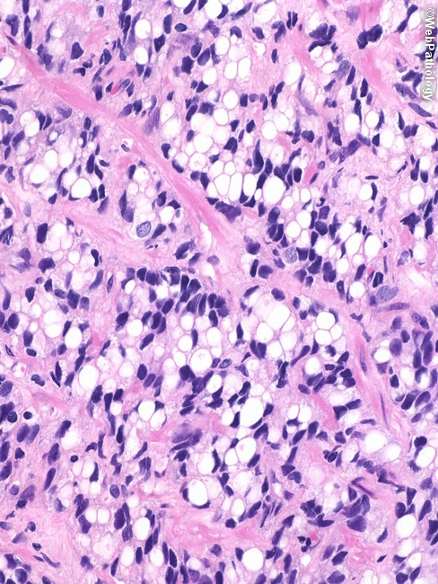
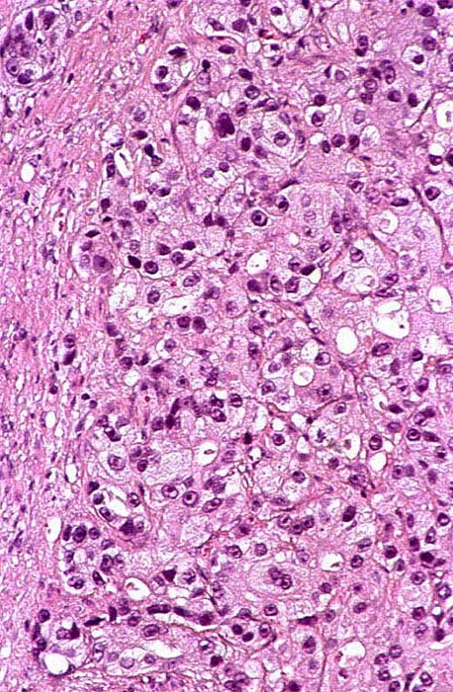
Signet ring-cell type carcinoma is a rare variant of prostatic adenocarcinoma , as a rule of high grade (Gleason scores 9 or 10) , with grim prognosis. It is generally agreed that at least 25% of the tumor should be composed of signet-ring cells for this classification. Most patients present at advanced clinical stages. Intracellular mucin is found only in rare cases in small quantities. For grading purposes, signet ring-like cells should not be confused with luminal /glandular differentiation of Gleason pattern 4.

Slide 24
Focal mucinous areas within a prostate acinar adenocarcinoma. Extracellular mucin is secreted in sufficient quantity to result in lakes. In prostate, the cut-off point of 25% has been used for the diagnosis of mucinous (colloid) prostatic adenocarcinoma; of course, this diagnosis can be made reliably only on radical prostatectomy specimens. This variant of prostate adenocarcinoma is associated with aggressive biologic behavior.

Slide 25
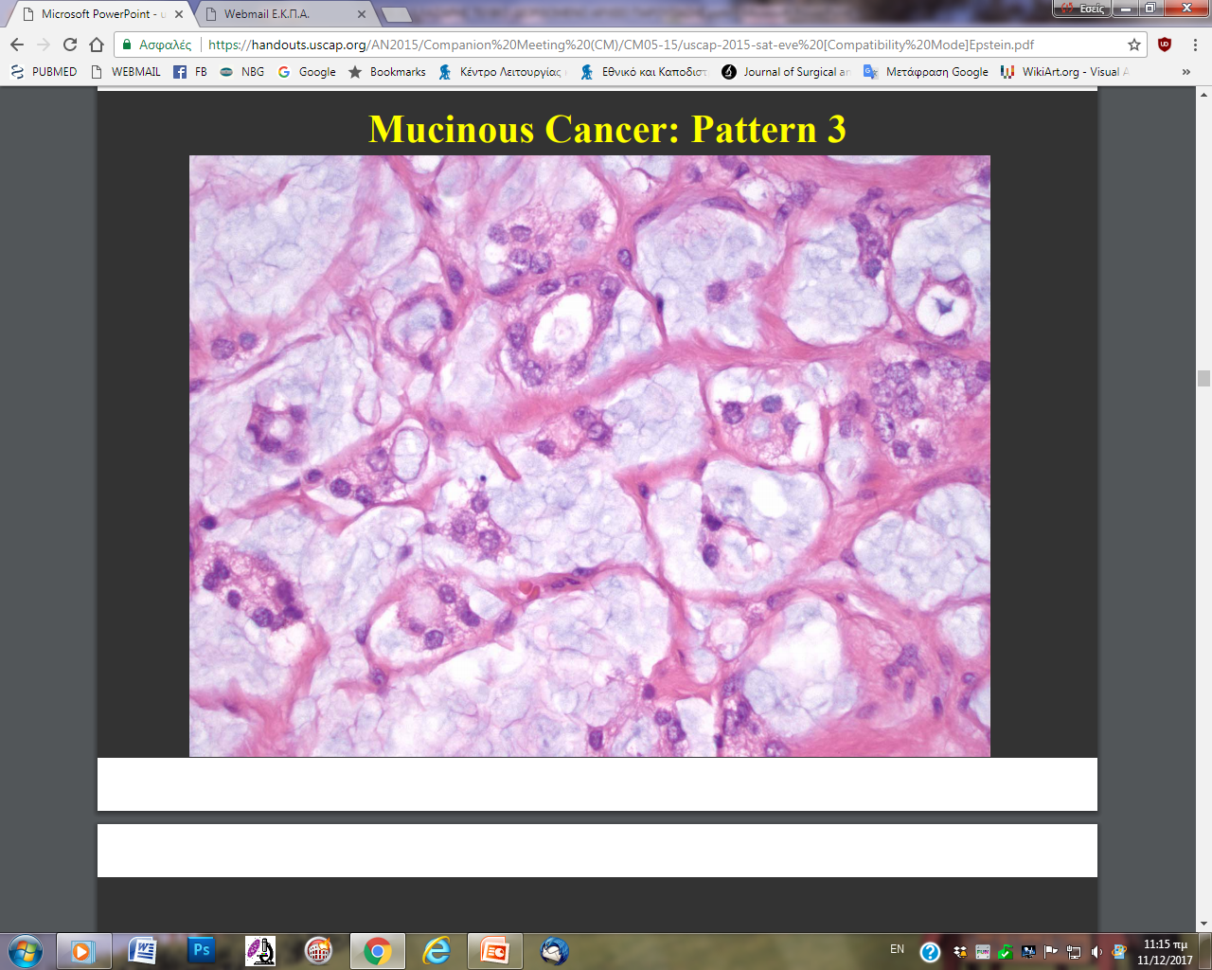
Mucinous variant of prostatic adenocarcinoma:
malignant glands within abundant extracellular mucin. For grading purposes, glandular configuration should be taken into account, disregarding the extracellular mucin.

Slide 26
Atypical intraductal proliferation / Intraductal carcinoma of the prostate gland Confluent, extensive, complex, cribriform structures of an intraductal carcinoma of the prostate gland. Intraductal carcinoma of the prostate is defined as a proliferation of prostate noncolumnar acinar/secretory carcinoma cells with round nuclei, which are already invasive elsewhere but here are within and may significantly expand the native prostatic ducts and acini, with the latters’ basal cell layer at least partially preserved; so, high grade Gleason pattern of acinar adenocarcinoma is excluded. We can understand the critical importance of seperating HG PIN from intraductal carcinoma of the prostate in needle biopsy. High grade PIN is less often associated with invasive disease, and by itself, of course has a better prognosis, since it constitutes an early event in prostate cancer natural history in contrast to intraductal carcinoma which constitutes a late event.

Slide 27
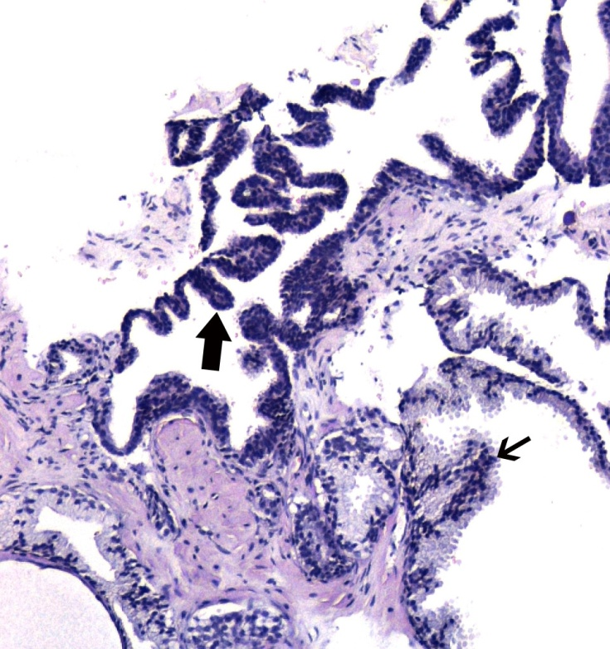
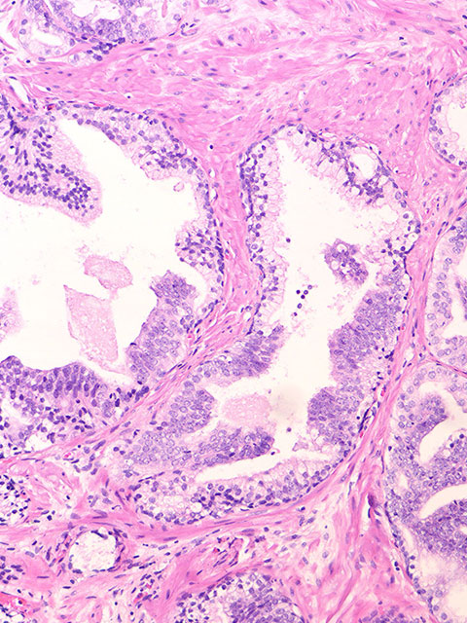
HG PIN Considerable amount of stroma, seperating glands of relatively simple architecture, with atypical acinar/secretory cells with round nuclei. Basal cells present (could be absent in small focus, though). Segmental glandular involvement and maturation phenomenon, possibly observed in HGPIN.

Slide 28
PIN-like prostate adenocarcinoma with acinar or ductal features, uncommonly present in pure form. The one with ductal morphology should be differentiated from traditional ductal adenocarcinoma due to differences in grade; it is assigned Gleason pattern 3 and has behavior akin to Gleason pattern 3 acinar adenocarcinoma .
Simple, non-cribriform/non-papillary, proliferation of many large infiltrating glands, often back to back, with flat, tufted or micropapillary architecture and nuclear stratification that closely mimics HGPIN. Lack of basal cells and frequent AMCR or ERG expression.
Double immunostain ERG-Ker34βE12

Slide 29
Traditional ductal adenocarcinoma of the prostate gland. Complex, cribriform, papillary and solid architecture. Columnar cells with cylindrical, ovoid nuclei (ductal morphology). Basal cells may be focally preserved without changing the diagnosis. Gleason pattern 4 or 5 (the latter,lower right image)

Slide 30
Large glands with ductal epithelium. Pay careful attention to architectural details to differentiate the relatively simple architecture of PIN-like ductal adenocarcinoma, Gleason score 3+3=6 (left image) from the more complex papillary architecture of traditional ductal adenocarcinoma of Gleason score 4+4=8 (right image).

Slide 31
Spermatocytic tumor of the testis (formerly known as spermatocytic seminoma)
Μean age at diagnosis : 55 years
Excellent prognosis after surgical excision (unless a sarcomatous component co-exists).
Evident diversity of neoplastic cells under microscopy. Three types of neoplastic cells.
No adjacent Germ Cell Neoplasia In Situ, not combined with any other germ cell tumour.

Slide 32
Basaloid squamous cell carcinoma of the penis. Increased metastatic potential. p16 immunohistochemical overexpression.HPV related lesion.

Slide 33
Basal cell carcinoma of the penile skin. A rare lesion. Lack of metastatic potential.

Slide 34
Warty – condylomatous carcinoma of the penis. Exophytic and papillomatous HPV-related tumor resembling typical condylomas with koilocytic atypia, but with clearly invasive features. Nodal metastasis is present in about 17-18% of cases.

Slide 35
Verrucous carcinoma of the penis Extremely differentiated keratinizing papillomatous and acanthotic neoplasm characterized by a broadly based pushing interface of tumour and stroma. No morphological or immunohistochemical evidence of HPV presence. METASTASIS DOES NOT OCCUR IN TYPICAL CASES.

Slide 36
Spindle-cell /Sarcomatoid squamous cell penile carcinoma. Biphasic tumor : spindle cell/sarcomatoid elements with marked nuclear pleomorphism and foci of squamous differentiation. Unfavorable prognosis.

Slide 37
www.hiponproject.eu
“ ICT e-modules on HistoPathology: a valuable online tool for students, researchers and professionals – HIPON ”
is a 3-year project supported and co-funded by the
Lifelong Learning Program
of the Education, Audiovisual and Culture Executive Agency,
The Commission of the European Union
(project reference number: 531203-LLP-1-2012-1-GR-KA3-KA3MP, Grant Agreement: 2012 – 4909 / 001 – 001, Key Activity 3- ICT Multilateral Projects)
HIPON’s principal aim:
Application of experiential learning principles in the field of Pathology,
namely, the integration of theory and practice
in Pathology
through experience-based
ICT learning activities.

Slide 39
The assimilation of theory through case studies in medical literature. A. C. Lazaris (ed.) CLINICAL GENITOURINARY PATHOLOGY: A Case-based Learning Approach. SPRINGER, Berlin 2018.

Slide 40
NEMANJA VUČKOVIĆ : Beskonačnost, 2017.

