Slide 1
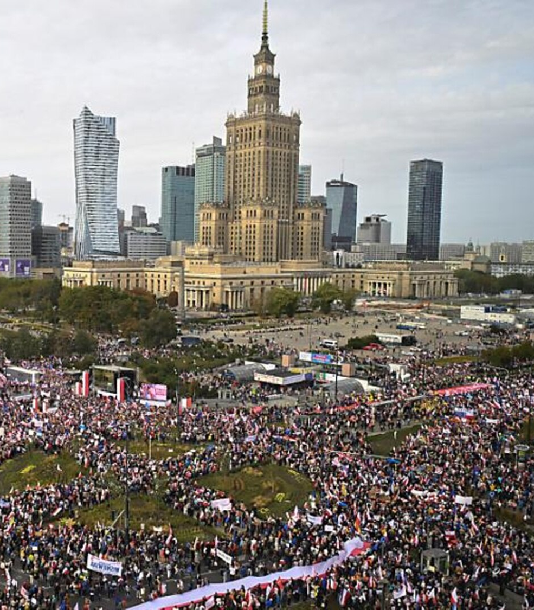
POLAND- EU Member
Laura Burzacchini
Johannes Gutenberg-Universität Mainz

Slide 2
Structure
History
Place on the Map & Factor of Size
Economy
Politics
Crises
Rule of Law Crisis
Russia-Ukraine War
Euroscepticism
Sources

Slide 3
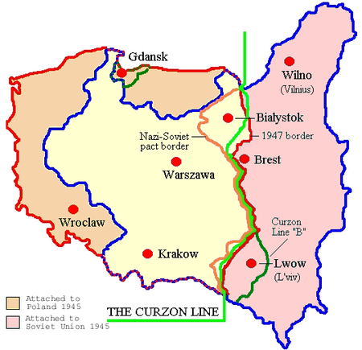
History
966 babtism of Poland
87.2% catholic
18th century partitions of Poland
123 years no sovereign polish nation
1918: Second Polish Republic, Józef Piłsudski
Suffering during 2. World War
Division and new borders
Polish people's Republic
Communist regime
Independent trade union Solidarność founded after strikes

Slide 4
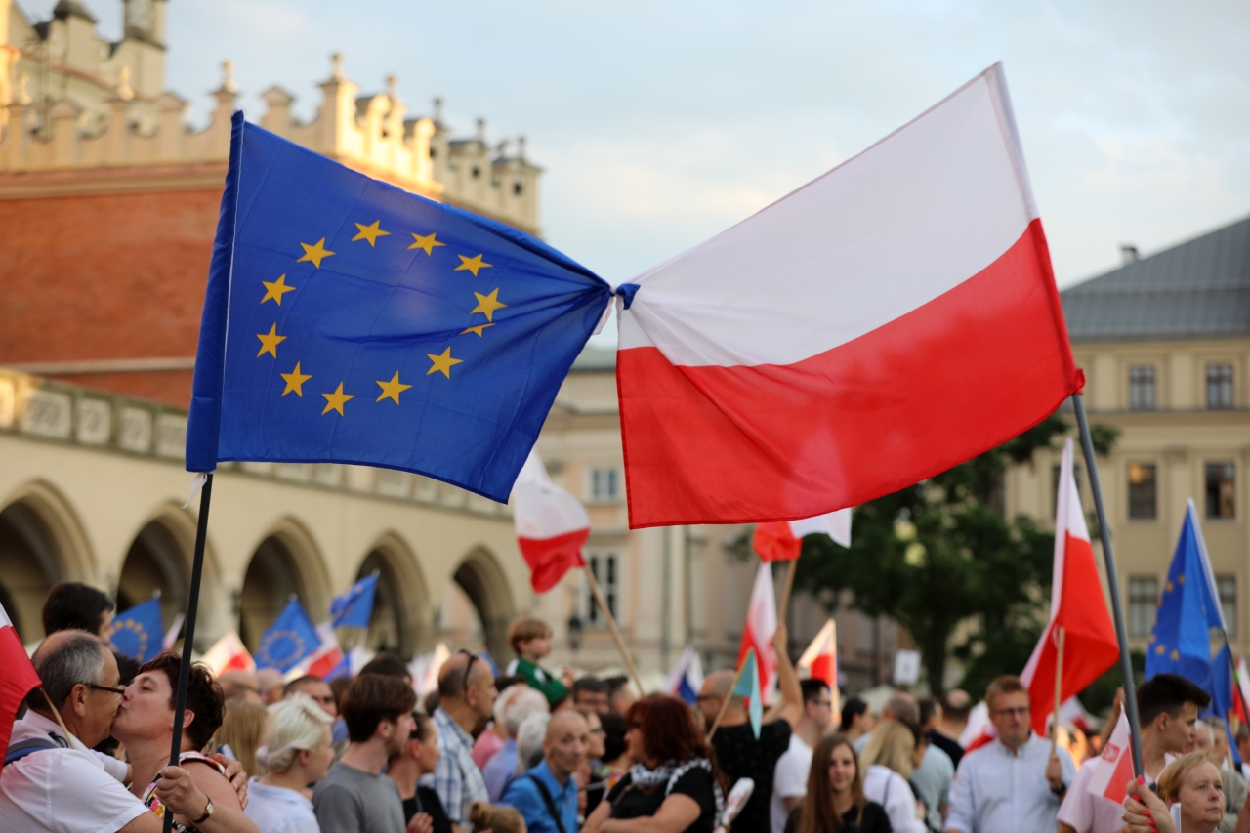
History
1989: Third Polish Republic
1991: warsaw pact ended
1994: Association agreement
Good relations with EU and US biggest foreign policy goal
Integration into western political, military and economic structures
2004: joined EU
Mostly economic reasons
Leaving soviet past behind

Slide 5
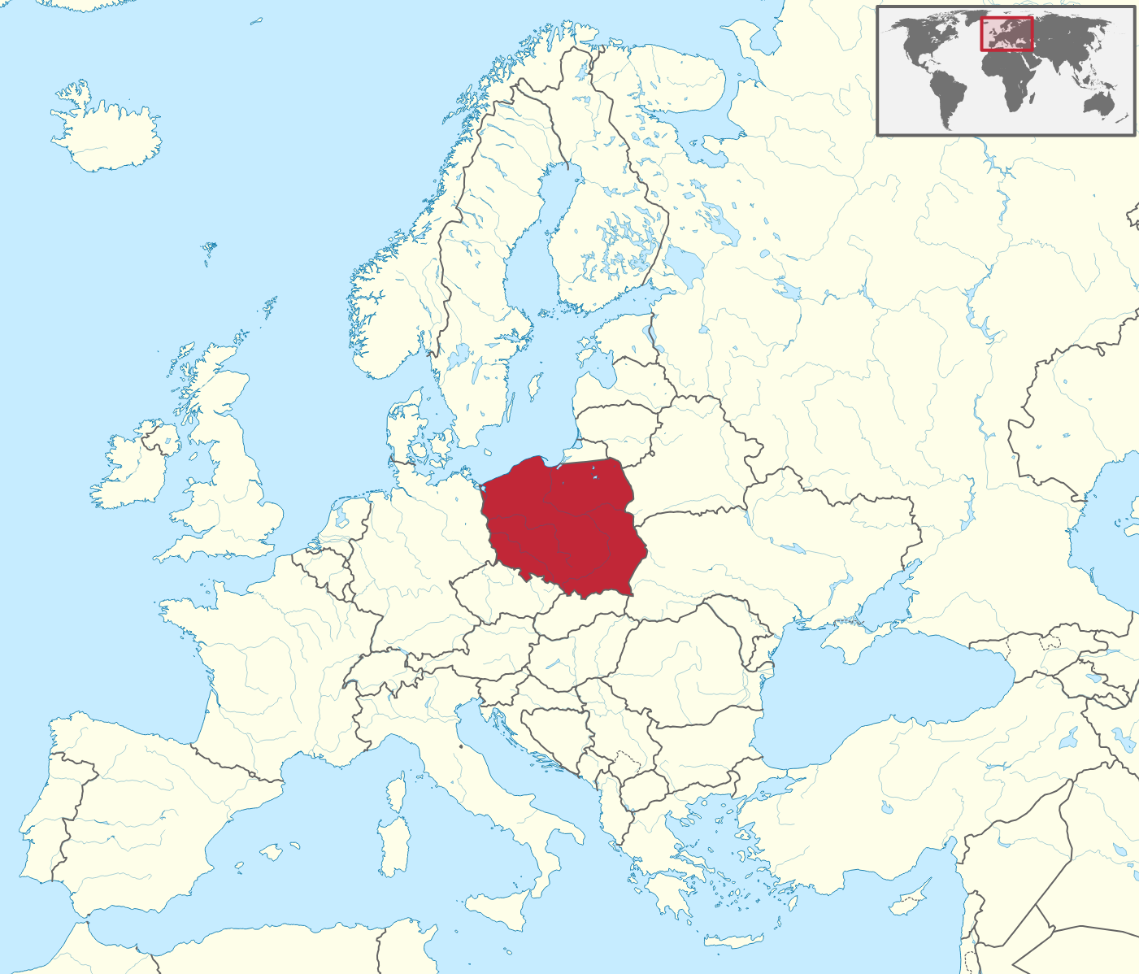
Place on the map & Factor of size
Capital: Warszawa
Between „east“ and „west“
External EU-border
Many neighbour states
Smallest of „big 5“
Population: 36.7 Mio
8.2% of European Population
Biggest of new members 2004

Slide 6
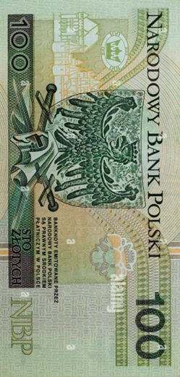
Economy
GDP per capita in PPS: 80
EU: 100
Trade partners
Exports: 75.3% EU
Imports: 66.9% EU
Unemployment: 2.9%
EU: 6.8%
Poland 2004: 19.1%

Slide 7
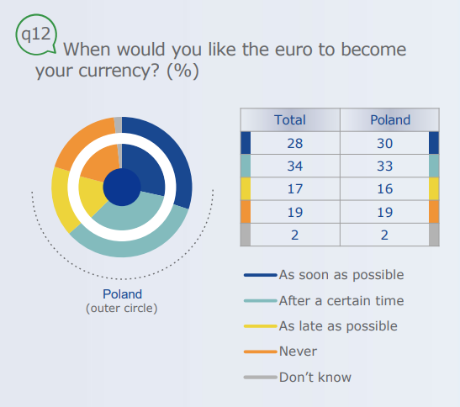
Economy – Euro?
Currency: Złoty
Adoption of Euro officially as soon as possible
Previous government against Euro
Different positions in current government
Nearly no impact during economic crisis of 2008 for Poland
Złoty popular
European Union, 2022.

Slide 8
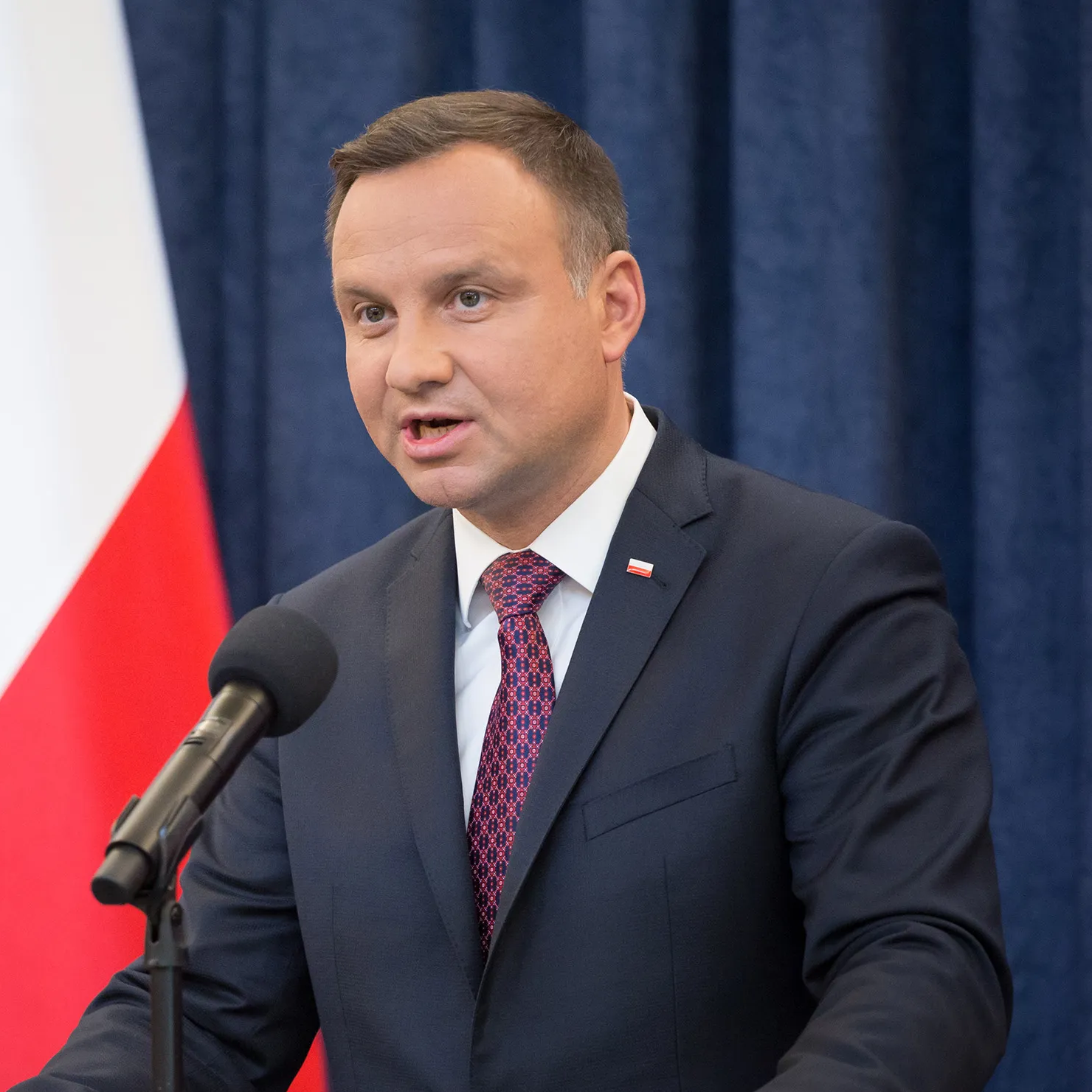
Politics
Parlamentary Republic
Senate and Sejm
President: Adrzej Duda
European Politics
„complicated member“
Blocked EU climate policy
2022: net receipt getting most money from EU (11.9 Billion)
Security interests
Europe of Homelands - rejection of modelling role of EU
Instrumental approach to EU
Adrzej Duda

Slide 9
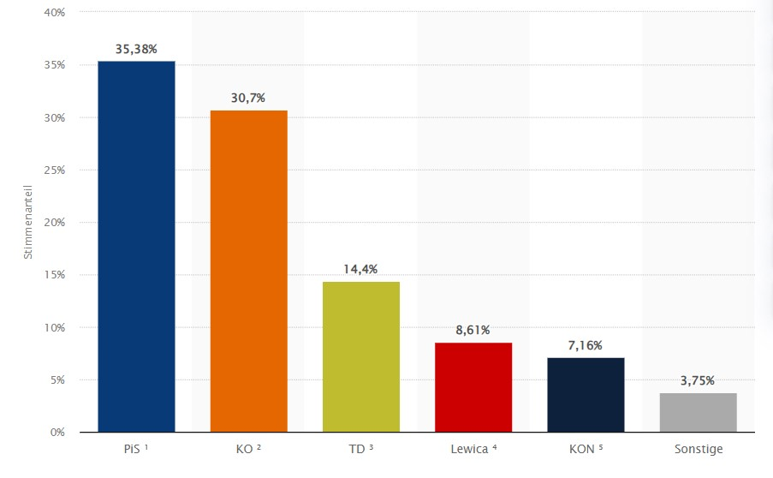
Politics – Recent Elections
15. October: elections of parliament
Additionally referendum about 4 questions
Turnout: 74,38%
New Prime Minister Donald Tusk (KO)
13. December sworn in
Ex-Prime minister Mateusz Morawiecki lost vote of confidence
Coalition between KO, TD and Lewica
Goals
Reciving blocked EU money, change free state media, imrove EU relations, change abortion law
Statista, 2024.
Law and Justice (Prawo i Sprawiedliwość, PiS)
Civic Coalition (Koalicja Obywatelska, KO)
Third Way (Trzecia Droga, TD)
The Left (Lewica)
Confederation (Konfederacja)

Slide 10
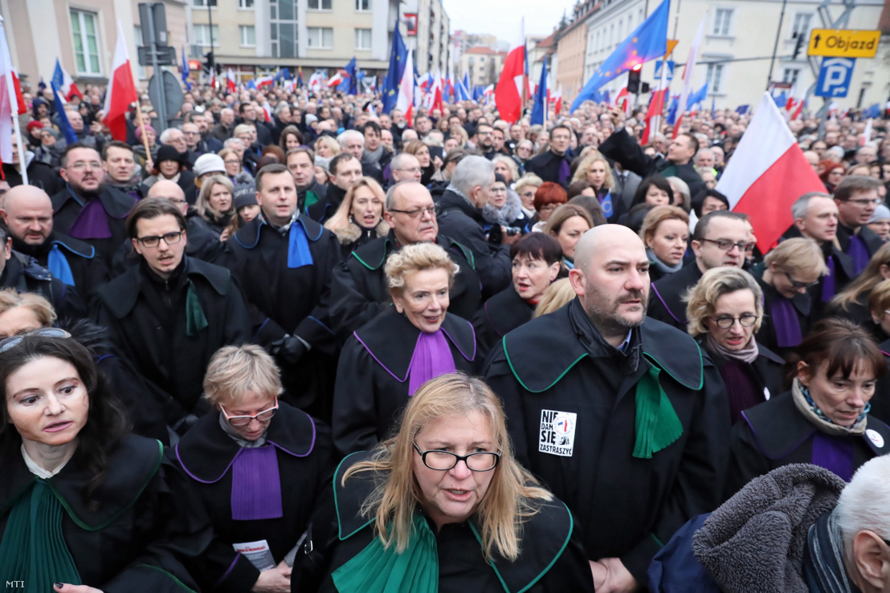
Rule of Law Crisis
Since 2015 PiS government trying to assert power over judiciary
Changed procedural rules
Government-friendly judges
Absence of judicial independence and seperation of power
Effective application of EU law complicated
European commission blocked EU development money
Judges in Warszawa, 2020

Slide 11
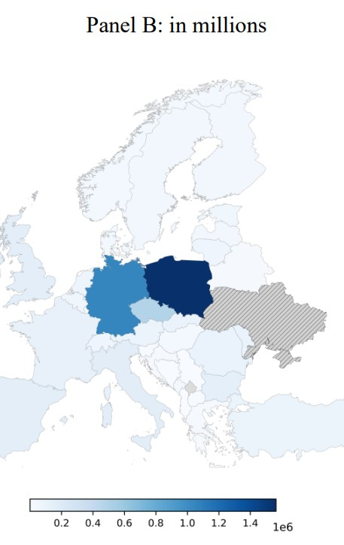
Russia-Ukraine War
Poland one of the biggest supporters of Ukraine
High humanitarian, financial, and military support
Civic support
High number of refugees in Poland
Economic impact
Russian energy – Poland taped down Russian supplies
Import bans on Ukrainian grain
Protection of polish agriculture
Historical, geopolitical and current interests
Refugees from Ukraine recorded across Europe as of January 31, 2023, in millions

Slide 12
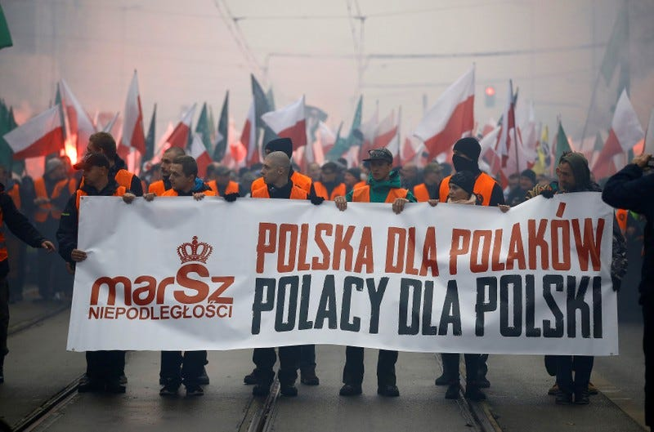
Euroscepticism
Hard euroscepticism :
‘Our country could better face the future outside the EU’
45% agree, 50% disagree
Second highest EU
Soft euroscepticism:
‘At the present time, things are going in the wrong direction in the EU’
35% wrong direction, 50% right direction
PiS soft eurosceptist party
New government pro-EU
Poland for the Poles - Poles for Poland
Eurosceptist demonstration in Warszawa, 2019

Slide 13
Sources
History
https://www.academia.edu/44073256/Baptism_of_Poland_in_966_introduced_the_country_into_a_new_cultural_reality_Maciej_Replewicz_PAP_rozmowa_z_prof_A_M_Wyrwa_Chrzest_Polski_2016_rozmowa_http
https://www.deutschlandfunkkultur.de/250-jahre-teilung-polens-100.html#:~:text=Polen%20wurde%20im%2018.,Nachbarn%20Russland%2C%20Preu%C3%9Fen%20und%20%C3%96sterreich.
https://www.visegradgroup.eu/basic-facts-about/poland/brief-history-of-poland
https://www.youtube.com/watch?v=VjKdtZiRSXg
New Government
https://www.politico.eu/article/poland-bye-to-pis-and-hello-to-donald-tusk/
https://www.csis.org/analysis/polands-election-could-transform-european-union
https://www.euronews.com/business/2023/10/24/what-will-polands-new-government-mean-for-the-eu-economy
https://www.deutschlandfunk.de/polens-parlament-beauftragt-tusk-mit-regierungsbildung-morawiecki-verliert-vertrauensabstimmung-100.html
https://visegradpost.com/de/2023/10/22/polen-die-gruende-fuer-die-wahlniederlage-der-pis/
https://www.tagesschau.de/ausland/europa/polen-regierungswechsel-102.html
https://www.deutsches-polen-institut.de/blogpodcast/blog/parlamentswahlen-und-landesweites-referendum-an-einem-tag-warum-ist-das-problematisch/
https://ukandeu.ac.uk/what-next-for-the-new-pro-eu-coalition-in-poland/
https://www.lemonde.fr/en/europe/article/2023/10/01/polish-opposition-rally-draws-a-million-protesters-to-warsaw_6142279_143.html
https://www.euractiv.de/section/europa-kompakt/news/neue-polnische-regierung-unter-tusk-koennte-eingefrorene-eu-gelder-freischalten/
https://de.euronews.com/my-europe/2023/10/16/polens-liberale-opposition-vor-regierungsubernahme
https://www.sueddeutsche.de/politik/polen-tusk-stellt-kabinett-vor-1.6317997
https://de.euronews.com/2024/01/02/so-will-donald-tusk-polen-wieder-auf-europaischen-kurs-bringen
Rule of Law crisis
https://www.theguardian.com/world/2020/jan/12/poland-march-judges-europe-protest-lawyers
https://judicature.duke.edu/articles/the-collapse-of-judicial-independence-in-poland-a-cautionary-tale/
https://www.deutschlandfunk.de/polen-umstrittene-justizreformen-102.html
https://www.bpb.de/themen/europa/polen-analysen/255589/analyse-das-polnische-justizwesen/
https://ec.europa.eu/commission/presscorner/detail/en/ip_17_5367
https://www.euronews.com/2019/12/17/time-is-fast-running-out-for-judicial-independence-in-pis-ruled-poland-view
EU
https://europa.eu/eurobarometer/surveys/detail/2971
https://www.pewresearch.org/global/2022/06/22/spotlight-on-poland-negative-views-of-russia-surge-but-ratings-for-u-s-nato-eu-improve/
https://tvthek.orf.at/history/EU-Entwicklung-Erweiterung/7735380/Das-neue-Europa-Polen/7717812
https://www.ardmediathek.de/video/onthisday/onthisday-eu-osterweiterung-01-05-2004/phoenix/Y3JpZDovL3Bob2VuaXguZGUvMzEyMzMwMw
https://www.bpb.de/kurz-knapp/hintergrund-aktuell/332227/10-jahre-arbeitnehmerfreizuegigkeit-fuer-die-eu-beitrittsstaaten-von-2004/
https://www.jstor.org/stable/25779367?seq=1
https://www.bpb.de/themen/europa/polen-analysen/257431/analyse-polen-in-der-europaeischen-union-konflikte-und-falsche-ansaetze/
https://osteuropa.lpb-bw.de/beziehungen-zur-eu-polen#c7489

Slide 14
Sources
Economy
https://economy-finance.ec.europa.eu/euro/eu-countries-and-euro/poland-and-euro_en#adoption
https://www.macrotrends.net/countries/POL/poland/unemployment-rate
https://europa.eu/eurobarometer/surveys/detail/2662
file:///C:/Users/user/Downloads/Introduction_euro_in_MS_not_yet_adopted_common_currency_FL_508_summary_en.pdf
file:///C:/Users/user/Downloads/Introduction%20of%20the%20euro%20in%20the%20Member%20States%20that%20have%20not%20yet%20adopted%20the%20common%20currency%20-%20Spring%202022_fact_PL_en.pdf
https://visegradpost.com/de/2023/01/14/der-euro-ist-fuer-polen-immer-noch-nicht-attraktiv/
https://ideas.repec.org/a/wsd/irgpim/v86y2011i2p39-66.html
file:///C:/Users/user/Downloads/9781616353810-ch012.pdf
https://www.polskieradio.pl/400/7764/artykul/3262743,polen-hat-seit-dem-eubeitritt-238-mrd-eur-erhalten
https://www.bpb.de/kurz-knapp/zahlen-und-fakten/europa/70580/nettozahler-und-nettoempfaenger-in-der-eu/
General
https://freedomhouse.org/country/poland/freedom-world/2022
https://www.deutsches-polen-institut.de/
https://shop.kohlhammer.de/politik-in-polen-34547.html#147=9
Climate Policy
https://www.climatechangenews.com/2023/10/18/polish-election-result-improves-prospects-for-eu-climate-ambition/
https://www.politico.eu/article/poland-challenge-eu-climate-laws-fit-for-55-before-european-union-court-justice-minister-anna-moskwa/
https://www.energymonitor.ai/green-deals/can-poland-dismantle-the-eu-green-deal-with-legal-challenges/?cf-view
https://www.energiezukunft.eu/politik/warum-sich-osteuropa-gegen-eine-klimaneutrale-eu-stemmt/
https://www.visegradgroup.eu/about/history
https://www.jstor.org/stable/pdf/10.5406/polishreview.62.1.0093.pdf?refreqid=fastly-default%3A6217673e7960a48911abbef4b608089c&ab_segments=0%2Fbasic_search_gsv2%2Fcontrol&origin=&initiator=&acceptTC=1
file:///C:/Users/user/Downloads/ceka-sojka-2016-loving-it-but-not-feeling-it-yet-the-state-of-european-identity-after-the-eastern-enlargement.pdf
https://journals.sagepub.com/doi/full/10.1177/1465116516631142
file:///C:/Users/user/Downloads/VoRKoniecznaSaamatinSawickaEUintheeyesofcatholicnationalistcircles05.pdf
Ukraine Russia War
https://apnews.com/article/ukraine-russia-war-grain-exports-poland-lithuania-7f522211115d06aab93359c5d963a996
https://www.bpb.de/themen/europa/polen-analysen/nr-292/508365/analyse-die-folgen-des-russischen-angriffskrieges-gegen-die-ukraine-fuer-polen/
https://www.ifw-kiel.de/fileadmin/Dateiverwaltung/IfW-Publications/fis-import/87bb7b0f-ed26-4240-8979-5e6601aea9e8-KWP_2218_Trebesch_et_al_Ukraine_Support_Tracker.pdf
https://www.dw.com/en/why-is-poland-no-longer-sending-arms-to-ukraine/a-66889180

Slide 15
Sources - Pictures
https://www.google.com/url?sa=i&url=https%3A%2F%2Ftime.com%2F4870632%2Fpolands-president-vetoes-controversial-judicial-laws%2F&psig=AOvVaw1wtnw7ifkxJLBuQTeug3pu&ust=1702391882470000&source=images&cd=vfe&opi=89978449&ved=0CBEQjRxqFwoTCMi41pbOh4MDFQAAAAAdAAAAABAI
https://en.wikipedia.org/wiki/File:Map_of_Poland_(1945)_corr.png
https://de.wikipedia.org/wiki/Parlamentswahl_in_Polen_2023#Gleichzeitige_Volksabstimmung
https://www.google.com/url?sa=i&url=https%3A%2F%2Fwww.spiegel.de%2Fausland%2Fpolen-massenproteste-gegen-rechte-pis-regierung-a-29849a7b-f00f-4383-9140-a2cf928b2188&psig=AOvVaw1C-wU4OPiiOsJxNZjXQeo0&ust=1702470038252000&source=images&cd=vfe&opi=89978449&ved=0CBEQjRxqFwoTCIicgKPxiYMDFQAAAAAdAAAAABAG
https://www.google.com/url?sa=i&url=https%3A%2F%2Fen.m.wikipedia.org%2Fwiki%2FFile%3APoland_in_European_Union_%2528-rivers_-mini_map%2529.svg&psig=AOvVaw3d0iW_yFSGYAlNztTkK90B&ust=1702470174472000&source=images&cd=vfe&ved=0CBEQjRxqFwoTCJC26-LxiYMDFQAAAAAdAAAAABAE
https://www.ifw-kiel.de/fileadmin/Dateiverwaltung/IfW-Publications/fis-import/87bb7b0f-ed26-4240-8979-5e6601aea9e8-KWP_2218_Trebesch_et_al_Ukraine_Support_Tracker.pdf
https://www.pewresearch.org/global/2022/06/22/spotlight-on-poland-negative-views-of-russia-surge-but-ratings-for-u-s-nato-eu-improve/
https://www.google.com/url?sa=i&url=https%3A%2F%2Findex.hu%2Fenglish%2F2020%2F01%2F29%2Fpolish_judiciary_interview_monika_frackowiak_dariusz_mazur_polish_judges_muzzle_law%2F&psig=AOvVaw3kIU2qnRwdUCcm9EgRat1a&ust=1702499616196000&source=images&cd=vfe&opi=89978449&ved=0CBEQjRxqFwoTCLDfvbzfioMDFQAAAAAdAAAAABAu
https://emerging-europe.com/wp-content/uploads/2017/09/bigstock-196660984-e1504879882346.jpg
https://www.insider.com/r-polands-eurosceptic-leaders-to-hold-joint-march-with-far-right-groups-2018-11

