Slide 1
HIPON IMAGES ON PROSTATE PATHOLOGY
Diagnosis of conventional acinar adenocarcinoma of the prostate. The small gland pattern.
Andreas C. Lazaris

Slide 2
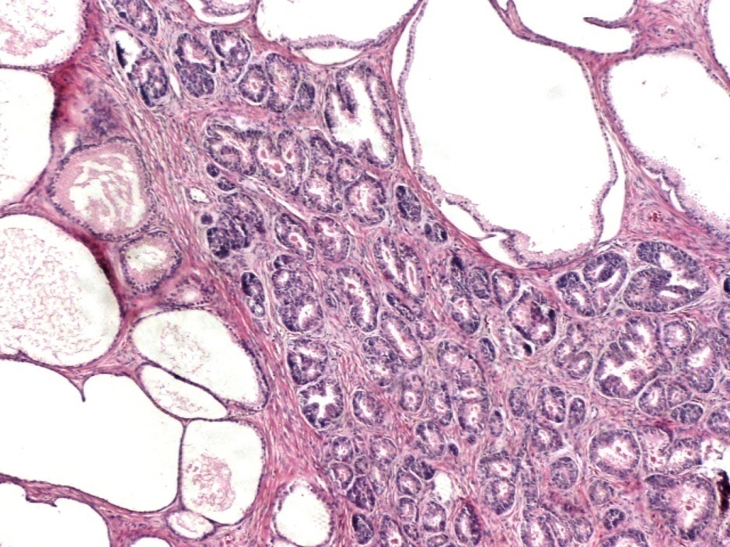
Gleason’s pattern 3 / Intermediate differentiation of prostate acinar adenocarcinoma: the commonest type of prostate cancer, under low magnification
Cancerous glands of small size (black arrows) surround bigger non-neoplastic glands (asterisks).
Small glands located between larger, cystically dilated ones (black circles). Despite the somewhat basophilic appearance of the small glands below -which though not characteristic of cancer, can be rarely noticed when malignant nuclei appear somehow stratified- their infiltrative architectural pattern is certainly indicative of cancer. Complete lack of basal cells can be immunohistochemically confirmed.

Slide 3
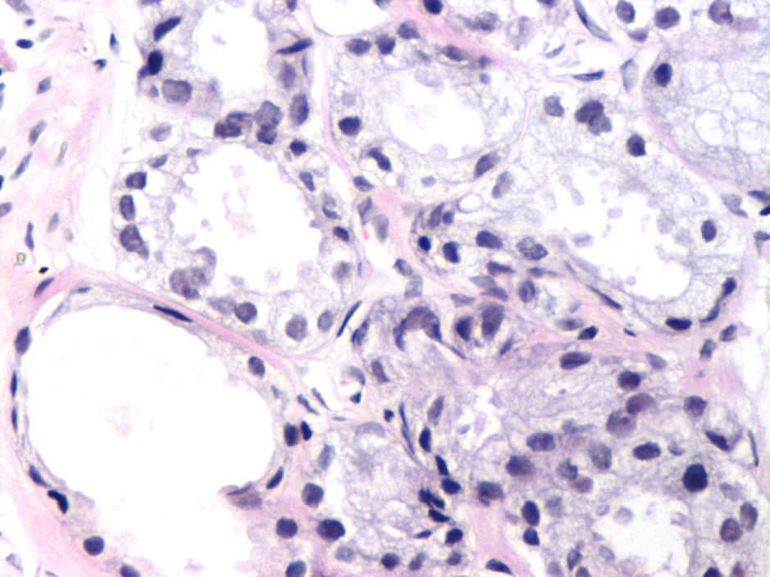
Usual appearance of cancerous prostate glands, under intermediate and high magnification
Abundant cytoplasm in cancerous glands (thin black arrows) as opposed to an adjacent, completely atrophic and thus basophilic, gland (asterisc)
Nuclear enlargement (red arrows) and hyperchromasia (purple arrows)
Sharp luminal borders in cancerous glands (green circles)
Thin, hyperchromatic , characteristically elongated nuclei of fibroblasts of prostate stroma (blue arrows), with basal “location”, mimicking basal cells of normal prostate glandular epithelium. Prostate cancer is entirely devoid of basal cells. The presence of fibroblasts in close proximity with cancerous glands can occasionally be confusing.

Slide 4
Cancerous glands, under high magnification, with abundant (here foamy) cytoplasm, surrounding two atrophic glands with basophilic appearance (purple asterisks). Note that in cancerous glands the abundant cytoplasm is mainly noticed over the nuclei, up to the sharp luminal border (thin black arrows) and not so much among the nuclei. A lateral location of cytoplasm with regard to nuclei is consistent with partial atrophy, a benign entity, often confused with cancer .

Slide 5
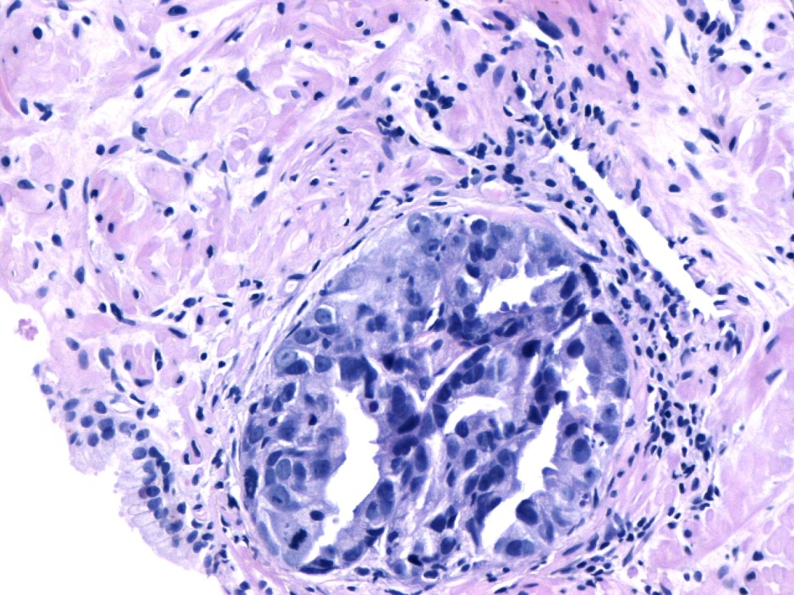
Malignant nuclei features under intermediate and high magnification
Prominent nucleoli, identifiable with the 10X lens [upper image (X 100 magnification), red arrows in both images]
Mitotic activity (yellow arrow)
Nuclear enlargement easily noticed when a comparison to adjacent normal prostate cells nuclei (green arrow) is possible.
Nuclear hyperchromasia (thin orange arrows)
Malignant cells’ features are better estimated when compared with features of normal adjacent prostate secretory/acinar (not basal) cells (green arrows).

Slide 6
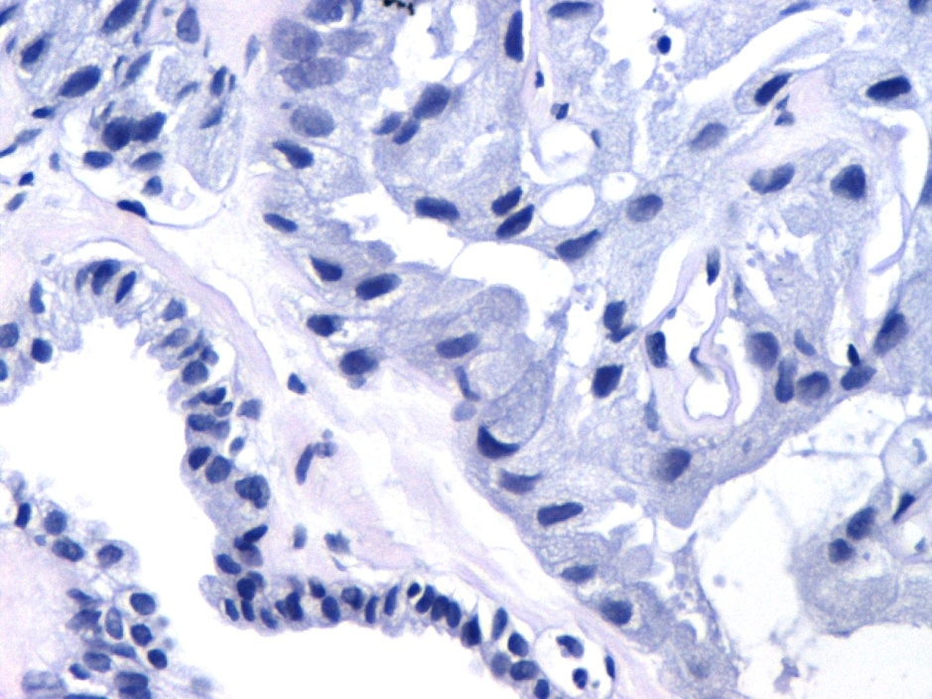
Evaluation of malignant nuclear features. AMACR (racemase) immunostaining of malignant glands/acini
Nuclear enlargement in cancerous cells (red arrows) can be properly evaluated when compared to the size of benign nuclei of neighboring secretory cells (green arrows) .
Specific AMACR (racemase) immunostaining (yellow double arrow) can be quite helpful in the confirmation of malignancy as far as ordinary, moderately differentiated acinar prostate adenocarcinoma is concerned .

Slide 7
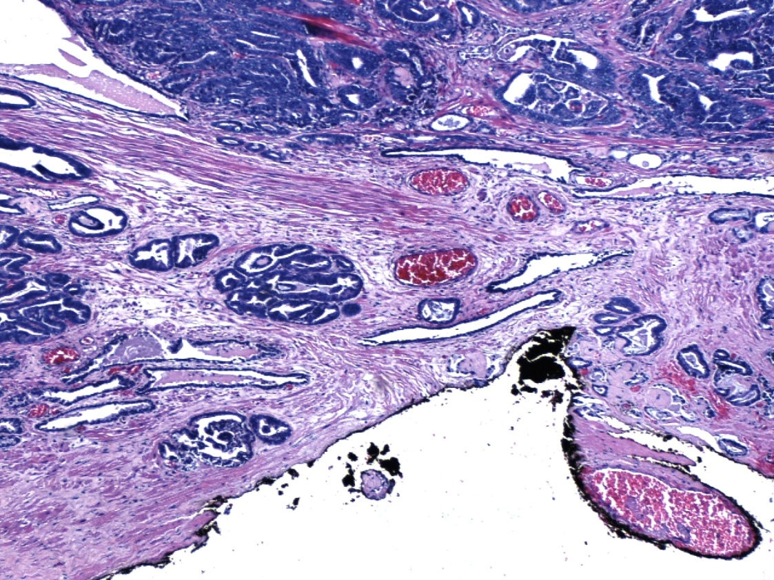
Cancer staging in radical prostatectomy specimens. Positive surgical margins but no evidence of extracapsular extension ( pT2 stage )
Cancerous glands in close proximity (red arrows) or direct contact (yellow arrow) with the inked surgical margin which in this case is identical to the prostate “capsule”.
Capsular invasion is quite common , but it should not be confused with extracapsular extension ie, infiltration of extraprostatic adipose tissue (pT3 stage)

Slide 8
Imminent extracapsular invasion of prostate cancer
Malignant prostate acini in direct contact with periprostatic adipose tissue ( thick blue arrows ).
Wispy blue-tinged mucin in the lumen of malignant glands (thin blue arrows) . A minor criterion in the diagnosis of prostate cancer.

Slide 9
Cancerous prostate glands, under intermediate and high magnification
Prominent nucleoli noticeable even in the X100 magnification (left image),
(red arrows pointing to a prominent nucleolus in both images)
Sharp luminal border (green circle)
Intraluminal crystalloids (blue arrows)

Slide 10
Cancerous glands adjacent to an atrophic gland
Abundant, amphophilic cytoplasm of cancerous glands (purple arrow) in contrast to the little amount of cytoplasm in the remaining basophilic basal cells (blue arrows) of an adjacent, benign gland with complete (simple) atrophy. In cancerous glands, the abundant cytoplasm is noticed over (and not among) the nuclei , up to the sharp luminal borders ( thin black arrows).
Intraluminal pink amorphous secretions in cancerous glands (pink asterisks)
Sharp luminal borders of cancerous glands

Slide 11
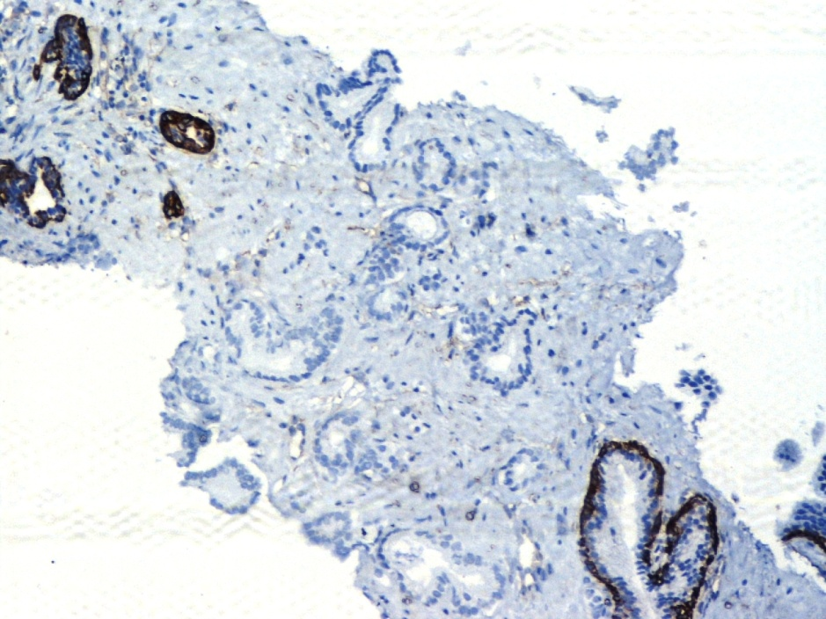
Prostate cancerous glands in needle biopsy material
Vertical orientation of cancerous glands (thin blue arrows).
Complete lack of basal cells in cancerous glands evidenced by negative immunostaining against high molecular weight cytokeratin (34βE12). Detection of basal cells in tumor-adjacent, benign glands, either normal with papillary infolding (blue circle) or atrophic (blue triple arrow).

Slide 12
Invasion of prostate fibromuscular stroma by cancerous glands. Stroma elements being interrupted by cancerous glands. Lack of stromal reaction is usual in acinar adenocarcinoma of the prostate.

Slide 13
Prostate cancerous glands
Nuclear enlargement and hyperchromasia
Sharp luminal border (green circles)
Pink amorphous secretion (pink arrow)

Slide 14
Circumferential perineural invasion (asterisks) by cancerous glands . A cancer–specific (pathognomonic) finding.

Slide 15
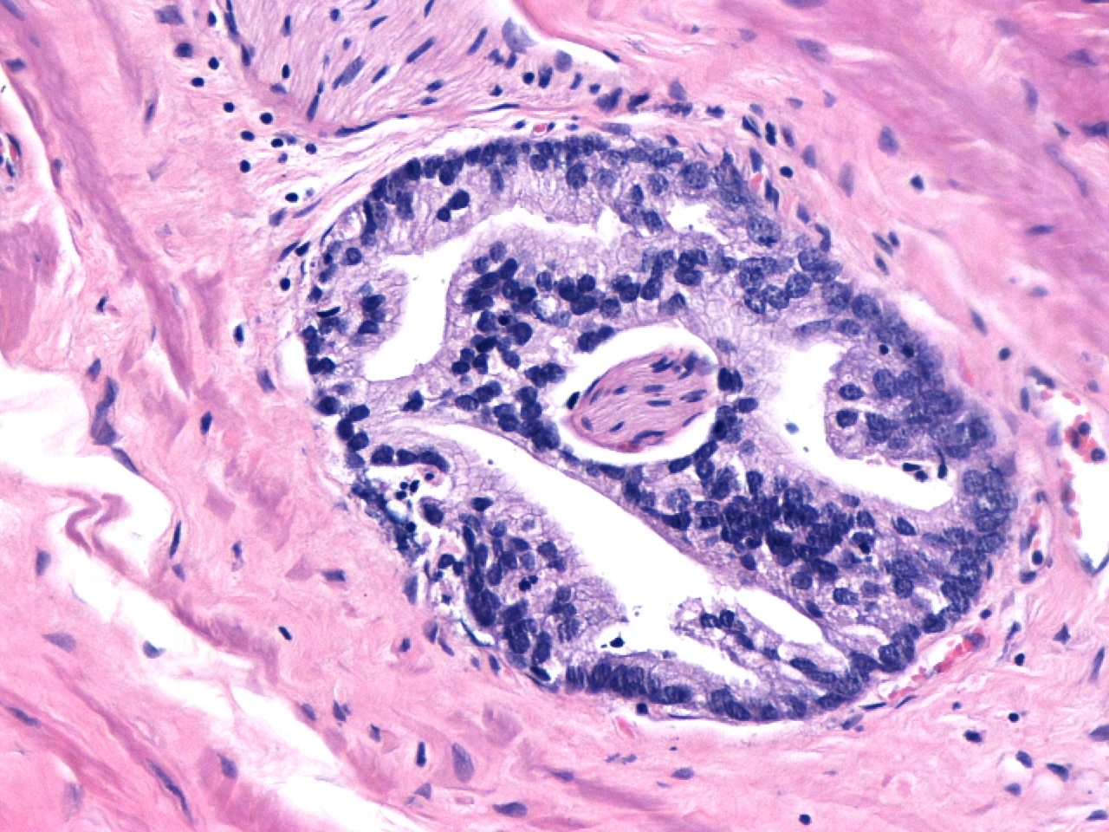
Circumferential perineural invasion (asterisk) by cancerous glands forming a cribriform gland of medium size.

Slide 16
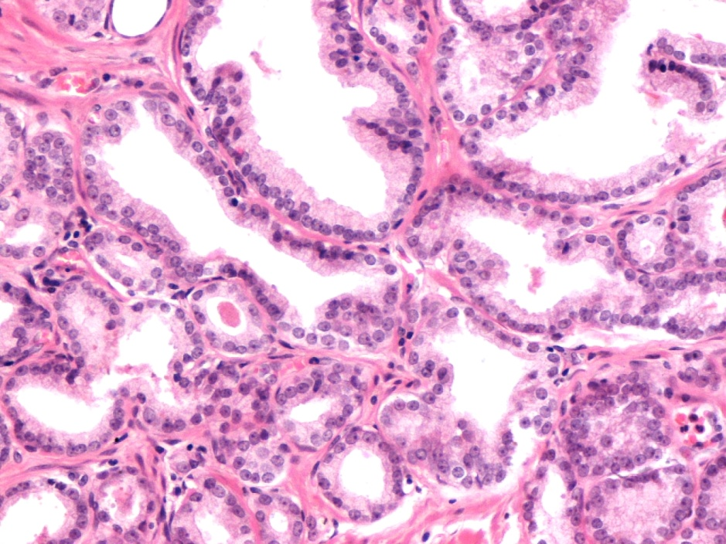
Well differentiated /low grade prostate acinar adenocarcinoma
Well – circumscribed nodule of small to medium sized, separate glands that do not infiltrate into adjacent tissue .
Relatively loose arrangement
(Gleason pattern 2)
Abundant pale cytoplasm of cancer cells (purple arrow) , a common finding in well differentiated acinar adenocarcinoma of the prostate.

Slide 17
Well differentiated / low grade prostate acinar adenocarcinoma. Crowded, separate glands.

Slide 18
Well differentiated/low grade prostate acinar adenocarcinoma with only minimal infiltration into adjacent prostatic parenchyme (pink asterisk). Presence of amyloid bodies (red arrows) in benign prostate glands with papillary infolding of their epithelium (blue asterisks).

Slide 19
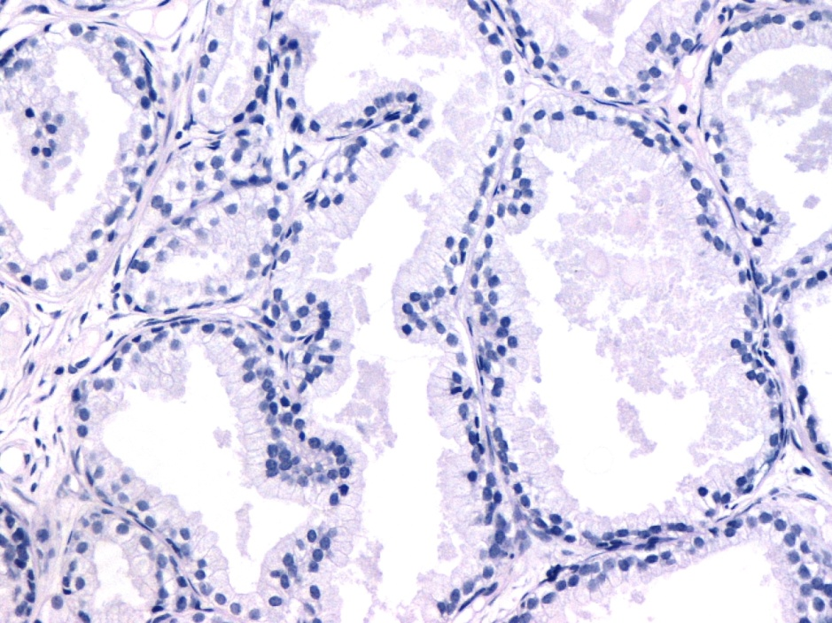
Atypical adenomatous hyperplasia-adenosis Differential diagnosis from well differentiated/low grade prostate acinar adenocarcinoma
Adenosis:
Small glands share cytoplasmic and nuclear features with admixed larger benign glands
No nuclear or nucleolar enlargement
Pale – clear cytoplasm.
Not so sharp luminal borders (asterisks)
Cancer :
Small glands differ from adjacent benign glands in cytoplasmic and/or nuclear features
Cytoplasm may be amphophilic.

Slide 20
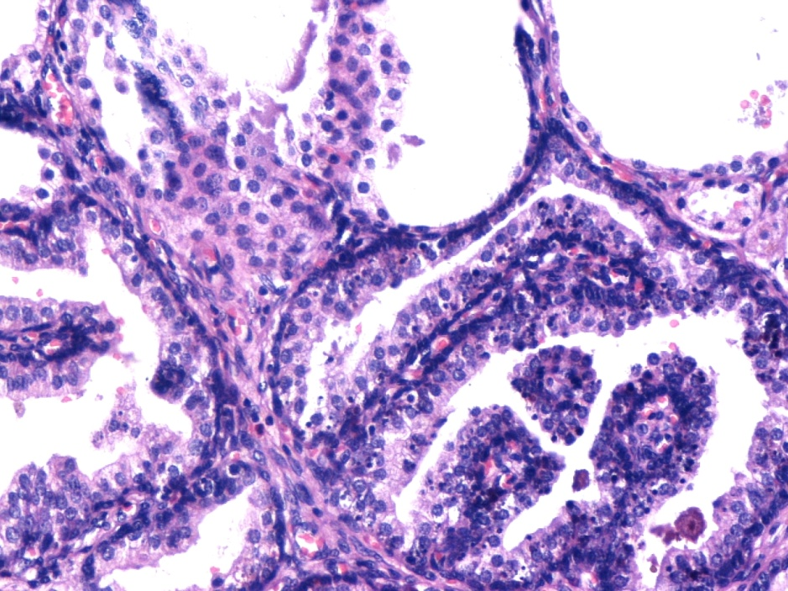
Atypical adenomatous hyperplasia-adenosis Differential diagnosis from well differentiated prostate acinar adenocarcinoma
Adenosis:
Small crowded glands admixed with similar, larger glands .
Glands with basal cells (blue arrows).
Cancer:
Frequently pure population of small crowded glands
Basal cells totally absent

Slide 21
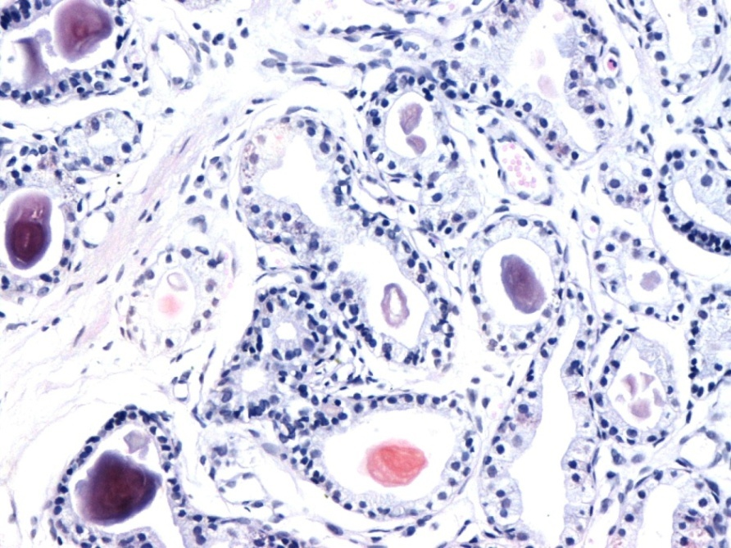
Verumontanum mucosal gland hyperplasia in biopsy material – Differential diagnosis from low grade prostate acinar adenocarcinoma due to small size and crowded nature of verumontanum mucosal glands
Lack of the infiltrative and haphazard arrangement
of glands typically found in the commonest type of prostatic acinar adenocarcinoma ( i.e., moderately differentiated).
Numerous dark staining bodies and distinctive orange concretions in the glands’ lumen .
Presence of basal cells ( thin blue arrow)

Slide 22
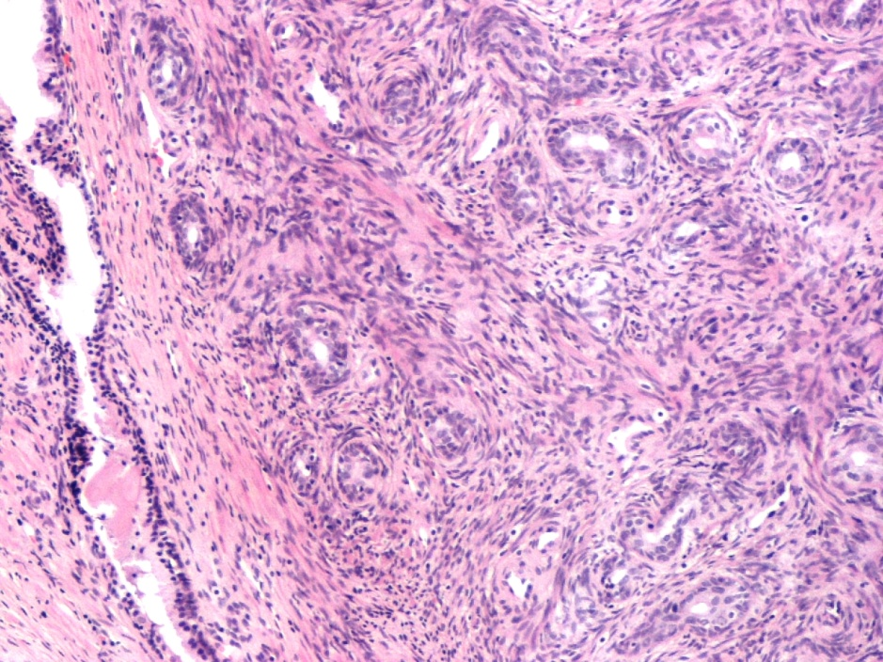
Sclerosing adenosis , a lesion commonly observed in surgical specimens
A nodular mixture of well-formed glands and possibly single cells within a cellular spindle cell component ( purple asterisks). An eosinophilic ring around some glands (circles) is supportive of this benign mimicker of cancer.
When there is some degree of nuclear atypia, immunopositivity of cytokeratin 34βE12 as well as smooth muscle actin (SMA) and S-100 protein in basal cells confirms the diagnosis of this benign lesion of the prostate.
In contrast, adenocarcinomas of the prostate usually show no apparent stromal response .

Slide 23
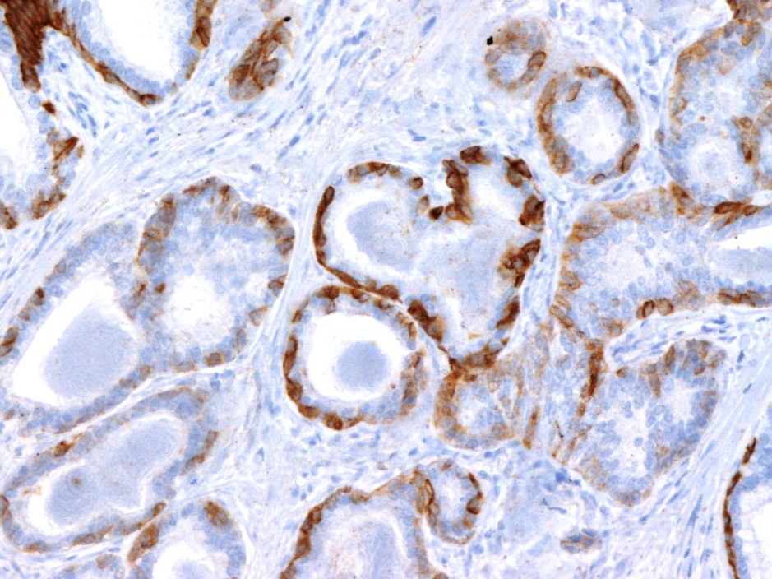
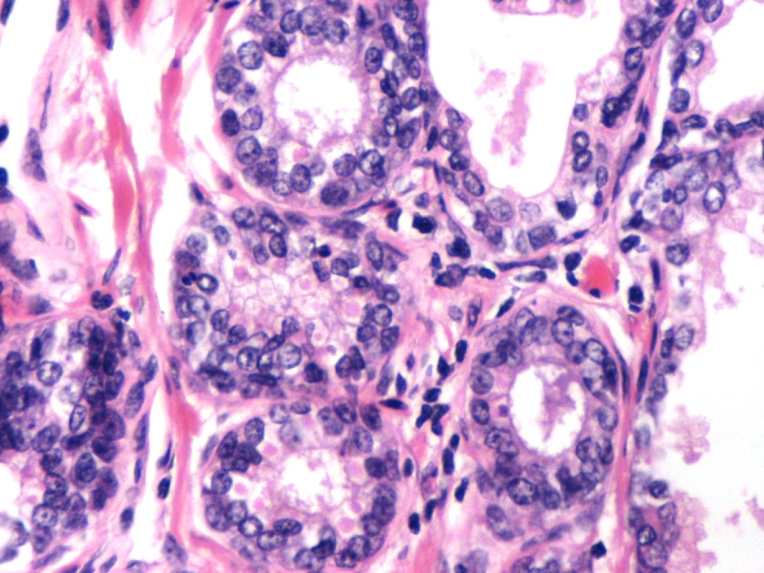
Basal cell hyperplasia. A lesion of the transition zone.
Basophilic appearance of small glands due to multilayering of the hyperplastic basal cells which have scant cytoplasm (blue arrows). Cancerous glands are rarely basophilic due to the generally sufficient or abundant cytoplasm of prostate acinar cancer cells.
Intermingling of glands of basal cell hyperplasia (purple asterisks) with normal prostate glands (yellow asterisks). A suspicious architectural pattern which possibly warrants immunohistochemical investigation. Immunohistochemical confirmation of basal cells by their positive staining for CK 34βΕ12.
CK 34βΕ12

Slide 24
A basophilic area of chronic active inflammation. Minimal nuclear atypia in prostate epithelial cells can be justified by inflammation. Numerous neutrophils ( thin arrows) among other, mononuclear inflammatory cells, mainly lymphocytes.

Slide 25
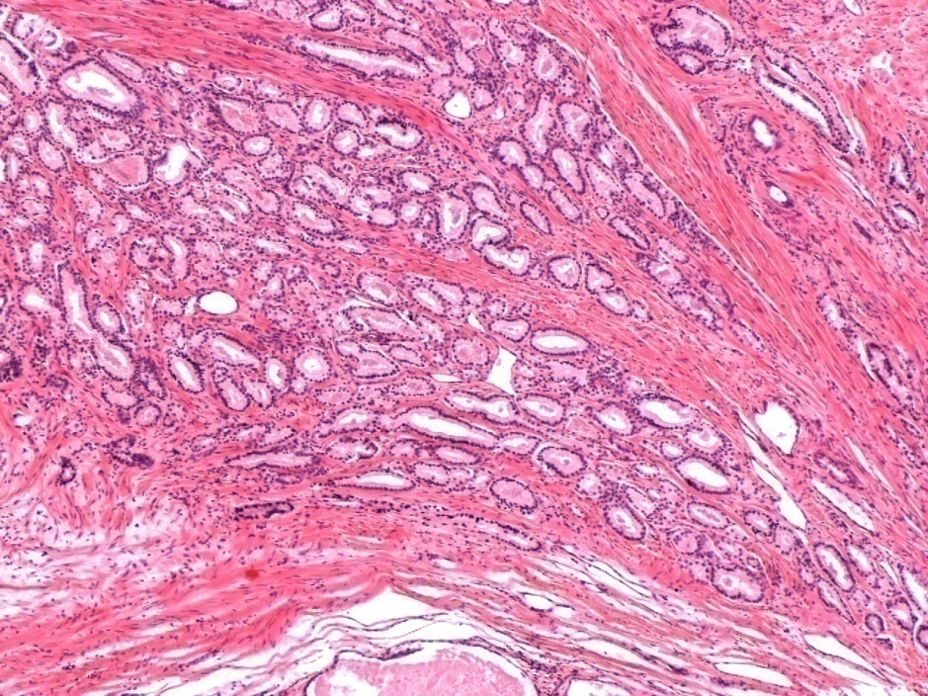
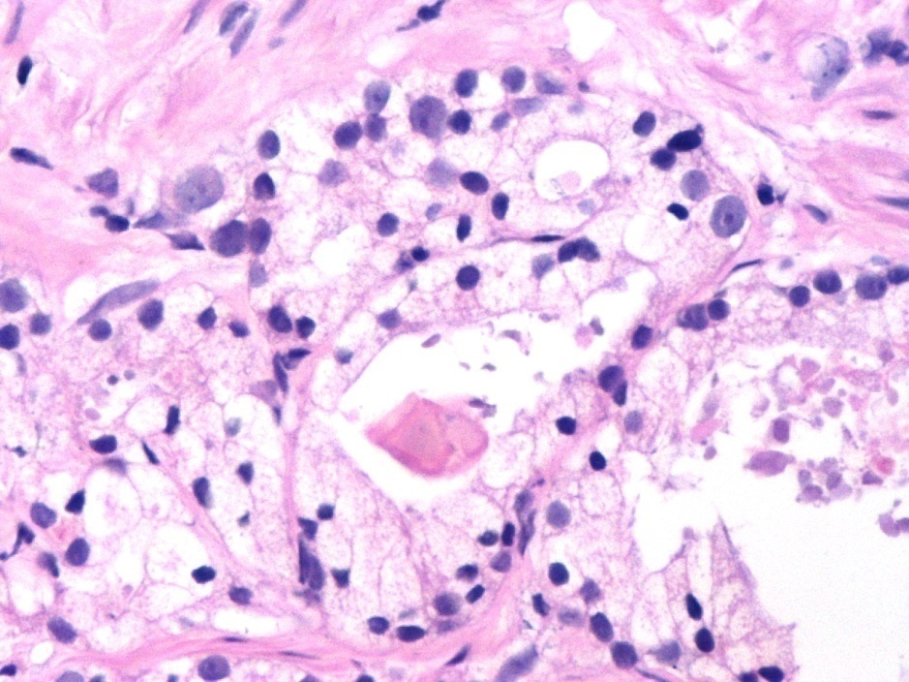
The diagnosis of moderately differentiated prostate carcinoma in transurethral resection specimens is primarily based on architecture: thick muscular bundles (pink asterisks) separate cancerous glands. Concomitant nuclear enlargement , visible nucleoli (blue arrows), pink amorphous secretions and intraluminal crystalloids (pink circles).

Slide 26
Intermediate and poor differentiation of prostate acinar adenocarcinoma
Cancerous glands on the upper half of the picture are separate.
( Gleason pattern : 3 , intermediate differentiation/grade , yellow asterisk)
The rest of the glands are obviously fused ( Gleason pattern : 4 , poor differentiation/high grade, red asterisks).

Slide 27
Poorly differentiated/high grade prostate acinar adenocarcinoma
Fused cancerous glands (red asterisks) invading prostatic parenchyme ( larger, benign glands with papillary projections , blue asterisks) .

Slide 28
Fused cancerous glands invading prostate fibromuscular stroma . Lumen barely noticeable. Gleason pattern 4 – Poor differentiation/high grade.

Slide 29
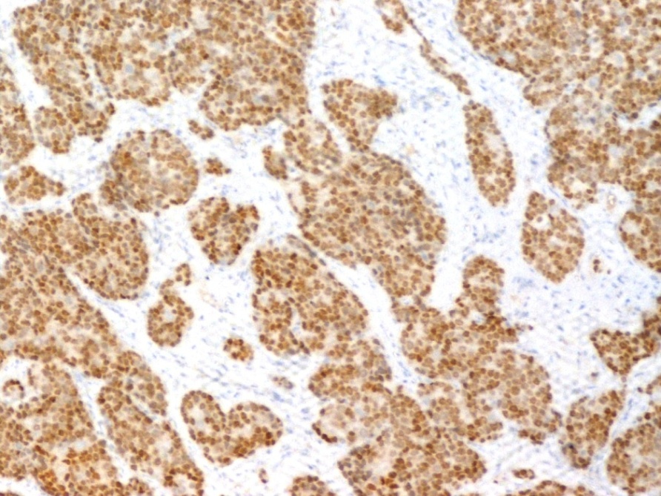
Solid cancerous structures. Gleason pattern 5 – Poorly differentiated/undifferentiated carcinoma. Immunohistochemical confirmation of prostatic origin [ PSA, PSMA and androgen receptor (AR) positivity] is frequently necessary , especially in metastatic sites.
PSMA
AR

Slide 30
Prostate cancer : focal mucinous areas. Extracellular mucin secreted in sufficient quantity to result in pools.

Slide 31
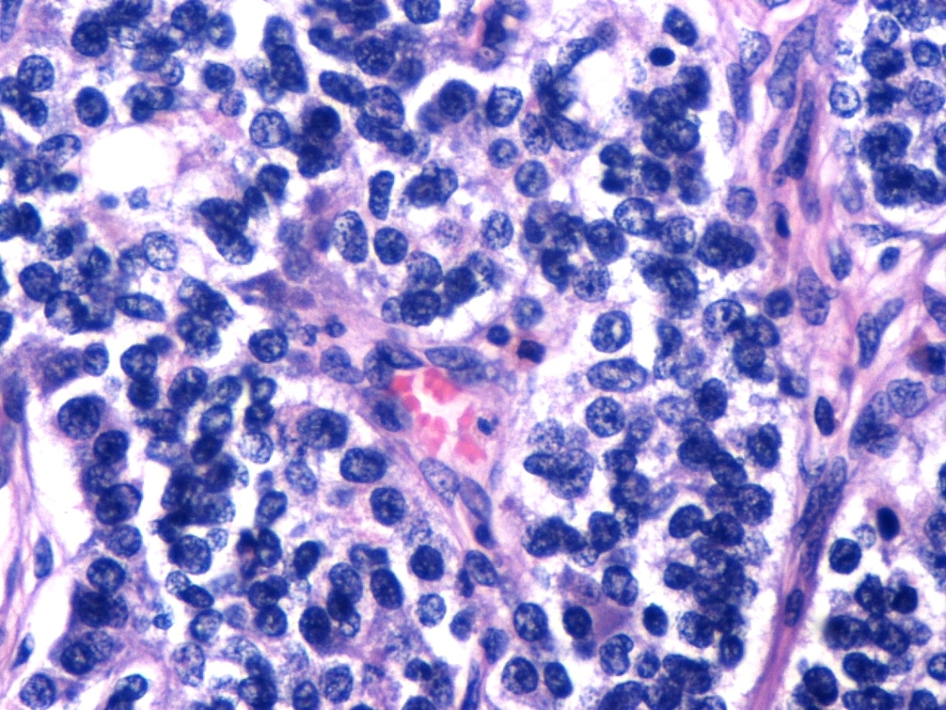
Neuroendocrine differentiation in prostate cancer
Area of neuroendocrine differentiation with a “carcinoid” appearance (brown arrows) within a poorly differentiated/high grade prostate carcinoma .
Chromogranin immunopositivity confirms the neuroendocrine differentiation of a cancer cell subpopulation.
Chromogranin

Slide 32
The supplementary role of immunohistochemistry in the diagnosis of prostate cancer. High Molecular Weight Cytokeratin (CK34βΕ12 or CK5/6) immunoreactivity in basal cells of non cancerous prostate glands.

Slide 33
Complete absence of basal cells in cancerous prostate glands (red arrows). Totally negative immunostaining for basal cell markers in infiltrating cancerous glands i.e., high molecular weight CK and nuclear marker p63 .
CK 34βΕ12
p63

Slide 34
Intense specific immunostaining of racemase (AMACR) in cancerous glands with simultaneous negative expression in non malignant, adjacent gland.

