Slide 1
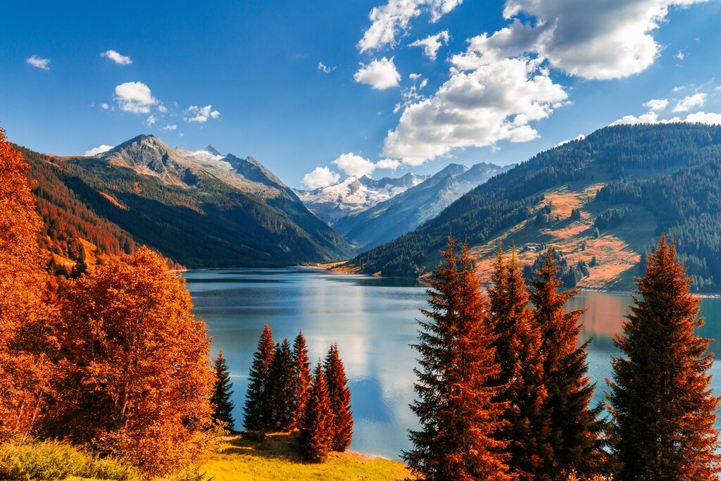
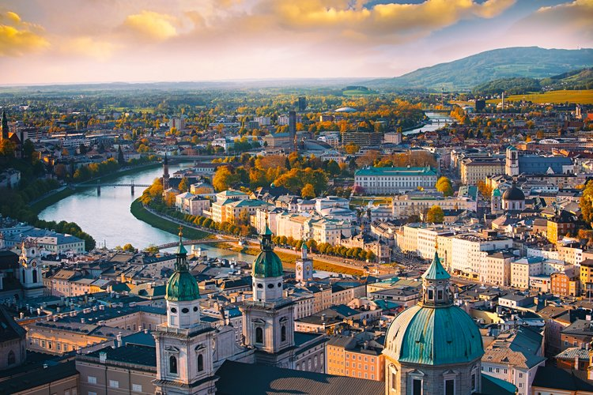
Austria
Juliette Leblond

Slide 2
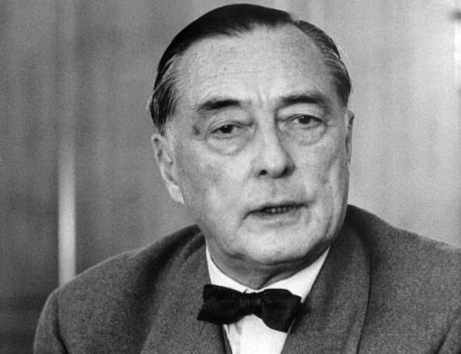
Austria and the “EU’s grandfather”
Richard Coudenhove-Kalergi (1894-1972)

Slide 3
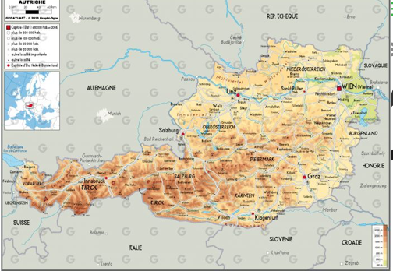
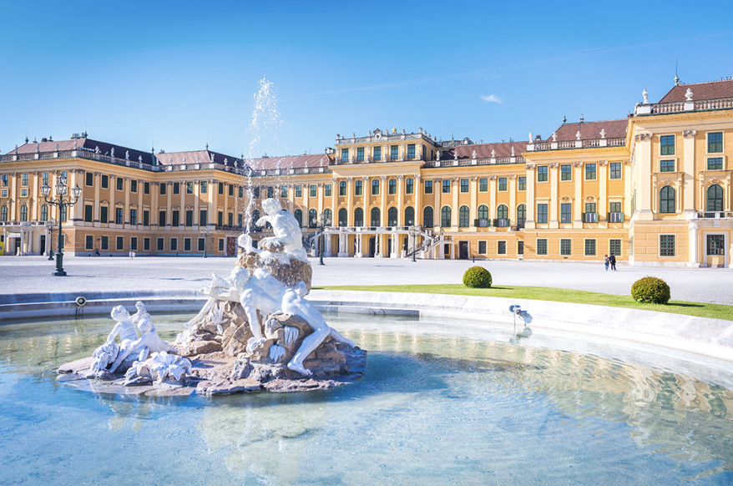
Capital City : Vienna
Relief : 84 000 km2 of hills and mountains.
Inhabitants : around 9 millions in January 2023.
National Day : 26th of October.
Language : German.
It welcomes a lot of international/ regional institutions:
OPEC since 1965.
The Secretariat of Energy Community since 2000.
The international Center for Migration Policy development.

Slide 4
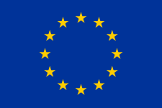
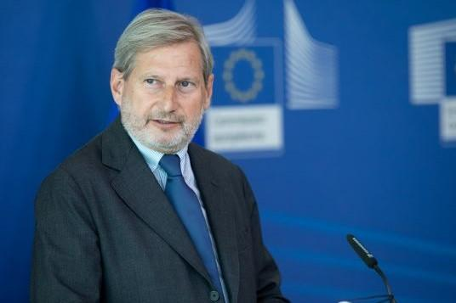
General information about Austria in the EU :
Joined the EU on the 1st of January 1995
Joined Schengen in April 1995
Adopted Euro in March 1999 in circulation in 2002.
Represents 2% of the EU’s population.
Number of seats in the EU Parliament : 19
Commissioner : Johannes Hann, Budget and administration since 2019
Austria had the presidency of the Council of the EU in 1998, 2006 and 2018.

Slide 5
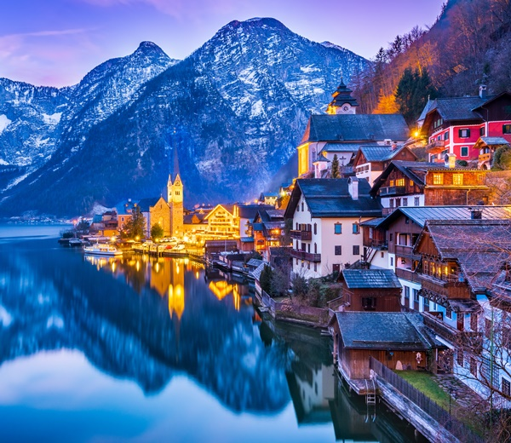
Structure :
Implication of historical and geographical factors
The economic factor : Austria as a medium size country with a high performance economy.
Domestics politics: the impact of partisan system on the European level.
Euroscepticism : an ambivalence
Ukraine-Russian War : a country challenging with its neutral position.
Austria and the Israel-Hamas crisis : how a medium-size country tries to shape the EU position.

Slide 6
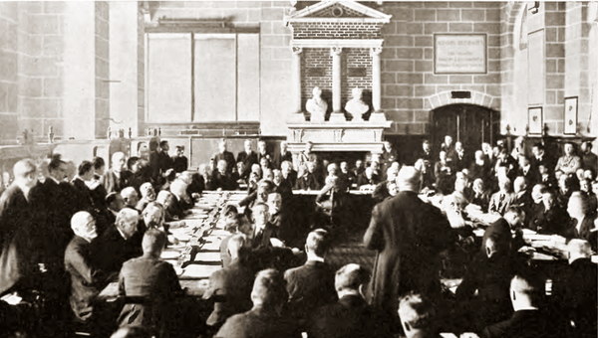
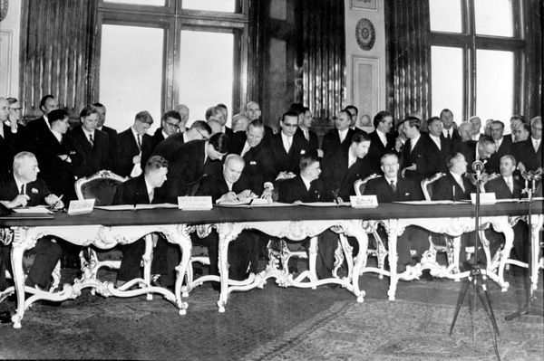
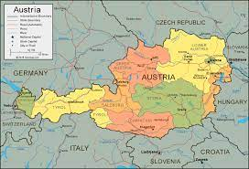
Implication of historical and geographical factors :
Treaty of Saint-Germain-en-Laye 1919:
Dissolution of the Austro-Hungarian Empire, creation of the 1st Austrian Republic.
Austria State Treaty 1955 :
It recovers its sovereignty. Neutrality imposed by the USRR written in the constitution
Austria cannot join NATO .
Austria cannot take part in conflicts except if attacked.
Austria is bordered by Germany, Czech Republic, Slovenia, Switzerland, Italy, Hungary, Slovakia and Liechtenstein.
=> 6 EU members.
8 Schengen members.

Slide 7
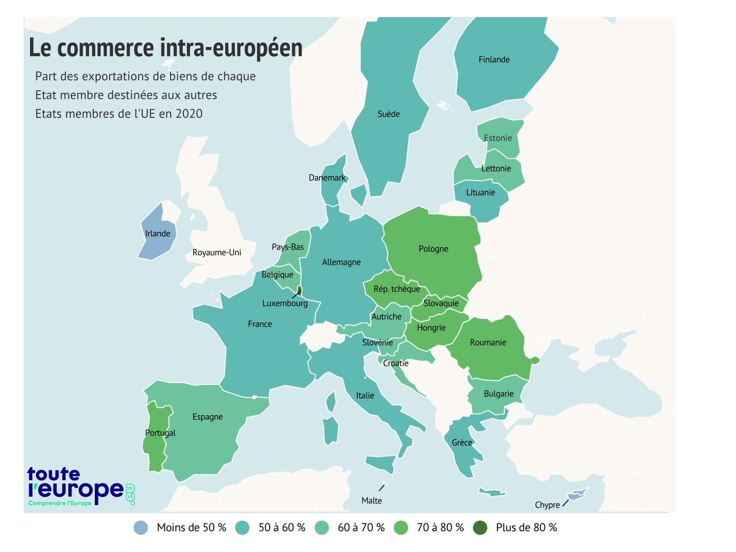
The economic factor : Austria as a medium-size country with a high performance econmy
In 2022, the EU captured 68,5% of Austria’s exportations and provided 65% of its imports.
Her major partners are :
Germany (captures 30% of exports, provides 41% of its imports).
Italy (6% of both its exports and imports).
Czech Republic (provides 4% of its imports).
Switzerland (around 7% of imports and exports)
Austria benefits from Schengen and the EU for the domestic economy.

Slide 8
The economic factor : Austria as a medium-size country with a high performance economy
Data perspective made by the European Commission: https://economy-finance.ec.europa.eu/economic-surveillance-eu-economies/austria/economic-forecast-austria_en
GPD per capita in PPS in 2022 : 125
Above the EU average. Austria is the 5th country of the EU with the biggest GPD per capita.
Unemployment of 5% in 2022 so lower compared to the EU average.
National debt in 2022 : 78.4% : Austria is a good student
However, due to the Ukraine-Russia War and imports of gas, Austria’s deficit commercial balance grew up but it is still manageable.
Austria’s financial credits are exposed to the Balkan countries.

Slide 9
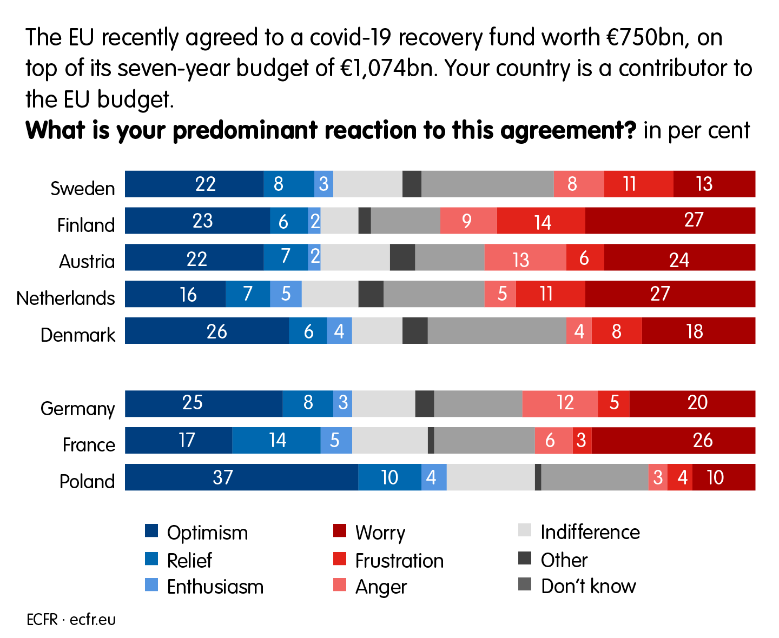
The economic factor : Austria as a medium-size country with a high performance economy
Austria is part of the “4 Frugal states” since 2020:
For example they strongly opposed to the post-covid Resilience Plan. There was a huge propaganda around it and it has an impact on the population as shows this survey of the European Council of Foreign relations.

Slide 10
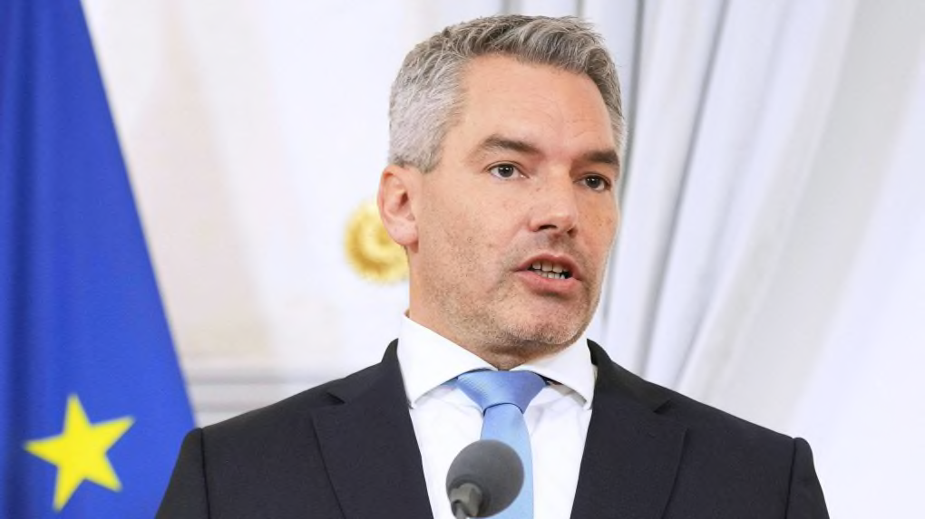
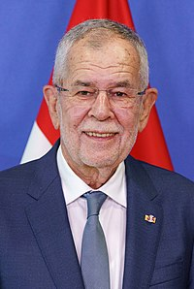
Domestic politics factor :
Austria is a semi-presidential Republic meaning the executive power is shared between the president and the chancellor. The president has powers of dissolutions.
It is a federal state (9 Länder) and the Parliament is bicameral :
Nationalrat : elected by the people
Bundesrat : elected by the Landtagen regional Parliament.
From the left to the right :
Chancellor Karl Nehammer (since 2021) ÖVP . In coalition with the Green.
Political priority : ecology and immigration.
President Alexander Van der Bellen (since 2017)

Slide 11
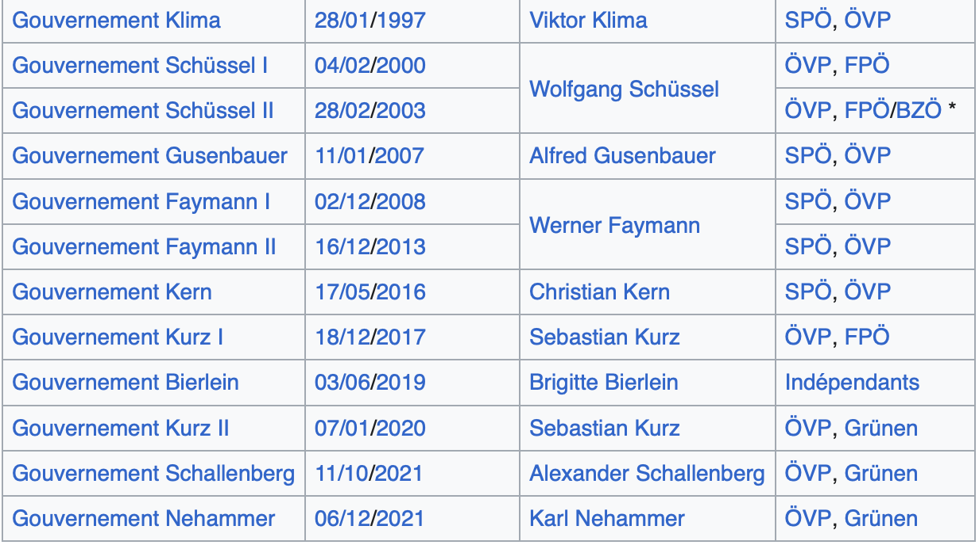
Domestic politics factor :
Vote rule : proportional law.
It means that there are coalition government of 2 parties.
- Most of the time coalition formed by Socio-democrats (SPÖ- and Conservatives (ÖVP) and they alternate.
- Rise of far-right FPÖ party since the 2000s.
- Grünen in the coalition since 2020 because of the mitigate results of SPÖ and their wish to stay in the opposition.
Data : https://fr.wikipedia.org/wiki/Gouvernement_fédéral_(Autriche)#:~:text=Le%20gouvernement%20de%20Karl%20Nehammer,depuis%20le%206%20décembre%202021%20.

Slide 12
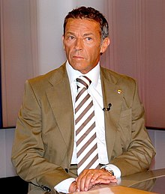
Domestic politics factor :
The Jörg Haider Affair: how domestic politics impact the EU :
Coalition government in 2000 of ÖVP and FPÖ.
Jörg Haider had xenophobe and negationist ideas.
14 EU member states decided to take political measures against Austria.
The EU Commission said that they were worried about Austria.
First far-right party in Europe.
Political message of the EU toward the Balkan countries that are in the process of Enlargement.
Jörg Haider (1950-2008)

Slide 13
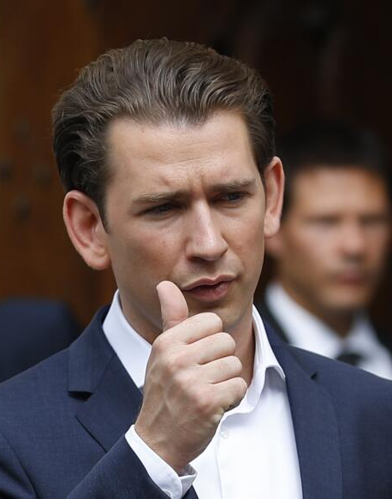
Domestic politics factor :
Sebastian Kurz : how did the youngest EU leader put immigration in the Austrian and EU political agenda?
Minister of Foreign Affairs from 2013 : he called for anti-immigration laws in the EU. He wanted to close the Balkans Road and and it pushed A. Merkel to make a controversial pact with Turkey.
Elected leader of ÖVP in 2017.
Called for election in 2017, unhappy with the coalition. Create a new coalition with FPÖ.
EU presidency of the Council of the EU in 2018 with 3 priorities :
Implementation of the defense and security policy
Migration policy
Development of the economical competitivity of the EU.
Corruption scandal in 2021 and he resigned from politics.

Slide 14
Euroscepticism : an ambivalence :
Vote in favor in general pro-European parties, expect 3 seats for the FPÖ which is Eurosceptic.
Data from the EU Parliament :
https://www.europarl.europa.eu/election-results-2019/en/tools/widget-country/austria/2019-2024/

Slide 15
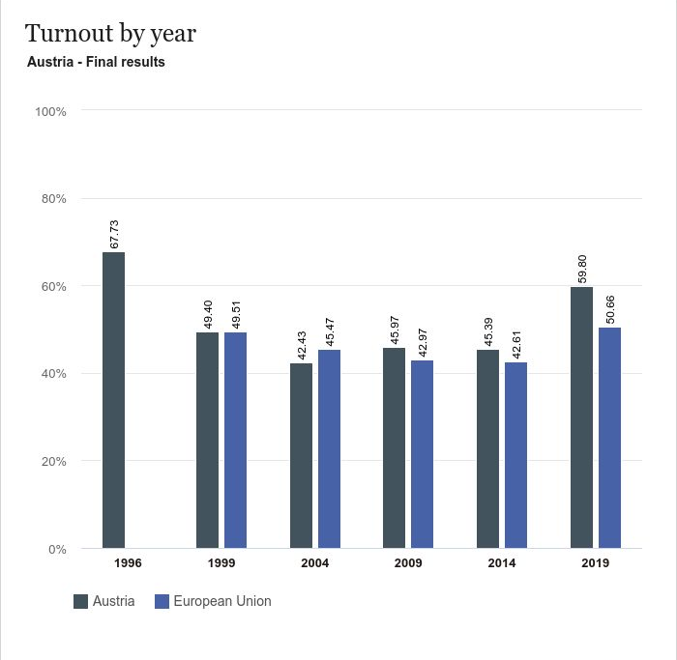
Euroscepticism : an ambivalence :
- A participation on the average compared to the average of the global EU members participation.
- 2019 election shows an increase of participation reaching almost 60%. It is one of the countries with the most participation in the election.
Data from the EU Parliament :
https://www.europarl.europa.eu/election-results-2019/en/tools/widget-country/austria/2019-2024/

Slide 16
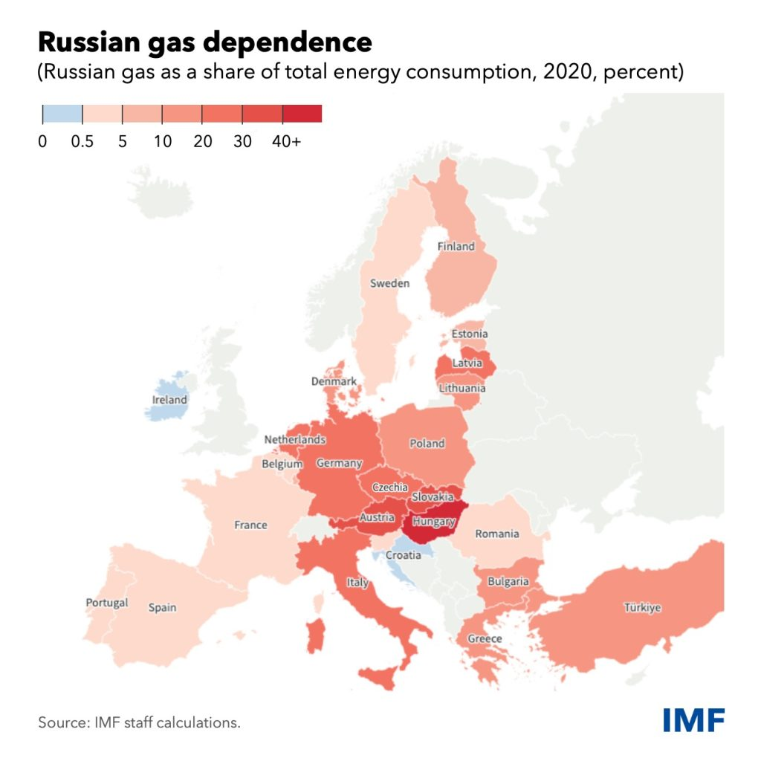
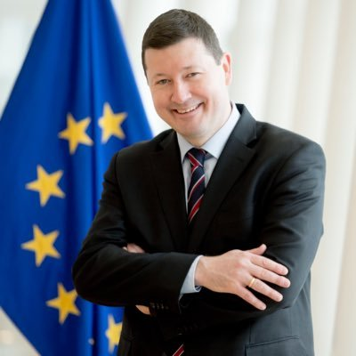
The Ukraine-Russian War:
A high dependance towards Russian Gas despite the War.
Martin Selmayr, former head of European Commission Representation in Austria.

Slide 17
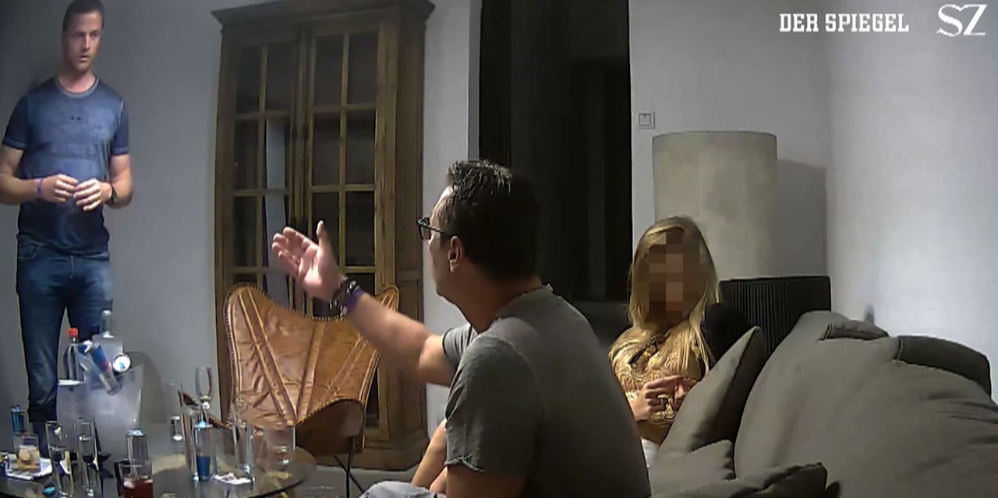
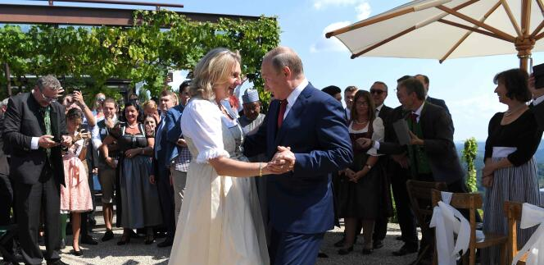
The Ukraine-Russian War:
Some FPÖ members have pro-Russia speeches/actions :
The Ibizagate in 2017 : hidden camera showing the vice-chancellor (FPÖ) proposing some government procurement to an actress pretending to be the daughter of a Russian oligarch.
Karine Kneissl : Former Minister of Foreign Affairs from 2017-2019 qualifying the behavior of Austria towards Russia of “Schizophrenia”. She also decided in September to go to Russia on holidays. She also recently announced her wish to move to Russia.

Slide 18
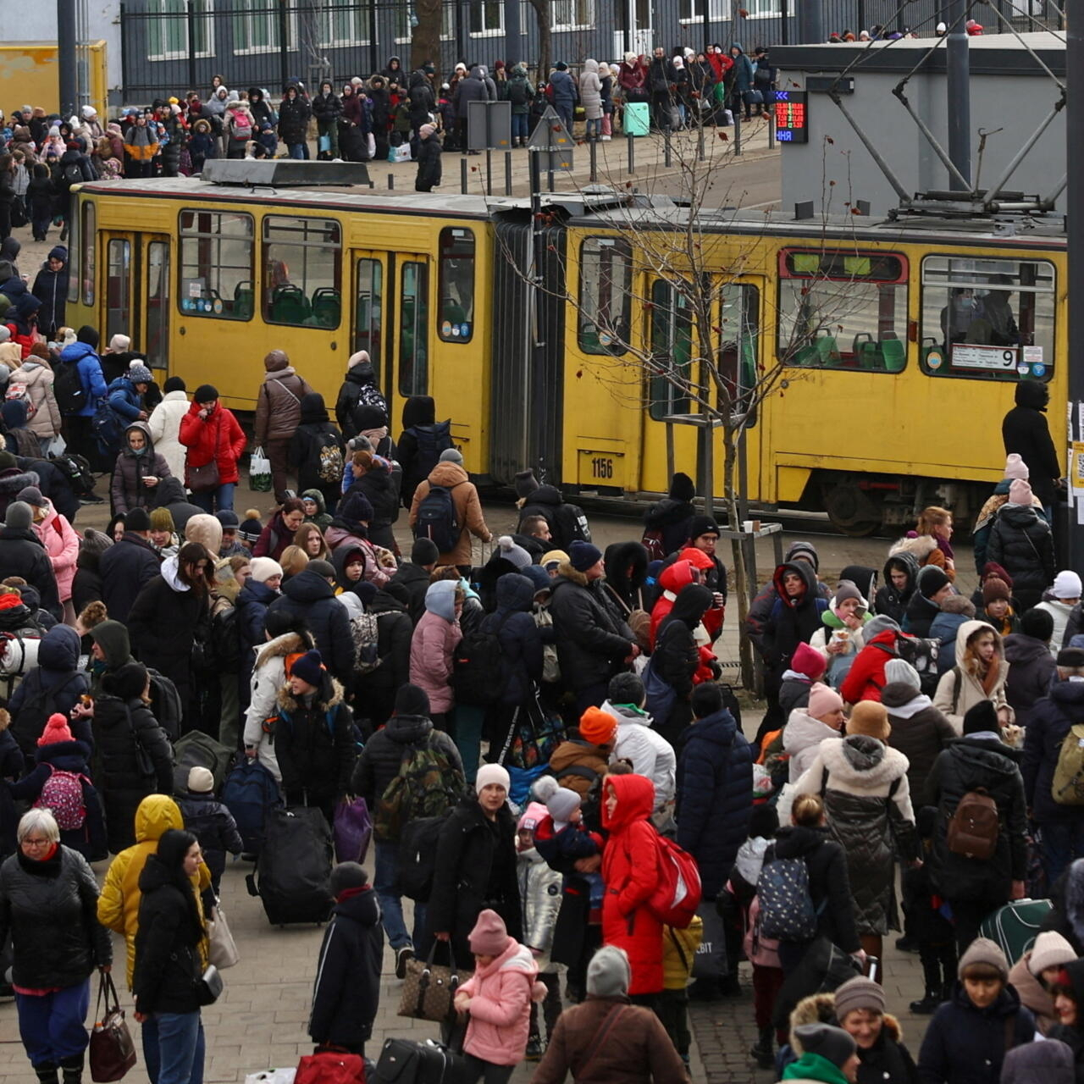
The Ukraine-Russian War:
Karl Nehammer met in person V. Putin in April 2022. He is the first European leader to meet in person after the Russian invasion of Ukraine. National Newspapers highlight the difficulties of the Austrian neutral position in this conflict.
Austria support to Ukraine :
Substantial humanitarian aid.
Donations to the association Neighbors in Need.
Welcoming of refugees (around 70 000 people).
Approvement and application of EU sanctions.

Slide 19
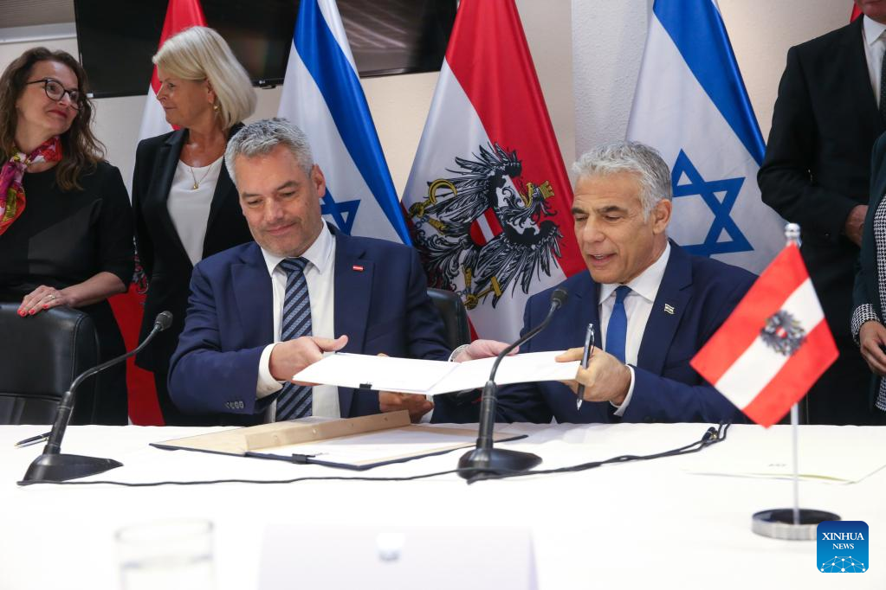
The Israel-Hamas crisis : how Austria tries the shape the EU position :
Pressure of Austria that leads to 2 major decisions:
The EU recognition of the Hamas as a terrorist organization.
A close look at the 691M° EU fundings towards Palestine announced by the European Commissioner of Enlargement (Olivier Varheyli).
Austria also blocked also decision:
The project of humanitarian break and help to Gaza.

Slide 20
Bibliography :
Borrell Joseph, « EU fails to agree on call for ‘humanitarian pause’ to allow aid into Gaza », Politico, 10/2023, https://pro-politico-eu.ezpaarse.univ-paris1.fr/news/170498
Brozozowski Alexandra and Pugnet Aurélie, » L’Autriche en faveur d’une intégration « progressive » des Balkans occidentaux à l’UE », Euractiv, 29/09/2023.
Camus Nicolas « Austrian ex-minister who danced with Putin moves to Russia », Politico, 12/9/2023, https://pro-politico-eu.ezpaarse.univ-paris1.fr/news/168504
Gallouët Laure, “Non à la fin de la neutralité ? Enjeux de la politique de sécurité autrichienne depuis les années 1990”. Trajectoire. Revue de la jeune recherhce Franco-Allemande, 2018, n°11 : https://journals.openedition.org/trajectoires/2517
Hülsemann Laura, « EU’s man in Austria Martin Selmayr in hot water over Russian ‘blood money’ comment », Politico, 7/9/2023 : https://pro-politico-eu.ezpaarse.univ-paris1.fr/news/168339
Kurmayer Nikola, « Loi européenne sur l’efficacité énergétique : l’Autriche pourrait écoper d’une amende pour non-transposition », Euractiv, 7/4/2023
Kurmayer Nikolaus, « L’Autriche appelle de ses vœux à une intégration rapide des Balkans occidentaux dans l’UE », Euractiv, 4/11/2022, https://www.euractiv.fr/section/elargissement/news/lautriche-appelle-de-ses-voeux-a-une-integration-rapide-des-balkans-occidentaux-dans-lue/
Noyan Olivier, « Réforme des règles budgétaires européennes : l’Autriche fait blocage », Euractiv, 17/10/2023, https://www.euractiv.fr/section/economie/news/reforme-des-regles-budgetaires-europeennes-lautriche-fait-blocage/
Tupier Vincent, « Réforme du marché européen de l’électricité : la France obtient gain de cause sur le nucléaire », Toute l’Europe, 18/10/2023.

Slide 21
Bibliography : websites :
-CVCE : https://www.cvce.eu/search?q=austria
EU Commission : https://economy-finance.ec.europa.eu/economic-surveillance-eu-economies/austria/economic-forecast-austria_en
EU Parliament : https://www.europarl.europa.eu/election-results-2019/en/tools/widget-country/austria/2019-2024/
Toute l’Europe (French Government about the EU countries) : https://www.touteleurope.eu/pays/autriche/
Direction du Trésor (French ministry of economy) : https://www.tresor.economie.gouv.fr/Pays/AT/l-autriche-petit-pays-certes-mais-au-carrefour-de-l-europe

