Slide 1
Euroscepticism in Czech Republic
Marek Tomašovič

Slide 2
Czech Republic and the EU
EU member country: since 1 May 2004.
Currency: Czech crown.
Schengen area member since 21 December 2007.
There are 21 members of the European Parliament from the Czech Republic.
The Commissioner nominated by the Czech Republic to the European Commission is Vĕra Jourová.
Czechia has 12 representatives on the European Economic and Social Committee and also on the European Committee of the Regions.

Slide 3
Euroscepticism in general
Euroscepticism as a political movement became the most prominent following the Treaty of Maastricht in 1992, which gave the union a stronger political basis rather than being merely an economic arrangement.
Euroscepticism may come in hard or soft varieties.
Hard Euroscepticism – represented by movements to leave the European Union.
Soft Euroscepticism – doesn‘t oppose the existence of the EU but instead seeks to stop or provide checks to further integration, or they don‘t like the direction in which the EU is headed.

Slide 4
Some points of the strongest Euroscepticism in history:
the great recession and Eurozone crisis of the early 2010s
massive migration flows of refugees fleeing the war in Syria in 2015
Brexit
After the Covid-19 pandemic and Russia's invasion of Ukraine, the support for the EU has risen – both situations required joint action by member states.
Euroscepticism is often a characteristic of far-right nationalistic political parties.

Slide 5
Eurosceptic political parties in the Czech Republic – ODS
The Civic Democratic Party (Czech: Občanská demokratická strana, ODS) – conservative and soft Eurosceptic political party.
Modelled based on the British Conservative Party.
Holds 34 seats in the Chamber of Deputies.
The second strongest party by number of seats following the 2021 election.
Founded in 1991 by Václav Klaus.
Prime Minister Petr Fiala is currently leading the party.
After Klaus and some other members left ODS (2006), the party stopped being as eurosceptic as it was before.

Slide 6
ODS
ODS supports maintaining Czech sovereignty and integrity against the European Union.
They call for a fundamental reform of the EU and strongly oppose any federalisation of Europe.
The party is a member of the national-conservative European Conservatives and Reformists group.
The party supports compulsory measures for immigrants to speak Czech, learn about Czech history, and adapt to local customs and cultures.
ODS also opposes compulsory EU migrant quotas by arguing that the Czech Republic should have sovereignty over its border control.
ODS also supports citizen‘s right to own and carry firearms.

Slide 7
SPD
Freedom and Direct Democracy (Czech: Svoboda a přímá demokracie, SPD) is a right-wing populist political party in the Czech Republic.
It is led by Tomio Okamura, and it holds 20 seats in the Chamber of Deputies.
The party was founded in May 2015 by Tomio Okamura and Radim Fiala when eight Members of Parliament left the Dawn of Direct Democracy parliamentary group (also Eurosceptic, the party was dissolved in March 2018).
The party has links with Marine Le Pen's National Front.
In 2019, following the European Parliament elections, the SPD entered the European Parliament with two MEPs, who sit with the Identity and Democracy group.

Slide 8
The party opposes Czech membership of the European Union and calls for the Czech Republic to leave the bloc – Hard Euroscepticism.
They also want to pursue a more restrictive immigration policy, particularly towards immigration from Islamic nations, and reject multiculturalism.

Slide 9
KSČM
The Communist Party of Bohemia and Moravia.
The party was formed in 1989 by a congress of the Communist Party of Czechoslovakia.
They are one of the few former ruling parties in post-Communist Central Eastern Europe to have not dropped the Communist title from its name.
The only parliamentary political party that was against joining the EU in the 2003 referendum.
Now – soft Euroscepticism.

Slide 10
Svobodní
Right-libertarian Eurosceptic political party in the Czech Republic founded in 2009 by Petr Mach.
Its platform called for a referendum on introducing the euro in the Czech Republic and rejecting the Treaty of Lisbon.
The party is against the EU‘s environmental policies.
Supports leaving EU – Hard Euroscepticism.

Slide 11
Seats in the parliament and EP
Senate – 81 seats / Chamber of Deputies – 200 seats/ EP - 21 seats
ODS (soft Euroscepticism) – 34 in the CHoD, 5 in S.
4 seats in EP
SPD (hard Euroscepticism) – 20 in CHoD, 0 in S.
2 seats in EP
KSČM (soft) – only some seats in the regional council.
1 seat in EP
Svobodní (hard) –1 seat in S.

Slide 12
Key figures that influenced opinions towards EU: Klaus and Zeman
Václav Klaus
The first prime minister of the Czech Republic from 1993 to 1998.
Second president from 2003 to 2013.
Co-founder and leader of the Civic Democratic Party (ODS).
One of the critical figures of Czech Euroscepticism – speeches.
In 2005, Klaus called for the EU to be replaced by a free trade area.
EU "as big a threat to freedom as the Soviet Union was."
The last head of state in the EU to provide a signature for the Treaty of Lisbon – put the treaty to court.
He criticised the Euro as a currency.

Slide 13
Miloš Zeman
3rd President of the Czech Republic (2013 – 2023) – 1st one to be voted by direct election.
Served as the prime minister of the Czech Republic from 1998 to 2002.
Leader of the Czech Social Democratic Party.
Climate change denier and populist.
He expressed supportive and critical positions regarding the European Union (populism).
Supports holding a referendum on Czech EU membership but is personally against leaving.
Opposes the EU's migrant quotas, pro-Russian (economic pragmatism) but against Russian invasion of Ukraine.

Slide 14
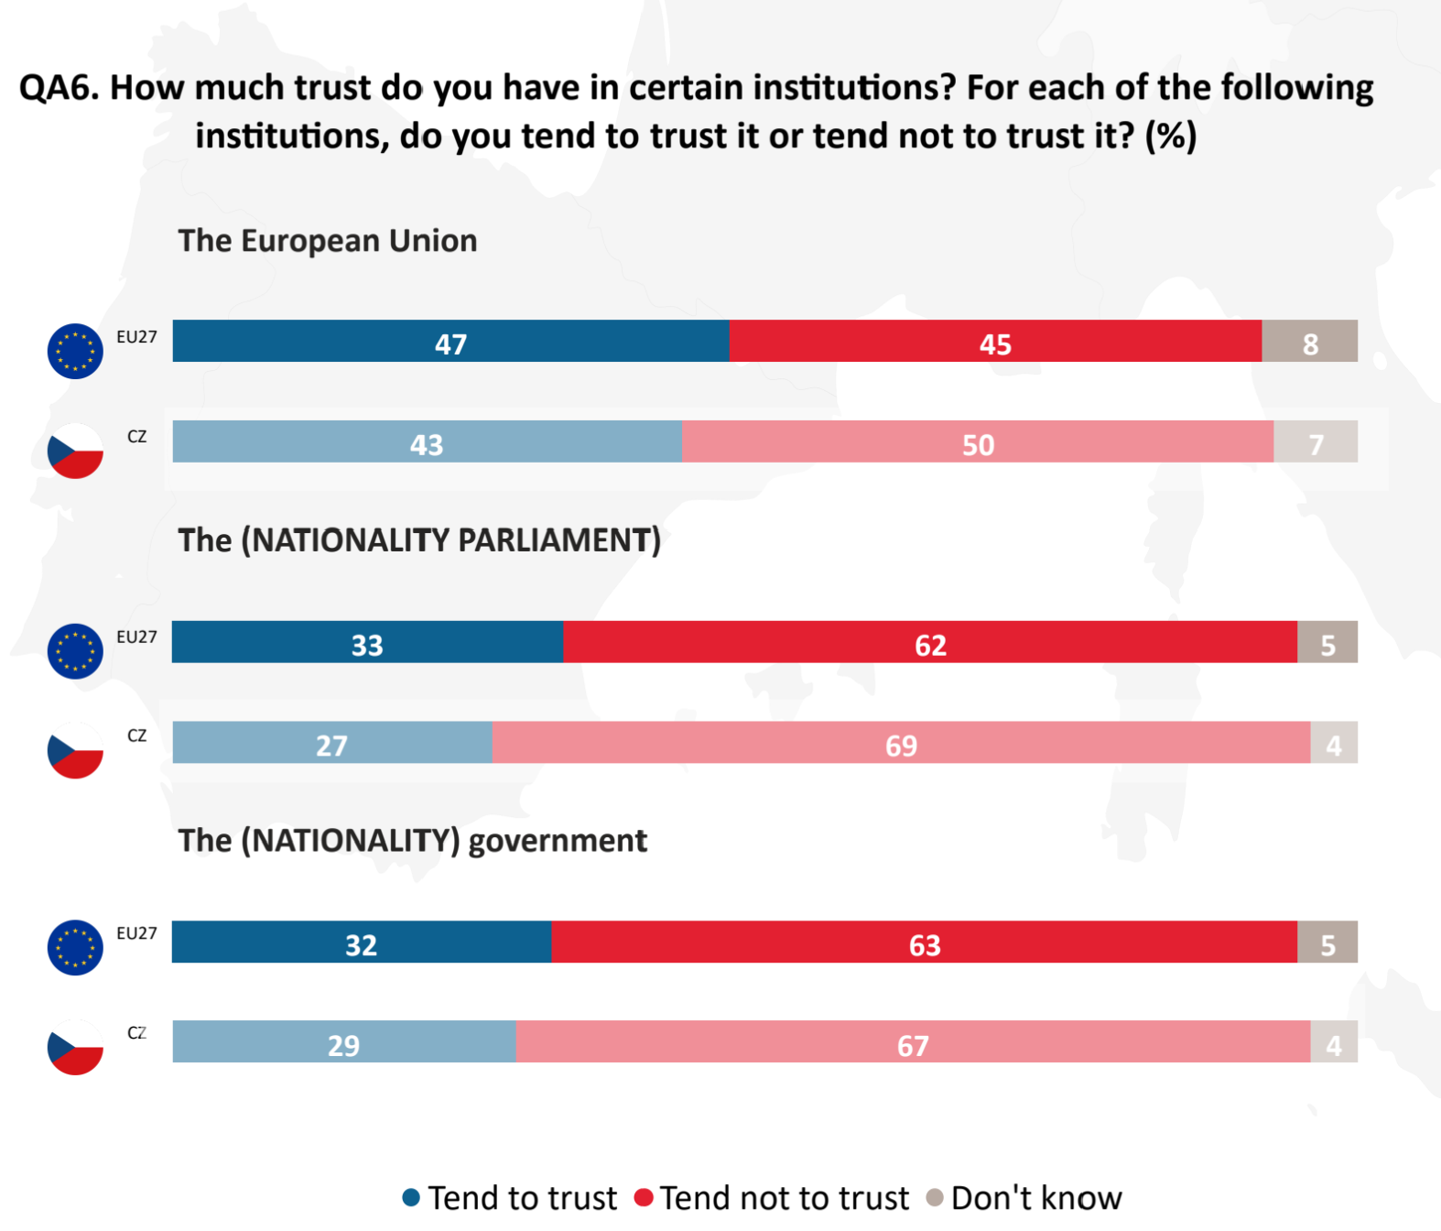
Public opinion 2023

Slide 16
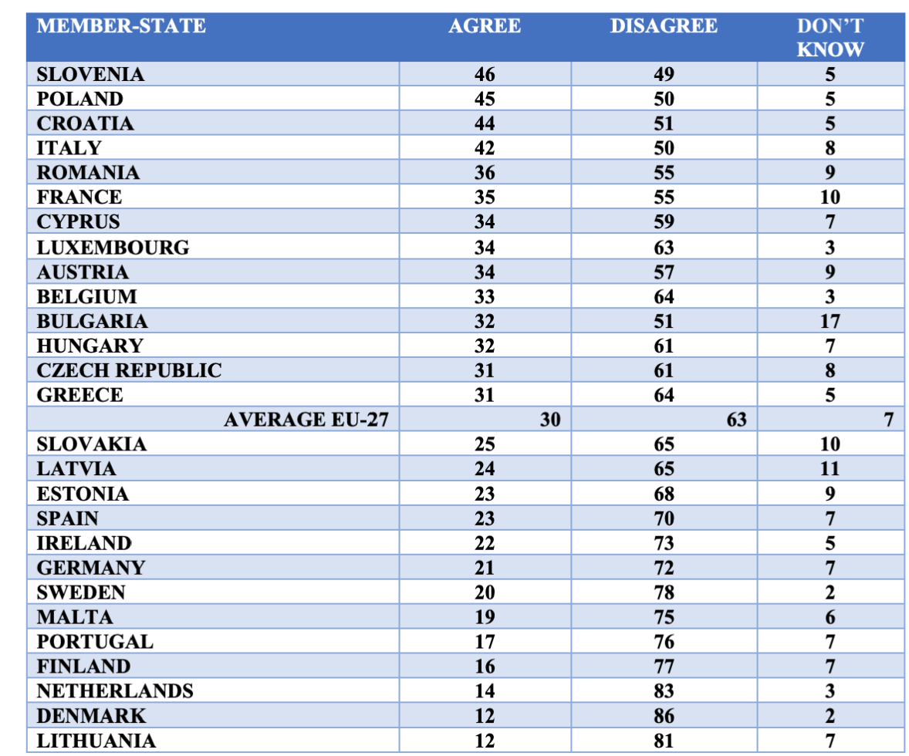
Eurobarometer May-June 2O23 ‚‚Our country could better face the future outside the EU‘‘

Slide 17
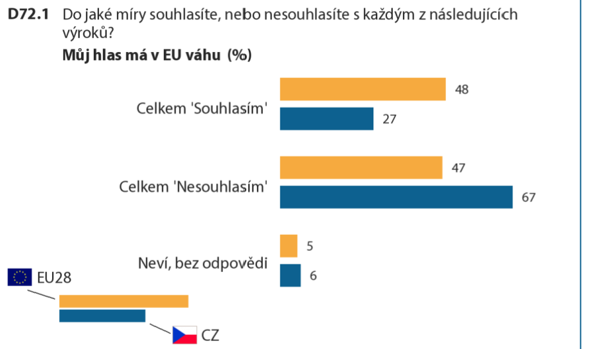
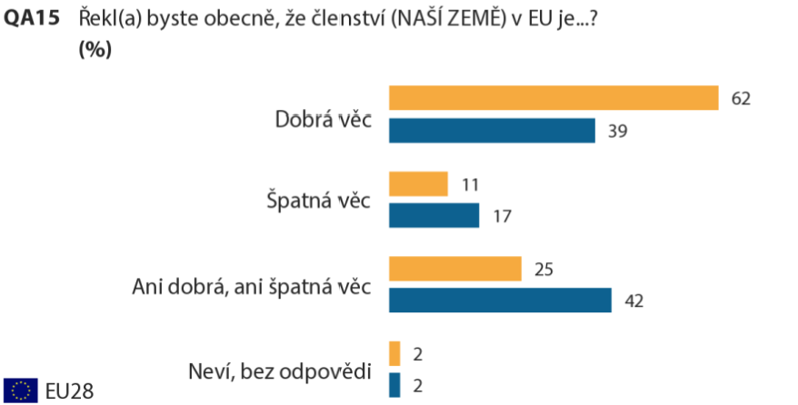
2018

Slide 18
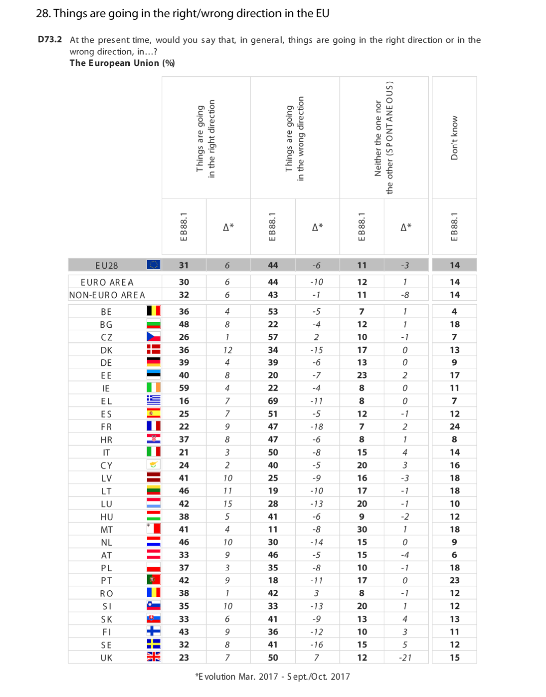
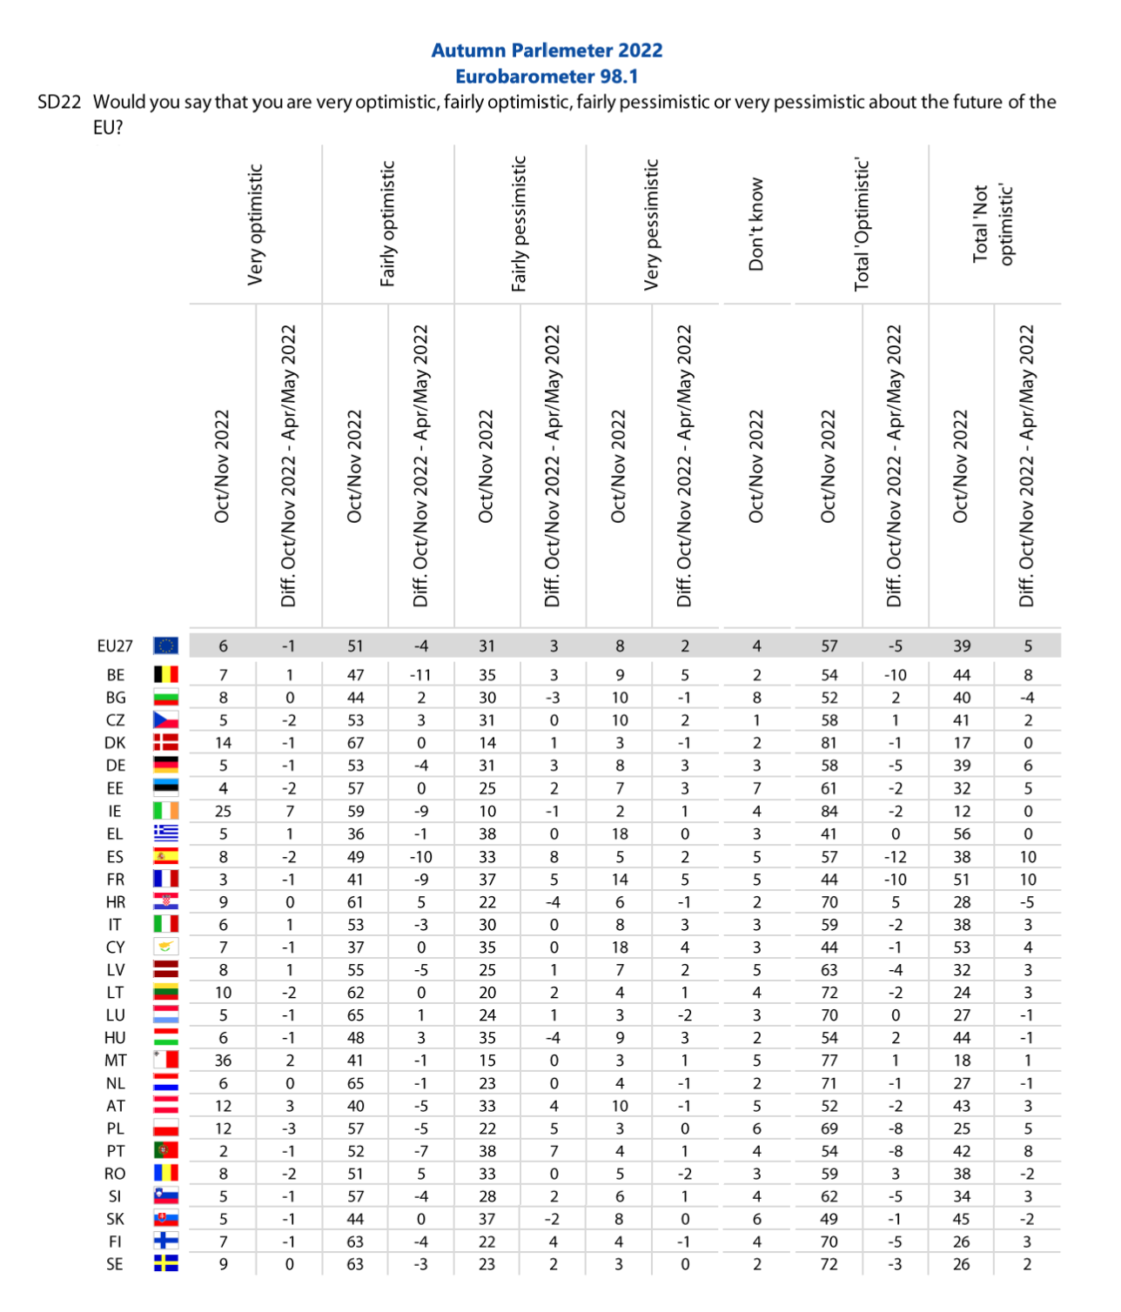
2022
2017

Slide 19
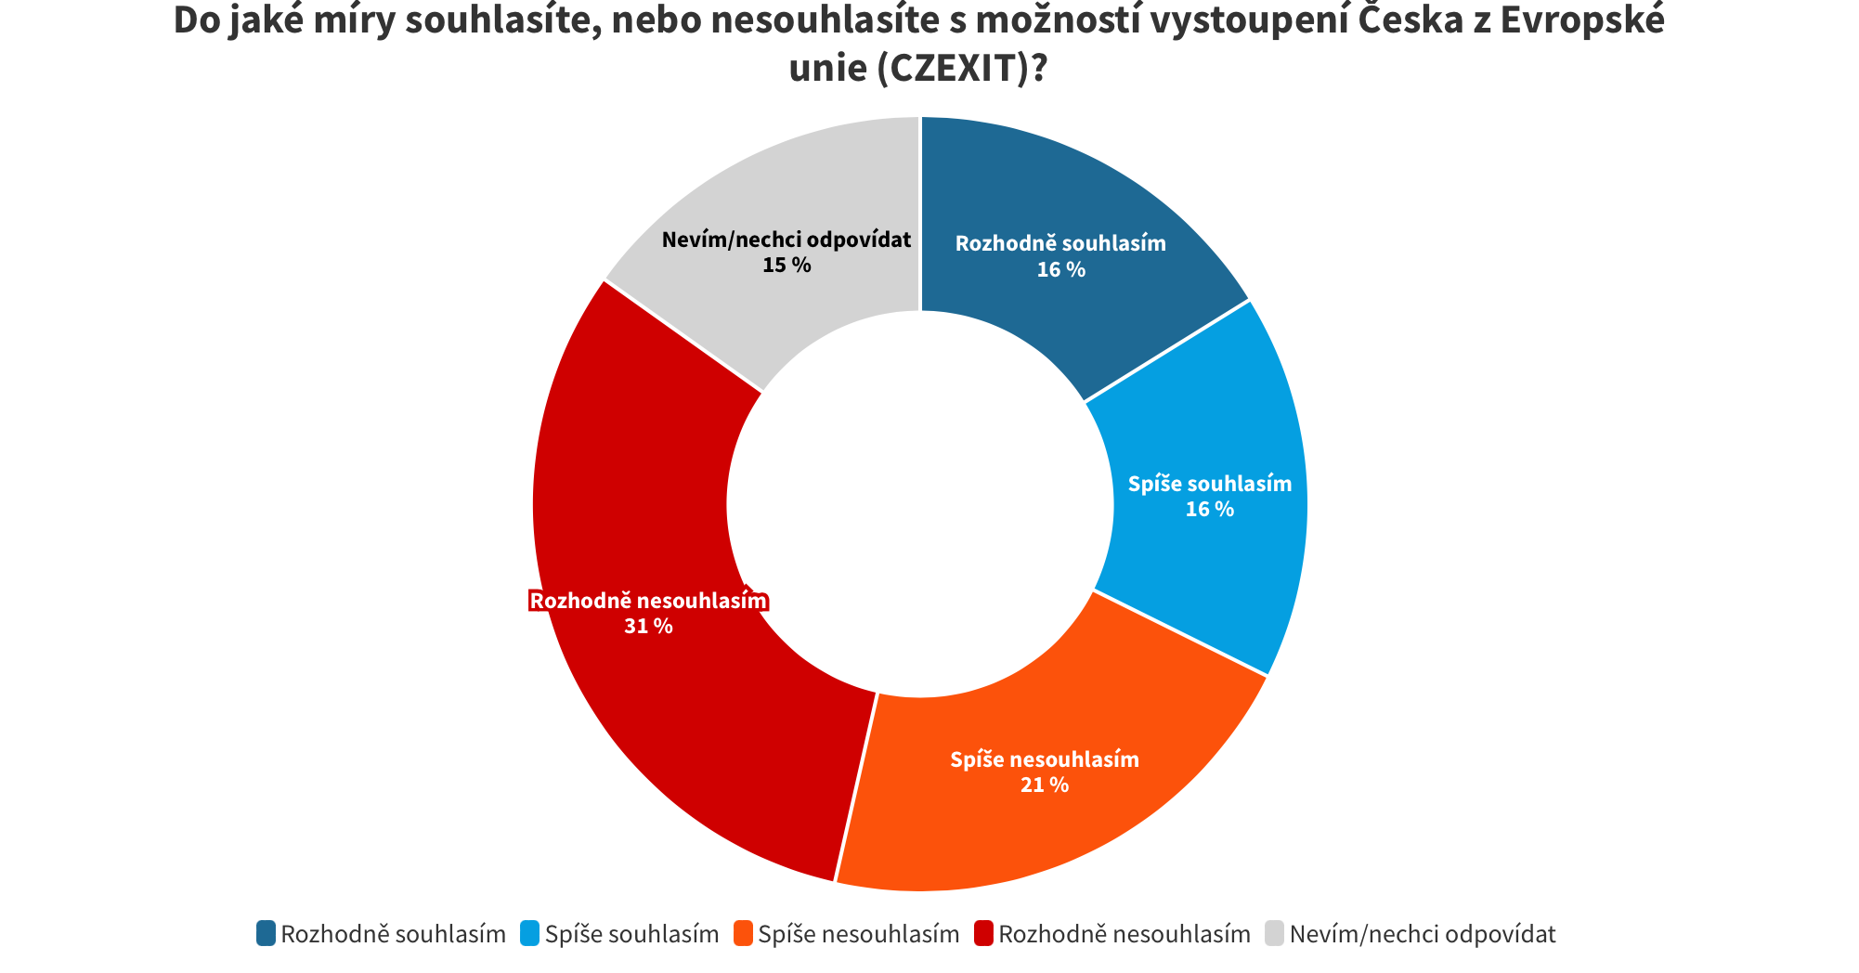
Czexit
In 2015 – 11 members of the parliament wanted to execute a referendum about leaving the EU.
2016 – political parties talking about the referendum: SPD, Úsvit (former party from which SPD was formed), Svobodní.
The Chamber of Deputies voted against the referendum.
For the referendum: 29 members of the communist party and 12 members of ODS.
NMS Market Research poll in 2023 – 52 % for staying in the EU, 32 % for leaving, 15 % is not sure.

Slide 20
Possible Reasons for Czech Euroscepticism
The democratic institutions were still forming while entering the EU – the Czech Republic has existed as an individual country since 1993 (For many citizens, the pressure to hand over competencies handed over to national governance only years ago was premature).
Another stimulus for Euroscepticism in the Czech Republic was the process of the ratification of the Lisbon Treaty in 2008, which in the public sphere could be simplified into a duel between a strongly Eurosceptic president, Václav Klaus, and progressive pro-European government, represented by Mirek Topolánek (both of them were former leaders of ODS).
Eurosceptic attitudes in the Czech Republic were strengthened in 2008 by the financial crisis.

Slide 21
Another reason for Czech Euroscepticism was the mass migration in 2015. Proposed solutions, monthly financial aid, or quotas were perceived as unfair to the locals regarding their income.
The Czechs have little interest in European political events and are thus less informed. Czech scepticism is also exploited by the political elite, who often do not even know how the European Union actually works.
After the entry to the EU, the price of goods has been rising faster than the wages. Prices of several commodities have been brought in line with EU prices, but wages have been several times lower.

Slide 22
Why are the Czechs against the Euro?
An argument of ODS: The national bank can act faster in case of an inflation or crisis
They think that the prices would rise if they switched to the Euro
The Czech crown as a Symbol of national sovereignty
Pavel, the new president, wants to switch to Euro in the upcoming years – he said so in the New Year speech!
The reaction of Fiala (ODS) – negative; they first want to deal with the financial crisis and maybe then discuss switching to Euro
73%. of Czechs are against the euro, according to a CVVM survey held in 2023

Slide 23
THANK YOU FOR YOUR ATTENTION!

