Slide 1
Virtualization and the Cloud
Virtualization Requirements: Safety, Fidelity, Efficiency
Sensitive Instructions: different effects in: a) user b)kernel, modes
Privileged Instructions: lead to trap in user mode
Virtualization Technology
Intel: Virtualization Technology
AMD: Secure Virtual Machine
create containers in which virtual machines can be run
A guest operating system runs in a container → until it causes an exception and traps to the hypervisor, e.g. by executing an I/O instruction.
The set of operations that trap is controlled by a hardware bitmap set by the hypervisor With these extensions the classical trap-and-emulate virtual machine approach becomes possible.

Slide 2
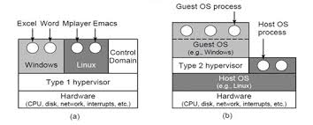
Hypervisors Type 1: the only program running in the most privileged mode. support multiple copies of the actual hardware, called virtual machines (run on bare metal) Type 2: a program relying on the OS to allocate and schedule resources The OS over the Hypervisor (both) is guest OS. For type 2 the OS over the hardware is the host OS

Slide 3
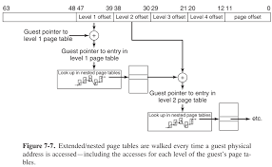
Virtualizing Memory: Shadow page tables

Slide 4
Virtualizing Memory
Today’s hardware supports nested page tables (AMD) or called extended page tables (Intel) ERT.
In addition to the guest virtual addresses, we now also have guest physical addresses and subsequently host physical addresses (sometimes referred to as machine physical addresses).
With EPT, the hypervisor still has an additional set of page tables, but now the CPU is able to handle much of the intermediate level in hardware also.

Slide 5
Clouds
National Institute of Standards and Technology
→ On-demand self-service
→ Broad network access
→ Resource pooling: assign resources dynamically
→ Rapid elasticity: acquire and release resources elastically
→ Measured service: conform to the contracts
Provide:
Infrastructure As A Service (IAAS)
Seamless live migration: move/change/replace machines while they are operational.

