Slide 1
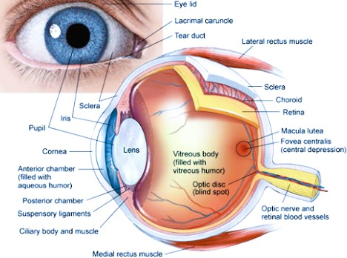
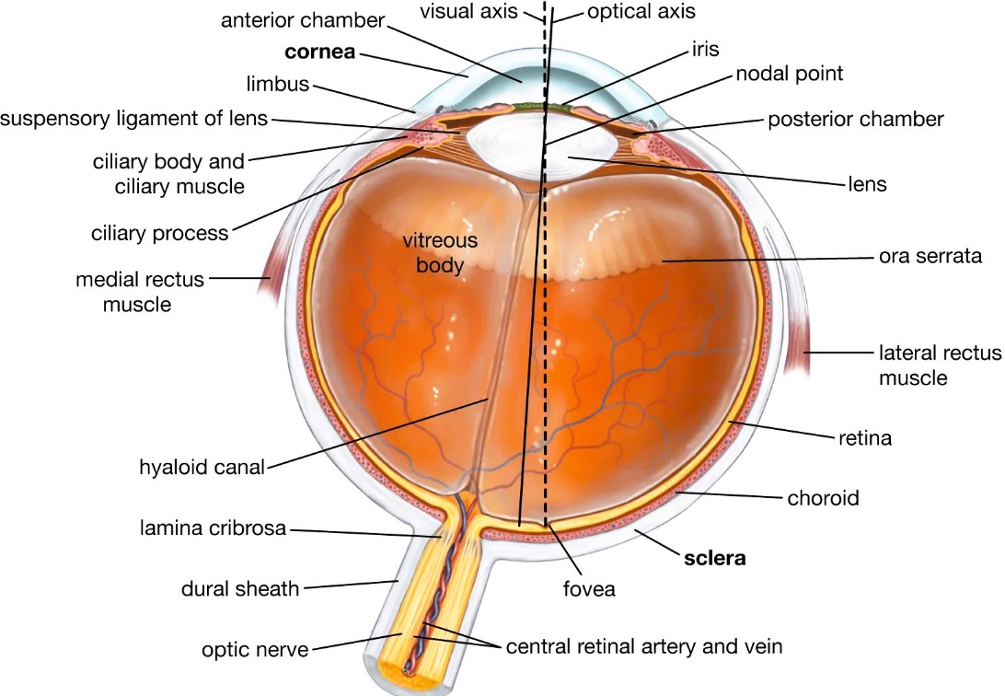
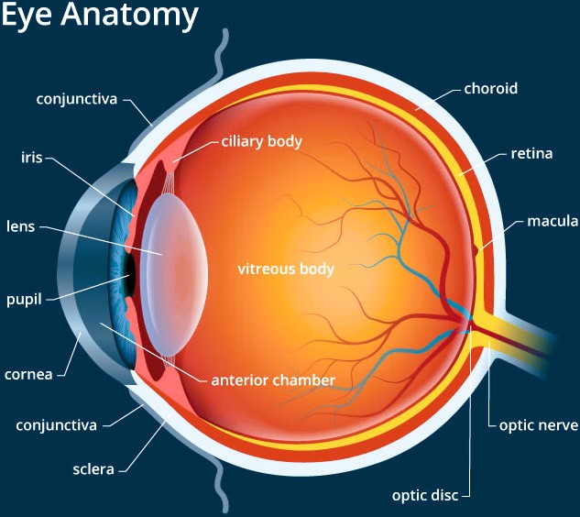
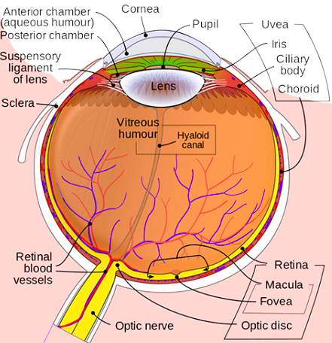

Slide 2
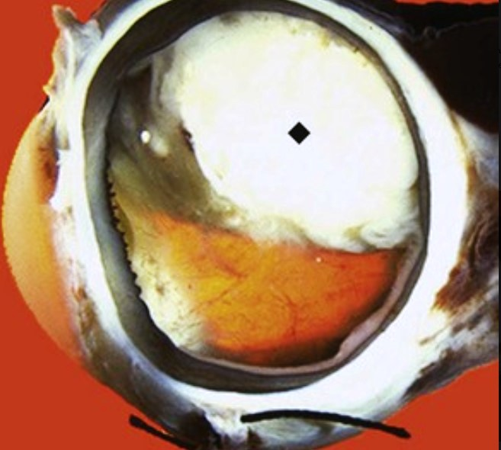
A 5-year-old boy has a 1-year history of deteriorating vision in his right eye. On examination, he has leukocoria in that eye (i.e., a whitish mass without the typical retinal “red reflex”). The gross appearance of his enucleated eye after surgery is shown.
1.What is your diagnosis?
2.What gene mutation is present?
3.What is the typical microscopic appearance?
4.Where should you expect metastases?
The large intraocular tumor (♦) that extends into the vitreous of the posterior chamber is a retinoblastoma. This tumor is blocking the funduscopic view of the retina and yielding a “white pupil” on examination.
There is a mutation in the tumor-suppressor gene RB. Retinoblastomas that appear at a young age are often familial and bilateral because there is an inherited germline mutation in one gene; the second mutational “hit” in the residual normal gene occurs early in life.
This is one of the “small round blue cell tumors” of childhood. The cells are often arranged in rosettes.
The brain and bone marrow are favored sites; lung metastases occur infrequently.

Slide 3
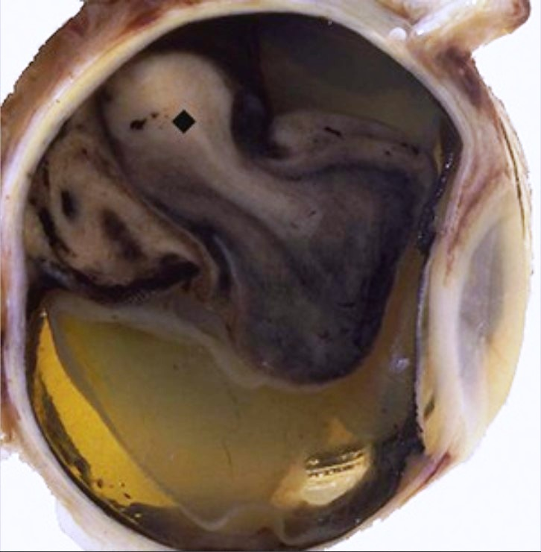
A 53-year-old man with a 1-year history of deteriorating vision in the left eye suddenly loses almost all vision in that eye. His enucleated eye after surgery is shown.
1.What is your diagnosis?
2.In what part of the eye did this condition arise?
3.What sudden complication likely occurred?
4.Where are metastases most likely to be found?
This intraocular malignant melanoma (♦) nearly fills the posterior chamber. Note the dark pigmentation from melanin production.
Ocular melanomas are most common in adults. They typically arise in the uvea, which is composed of the iris, the choroid, and the ciliary body.
Retinal detachment occurred.
Hematogenous metastases occur, with the liver being a common site.

Slide 4
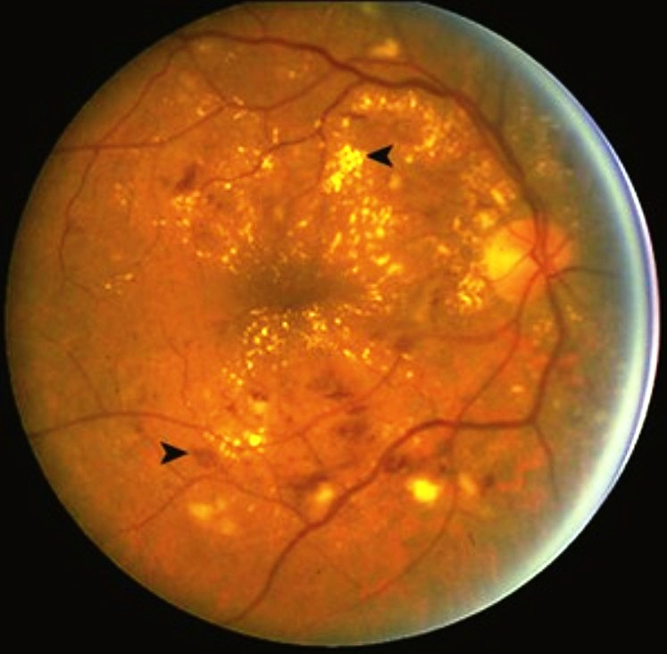
A 54-year-old woman has had deteriorating vision for 5 years. She has an irregular loss of visual fields on objective testing. Her hemoglobin A1c level is 9% (nl <6%), and she had a myocardial infarction 1 year ago. Funduscopic examination reveals the findings shown.
1.What is the underlying diagnosis?
2.How has this disease affected the retina?
The elevated hemoglobin A1c level and the early age of myocardial infarction (presumably as a result of advanced atherosclerosis) suggest diabetes mellitus.
This is preproliferative (“background”) diabetic retinopathy. Microangiopathy at this stage is associated with the loss of pericytes, with aneurysm formation and basement membrane changes. As a consequence, there is edema in addition to retinal exudates that represent either “soft” microinfarcts (▸) or “hard” yellowish waxy exudates (◂) composed of deposits of plasma proteins and lipids.

Slide 5
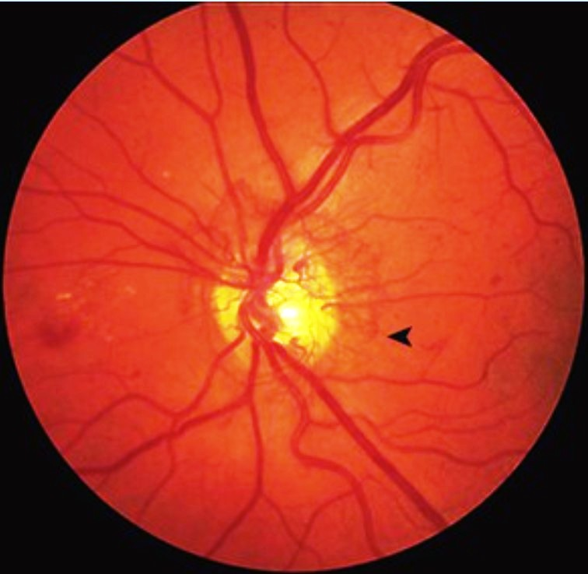
A 60-year-old man with a 6-year history of progressively worsening vision has noted an acceleration of this process during the past 3 months. His fasting serum glucose level is 200 mg/dL (nl <110 mg/dL). Funduscopic examination reveals the findings shown.
1.What is the underlying disease?
2.Describe the findings shown.
3.What sudden complication can occur?
4.What biochemical abnormalities contribute to the tissue damage?
This patient has diabetes mellitus.
The neovascularization (◂) of proliferative diabetic retinopathy is shown, with the angiogenesis of small vessels near the optic disc. These delicate new vessels grow toward the vitreous humor; they are prone to bleeding and producing vitreal hemorrhages that obscure vision.
The proliferation of fibrovascular and glial tissue ensues; when this contracts, there is a risk for retinal detachment.
Endothelium and pericytes transport glucose independently of insulin levels. Consequently, a high level of circulating glucose leads to high intracellular concentrations (by conversion to sorbitol) and thus accompanying hyperosmolar damage and increased oxidative stress. High glucose levels also lead to endothelial advanced glycation end products (AGEs), which lead to dysfunction.

Slide 6
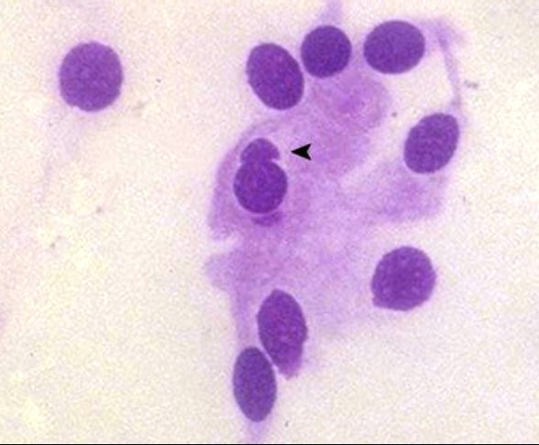
A 4-year-old girl with a 1-month history of right eye irritation (and associated rubbing) is found to have enlarged upper tarsal conjunctival lymphoid follicles. The microscopic appearance of a conjunctival scraping (Giemsa stain) is shown.
1.What is your diagnosis?
2.What complication can occur with chronic infection?
3.What are risk factors for this disease?
The conjunctival scraping reveals an intracytoplasmic elementary body (▴) of Chlamydia trachomatis.
Trachoma is a chronic progressive infection of the eye. Eventually, trichiasis occurs, which involves the lid turning inward so that eyelashes impinge on the conjunctiva and induce further trauma and scarring (e.g., conjunctival scarring, possible blindness from corneal opacity). Antibiotic therapy (e.g., azithromycin) is useful for controlling trachoma. Eyelid surgery can be helpful to treat the trichiasis.
This occurs mainly as a result of social conditions in which there is poor hygiene. It typically results from a lack of clean water for washing the hands and face.

Slide 7
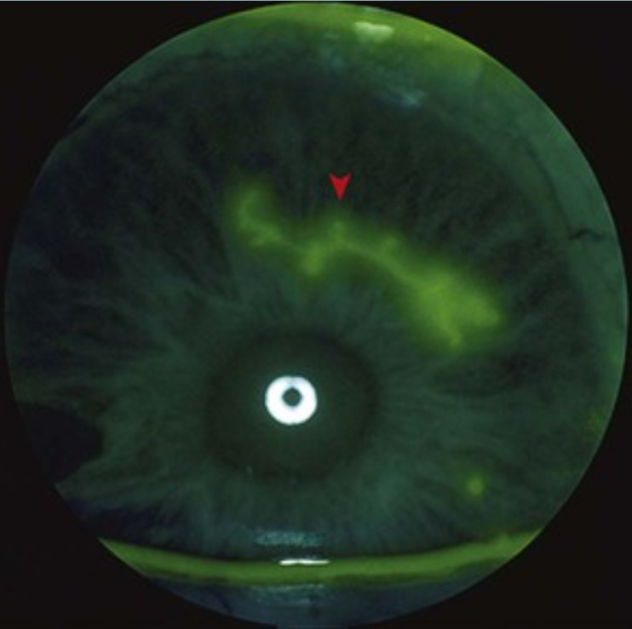
A 27-year-old woman has a 1-day history of visual clouding, pain, photophobia, and excessive tearing in her right eye. On examination, she is found to have blepharoconjunctivitis, with vesicles on the skin of her eyelids. She undergoes a slit-lamp examination under fluorescent light, which reveals the findings shown.
1.What is your diagnosis?
2.What sudden complication can occur?
This patient has herpetic keratitis as a result of herpes simplex virus (HSV) infection. Fluorescein dye has been placed on the surface of the eye, and it is collecting at the top and bottom of the conjunctival margins. The lesion seen is a characteristic dendritic ulceration (▾) in the corneal epithelium.
Such a dendritic ulcer can penetrate through the cornea to rupture the globe, so it must be treated promptly. HSV infection of the eye may become recurrent.

Slide 8
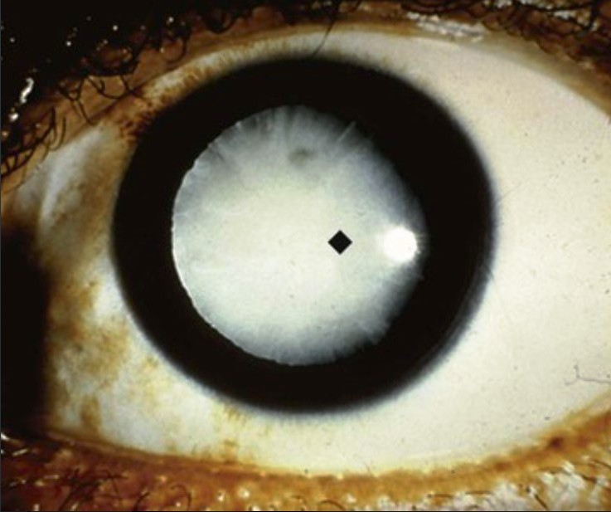
A 77-year-old man has an 8-year history of painless deterioration of vision. On examination, he has the finding shown.
1.What is your diagnosis?
2.What is the effect on his visual fields?
3.How does this lesion develop?
Opacification of the crystalline lens is a cataract (♦).
The center of the visual field would be affected first, with gradual expansion as the cataract enlarges.
The opacification results from a series of events that begin in the lens cortex with the rarefaction and then liquefaction of cortical cells. This leads to the fragmentation of lens fibers and extracellular globule formation. In the lens nucleus, there is a progressive increase in insoluble proteins, which leads to hardening (sclerosis) and brownish discoloration (brunescence).

Slide 9
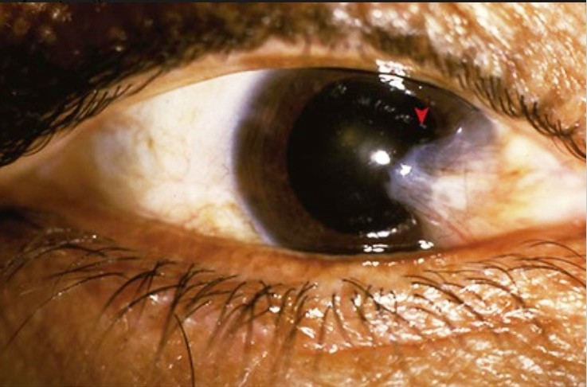
A 69-year-old man has an 18-month history of the progressively enlarging lesion of the sclera shown. He now reports that it is beginning to interfere with his vision.
1.What is your diagnosis?
2.What would it be called if it did not involve the cornea?
3.How does this lesion develop?
4.Why could corneal ulceration occur?
This is a pterygium (▸). It is an area of elastosis and basophilic degeneration of the substantia propria collagen.
Pinguecula.
This raised, whitish yellow lesion is associated with advancing age. It is thought to be the result of environmental or solar exposure over a lifetime.
Conjunctival irregularity caused by this lesion can interfere with tear film distribution. This may lead to focal corneal dryness, which predisposes the eye to epithelial damage and ulceration.

Slide 10
A 64-year-old woman with hyperopia has had deteriorating vision for the last 4 years. She undergoes an excavation of the optic nerve heads with funduscopic examination. The appearance of her visual field is shown.
1.What is your diagnosis?
2.Can you relate this patient's hyperopia to the visual loss?
3.What pharmacologic treatments can be given?
She most likely has primary angle closure glaucoma (the most common form of glaucoma) with increased intraocular pressure.
Her hyperopia potentially results from an elongated eyeball yielding a more acute angle to the anterior chamber margin; this results in the diminished reabsorption of aqueous humor.
Topical agents such as prostaglandin receptor agonists (e.g., latanoprost) are often used initially to increase aqueous humor outflow. β-Adrenergic receptor–blocking agents (e.g., timolol), carbonic anhydrase inhibitors (e.g., dorzolamide), and α2-adrenergic agonists (e.g., brimonidine) all decrease the production of aqueous humor.

Slide 11
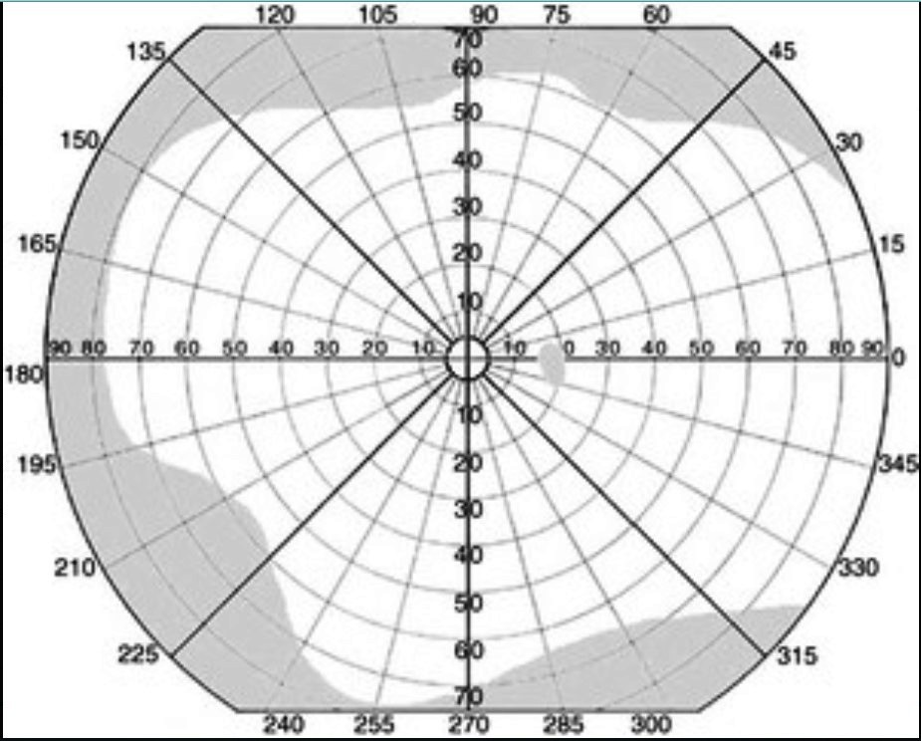
A 52-year-old African-American man has a 3-year history of deteriorating vision; everything seems darker to him. The objective map of his visual field is shown.
1.What is tonometry likely to show?
2.What is gonioscopy likely to show?
3.What causes a secondary form of this disease?
Tonometry would show the increased intraocular pressure of glaucoma; this typically involves a device that blows a puff of air into the eye. A more exact measurement can be made with an applanation tonometer as part of a slit-lamp examination.
Gonioscopy with a goniolens views the angle of the anterior chamber to determine if open-angle or closed-angle glaucoma is present. This patient likely has open-angle glaucoma (the most common form of glaucoma).
Concurrent ocular disease—including intraocular hemorrhage, uveitis, neoplasia, and lens displacement—may cause secondary glaucoma.

Slide 12
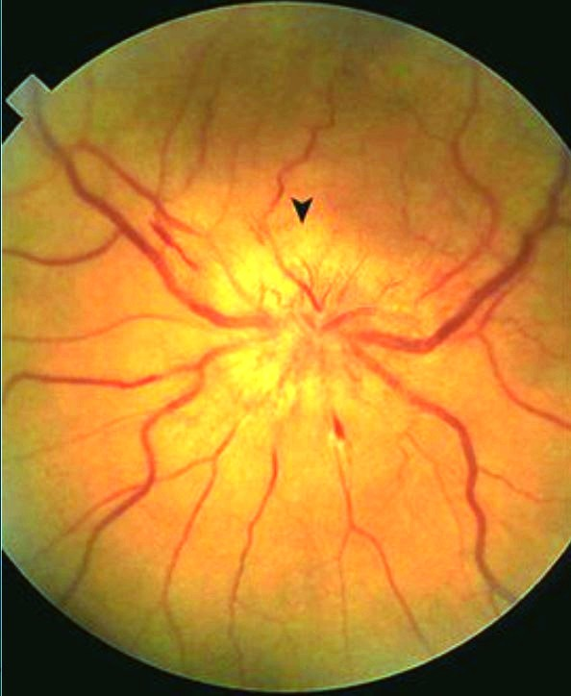
A 44-year-old man has had a severe headache for the past day. On examination, he has a fever, nuchal rigidity, and the funduscopic finding shown. An MRI of his brain shows flattening of the gyri and narrowing of the sulci.
1.What does funduscopy show? 2.What could cause this finding?
3.Would you do a lumbar puncture? 4.What is the most likely diagnosis?
The indistinct and blurred optic disk margins (▾) indicate papilledema.
Any condition that increases intracranial pressure (e.g., edema, hemorrhage, mass lesions) produces papilledema. The intracranial pressure must be relieved, or the patient may experience herniation (i.e., of the cerebellar tonsils, the uncus of the hippocampus, or the cingulate gyrus).
No. Lumbar puncture could potentiate herniation.
These findings suggest diffuse cerebral edema from infection, probably meningitis.

Slide 13
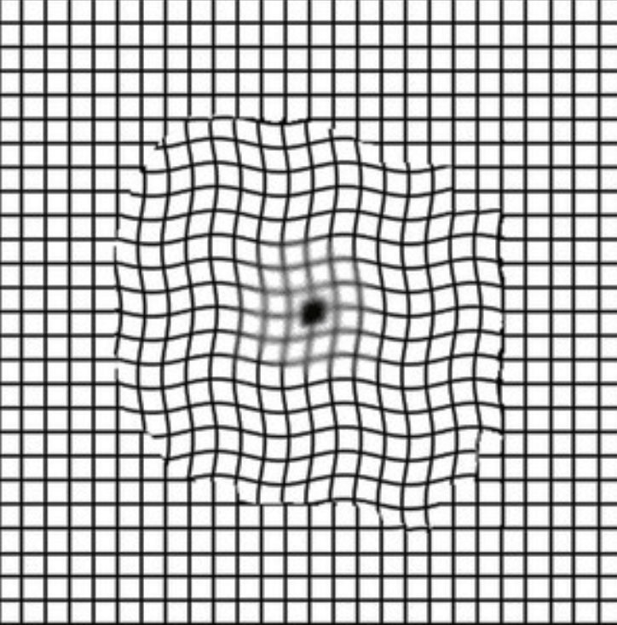
A 75-year-old woman has a 5-year history of increasing visual impairment. On funduscopic examination, she has discrete yellowish deposits in the Bruch membrane and geographic atrophy of the retinal pigment epithelium. Her visual defect is shown on the Amsler grid.
1.What is your diagnosis? 2.Name these deposits in the Bruch membrane.
3.What microscopic changes are present?
This is age-related macular degeneration (ARMD). The macula with the greatest density of photoreceptors is the most sensitive area for visual acuity and is affected the most. The Amsler grid reveals central visual field distortion.
The atrophic form of ARMD is associated with deposits known as drusen.
Choroidal neovascular membranes represent angiogenesis. These new leaky vessels penetrate through the Bruch membrane beneath the retinal pigment epithelium; their intrinsic leakiness results in the characteristic exudates.

