Slide 1
Investigating Specific Operational Definitions in Observer Bias utilizing Signal Detection Theory(SDT)
KOΝΙΑΡΗΣ ΣΤΑΜΑΤΗΣ
Experiment utilized SDT as a framework to analyze observer behavior in the presence of ambiguous stimuli, akin to detecting signals in noise
The study aimed to determine if observers could be reliably biased in a laboratory setting by scoring videotaped segments of simulated child-teacher interactions containing clear and ambiguous samples of designated behaviors.
Building on Signal Detection Theory (SDT), the hypothesis was that hits and false alarms would increase when observers were provided brief feedback and contingencies, potentially altering their response bias without affecting sensitivity..

Slide 2
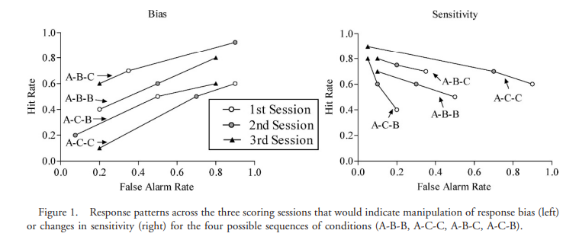
Objective: The primary goal of Experiment 1 was to develop and test a procedure to assess factors influencing observer accuracy and bias in behavioral assessment, specifically focusing on the impact of feedback and contingencies on observer scoring behavior.
Significance: By investigating how feedback and contingencies influence observer bias in scoring behaviors, Experiment 1 sought to enhance understanding of the factors affecting observer accuracy and consistency in behavioral measurement.

Slide 3
Results of Experiment 1 Analyzed Using Signal Detection Theory (SDT)
SDT Perspective: Sensitivity in SDT refers to the ability to discriminate signals (aggressive behaviors) from noise (non-aggressive behaviors).
Interpretation: By examining the patterns of hits and false alarms in Experiment , researchers can infer how feedback and contingencies influenced observers' decision-making processes.
Separating Sensitivity and Bias: Applying SDT allows researchers to disentangle the effects of sensitivity and response bias on observer behavior, providing a more nuanced understanding of how feedback and contingencies shape scoring accuracy.

