Slide 1
AMERICAN WOMEN POETS OF THE 20TH & 21ST CENTURY
Dr. VASILEIOS N. DELIOGLANIS
GENDERED MODERNISM
Department of English Language and Literature, National & Kapodistrian University of Athens

Slide 2
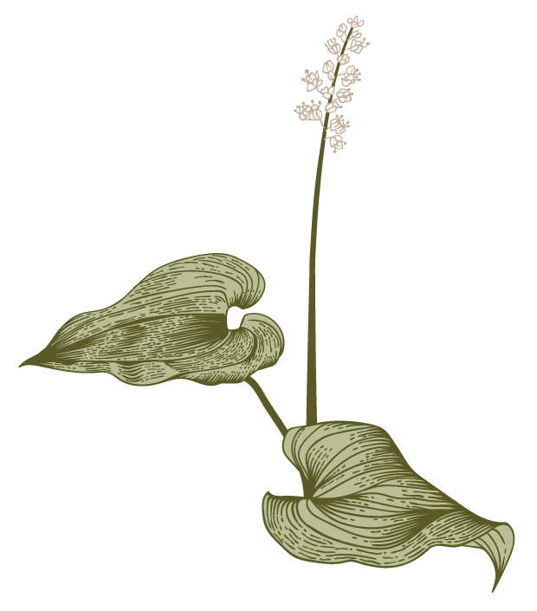
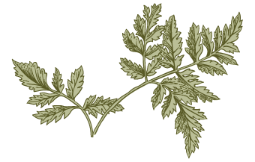
Transition from Romantic and Victorian to modern modes of poetry
Influenced by Darwin, Marx, Freud, and Einstein
New modes of verbal expression
Revival of classical and religious myths
change in literary values
emerging classicism
reassertion of tradition
New visual art: motion, speed, urbanity, machinery, accelerated pace of life
1913: the Armory Show: awareness of the revolutionary and distinctive newness of 20th century life and culture
parallels for the impressionists, the cubists, the surrealists, and the futurists in their poetry
The Emergence of the Modern

Slide 3
Women poets: Women’s importance as poets / dismissed but later recognized
Two groupings of women poets:
traditionalists:
use of more conventional forms such as the sonnet
explore their personal experiences and gendered positions in society
experimentalists: formal and linguistic innovation
Ambivalence about traditional constructions of gender: androgyny
Gendered Modernism

Slide 4
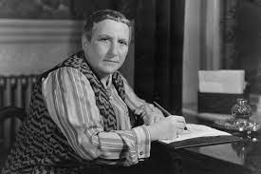
Gertrude Stein (1874-1946)

Slide 5
Gertrude Stein (1874-1946)
Influenced by William James
Use of stream of consciousness technique
Influenced by Cubist paintings
Nature and properties of language: Playfulness
Repetition
Attention to the process of composition
Sense of flux

Slide 6
Cubist Paintings
Abstraction
Distortion
Ambiguity
3D geometrical shapes
Fragmentation
Colors
Continuity
Piling up of images
Disorder
Mobility
Marcel Duchamp – Nude Descending a Staircase (1912)

Slide 7
Tender Buttons: A Substance in a Cushion (1914)
Images / other concrete things
Repetitions
Colors
Change
There is
Does not
Shows
Likely
Difference
Thing
Sight
Band
Supposing
Red
White
Pink
Purple
Light blue
Black
Green
Table
Chairs
Closet
Bed
Swan
Ivy
Suit
Matches
Oyster
Feather
Seal
Cotton

Slide 8
Writing Style
Emphasis on how we see things
3-Dimensionality – Moving away from fixed points of view
Prose + Poetry collide
Emphasis on fragmented forms & discontinuous narratives – poems as collages of disparate words & images
Repetition
Present Tenses
Spontaneity & Discovery (stream of consciousness)
Rhythm (alliteration)
No personal pronouns
Punctuation (no commas, but fullstop)
Tender Buttons: A Substance in a Cushion (1914)

Slide 9
Poem full of secret codes
Poem that mingles together poetic experimentations with erotic desire
Poem to be enjoyed
Poem full of language games
No personal feelings
No unity, no order, no cohesion, no coherence
Poem that speaks to our senses and our uncontrolled emotions
Tender Buttons: A Substance in a Cushion (1914)

Slide 10
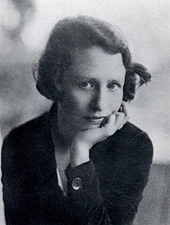
Edna St. Vincent Millay (1892-1950)

Slide 11
Edna St. Vincent Millay (1892-1950)
Skillful use of the sonnet
Live life to its full potential
Against traditional ideologies of gender and sex
Reversal of conventional gendered roles

Slide 12
[I, being born a woman] (1923)
Revisioning the Italian tradition of the Petrarchan poem
Millay’s poem
Petrarchan poem
External appearance retained – Rhyme
Content subverted
Rhyme pattern – Octave & sestet: ABBA ABBA CDCDCD
Content: pains and hopes of a male lover
Octave: ideas & arguments
Sestet: answer to previous arguments
Rhyme patter – Octave & sestet: ABBA ABBA CDCDCD
Content: sexual love, emotional disorder, female individuality & empowerment
Octave: ideas & arguments
Sestet: answer to previous arguments

Slide 13
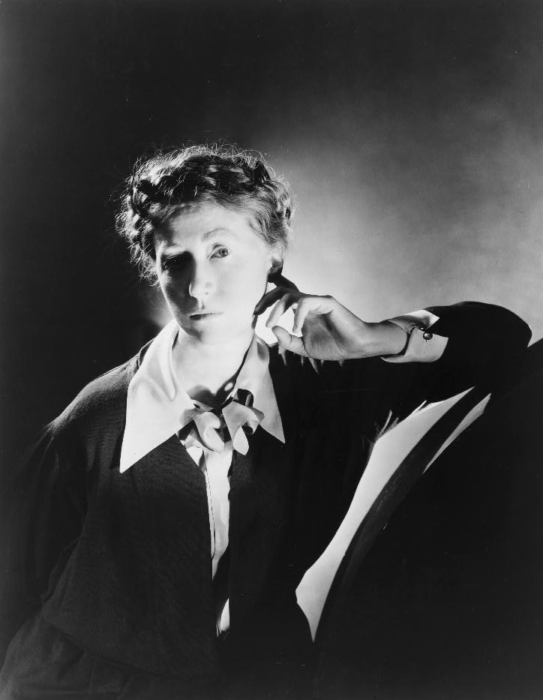
Marianne Moore (1887-1972)

Slide 14
Marianne Moore (1887-1972)
Experimental poet
Literary tradition is contingent (Raymond Williams & Julia Guillory)
Clarity and precision in language – playfulness
Use of sound (Alliteration, assonance and rhyme)
Breaks formal rules about rhyme, line endings, and the coherence of stanzas
Attention to things, objects, people, animals, and plants that surround us
Multiple points of view
Influenced by Precisionist painters: emphasis on vivid color, precise detail, motion, 3D perspective

Slide 15
“Nevertheless” (1944)
Conversational tone – stepped verse
Words split: energy
Nothing remains the same – all things change
Model of survival and persistence
Tenses: Present Perfect & Present Simple
Constant revolution, progression, transformation, evolution, metamorphosis

