Slide 1
Migration and Southern European member-states
The European Policies of the EU Member-states, Teresa Perri,
2023-2024
Painting: Jacob Lawrence ,The migration series

Slide 2
How specific Southern EU member-states have been affected by the migration issue including during the crisis of 2015/2016, and after, and what they would like to see in terms of an EU policy towards the issue?
TOPIC
CHAPTERS
Factors shaping their stance towards EU in general and EU migration and asylum policy
What Europe? What Migration and asylum policy?
Current and recent crisis
Public Opinion on Migration
Greece
Italy
Malta
Spain
Cyprus

Slide 3
Factors shaping the stance of Southern EU member-states towards EU migration and asylum policy
Place on the Map
Population and size
Unemployment rate 2015

Slide 4
Timeline of the Migration crisis, events (2015-)
2015
Nearly a million migrants
enter Europe through
Eastern med. and Balkan
route
2016
EU-Turkey deal
2017
Italy gateway-Central Mediterranean Route
2018
Italy closes ports
2020
Turkey reopens borders to Greece
Spain receives "Aquarious" rescue ship
Political Tension on Voluntary relocation mech.
2022
Fear of a repeat of 2015
Russia-Ukraine war
Ukrainians fleeing to EU member states

Slide 5
Main Migration passages in the EU

Slide 6
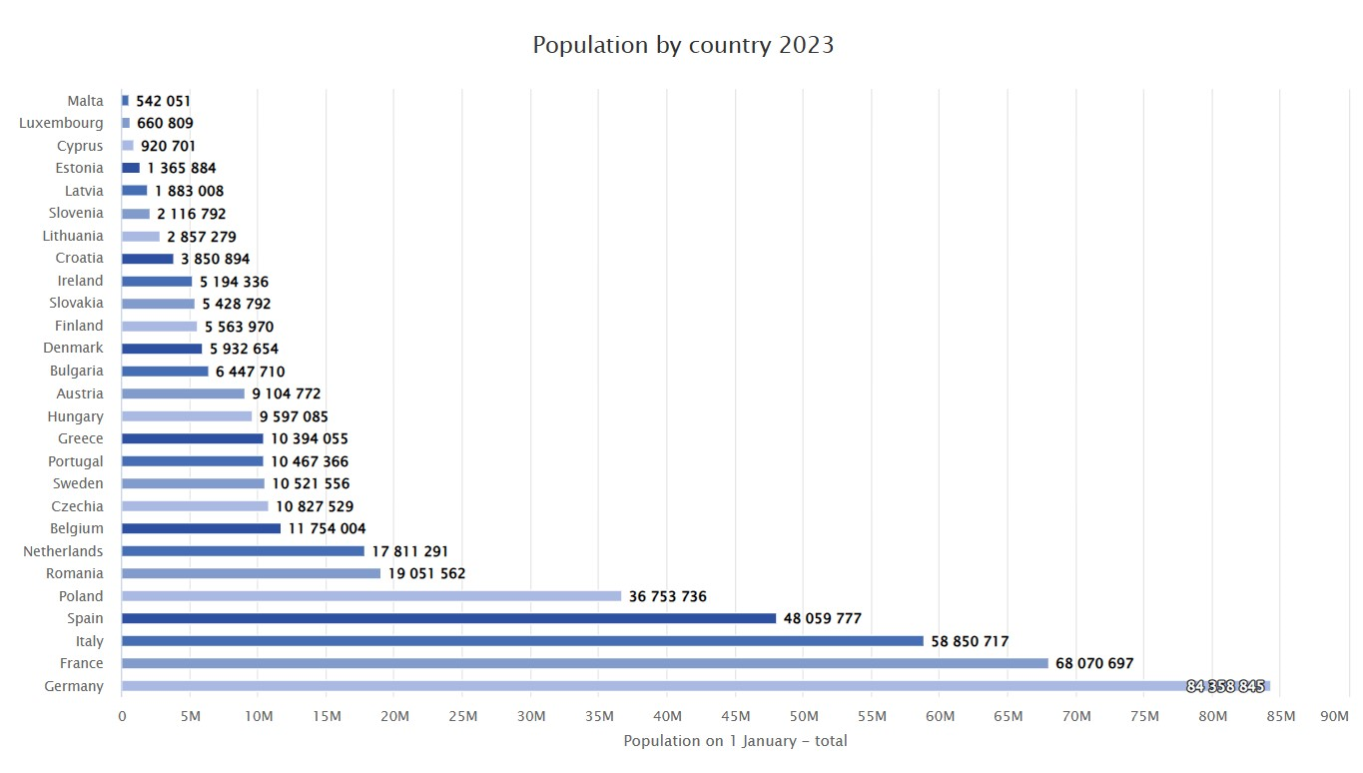
Population of S-EU member-states
Size and population matter in regard to the qualified majority voting process
Also (!) the bigger the state , the more developed the infrastructure/mechanisms to cope with asylum applications

Slide 7
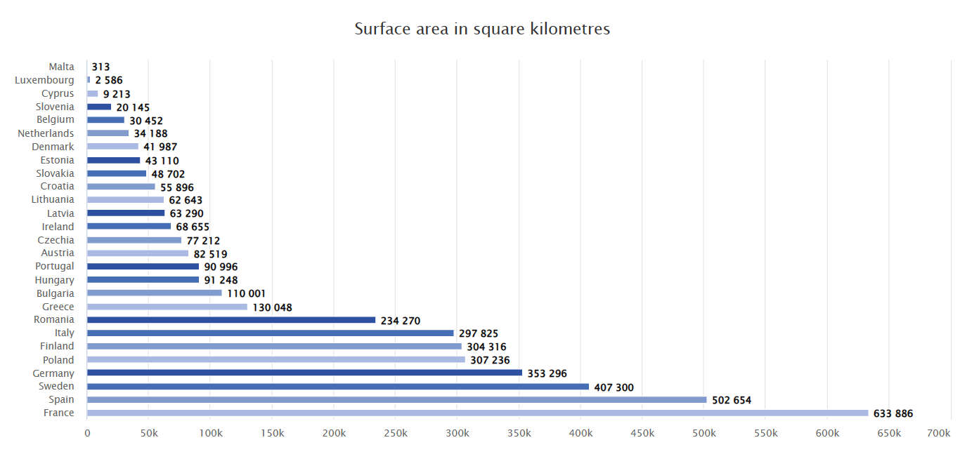
Size of S-EU member-states

Slide 8
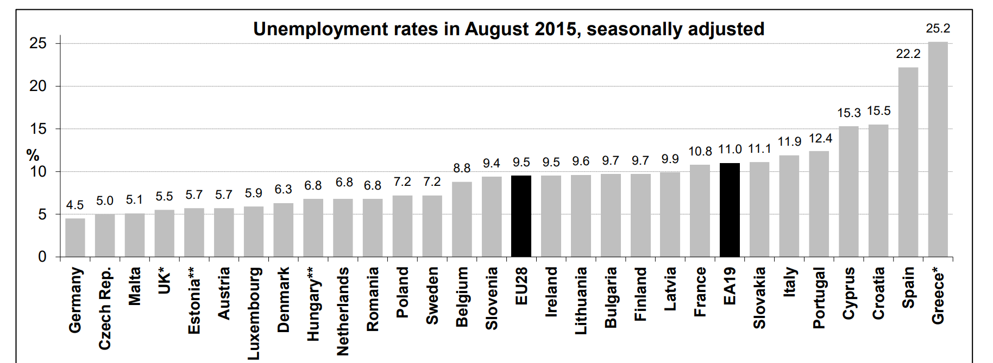
Unemployment Rate 2015: S-E member-states, the best of the last

Slide 9
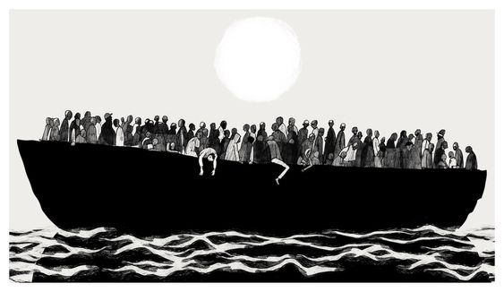
What Migration and Asylum Policy? What Europe? Current and Recent Crisis

Slide 10
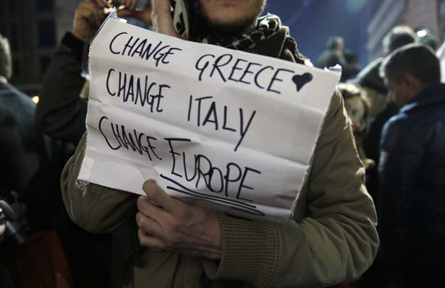
Why does the stance of Southern EU member states matter?
" I can be in a pro-Europe Government ,while dreaming of a different Europe"
"I refuse to think of substituting 10 million Italians, with 10 million migrants"
" There will ,unfortunately, be cases where it will simply be impossible to always save human life"
Statements: top government officials of SE member states on migration
Photo: Protester, Athens, Jan 25,2015

Slide 11
Timeline on agreements and regulations
2013
2015
Valetta Action Plan
2016
EU-Turkey common statement
2017
European Agenda on migration
2020
2023
New Pact on Migration and Asylum(Commision)
Dublin Regulation
Malta Declaration
EU-Tunisia Agreement
Italy-Albania deal
Dublin Regulation(2013)
Dublin Regulation arranges which member state is responsible for each asylum application. Most importantly , indicates hierarchically the criteria for the determination of the responsible m-s to process the application.
First Entry M-State > responsible for the processing of the asylum applications
Pressure on the "Front Line M-S"

Slide 12
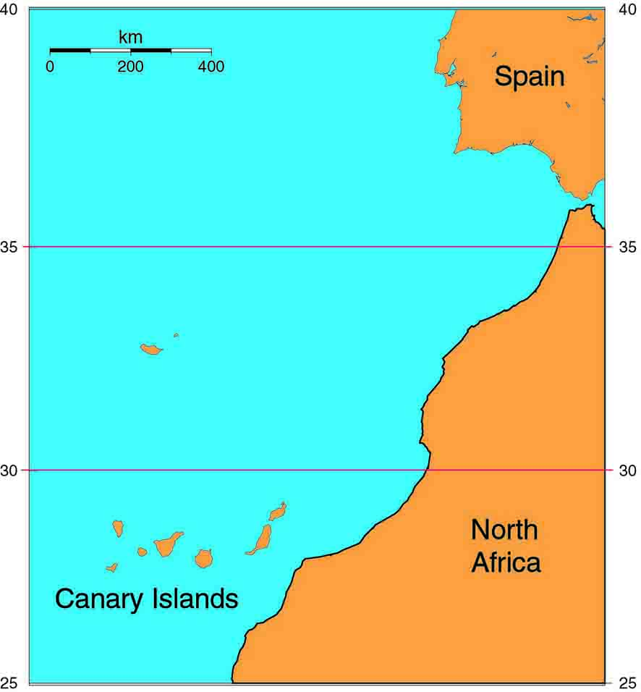
Recent Lampedusa Crisis, Italy, September 2023
July 2023: European Commision and Tunisian Gov. Accord
September 2023: Lampedusa (closer to Tunisia than Sicily) receives almost 7.000 in a day (Islands migrant camp designed to host fewer than 300)
Official Visit to Lampedusa by Ursula von der Leyen along with Meloni
Italian Government called for solidarity from the EU, though received dismissal from other EU members.
November 2023: Italy - Albania Deal
Canary Islands, Spain, October 2023
Oct.5th Pedro Sanchez pleaded for solidarity on irregular immigration to Canary and Balearic islands and the Spanish south, in the wake of increased arrivals from Senegal and other African countries.

Slide 13
Place of Lampedusa on the Map

Slide 14
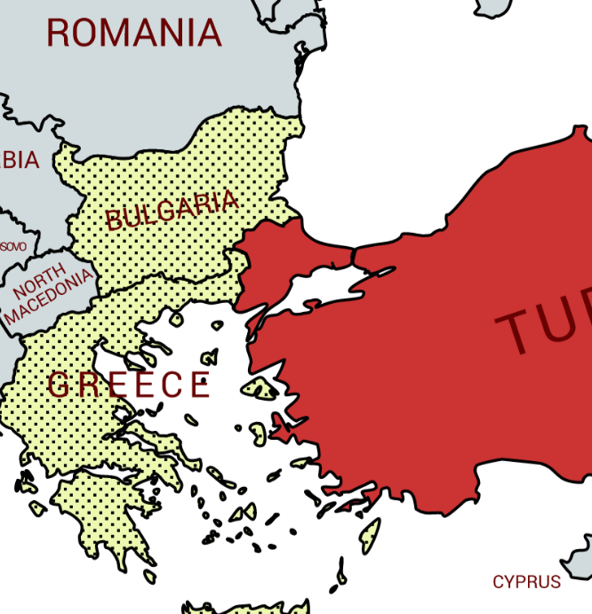
External Borders of the EU
The "protection of the External Borders of the EU" is probably one of the most famous government statements of the Southern EU m-s.
According to Regulation 2016/399(Schengen borders code), EU's external borders are the borders of Schengen m-s(sea ,river, air borders) that are not common borders with another Schengen M-s.
Crisis in Evros, Greece, 2020 (example of emphasis on external b.)
Feb 2020 : Turkey announces the crossing of 80.000 migrants to Greece through Evros borders(highlighted)
Greek Gov. Closes its borders in Evros and announces the building of a fence for the protection of Greece's and EU's external borders.

Slide 15
New Pact on Migration and Asylum(2020-), Stance of S-EU member-states
Cyprus
Small state (as the case of Malta)
Greece
Sceptic on effectiveness of bureacratic process
Positive on relocation and solidarity mechanisms
Italy
Positive as well on solidarity measures
Sceptic on part about search-and-rescue services by NGO vessels in the med. (Council of interior ministers)
Malta
Seriously sceptic on the pact, concerns about lack of change of "Dublin Regulation"
Pressure on small states
Spain
Promotes the pact through the Presidency of The Counsil (difference with Malta, developed and complicated public sector by nature)
The Pact is not inserting any reform on Dublin Regulation.
As a consequence, generally all S-EU member-states would want to see a reform of the Dublin Regulation, probably, additionally to the new Pact.

Slide 16
Southern EU member states and Ukrainian refugees
Ukrainian Refugees are under "Temporary Protection" in the EU member states.
Even though, southern EU M-S support Ukraine and Ukrainian refugees they don’t host as much as Germany and Poland for example(or other smaller member states closer to Ukraine in relation to their size)
Spain and Italy are hosting around 170.000 refugees each while also providing important financial support.

Slide 17
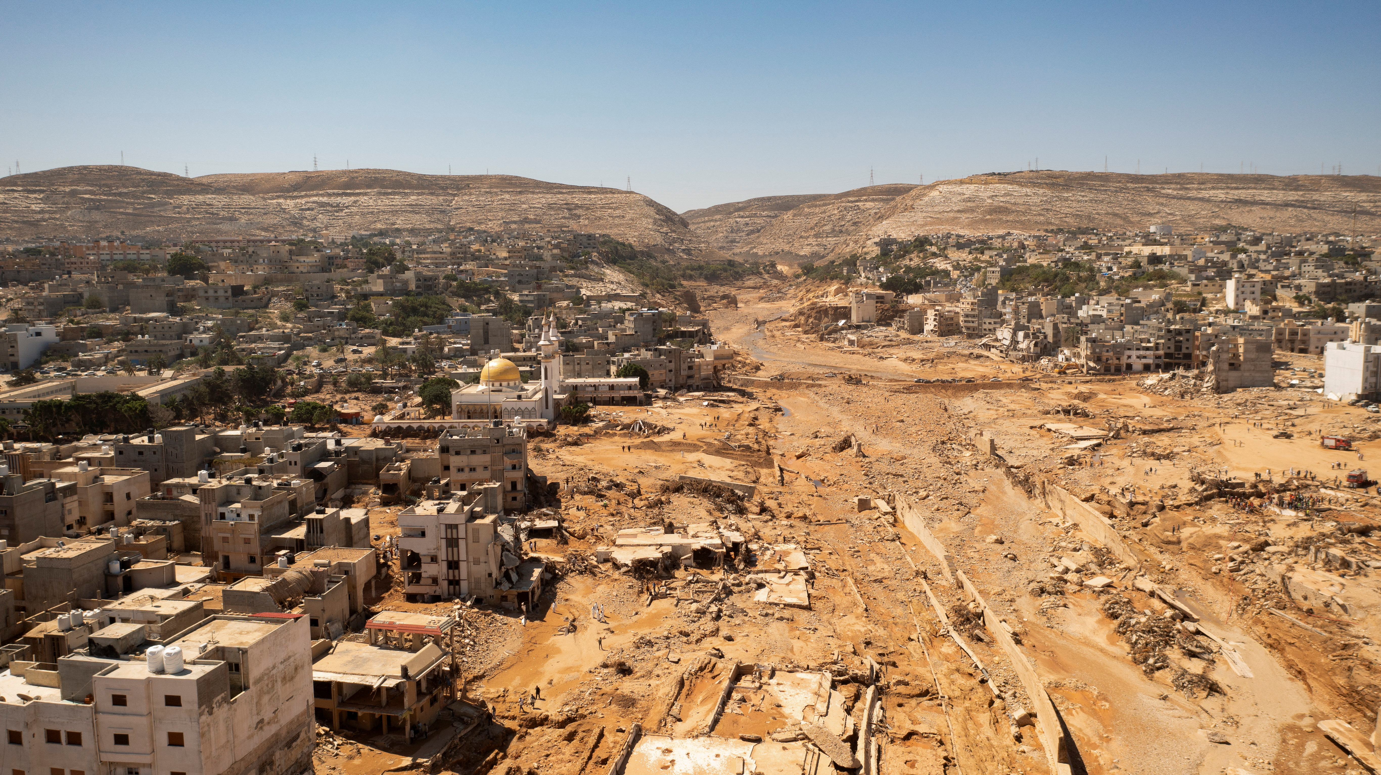
Climate Crisis and European Migration
Jean Claude Juncker,2015: Climate change is even one of the root causes of the new migration phenomenon
Why is it important for our talk considering the Southern European
M-S?
March 2022: Report "The future of climate migration" for MEP'S of EU Parliament, EPRS
Report states: high level of ecological threat to the MENA countries- Middle East and North Africa
Southern EU members and EU external borders susceptible to new, mass arrivals
Geopolitical risk (Conflicts)
Lack of goods, infrastructure and services
Risk of Natural disasters(floods , desertification etc.)
Greek Minister on Mig. And Asylum, Sep. 2023:
In need of a Euro-Turkish Deal to manage multiple crisis in MENA(earthquakes in Morocco, floods in Libya)
Photo: Derna, Libya ,September 2023 after deadly floods killing around 11.500

Slide 18
Public Opinion on Migration: Sceptic and hesitant or realistic to worldwide challenges?

Slide 19
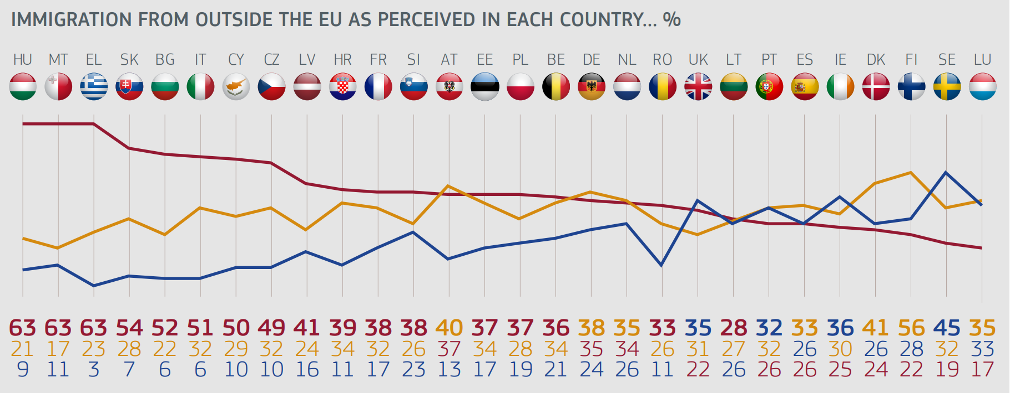
Public opinion
According to Eurobarometer Survey of 2018,
except for Spain, in all the rest S-EU member states ,
more than a half/half the population of the survey considers immigrants(*) as "more of a problem"
*non-EU nationals staying legally in the EU
Red line: more of a problem Yellow l. : equally a problem & an opportunity Blue: More of an opportunity

Slide 20
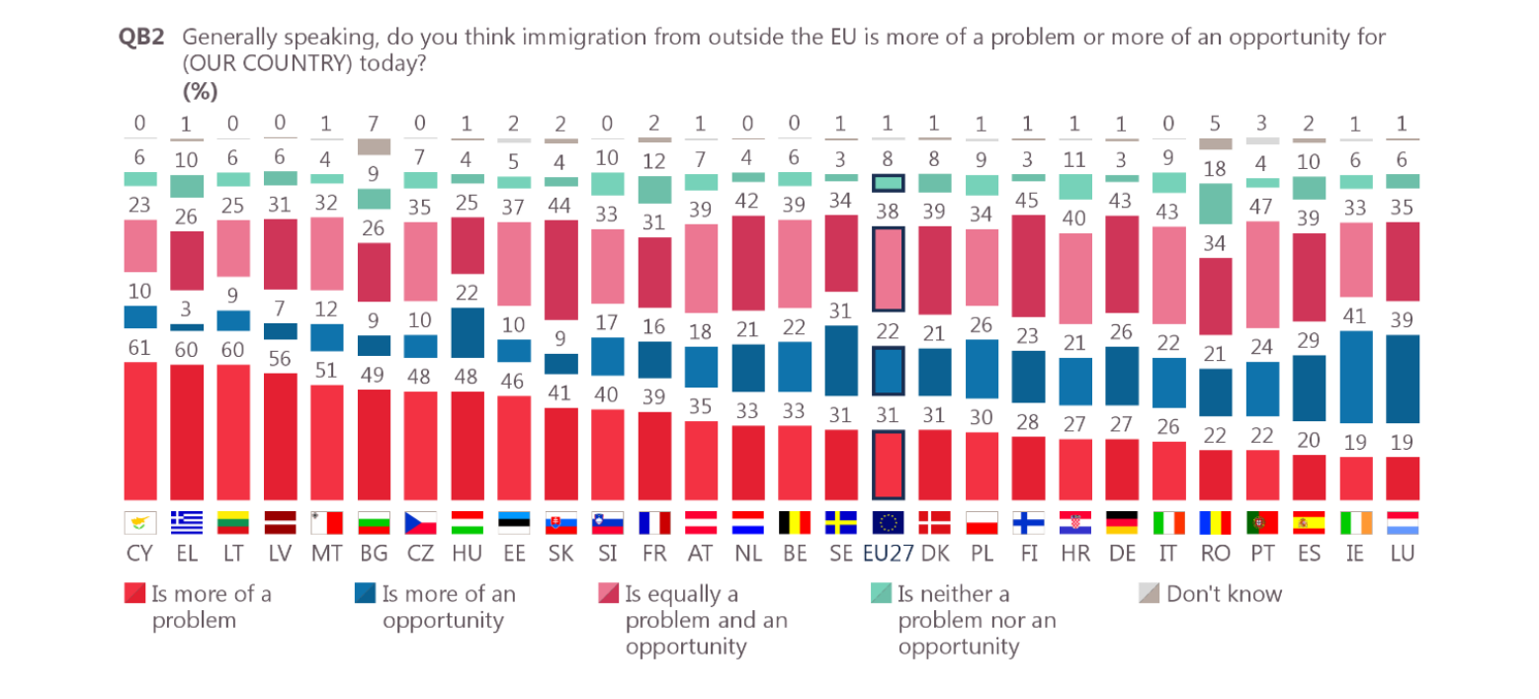
2022 Eurobarometer Survey: Immigration(*) more of a problem? For which member-states?
In contrast to 2018 findings the only significant change has been seen to Italian Public opinion stance(in a positive manner). While Cyprus, Malta and Greece sustain their high figures in considering immigration as more of a problem

