Slide 1
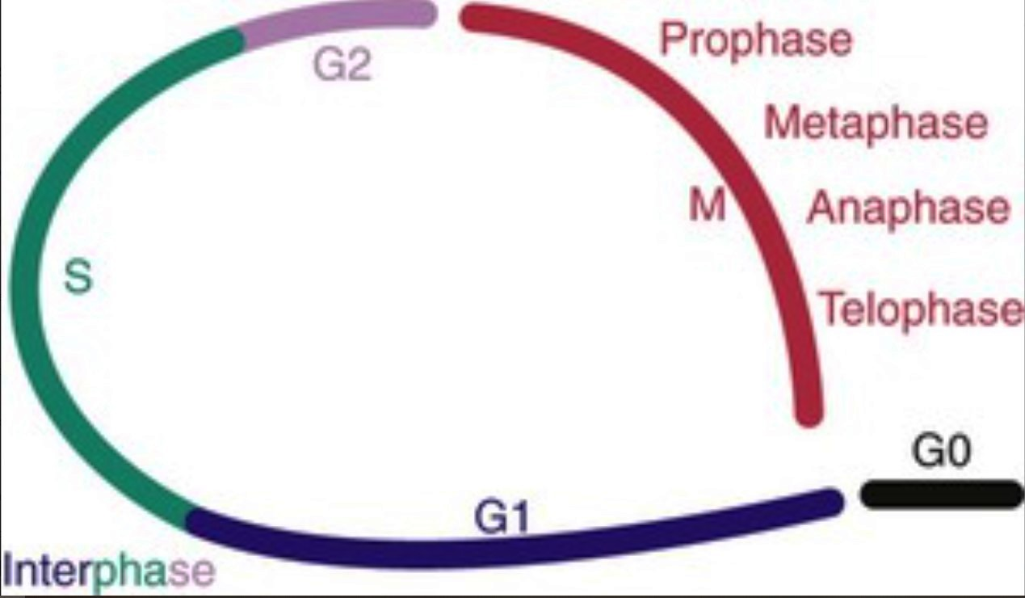
A 42-year-old man with Hodgkin lymphoma receives a multidrug regimen and radiation therapy, with a good radiographic response (the tumor mass shrinks). A cell cycle schematic is shown.
1.At what point is the p53 protein going to arrest the cell cycle?
2.At what point is cell cycle arrest most likely to occur in response to radiation?
1.This will occur at the G1-S transition. Cells want to ensure DNA fidelity before they commit to a round of replication. Existing DNA damage (e.g., as a result of chemotherapy) increases levels of p53; p53 induces transcription of the cyclin-dependent kinase (CDK) inhibitor p21; and p21 blocks Rb phosphorylation, which prevents new DNA synthesis. If DNA damage is irreparable at this point, cells may undergo apoptosis.
2.This will likely occur at the G2-M transition. Ionizing radiation leads to acquired mutations, largely in newly synthesized DNA. To prevent the transmission of chromosomal abnormalities to daughter cells, p53-dependent and p53-independent pathways arrest the cell cycle by inducing CDK inhibitors.

Slide 2
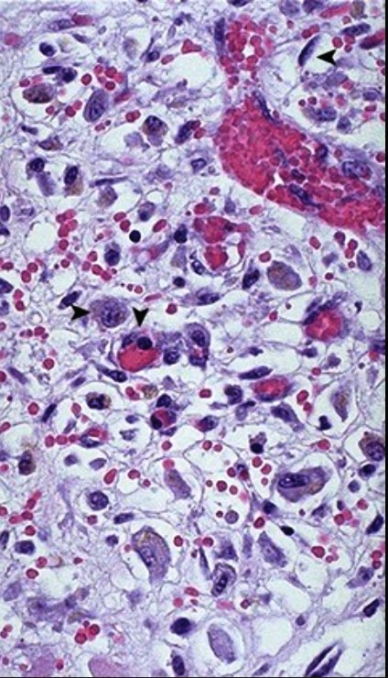
A 15-year-old boy incurs a laceration to his right calf after falling off of his skateboard onto a pile of bricks. Ten days later, the histologic appearance of the dermis is shown.
1.Name the histologic change shown.
2.What dermal cells have transitioned from G0 to G1?
3.What growth factors are responsible for this transition?
This is granulation tissue, which is marked by angiogenesis (new capillaries, ▾), macrophages (▸), and fibroblasts (◂), with loose, edematous connective tissue.
Connective tissue cells (fibroblasts) and endothelial cells can re-enter the cell cycle after being stimulated by tissue injury, with ensuing inflammation and growth factor release.
Fibroblast migration and proliferation are stimulated by epithelial growth factor, basic fibroblast growth factor, and platelet-derived growth factor. Angiogenesis is stimulated by vascular endothelial growth factor and basic fibroblast growth factor.

Slide 3
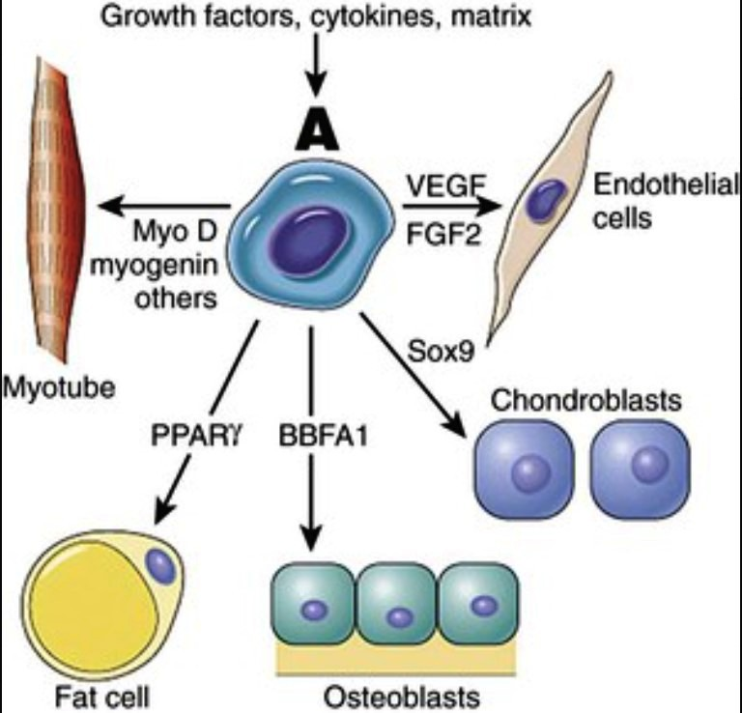
Depending on the tissue environment, certain cells can re-enter the cell cycle and differentiate. This is shown in the diagram.
1.What is the quiescent cell marked “A”?
2.Where in the cell cycle is “A”?
3.Is cell “A” an embryonic stem cell?
This is a pleuripotent bone marrow stromal stem cell.
This cell is in G0. Growth factors activate intracellular signal pathways that control gene expression through transcription factor binding to nuclear DNA.
No, it is a pleuripotent adult stem cell capable of differentiating into several different mesenchymal lineages. Embryonic stem cells capable of forming all tissues in the human body (totipotential) are largely confined to the blastocyst stage.

Slide 4
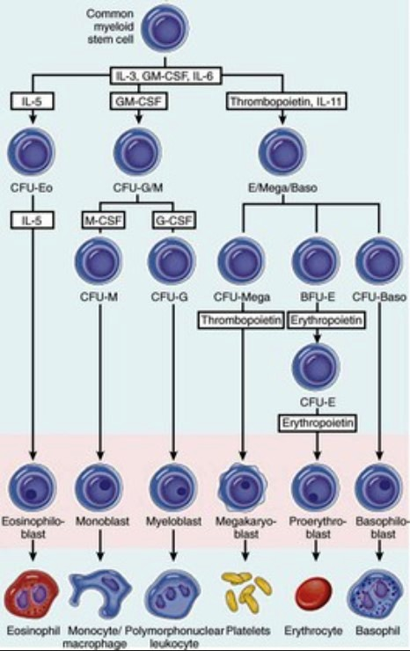
A multipotent common stem cell (top) is derived from a pleuripotent stem cell in the embryonic mesoderm; it can reconstitute bone marrow and generate all circulating blood cells after lethal irradiation. Stem cells have a high capacity for self-renewal, but they are largely quiescent (i.e., in the G0 state). With successive commitment to differentiation, the ability for self-renewal wanes, but the cells more actively proliferate.
1.What is the critical feature of pleuripotent stem cells?
2.Do the factors shown in the boxes induce differentiation?
3.Can cells in colony-forming units give rise to stem cells?
1.Asymmetric replication is the critical feature. When this occurs, one cell of every division retains the capacity for self-renewal; this is the functional definition of “stemness.”
2. Rather than directly inducing differentiation, each of the factors indicated in the boxes acts on specific surface receptors in a given population subset to provide signals that promote survival. In the absence of the appropriate cytokine or factor, the committed precursor cell dies.
3. No. They are already differentiated into specific lineages.

Slide 5
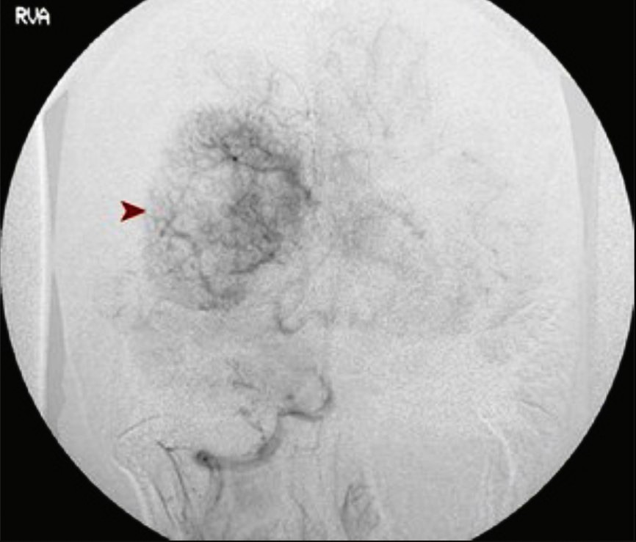
A 43-year-old woman with a 5-month history of recurrent headaches undergoes an MRI, which reveals a well-circumscribed superficial parasagittal mass compressing but not invading the cerebral cortex. Her cerebral angiogram is shown here.
1.What is the likely diagnosis?
2.Explain the angiographic appearance.
3.What growth factor is responsible, and what is the cell of origin?
This is almost certainly a meningioma. This diagnosis is based on the lack of invasion and the circumscribed nature of the tumor.
This neoplasm is highly vascular, which accounts for the “blush” of vessels (▸) within the tumor mass.
Neoplasms (in this case, the meningioma cells) secrete growth factors, such as vascular endothelial growth factor (VEGF), which promote angiogenesis. As tumors grow, they exceed the capacity of the existing blood supply to provide adequate oxygenation and nutrition. Relative tissue hypoxia typically drives the VEGF expression that induces new vessel growth.

Slide 6
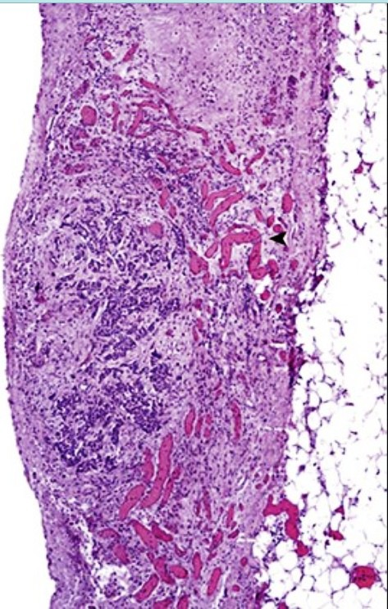
A 71-year-old man has had chest pain for the past week. On examination, he is found to have pulsus paradoxus. Pericardiocentesis yields 300 mL of bloody fluid. The appearance of tissue from a pericardial biopsy specimen is shown.
1.What is shown here?
2.How does this lesion account for pulsus paradoxus?
This is an epicardial metastasis of carcinoma. Note the extensive vascularity (◂) surrounding the tumor.
Epicardial and pericardial metastases tend to hemorrhage, and the collection of blood in the pericardial cavity produces cardiac tamponade. This leads to decreases in systolic blood pressure on inspiration of more than 10 mm Hg less than the systolic pressure on expiration—hence pulsus paradoxus.

Slide 7
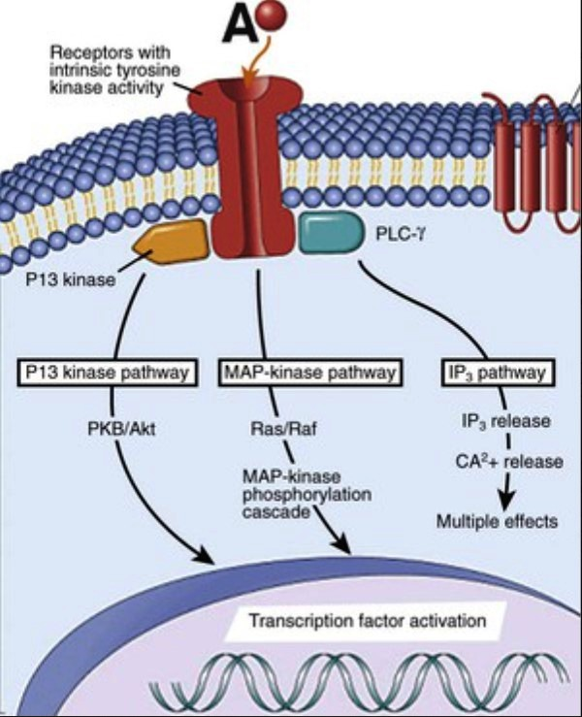
A surgical incision healing by primary intention contains a smorgasbord of growth factors that orchestrate orderly cellular proliferation and matrix synthesis. Some mediators made during this process—represented as “A” in the figure—act through cell surface receptors with intrinsic kinase activity (i.e., with the ability to phosphorylate select protein substrates).
1.What substance leads to endothelial cell mitogenesis with capillary proliferation and increased vascular permeability?
2.What substances can increase keratinocyte and fibroblast mitogenesis?
3.How do these extracellular molecules induce their intracellular effects?
1.Vascular endothelial growth factor (VEGF)
2. Fibroblast growth factor and epidermal growth factor
3.Growth factors activate signal transduction pathways that modulate gene transcription. This occurs through the modification of transcription factors, thereby preventing their degradation or allowing their nuclear localization so that they can bind to nuclear DNA and enable the transcription of relevant effector genes.

Slide 8
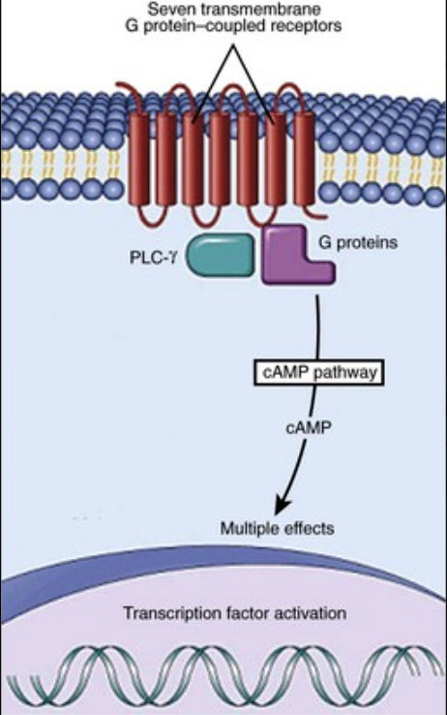
A substance acts via the receptor mechanism diagrammed. Subsequently, there is tachycardia, perspiration, decreased bowel peristalsis, and mydriasis.
1.What hormone action is described?
2.What inactive protein is exchanged for the active form in this pathway?
3.In addition to cAMP, what second messenger ion can be released through the action of activated G proteins?
1.Catecholamines (epinephrine and norepinephrine).
2.GDP in the inactive protein is exchanged for GTP, which leads to G protein activation. Increased cAMP production is one associated downstream effect.
3.Inositol 1,4,5-triphosphate (IP3) induces the release of calcium from endoplasmic reticulum stores.

Slide 9
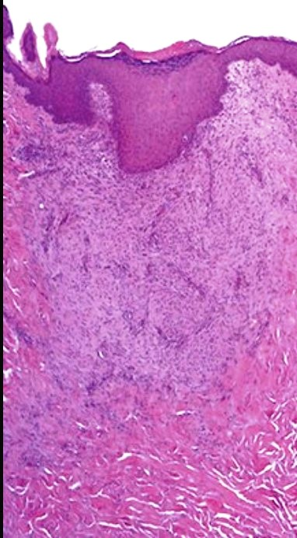
One week after an uncomplicated laparoscopic hernia repair, a 37-year-old pathologist elects to have the healing incision site biopsied for educational purposes. The microscopic appearance is shown.
1.What is wound strength at 1 week? What is wound strength at 2 to 3 months?
2.What enzymes are responsible for wound remodeling?
3.What vitamin deficiency delays this process?
4.What hormone delays this process?
5.What matrix components are poorly regenerated?
With suture removal at 1 week, wound strength is 10%; 70% to 80% of pretrauma strength is achieved after 2 to 3 months.
Metalloproteinases (collagenases, gelatinases, stromelysins, and membrane-bound forms).
Vitamin C (ascorbic acid) promotes the hydroxylation of procollagen. Deficiency of this vitamin (scurvy) leads to poorly healing wounds.
Glucocorticoids such as cortisol impede wound healing, largely by attenuating the activation of macrophages.
Basement membrane scaffolding may not be perfectly regenerated, which can lead to imperfect epithelialization. Elastic fibers are also lost, so the scar is less distensible.

Slide 10
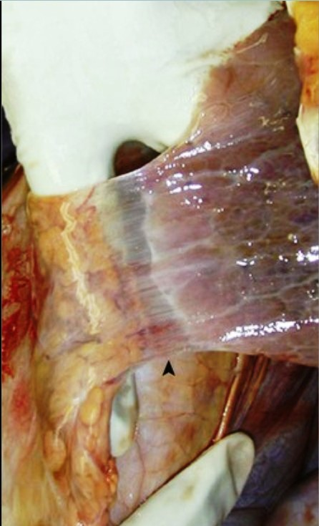
A 36-year-old man with a history of a severe pneumonia is found on follow-up chest radiography to have developed loculated pleural effusions. Had we looked, his pleura would have appeared as shown.
1.What is your diagnosis?
2.What cytokines promote this process?
3.What cells play a key role in this outcome?
This pleural adhesion (▴) is a form of fibrous scar; it divides the pleural cavity into separate regions so that fluid cannot freely move between them.
Fibroblast proliferation and activation are driven largely by tumor necrosis factor and interleukin-1. Collagen synthesis is driven by transforming growth factor-β.
Macrophages are key cellular elements that create the cytokine environment that directs healing. Proliferating endothelial cells allow for the leakage of plasma proteins (e.g., fibrinogen) that create a provisional stroma in which fibroblasts can proliferate.

Slide 11
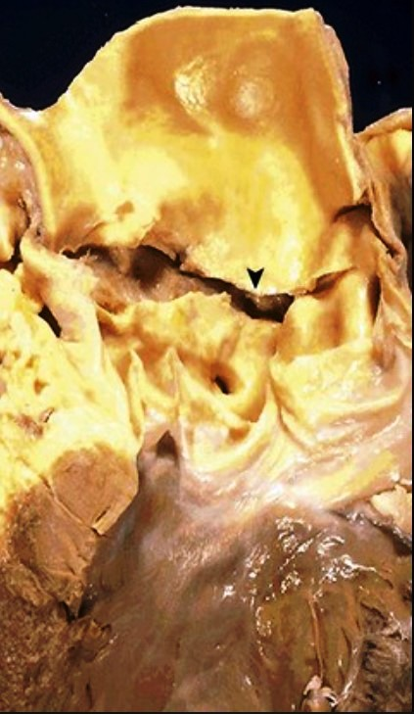
A 35-year-old woman has an abrupt loss of consciousness with a weak pulse, distant heart sounds, and hypotension. Her electrocardiogram shows reduced voltages. An emergency department physician astutely notices the patient's lens subluxation, arachnodactyly, and tall stature. Despite aggressive resuscitative efforts, the patient dies. Her aorta is shown.
1.What has happened? Why did the patient die?
2.What extracellular matrix component is abnormal?
3.What genetic diseases cause similar aortic changes?
This is an acute aortic dissection with a transverse tear (▾) and clinical findings of terminal cardiac tamponade.
This patient most likely has Marfan syndrome, which is one of several typically autosomal-dominant fibrillin-1 (FBN-1) gene mutations that lead to the defective assembly of microfibrils and consequently abnormal elastin fibers. Elastin is an important vessel matrix component, particularly for maintaining aortic integrity during repeated cycles of pulsatile high-pressure flow.
Any defect in extracellular matrix synthesis or turnover can potentially cause this condition. Ehlers-Danlos syndrome, defects in collagen synthesis, vitamin C deficiency (ascorbate is a necessary cofactor in collagen cross-linking), and transforming growth factor receptor mutations (Loeys-Dietz syndrome) are all causes of aortic aneurysms and dissections.

Slide 12
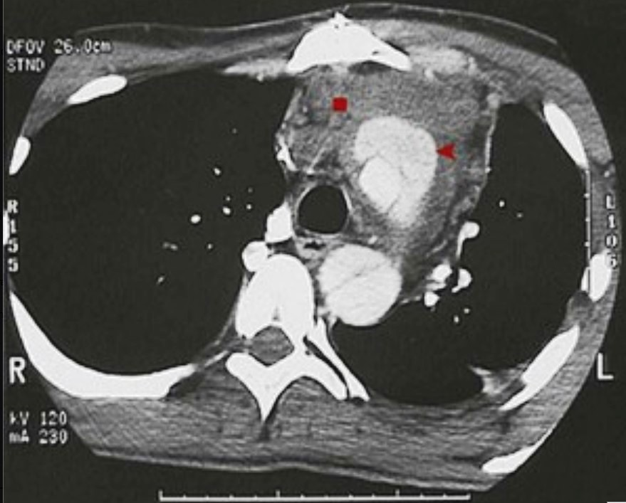
A 70-year-old man with uncontrolled hypertension and diabetes mellitus has a sudden onset of severe stabbing anterior chest pain that radiates to his back. His chest CT scan with contrast enhancement is shown.
1.What has happened to his aorta?
2.What is in his mediastinum?
3.Describe the microscopic changes that would occur in the aorta under these circumstances.
The “double lumen” (◂) in the ascending and descending aorta represents an aortic dissection.
The fluid density (▪) in the mediastinum is blood that has dissected through the aorta. Blood from aortic rupture may also (fatally) accumulate in the pericardial sac (hemopericardium) and the pleural cavity (hemothorax).
The aorta likely shows “cystic” medial degeneration, with a loss of smooth muscle cells and elastic fibers and an accumulation of excess glycosaminoglycans. A tear into this weakened mediastinum can produce a false channel (the so-called “double-barrel aorta”).

Slide 13
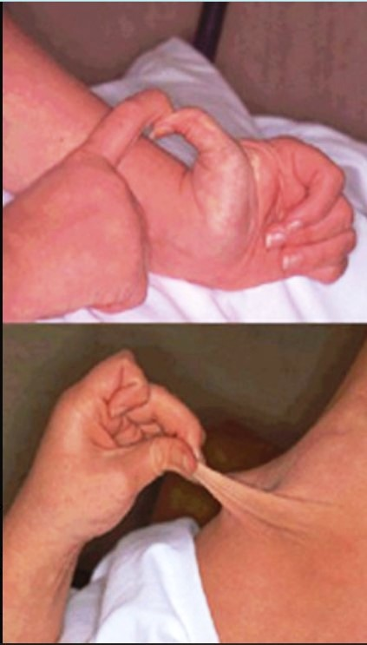
A 20-year-old woman had a diaphragmatic hernia repaired during infancy. Throughout her life, even minor trauma has resulted in poor wound healing, and joint dislocations occur frequently. Some of her physical examination findings are shown.
1.What extracellular matrix component is abnormal?
2.What is the genetic basis for her disease?
3.What similar gene mutation leads to vascular rupture?
This is most likely the classic form of Ehlers-Danlos syndrome (EDS). A defect in type V fibrillar collagen formation leads to fragile, stretchable skin and joint laxity.
This autosomal-dominant condition involves mutations in the COL5A1 and COL5A2 genes.
The EDS type associated with vascular abnormalities (including spontaneous rupture) involves abnormalities in type III collagen (the COL3A1 gene).

Slide 14
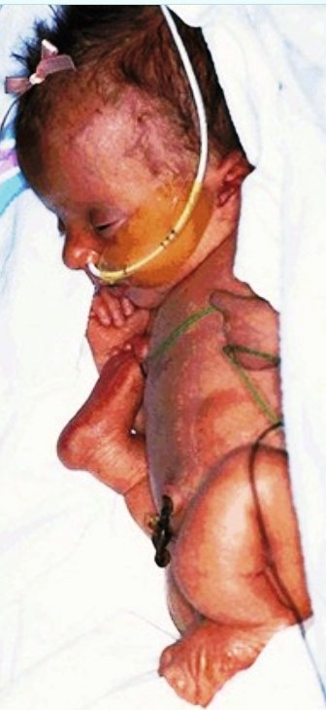
A term infant has the appearance shown at birth. Decreased movement was noted during pregnancy, and ultrasound showed limb shortening and deformity. The child died shortly after birth from respiratory failure (pulmonary hypoplasia).
1.Explain the marked limb deformities.
2.What is the underlying genetic defect, and what extracellular matrix component is affected?
3.If the patient were to survive to the age of 20 years, what form of the disease would she have?
This is the perinatal lethal form of osteogenesis imperfecta (OI) or “brittle bone” disease. The markedly osteopenic bones fracture easily in utero (and during delivery), which results in bone deformity and shortening.
This type II variant of OI is sometimes an autosomal-recessive condition, and it results from mutations in the genes that encode the type I collagen α1 and α2 chains.
Type I OI is an autosomal-dominant condition caused by defective type I collagen synthesis; it allows for greater longevity than type II OI, albeit with multiple recurrent bone fractures. Dental abnormalities, deafness, joint laxity, and blue sclerae are also features of type I OI.

Slide 15
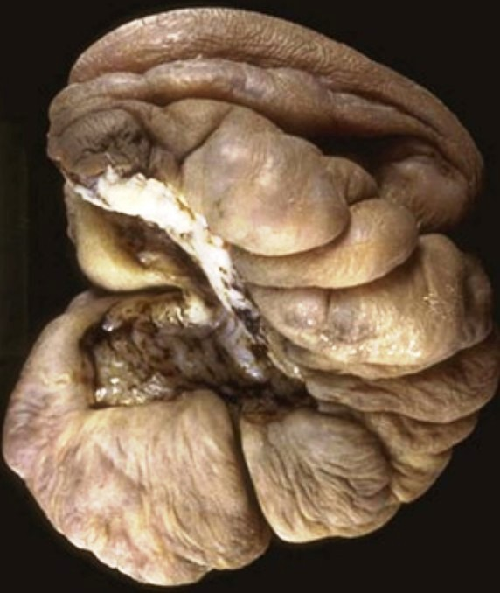
A year after the laceration of his ear, a 24-year-old African American man develops the lesion shown.
1.What is your diagnosis?
2.A similar lesion characteristically does not extend beyond the original scar and can regress. What is it called?
3.What therapies have been used for these lesions?
1.This keloid is an overgrowth of dense fibrous tissue that develops during the healing of an injury. The exuberant fibrous proliferation extends beyond the borders of the original wound, does not regress spontaneously, and often recurs after excision.
2. Hypertrophic scar.
3. Treatment includes excision, occlusive dressings, compression therapy, and corticosteroid injections into the lesions, the last-mentioned of which is used to reduce cellular (particularly macrophage) activation. Anti–transforming growth factor-β therapy has also been used.

Slide 16
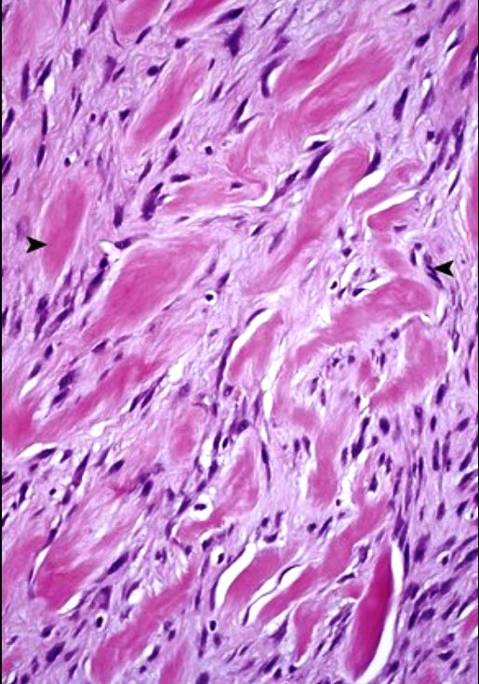
A 15-year-old Chinese girl had her earlobes pierced. Over the course of the next 4 months, she notes the growth of nodular scar tissue to 1 cm in size. The lesions are excised, and their microscopic appearance is shown.
1.What is your diagnosis?
2.What should normally occur in response to injury?
3.What family of enzymes is important in wound remodeling?
1. There is a proliferation of fibroblasts (◂) forming dense bundles (▸) of pink collagen. This is consistent with keloid formation.
2. A normal healing reaction involves the formation of granulation tissue with capillaries and fibroblasts that fill the void, followed by re-epithelialization over the surface. The scar normally contracts over time as a result of matrix remodeling and the action of myofibroblasts, thereby minimizing the residual collagenous fibrosis.
3. Matrix metalloproteinases (MMPs) degrade collagen and other extracellular matrix proteins. The MMPs depend on zinc for their activity.

