Slide 1
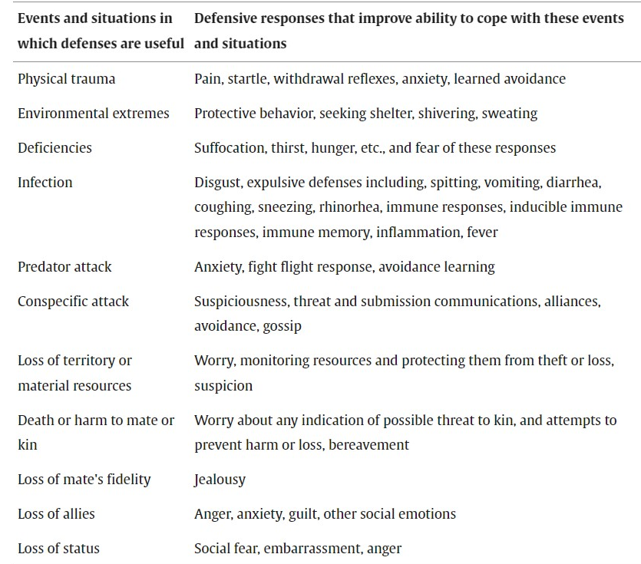
Natural Selection and Signal Detection Theory
Natural selection: bodily defense mechanisms(unpleasant) protect from harm and danger(useful)
Natural selection should shape regulation mechanisms that express defenses only in situations where their benefits exceed their costs, but defenses are often expressed in situations where they seem unnecessary, with much resulting useless suffering.
An explanation emerges from a signal detection analysis of the costs and benefits that shape defense regulation mechanisms.
Optimal clinical practice requires understanding how defense are regulated as a basis for deciding when it is safe to block them and it is not.

Slide 2
How optimal defense regulation systems should function?
If the defense offers perfect protection and the potential harm is 100% certain, then an optimal mechanism will express defense whenever the cost of defense(CD) is less than the cost of harm(CH) that will occur when the danger is present and no defense is expressed.
The “smoke detector principle”: the preponderance of false alarms in an optimal defense regulation system.
probability of potential source of real harm: p(H)
optimal system express defense: p(H)>CD/CH
e.g.: for an impala the cost of a panic flight=300 kcal,
cost of unprotected attack=300.000 kcal
=> p(H)>0.001
Out of 1000 episodes of flight at this response threshold, on the average, 999 will be false alarms and only 1will be flight from an actual predator.
likelihood ratio (at the position of criterion β): the ratio of the probability density functions of signal and noise
Utility is maximized if the organism respond

Slide 3
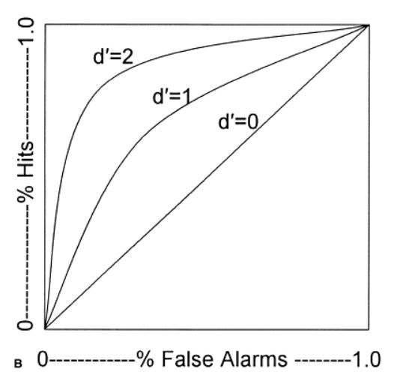
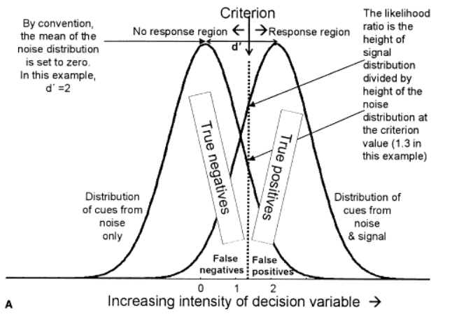
The defense should be expressed less readily (at higher criterion/conservative) as noise becomes more prevalent than signal, as the costs of false alarms increase and the costs of missed response decreases.
Normal systems express many false alarms, especially if the cost of the defense is low relative to the cost and prevalence of harm, and the base rate of events from noise is high
The optimal threshold for expression of a defense depends not only on the means and standard deviations of signal and noise, but also on relative costs of false alarms and missed responses and the relative prevalence of stimuli associated with actual danger

Slide 4
If p(s)=p(n)=0.5, d’=2 and CD=1 CH=10=> β=0.091 and lik/d rate would be located at signal intensity of -0.2.
98.6% of actual danger is hits 49.3% of all events will result in hits
1.4% of actual danger is misses 0.7% of all events will result in misses
57.9% of noise stimuli is false alarm 29% of all events will result in false alarms
42.1% of noise stimuli correctly not respond 21% in correct lack of response
About 37% of all responses will be false alarms
If CH/CD => optimal threshold to the left => false alarms
e.g.: CD=1 CH=1000 -> β=0,01 and lik/d rate would be located at signal intensity of -2.46
99.9996% of actual danger is hits but 99.3% of noise is false alarms>57.9%
About 50% of all responses will be false alarms
v
v
If p(n)>p(s) => optimal threshold to the right => false alarms
e.g.: β=0.009 and p(s)=10% -> lik/d rate would be located at signal intensity of -1.36
99.96% of actual danger would arouse response but 91.3% of noise is false alarms< 99.3%
Because such high proportion of stimuli is from noise only, about 89% of all responses will be false alarms
system’s sensitivity d’ => improves things only a little
e.g.: d1’=2 => d2’=4
The optimal criterion and false alarms rate to cues from the noise disturbance stay the same but misses increase from 0.04% to 0.07% and the overall false alarm is reduced to 65% of all responses
v
https://www.sciencedirect.com/science/article/pii/S109051380400056X

