Slide 1
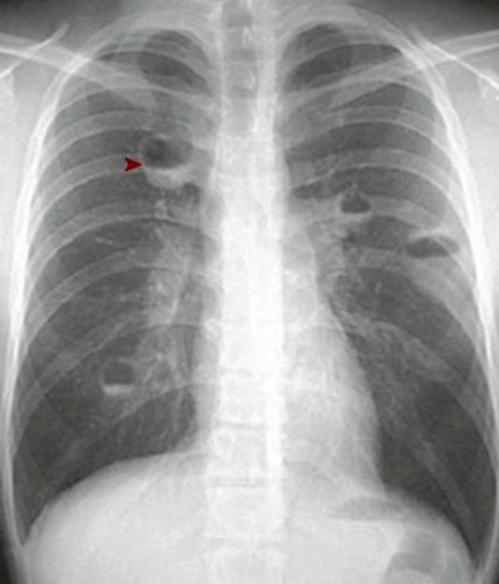
A 27-year-old man presents with fever and general malaise. In his left antecubital fossa are needle tracks, and pus is draining from a 2-cm erythematous, fluctuant, and tender subcutaneous nodule. There is jugular venous distention with an S3 gallop and a pansystolic murmur that is best heard along the lower left sternal border and is accentuated during inspiration. The patient's chest radiograph is shown.
1.Explain the appearance of nodules on the radiograph.
2.Suggest a pathophysiologic mechanism for the clinical findings.
The four nodular lesions have an air-fluid level (▸) that is typical for abscess. Neutrophil enzymes and reactive oxygen species destroy surrounding tissues, which causes liquefactive necrosis; the abscess contents layer out in an upright patient.
Intravenous drug abuse led to an antecubital fossa injection site abscess caused by bacterial skin contaminants. Subsequent hematogenous spread and endocarditis led to tricuspid valve destruction with regurgitation (hence the JVD, heart murmur, and S3, reflecting a volume overload). Septic emboli from right-sided valvular vegetations traveled to the lungs to produce abscesses.

Slide 2
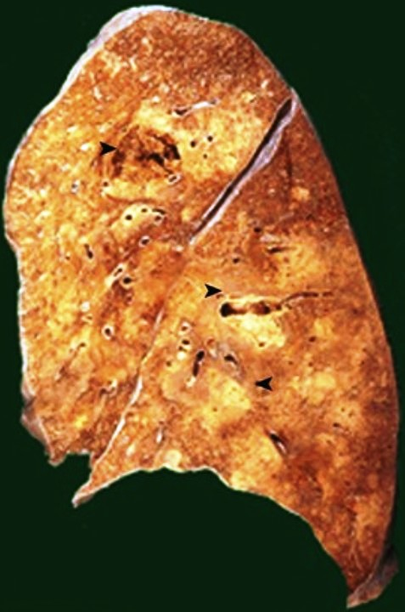
The same patient described on the previous slide has a WBC count of 17,400/mm3 (nl 4000/mm3 to 11,000/mm3) with 72% neutrophils, 8% bands, 16% lymphocytes, and 4% monocytes. Despite the use of appropriate antibiotics, the patient dies of sepsis and pulmonary failure. His lung is shown.
1.In addition to cavitating abscesses (▸), what else is present?
2.Explain the peripheral blood findings.
There is multifocal pneumonic consolidation, which is reflected grossly by white-tan areas (◂) of firmness. Microscopically, exudative airspace filling composed of neutrophils, blood, fibrin, and bacteria would be seen.
Acute bacterial infections lead to peripheral neutrophilia with “left shift” (i.e., the presence of band forms) as a result of the early bone marrow release of immature granulocytes.

Slide 3
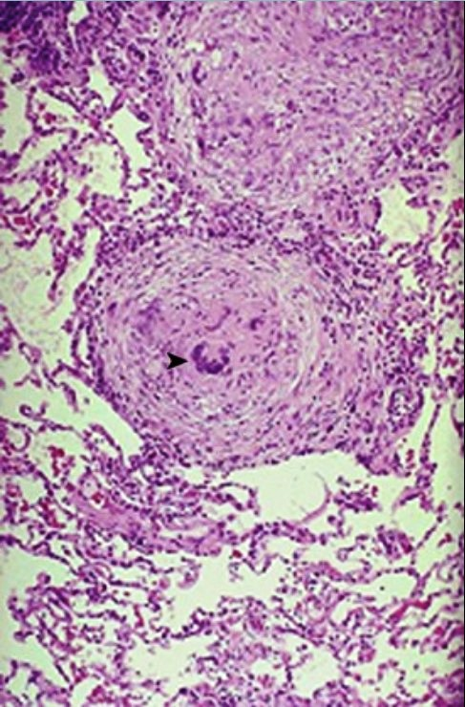
A 45-year-old woman has had a nonproductive cough, intermittent fevers, and night sweats for 4 months; also, she has lost 3 kg without dieting. A transbronchial biopsy specimen shows the findings here.
1.Describe this pathologic lesion.
2.What are possible noninfectious causes?
This is granulomatous inflammation. There are prominent Langhans multinucleated giant cells (▸) but no caseation here. The absence of caseation does not preclude an infectious etiology.
Granulomas can be infectious or noninfectious. Noninfectious granulomas result from innate or adaptive immune responses to large or persistent antigens that can include foreign material (dusts), self (rheumatoid nodules), and unknown agents (sarcoidosis).

Slide 4
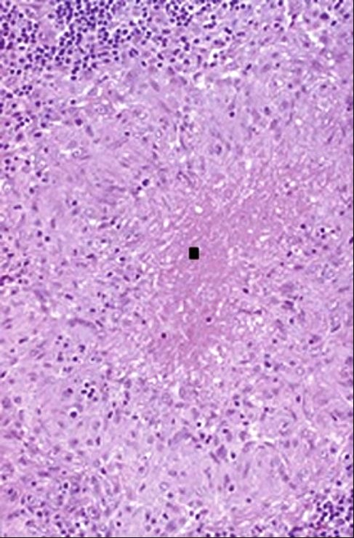
A 51-year-old woman presents with dyspnea, rales in the upper lung fields, and faint inspiratory wheezes. A chest radiograph shows a reticulonodular pattern of infiltrates, mainly in the upper lobes, with prominent hilar lymphadenopathy. A lymph node biopsy is performed, and the results are shown.
1.Explain the pathogenesis of this lesion.
2.What are possible infectious causes?
There is central pink caseation (■) surrounded by enlarged activated (“epithelioid”) macrophages driven into a frenzy under the influence predominantly of interferon-γ produced by a surrounding rim of T lymphocytes. The scattered nodules produce the radiographic reticulonodular appearance.
The upper lobe distribution and the caseation suggest an infectious cause. This is most often Mycobacterium tuberculosis, but it may also potentially be other mycobacteria (e.g., Mycobacterium kansasii) or fungi such as Cryptococcus or Histoplasma.

Slide 5
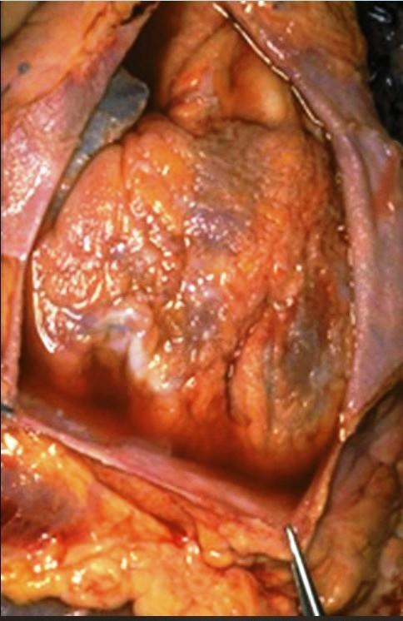
A 15-year-old girl had streptococcal pharyngitis 3 weeks ago; she now has a low-grade fever, pleuritic chest pain, waxing and waning arthritis, and painful subcutaneous nodules. A friction rub is audible with chest auscultation. She suddenly dies of an apparent arrhythmia. The heart and pericardial sac are shown.
1.Describe the epicardial finding.
2.Explain the pathophysiology of this disease.
The epicardium shows a dull, shaggy fibrinous exudate as well as serous fluid pooling in the pericardial cavity.
She had acute rheumatic fever caused by development of antibodies against certain streptococcal bacterial antigens; these antibacterial antibodies also cross-react with binding to self endocardial, myocardial, and pericardial antigens to cause inflammation (pericarditis) with fluid and blood protein exudation. Extravasated fibrinogen polymerizes to form fibrin strands that produce the shaggy exudate. Similar inflammation in the myocardium can cause myocyte damage and arrhythmia.

Slide 6
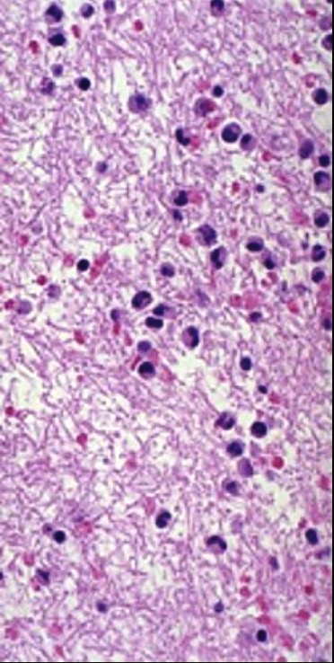
A 13-year-old boy with recent “strep throat” develops a new heart murmur. Echocardiography shows small mitral valve vegetations. His WBC count is 12,130/mm3 (nl 4000/mm3 to 11,000/mm3), and his erythrocyte sedimentation rate is 30 mm/hr (nl 20 mm/hr). His antistreptolysin O titer is 1 : 512, and his anti–DNAse B titer is 1 : 240; both of these values are elevated. Two weeks later, these titers are increased fourfold. The microscopic appearance of the patient's epicardial and mitral valve vegetations is shown.
1.Describe the findings.
2.How does streptococcal infection induce rheumatic fever?
There is a fibrinous exudate with pink fibrin strands that enmesh the leukocytes.
Rheumatic fever is caused by an immunologic response to a group A beta-hemolytic Streptococcus infection. In particular, antibodies against streptococcal M-proteins and other bacterial antigens (as reflected in the antistreptolysin O and anti–DNAse B titers) cross-react with heart valve glycoproteins. The antibodies cause injury by activating complement and by recruiting and activating neutrophils and macrophages.

Slide 7
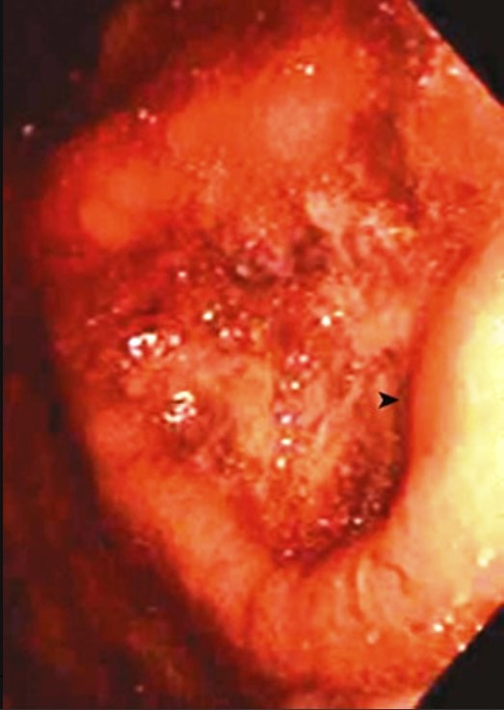
A 37-year-old man has a year-long history of worsening epigastric pain that is relieved by eating. Upper gastrointestinal endoscopy reveals the gross appearance shown.
1.What is the diagnosis?
2.Explain the pathophysiology of this disease.
The endoscopic view shows a large gastric ulcer with raised, rolled edges (▸).
Marked inflammation of the mucosal epithelium has led to necrosis with sloughing of the epithelial cells forming the central bed of the ulcer. Surrounding vascular dilation and edema are responsible for the raised, rolled edge. Neutrophils are recruited by mediators such as complement C5a and leukotrienes; they adhere to vascular endothelium and move via diapedesis between endothelial cells. Extravasated neutrophils release proteases, arachidonic acid metabolites, and oxygen-free radicals that damage the epithelium.

Slide 8
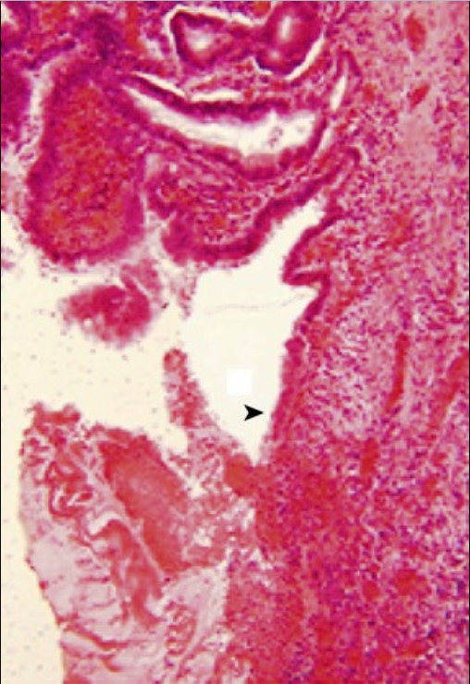
A biopsy specimen of the interface between the central erosion and the rolled edge of the gross lesion shown on the previous slide has the histologic appearance shown.
1.What is going on here?
2.What can cause this lesion?
Ulceration is the loss of epithelium (▸) and underneath organization of granular inflammation tissue. In its place are mucus, hemorrhage, fibrin thrombus, inflammatory cells, and necrotic debris. The surrounding submucosal tissue is showing classic signs of acute inflammation with vascular dilation, perivascular edema, and an infiltrate made predominantly of neutrophils.
In a broad sense, peptic ulcers result from an imbalance of mucosal defense mechanisms and injurious insults (e.g., hydrochloric acid, pepsin). Helicobacter pylori is a major cause of peptic ulcers as a result of its induction of intense inflammatory responses. It breaks down urea into toxic metabolites and reduces duodenal bicarbonate production while increasing gastric acid production and inducing capillary thrombosis. Alcohol and cigarettes may cause ulcers by direct toxic effects, and nonsteroidal anti-inflammatory drugs (NSAIDs) can affect gastric arteriolar tone and reduce blood flow.

Slide 9
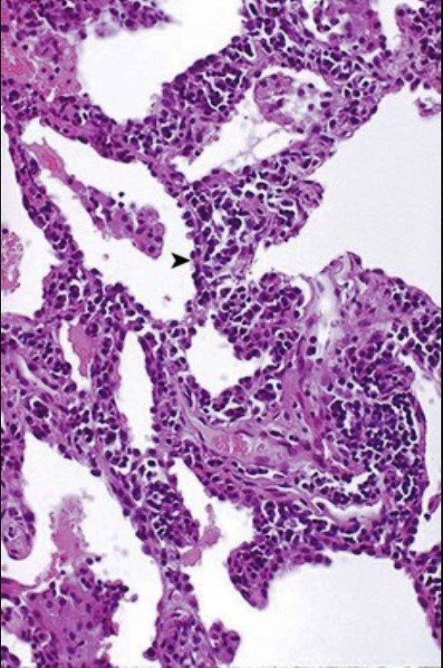
A 37-year-old man has a 2-week history of increasing dyspnea and a nonproductive cough. Rales are heard in all lung fields. His WBC count is 11,130/mm3 (nl 4000/mm3 to 11,000/mm3), with a differential count of 50% neutrophils, 4% bands, 35% lymphocytes, and 11% monocytes. If a lung biopsy specimen were obtained, it would have the microscopic appearance shown. The patient improves over the next 2 weeks without therapy.
1.What is the pattern of inflammation?
2.What infectious agents are most likely to cause this?
The patient has interstitial pneumonitis. Most of the cells present are mononuclear, and they are mainly lymphocytes; this correlates with his peripheral blood lymphocytosis. The mononuclear cells are within the interstitium (▸) and not filling the alveolar spaces, which explains his nonproductive cough.
Viral infections, including the respiratory pathogens influenza A and B, parainfluenza, adenovirus, and respiratory syncytial virus, are most likely in this setting. Pneumocystis jiroveci and cytomegalovirus can be seen in immunocompromised hosts.

Slide 10
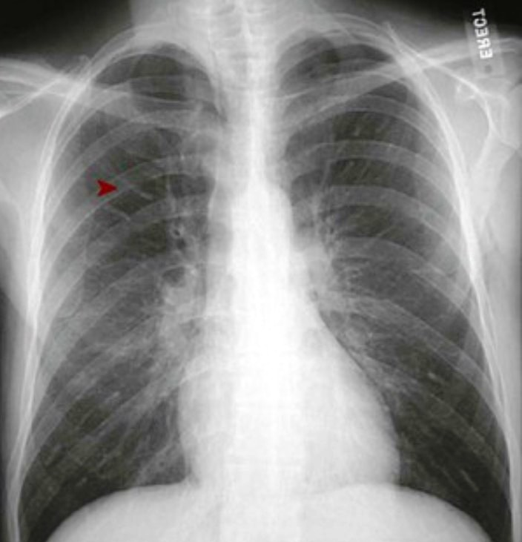
A 33-year-old man has a 1-week history of fever, malaise, and dyspnea, with a nonproductive cough. Sputum Gram staining shows normal flora; serologies show increasing titers of IgM against the influenza B virus. The patient's chest radiograph is shown.
1.What is the pattern of the chest radiograph?
2.What kind of inflammatory infiltrates are likely to be present?
The radiograph shows an interstitial pattern of infiltrates, with fine bright lines (▸) extending outward from the hila.
The inflammatory infiltrates are composed of mononuclear cells, including lymphocytes, macrophages, and plasma cells. There may be a few neutrophils; inflammatory processes do not involve only one cell type, and various immune responses occur simultaneously.

Slide 11
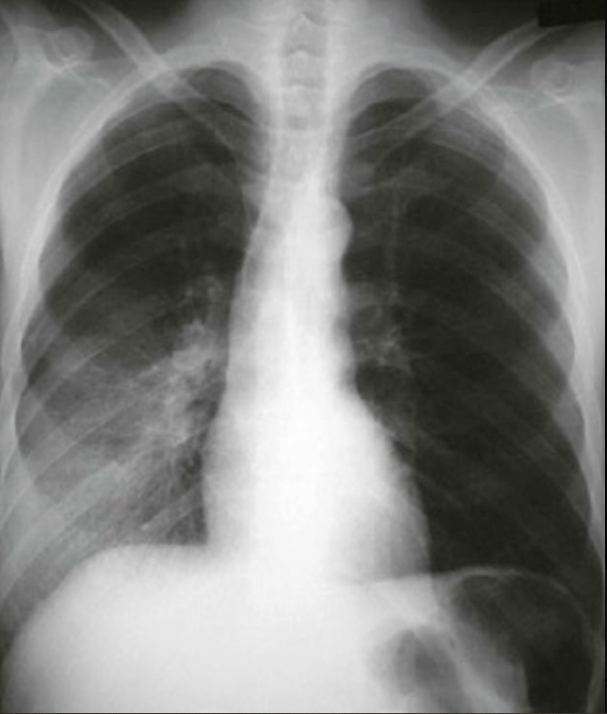
A 42-year-old man with a 2-day history of fever and a cough productive of yellow sputum has coarse rales along with dullness to percussion in his right lower lung. His WBC count is 14,720/mm3 (nl 4000/mm3 to 11,000/mm3), with a differential count of 76% neutrophils, 9% band forms, 11% lymphocytes, and 4% monocytes. His chest radiograph is shown.
1.What is the pattern of the chest radiograph?
2.Describe the inflammatory infiltrates.
3.Explain this patient's WBC count and differential values.
The patient has patchy infiltrates involving the right lower lobe that are consistent with bronchopneumonia.
The infiltrates likely contain neutrophils and protein exudates that fill alveolar spaces, thereby causing the opacification seen in the chest radiograph.
He has a neutrophilic leukocytosis; the “left shift” from increased bands is due to premature bone marrow release of immature forms, presumably to fight the infection.

Slide 12
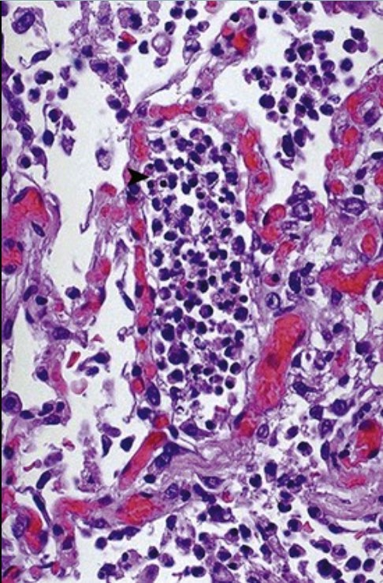
A 73-year-old woman has a 3-day history of fever, dyspnea, and a productive cough. Markers of an acute-phase response (e.g., erythrocyte sedimentation rate, serum fibrinogen levels, C-reactive protein) are all increased. Despite the use of antibiotics, the patient dies. The microscopic appearance of the lung at autopsy is shown.
1.What is the pattern of inflammation?
2.What are the most likely infectious agents?
3.Why might the patient have died despite the use of antibiotics?
This is acute inflammation with exudation of neutrophils (▸) into alveolar spaces.
Bacterial organisms are the likely infectious agents.
Causes of death may include the use of the wrong antibiotic, a resistant organism, a significant comorbidity (e.g., congestive heart failure, coronary artery disease), or a pulmonary embolism caused by prolonged bed rest.

Slide 13
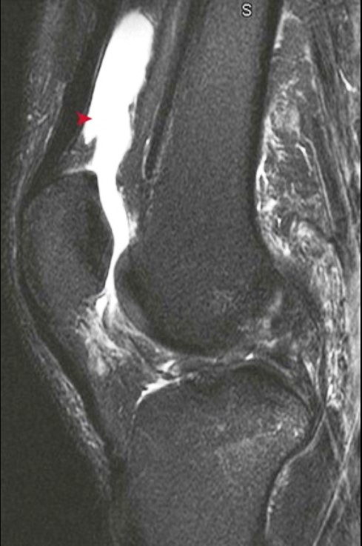
During an aggressive game of croquet, a 24-year-old man sustained multiple blows to his knee. The next day, he had swelling, pain, and tenderness upon palpation. An MRI of the knee is shown. The fluid is aspirated, and it has a low protein and cell count.
1.What is the diagnosis?
2.What is the mechanism of fluid collection?
3.What would this collection of fluid be called if the fluid were blood?
This effusion (▸) in the suprapatellar bursa followed an acute soft-tissue injury. The onset of this moderate effusion 1 day after injury is more consistent with a meniscal injury or a ligamentous sprain than with a rapidly forming large effusion (in ≤2 hours), which suggests the rupture of the anterior cruciate ligament or the fracture of the tibial plateau.
The injury produced local inflammation that was mediated by histamine, bradykinin, and leukotrienes; these substances caused vasodilation, stasis, increased hydrostatic pressure, increased permeability through endothelial gaps, and, ultimately, fluid leakage (protein-poor and mostly composed of water and electrolytes) into the extravascular spaces.
A hematoma is a localized collection of blood in the soft tissue.

Slide 14
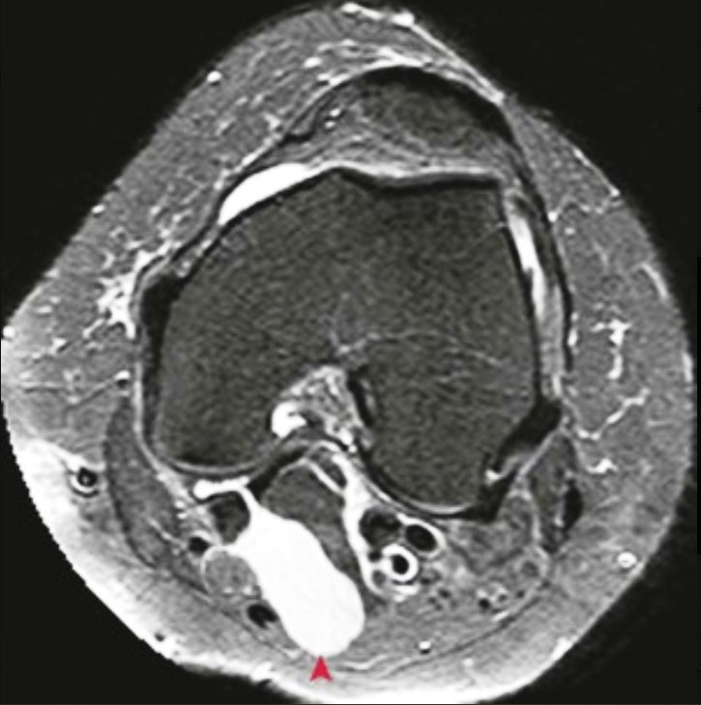
A 59-year-old man with chronic knee pain that is worsened by increased walking and bending now has new pain with localized swelling behind the knee. His MRI is shown.
1.Where is this lesion located?
2.What caused this lesion?
3.What are the cell count and protein content of this fluid?
Posterior to the medial condyle is a popliteal cyst (Baker cyst). This is a fluid collection (▴) that extends between the semitendinosus and gastrocnemius tendons into a potential bursal space.
Arthritis (particularly end stage osteoarthritis) produced this inflammation, which caused increased vascular permeability and the resulting fluid collection.
This is likely to be a transudate with very little protein and few inflammatory cells. An exudate would have many cells and higher protein content.

Slide 15
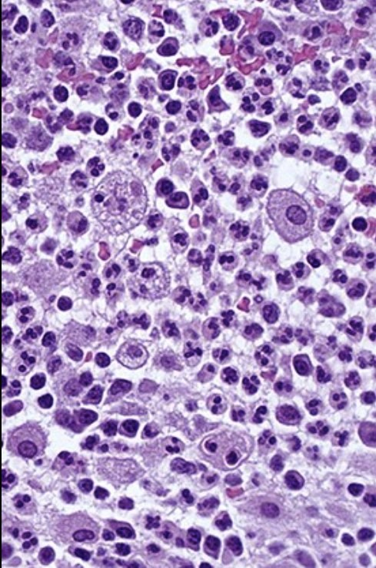
One week after a deep puncture wound to his forearm, a 48-year-old man develops local pain, erythema, swelling, and warmth at the site. The microscopic appearance of a biopsy specimen is shown.
1.What phagocytic cells are present?
2.What cell surface components are needed for microbe binding and phagocytosis?
3.What opsonins aid in this phagocytic process?
Neutrophils and macrophages are present. The macrophage cytoplasm contains phagocytized and vacuolated debris. The history and findings strongly suggest a bacterial infection at the site.
Integrins such as CD11, CD18, scavenger receptors, mannose receptors, and Toll-like receptors (pattern recognition receptors) aid in binding to microbes as part of innate immunity.
The major opsonins that bind to microbes and aid in their phagocytosis include IgG (phagocytes bind via Fc receptors) and the C3b complement fragment.

Slide 16
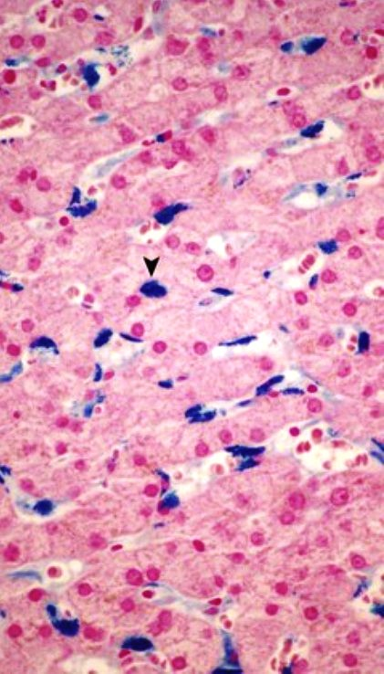
A 67-year-old woman has skin “bronzing” along with arthritis and nocturnal dyspnea that have been present for the past year. She has an elevated blood glucose level and an abnormal glucose tolerance test. The microscopic appearance of her liver biopsy specimen stained with Prussian blue iron stain is shown.
1.In what form is this iron stored, and in what cells is it contained?
2.What underlying disease does this patient have?
3.Where does iron in the body normally reside?
The iron is stored as hemosiderin granules (aggregates of ferritin micelles) that are mainly contained within Kupffer cells (▾), which are the macrophages of the liver.
The patient has hemochromatosis, a hereditary condition characterized by excessive iron absorption, retention, or both. Her skin changes reflect increased cutaneous iron stores, and her diabetes is due to iron-driven free radical injury to beta cells in the islets of Langerhans.
The body contains 2 to 4 g of iron. Most is stored as hemoglobin; some is stored as myoglobin, and some is stored as hemosiderin iron. Hemosiderin iron is found mostly in the bone marrow, but it may also appear in the spleen and the liver.

Slide 17
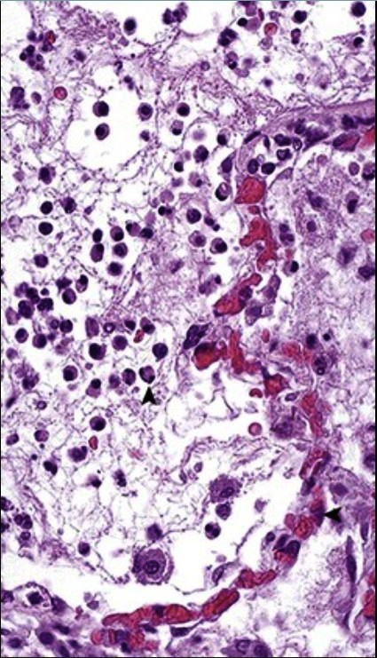
A 62-year-old woman with a 4-day history of productive cough and fever has a WBC count of 14,260/mm3 (nl 3800/mm3 to 10,800/mm3), with 70% neutrophils and 10% band forms. A chest radiograph shows focal consolidation. Serum C-reactive protein and fibrinogen levels are increased. Her lungs would have the microscopic appearance shown.
1.How do neutrophils attach to endothelium?
2.What promotes neutrophil diapedesis?
3.Explain the laboratory findings.
Endothelial cells (◂) express E-selectin, intercellular adhesion molecule-1 (ICAM-1), and GlyCam-1; the corresponding neutrophil (▴) ligands are sialyl-Lewis X, CD11 and CD18 integrins, and L-selectin.
Chemotactic factors that promote neutrophil diapedesis include complement fragment C5a, interleukin-8, lipoxins, and leukotriene B4.
Neutrophilic leukocytosis with a “left shift” and increased acute-phase reactants (e.g., fibrinogen, CRP) are features of acute inflammation. These are driven by inflammatory cytokines, particularly interleukin-1 and tumor necrosis factor.

Slide 18
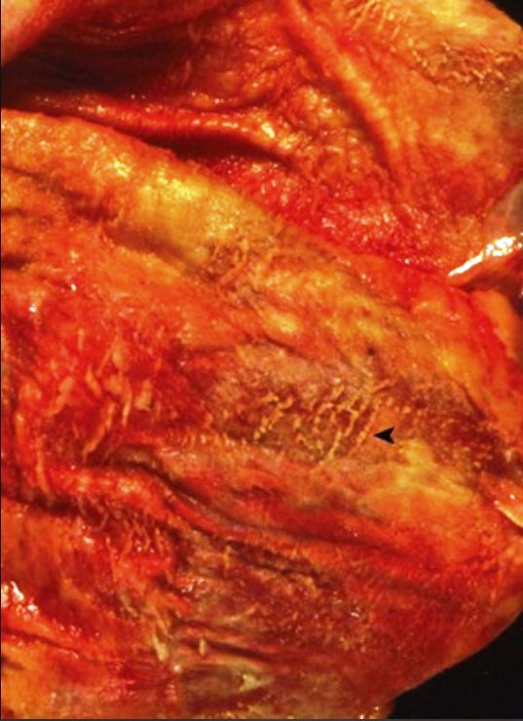
A 56-year-old woman with rheumatic valvular disease develops endocarditis after a dental procedure. Despite the use of antibiotics, she develops chest pain followed by hypotension, and she dies. The gross appearance of her heart and pericardial sac is shown at autopsy after the removal of 350 mL of fibrinohemorrhagic and purulent fluid.
1.What is the diagnosis?
2.What mediators influence endothelial permeability?
3.What cytokines promote vasodilation?
Note the shaggy fibrin (◂) with fibrinous pericarditis, causing a fatal pericardial tamponade.
Histamine, serotonin, interleukin-1, and tumor necrosis factor, among others, activate signaling pathways that phosphorylate cytoskeletal and other intracellular proteins to cause a loss of cell-cell adhesions and to induce endothelial cells to retract (separate) from each other.
Vasodilation is induced by various factors, including nitric oxide; histamine; serotonin; bradykinin; prostacyclin; and prostaglandins E1, E2, and D2. Arterioles and venules may be differentially susceptible to the various mediators.

