Slide 1
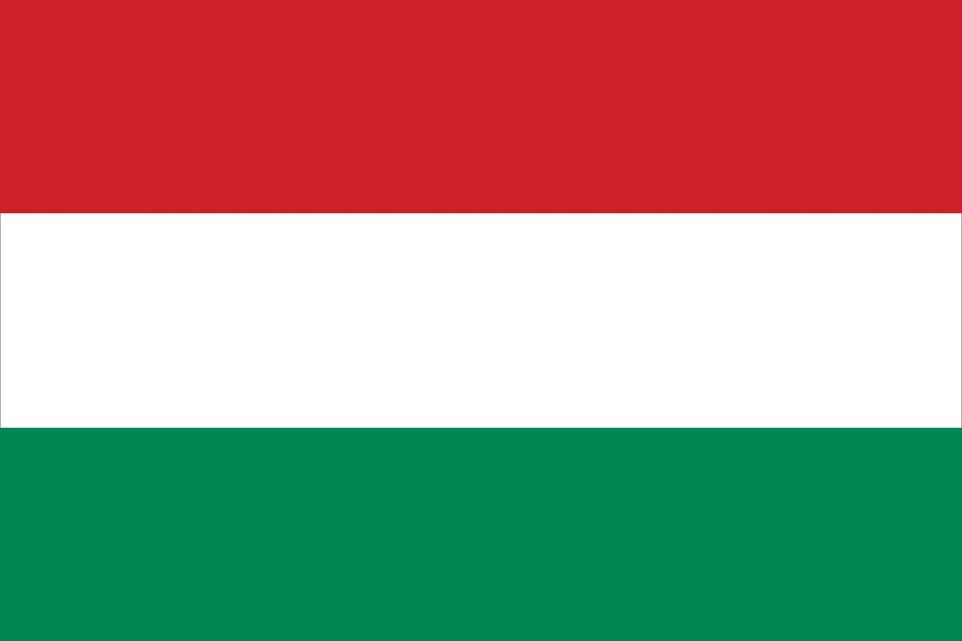
HUNGARY

Slide 2
STRUCTURE
Facts about Hungary
Hungary’s Profile
History
Economy
Political System
Challenges
Russia – Ukraine war
Euroscepticism

Slide 3
The Hungarian Parliament is the 3rd largest Parliament building in the world, with 691 rooms and 20 kilometres of stairs.
Rubik's Cube was invented by a Hungarian architect.
There are 44 letters in the Hungarian alphabet.
No Building In Budapest Is Taller than 96 Meters.
Hungary Is Home To The Largest Lake In Central Europe.
Gulyás or Goulash in English, Hungary’s national dish, is a spicy meat stew containing lots of paprika pepper.

Slide 4
Hungary’s Profile
Capital: Budapest
Population: 10,156,239 (0.13% of the total world population)
Official language: Hungarian
Currency: Hungarian forint (HUF)
Place on map: Central Europe, bordered by Slovakia, Romania, Croatia, Austria, Serbia, Ukraine and Slovenia.
Joined NATO in 1999
EU Member-State since 1st of May 2004 after the 2003 Hungarian referendum about EU membership.
Acceded to the Schengen area: 21st of December 2007

Slide 5
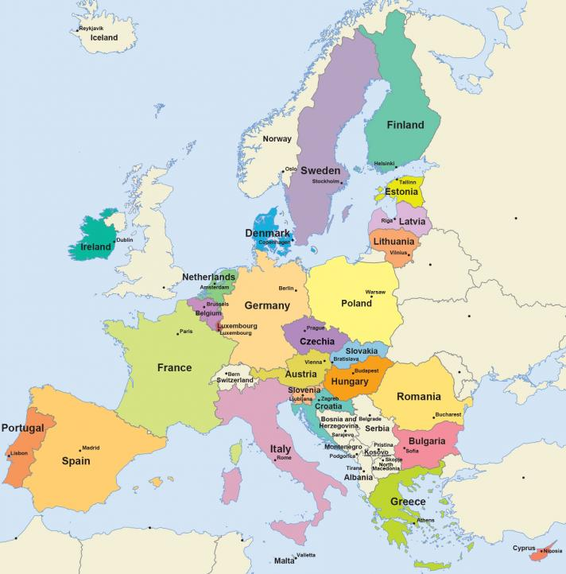

Slide 6
Important History Events after WW1
World War I - Hungary lost two thirds of its territory and 3.3 million Hungarians suddenly became citizens of Hungary’s neighbouring countries.
World War II - a death toll of approximately one million citizens. The Soviets drove the Germans out of the country in 1945 and stayed here for the next four and a half decades, incorporating the country into the Soviet bloc.
The revolution and freedom fight of 1956 - Along with many others in the Eastern bloc, the revolution of ’56 is one of the symbols of resistance against the Soviets during the cold war.
Democratic transformation after the fall of the Soviet bloc - The first democratic, multi-party elections were held in 1990.
Joining the EU - Hungary became a member of the European Union in 2004

Slide 7
Economy
Total imports - $139 billion
Germany: $33 billion, China: $9 billion, Austria: $8 billion, Slovakia: $8 billion.
Total exports - $141 billion
Germany: $37 billion, Italy: $8 billion, Romania: $7 billion, Slovakia: $7 billion.
Unemployment rate: 4,3%

Slide 8
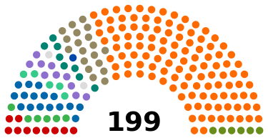
Political System
Hungary is a parliamentary republic
Head of state is the President of the Republic who currently is Ms. Katalin Novák
Head of government is the Prime Minister who currently is Viktor Orbán
Main political parties in Hungary
Fidesz (116)
KDNP (19)
United for Hungary (57)
DK (16)
Momentum (10)
MSZP (10)
Jobbik (8)
Dialogue (6)
LMP (5)
MHM (6)

Slide 9
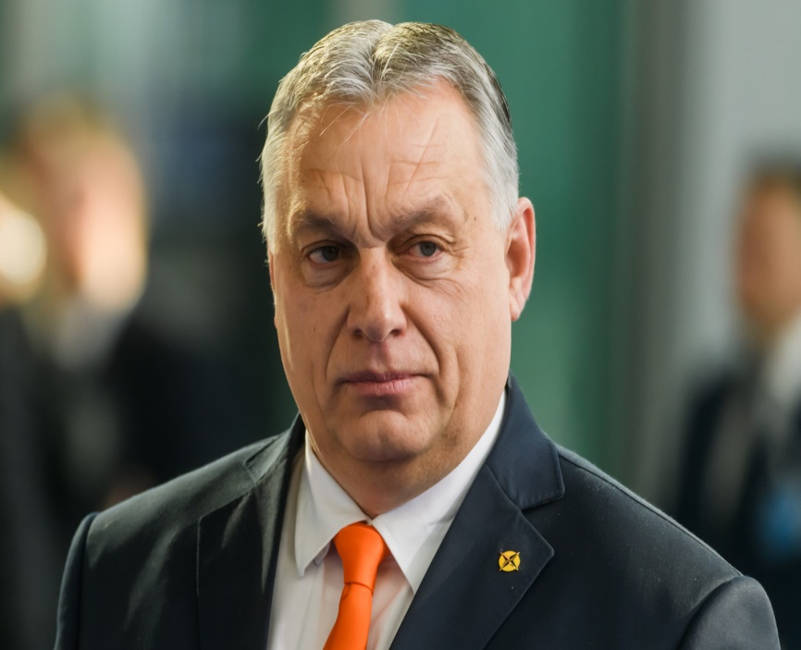
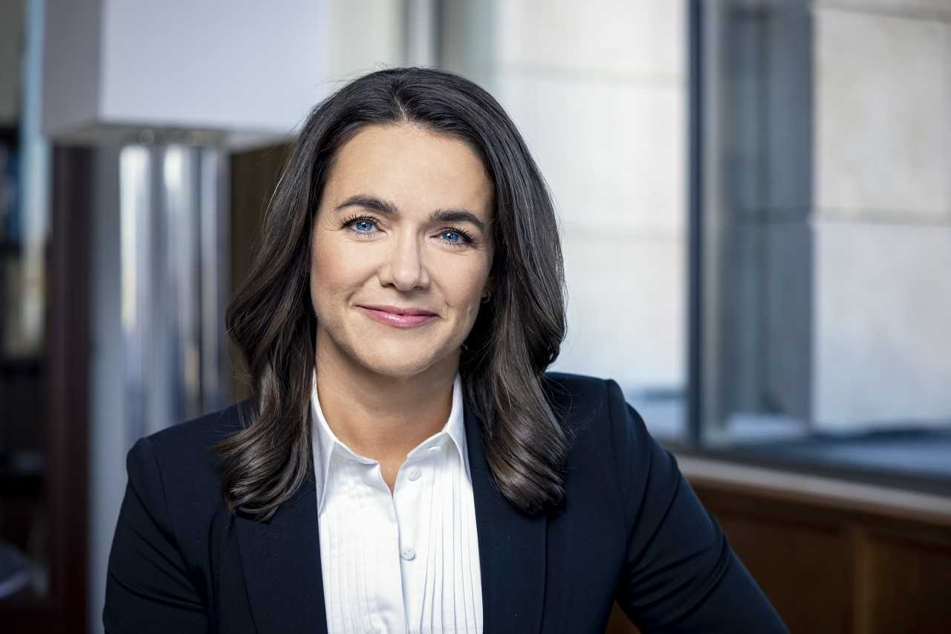
Orban scores a crushing victory in the last election (135 seats in a 199 member parliament).
Ms. Katalin Novak became the first female President of Hungary. (2022)

Slide 10
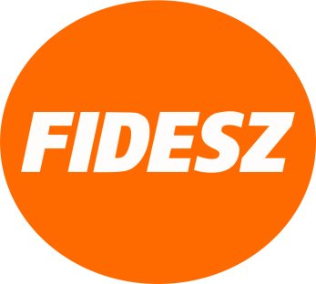
Fidesz
Fidesz is the party in charge in Hungary winning the last elections with a supermajority of 135 seats.
It was founded on March 30, 1988.
It’s considered a right wing national conservative party with extreme beliefs.
Extreme characteristics:
It opposes the LGBT+ community
In favor of death penalty
Policies of economic nationalism
Eurosceptic party
All of these characteristics are opposed to the model of a modern EU member state.

Slide 11
CHALLENGES
FREEDOM OF MEDIA
Most media outlets remain directly or indirectly controlled by the government.
In July 2022, the European Commission referred Hungary to the Court of Justice of the European Union because its Media Council refused to extend an independent radio station broadcasting license “on highly questionable grounds,” effectively forcing the station off the airwaves. Later, the frequency was awarded to a group close to the government.
Sexual Orientation and Gender Identity
In April, on national election day, the government held a hostile referendum about limiting children’s access to information on LGBT issues. As the referendum declared void, the National Election Commission fined 16 human rights organizations for encouraging invalid votes. In July, Hungary referred to the Court of Justice of the EU for its 2021 amendments to the Child Protection Law, which included unjustified restrictions on LGBT content.

Slide 12
CHALLENGES
WOMEN’S RIGHTS
The Ministry of Health issued a decree making it mandatory for women seeking abortions to listen to the fetal heartbeat prior to terminating the pregnancy.
Migration and Asylum
Access to Hungary’s asylum system remained virtually impossible. Violent pushbacks to Serbia is becoming a very common thing as Prime Minister stated that “we will not do anything to change the system of border protection… We will maintain the existing regime, even if the European court ordered us to change it.”
Covid-19
Total Covid-19 cases: 2,223,779
Total Covid-19 deaths: 48,896

Slide 13
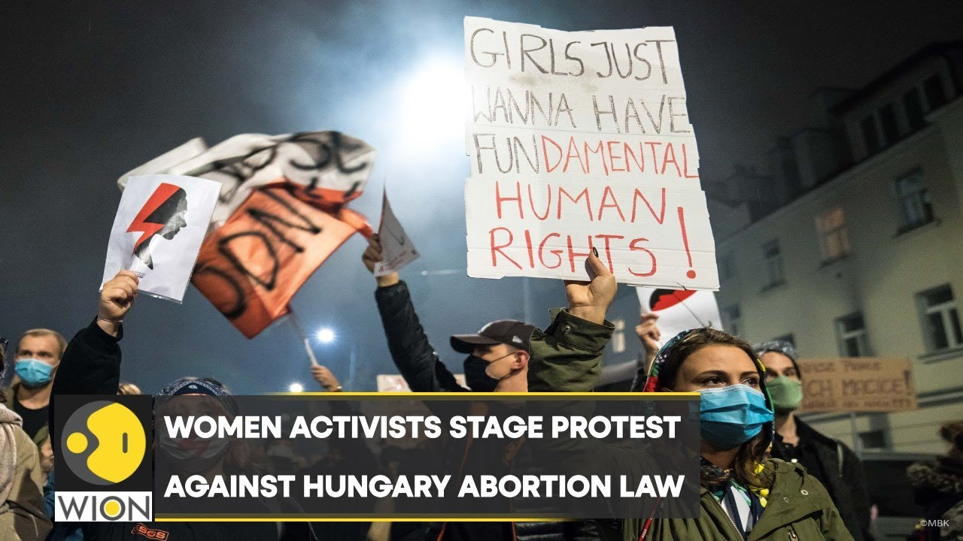
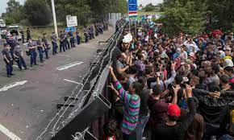
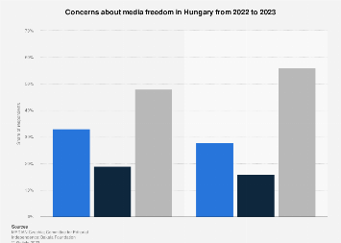
Increase of concerns about media freedom in Hungary from 2022 (48%) to 2023 (56%)

Slide 14
RUSSIA-UKRAINE WAR
In 2022 Hungary supported bid for Ukraine to become EU member.
PLOT TWIST
In December 2023 Hungary blocks €50bn EU package for help to Ukraine.
Mr. Orban took the decision to veto the latest package of economic aid for Ukraine, because he says Hungarian taxpayers' money should not go against their own interests.
He says membership for Ukraine in the EU would be a disaster for EU, including Hungarian farmers. It would also take away funds from Hungarians and others.
He sees Ukraine not as a future EU member, but as a buffer-zone between the EU and Russia.
The US ambassador to Budapest complained that while Russia was striking Ukrainian civilians, "Hungary pleads for business deals".

Slide 15
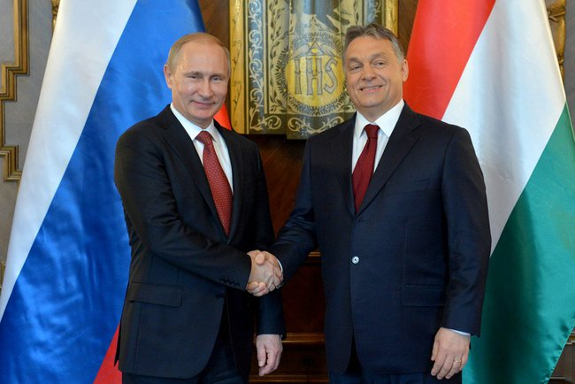

Slide 16
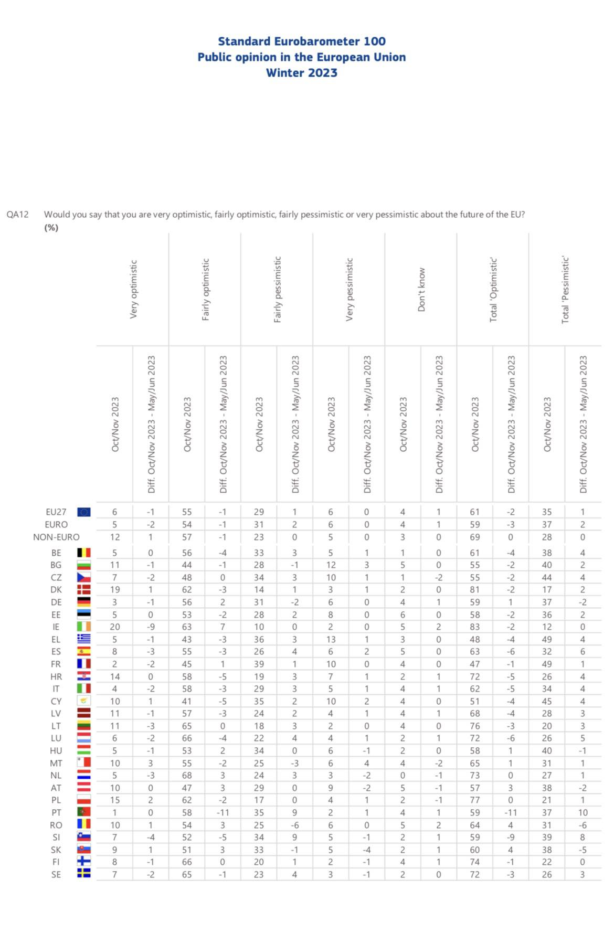
EUROSCEPTICISM

Slide 17
EUROSCEPTICISM
In the question «our country could better face the future outside the EU»
Hungary: 65% disagree , 29% agree, 4% don’t know
In the question «would you say that you are very optimistic, fairly optimistic, fairly pessimistic, very pessimistic about the future of the EU»
Hungary: total optimistic: 58%
Total pessimistic: 40%
Don’t know: 2%
From these stats we can say that Hungary has a Europhile Public
From government policies and decisions we can say that Hungary has a Eurosceptic Governing Elite.

Slide 18
THANK YOU FOR YOUR ATTENTION
Loizos Mavrellis

