Slide 1
Color Constancy
Ονοματεπώνυμο: Έλενα Μαραγκού
Color constancy: the effect whereby the perceived or apparent color of surface remains constant despite changes in the intensity and spectral composition of the illumination
The grapes look green and the orange looks orange in both photographs, despite different illuminants
The chromaticity of grapes under reddish illuminant and the orange under the greenish illuminant is the same in both photographs
The visual system compensates for changes in lighting, allowing us to perceive the true colors of objects consistently

Slide 2
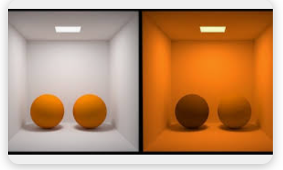
Color constancy has limits and requires certain spectral properties of surfaces and illuminants to work effectively.
Metamerism: is a phenomenon where the color of two objects/surfaces appear the same under a particular light source, but actually have different spectral energy distributions. When a different kind of light is used, the color difference between them is revealed.
e.g.: an item of clothing ->one color in artificial lighting and different color under natural daylight -> lighting conditions affect the wavelengths of lights reflected by the item-> changes in cone excitations -> maybe surfaces lead to the same cone excitations under one illuminant (metamerism) but to distinctly different cone excitations under another illuminant (metamer mismatching)
Chromatic adaptation: a mechanism that allows for constant color appearance across illuminants
Methods involving simultaneous displays reduce the impact of adaptation to color constancy. The observer cannot fully adapt to both scenes simultaneously.
Crucial role of inferential constancy and instructions.

Slide 3
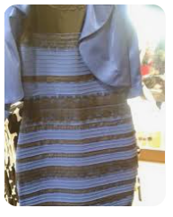
#The Dress: Blue and Black or White and Gold?
Individual differences in color constancy.
Observers infer different incident illuminations to overcome the ambiguity of the image:
Blue dress under yellow light
or
White dress under blue light
The perceptual mechanisms behind color constancy are believed to involve an unconscious inference about the illumination, which is then adjusted to recover the constant surface properties.
Individual differences in how the photograph is perceived stem from observers making different assumptions about the scene’s illumination spectrum. The colors in the photograph could either be due to a blue dress illuminated by yellow light or a white dress by blue light.
Observers might unconsciously draw on past experience to infer the most likely illumination and resolve the uncertainty in visual information.
https://www.annualreviews.org/content/journals/10.1146/annurev-vision-091517-034231
https://www.ncbi.nlm.nih.gov/pmc/articles/PMC5812438/

