Slide 1
US Foreign Policy
W - 2

Slide 2
The domestic Context: FP Politics and the Process of Choice
“Politics stops at the water’s edge” (Arthur Vandenberg, 10-1-1945)
For 3 reasons it is a myth:
Exception to the rule
Not always a good thing
Domestic conflict not always a bad thing

Slide 3
Five groups of actors
President and the Congress and “Pennsylvania Avenue Diplomacy”
Politics and Decision-making within the executive branch
Interests groups
News media
Public opinion

Slide 4
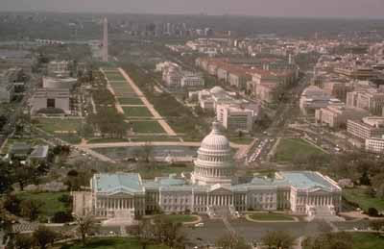
The President and the Congress and “Pennsylvania Avenue Diplomacy”
4 Patterns:
Cooperation
Constructive compromise
Institutional competition
confrontation

Slide 5
PAD
The dynamic is structural:
Not so much “separation of powers”
But “separate institutions sharing powers”

Slide 6
Principal FP Provisions of the Constitution
 | President | Congress
War Power | Commander in chief of armed forces | Provide for the common defense, declare war
Treaties | Negotiate treaties | Ratification of treaties, by two-thirds majority (Senate)
Appointments | Nominate high-level government officials | Confirm president’s appointments (Senate)
Foreign Commerce | No explicit powers, but treaty negotiation and appointment powers pertain | Explicit power “to regulate foreign commerce”
General Powers | Executive power, veto | Legislative power, power of the purse, oversight and investigation

Slide 7
War Powers
Presidentialists (Alexander Hamilton)
“Energetic government”
Congressionalists (James Madison)
“declare war”

Slide 8
Treaties and other international commitments
The President negotiates and he Senate ratifies (2/3)
Other ways to influence treaties (Congress):
“observer groups”
Amendments, reservations
Circumvent the Senate (President):
Executive Agreements
Declaratory Commitments

Slide 9
Appointments
The President nominates, the Senate confirms (simple majority)

Slide 10
Commerce with Foreign Nations
“Congress regulates commerce with foreign nations”
Smoot-Hawley Tariff Act (1930)
The Reciprocal Trade Agreements Act (1934)
“Pressure-diverting policy management system”

Slide 11
Commerce: 5 key executive players
USTR
Secretary of the Treasury
Secretary of Commerce
State Department
International Trade Commission

Slide 12
General Powers
Executive Power, veto, “pork barrel”, “bully pulpit”
Legislative Power: Substantive, Procedural
The Supreme Court as referee?
US v Curtiss-Wright (1936)
Youngstown Sheet and Tube v Sawyer (1952)
INS v Chadha (1983

Slide 13
Executive branch politics
“The executive branch has its own politics”
Presidents as FP Leaders
Senior FP Advisers and Bureaucratic Politics

Slide 14
Interests Groups and their influence
Type | General examples
Economic interest groups | AFL-CIO (trade unions) National Association of Manufacturers Consumer Federation of America Major multinational corporations (MNCs)
Identity groups | Jewish Americans Cuban Americans Greek Americans African Americans
Political issue groups | Anti-Vietnam War movement Committee on the Present Danger Amnesty International Refugees International
State and local governments | Local Elected Officials for Social Responsibility, California World Trade Commission
Foreign governments | Washington Law firms, lobbyists, PR companies

Slide 15
The impact of the news media
Agenda setting
Shaping public opinion
Influence directly on policy makers
Freedom of the press vs. national security

