Slide 1
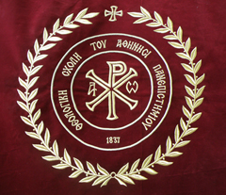

Slide 2
The National and Kapodistrian University of Athens School of Theology
&
Faculty of Social Theology
Kindly
welcome you

Slide 3
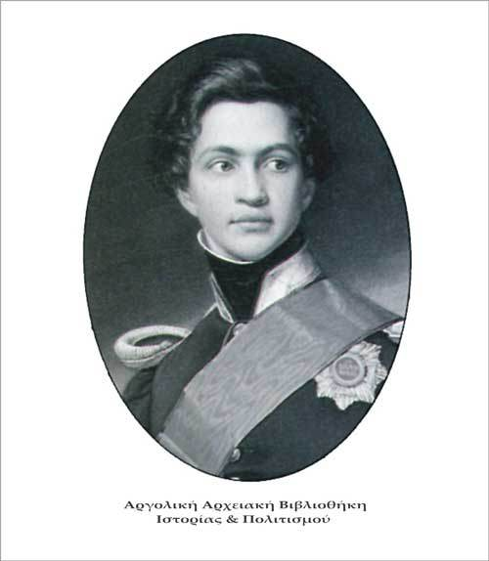
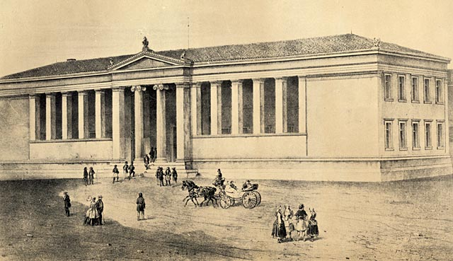
Dear guests you have the honor to be in one of the first University’s School which was established in 1837 by King Othon in Athens and it was the First University in the Balkan and East Mediterranean area after the fall of the Ottoman empire. The school of Theology was one of the first four Schools which were contained the othonian University besides Law, Philoshophy and Medical School .

Slide 4
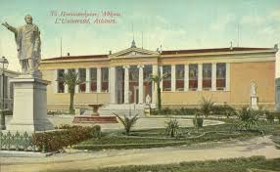
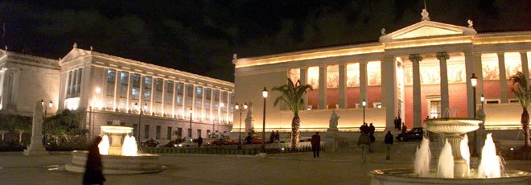
The Famous architect Christian Hansen designed the historical building in one of the most important streets in the center of the of Athens.
This amazing new building was planned to be the center of knowledge and civilization for the new Greek Country. It was also the first home for the School of Theology

Slide 5
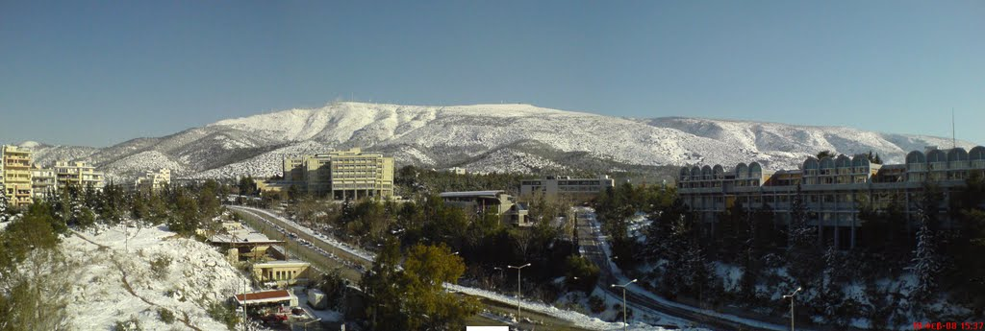
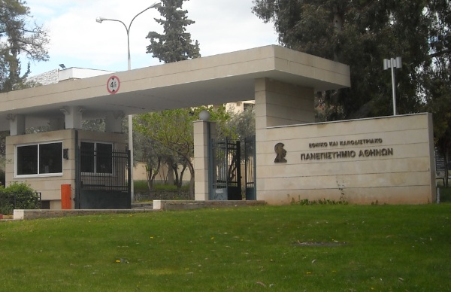
During the decade of the 1970’s the school moved to the new big campus in the Ζografou area, big enough to meet all the needs of the students.
The new environment is in one of the lush green places of Athens and gives the opportunity to students and staff to live their science in a natural surrounding.
The place is ideal for nature activities and sports, according to the ancient Greek saying “ νοῦς ὑγιής ἐν σώματι ὑγιεῖ΄”

Slide 6
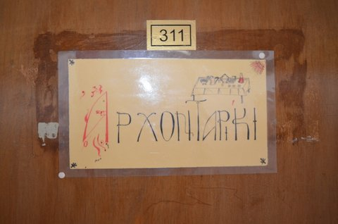
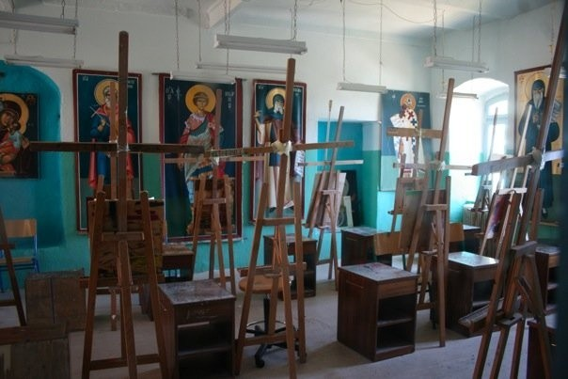
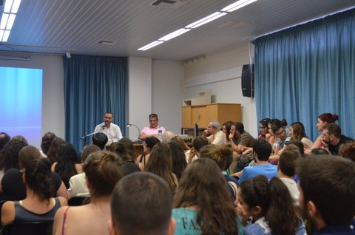
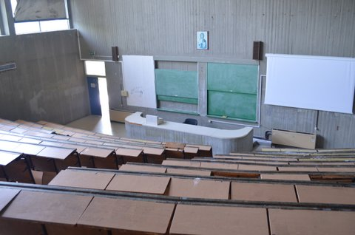
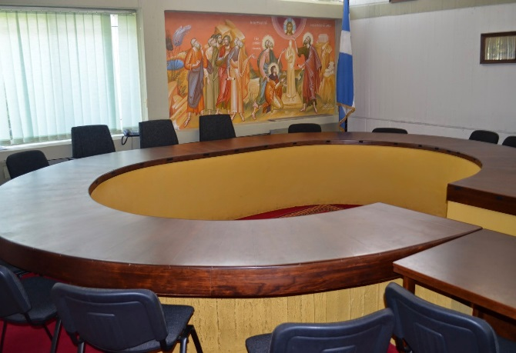
The new building was designed according to Le Corbusier’s architectural schemes (New Brutalism) and today it houses not only classrooms, but also secretary services, library, biblical & archaeological museum, conference rooms, archontariki, multimedia rooms, outdoor theater, iconography laboratory, Sinai studying center and the Apostle Paul's chapel.

Slide 7
KAPNIKAREA CHURCH
The School feels proud of being the administrator and owner of one of the most beautiful and important byzantine churches in the area of Athens.
The jewel of “Panaghia Kapnikarea” is situated on Ermou street, right on the nerve of the city.
It was built in the 11th century by Queen Evdokia upon the remains of an ancient Greek temple of the goddess Dimitra or Athina. There was a destruction plan for the church but luckily in 1834 King Ludvich forbade it.
The peculiar name “Kapnikarea” possibly came from the person who gave money for the building. He was collecting a kind of tobacco tax (kapnos in Greek) during the byzantine years. In older times it’s name was “Kamucharea” possibly taken from the quality of an excellent and precious fabric “kamuchas”, which was made in workshops near this area.

Slide 8
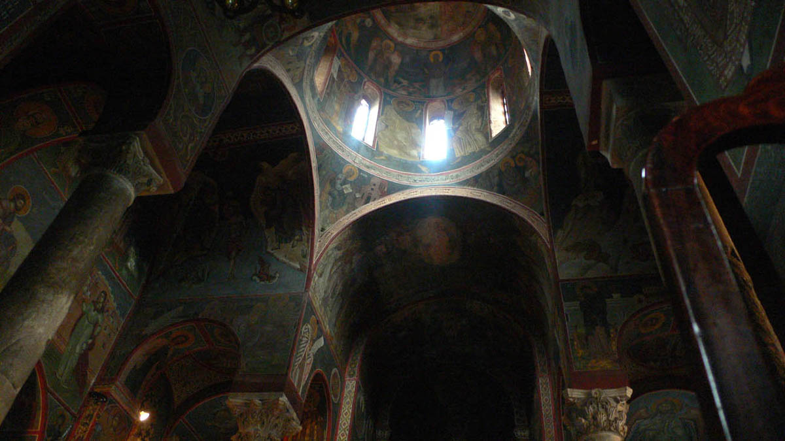
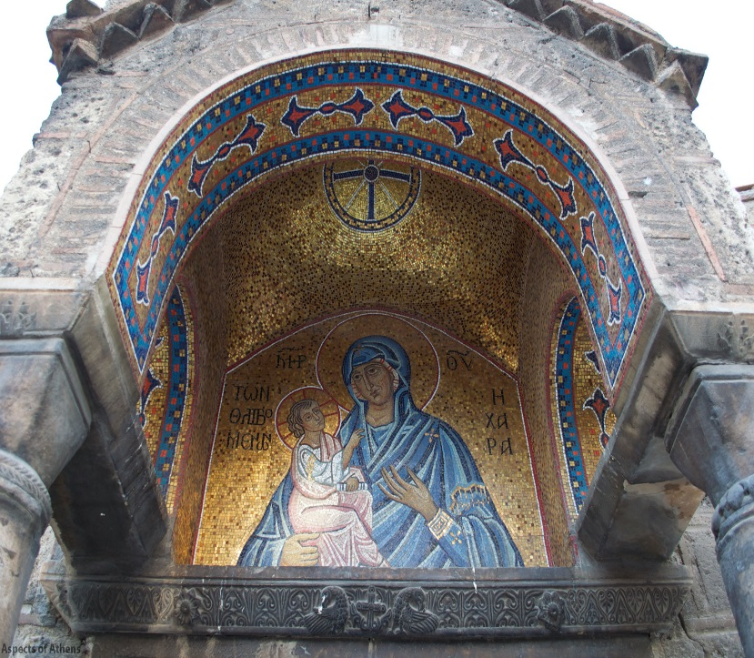
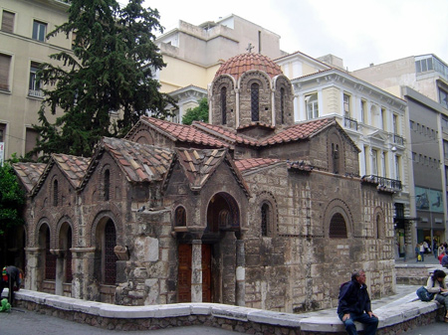

Slide 9
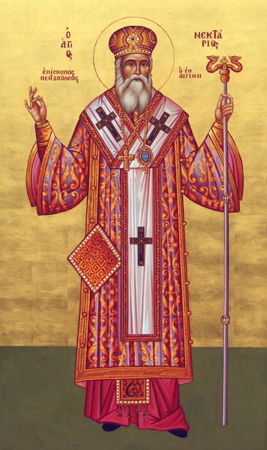
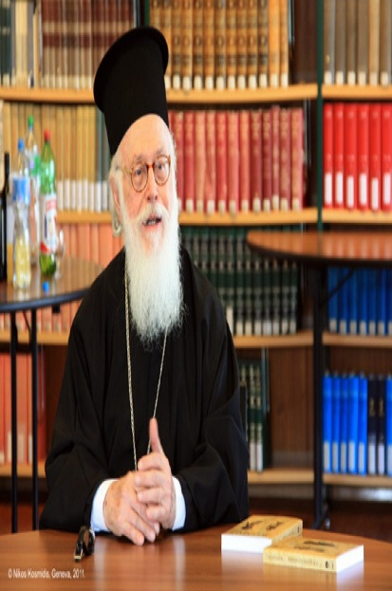
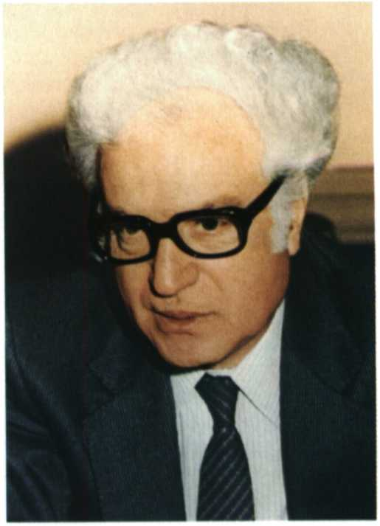
Many holy and brilliant personalities have been professors and students here. Also some of the orthodox church leaders all around the world have graduated from Theology School of Athens. Some of them….
anastasios Archibishop of albania
saint nectarius of aegina
Nikos Nisiotis
Prof. in Philosophy of theology

Slide 10
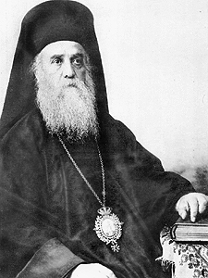
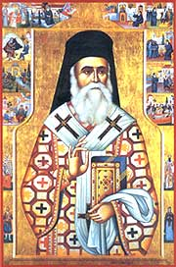
Aghios Nektarios The greatest honor for the school is his holiness. His name was Anastasios Kefalas and he studied here from 1881-1885. He is also called the “ Saint of the 20th century”. He really was one of the most brilliant and important personalities in the last century and the Orthodox Patriarchy announced him a saint in 1961.

Slide 11
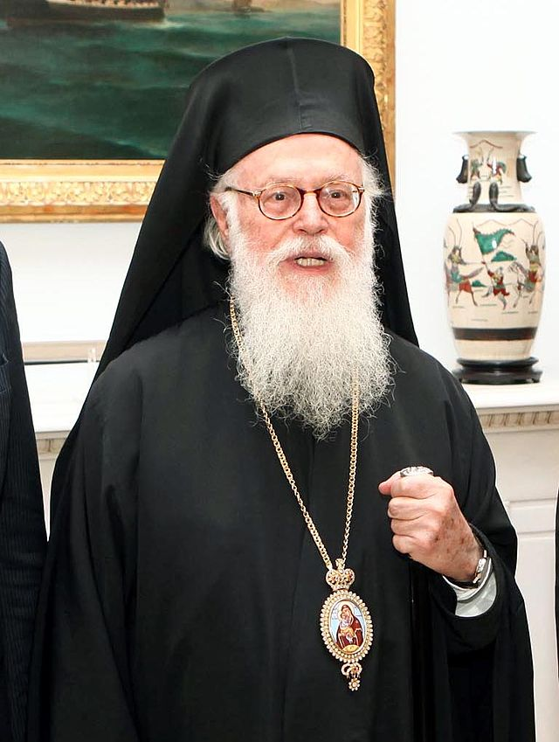
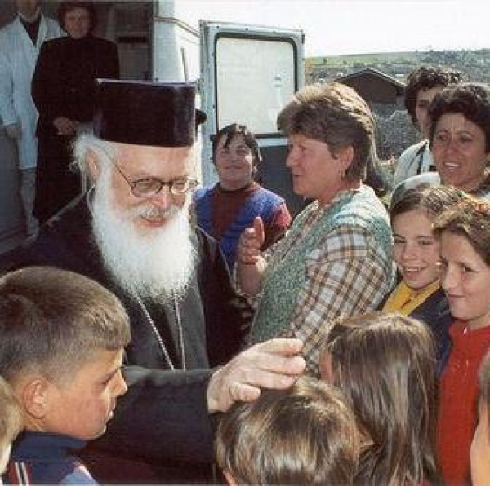
Anastasios of Albania ArchiBishop of Albania was an A grade student but also later became Professor of Religious History. He served as the head of the Apostoliki Diakonia of the Church of Greece, and he also accomplished important missionary work in Africa.

Slide 12
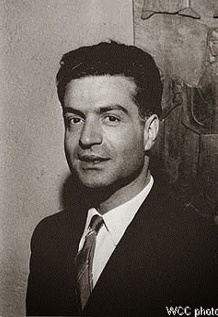
Dr. Nikos Nisiotis
He was Professor of Philosophy of Religion in NKUA, he also taught in many universities in Europe. From 1956 -1974 he was a member of the WCC.
He was the orthodox observer at 2nd Vatican Congress from 1962 -1965.
He was also a famous athlete and trainer of the Greek national basketball team and permanent member of the IOC.

Slide 13
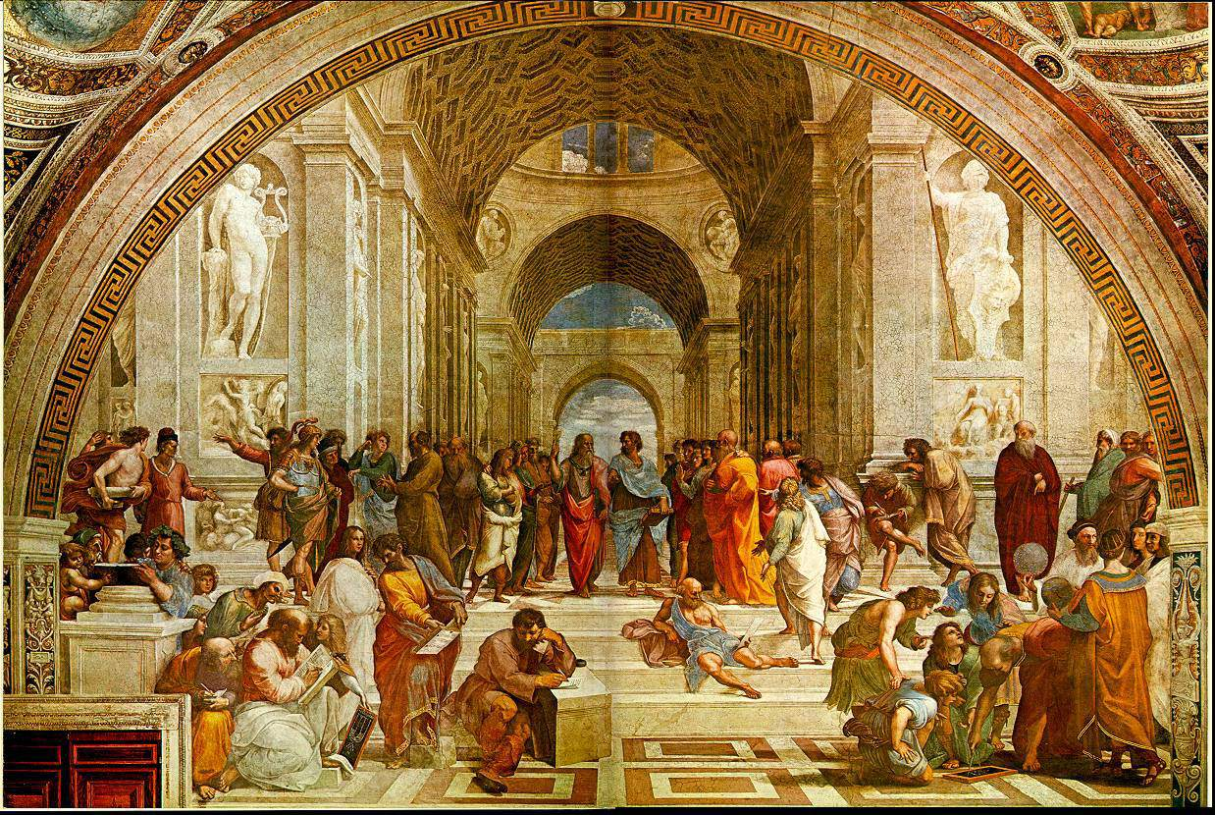
Human studies and religious spirit keeps going on in Greece….

Slide 14
Today more than ever, we need faith in our hearts. Faith to believe and get along in life with a new perspective. Theology is here for us, near us, inside us…. Theology studies are being connected with every part of daily life. Every day there is a chance for a new approach in…..

Slide 15
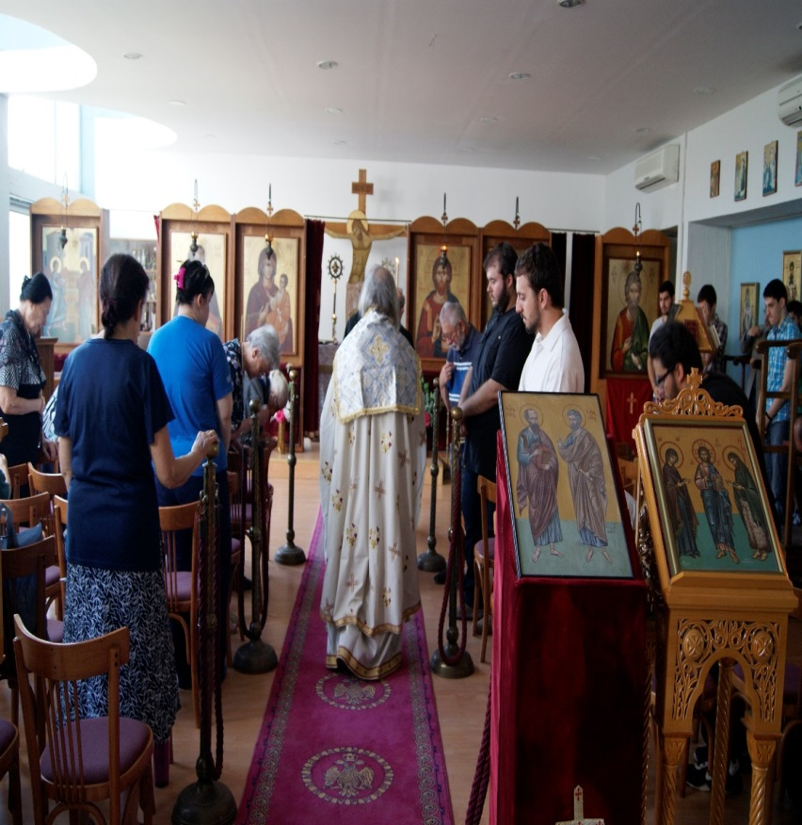
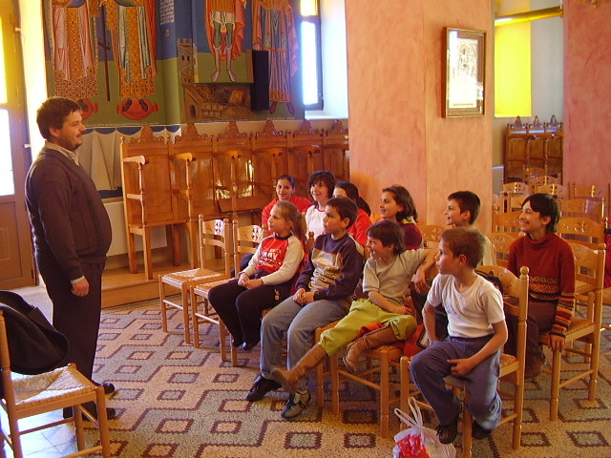
Ecclesia and Life
Education for priests and catechists capable enough as “shepherds” but also as tutors who can create selfconfident and faithful young people
Ecclesia and Life
Education for priests and catechists capable enough as “shepherds” but also as tutors who can create selfconfident and faithful young people

Slide 16
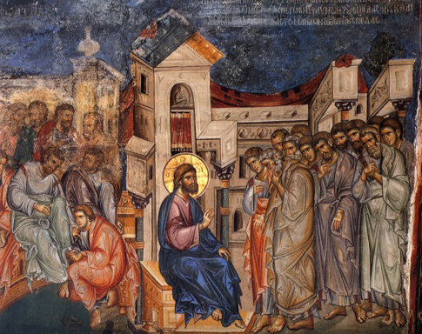
Education and Culture Our students learn all the new teaching methods according to the latest pedagogical systems

Slide 17
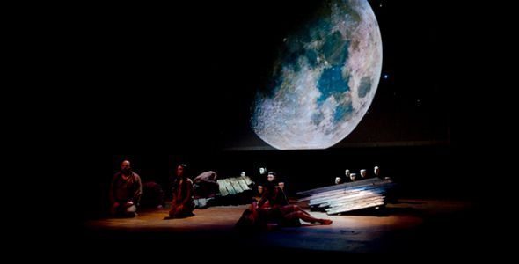
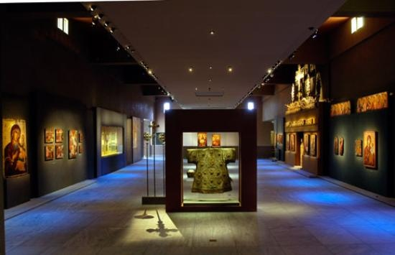
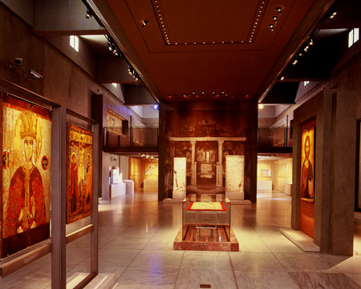
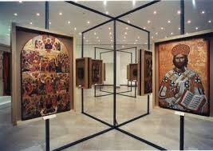
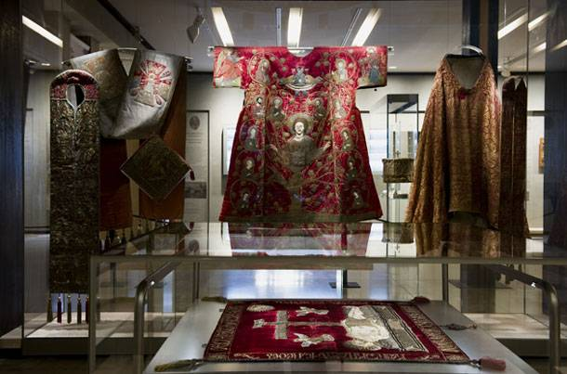
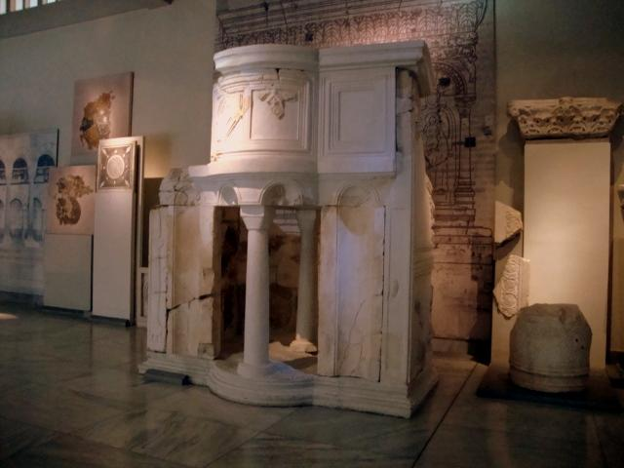
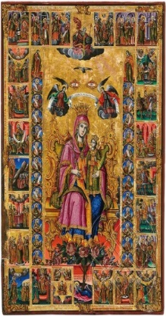
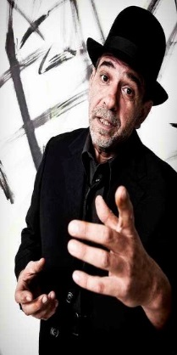
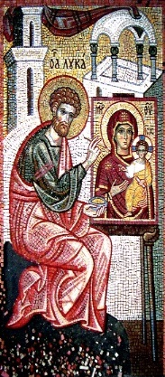
Religious studies are also in touch with Christian arts and literature

Slide 18
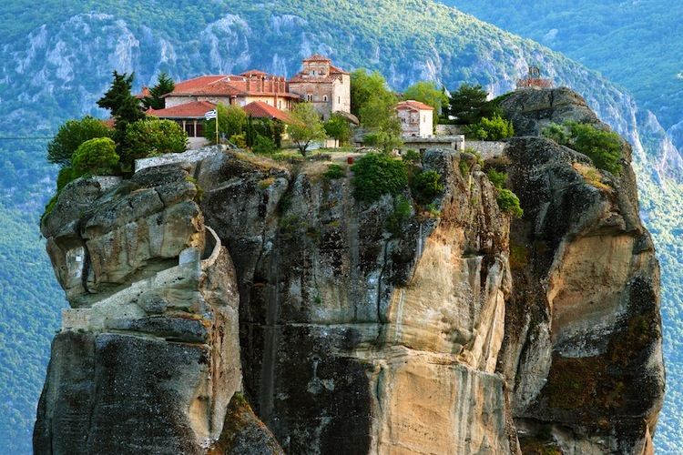
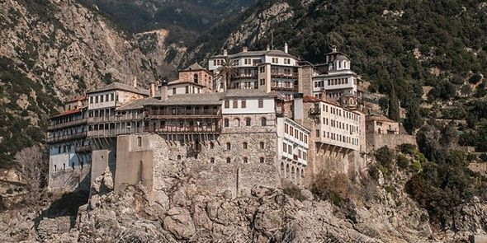
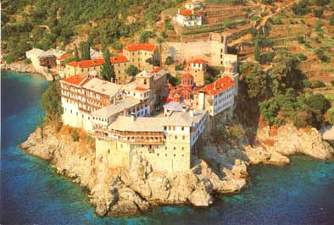
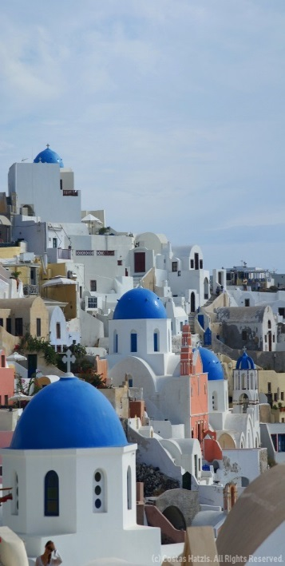
Religious traveling A new perspective in theological studies is to educate tourist guides specialized in our byzantine and religious heritage

Slide 19
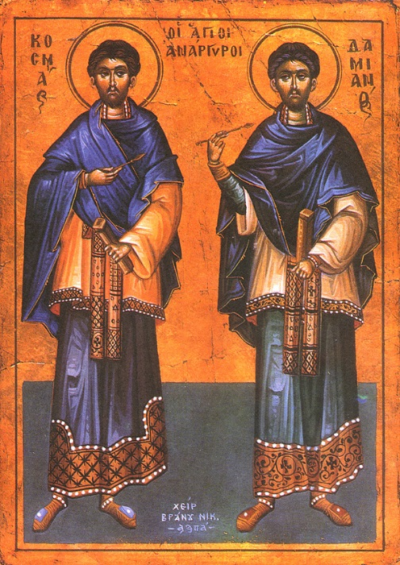
Health and Mental Health The educational program includes psychology as well as bioethics courses aiming to approach and integrate as far as possible the human being, which in the Greek we call “Psychi”.

Slide 20
Science
Theological studies are here not as an enemy but as a benefactor in science and technology.
We don’t forget that God gave us the world and our existence to keep it and to work for it (Gen.2,15)

Slide 21
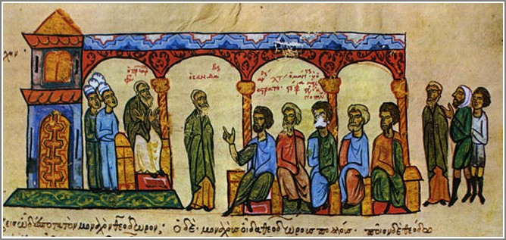
Society
Sociology studies are one of the main course's sector. Orthodox spirit becomes reality only through the love of the “Others” or “Your neighbors”

Slide 22
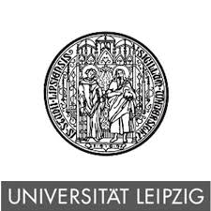
Every year the Social Theology Faculty accepts the biggest number of foreign students from all around in comparison with any other university school in Greece. The School also associates with famous universities through the Erasmus program for all levels of students and for professors

Slide 23
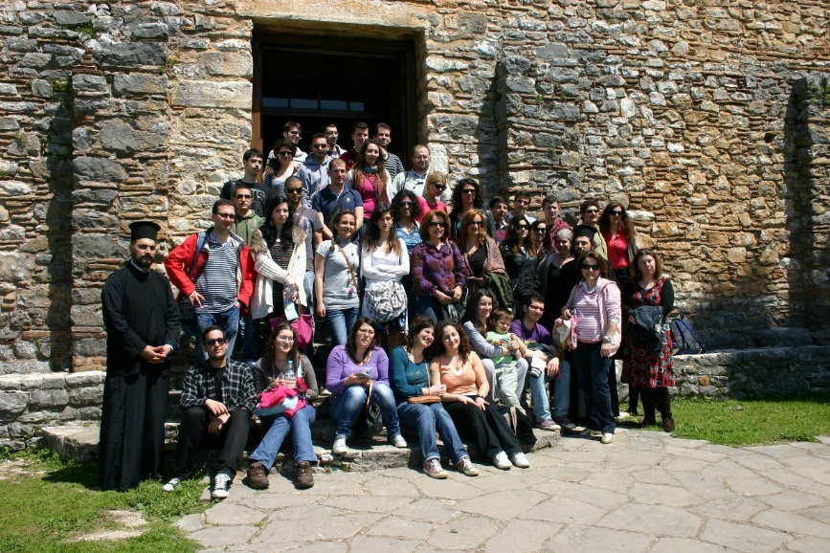
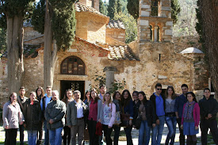
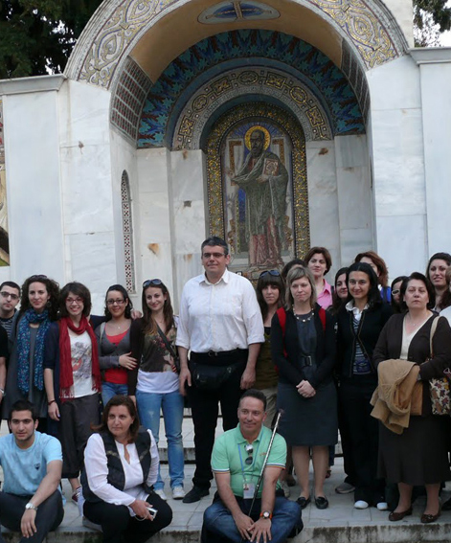
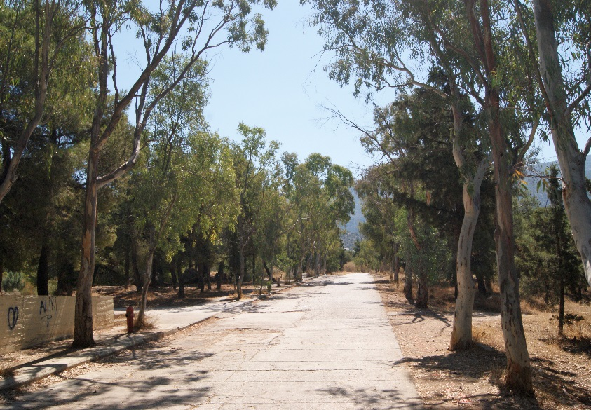
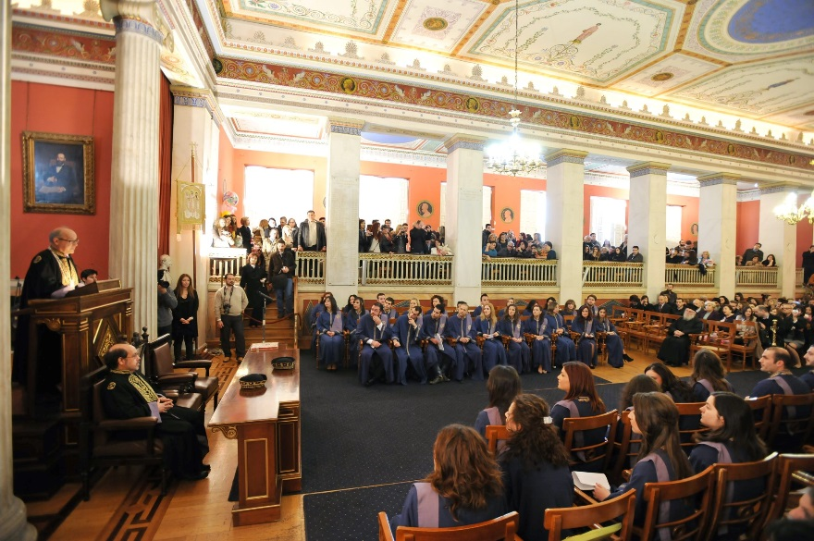
Educational trips
Educational trips
Life into the University
Life into the University
Notes:
Life into the University

Slide 24
Thank you very much for your interest.
We appreciate for their help
Dr Despotis Sotirios
The archive’s department of National and Kapodistrian niversity of Athens,
the municipality of Athens,
Byzantine and Christian museum of Athens
Mr Panos Axaridis
&
Monks from the monastery of Simon Petras in Holy Mountain

Slide 25
Research & Production
Elena Evagelou
under supervisoring by
Mr Sotirios Despotis
Prof. of Theology School in UOA

