Slide 1
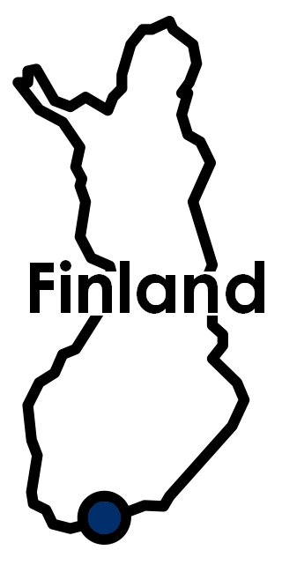
The European Policies of the E.U. Member-State
Maxime Breton
13/12/2023

Slide 2
Outline
What is Finland?
Territory
People
Structure of the state
Society characteristics
History (until 1995)
II. Finland in the E.U.
History (after 1995)
Representation in the E.U.
Economy in the E.U.
Finland policies in the E.U.
Euroscepticism
III. A current crisis: Russia-Ukraine war

Slide 3
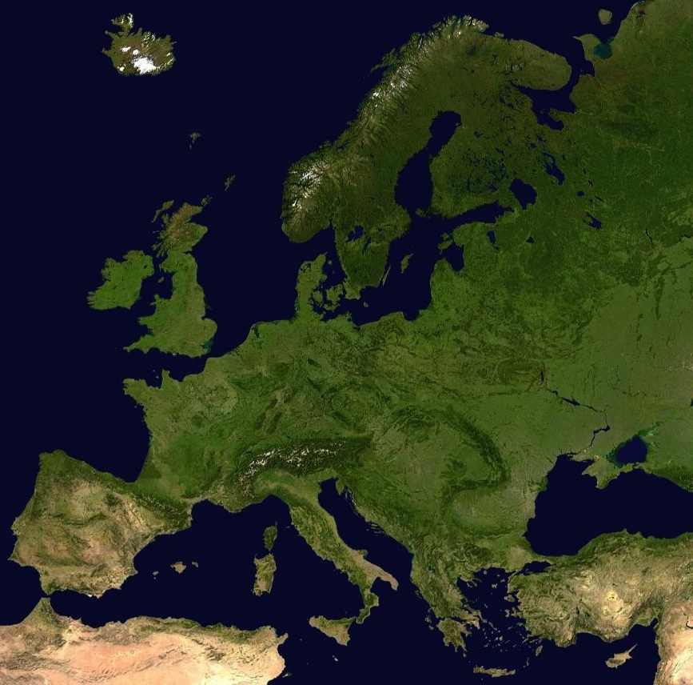
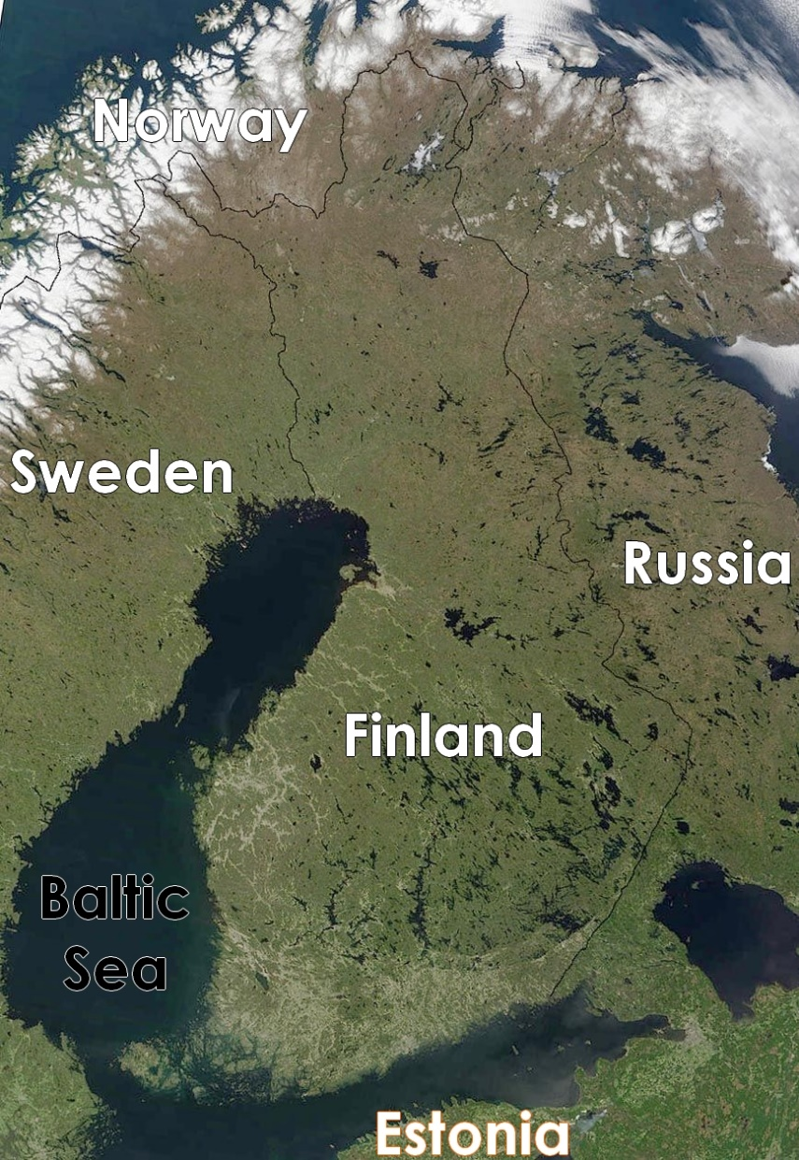
I. What is Finland?
A. Territory
338 145 km²
(5th in E.U.)
Subarctic
Coast: 1100 km

Slide 4
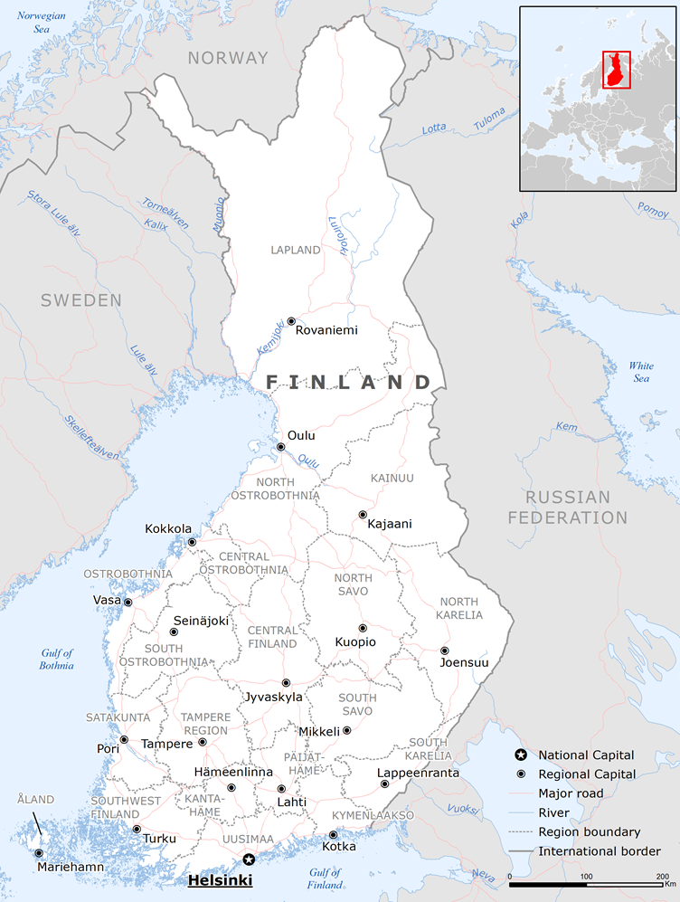
B. People
Population: 5,614,571 (17th in E.U.)
Density: 18 inhabitants/km² (lowest in E.U.)
Urbanization: 86% (75% E.U.)
Capital: Helsinki
1,338 millions inhabitants (27% of the population)
Ethnic groups:
Finns (91.5%)
Swedes (5%)
Romani (11,000)
Sami (10,000)
Russian (5,000)
Estonian

Slide 5
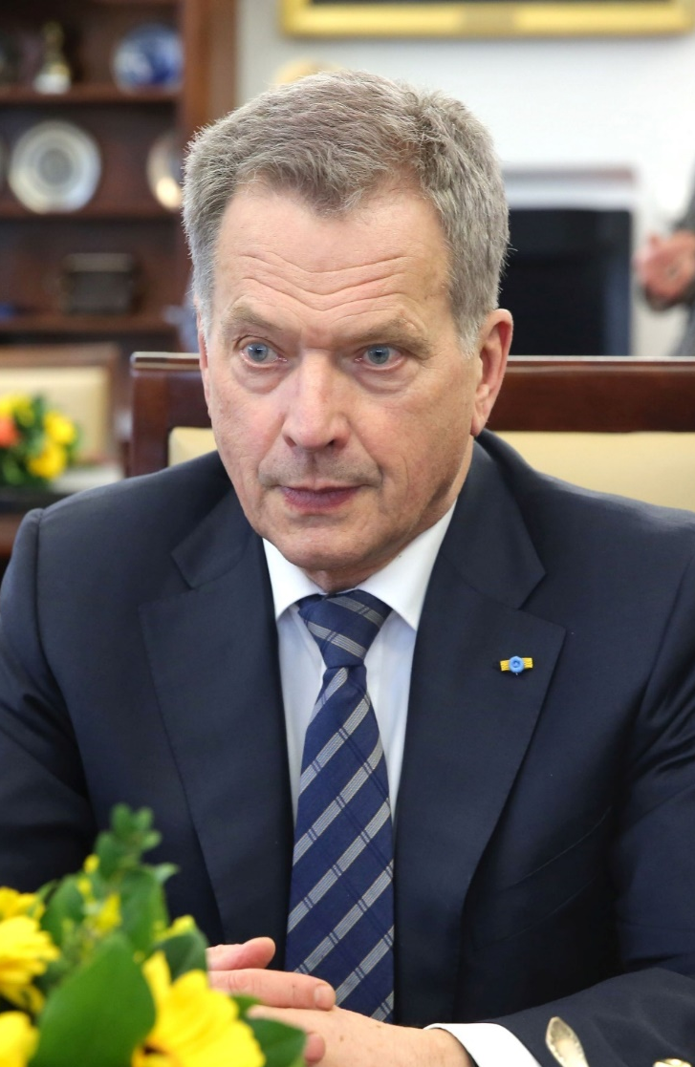
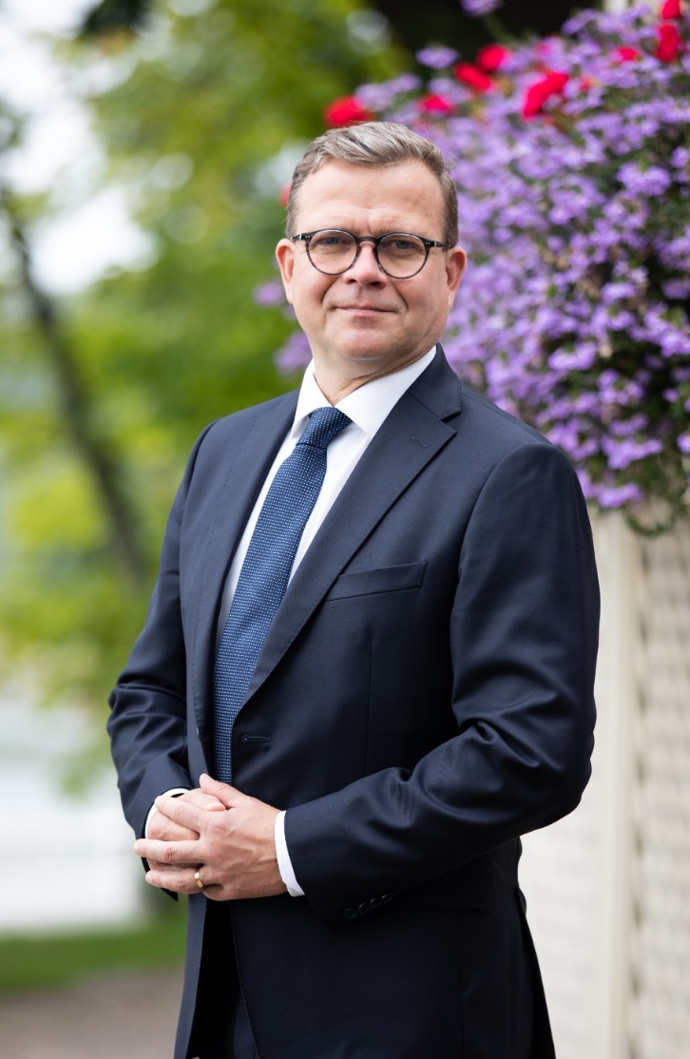
C. Structure of the State (1/2)
Parliamentary republic
Unicameral parliament: the Eduskunta
200 deputies
4 years mandate
President: Sauli Niinistö (2012-2024)
Prime Minister: Petteri Orpo (2023-2027)
Next elections:
Presidential: January 2024
Legislatives: 2027
Sauli Niinistö Petteri Orpo

Slide 6
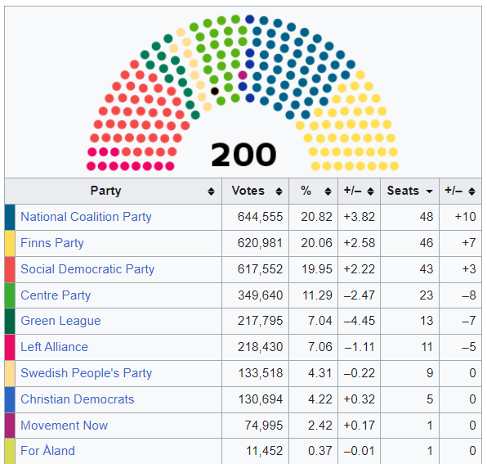
C. Structure of the State (2/2)
Government parties:
National Coalition Party (KoK)
Finns Party (PS)
Swedish People’s Party (SFP)
Christian Democrats (KD)
Opposition parties:
Social Democratic Party (SDP)
Centre Party (Kesk)
Green League (Vihr)
Left Alliance (Vas)
Movement Now (LIIK)

Slide 7
D. Society characteristics (1/2)
Nordic Model
GDP 2022: 28,83 billions (14th in E.U.)
GDP per capita 2022: 50,536 (7th in E.U.)
0,940 HDI (6th in E.U., 11th world)
5.1% population under poverty threshold (lowest)
Despite having the 8th highest cost of life in E.U. (20th world)
Ecology

Slide 8
Finland GDP growth
2000-2008 | +3,5
2009 | -8,1
2010-2011 | +2,8
2012-2015 | -0,73
2016-2017 | +3
2018-2019 | +1,15
2020 | -2,4
2021 | +3
2022 | +2,1
2023 | -0,2
D. Society characteristics (2/2)
The most precarious economy among the Nordic countries
Irregular growth
Unemployment increasing: 6.8% in 2022
Public deficit 2023: 3,8% (E.U. average: 3,2%)
Public debt: 71.7% of the GDP (10th in E.U.)

Slide 9
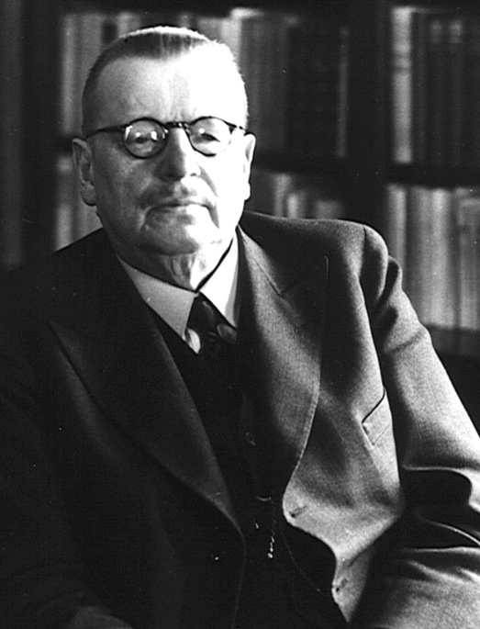
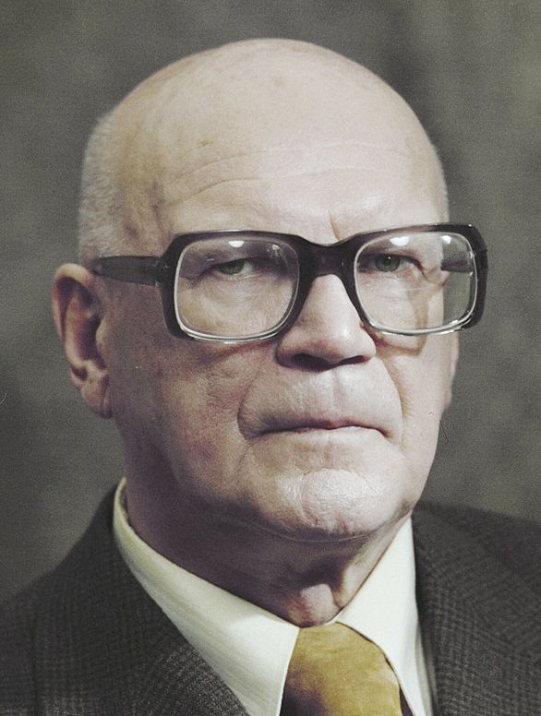
E. History (until 1995)
1809: Russian conquest
1917: independence
1918: civil war
1939-1940: Winter War
1941-1944: Continuation War
1948: Finno-Soviet Treaty
1961-1994: member of the AELE
1975: joined OSCE
1991: USSR collapse, economic crisis
1992-1995: E.U. candidacy
Juho Kusti Paasikivi (1946-1956) Urho Kekkonen (1946-1982)

Slide 10
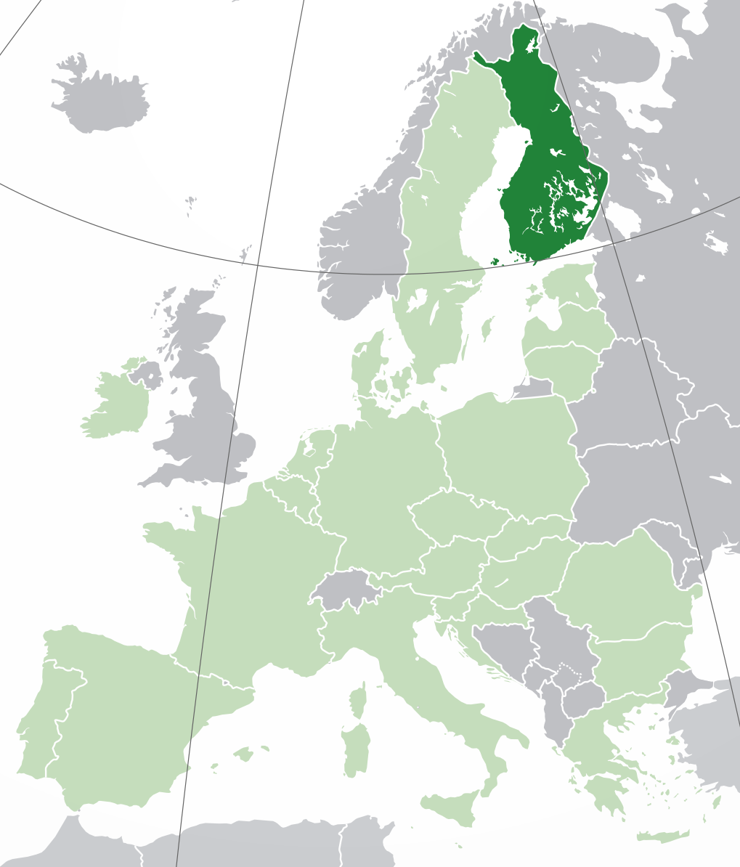
II. Finland in the E.U.
A. History (after 1995)
1995: join European Economic Area
1996-2001: Schengen
1999-2002: Euro
1994 referendum: “yes” by 56.9%
1999: Northern Dimension by Paavo Lipponen (Prime minister 1995-2003)

Slide 11
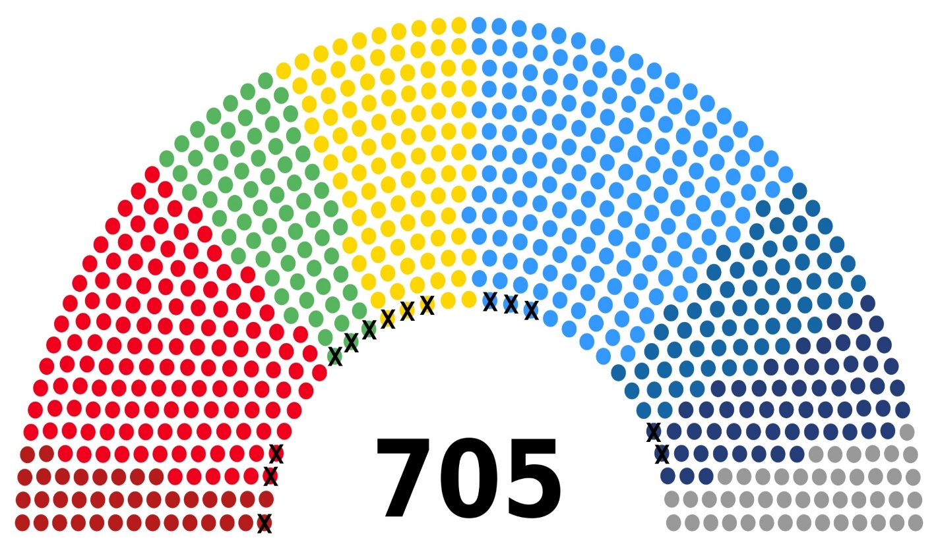
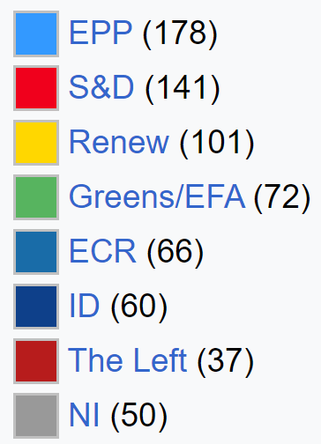
B. Representation in the E.U.
European Parliament
3 from KoK in European People’s Party (EPP)
3 from Vihr in Greens
1 from SFP and 2 from Kesk in Renew
2 from PS in Identity and Democracy (ID)
2 from SDP in Socialists and Democrats (S&D)
1 from Vas in European united left (GUE-NGL)
Presidency of the Council of E.U.
2nd half 1999
2nd half 2006
2nd half 2019

Slide 12
Finland trade economy (2021)
Partner | Import | Export
EU | 58 % | 56 %
Eurozone | 38 % | 27 %
Germany | 14,9 % | 13,3 %
Sweden | 11,6 % | 10 %
Netherlands | 5,3 % | 6,8 %
Outside EU | 42 % | 44 %
Russia | 11,9 % | 5,4 %
USA | 3,2 % | 6,8 %
China | 9 % | 5,3 %
United Kingdom | - | 3,7 %
C. Economy in the E.U.
Trade economy :
E.U. budget:
Debtor since 2004
In 2020:
2,32 billions gave
1,56 billions received
-756 millions net

Slide 13
D. Finland policies in the E.U.
E.U. budget:
Frugal fifth?
Credit rating: AAA
Negotiations about the Greek bailout
Enlargements supports:
Baltic countries
Ukraine?
Spread the Nordic model
Sanna Marin (PM 2019-2023) and Volodomyr Zelensky in 2022

Slide 14
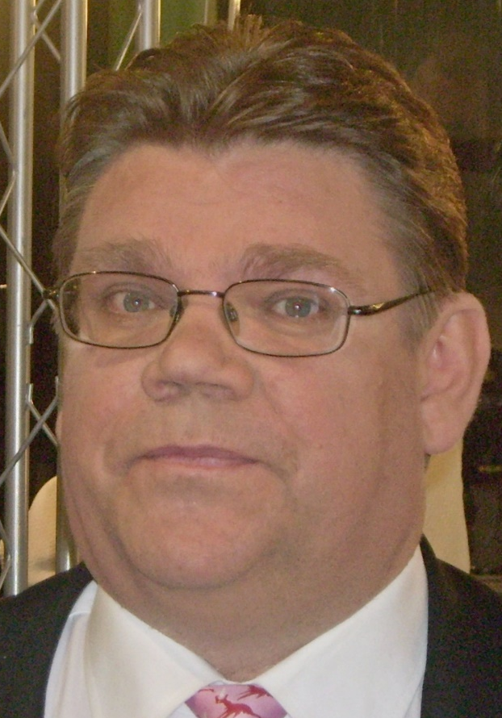
E. Euroscepticism
Hard euroscepticism |  | Agree | Disagree | Don’t know
Our country could better face the future outside the EU | Finnish | 16 | 77 | 7
 | EU | 30 | 63 | 7
Soft euroscepticism |  | Wrong direction | Right direction | Neither | Don’t know
Things are going in the wrong direction in the EU | Finnish | 38 | 35 | 13 | 14
 | EU | 48 | 36 | 7 | 9
Timo Soini
PS president (1997-2017)
Foreign Affairs (2015-2019)

Slide 15
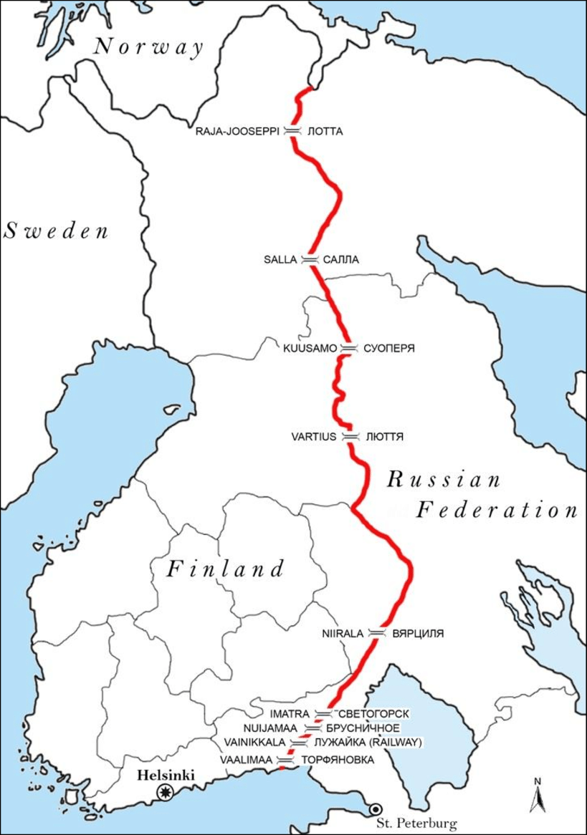
III. A current crisis: Russia-Ukraine War
Finland joined NATO in March 2023
Opinion poll about NATO membership
28% to 53% (Yle) after Russia invasion
November-December 2023 border crisis

