Slide 1
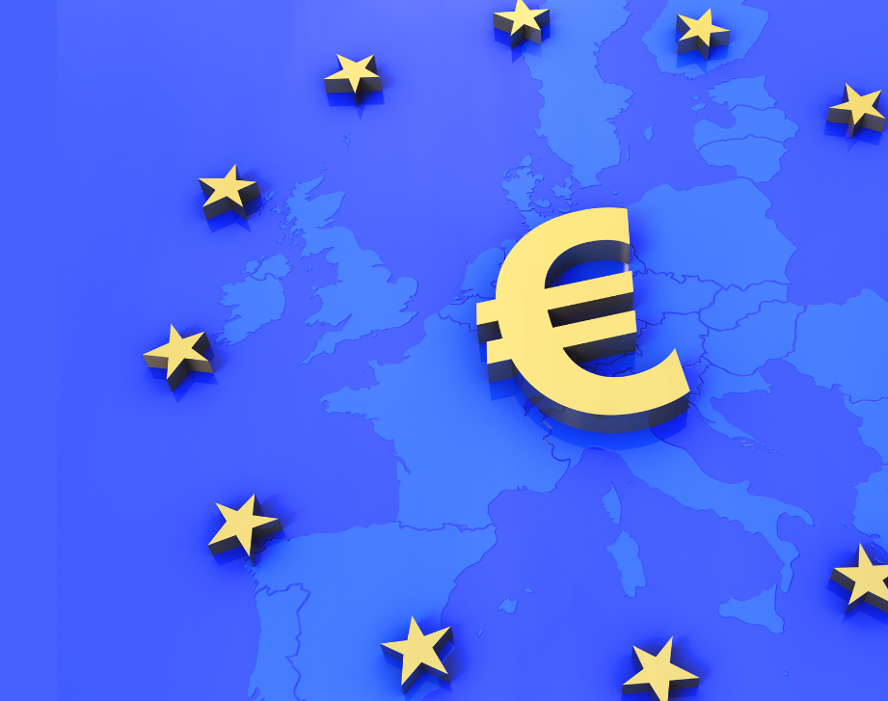
Construction and extension of the Eurozone: between rejection and integration

Slide 2
Geography and composition of the Euro zone
Euro zone member countries : Germany, Austria, Belgium, Cyprus, Croatia, Spain, Estonia, Finland, France, Greece, Ireland, Italy, Latvia, Lithuania, Luxembourg, Malta, Netherlands, Portugal, Slovakia, Slovenia
non-Euro zone members of the EU :
Bulgaria, Czech Republic, Denmark, Hungary, Poland, Romania, Sweden

Slide 3
Criteria for integration
a public deficit below 3% of GDP
a public debt not exceeding 60% of GDP
controlled inflation
independence of the country's central bank
a stable national currency for at least two years within ERM II.

Slide 4
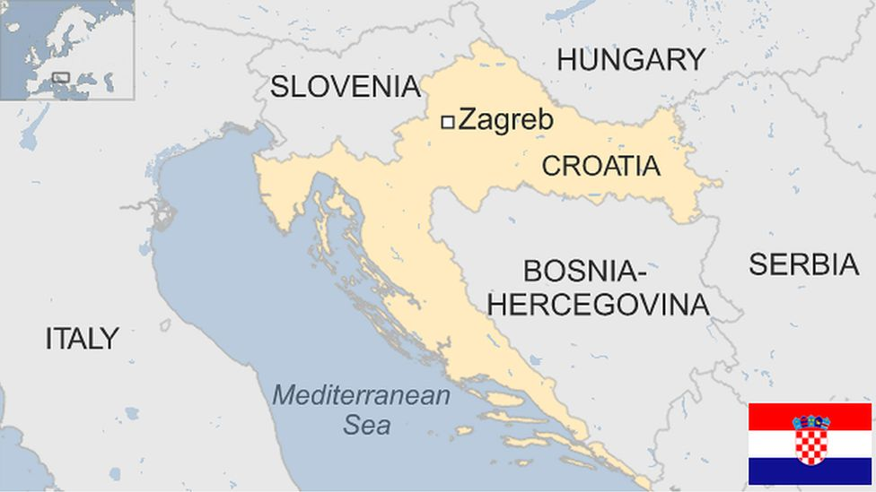
A successful integration process: the example of Croatia
Quick reminder:
Capital : Zagreb
Population : 4,008,617
Joined the EU in 2013

Slide 5
An effective economic policy :
since joining the EU (2013), significant progress has been made in the country's finances and economy
During the term of office of the current Prime Minister, Andrej Plenkovic, there have also been many advances towards this integration process :
-It exited the excessive deficit procedure (2017)
- joined the Treaty on Economic and Monetary Stability (2018), -- resolved excessive macroeconomic imbalances (2019
- joined the European exchange rate mechanism and banking union, securing 25 billion euros for its development (2020).
In 2023, Croatia joined the euro zone, the Schengen area and the European Stabilization Mechanism.

Slide 6
A particular interest in joining the euro zone
Its specialization (tourism and banking) makes its economy less sensitive to price competitiveness than countries more focused on relocatable manufacturing. It doesn’t neeed low exchange rate.
What's more, many tourism activities and transactions are already largely conducted in euros. Citizens' home loans and corporate borrowing are also already partly denominated in euros, to obtain lower interest rates.
Croatia has little population and economic weight in the world so it has an interest belonging to the euro-zone to participate in the European Stability Mechanism.

Slide 7
The perfect candidate then?
Croatia does not exactly meet the accession criteria. Its debt, although falling, has reached 70% of GDP, against a target of 60%. Inflation, which in principle should not exceed the average of the three countries with the lowest inflation by 1.5 points, did not reach this level until April 2022, when the accounts were officially drawn up.
This shows that over and above compliance with certain economic criteria, membership of the euro zone union is also and above all based on an appreciation of political will

Slide 8
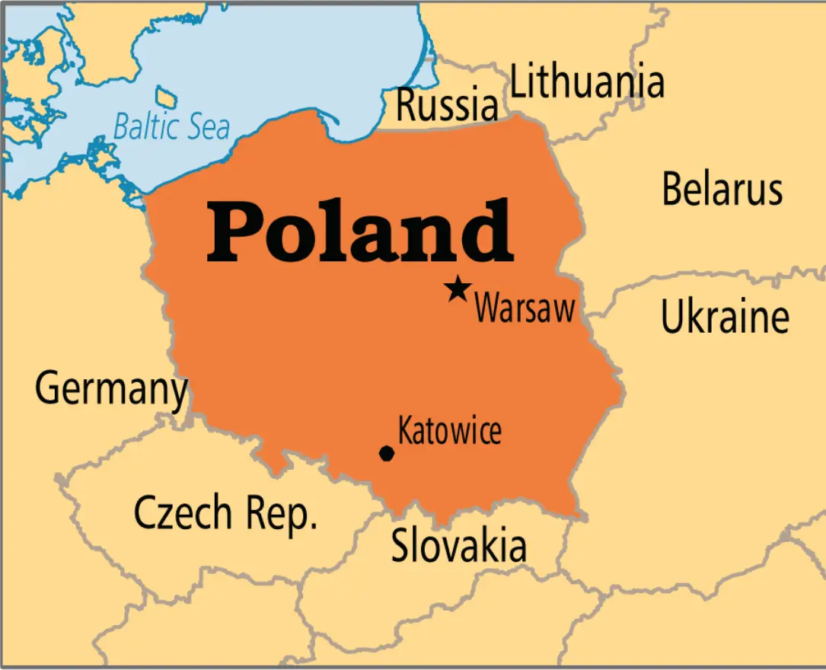
Joining the euro zone : an intrinsic commitment not always respected -the example of Poland-
Quick reminder:
Capital : Warsaw
Population : 41,026,067
Joined the EU in 2004

Slide 9
voluntary postponement of entry into the euro zone
when the country joined the EU (2004), non-compliance with economic criteria was a valid and admissible argument
By 2006, the country had already met the most difficult criteria (inflation and deficit rates), but has not started the accession procedure
deliberate resignation from official membership of the ERM2 exchange-rate mechanism: does not meet all the criteria. This is a pretext for not joining the euro zone.

Slide 10
lack of political will and economic concerns
which is explained by :
the conservative party in power. When he came to power in 2015, the party's leader and main ideologue, Jarosław Kaczyński, asserted in a speech that adopting the euro would entail enormous costs, a considerable rise in prices, an inevitable recession and widespread impoverishment of society, and that it was therefore only possible when Poland's GDP per capita reached 85% of Germany's (with the current level equal to 56% of Germany's, and with the rate of convergence observed over the last decade, this would mean the early years of 2045-50).
The flexibility argument: Poland wants to retain control of its currency, so that it can devalue it if necessary. Experience of economic crises (notably that of 2008-2009, when it devalued its currency by up to 22%) convinced Poland that it was not in its interest to join the eurozone, and that having control of its currency would enable it to soften the blow of economic crises.
-> comparison with neighboring Slovakia, which joined the euro zone in 2009, shows that these beneficial effects in the face of a crisis apply only in the short term and are very limited when facing a less violent crisis.

Slide 11
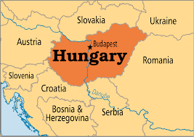
Hungary
Quick reminder:
Capital : Budapest
Population :9 547 954
Joined the EU in 2004

Slide 12
A postponement of membership for economic reasons?
Inflation is among the highest in the EU, the currency is very weak, the budget deficit is widening and now stands at 7% of GDP, and Hungary is still not part of the European Exchange Rate Mechanism II (ERM II).
Its economy is highly dependant on outsourced manufacturing and need a low exchange rate.
Today, the country's economic situation is not compatible with entry into the euro zone, but the situation was different in the 2010s. At that time, the country was reaping the benefits of EU membership and regained sovereignty after 50 years of Soviet occupation. The country met almost all the convergence criteria required to adopt the euro.

Slide 13
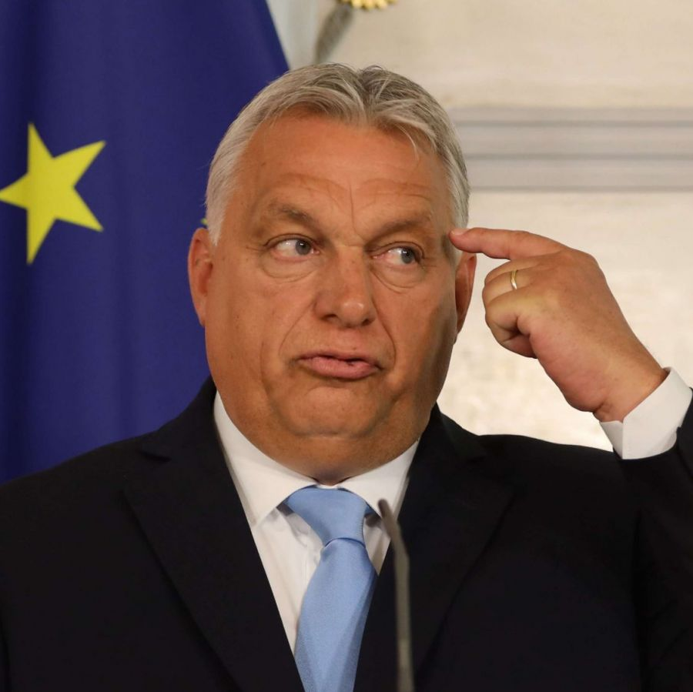
once again, a refusal to join the EU that has more to do with political will than economic context
A conservative, eurosceptic party led by its leader Victor Orban, Prime Minister since 2010 (and between 1998 and 2002), rules the country.
they consider that joining the euro zone would mean a loss of sovereignty and national identity for Hungary.
Despite a population over 60% in favor of joining the euro zone.

Slide 14
Conclusion
Although joining the European Union is in principle an obligation to be fulfilled over the medium to long term, entry into the euro zone is subject to resistance from some countries, which voluntarily extend the duration of their derogation.
In principle, a country's economic context is the major factor determining whether or not it joins the eurozone, but political will is just as decisive. Whether it's the will of the country in question, which for one reason or another wishes to delay or even block its entry into the euro zone, or whether it's the will, the policy applied at a given time by the European Commission and the European Central Bank, which consider that there is an interest in integrating countries into the euro zone in the more or less short term (to symbolically demonstrate its attractiveness, for example) or not.

