Slide 1
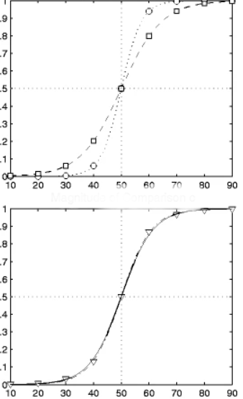
Method of Forced Choice
In psychophysics, the forced-choice method is a technique used to measure perceptual thresholds or sensitivity to stimuli. It is particularly useful for studying sensory perception in various modalities such as vision, hearing, touch, and taste

Slide 2
Typical Steps:
Stimulus Presentation: The experimenter presents the participant with a series of sensory stimuli.
Forced Choice: After each presentation of the stimulus pair, the participant is required to make a judgment or response indicating which stimulus in the pair they perceived. Importantly, the participant is forced to choose one of the stimuli, even if they are unsure or perceive the stimuli as being identical.
Response Format: The response format in forced-choice tasks can vary depending on the experimental design. Common response formats include:
-Two-alternative forced choice (2AFC): Participants choose between two alternative stimuli presented simultaneously.
-Three-alternative forced choice (3AFC): Participants choose between three alternative stimuli.
-n-alternative forced choice (nAFC): Participants choose between multiple alternative stimuli.
Method of Adjustment: In some forced-choice tasks, the stimulus parameters (e.g., intensity, duration) may be adjusted dynamically based on the participant's responses
Threshold Estimation
Analysis: Statistical analysis techniques, such as signal detection theory or psychometric curve fitting

