Slide 1
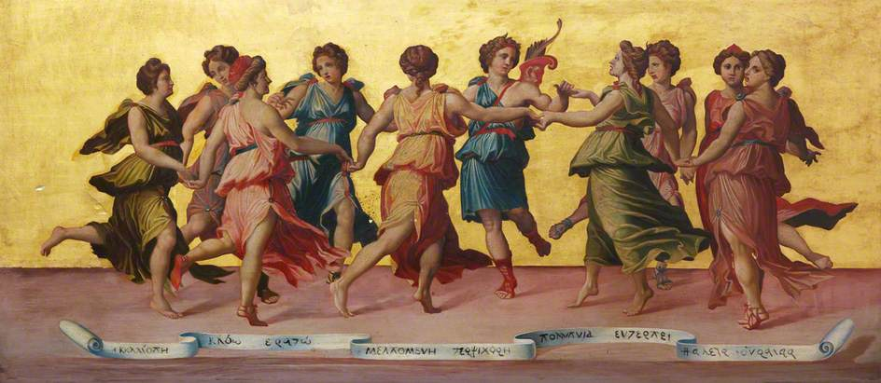
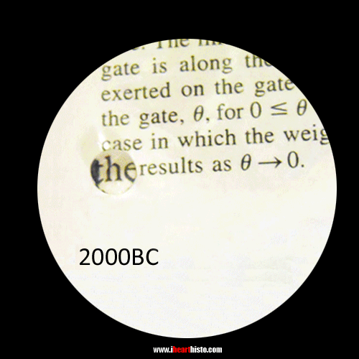
European Society of Pathology (ESP) Special Session – Pathology and Public 28.9.2016 The Arts Meet Pathology in Practice: A Personal Approach.
ROBERT SANDERSON (1848-1908) Apollo and the Muses.
Dr Andreas C. Lazaris, Pathologist

Slide 2
Art, according to Aesthetics, is the conscious energy, but also the human ability to create works that cause aesthetic emotion and thinking. The microscopic images with which a pathologist comes into daily contact, in addition to diagnostic thinking, potentially stimulate his/her feeling through their beauty; so they constitute genuine artistic stimuli.
Οn condition man intends to respond to the call of Art,
what does Art principally has to offer
in everyday life ?
It delivers man from daily routine, exempts him from boredom, fatigue, stress and leads to felicity. Entertains, relieves and liberates.
Ιt cultivates the individuals’ aesthetics.
It contributes to the betterment of life and, potentially, to the completion of one's personality. In my opinion, Art-associated aesthetic pleasure alone, when not accompanied by reflection, cannot radically reform one’s character for the better or improve one’s behaviour towards others , but it can at least enrich life with beauty and meaning.
Through art the person eliminates introversion, isolation, complexes and possibly becomes cheerful and optimistic.
The Splendor of Color Kaleidoscope Video v1.3 - hdcolors.com

Slide 3
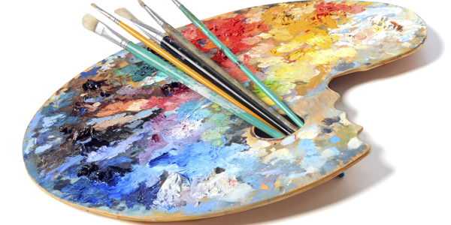
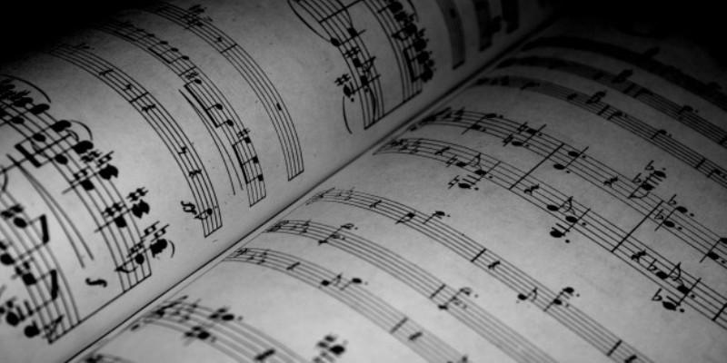
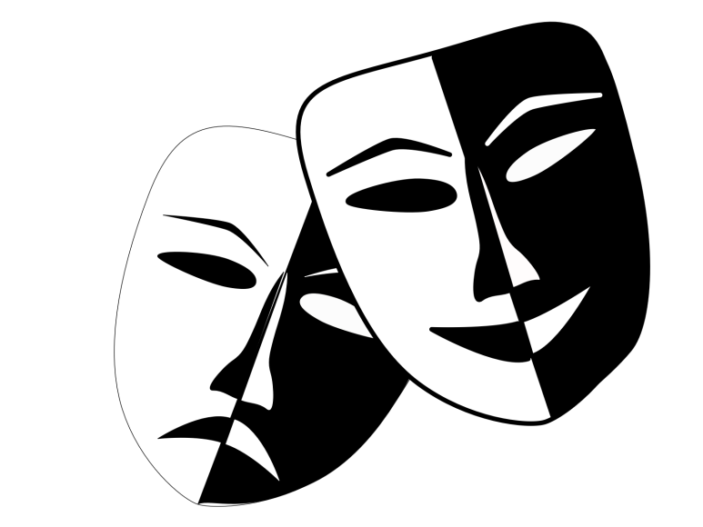
Grounds of this presentation
Openness, extraversion: common features of Art and of the under establishment, ESP “Pathology and Public” Subcommittee. Making pathology less esoteric and more accessible to nonmedical people. Just consider the size of the impact the You Tube videos with actors highlighting Pathology issues, had, compared with any printed informative text.
Although, personally, I am neither an artist nor a theorist of art, but only an art lover pathologist, Ι always wanted firstly to record (with words, inevitably,) my personal experience of the contact points of the art forms which are peculiar to my nature, with my daily work as Pathologist, and, secondly, to make known the contribution of colleagues with most of whom I am acquainted, in Art.
So, how can Art make sense of science, and Pathology in particular?

Slide 4
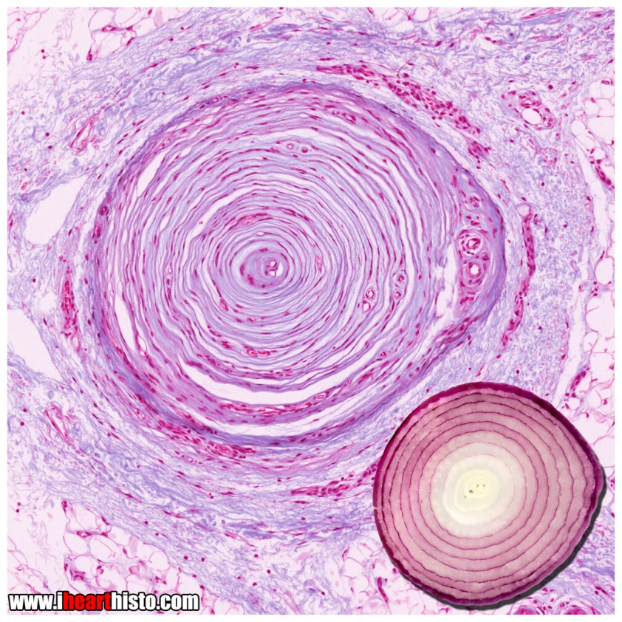
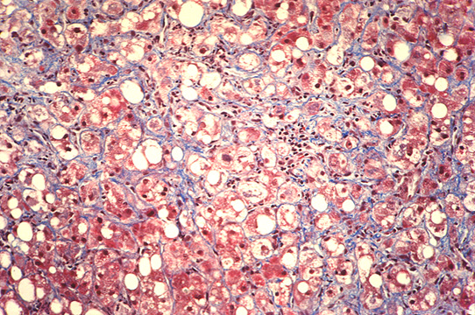
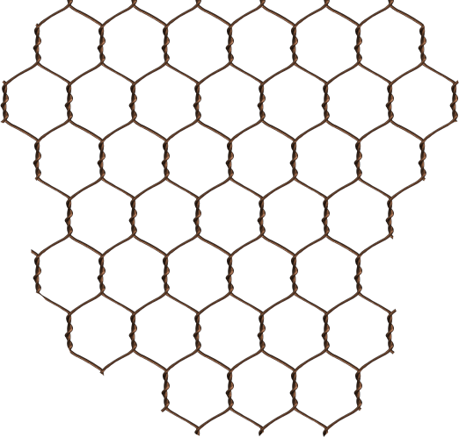
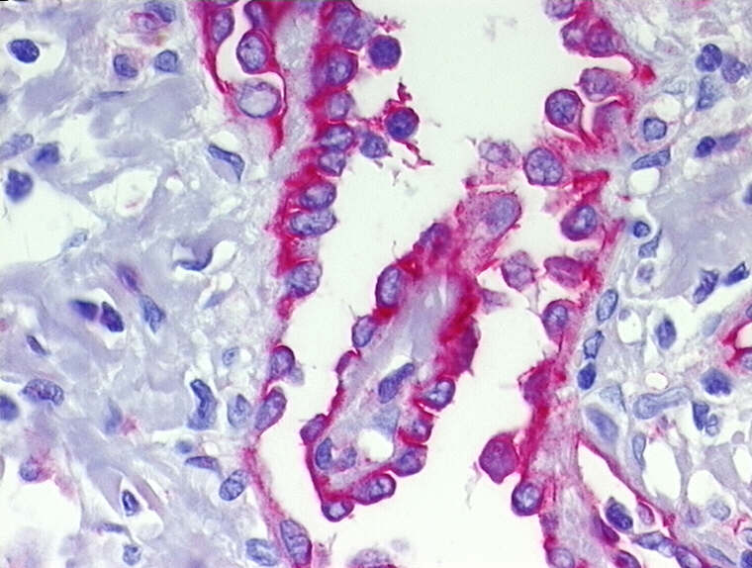
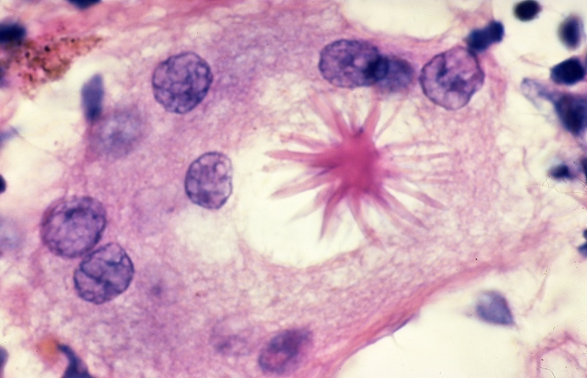
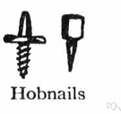
Descriptive Pathology & Histology: the art of simile in the diagnostic procedure is an excellent exercise of imagination.
Pericellular, chicken wire, alcoholic liver fibrosis
Pacinian corpuscle
in the dermis
Sarcoidosis - Asteroid body
Skin, hobnail hemangioma

Slide 5
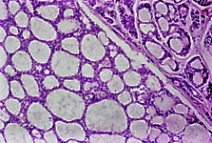
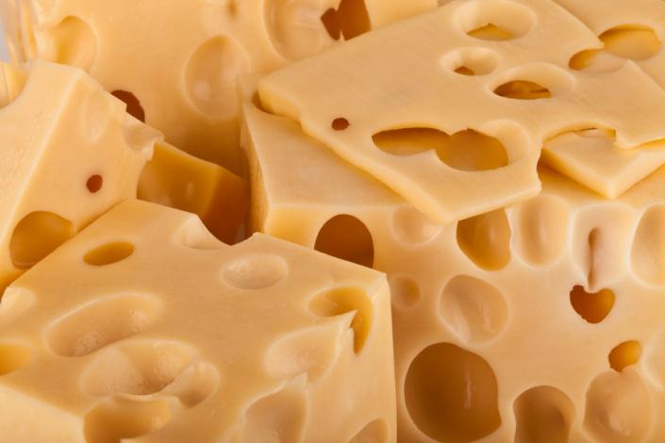
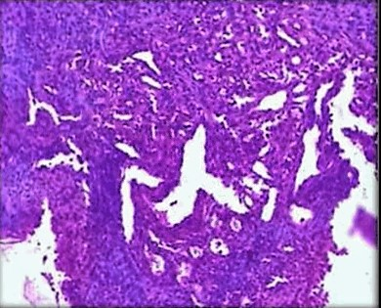
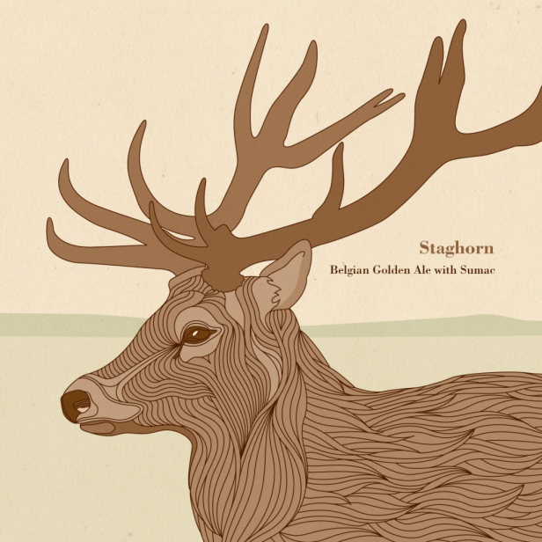
The art of simile in Descriptive Pathology patterns.
Salivary
adenoid cystic carcinoma: swiss cheese pattern.
Hemangiopericytoma.
Irregular branching of vascular spaces in the characteristic “stag-horn” pattern.

Slide 6
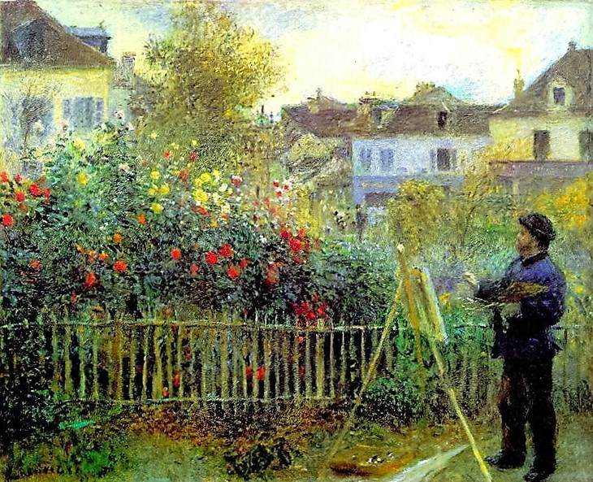
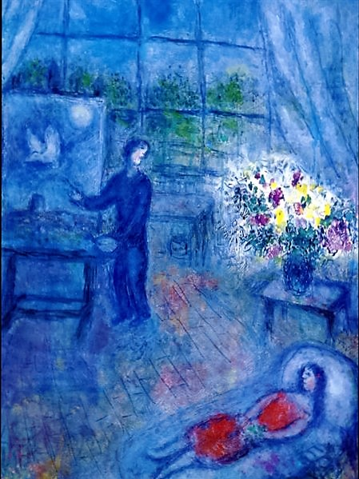
The fundamental importance of inspiration
in creating Art.
A. RENOIR Monet painting in his garden at Argenteuil, 1873.
An artist emerges and is made worthy above all from his/her own inspiration.
Inspiration is to devise, to practise imagination, and, with spontaneity and sensitivity, capture images and situations of the external world and externalize the animated sentiment with aesthetic means, transferring it to others.
M. CHAGALL Artist and his model, 1973.

Slide 7
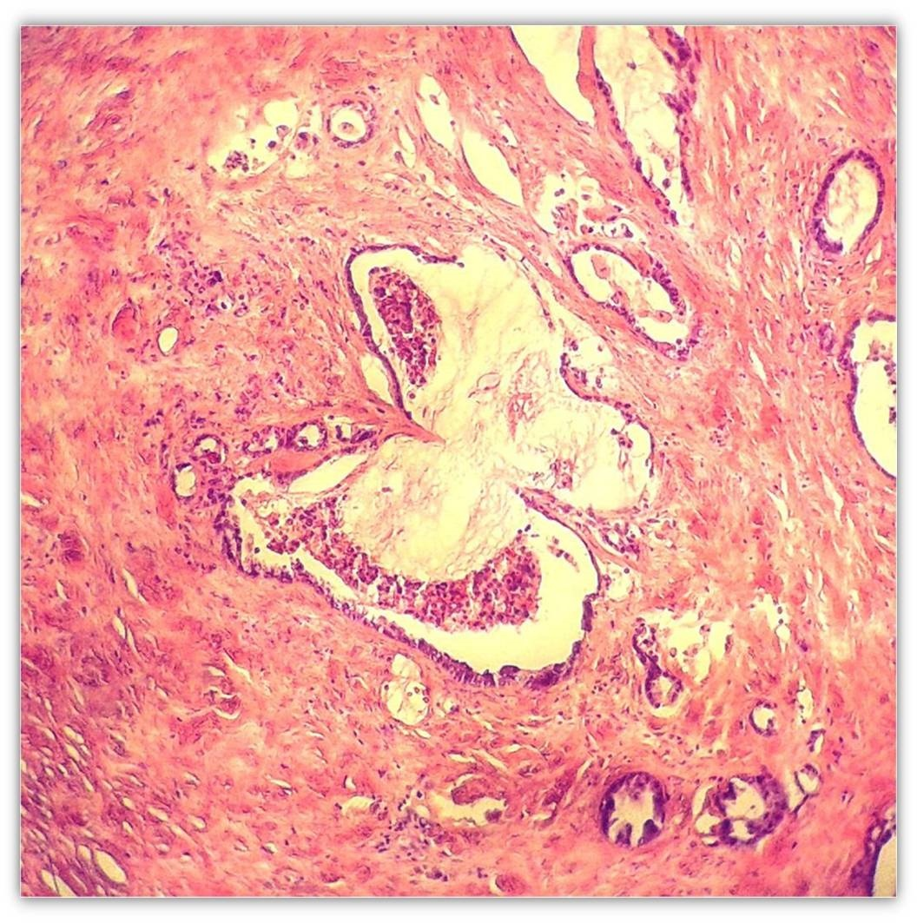
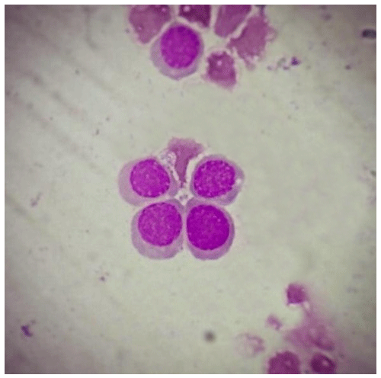
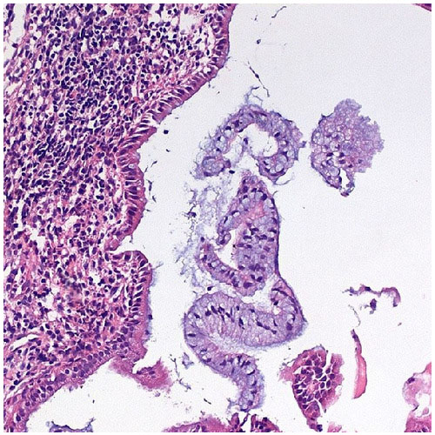
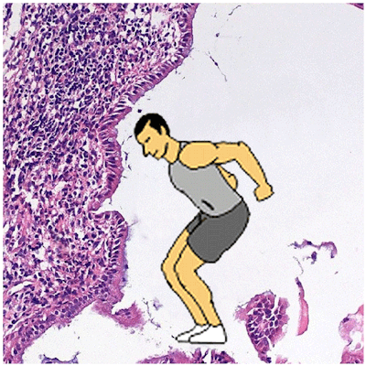
An excellent exercise of imagination takes place through microscopic structures.
”Flying through Pathology”
Dr Aleksandra Lovrenski, Pathologist.
1st scoring rank,
ΑRT PATHS ARTISTIC EXHIBITION,
ECP 2015, BELGRADE.
Megaloblastic Butterfly Hatched from a bone marrow smear
taken from a patient with megaloblastic anemia.

Slide 8
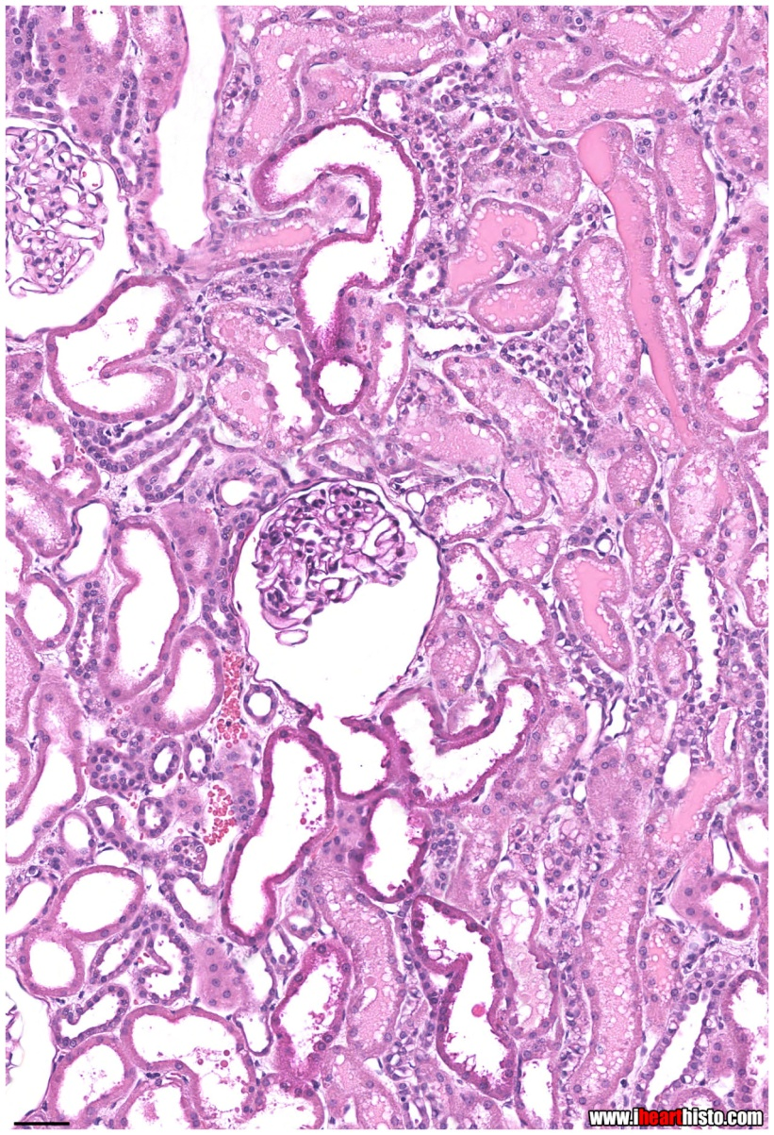
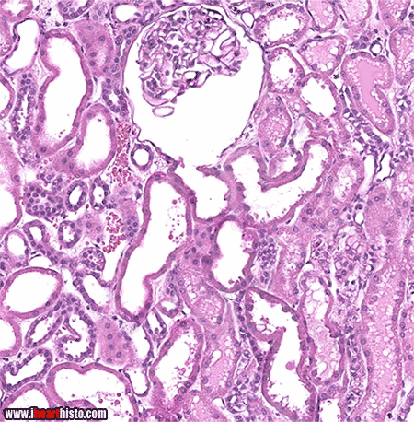
Unbridled imagination. When you smoke, your kidneys smoke too!

Slide 9
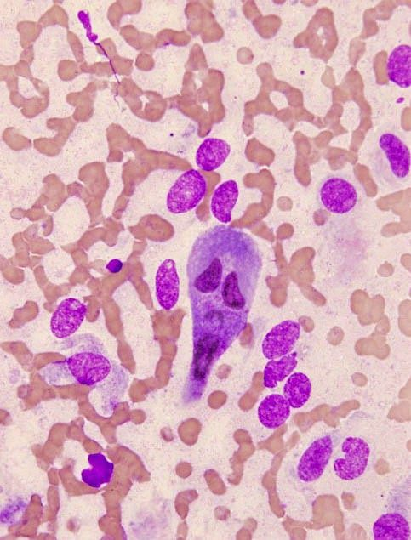
Αpproaching visual arts by practicing pathology.
By microscopy,
the pathologist is exercised daily
in recognition of shapes, colours, tones and patterns of harmony and disharmony.

Slide 10
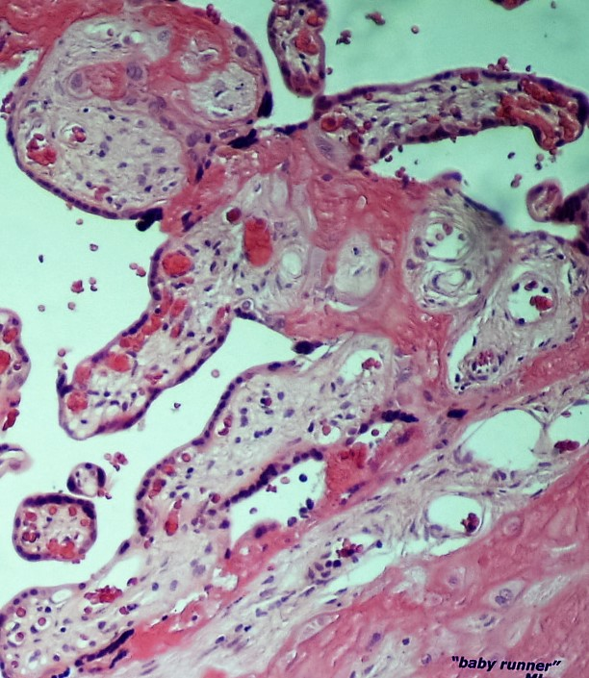
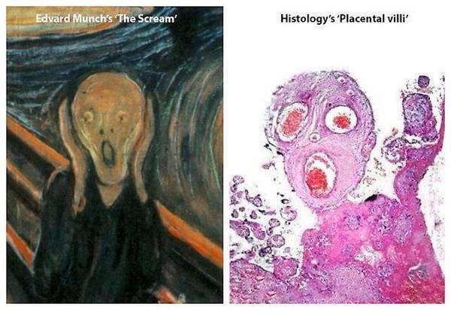
Αpproaching visual arts by practicing pathology. Εvaluating morphology of histological structures stimulates the imagination, a fundamental gift of every artist.
Baby runner by Assoc. Prof. Dr M. Lambropoulou

Slide 11
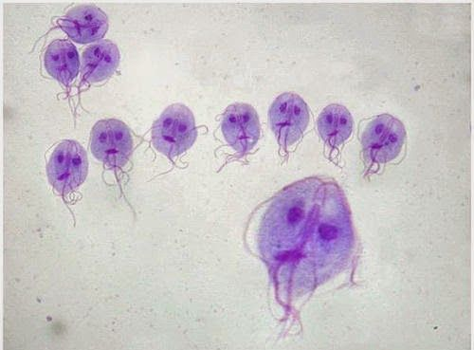
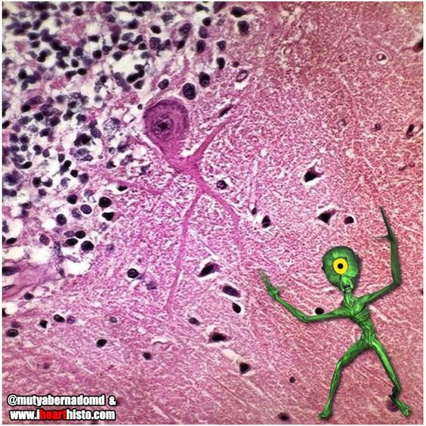
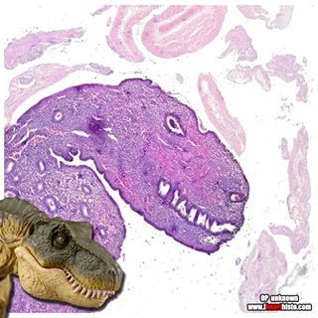
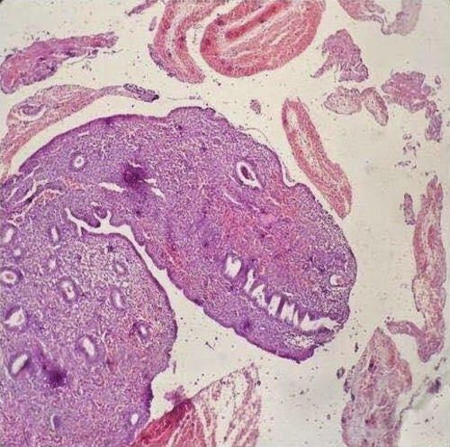
Exercise in figures via pathology.
An escape window to the world of fantasy.
Giardia

Slide 12
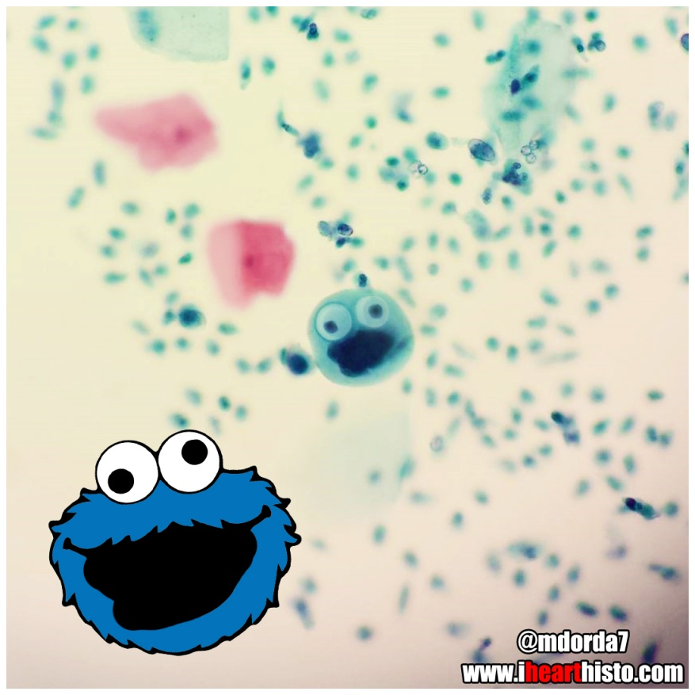
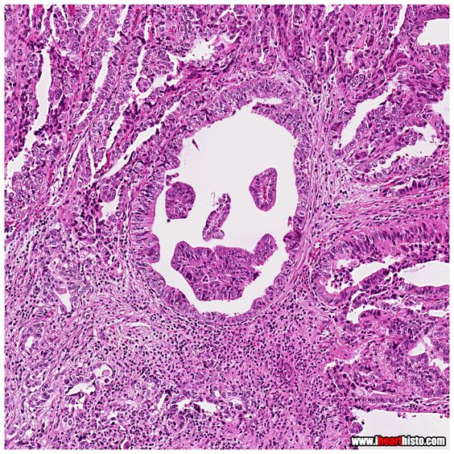
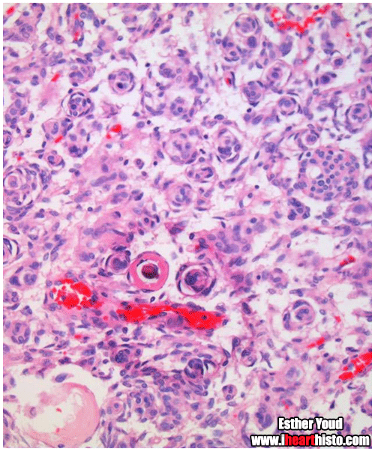
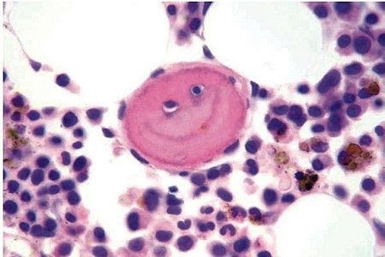
Everyday exercise in figures via pathology. Discover smileys and cheer up every day!
Cookie Monster in a Pap Smear

Slide 13
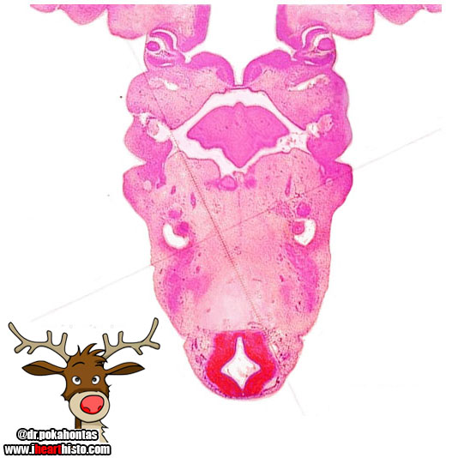
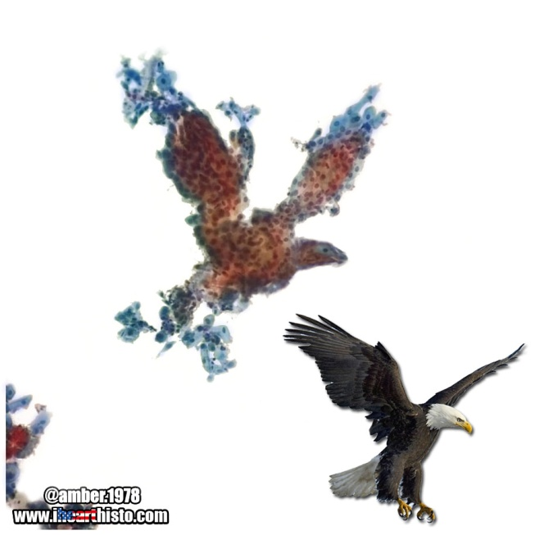
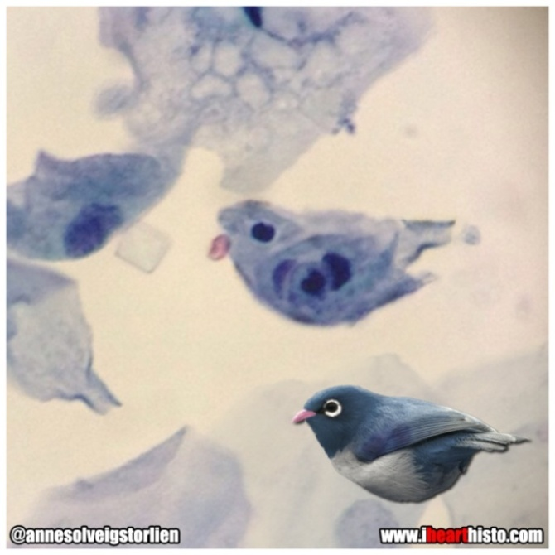
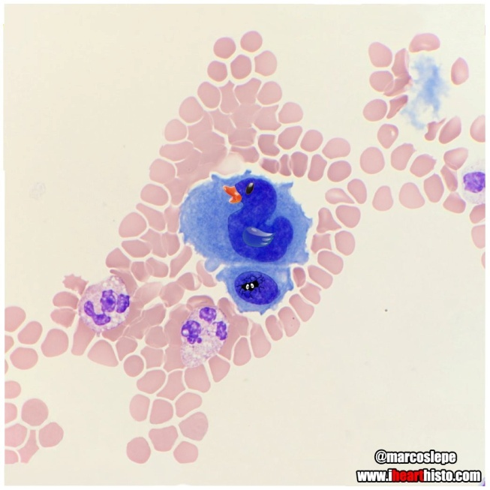
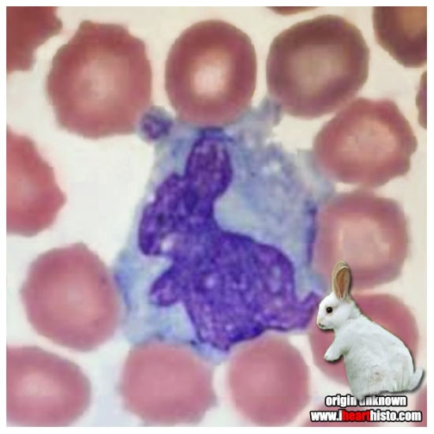
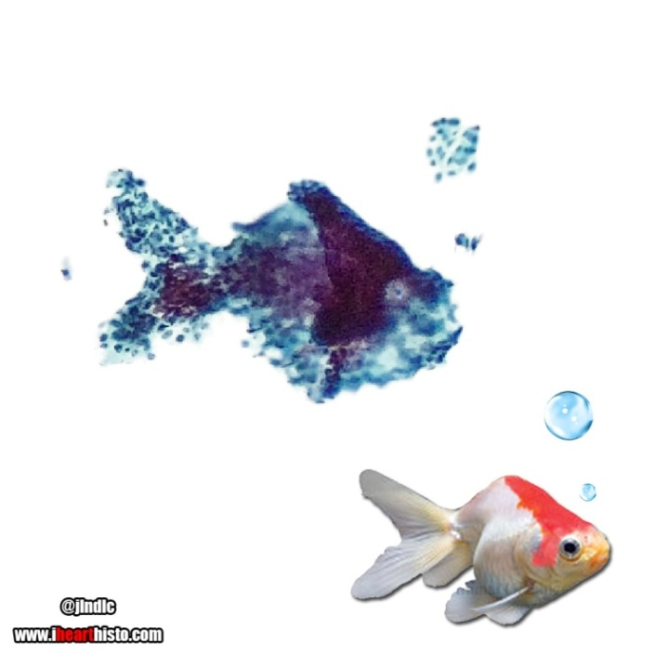
Τhe animal lover surely finds his delight under a microscope.

Slide 14
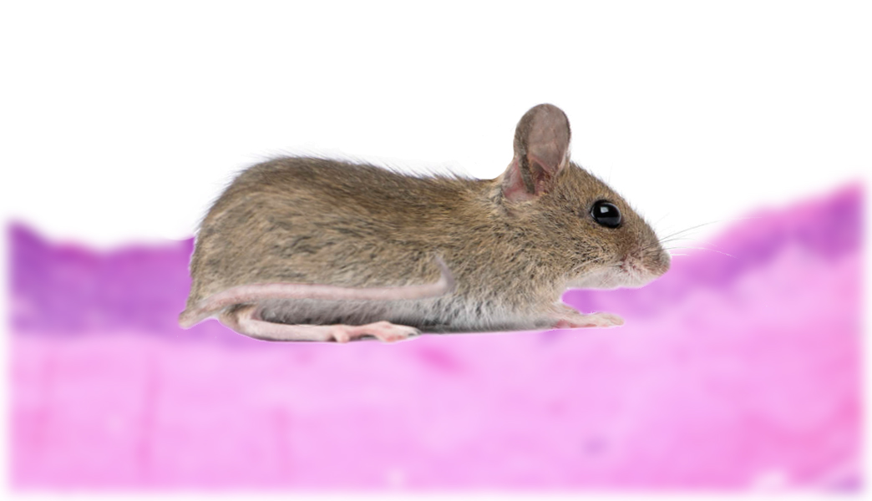
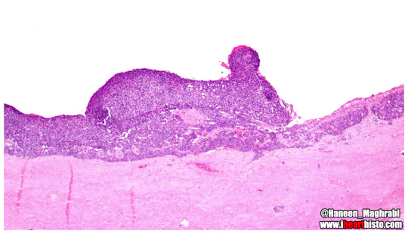
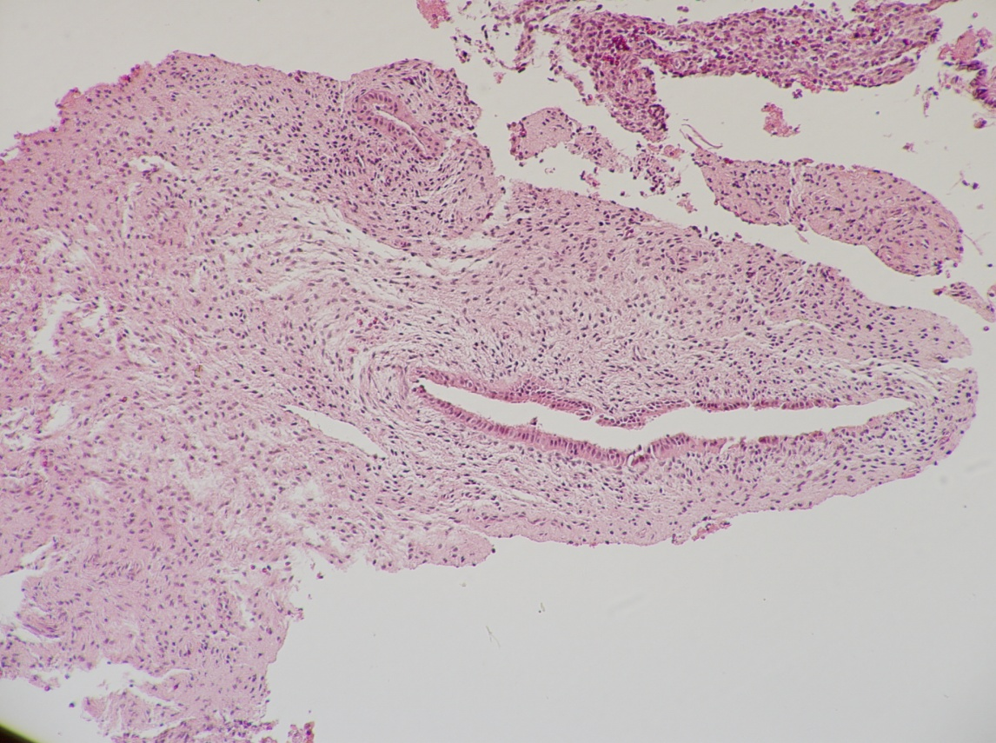
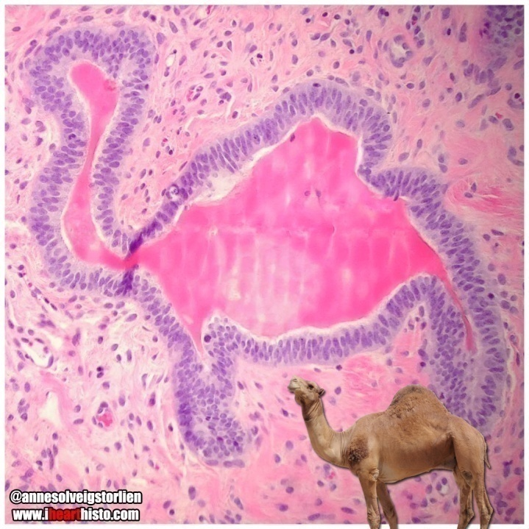
Τhe joy of the zoophilous.
Dr H. Vlotinou, Pathologist

Slide 15
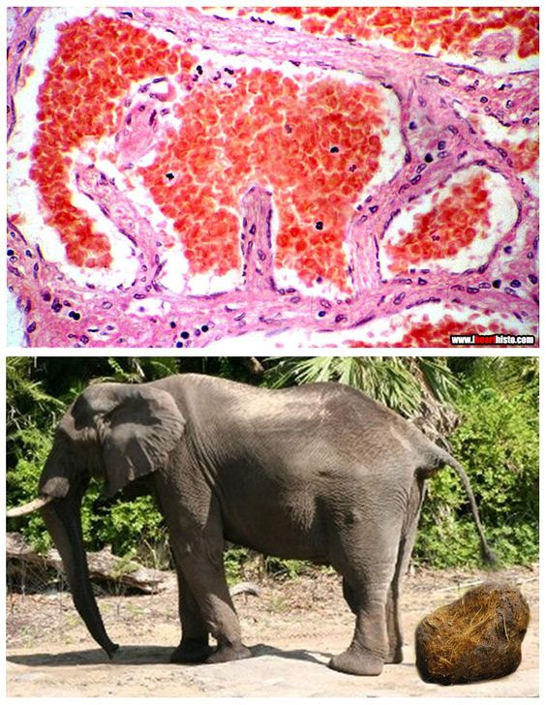
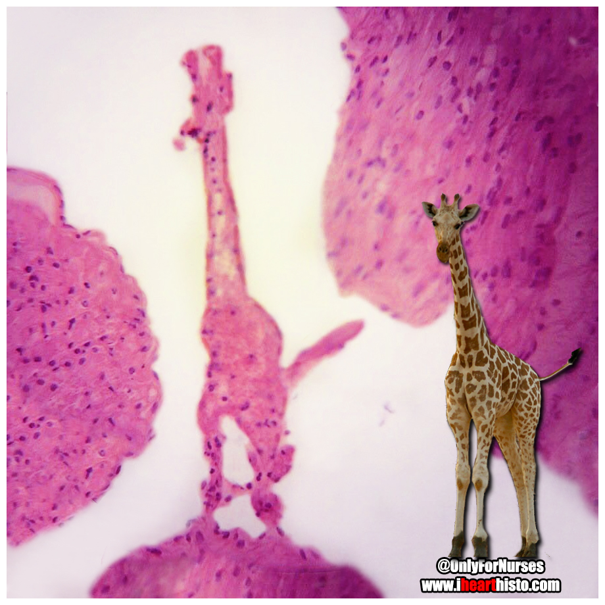
Τhe joy of the zoophilous.
Is this smooth muscle?
You bet giraffe it is!

Slide 16
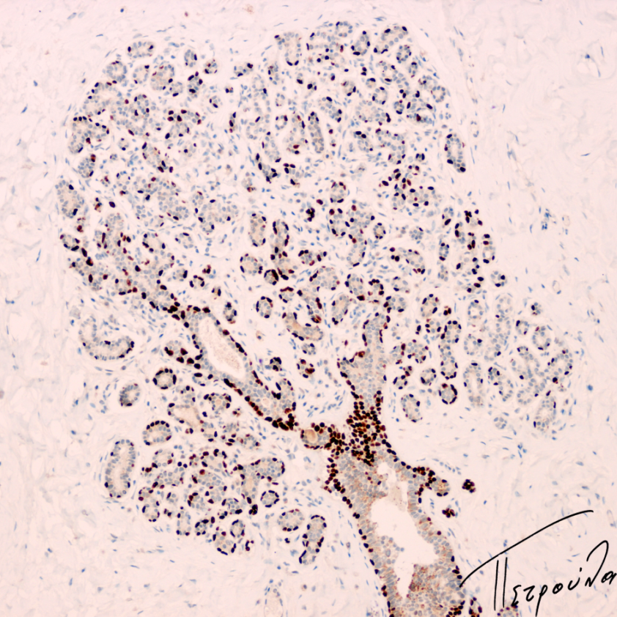
Dr P. Arapantoni Dadiotis, Pathologist
Dendrology via Pathology.
Τhe joy of the tree researcher.
Olive tree
Fall tree
Tree of life

Slide 17
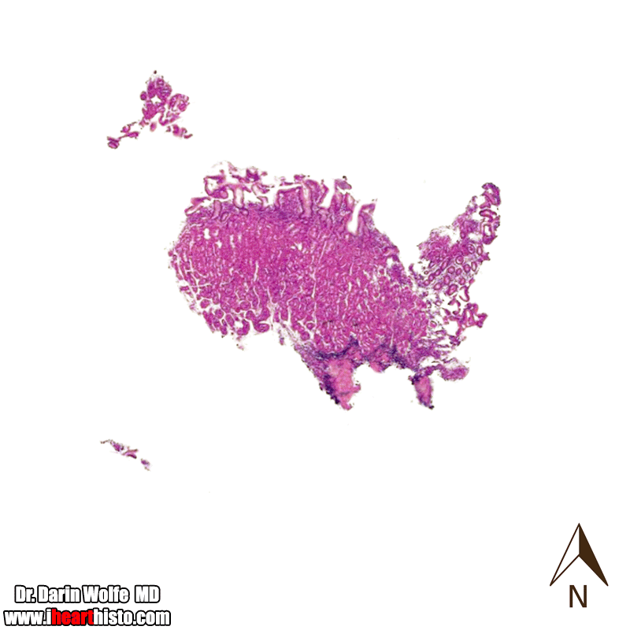
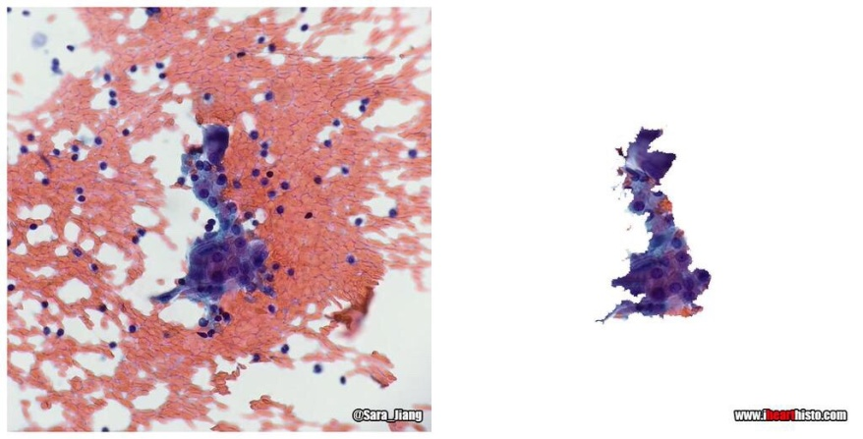
Everyday exercise in figures via pathology.
Warthin’s tumour v the UK
The United States
of a gastric mucosa!
The joy of the geographer, too.

Slide 18
THE VISUAL ELEMENTS of line , shape, tone, colour, pattern, texture and form are the building blocks of composition in art.
When we analyse any drawing, painting, sculpture or design,
we examine these component parts to see how they combine
to create the overall effect of the artwork.
The Visual Elements have a relationship to one another.
Each of the elements may also be used individually
to stress their own particular character in an artwork.
Through macroscopy and microscopy, the pathologist potentially becomes familiar with all these visual elements.

Slide 19
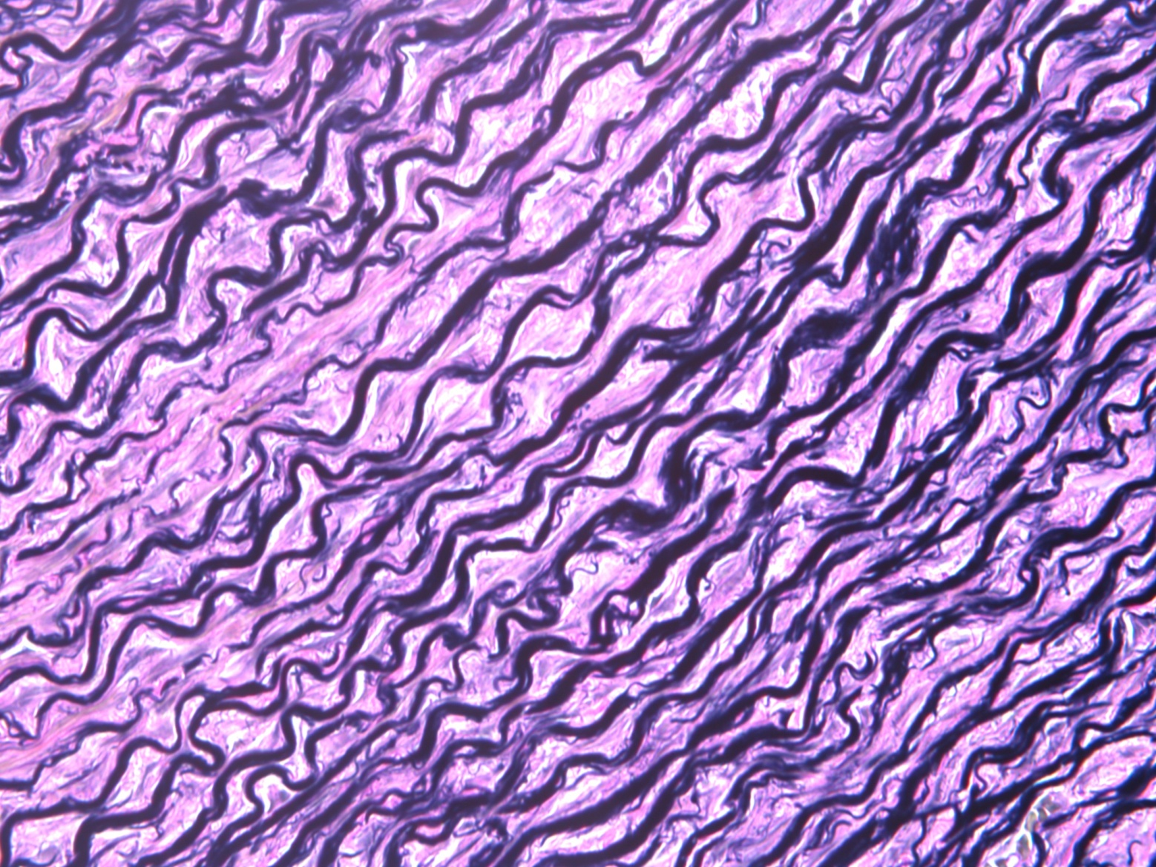
LINE is the foundation of all drawing. It is the first and most versatile of the visual elements. Line in an artwork can be used to suggest shape, pattern, form, structure, growth, depth, distance, rhythm, movement and a range of emotions.
The painting is as much about surface as it is about depth; it is as much about abstraction as it is about representation, and it is as much about the relationship between man and his environment, with nature reclaiming its own habitat as the architecture is menacingly encircled by the encroaching forest.
PETER DOIG The Architect’s Home in the Ravine, 1991 (oil on canvas) .
Elastic fibers. Verhoeff Van Gieson Stain.

Slide 20
The line in the service of creative imagination.
Links to video paintings
by Dr Gakiopoulou:
https://youtu.be/FVo-75l_jno
https://youtu.be/W5-W8PoOckY
https://youtu.be/SM2OHiKNemc
https://youtu.be/ZISjXJv8s10
https://youtu.be/sczO40DaEoM
https://youtu.be/Q_cjqJzzbjE
https://youtu.be/nEdhP4QZ5n4
Assoc. Prof. Dr Ch. Gakiopoulou, Pathologist

Slide 21
Assessment of shapes under the microscope: a common tactic.
Distorted shape of a crypt in ulcerative colitis.
Different shapes of cell nuclei
in brain tumours.
Epithelioid and round, polygonal, or oval in shape, kidney tumour cells.
Spindle shaped cells of a schwannoma.

Slide 22
SHAPE
'The Blue Fan' uses accurate representational shapes which play a major role in the composition of the work; the balance of the other visual elements is altered for creative effect: tone and texture are suppressed to allow the expressive qualities of shape, colour and pattern to flourish.
Organic shapes are usually natural, irregular and freeform in character. They are often associated with anatomical forms such as heart and kidney shapes.
Organic shapes can convey a sense of formation and development, and suggest qualities such as softness, sensuality, flexibility and fluidity.
GRAHAM SUTHERLAND Pastoral, 1930 (etching).
FRANCIS CAMPBELL BOILEAU CADELL
The Blue Fan, 1922 (oil on canvas).

Slide 23
Identifying tone of colour under the microscope: basophilic-amphophilic-oxyphilic cytoplasm.

Slide 24
TONE The visual element of tone defines the lightness or darkness of a colour. The tonal values of an artwork can be adjusted to alter its expressive character.
A silkscreen print that explores the parameters of perception in relation to tone, colour and form. Cohen uses a photographic halftone grid to reduce a black and white image of the pop artist Richard Hamilton to a network of dots. This also has the effect of reducing the resolution of the image to the threshold where any further reduction would make its form unrecognizable. In each of 10 similar prints, Cohen allocates three different colours which create a tonal relationship: one colour is applied to the dot structure, one colour to the background and one colour to the drop-shadow that lifts the dots off the background. The final series of prints explores the relationships between tone and colour and how they affect our perception of form.
HAROLD COHEN Richard V, 1967 (silkscreen on paper).

Slide 25
Glue and air bubbles by Assoc. Prof. Dr M. Lambropoulou
Accordingly to the previous artwork,
two studies
in the use of tone.

Slide 26
A daily colour burst under the microscope.
Movat’s Pentachrome stain on Bronchus as a striking example
Five stains are combined to monitor airway damage after lung transplantation.
Elastic fibers - black, mucin - blue,
muscle - red,
collagen - yellow, and fibrin - intense red.

Slide 27
COLOUR: the visual element with the strongest effect on our emotions.
GINO SEVERINI The Dance of the Pan-Pan at the Monico, 1909-1911/1959-1960
(240cm x 400cm, oil on canvas).
COLOUR AS MOOD - NOISE
Severini smashes this image into countless fragments which he reassembles in a dynamic composition that captures the collective consciousness of Futurism. Contrasts of opposite colours collide in a shatterproof structure that frames the fun, frolics, noise and excitement of modern entertainment.

Slide 28
Joy and vividness of colours- joy and vividness of soul.
Poppy cells
House in Ioannina
Prof. Dr A. Batistatou, Pathologist
Spring

Slide 29
ANALOGIES IN MEDICINE: STARRY-SKY APPEARANCE
Descriptive Pathology has always relied on microscopic morphological patterns. Pathologists use analogies and metaphors to help them remember specimen patterns.
Dr D. Burkitt, a child with Burkitt lymphoma (BL) and the “starry-sky pattern”
In BL the histological sections have a unique appearance at low power. The tumour cells, which are medium sized and round with minimal cytoplasm, are closely apposed to each other, forming a dark blue background (the “sky”). These cells have a very high turnover rate, so the macrophages that happen to be hanging around get stuffed with cellular debris (they are at this point called “tingible body macrophages”), and upon fixation, the cytoplasm falls away, leaving round white spaces filled with debris (the “stars”). This “starry-sky pattern” can be seen on bone marrow, lymph node and extranodal masses sections, and it is quite specific, although by no means pathognomonic, for Burkitt lymphoma.
Perhaps, this term was inspired by van Gogh’s beautiful night paintings.

Slide 30
VAN GOGH Starry Night over the Rhone, 1888.
In September 1888, before van Gogh’s December breakdown that resulted in his hospitalization in Arles, he painted Starry Night over the Rhone. Working by night under a gas lamp, Van Gogh painted this work directly from nature. “It does me good to do what's difficult”, Van Gogh wrote, “That doesn't stop me having a tremendous need for, shall I say the word - for religion - so I go outside at night to paint the stars”.
“The imagination is certainly a faculty which we must develop and it alone can bring us to creation of a more exalting and consoling nature… A star-spangled sky, for instance, that's a thing I would like to try to do... But how can I manage unless I make up my mind to work... from imagination?” van Gogh’s letter, 4.1888.

Slide 31
The Starry Skies of Pathology
Among the nine Muses of Greek mythology, Urania was that of astronomy; the latter inspires another analogy with Pathology. “When you’re a kid, the night sky all looks the same. But then somebody points out three stars in a row and tells you that’s the belt of Orion.” Pathology, Dr J.Sickle says, is very similar. You pick out patterns and you name them. Mastery comes with practice, just like learning to pick out a constellation in a starry night. Dr Sickel founded El Camino Hospital’s Healing Arts Program in Mountain View, California, in 2002. Disease is his focus, of course, but he also is interested in the power of art, music, and laughter as therapy to ease pain.
“To be a pathologist,” he admits, “it helps to have a vivid imagination.” Dr Sickel tries to reconcile the inherent paradox: that something like a life-threatening tumour can be so beautiful and so tragic at the same time.
“Authors, playwrights, poets, and artists deal with this all the time,” he says. “These are very unpleasant, unsavory issues—and yet presenting and reflecting on their beauty under the microscope may soften the edges of these otherwise appalling issues.” In the same reasoning, it is undeniable that many horrific circumstances can be cleared through all forms of Art.
VAN GOGH The starry night, 1889.

Slide 32
Ηarmony patterns in normal cells and tissues.

Slide 33
Disarmony patterns in malignancy

Slide 34
Based on the healing power that Ray’s own art had for him, a project was born, i.e.
a book entitled
Healing Art
of Pathology.
Sponsored by the College of American Pathologists, this book will be a compilation of art derived from, or inspired by, pathology - the study of disease.
The previous abstract paintings derived from a project called “My Sarcoma”, during which Ray Paul, an artist and a myxofibrosarcoma patient, painted over the top of his OWN histology images; thus, Ray was transformed from a sick and dying patient back into a living and vibrant artist and survivor.
An example of collaborative art:
Each of the paintings that Ray has made during this journey has had more than just Ray’s hands involved. Indeed, to make the paintings as you see them, a surgeon had to cut out his tumour, a pathologist had to have the tissue stained and mounted and a screen printer had to prepare the canvas.
Inspiring!

Slide 35
PATTERN is made by repeating or echoing the elements of an artwork to communicate a sense of balance, harmony, contrast, rhythm or movement.
The first thing you see in McEwen's leaf is the natural pattern of its veins. As you are drawn more into the detail of the image, this pattern takes on a fractal nature where you notice the same natural formation on different scales. For example, in the delicate growth pattern of the veins you can see the structural form of the branches of a tree. You can then expand your vision to a geological scale where the image becomes an aerial view as the veins turn into rivers and tributaries cutting their way through a landscape to the coastline. A more melancholic metaphor could relate the anatomy of the dying leaf to a Vanitas theme of mortality, as its veins hemorrhage a vascular red into the chlorophyll green of its decomposing skin. If we looked at our world through the same mindful spectacles as Rory McEwen, our sense of sight and the art we produce would both be the richer for it.
a NATURAL PATTERN HERE
The artist slows us down and shows us the exquisite beauty that we miss by not really looking at what we see. His remarkable skill in observing a single leaf reveals an infinite world of mystery in the commonplace.
RORY McEWEN Kensington Gardens 1, 1979
(watercolour on vellum).

Slide 36
Liver city subway map by Assoc. Prof. Dr D.Tiniakos, Pathologist, ESP Executive Committee President-Elect
Pattern of architectural organization of hepatic tissue.
What resourcefulness!

Slide 37
Paget’s disease of bone: haphazard arrangement of cement lines. Mosaic pattern.

Slide 38
Among the criteria for squamous cell carcinoma, the cellular arrangement showing a pavementing or mosaic pattern is taken into account.
The mosaic pattern
Cervical dysplasia mosaic pattern in colposcopy.
Mosaic by Prof. Dr L. Nakopoulou, Pathologist
Besides a histopathological pattern, the mosaic is, actually, a visual art form.
Well-differentiated invasive squamous cell carcinoma.

Slide 39
A pathologist’s eye is trained to distinguish inlays’ tints when he himself/ she herself creates mosaics works.
Mosaics by
Prof. Dr L. Nakopoulou,
Pathologist

Slide 40
The mosaic of the human face
Faiyum
mummy portraits.
Mosaics by
Prof. Dr L. Nakopoulou, Pathologist
Mosaics by

Slide 41
Τexture in Pathology-Texture in Art

Slide 42
The examination of the texture in Pathology
Renal Cell Carcinoma
The tumour has marked variability in colour and texture. Some areas are bright yellow and friable, others brown, perhaps from remote hemorrhage to tan and fleshy. Tan, fleshy areas must be adequately sampled to determine the presence of sarcomatoid transformation, an adverse prognostic finding.
Dystrophin deficiency consistent with a progressive muscular dystrophy, Duchenne.
Different areas on HE stain disclose mainly fibrosis in endomysium, surrounding rounded fibers varying in size, staining pattern, and texture.

Slide 43
The pathologist tries to focus on key points for the microscopic diagnosis; thus, he/she chooses to look either away or more closely. In a similar way, this artist tries to focus on those key elements that contribute to the emotional impact of the landscape. In 'Seeded Grasses and Daisies, September', the artist’s total immersion in the subject led her to incorporate stalks of meadow grass and flowers as key elements in order to ground the abstract texture of the work in reality.
Texture
defines the surface quality of an artwork - the roughness or smoothness of the material from which it is made.
We experience texture in two ways: optically (through sight) and physically (through touch).
JOAN EARDLEY Seeded Grasses and Daisies, September, 1960
(oil on board with grasses and seedheads).

Slide 44
Form relates to the physical volume of a shape and the space that it occupies.
NAUM GABO Head No.2, 1916.
(Cor-ten sheet steel - copy of cardboard original). The edges of the planes delineate the form of the head and unite its internal and external space.
Confocal microscopy enables the reconstruction of three-dimensional structures from the obtained images by collecting sets of images at different depths within a thick object.
Ran Li and Ann Marie Pendergast
Tubulogenesis by HGF-treated MDCK cells grown in 3D collagen culture. 3D reconstruction of a confocal z-stack generated using Volocity. E-cadherin.
FORM AS CONSTRUCTION
3-D tissue model of cirrhosis
in the liver which permits the pathologist to examine the cirrhosis in detail.

Slide 45
Art Paths Exhibitions Lisbon (2013), [Athens (2014), Belgrade (2015), Ioannina (2016)]
How does “The Art of Pathology” fit in?
First, pathology epitomizes the
intersection between profession, science and art.
Second, this initiative furthers the goals of the ESP
by broadening the scope of its influence
among European pathologists.
Fatima Carneiro, former President of the ESP
“Science describes things
as they are;
Art as they are felt,
as they are felt to be...”
Fernando Pessoa

Slide 46
ART PATHS BELGRADE DYNAMIC EXHIBITION 2015 Pathology as a source of inspiration and creative mood.

Slide 47
Fete by the Rhine. Prof. Dr C. Scopa

Slide 48
Α Collection of Poems by Dr A. Androulaki, Pathologist
According to the classicist tradition, painting and poetry are sister arts. Painting finds its completion in word; it is the word that can best come close to the purity and immediacy of truth.
Shelley claims for language the highest place among the vehicles of artistic expression, on the ground that it is the most direct and the most plastic; it is itself produced by imagination instead of being simply encountered by it, and it has no relation except to imagination.

Slide 49
Dr D. Chrysanthakis, Pathologist
Around the trees
morning glory comes to an end beside the life sidewalks
care must be taken for the crossing river of
sadness
Do I stand there?
Do I hear the noise of the miracles?
Call the night
Look for the falling leaves
Wisdom grows
Choose the next moment or the next day
Shrink the feelings and shine again.

Slide 50
Spirits of Diagnosis. Prof. Dr A. Batistatou, Pathologist
As you ‘ve understood, we are moving for a while from the visual arts to the acoustic ones.
Pathological Diagnosis is a test of thought;
success is the result of
proper information processing.
Can music as part of our daily work environment contribute to this?
And what kind of music?

Slide 51
Unmusical life , living death.
Music can make routine tasks more enjoyable.
Rhythm and harmony reduce stress and put both soul and mind in relaxation, order and organization.
Hearing isolated musical components can actually change the way we think.
Listening to consonant intervals, used in myriad compositions as vehicles of resolution and harmony, helps us think in broad, inclusive categories, organize our data in an efficient way, and bring out the concrete mindset, so helpful to the pathologist for the diagnostic procedure.
The cognitive ramifications
of unpacked melodic compounds.
Music’s ability to conjure up
highly specific mental states.
It is a fact that surgeons often listen to music in the operating room and they work more effectively when they do.
Tiny, almost immeasurable features in a piece of music have the power to elicit deeply personal and specific patterns of thought and emotion in human listeners.

Slide 52
We can describe the beneficial effect of classical music on the brain being composed of two effects;the first is due to rhythm, that synchronizes with the body’s vital rhythms, and produces the proper mood for increased cognitive and creative capabilities. The second effect is melody, that gets along with thoughts’ resolutions and gives to the person the warm feeling that he or she is able to tackle new challenges, by setting a path in the invention of new solutions and providing the ability to make the correct choice among possible solutions. Melody and rhythm, together, act in synergy with the brain.
The rigorous order of the logical music from the baroque and classical periods causes the brain to experience more serotonin release, letting the body and mind perform better. This order includes specific patterns in rhythm and pitch, character contrast, repetitions, and alterations of the theme. It is the beat that establishes the crucial effect of music on our body, together with the enhancement of cognitive and creative functions of the brain, supported from the right melody.
Much of Mozart‘s music happens to be in the high-frequency range, which the French physician Dr Alfred Tomatis found to be the most brain stimulating and charging aspects of sound. The higher frequencies - sort of sonic Vitamin C - help activate our brains and
increase attentiveness.
Classical or instrumental music enhances mental performance more than music with lyrics.
Serotonin molecule
MOZART Adagio from Divertimento KV 334
(now playing)

Slide 53
The much-discussed Mozart effect
Mozart Sonata for two Pianos in D major K448
The 1997 book by Don Campbell, "The Mozart Effect: Tapping the Power of Music to Heal the Body, Strengthen the Mind, and Unlock the Creative Spirit", discusses the theory that listening to Mozart may temporarily increase one's IQ and produce many other beneficial effects on mental function.
It appears that any form of music that has energetic and positive emotional qualities ( provided that it is not played too loudly ) can call forth the intellectual benefits of enhanced mood and arousal;
the latter are not restricted to spatial-temporal reasoning, but extend to speed of processing and
creative problem solving.

Slide 54
Talking about music, I need to mention
Dr George Kontogeorgos, who, apart from being President-Elect of IAP Council Executive, and ranked 5th in the list of the 100 most influential
laboratory medicine professionals,
happens to be
a remarkable music composer.

Slide 55
Teaching as acting: the acting art serves in (pathology) teaching.
Whatever their personal style, all teachers are performers and the classroom is their stage. But success can depend on the kind of show they put on.
K. PETROV-VODKIN
(1878-1939)
Theatre Farce-Drama.
Teacher Power
is the personal attractiveness which the teacher possesses in the eyes of the students. It is sometimes referred to as charisma or personality. According to my conception of experiential education, the honest relationship among teacher and students sets the stage to free students to perform on their own, to feel free to share themselves like their teacher does with them, to be uninhibited with respect to sharing, yet conscious of their responsibility to show respect and honour to those who will receive their performance, or who will benefit from the sharing.
Teacher as performer is a very powerful role and one any teacher can savour. Research shows that a dynamic presentation of nonsense is valued more by most students than the most erudite and demanding series of facts, interspersed with poor presentation. Research underscores that this is even more applicable with secondary than elementary students, with those who are knowledgeable
more than those who are novices.
“All the world's a stage,
And all the men and women merely players.” Shakespeare ( “As You Like It”).
Teaching is a lot like acting,
a high-energy, performance profession
that requires a person to act as a role model.

Slide 56
Teachers as Performers: the Art of Selling Students on Learning.
There are many good teachers who balance these competing roles artfully by developing a classroom persona that is distinct and real to students. Their voices, gestures, clothes, verbal tics–all are part of the performance. They improvise when the unpredictable occurs in a lesson. They blend the academic and emotional roles into a mix that appeals to and prods students at the same time. And students who can smell a fake instantaneously, come to appreciate the performance which is characterized by genuine, sincere feeling and intent, and remember such teachers for the rest of their lives as positive models-sources of inspiration for creation.
Classroom performance.
The two imperatives facing
all teachers :
know your subject (the academic role and relevant teaching concept) and
know your students (the emotional role and experiential teaching concept).
These competing demands
upon teachers require both
distance from students (the academic role) and
closeness to students (the emotional role).
Good actors captivate their audience primarily by the authenticity of their feelings. Good teachers are great performers and storytellers that rivet their students' attention.
NORVAL MORRISSEAU (1932-2007) Teaching.
Note the ideal distance of the protective teacher from his disciples, neither too close nor too distant.
J. REYNOLDS
David Garrick between tragedy and comedy, 1761.
NICHOLAS ROERICH Shadow of the Teacher, 1932.

Slide 57
Resources
-J. Andrade-Filho. Rev Inst Med Trop Sao Paulo. 2014; 56(6): 541–542.
http://www.artyfactory.com
ART PATHS Exhibitions material
-Bradley A C . Oxford Lectures on Poetry. Atlantic Publishers and Distributors 1999.
-Philip Sidney, ‎Geoffrey Shepherd, ‎R.W. Maslen An Apology For Poetry Or The Defence Of Poesy Manchester University Press 2002 - ‎Literary Criticism
-Plato on Rhetoric and Poetry. Stanford Encyclopedia of Philosophy. http://plato.stanford.edu/entries/plato-rhetoric/
First published Mon Dec 22, 2003; substantive revision Thu Feb 4, 2016.
-Thompson, W.F., Schellenberg, E.G. & Husain, G. (2001). "Arousal, mood, and the Mozart effect". Psychological science 12 (3): 248–51.
-Husain, G., Thompson, W.F. & Schellenberg, E.G. (2002). "Effects of musical tempo and mode on arousal, mood, and spatial abilities: Re-examination of the "Mozart effect". Music Perception 20 (2): 151.
-Ilie, G., & Thompson, W.F. (2011). "Experiential and cognitive changes following seven minutes exposure to music and speech". Music Perception 28 (3): 247–264.
-DeLozier, M Wayne. The Teacher as Performer: The Art of Selling Students on Learning
Contemporary Education 51.1 (Fall 1979): 19.
-Tom Griggs. Teaching as Acting: Considering Acting as Epistemology and Its Use in Teaching and Teacher Preparation. Teacher Education Quarterly, Spring 2001.

Slide 58
Finally,
From my point of view, the essence of Art is to enhance our lives, to make us feel better, as when we fall in love with a living person. Of course, as with any good, to estimate Art and rejoice, you do not only need the appropriate stimuli - ie. not too personal artistic pursuits - but the appropriate intent and inclination, as well. If deprived of the latter, forget Art and live your life as best as you think; in this case, however, do not devalue something that you do not want to get to know.
let me express my gratitude to those who gave me the opportunity to reflect on something really important for me and to share my personal thoughts, which I hope were of some interest, with you.
Lascaux France Cave Painting, 15,000BC.
What prompted the hand of the prehistoric man
to create art?
Prehistoric men may have painted animals to "catch" their soul or spirit in order to hunt them more easily or the paintings may represent an animistic vision and homage to surrounding nature;
so they could have been for the transmission of practical information or they may be the result of a basic need of expression that is innate to human beings.
ART : A practical or a spiritual need?
Decide according to your frame of mind.

Slide 59
The city of Cologne through the ages.
This entire presentation is available, among other presentations, to any interested party, for further study, via the links below:
http://eclass.uoa.gr/modules/document/index.php?course=MED409&openDir=/4f8e670fkcr8
https://www.facebook.com/HIPON-Project-504573706265856/
JAN VAN DER HEYDEN AND ADRIAEN VAN DE VELDE
The church of St Severin in Cologne in a fictive setting,1672.
May the lecture you attended in this city be a stimulus for you to view Art favourably and brighten up your everyday life through Art!
The city of Cologne engraved by M J STARLING after LEITCH, 1850.
D. ROTH Cologne, 1970.

Slide 60
Without art, our life becomes dull, flat and monotonous. Τhe spirit weakens; hypocrisy, selfishness, amorality, clinging to the ephemeral, consumption mania and material eudemonism dominate.
Resist all this and consider to discover Art through Pathology.
PATHOLOGY:
A great way to fill your life with Art loving.

