Slide 1
Contemporary Greece
History: 19th – 20th cent.
Anna Karakatsouli
ankaraka@theatre.uoa.gr

Slide 2
20th century
From a nation united to a nation divided

Slide 3
20th century Greece
2 major fractures within the Greek society along with the two World Wars
  “National Schism” of 1916/17 (Venizelos vs. King Constantine)
  Civil War of 1944-1949
Both fractures had to do with:
  The position of the country in the international balance of power
  The ascent of new social forces

Slide 4
Language Question
Issue with a long and contentious history only resolved as recently as 1976, diglossia (διγλωσσία)
Spoken (demotike) vs. written, ‘purified’ (katharevousa) language
1901, Gospel riots (Evangelika)
1903, Oresteiaka
Ioannis Psycharis, The Language Question in Greece. Three Essays, 1902

Slide 5
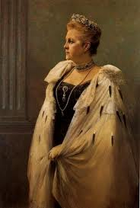
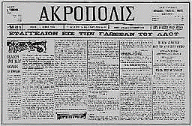
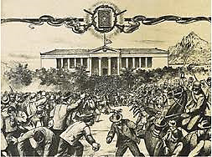
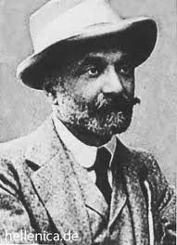
Gospel Riots, “Evangelika” (1901)
Queen Olga
1851-1926
8 Nov. 1901
8-11 demonstrators dead
70 wounded
Alexander Pallis
1851-1935

Slide 6
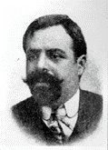
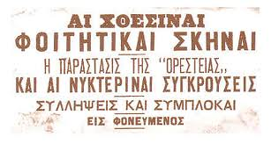
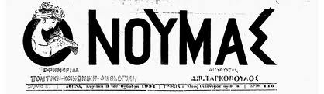
“Oresteiaka” (1903)
Dimitris Tagkopoulos
1867-1926
6-9 Nov. 1903
2 dead, 7 wounded

Slide 7
Literacy
Population above 8 years old
 |  | % literates | % illiterates
1907 | Men | 60,30 | 39,70
 | Women | 20,31 | 79,69
 | Total | 40,28 | 59,72
1920 | Men | 65,98 | 34,02
 | Women | 31,18 | 68,82
 | Total | 48,42 | 51,58
1928 | Men | 76,53 | 23,47
 | Women | 42,03 | 57,97
 | Total | 59,09 | 40,91
Source: Γ. Β. Δερτιλής, Ιστορία του ελληνικού κράτους, 1830-1920, τ. Α΄, Εστία, ³2005, σ. 246

Slide 8
Cretan Question
Continuous struggle for the incorporation into the Greek kingdom
Great strategic importance of the island
1866 rebellion (Arkadi, self-immolation of over 400 men, women and children)
1878, Halepa Pact guarantees local autonomy within Ottoman Empire
1895, the Porte announces the suspension of all civil liberties for the Christian population, Crete under martial law. New insurgency

Slide 9
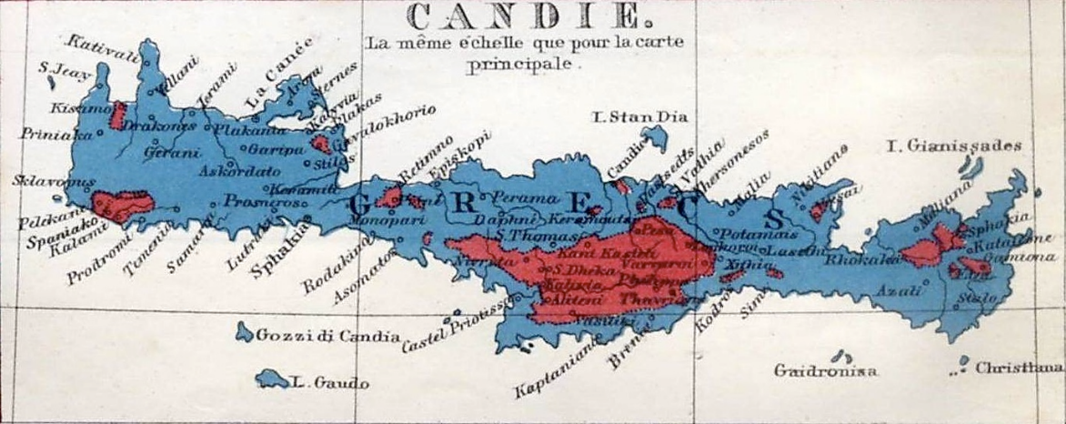
Map of the distribution of Christians (blue) and Muslims (red) in Crete in 1861

Slide 10
Cretan Question
1897 settlement
  Crete to become an autonomous polity under the sovereignty of the Ottoman Empire, but governed by a High Commissioner, Prince George of Greece, and a Chamber of Christian and Moslem deputies
Eleftherios Venizelos (1864-1936), leader of the liberal faction
March 1905, Therissos revolt against the Cretan government, declaration of unification with Greece (Ένωσις). Great Powers intervention
  Resignation of Prince George, Venizelos emerges as a hero

Slide 11
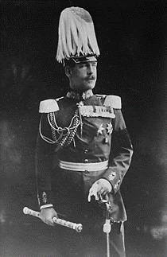
General unrest in SE Europe
1906, military reform, creation of a standing mass army
Discontent spread in the officer corps
July 1908, Young Turks revolution
  Overthrow of Sultan Abdul Hamid
  Restoration of the 1876 constitution
  Promises of equality for all, whether Muslim, Christian of Jewish
  Spring 1909, radical nationalist turn
Crown Prince Constantine
1868-1923

Slide 12
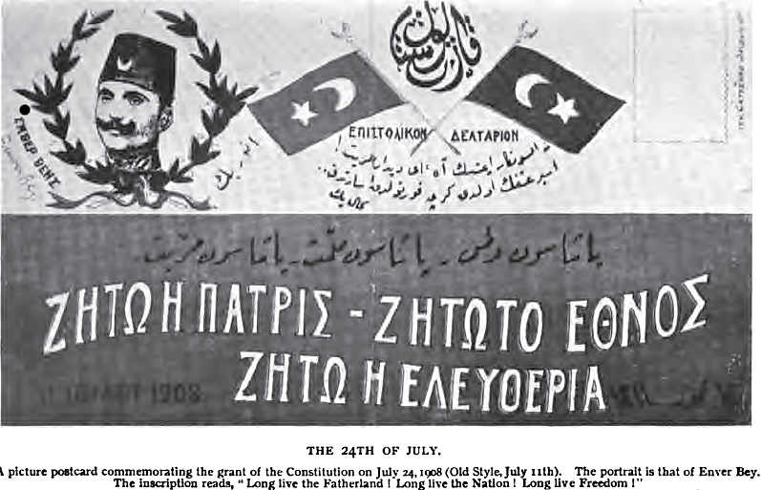
Young Turks flyer:
"Long live the fatherland, long live the nation, long live liberty"

Slide 13
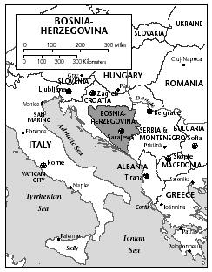
Immediate repercussions of the Young Turks revolution
Bulgaria declares its full independence
Austria-Hungary annexes Bosnia-Herzegovina
Cretan crisis remains unresolved
Goudi military coup in Greece (1909)

Slide 14
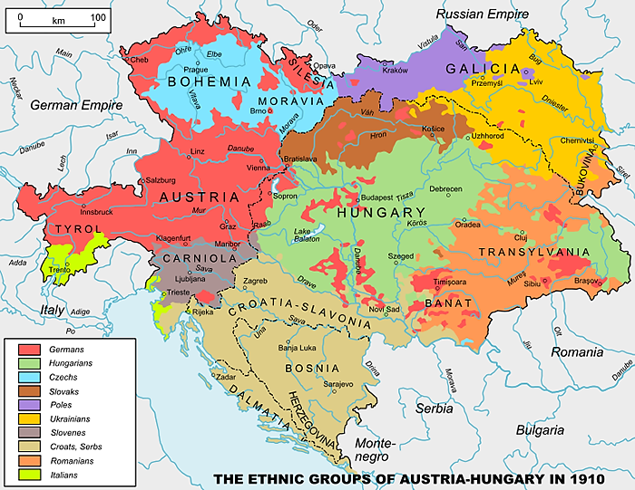

Slide 15
Political situation in Greece
Lack of adherence to party discipline
Excessive party propaganda, extravagant promises, corruption, and patronage
Rise of a new generation of Greek political figures following the deaths of Trikoupis and Deliyannis
  Stefanos Dragoumis, Dimitrios Gounaris
Formation of new political factions with diverse ideologies, such as anarchism, popular radicalism, and agrarian conservatism
Political stalemate and governmental inaction leading to public discontent

Slide 16
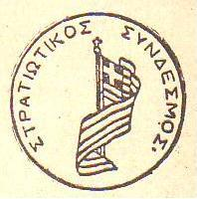
Goudi military coup (1909)
27/8/1909, memorandum of the Athens garrison demanding:
    The removal of royal princes from the armed forces
    The ministries of war and the navy to be held by serving officers
    A program of military and naval reconstruction
    The first military intervention in Greek politics
14/9/1909, huge popular rally in Athens. Government resigns
Invitation to Eleftherios Venizelos to assume power
December 1910, Venizelos and the Liberal Party win 300 out of 362 seats in the elections

Slide 17
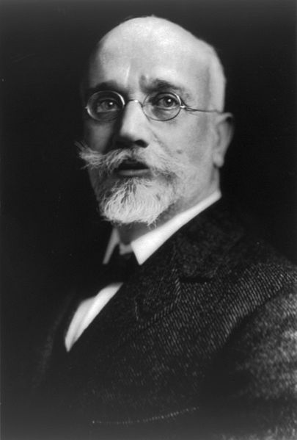
Eleftherios Venizelos
1864-1936

Slide 18
Eleftherios Venizelos
Liberal-democratic policies
Prime Minister from 1910 to 1920 and 1928 to 1933
Initiated constitutional and economic reforms that set the basis for the modernization of Greek society
Reorganized both army and navy
Established obligatory elementary education
Initiated labor legislation
Measures for the settlement of the landless peasants of Thessaly

Slide 19
Venizelos’ program
Creation of new bodies: Council of State and an advisory committee for legislative drafting
Changes made to the eligibility criteria for parliament, with a reduced qualifying age
Increased powers of the state, including public education, expropriation of private property for ‘public benefit’, and the ability to suspend fundamental civil liberties
Mandatory military service implemented
Modernization of the military and naval forces
Clear nationalist tendencies within the Liberal Party

Slide 20
Venizelos’ program (2)
Economic and political modernization
Land reform
Education reform
  Elementary education becomes compulsory
  Introduction of demotike in primary schools
Labor legislation
  Prohibition of child labor and night-shift work for women, minimum wages
  Regulation of the hours of the working week and the Sunday holiday
  Legalization of trade unions
Introduction of a progressive income tax

Slide 21
Eleftherios Venizelos
Charismatic leader
New dynamism and optimism into public life, new sense of national unity
Venizelos’ continuing popularity
Balkan turmoil
  Policy of forced ‘Ottomanization’ by Young Turks
  1911, Italian invasion of Libya
  Emergence of Albanian national movement
  Treaties between the Balkan states against the Ottoman empire

Slide 22
Balkan wars
1st Balkan war (“Turkish war”)
  October 1912 – May 1913
  Balkan Alliance (Serbia, Montenegro, Bulgaria, Greece) vs. Ottoman empire
  30/5/1913, Treaty of London
2nd Balkan war (“Bulgarian war”)
  June – July 1913
  Serbia, Greece, Romania vs. Bulgaria
  28/7/1913, Treaty of Bucharest
    Albania becomes an independent state

Slide 23
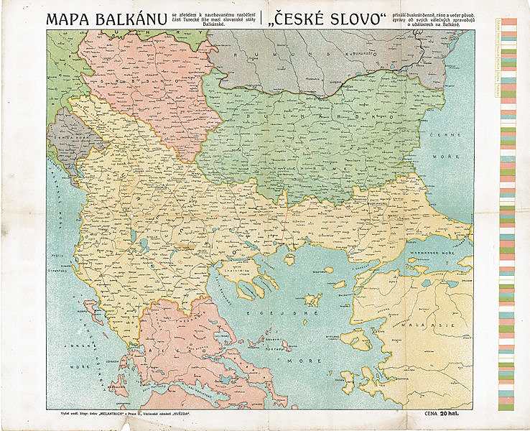
The Balkans in 1911

Slide 24
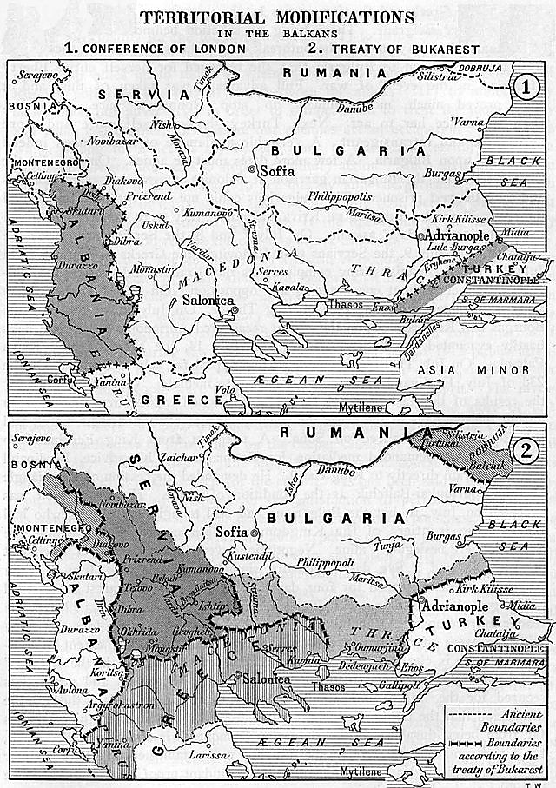

Slide 25
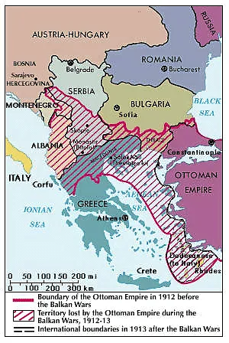
Balkan Wars
1912–13
8 October 1912 – 30 May 1913
29 June 1913 – 10 August 1913

Slide 26
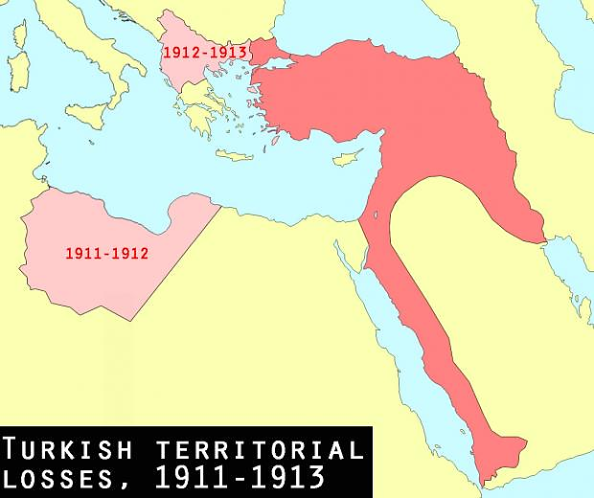

Slide 27
Balkan wars (2)
Greece’s territorial gains
  Thessaloniki
  Chios, Mytilini and Samos
  Ioannina
  Crete
  National territory increased by 70%
  Population rise from 2.800.000 to 4.800.000 inhabitants
  Important minorities in newly acquired territories (Jews, Slavs, Muslims, Vlachs)
In summer 1913 Greece emerges as a significant Mediterranean power

Slide 28
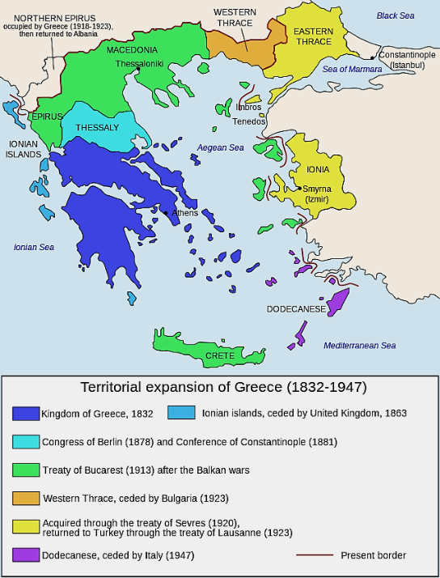

Slide 29
International situation on the eve of WWI
Aggravation of nationalist tensions and imperial antagonism
Unstable situation, consecutive crises
1905, 1st Moroccan crisis
1908-1909, Bosnia crisis
1911, 2nd Moroccan crisis
1912-1913, Balkan Wars
28.6.1914, assassination of Archduke Ferdinand in Sarajevo

Slide 30
World War I (1914-1918)
King Constantine I (1868-1923)
Central conflict with Venizelos regarding Greece's involvement in the war
  Venizelos’ close ties with Britain and France
  Constantine, an honorary Field Marshal in the German army and married to Kaiser Wilhelm II's sister, promoted a stance of neutrality
Significant division within Greek society, known as the ‘National Schism’ (Ethnikos Dikhasmos)

Slide 31
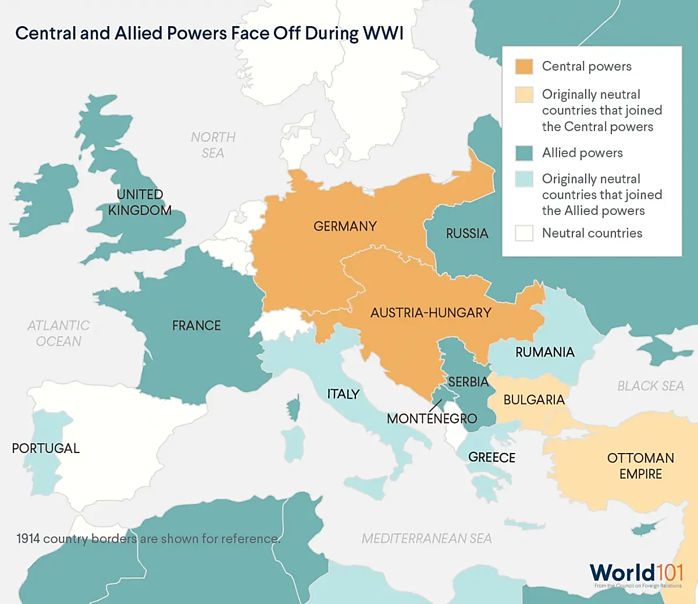

Slide 32
‘National Schism’
June 1915, Venizelos resigns and wins a clear majority in the elections
Sept. 1915, Bulgaria, aligned with the Central Powers, attacks Serbia
Venizelos invites Britain and France to send an expeditionary force to Thessaloniki in support of the Serbs. Constantine retracts from his original consent
Mounting discord between the Entente and the royalist government
30/8/1916, military coup in Thessaloniki. Venizelos forms a ‘Provisional Government of National Defense’

Slide 33
‘National Schism’ (2)
King Constantine leaves the country at the Entente’s demand without formally abdicating
Extensive purges against king’s supporters
June 1919, Paris Peace Conference
  10 August 1920, Treaty of Sèvres
  'Greece of two continents [Europe and Asia] and five seas [Black, Aegean, Mediterranean, Ionian, and Adriatic Seas]’

Slide 34
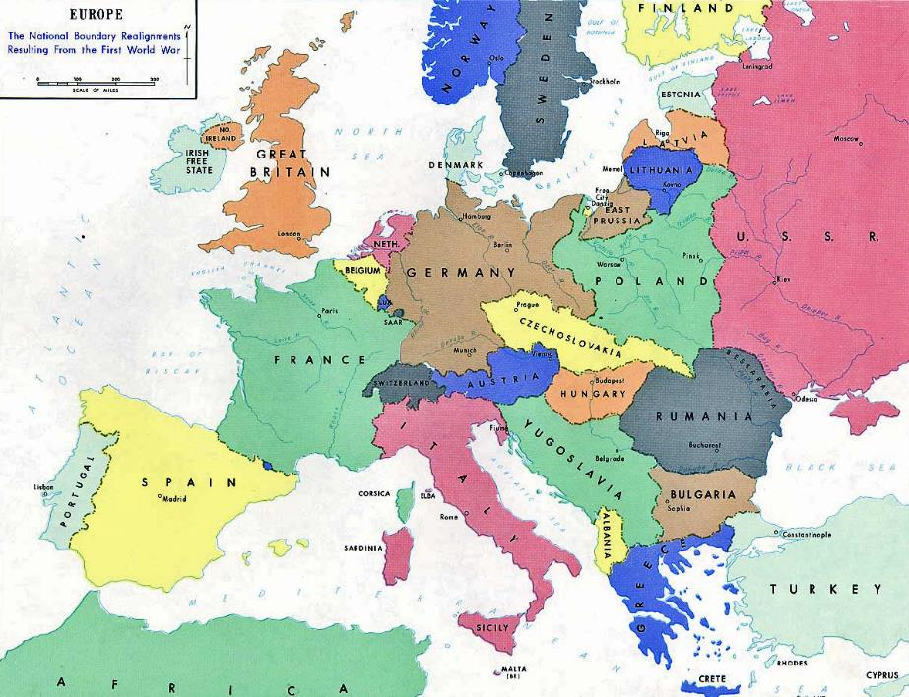

Slide 35
Domestic situation after WWI
Neither as many casualties nor destructions as in other European countries
Depression in agrarian sector
Large and increasing trade deficit, heavy debt
Rise and spread of labor unrest and class division, public unrest
  Workers' movements became more organized. Trade unions and workers‘ associations
  Emergence of specifically class-based political parties
    1918, Socialist Labour Party of Greece (SEKE)
    1924, it became the Communist Party of Greece

Slide 36
Greco-Turkish War (1919-1922)
August 1920, Treaty of Sèvres signed with the Ottoman Empire
  Greece to hold Smyrna administration for further five years with possibility of annexation following plebiscite
October 1920, death of King Alexander. Return of the exiled King Constantine
November 1920, Venizelos defeated at the elections
  War weariness, Greek men under arms since 1912
6 December 1920, King Constantine recalled by plebiscite. Anti-venizelist purges

Slide 37
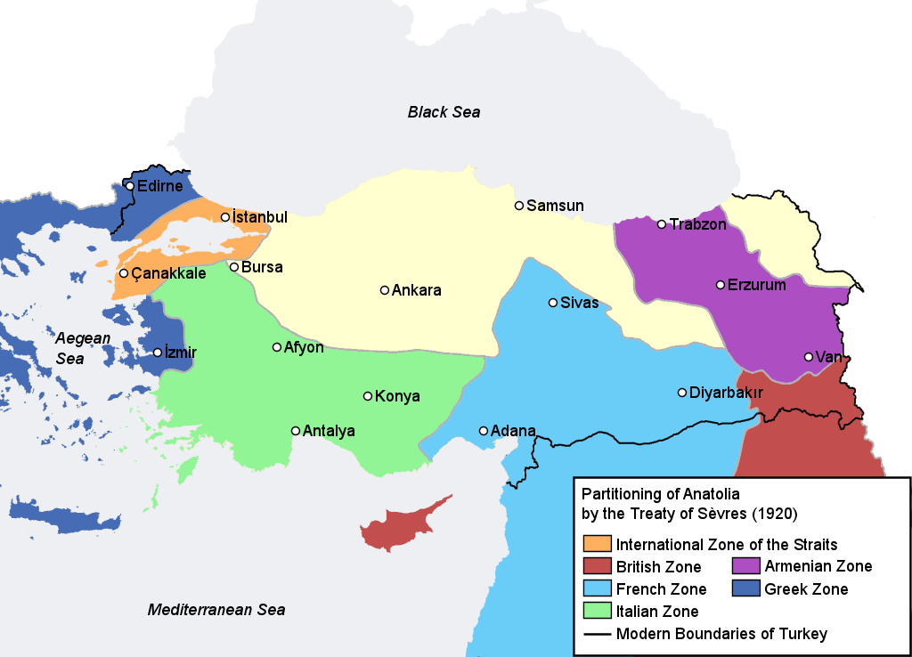

Slide 38
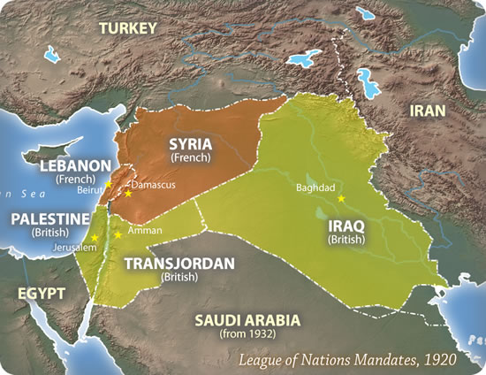

Slide 39
Greco-Turkish War (2)
  Revived Turkish nationalism under the leadership of Mustafa Kemal (Atatürk)
Former Allies declare their strict neutrality
Greece isolated, unable to obtain army supplies or to secure loans. Disastrous overextension of the Greek front line
August 1922, massive Turkish offensive. Greek army in full retreat
8/9/1922, Greek forces evacuate Smyrna
  13-22/9/1922, Great fire of Smyrna
  Massacre of some 30.000 Greek and Armenian Christians
Collapse of the ‘Great Idea’, end of Greece’s ‘civilizing mission’ in the Near East

Slide 40
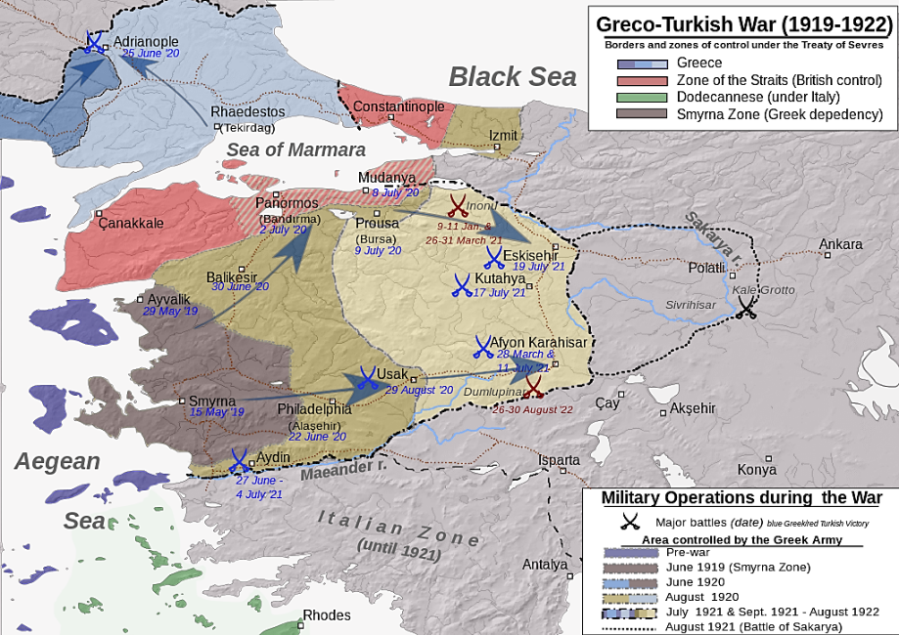

Slide 41
After 1922 - ‘Asia Minor Disaster’
Who would rule Greece? How to achieve peace in Asia Minor? How to cope with the flood of refugees?
11/9/1922, military coup led by Colonel Nikolaos Plastiras
Abdication of King Constantine, succeeded by King George II
November 1922, trial and execution of five royalist politicians, including the former PM, and of the former Commander-in-Chief as the main responsible for the defeat (‘Trial of the Six’)
Venizelos to lead negotiations with Turkey

Slide 42
Exchange of populations
14 July 1923, Treaty of Lausanne
  It ended the conflict and defined the borders of the modern Turkish state
  Exchange of populations between Greece and Turkey based on religion, rather than language or ‘national consciousness’
Some 1.300.000 Greeks moved to the Kingdom and 380.000 Muslims were transferred to Turkey
Approx. more 100.000 Greek refugees from revolutionary Russia and from Bulgaria
Exception for Thracian Moslems and Greeks of Istanbul

Slide 43
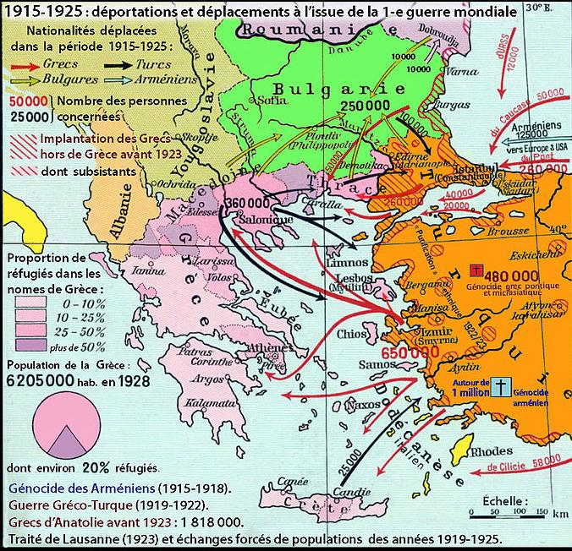

Slide 44
Refugee question
Massive influx of refugees, high rate of women and children
Tensions in their integration, cultural and linguistic diversities, prejudice
September 1923, Refugee Settlement Commission to deal with refugee settlement in rural and urban areas
Refugees resettled principally in the recently acquired lands of ‘New Greece’, thus significantly altering the country’s ethnic balance
Refugees remained faithful to Venizelos

Slide 45
1920s’ political turmoil
Deep cleavages dividing the country
  For or against Venizelos / Monarchy vs. Republic / Old Greece vs. New Lands / Indigenous vs. refugee Greeks
April 1924 referendum ⇨ 70% vote for the abolition of the monarchy. Proclamation of the Second Hellenic Republic
Turbulent period marked by succession of coups and dictatorships
  1924-1928: 10 Prime ministers, 2 Presidents deposed, numerous military coups
August 1928, Venizelos wins landslide victory in the elections (228 out of 250 seats)

Slide 46
Venizelos’ last governments – Foreign Relations
Policy of improved relations with neighboring countries to end Greece's diplomatic isolation
  Treaties of friendship with Italy (1928), Yugoslavia (1929), improvement of relations with Bulgaria and Albania
  Reconciliation with Turkey
    1930, Ankara Convention (resolution of bilateral disputes over the exchange of populations and clearing their properties)
  1934, Balkan Pact (mutual guarantee of existing frontiers)

Slide 47
Venizelos’ last governments – Home Affairs
Social unrest, reactions from the lower-classes whose conditions had worsened
1929, Venizelos introduces the so-called Idionymon, a law that made communism a “specific offence”, restricted civil liberties and initiated the repression against unionism, left-wing supporters and communists

Slide 48
1930s’ political chaos
The Great Depression impacts Greece in 1931/32.
  Greece, a struggling nation reliant on exports of luxury agricultural goods (such as tobacco, olive oil, and currants), shipping, and remittances from migrants.
Responses from the lower classes, whose circumstances deteriorated.
In 1932, Venizelos was compelled to default on the national debt of Greece. A monarchist coalition emerges victorious in the elections.
This era is marked by political instability and increasing polarization. The reinstatement of proportional representation led to a deadlock in parliament.

Slide 49
Venizelos’ last governments
Loss of refugees’ support because of concessions to Turkey
Τwo failed pro-Venizelist coups to preserve the Republic by General Nikolaos Plastiras (in 1933 and 1935)
1935, assassination attempt against Venizelos
Reprisal and purges, trials and executions of prominent Venizelists. Severe civil conflict
1936, self-exile and death of Venizelos in Paris

Slide 50
Cultural life after 1922
Seeking a new national identity distinct from the ‘Megali Idea’
In 1927, poet Aggelos Sikelianos organized the Delphic Festival as part of his broader initiative to rejuvenate the “Delphic Idea”
The “Generation of the Thirties”: contemplation of ‘Hellenism’, the core of Greek culture and its connection to European culture
  In 1929, Georgios Theotokas published The Free Spirit [To Elefthero Pnevma]
  Both were receptive to European avant-garde influences while remaining rooted in Greek tradition
  An appeal for a vigorous response to the challenges faced post-1922

Slide 51
Political instability
March 1935, Kondylis abolishes the Republic and restores Monarchy
Regime change confirmed by a rigged plebiscite (97,88% of votes). Return of King George II
January 1936, elections. No government can be formed: 143 royalists – 141 republicans – 15 communists. Labor unrest and big strikes
4 August 1936, Ioannis Metaxas with the king's support suspends parliament and establishes the 4th of August Regime, patterned after Mussolini’s fascist model

Slide 52
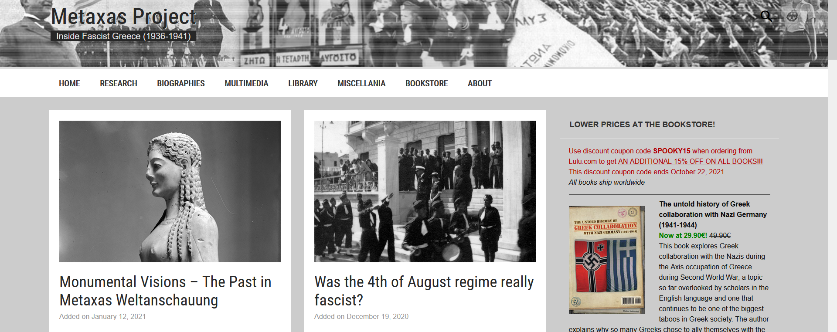
Metaxas Project: Inside Fascist Greece

Slide 53
Metaxas dictatorship
Authoritarian, backward-looking and paternalistic dictatorship
Anti-parliamentarism, anti-communism
Fascist-like rhetoric and style; corporatist state
Metaxas, preacher of the ‘Third Hellenic Civilization’
  Synthesis of the pagan values of Ancient Greece (Sparta) with the Christian values of Byzantium
No broad base of popular support
Climate of fear, civil liberties curtailed. Censure and book burnings, political opponents exiled

Slide 54
World War II (1939-1945)
28 October 1940, rejection of Italian ultimatum, invasion of Epirus (“OXI”)
Metaxas in accordance with the national mood, great wave of national exaltation
Greek troops soon pushed the invaders back to Albanian territory. ‘Liberation’ of the partly Greek-inhabited Southern Albania
January 1941, death of Metaxas. Alexandros Koryzis becomes prime minister
6 April 1941, launch of German offensive

Slide 55
World War II
18/4/1941, Prime minister Koryzis commits suicide
23/4/1941, fall of Athens
May 1941, ‘Battle of Crete’. The King and his government withdrew to Cairo
Collaborationist government in Greece led by General Tsolakoglou
June 1941, the whole of Greece is placed under tripartite occupation (German, Italian and Bulgarian)
September 1941, the Communists establish the National Liberation Front (EAM)

Slide 56
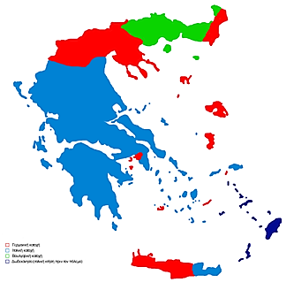
1941-1944

Slide 57
WWII (2)
Harsh occupational regime. Systematic plundering of the country’s resources, Greece had to pay for the costs of occupation
Food shortages, massive inflation, black market
Winter 1941/42, devastating famine, close to 200.000 victims in urban areas
Organization of a mass-based resistance movement under communist leadership
  EAM = National Liberation Front
  ELAS = National People’s Liberation Army
Non-communist resistance groups, mostly in north-western Greece
  EDES = National Republican Greek League

Slide 58
World War II (3)
Early 1943, deportation and extermination of the Jewish population of Thessaloniki (approx. 50.000)
Vicious German reprisals inflicted on civilians for resistance attacks (Kalavryta, Distomo, etc.)
Friction between communist-dominated and non-communist bands. Longer-term political objectives
Political actors: guerillas, British military and political authorities, the King and the government-in-exile
Sept. 1943, Italian armistice. ELAS takes hold of much of the weaponry of Italian forces in Greece while the British seek to sustain EDES

Slide 59
World War II (4)
August 1943, Cairo Conference between guerrilla leaders, the government-in-exile and the King
Demands of the resistance rejected
  That the King agree not to return to Greece until a plebiscite had been held
  That EAM/ELAS representatives be given the portfolios of interior, justice, and war in the postwar government
Onset of civil war between ELAS and EDES in October, the British opt for EDES

Slide 60
World War II (5)
March 1944, establishment of a Political Committee of National Liberation (ΠΕΕΑ) to exercise government functions in free ‘Mountain’ Greece
Mutinies by EAM sympathizers in the Greek Armed Forces stationed in Egypt suppressed by the British
Winston Churchill’s mounting obsession with the prospect of a post-war communist take-over in Greece
Deal with Stalin to assure British preponderance in post-war Greece in return for Russian hegemony over Romania (Feb. 1945, Yalta Conference)

Slide 61
World War II (6)
April 1944, Georgios Papandreou becomes prime minister of the government-in-exile (former Education Minister in last Venizelos’ government)
May 1944, Lebanon Conference, under British aegis, to build a government of national unity
12 October 1944, Athens liberated. Government of National Unity by Georgios Papandreou
Little interest in pursuing and punishing collaborators and members of the Security Battalions, fear and mistrust among population
Country devastated by the war

Slide 62


Slide 63
After the war
Ruined economy, communications disrupted
Merchant fleet almost wholly destroyed
Food in desperately short supply
Disease (particularly tuberculosis) rampant after years of malnutrition
Inflation out of control
Climate of fear and suspicion because of civil war
Thorny issue of demobilization of the guerilla armies and of their replacement by a regular national army
  Dec. 1944, EAM ministers resign from government

Slide 64

Civil War (1946-1949)
3/12/1944, police fires on mass demonstration organized in Athens by EAM
Furious street fighting between ELAS and British forces
February 1945, Varkiza agreement for a political settlement to the crisis. ELAS undertakes to disarm and in return an amnesty is promised
Acts of brutal and indiscriminate revenge on the left by ultra-right-wingers
1946, the Communists decide to abstain from elections. Overwhelming victory of right-wing coalition
Jorge Semprun, What a Beautiful Sunday (1982)

Slide 65


Slide 66
Monarchy and civil war
Sept. 1946, plebiscite, held in anomalous circumstances, in favor of the return of King George II
Former ELAS partisans go back to the mountains
‘White Terror”, Right wing death squads and paramilitary groups terrorize and kill leftists
1946-1949, civil war. Greek communists left unaided
United States take over the preponderant influence in Greece’s internal affairs from Britain
March 1947, substantial emergency aid to Greece by the US (Truman Doctrine of support to ‘free peoples’ threatened by internal subversion)

Slide 67
The legacy of the civil war
Savagely fought civil war, atrocities in both camps
American aid channeled into military objectives instead of economic development
Foreign dependency on the United States
Primary objective, the containment of communism
November 1952, massive victory for the Greek Rally (led by Marshal Papagos) after hasty reform of electoral system from proportional to majority
Theo Angelopoulos, The Traveling Players (O Thiasos) (1975)

Slide 68
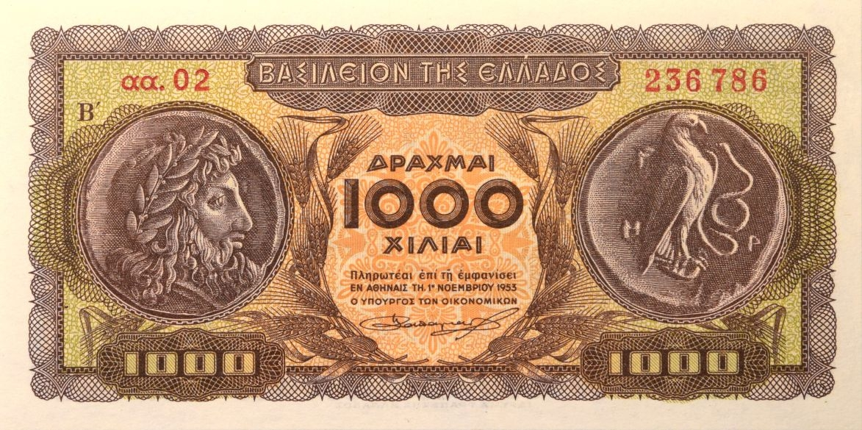
1950s
Close police watch on those suspected of left-wing sympathies
Police clearance required for those who sought state employment, a passport or even a driving license
Progress made towards economic reconstruction
  1953 drachma devaluation and tight monetary policy
  20-year period of monetary stability and economic growth
Flight from the countryside to the cities, internal migration and urbanization
New wave of emigration (Australia, Canada, Germany)
  1951-1980, 12% of the population

Slide 69
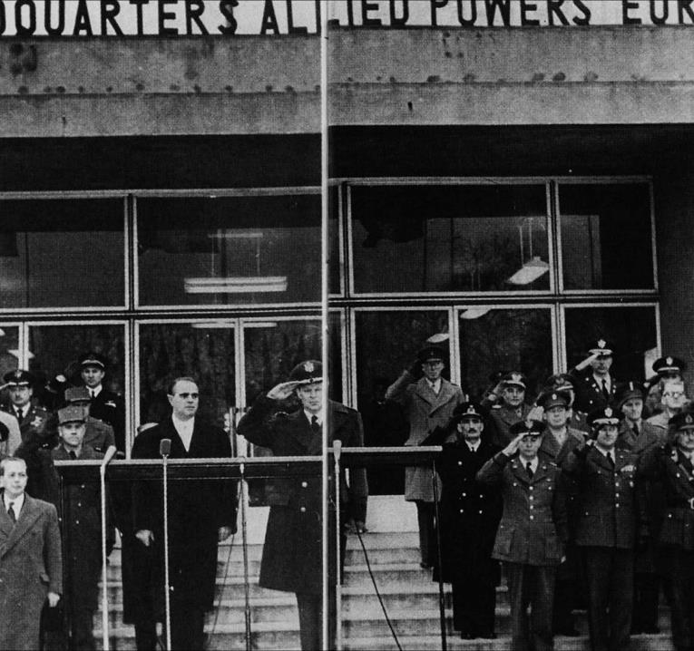
1950s (2)
1952, Greece and Turkey admitted to the NATO
Growing crisis in Cyprus (under British administration since 1878), EOKA (National Organization of Cypriot Fighters)
April 1955, anticolonial struggle of civil disobedience, bomb explosions
September 1955, highly destructive riots in Istanbul against Greek population (‘Septemvriana’)

Slide 70
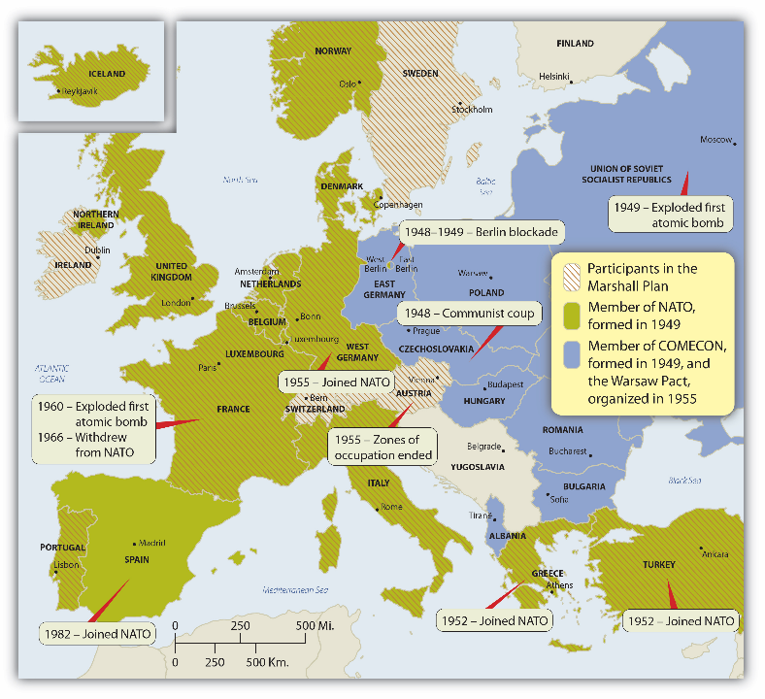

Slide 71
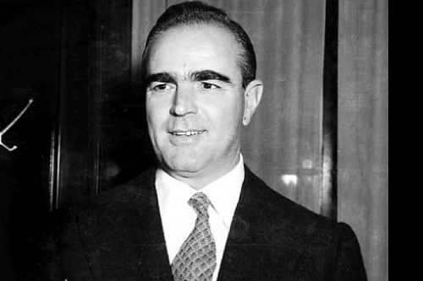
1950s (3)
February 1956, Greek women vote for the first time in national elections
Konstantinos Karamanlis’ ERE (National Radical Union) wins a clear majority of seats thanks to the electoral system
May 1958, EDA (United Democratic Left) emerges as the main opposition party
Κonstantinos Karamanlis (1901-1998)

Slide 72
1960s
October 1961, Karamanlis wins the elections, but the opposition denounces them as fraudulent and the result of manipulation
May 1963, murder of Grigorios Lambrakis, a high-profile United Democratic Left deputy
Tense relationship of Karamanlis with the Palace. He resigns in November 1963 and leaves for Paris
George Papandreou’s Centre Union wins the elections
1964, Constantine II succeeds to the throne. Clash with Prime minister Papandreou who is overthrown in July 1965
21/4/1967, successful military coup to pre-empt an almost certain Centre Union victory at the polls

Slide 73


Costa-Gavras film “Z” (1969)
Kosta-Gavras, Z (1969, trailer)

Slide 74
7-year military Junta
In December 1967, King Constantine II attempted a counter-coup that ultimately failed, resulting in his departure from the country.
Civil rights were heavily restricted, with a complete absence of press freedom.
Individuals suspected of being communists or political adversaries were either imprisoned or sent into exile on remote Greek islands, alongside a rising trend of violence and torture.
In December 1969, Greece chose to leave the Council of Europe voluntarily to evade expulsion.
In March 1972, dictator Georgios Papadopoulos was appointed as both Regent and Prime Minister.
Organized resistance emerged among intellectuals and exiles in Europe and the United States.
1967-1974

Slide 75


Slide 76
7-year military junta (2)
May 1973, HNS Velos mutiny. Increased international interest in the situation in Greece
Abortive attempts of Papadopoulos to legitimize and liberalize the military regime
June 1973, Papadopoulos proclaims himself President of the Republic after controversial referendum
17 November 1973, uprising at the Polytechnic University. Counter-coup by Gr. Ioannidis (25/11)
Aggressive internal crackdown and expansionist foreign policy
Documentary film by Stelios Kouloglou on the resistance against the dictatorship
Propaganda during the junta (Europeana)

Slide 77
7-year military junta (3)
15 July 1974, sponsored by Ioannidis, the EOKA-B organization takes power on the island of Cyprus by military coup. Archbishop Makarios III, the Cypriot president, is overthrown
20 July 1974, Turkish invasion and occupation of the northern part of the island
Cyprus fiasco leads senior Greek military officers to withdraw their support for the Junta
Invitation to former Prime Minister Constantine Karamanlis, in exile in Paris, to form a National Unity government that would lead the country to elections

Slide 78
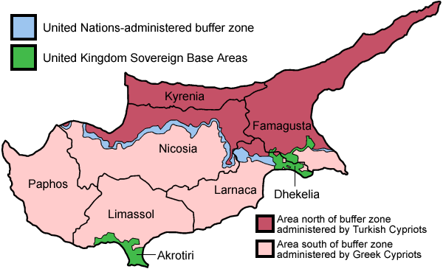

Slide 79
LINKS
Refugee relief work, 1922
The liberation of Athens, 12 October 1944
Jorge Semprun, What a Beautiful Sunday (1982)
Street fighting in Athens, 1944
Theo Angelopoulos, The Traveling Players (O Thiasos) (1975)
Kosta-Gavras, Z (1969, trailer)
Melina Merkouri, Je suis Grecque
Documentary film by Stelios Kouloglou on the resistance against the dictatorship
Propaganda during the junta (Europeana)

Slide 80
