Slide 1

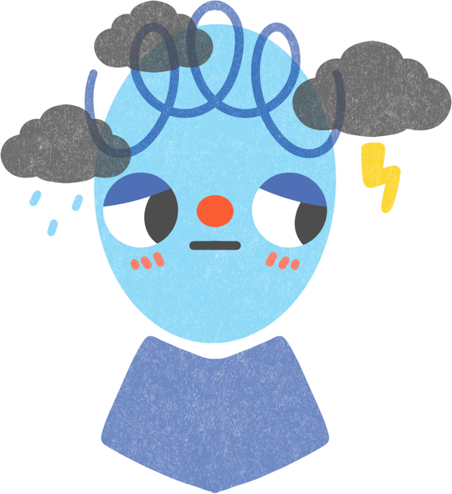
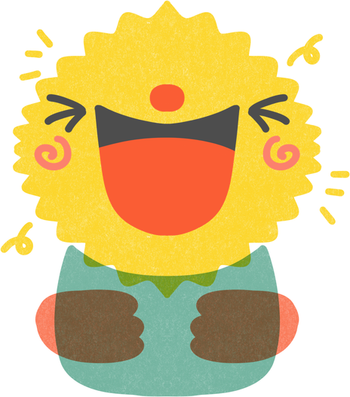
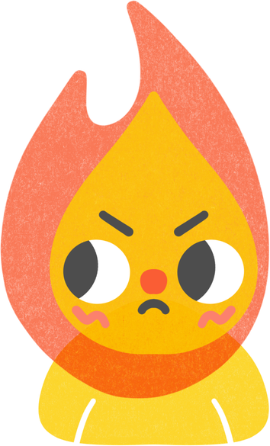
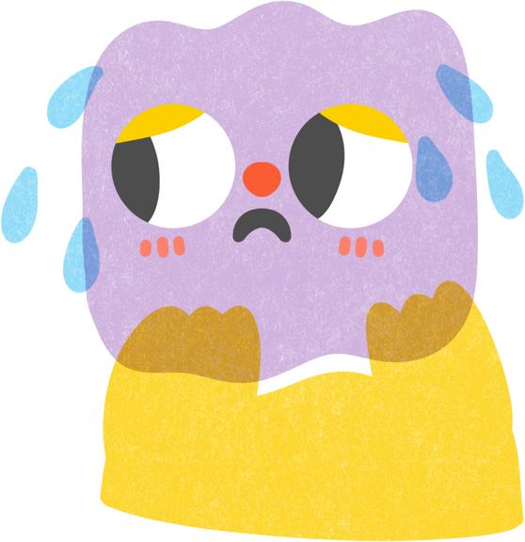
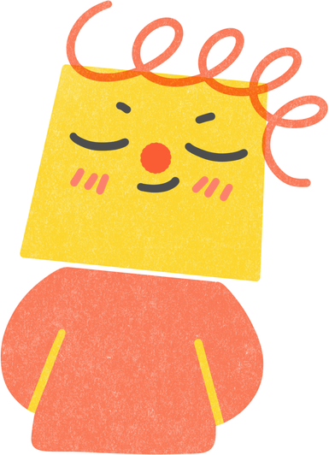
Me and the World – Me and My Emotions
Understanding Complex Emotions and Managing Them Responsibly

Slide 2


TODAY WE WILL LEARN TO:
  1
  2
  3
See how emotions affect behavior
Understand complex emotions
Practice responsible emotional choices

Slide 3
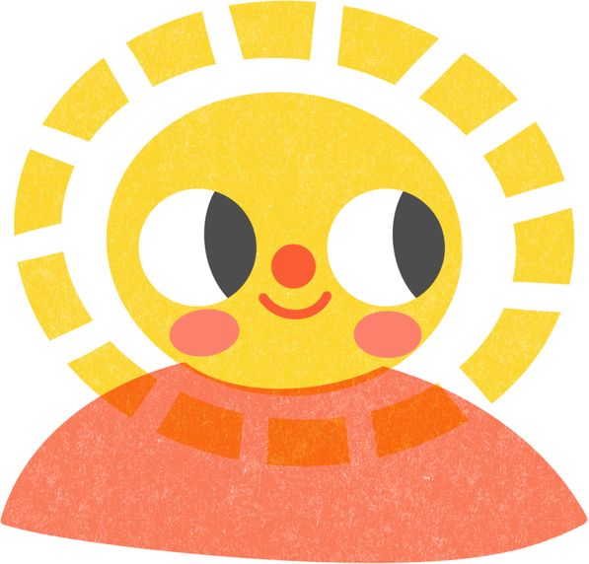


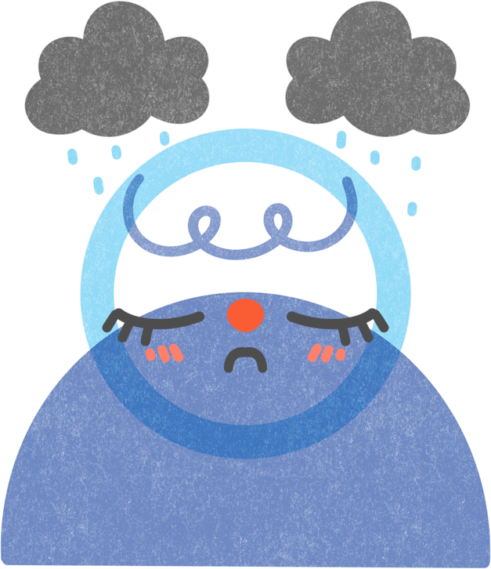


WHAT ARE EMOTIONS?
  Emotions are part of being human
  Everyone has emotions
  Strong emotions are normal

Slide 4
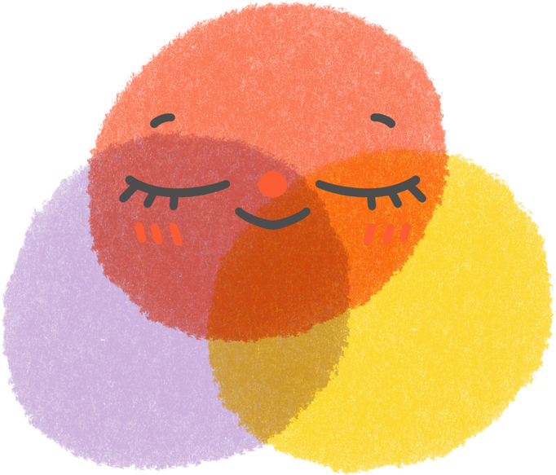
WHAT ARE COMPLEX EMOTIONS?
Complex emotions often appear in social situations and relationships.
They are connected to:
COMPARISON WITH OTHERS
EXPECTATIONS
SOCIAL RULES

Slide 5
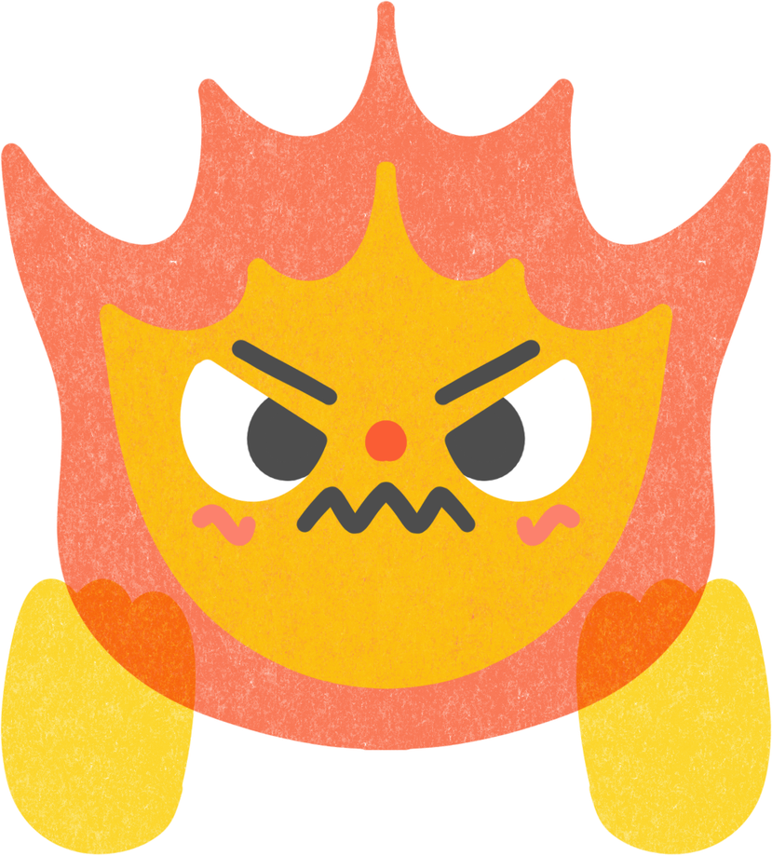
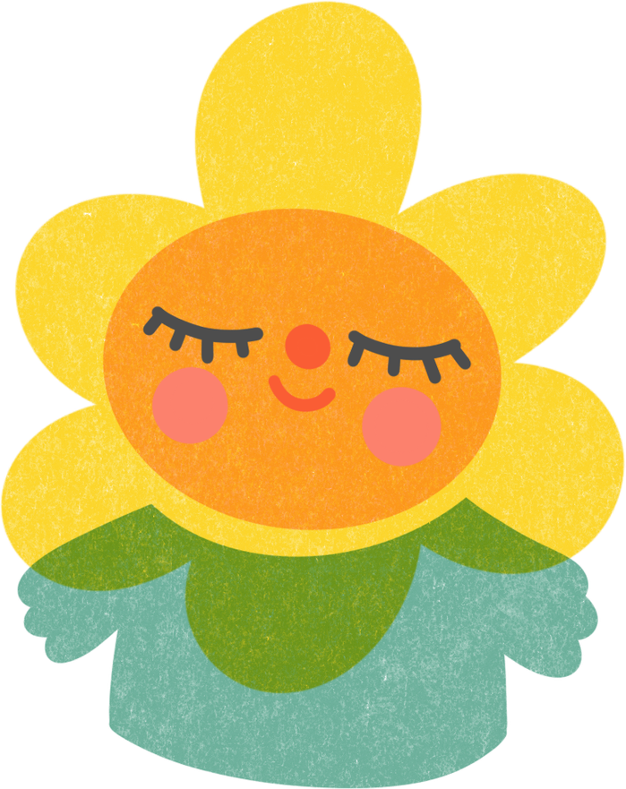
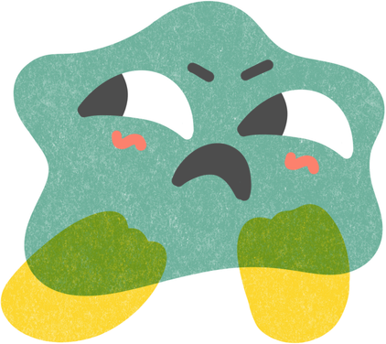
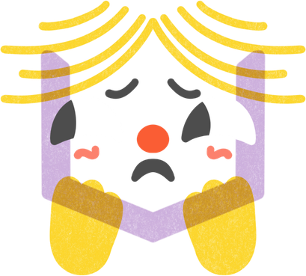
EXAMPLES OF COMPLEX EMOTIONS
anger
pride
shame
frustration
jealousy

Slide 6
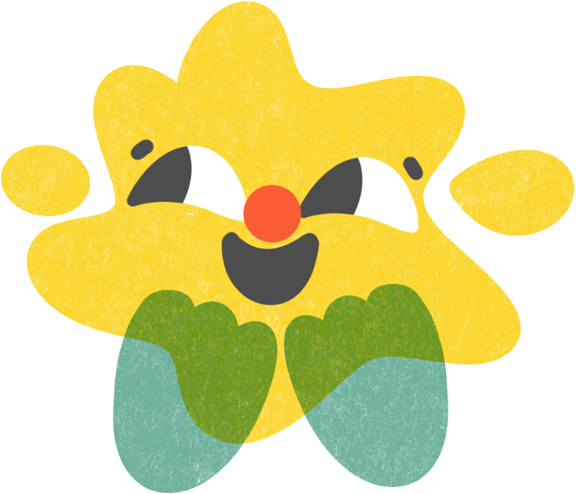
MORE THAN ONE EMOTION AT THE SAME TIME
  Person can feel more than one emotion
  Emotions can exist together
  This is normal

Slide 7
WHAT IS AN EMOTIONAL TRIGGER?
An emotional trigger is:
something that causes a strong emotional reaction
Triggers can be:
unfair treatment
exclusion
failure after effort
being judged

Slide 8
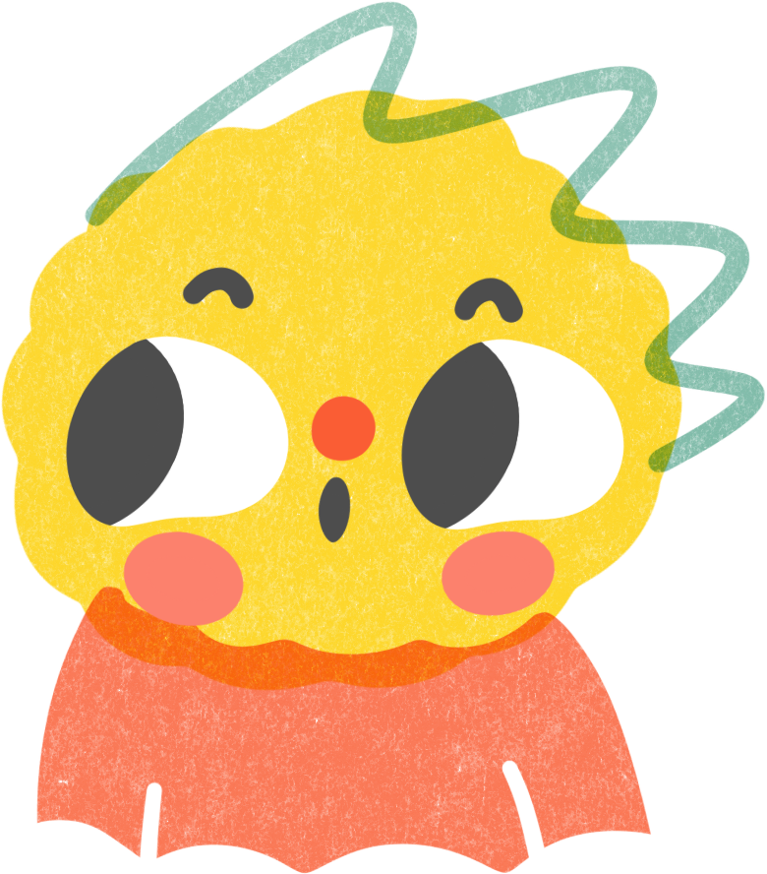
WHY TRIGGERS ARE IMPORTANT
Understanding triggers helps us:
pause before reacting
think calmly
choose responsible actions

Slide 9


EMOTIONS, CHOICE, AND RESPONSIBILITY
  1
  2
  3
Emotions happen automatically
Actions are choices
That causes an emotional reaction
Emotions are very fast.
Crying, screaming, laughing, are products of the emotions we feel.

Slide 10
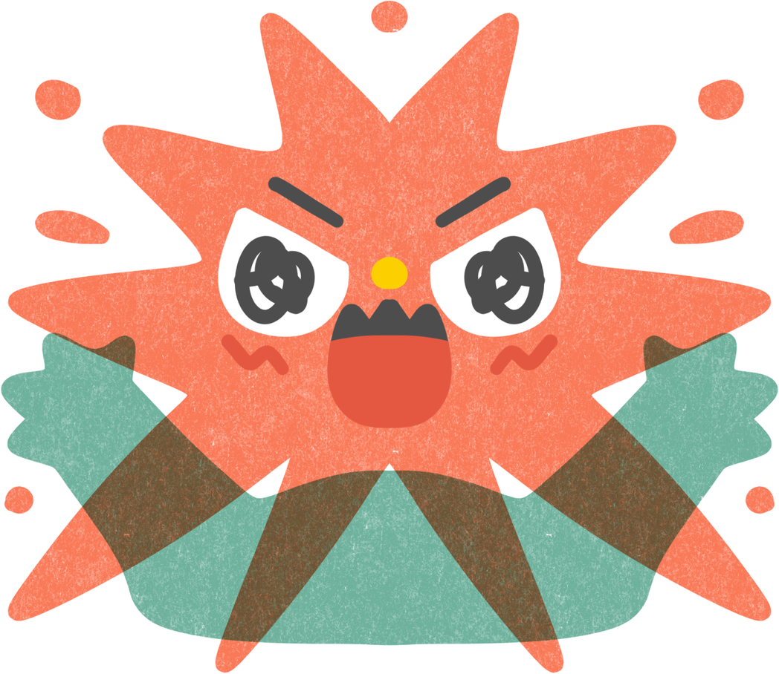
INTENSITY OF EMOTIONS
Some emotions feel very strong.
Strong emotions need:
  time to calm down
  space
  reflection

Slide 11
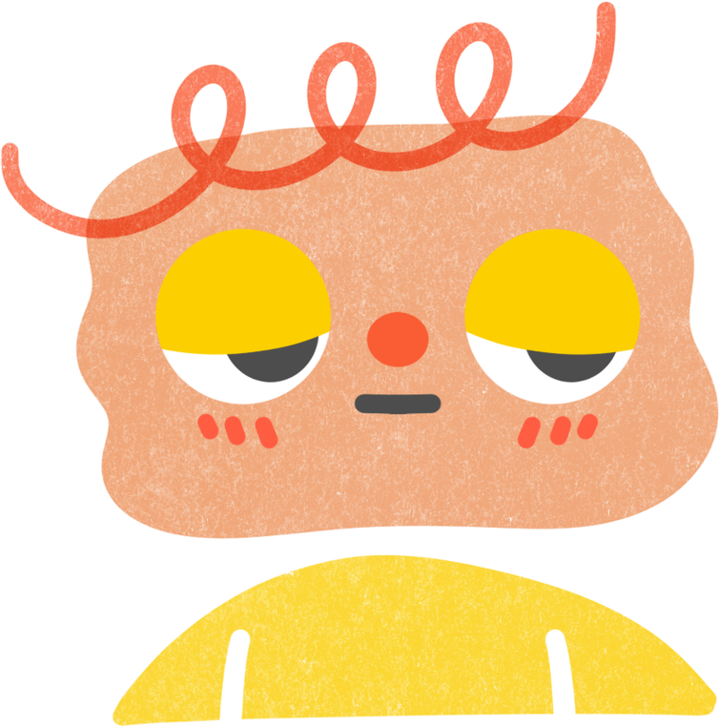
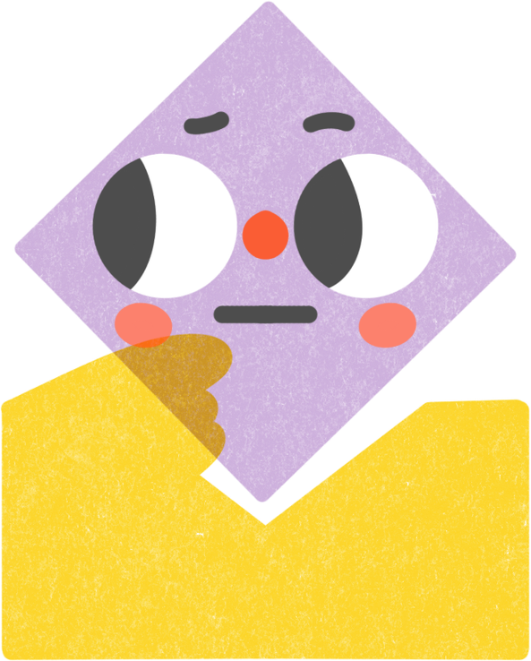
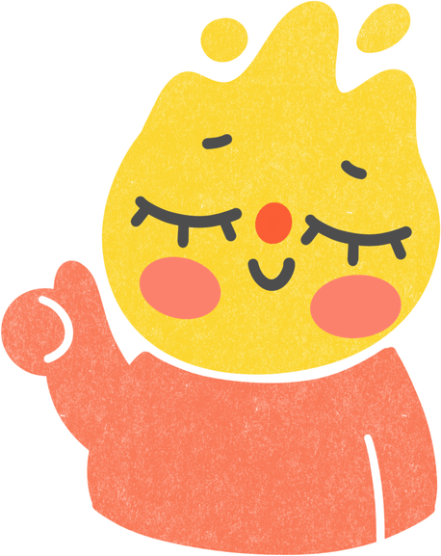
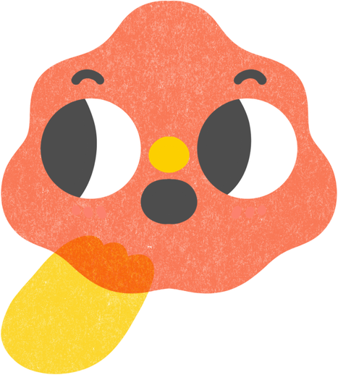
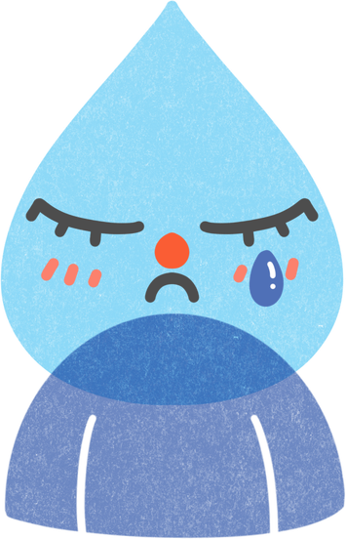
EMOTIONAL REGULATION
Regulation is a skill, not suppression.
1.noticing the emotion 2.naming the emotion 3.choosing a response

Slide 12
CASE STUDY: GROUP PROJECT CONFLICT
Situation:
A student works hard, but everyone gets the same grade.
Discussion focus:
  emotions involved
  emotional triggers
  responsible responses

Slide 13
SOCIAL EMOTIONS: PRIDE AND SHAME
  Pride can come from success
  Shame can appear after failure
  Both emotions are part of social life

Slide 14
RESPONSIBLE EMOTIONAL EXPRESSION
Responsible ways to express emotions:
1.calm words
2.respectful communication
3.listening to others

Slide 15
CONCLUSION
  Strong emotions are part of life
  Responsibility is how we act
  Reflection helps peaceful relationships

Slide 16
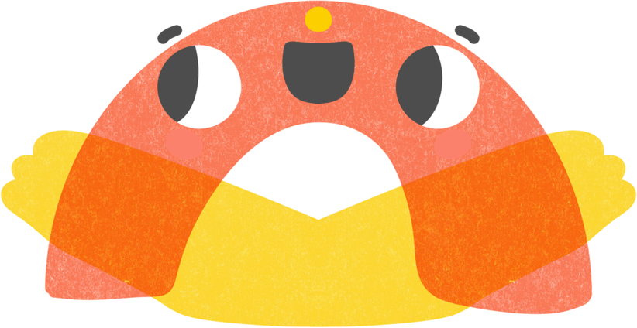
THANK YOU
SO MUCH

