Slide 1
My Duty, My Responsibility – Doing What Is Right Even When No One Sees

Slide 2
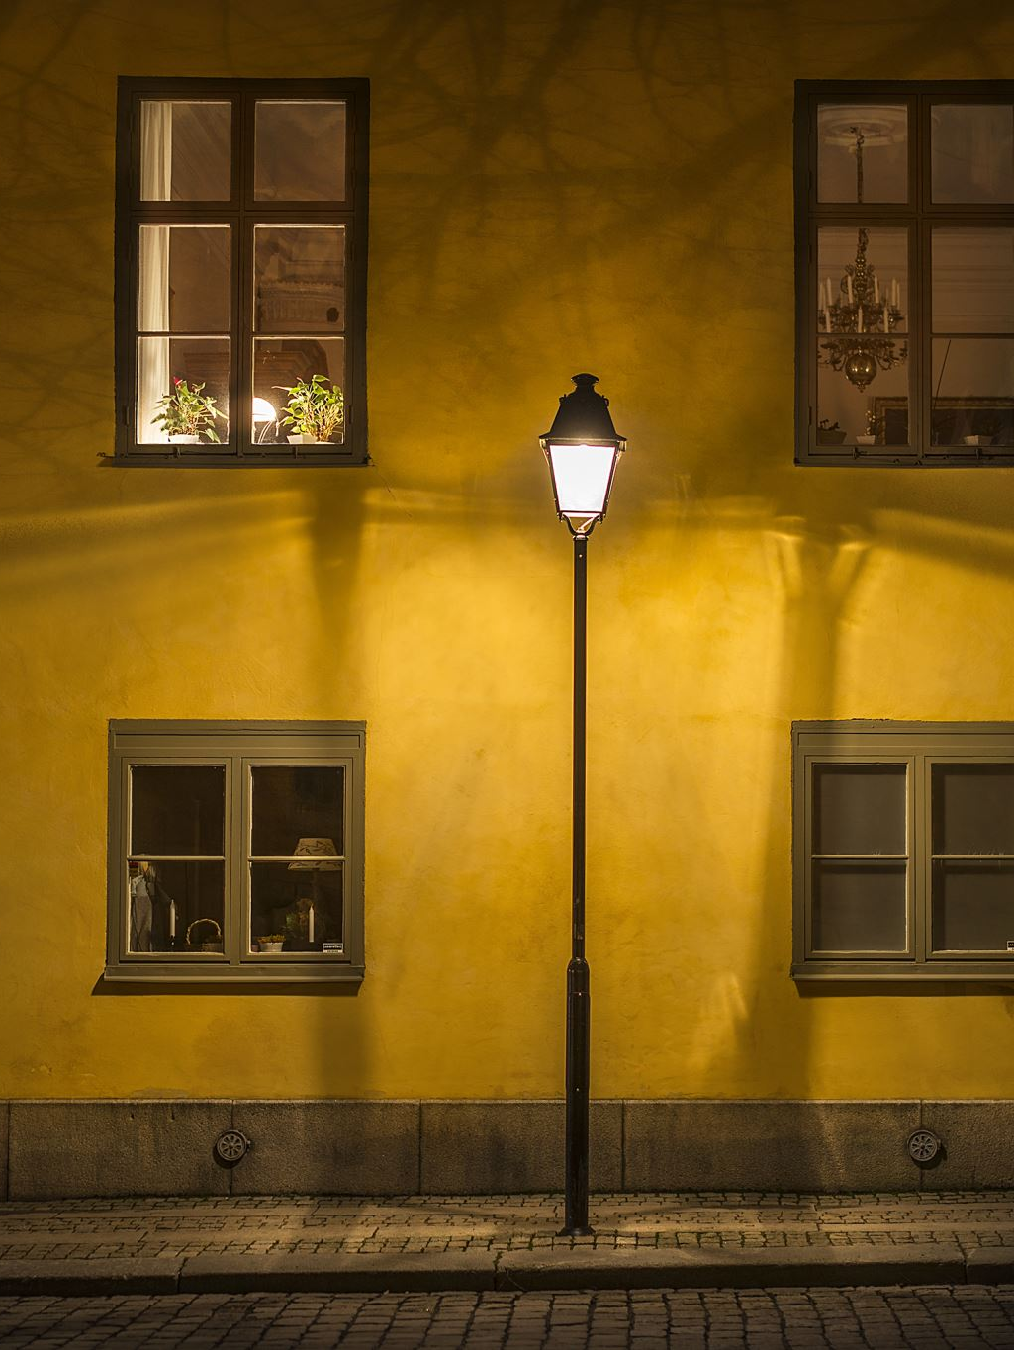
“The Two Lanterns”
Two lanterns hung outside a house.The first lantern always kept its light strong.The second lantern often dimmed—sometimes from laziness, sometimes because it hoped no one would notice.
One stormy night the road was dark. The strong lantern helped travelers find their way safely. But the dim lantern caused a person to stumble.

Slide 3
Discussion questions:
• Which lantern was responsible?
• Why does our “light” matter to others?
• When we have a duty, who depends on us?

Slide 4
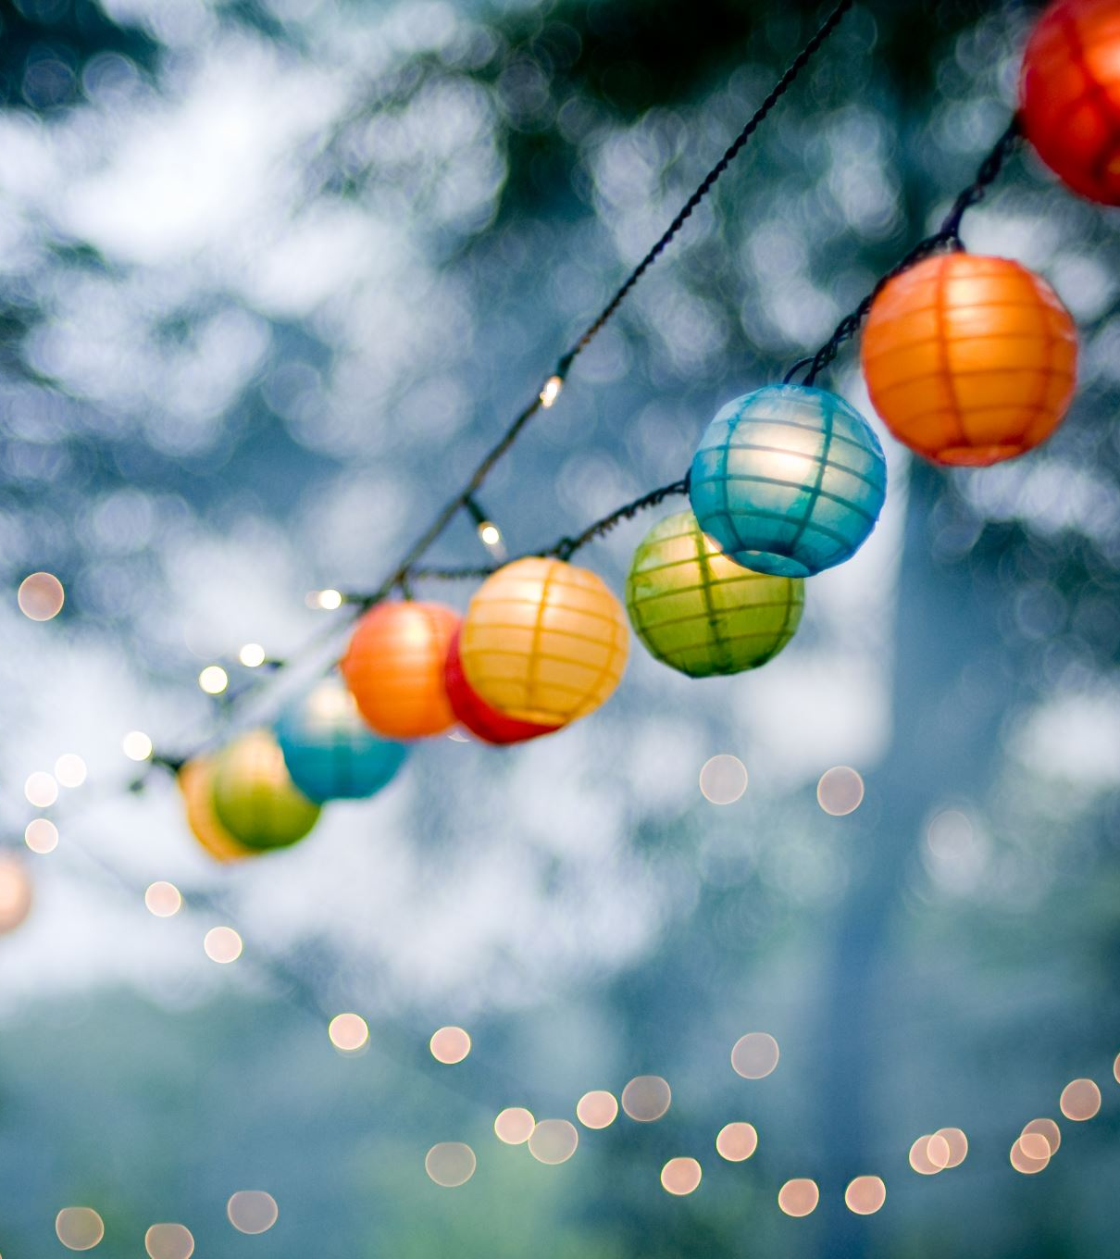
Today we will learn what responsibility means—how our actions guide others, just like lanterns lighting a path.

Slide 5
What Is Responsibility?
• Doing what you are supposed to do.
• Taking care of your tasks even if no one watches.
• Being reliable—people can trust you.
Examples:
– Feeding a pet daily
– Returning a borrowed item
– Finishing homework
– Helping at home

Slide 6
What Is Duty?
A responsibility that is important and necessary.
Duties can be at home, at school, to friends, or to ourselves.
In Islam, amanah (trust) means fulfilling duties honestly.
Examples:
– Keeping a promise
– Respecting parents and teachers
– Taking care of your things
– Following class rules

Slide 7
Why Is Responsibility Important?
Others rely on us
It keeps our community safe and peaceful
Helps us grow strong and confident
Builds trust with family, friends, and teachers
Brings reward from Allah for honesty and effort

Slide 8
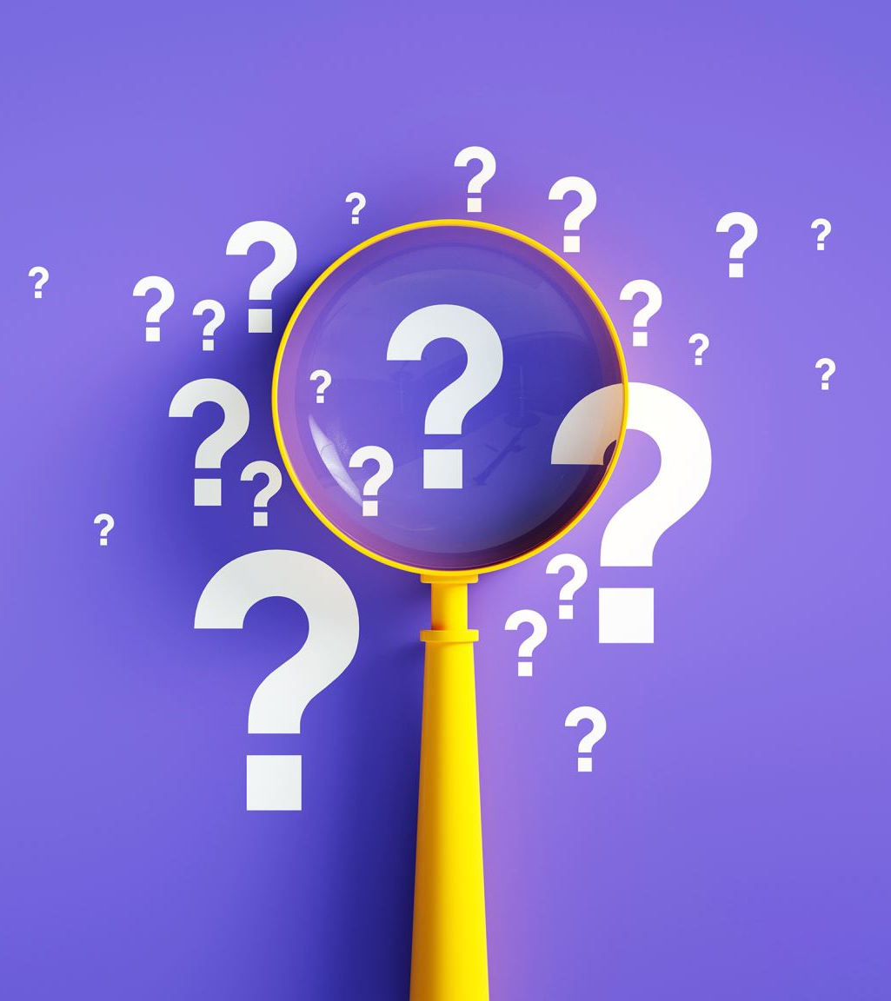
What Happens When We Ignore Responsibility?
Others may get hurt or upset
Trust is lost
Problems grow bigger
We feel guilty or disappointed

Slide 9
“Who Counts on Me?”
A child promises to help carry groceries.
A child wants to play a new game.
A student must bring the class notebook back.
Someone promised to water the class plant.
A child wants to buy ice cream.

Slide 10
Duty or Not? Responsible or Irresponsible?
• Blue card = responsible / duty
• Red card = irresponsible / not duty
– You clean your desk without being told.
– You forget to feed the pet.
– You help a younger sibling with homework.
– You leave your toys on the stairs and someone trips.
– You return a lost wallet to the teacher.

Slide 11
My Responsibility Web
Circle pictures of responsible acts
1
Draw or write one responsibility at home, one at school
2
Match pictures to “duty” or “not duty”
3

Slide 12
Thank you for watching!

