Slide 1

Me and my emotions
Lesson plan for 3rd grade

Slide 2
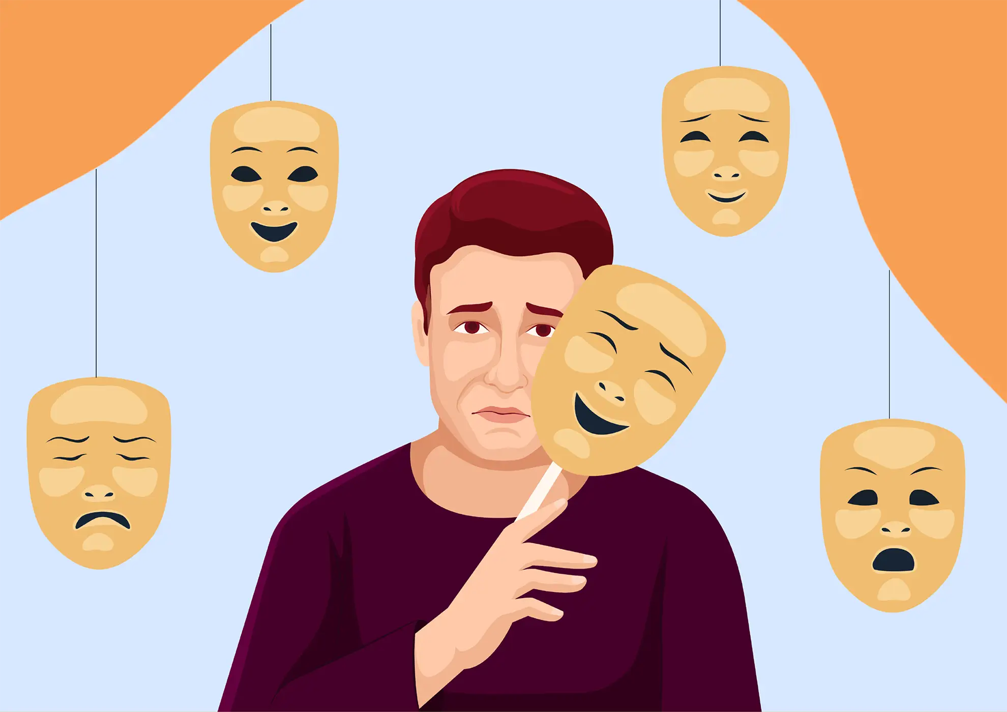
1.What are emotions?
Emotions are the feelings we have inside our hearts and minds. They help us understand what is happening to us and around us.
Everyone has emotions — children and adults. All emotions are normal. What matters most is learning how to understand them and express them in a kind and healthy way.

Slide 3
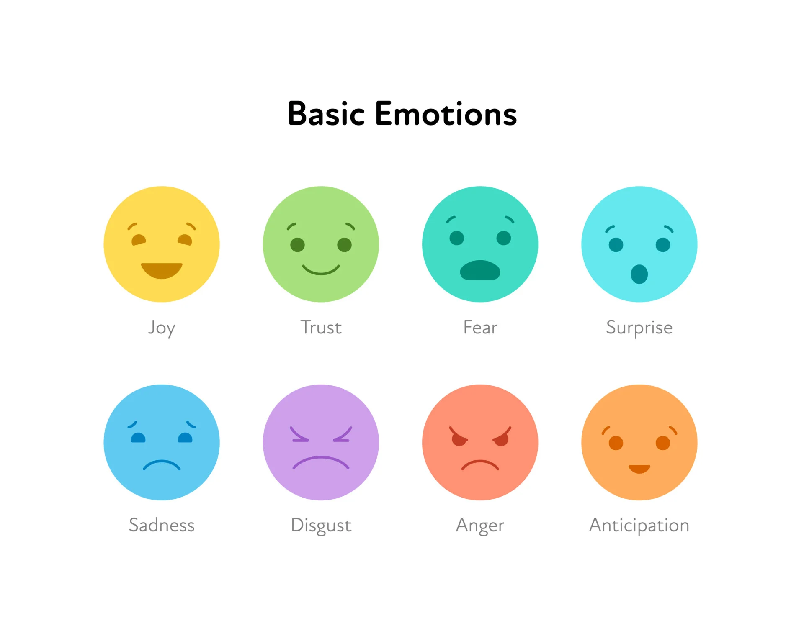
2.Basic emotions

Slide 4
3.Some exaples
When something good happens, we might feel happy.
When we lose something we like, we might feel sad.
If something scares us, we feel afraid.
When someone is unfair, we might feel angry.
When something is new and interesting, we feel excited.

Slide 5



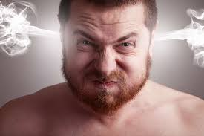

Slide 6
4.Why emotions are so important?
Help us know what we like and don’t like
Help us make decisions
Help us understand other people’s feelings
Help us tell others how we feel

Slide 7
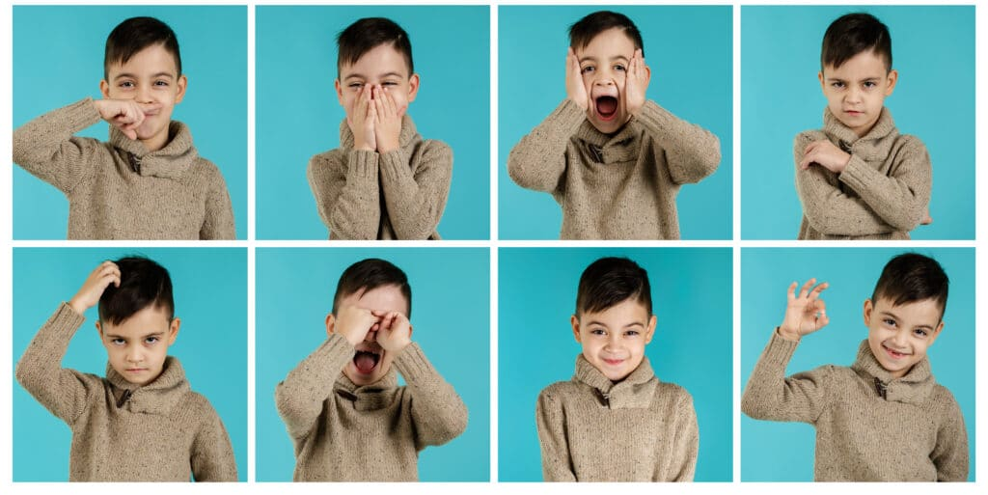
5.Emotions in the classroom

Slide 8
6.Peaceful behavior
Use kind words.
Say “please,” “thank you,” and speak politely, even when you are upset.
Listen to others.
Let other people talk and try to understand how they feel.

Slide 9
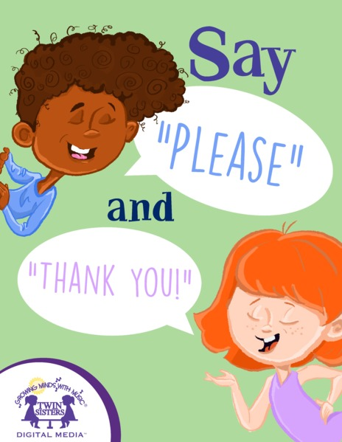


Slide 10

Peaceful behavior makes classrooms, homes, and playgrounds happier and safer places for everyone.

Slide 11
Thank you

