Slide 1
The European Union as a Community of Values, Rights, and Cooperation

Slide 2
What Is the European Union?
The European Union is a unique community formed by European countries that have chosen to cooperate closely. It is not a single country, but a union based on shared values, common goals, and democratic principles.

Slide 3
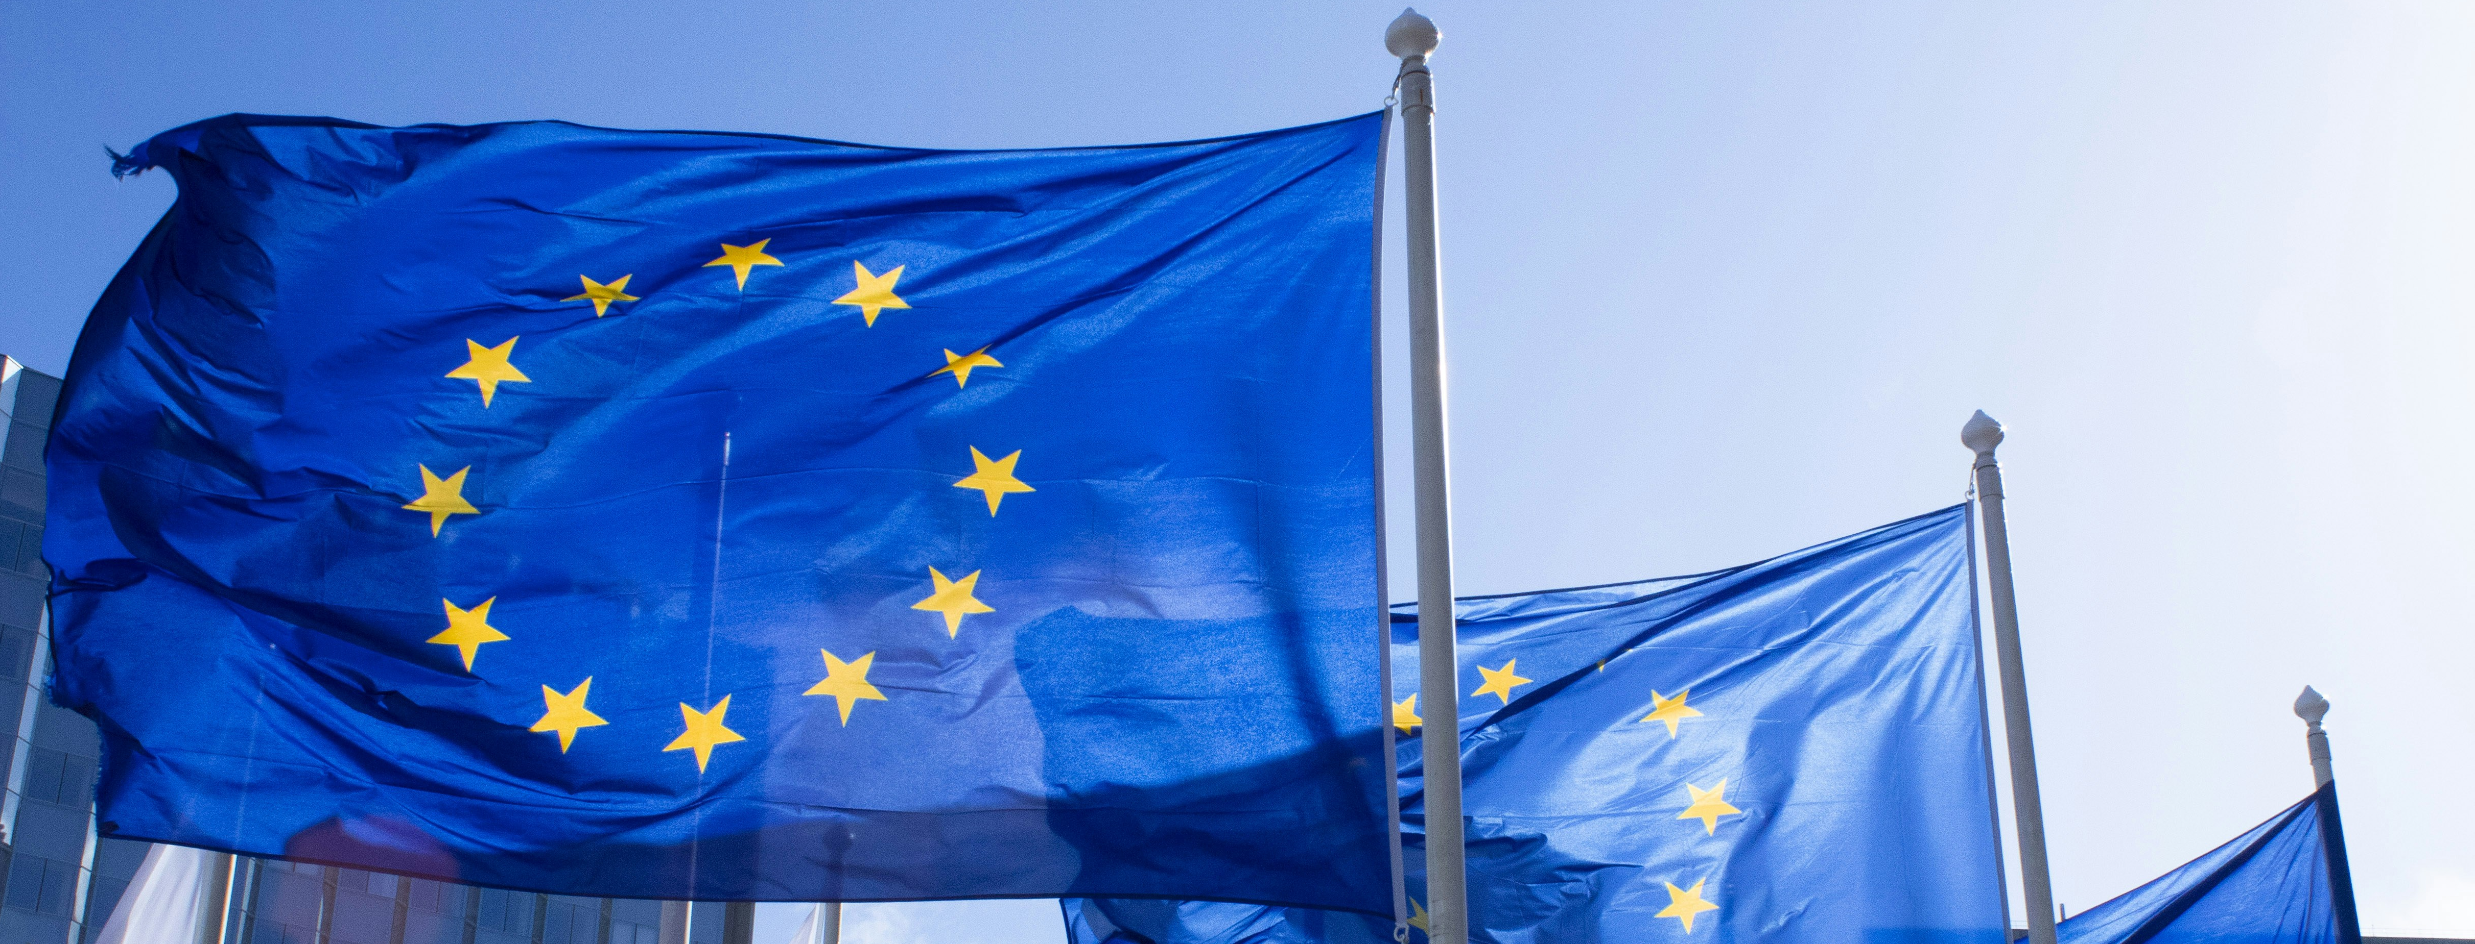
Why Was the EU Created?
The EU was created to promote peace, cooperation, and stability after periods of conflict in Europe.

Slide 4

Shared European Values
At the core of the European Union are shared values, including respect for human dignity, freedom, democracy, equality, the rule of law, and human rights.

Slide 5
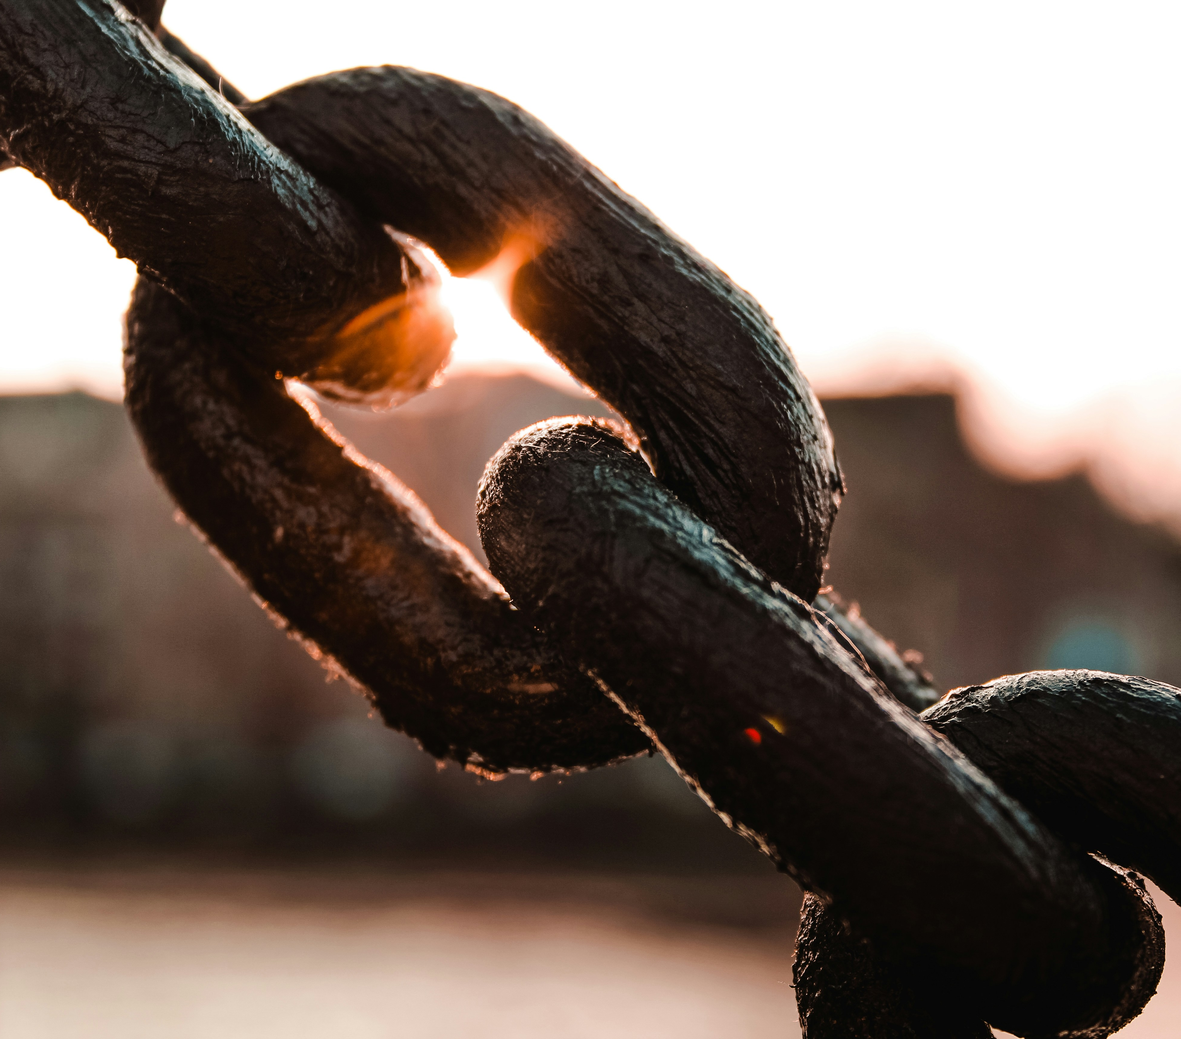
Why Values Matter?
These values guide how decisions are made and how people are treated within the Union. They apply to all Member States and form the ethical foundation of European cooperation.

Slide 6
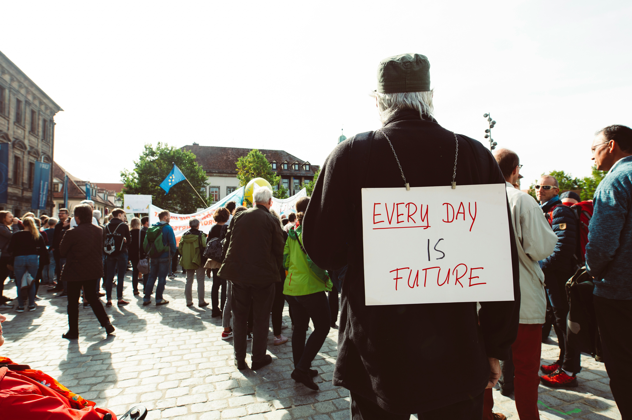
Democracy in the EU
Democracy is a central principle of the EU. Decisions are made through institutions that represent citizens and governments. Although institutions operate at a European level, their purpose is similar to democratic institutions in individual countries: to represent people, create rules, and protect rights.

Slide 7
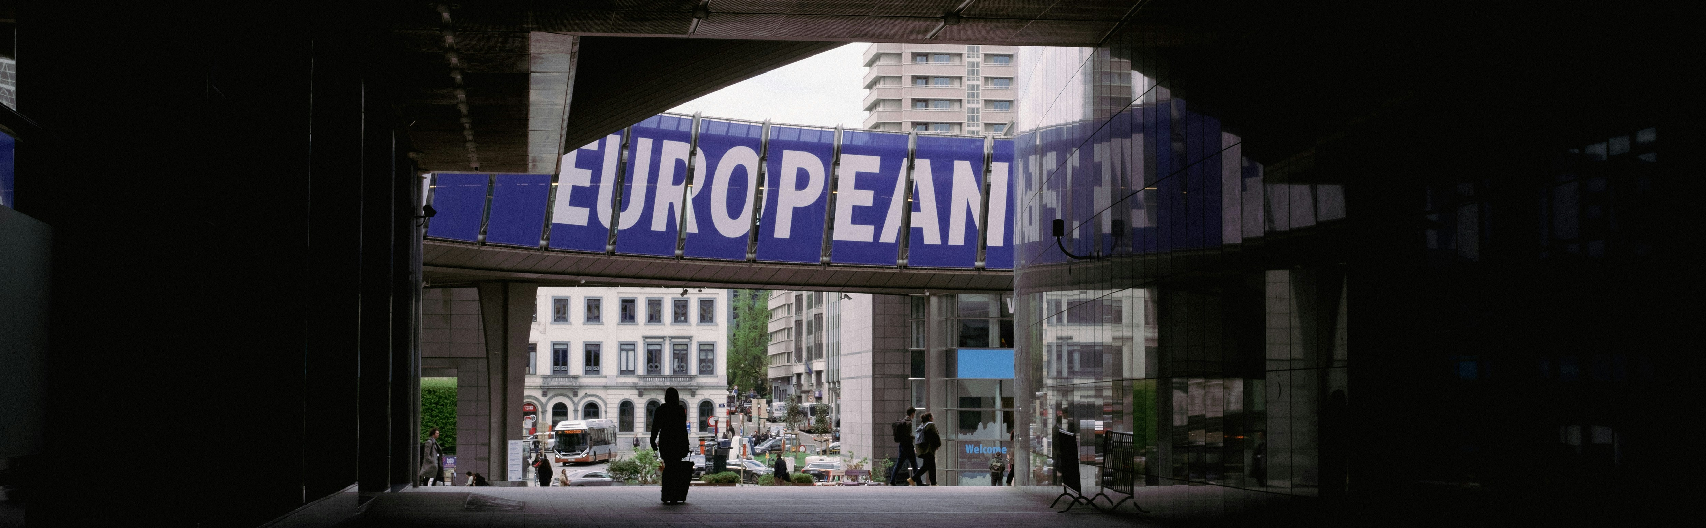
Main EU Institutions
the European Parliament
the European Commission
the Council of the European Union

Slide 8

What Do the Institutions Do?
These institutions work together to balance different interests and ensure democratic decision-making.
the European Parliament, which represents EU citizens,
the European Commission, which works for the common European interest,
the Council of the European Union, where Member States cooperate and decide together.

Slide 9
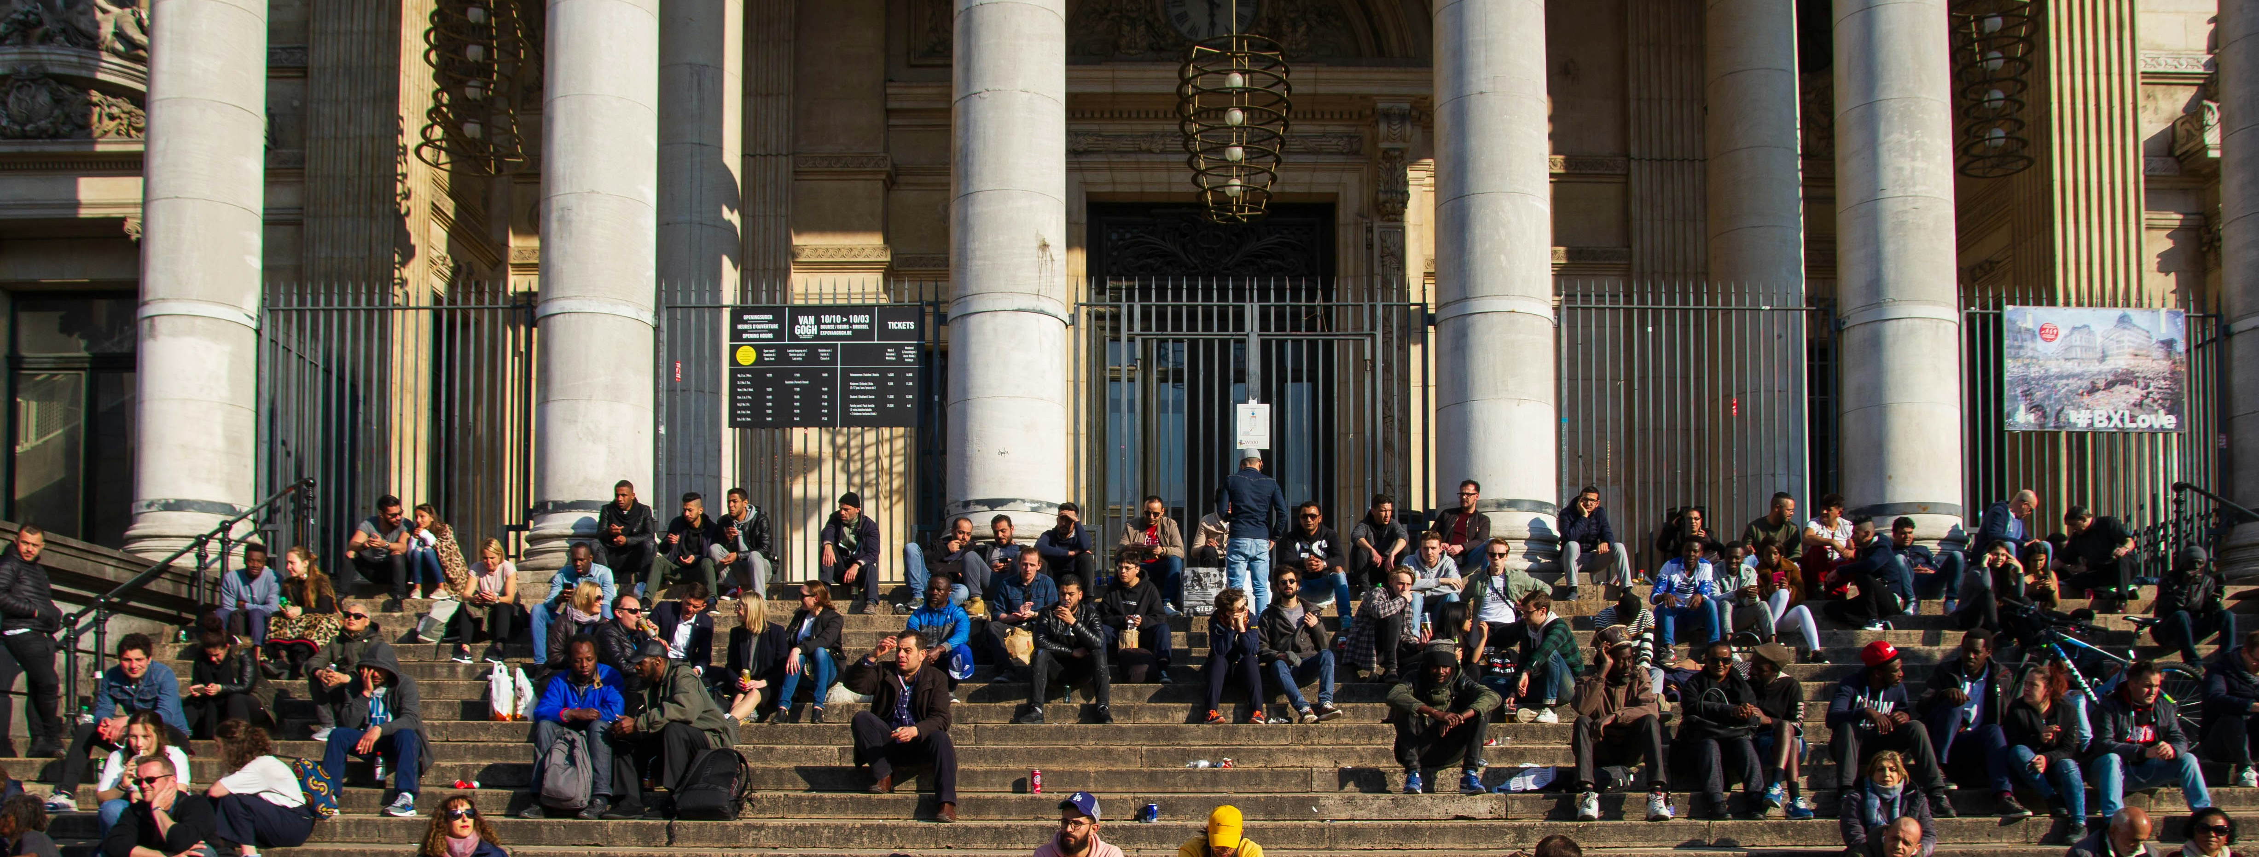
European Citizenship
European citizenship complements national citizenship.

Slide 10
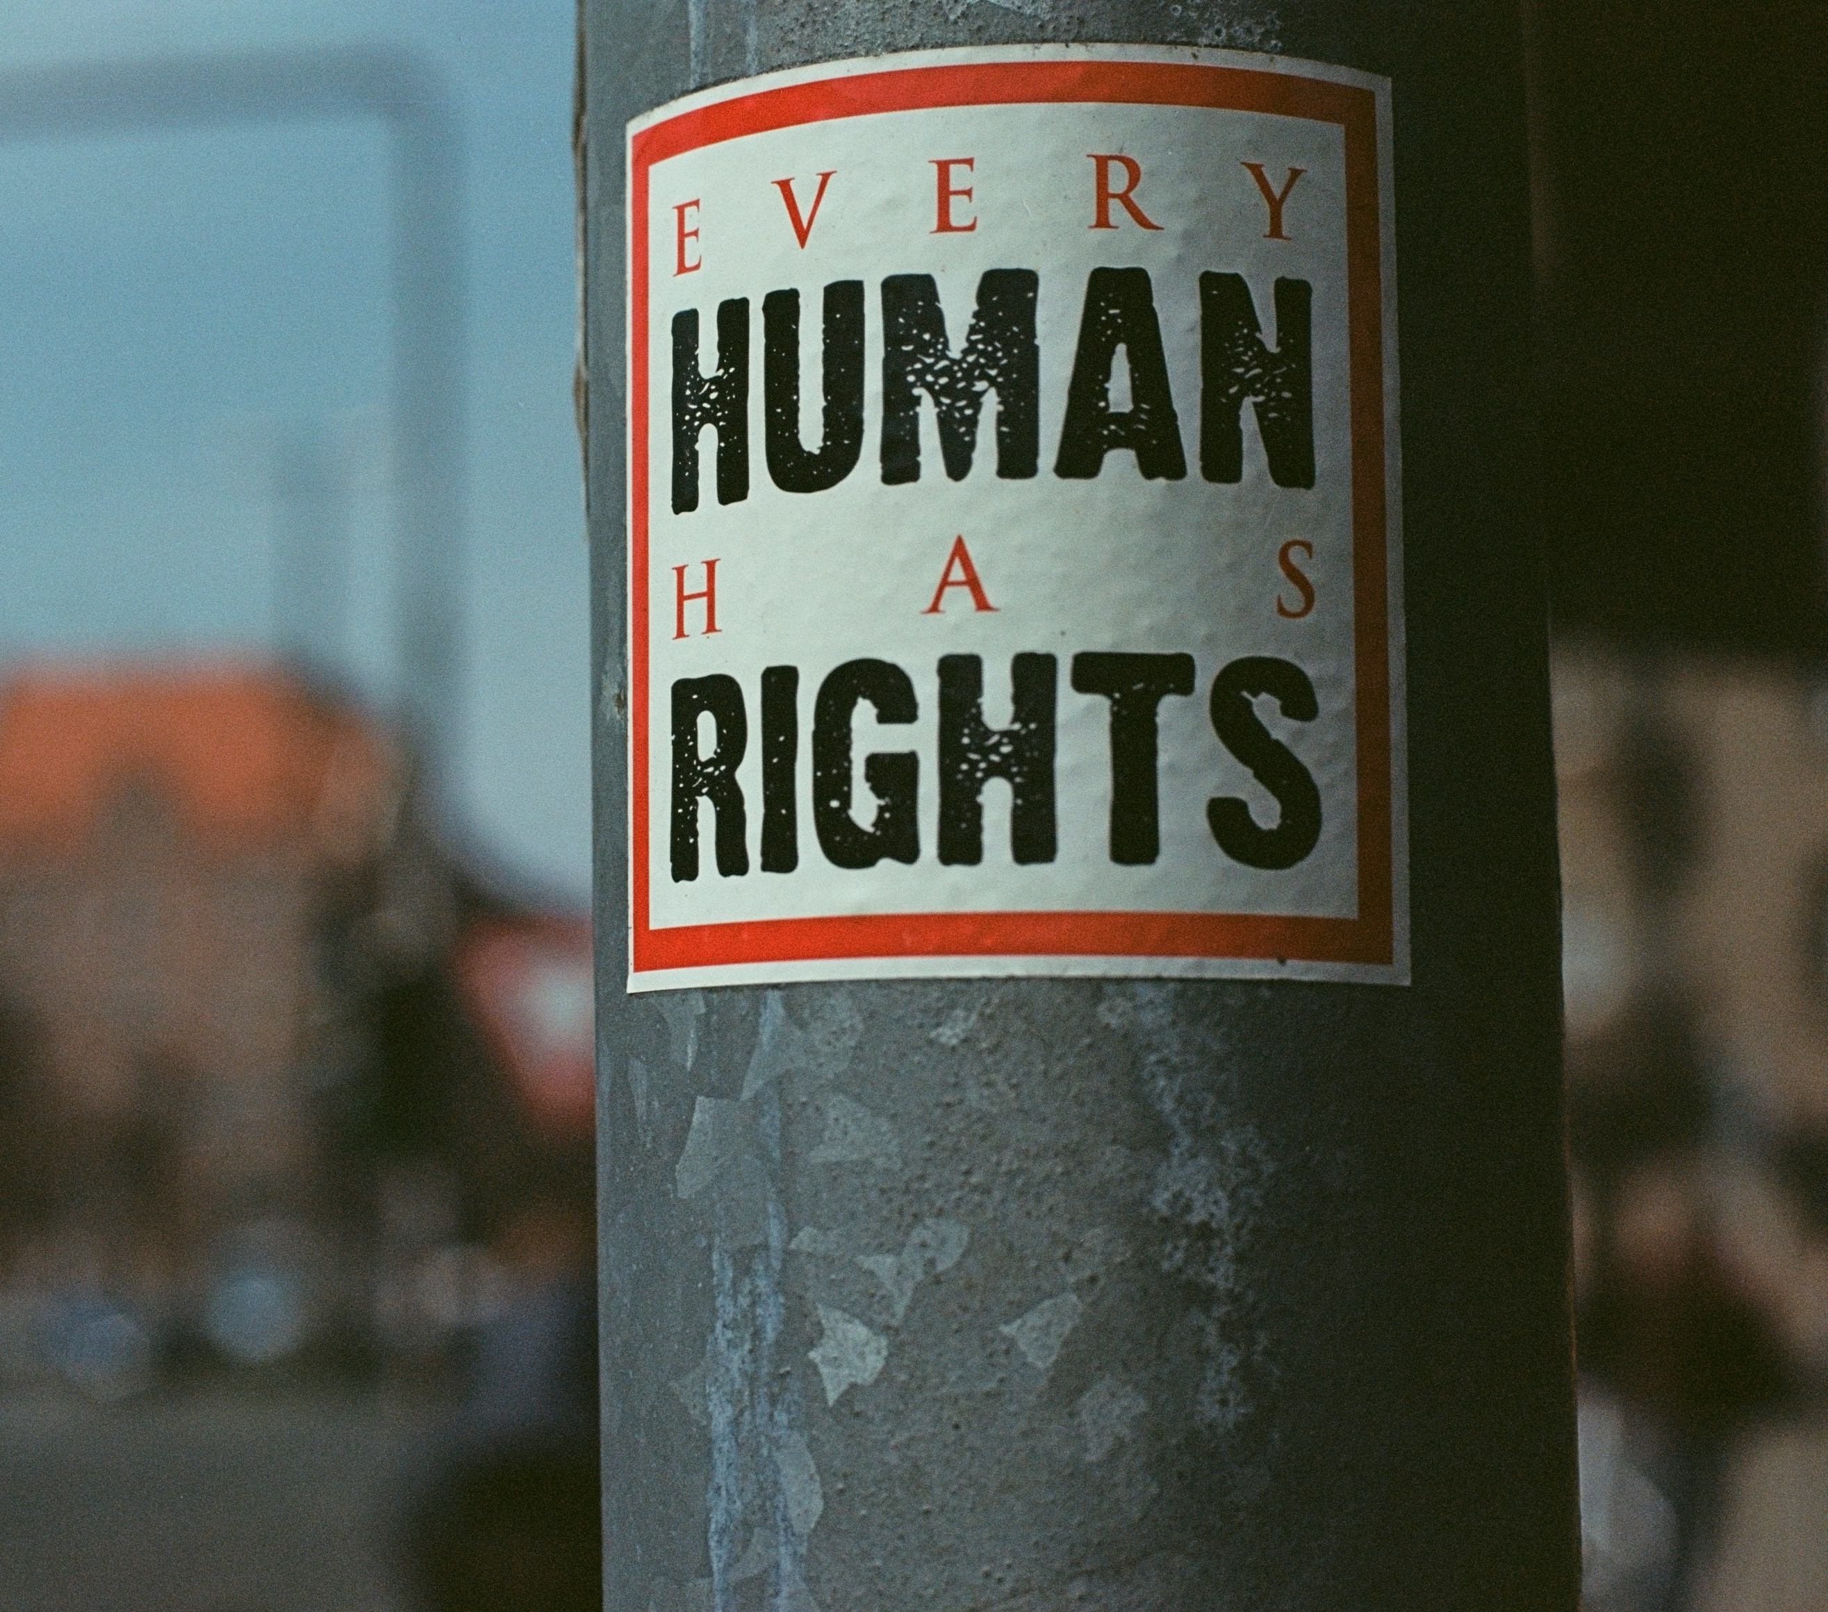
Rights of EU Citizens
It gives people additional rights, such as the right to move, study, and work in other EU countries, as well as the right to participate in democratic processes.

Slide 11
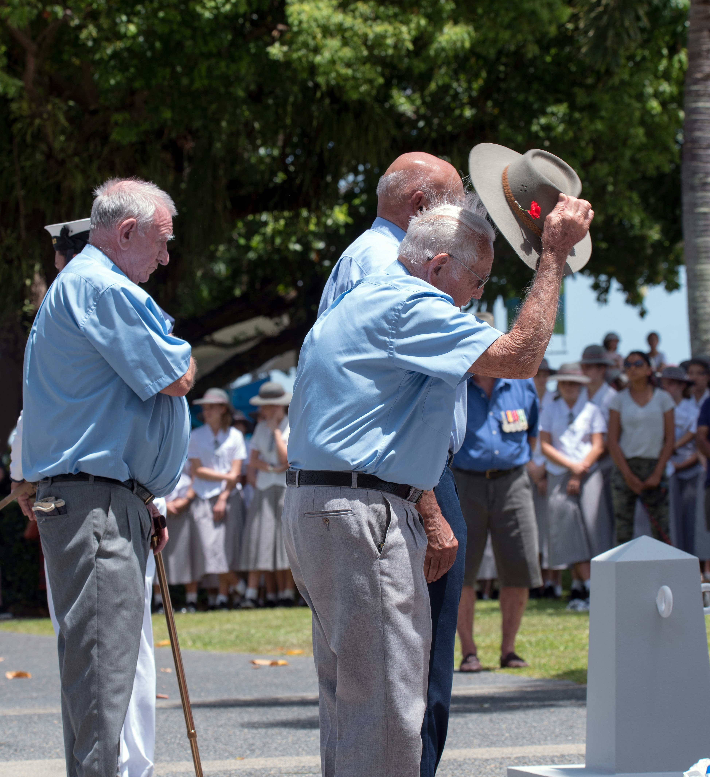
Responsibilities of Citizens
European citizenship also involves responsibilities, including respect for shared values and democratic rules.

Slide 12
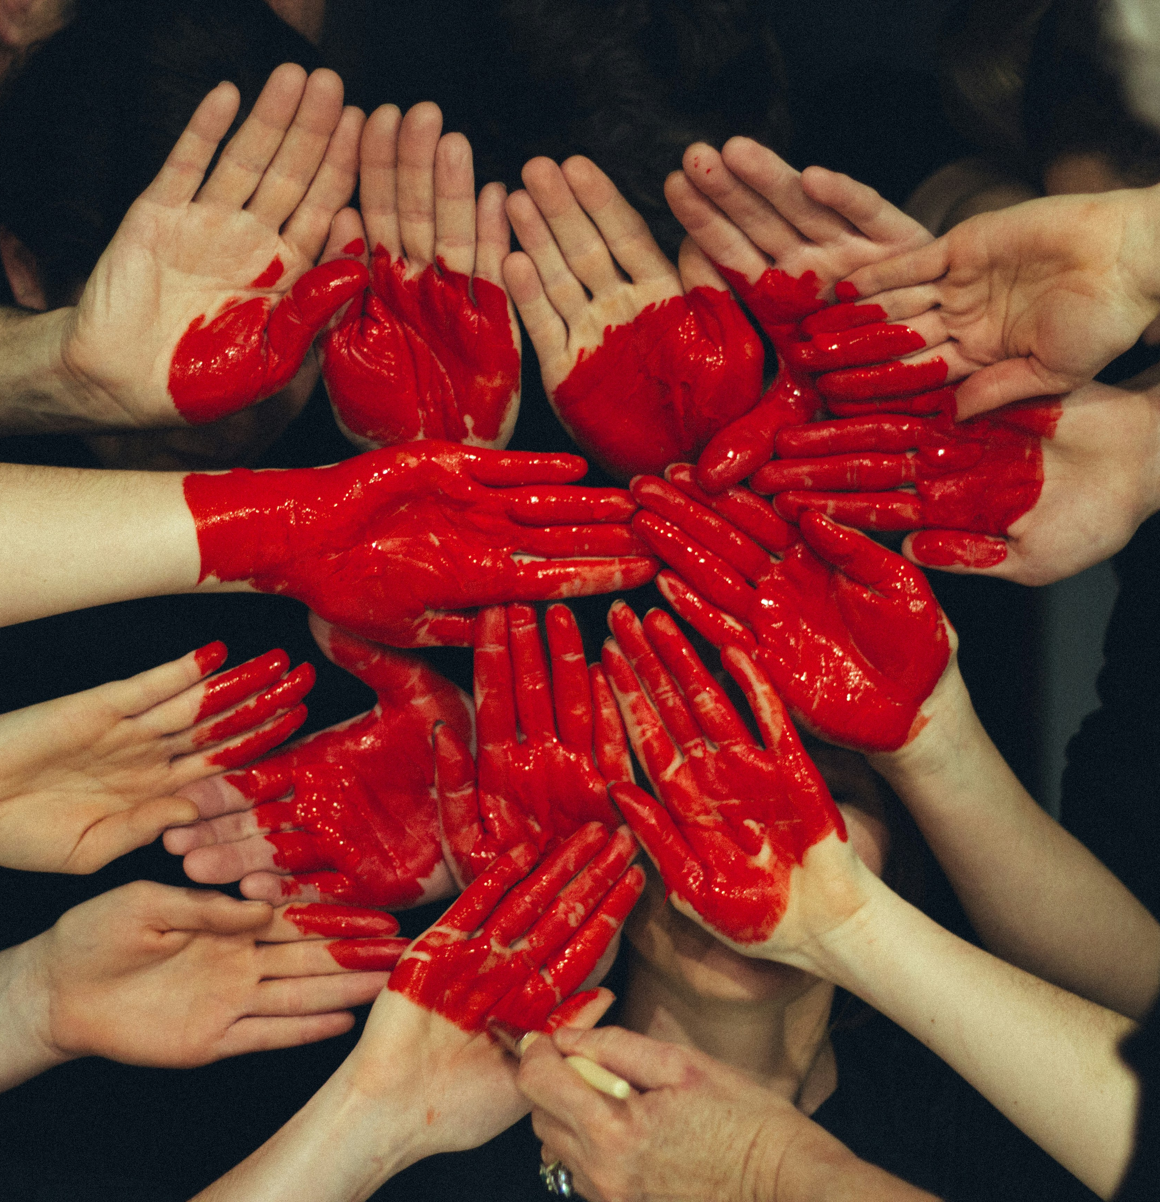
Solidarity
Solidarity is a key concept within the EU. It means supporting one another, especially in times of difficulty. Cooperation between countries helps reduce inequality, promotes development, and strengthens peace. Solidarity shows that challenges can be addressed more effectively together than alone.

Slide 13

Cultural Diversity
The European Union respects cultural diversity. While countries have different languages, traditions, and histories, shared values allow them to coexist peacefully. Diversity is seen as a strength rather than a problem.

Slide 14
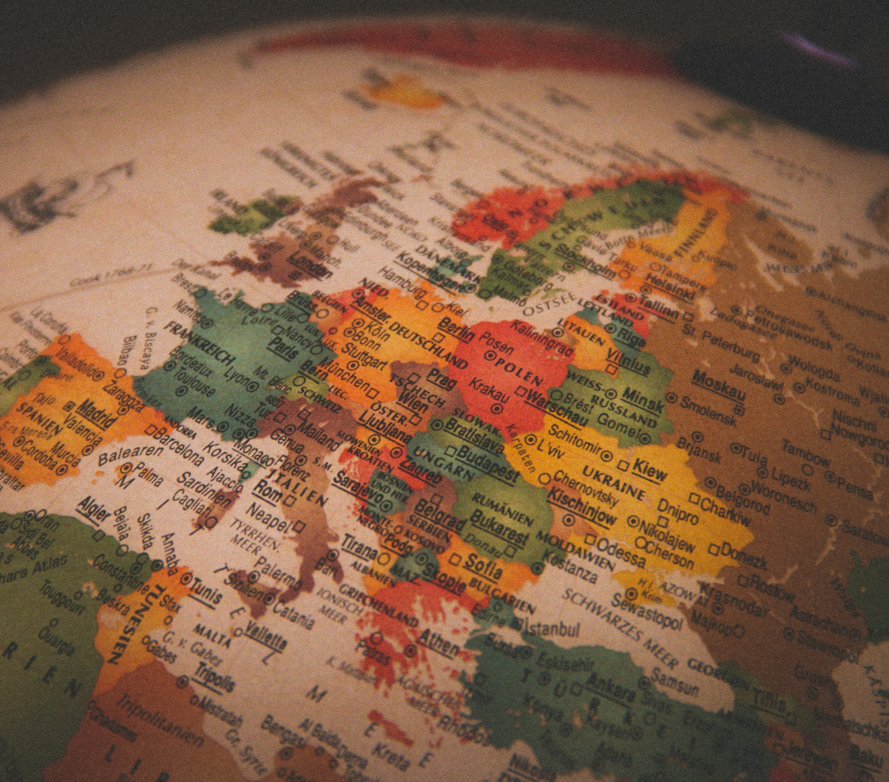
Case Study
Case Study 1 – Working Together in Europe
Case Study 2 – One Decision, Many Countries

Slide 15
Sources of Information
European Commission. (2020). The EU & me: A guide for young learners. Publications Office of the European Union.
European Parliament. (2019). Build your Europe! Educational toolkit.
Council of Europe. (2018). Reference framework of competences for democratic culture: Volume 1 – Context, concepts and model. Council of Europe Publishing. https://www.coe.int
Council of Europe. (2016). Competences for democratic culture: Living together as equals in culturally diverse democratic societies. Council of Europe.

