Slide 1
Me and My Community
Rights, Responsibilities, and Caring for Shared Spaces

Slide 2
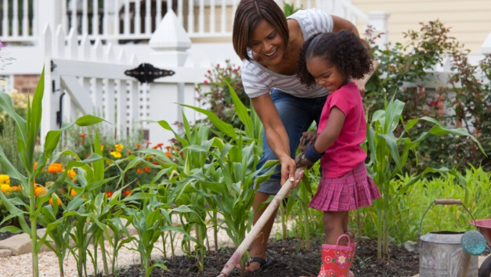
We Live Together
What Is a Community?
A community is a group of people who live and work together.
Our school is a community.
Our town is a community.
💡 We are all part of it!
Notes:
NOTE: To change images on this slide, select a picture and delete it. Then click the Insert Picture icon in the placeholder to insert your own image.

Slide 3
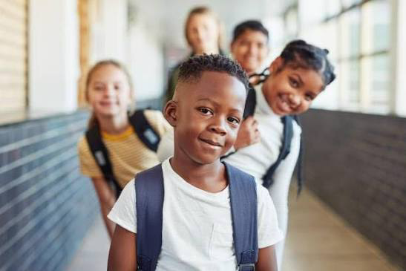
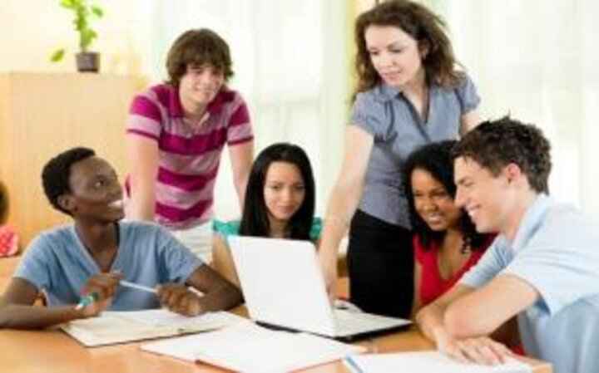
We Belong
What Does “Belonging” Mean?
Caption
We are members of our school and class.
We are important.
Our actions affect others.
❤️ Belonging means caring.
Notes:
NOTE: To change images on this slide, select a picture and delete it. Then click the Insert Picture icon in the placeholder to insert your own image.

Slide 4
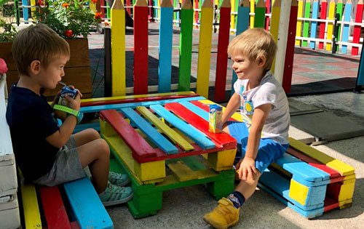
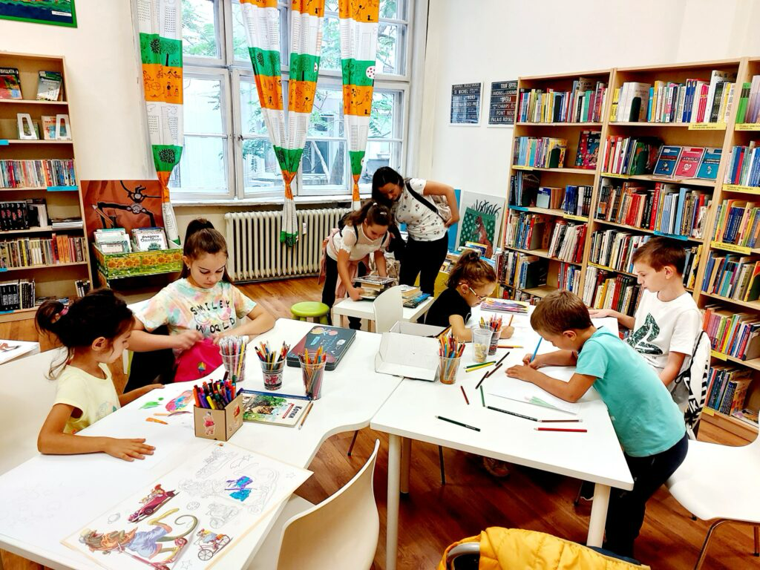
Public (Shared) Places
What Are Shared Places?
Shared places are for everyone.
Examples:
School
Park
Playground
Library
Street
Everyone can use them.

Slide 5
Why Should We Care?
Taking Care of Shared Places
If we damage them, everyone is sad.
If we keep them clean, everyone is happy.
We show respect when we care.
🌍 Shared places belong to all of us.

Slide 6
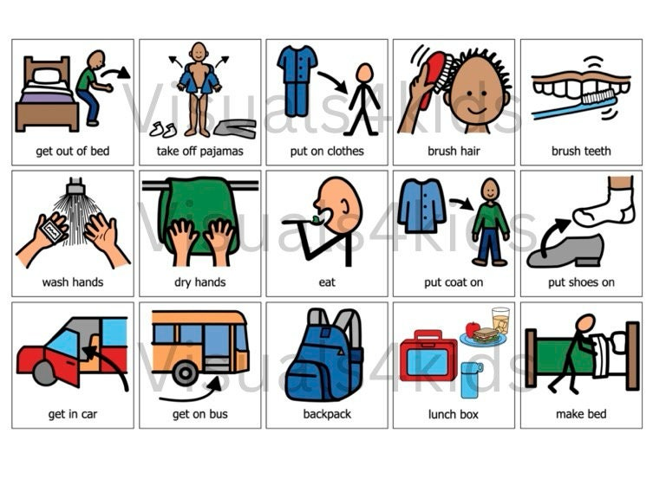
Private Property
What Is Private?
Some things belong to one person or one family.
For example: your backpack, your home.
We must respect other people’s things.

Slide 7
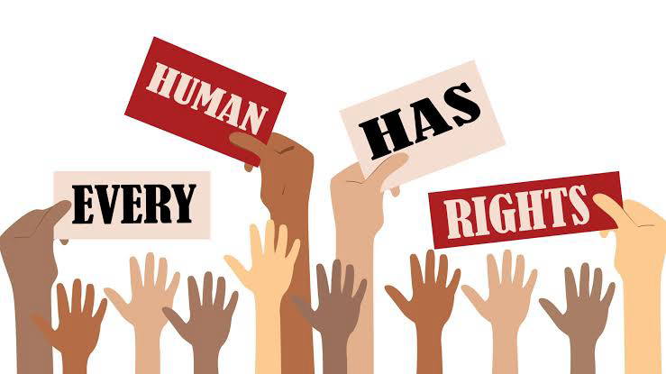
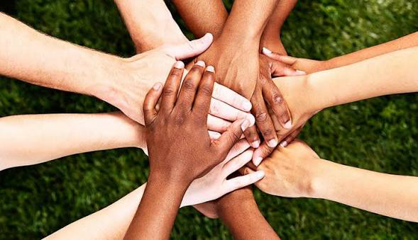
Rights
What Is a Right?
A right is something everyone should have.
Examples:
The right to learn
The right to play
The right to speak kindly
Rights help us feel safe and happy.

Slide 8
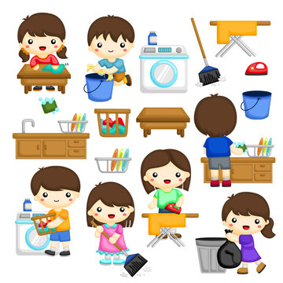
Responsibilities
What Is a Responsibility?
A responsibility is something we should do.
Examples:
Keep the classroom clean
Follow school rules
Be kind to others
Rights and responsibilities go together.

Slide 9
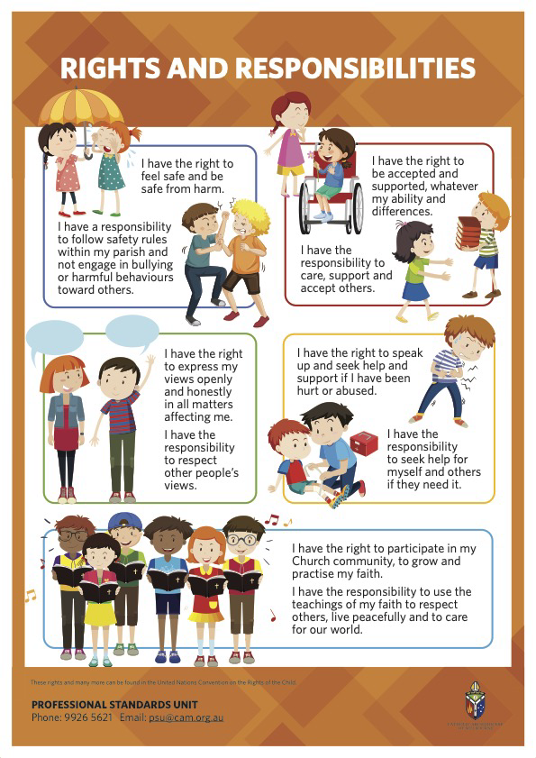
Rights + Responsibilities
If we have:
The right to learn → We take care of our school.
The right to play → We share and play safely.
The right to speak → We speak kindly.
⚖️ Fairness means thinking about others.

Slide 10
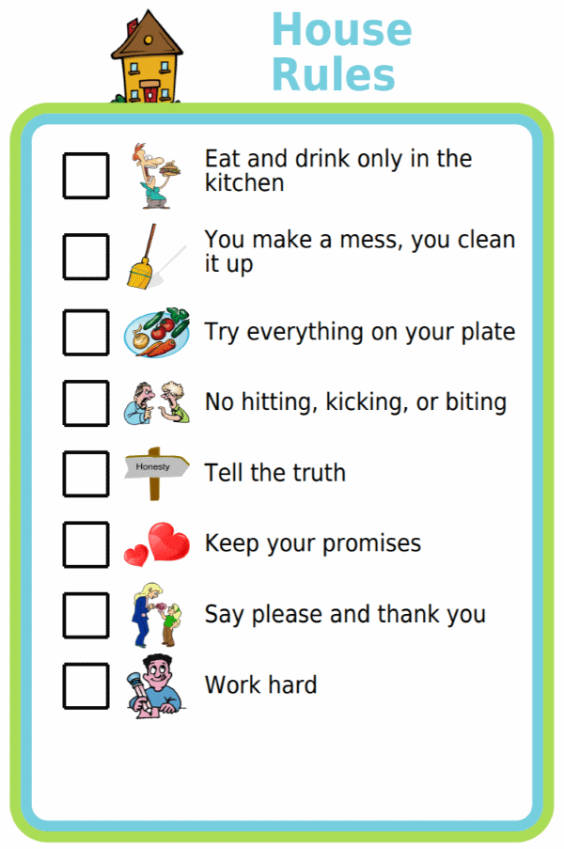
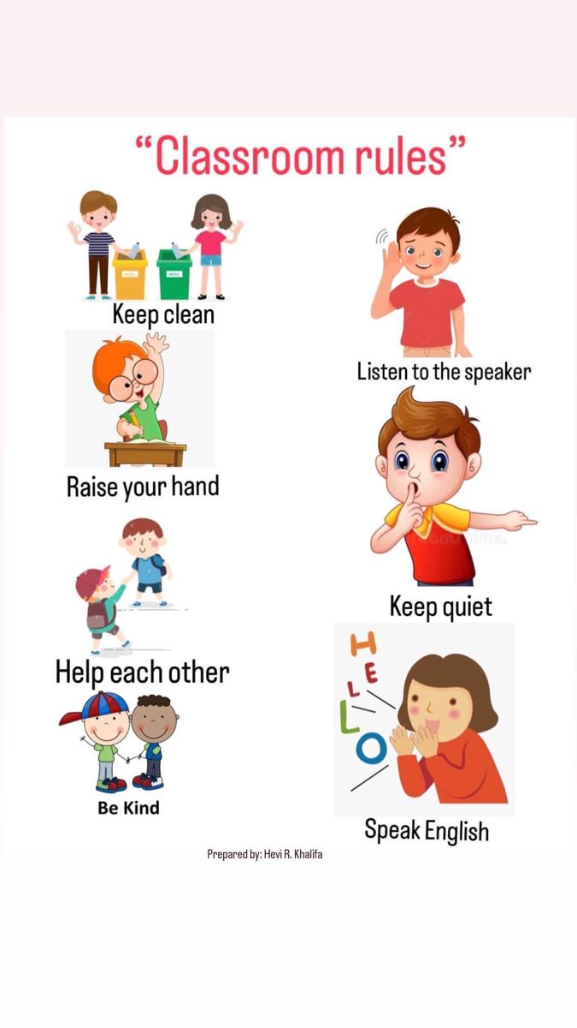
Why Do We Need Rules?
Rules Help Us
Rules keep us safe.
Rules help us be fair.
Rules are for everyone.
Without rules, things can become unfair.

Slide 11
Let’s Think!
Situation 1
Children leave trash in the hallway.
Questions:
Is this fair?
Who should clean it?
What would happen if everyone did this?

Slide 12
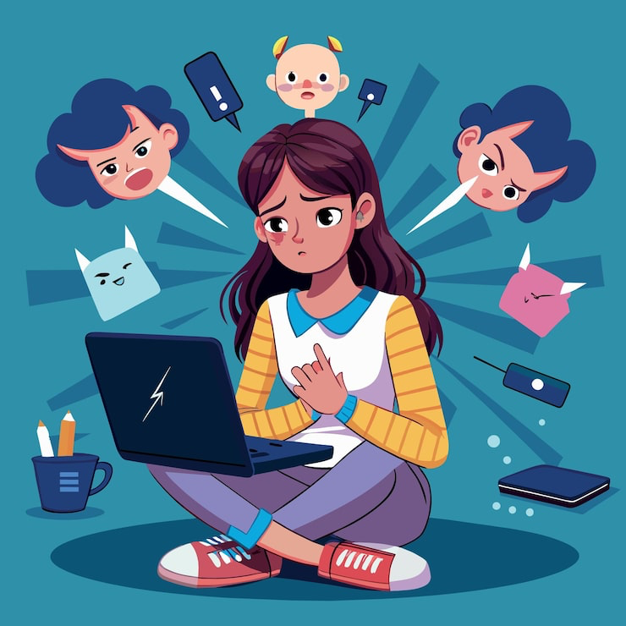
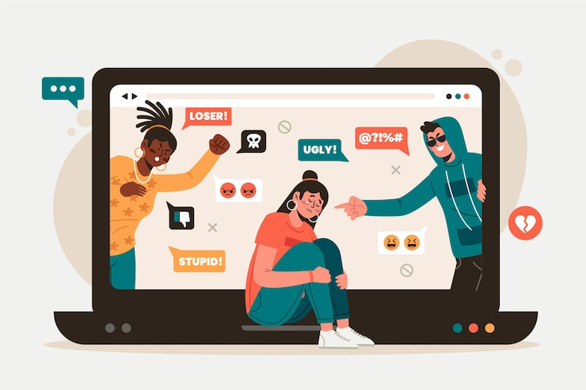
Online Behavior
Being Kind Online
Even online, we must:
Speak kindly
Respect others
Think before we post
Words can hurt.

Slide 13
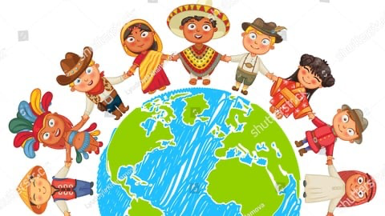
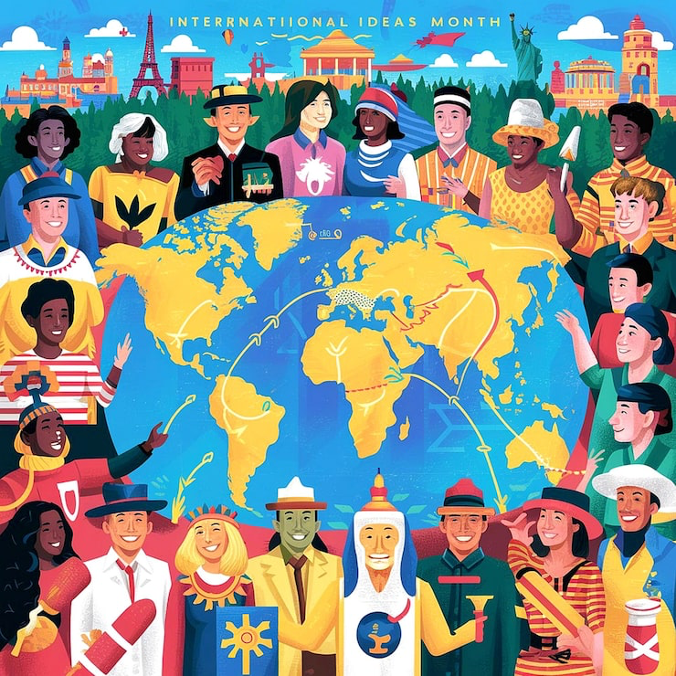
We Are All Different
Different Cultures – Same Values
People may have:
Different languages
Different traditions
But we all share:
Respect
Kindness
Responsibility

Slide 14

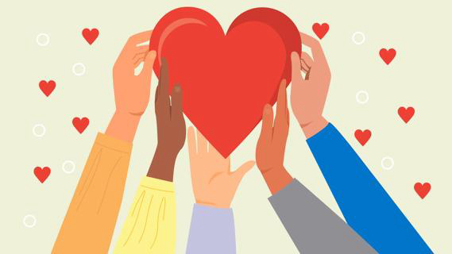
What Did We Learn?
Today we learned:
What shared places are
The difference between public and private
What rights are
What responsibilities are
How to be good members of our community

