Slide 1
Me and society – society and community

Slide 2
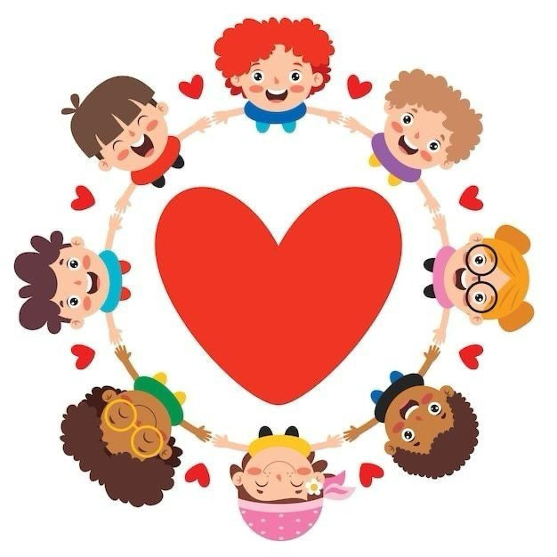
Lesson goals
The main goal of this lesson is to help students understand what society and community are.
Students will learn about responsibility, cooperation, and participation.
They will also develop respect for diversity and understand themselves as active members of society.

Slide 3
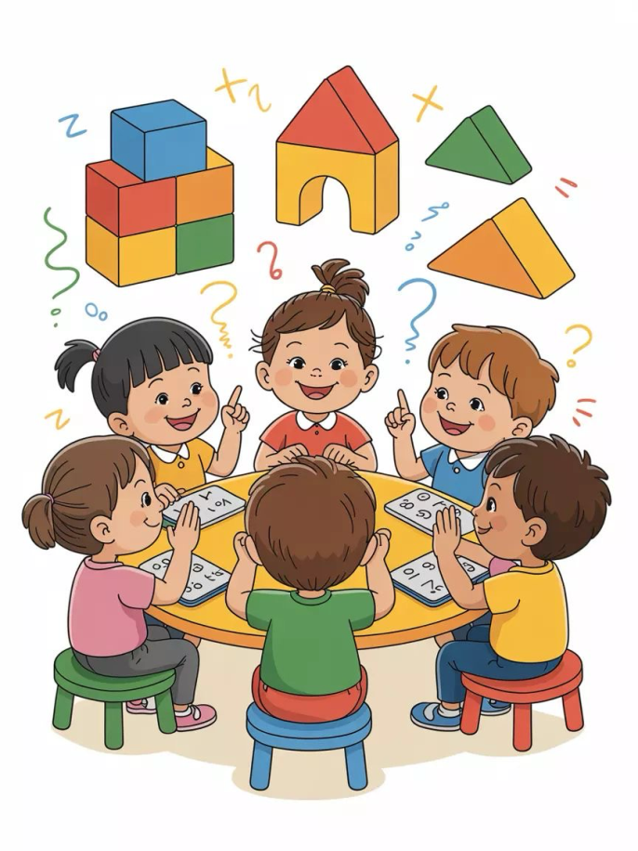
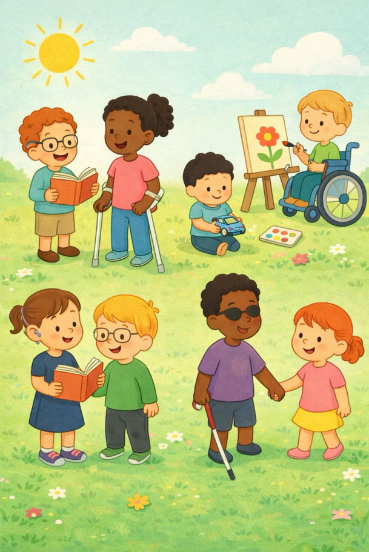
Key concepts
In this lesson, students become familiar with important civic concepts such as society, community, citizen, participation, responsibility, rights and duties, diversity, and inclusion.
Understanding these concepts helps students develop civic awareness and social understanding.

Slide 4
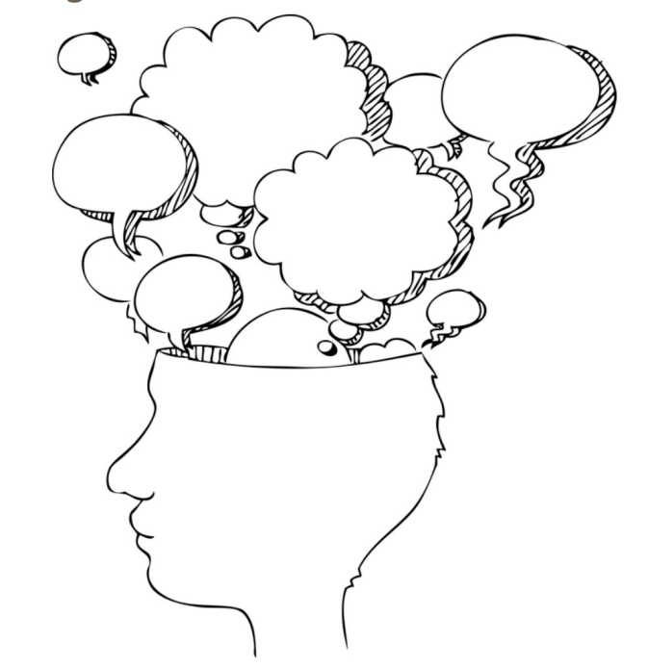
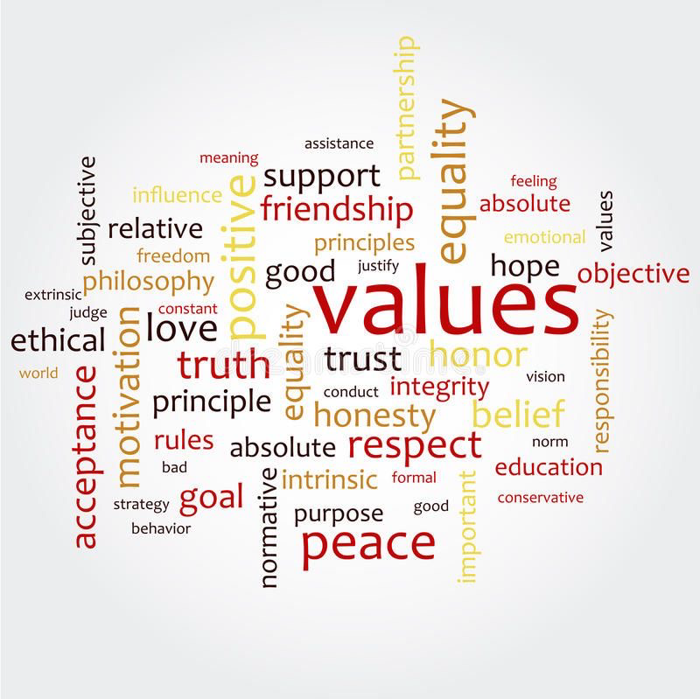
A society is a large group of people who live together and organize their lives through shared rules, values, and institutions.
Society includes many smaller communities.
It functions well when people understand that they are connected and that their actions affect others.
What is society?

Slide 5
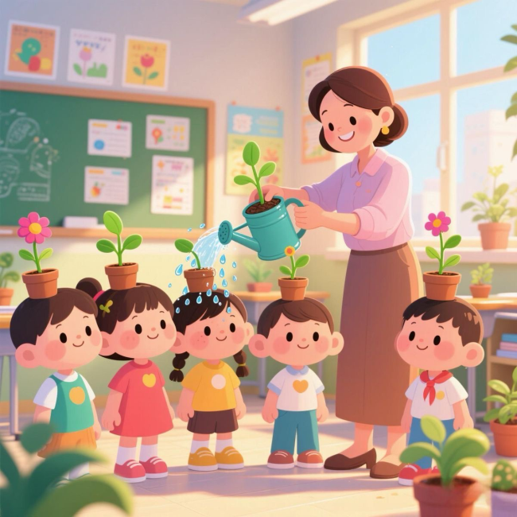
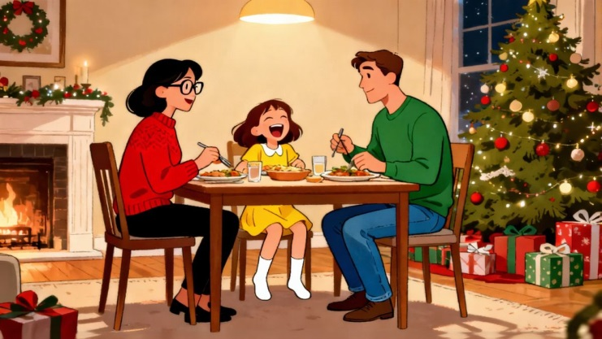
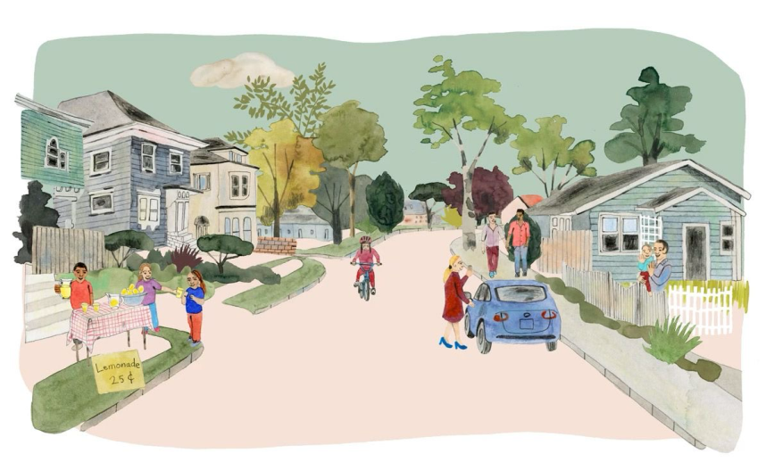
What is community?
A community is a smaller social group where people interact directly.
Examples include the family, the school, or the neighborhood.
Communities depend on cooperation, communication, and shared responsibility

Slide 6
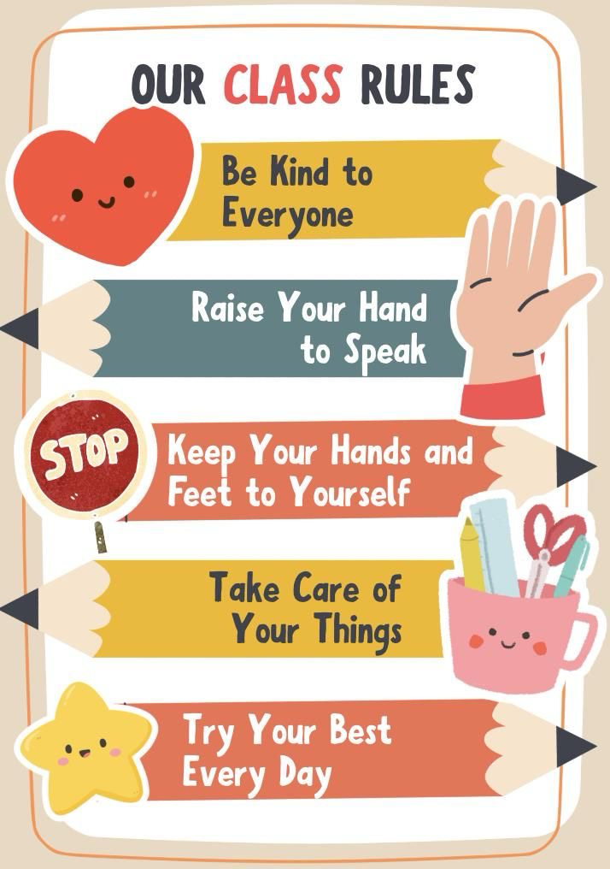
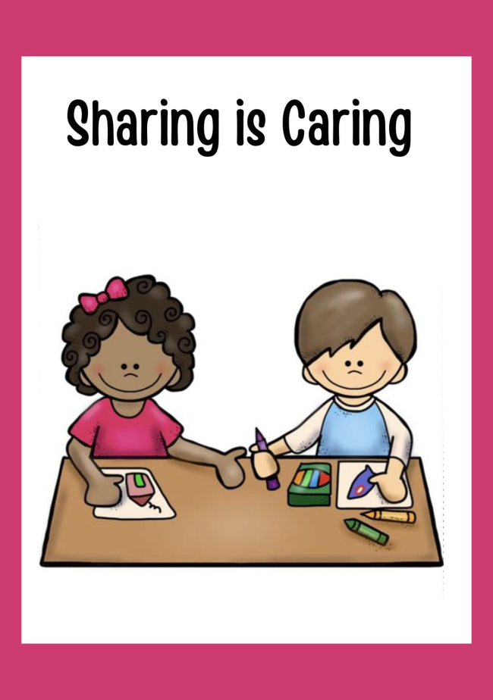
Rules and responsibility
Every society has rules.
Rules protect people’s rights and ensure fairness.
Responsibility means following rules, respecting others, and contributing to the common good.
At this age, students begin to understand that responsibility is not only personal but also social.

Slide 7
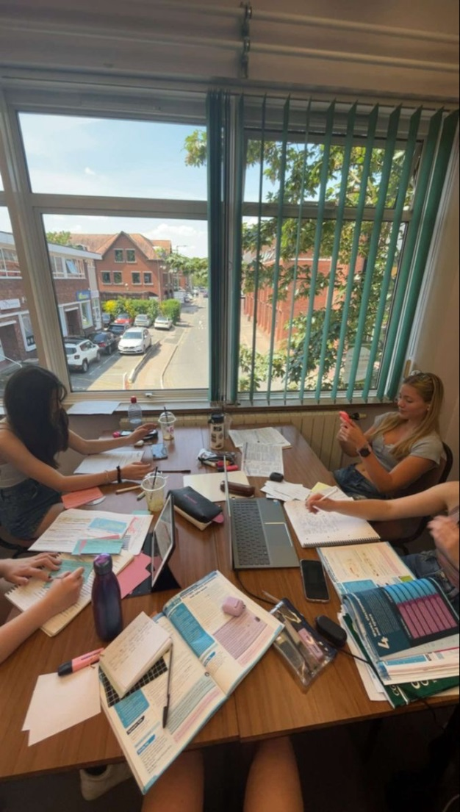
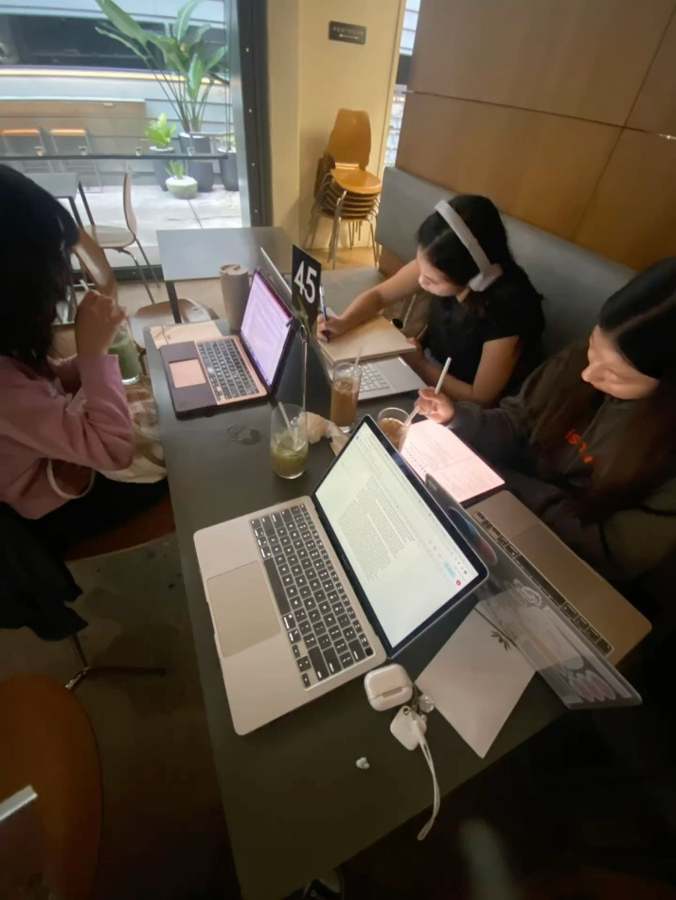
Cooperation and participation
Cooperation means working together to achieve common goals.
Participation means being actively involved in community life.
Even children can participate by expressing their ideas respectfully, helping others, and working in groups.

Slide 8
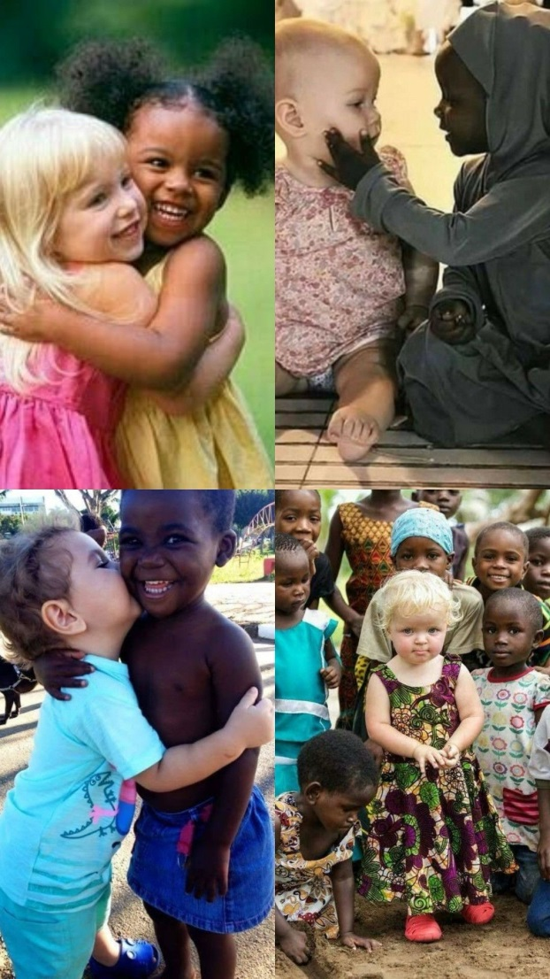
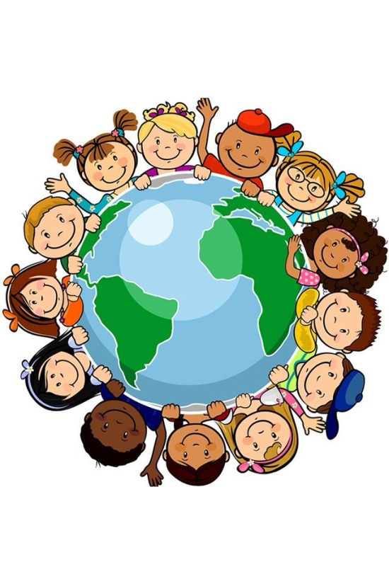
Diversity and inclusion
Modern societies are diverse.
People may differ in language, culture, traditions, or family background.
Diversity is natural.
Inclusion means making sure everyone feels respected and valued.
Understanding diversity helps prevent discrimination and conflict.

Slide 9
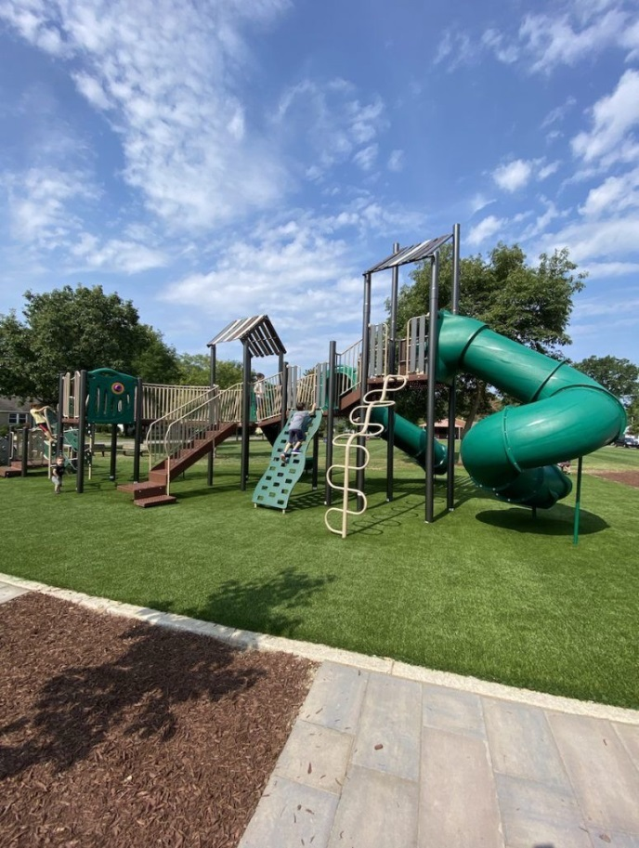
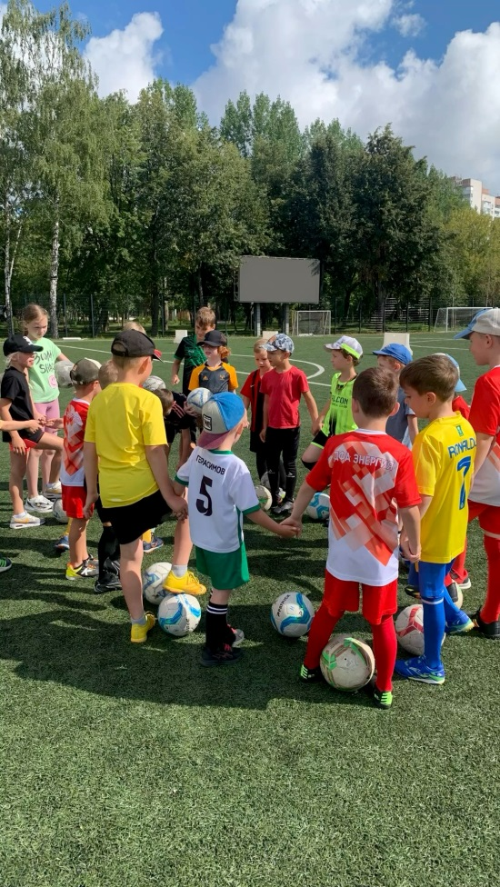
In this activity, students discuss a situation about a shared playground.
The problem appears when different groups use the same space and conflicts arise.
Students reflect on responsibility, cooperation, and possible solutions.
The key message is that shared spaces belong to everyone and require mutual respect.”
Case Study: The Shared Playground

Slide 10
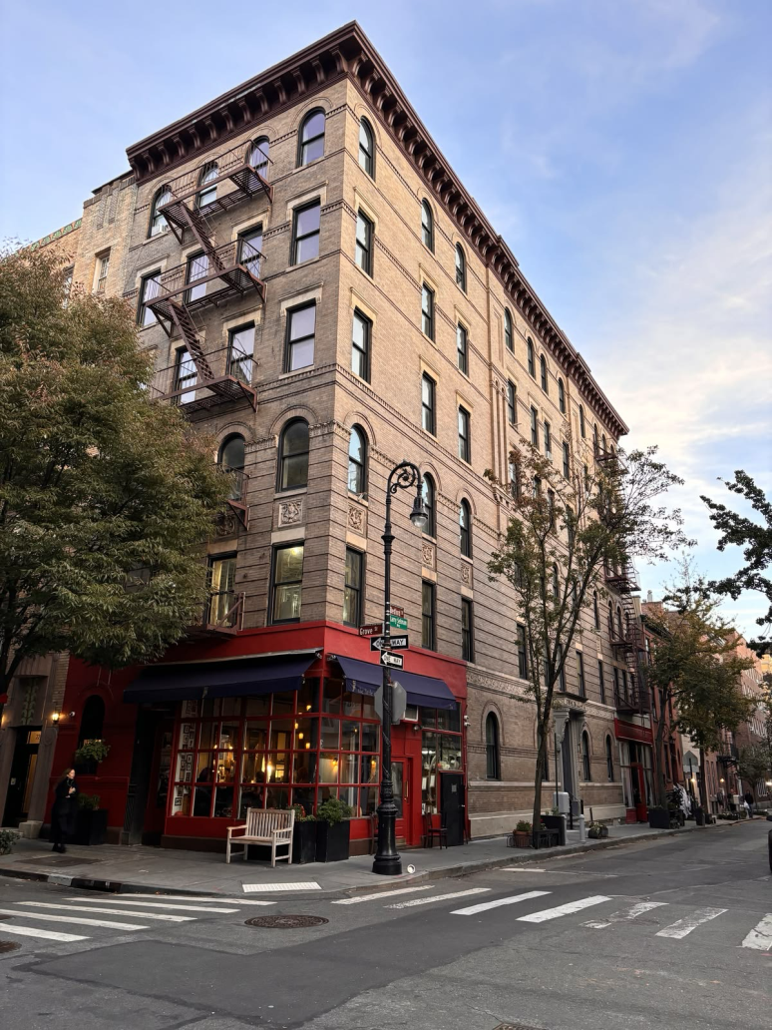
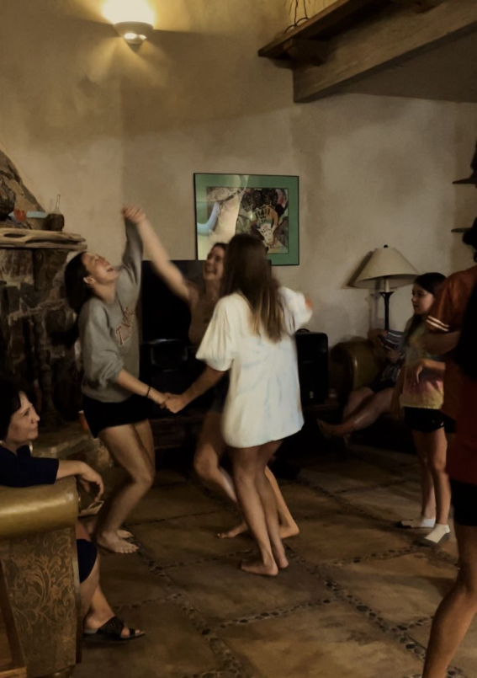
Case Study: Noise in the Building
This scenario focuses on noise problems in an apartment building.
Students explore how individual actions affect others.
They learn that communication and dialogue are essential for peaceful coexistence.”

Slide 11
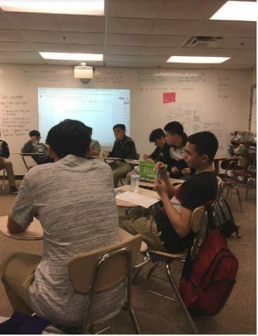
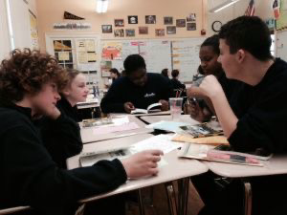
Reflection and Discussion
At the end of the lesson, students reflect on what they learned.
They complete sentences such as:
‘A community works well when…’
‘I am responsible for…’
‘Respect in society means…’
This encourages personal engagement and deeper understanding.

Slide 12
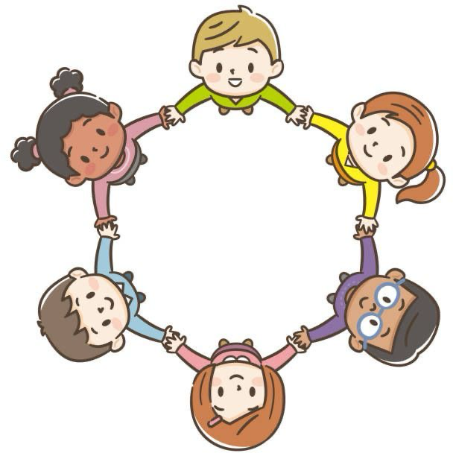
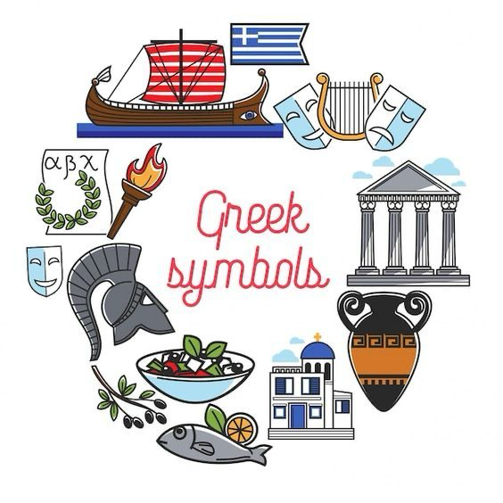
In conclusion, this lesson helps students understand that society functions well when people cooperate, participate actively, and respect diversity.
It encourages them to become responsible and active citizens.”
Conclusion

Slide 13
Thank you for your attention!

