Slide 1
Me and Society – Conflict and Reconciliation
5th Grade

Slide 2

Lesson Objectives
• To understand what conflict is
• To recognize emotions during conflict
• To learn steps for peaceful resolution
• To understand what reconciliation means
• To learn respect and cooperation

Slide 3

Key Concepts
Conflict
Dialogue
Respect
Responsibility
Reconciliation
Forgiveness
Cooperation
Justice

Slide 4

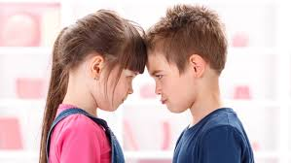
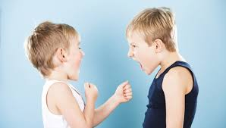
What is Conflict?
Conflict is a situation in which:
• People have different opinions
• They have different needs
• They experience different feelings
Conflict is a natural part of human relationships.

Slide 5
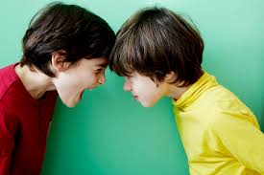

Where Do Conflicts Happen?
• In the family
• At school
• Between friends
• In society
Conflict is not something bad if it is resolved properly.

Slide 6
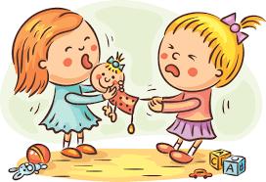
Why Do Conflicts Arise?
• Misunderstanding
• Lack of communication
• Strong emotions
• Unfair behavior
• Different interests

Slide 7
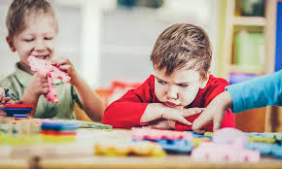
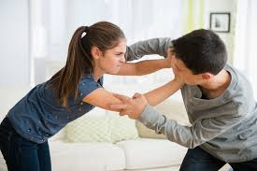
Emotions During Conflict
During a conflict we may feel:
• Anger
• Sadness
• Disappointment
• Fear
• Jealousy
It is important to recognize our emotions so we do not act impulsively.

Slide 8
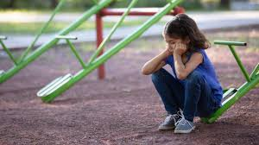
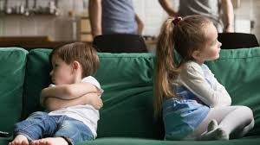
How Can We Become Aware of Our Emotions?
What can we do?
• Stop
• Take a deep breath
• Name our feeling
• Choose a calm conversation

Slide 9
Responsibility and Consequences
Responsibility means:
• Thinking before we act
• Understanding the consequences
• Taking responsibility when we make a mistake
Words can hurt, but they can also heal.
Our actions have consequences.
Everyone is responsible for their words and behavior.

Slide 10
Dialogue – The Key to the Solution
Dialogue means:
• Speaking calmly
• Listening carefully
• Not interrupting
• Asking questions
We listen to understand – not to reply.

Slide 11
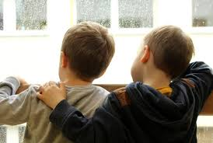
Peaceful Conflict Resolution
• Look for compromise
• Respect differences
• Choose cooperation
• Seek a fair solution

Slide 12
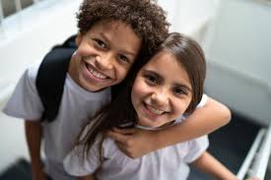
Reconciliation
Reconciliation means:
• Admitting our mistake
• Apologizing sincerely
• Accepting an apology
• Forgiving and moving forward

Slide 13
Intercultural Understanding
Different cultures:
• Express emotions in different ways
• Have different traditions
But they share common values:
• Respect
• Justice
• Peace
• Cooperation
In different cultures people may express emotions differently, but we all value respect and peace.

Slide 14
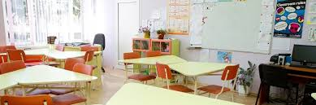
Safe Classroom Environment
In our classroom:
• Everyone has the right to an opinion
• No one is better than others
• We respect differences
• We learn from our mistakes

Slide 15
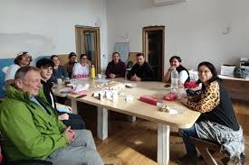
Case Study for Discussion
Two classmates argue over a game.
Discuss:
• What caused the conflict?
• How do they feel?
• How can they solve the problem peacefully?

Slide 16
Steps Toward Reconciliation
• Stop and calm down
• Speak calmly
• Listen to the other person
• Look for a fair solution
• Apologize if necessary

Slide 17
Conclusion
Peaceful conflict resolution:
• Makes us more mature people
• Strengthens friendships
• Makes society stronger
• Creates more justice
Conflict can teach us something important.
Think:
• How do I react in a conflict?
• Can I be calmer?
• How could I help create peace in the class?

