Slide 1

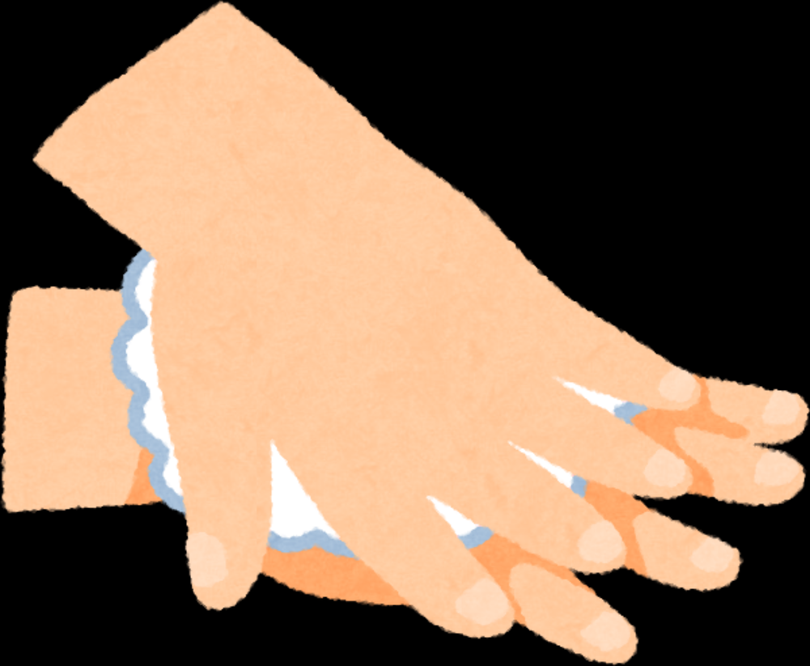

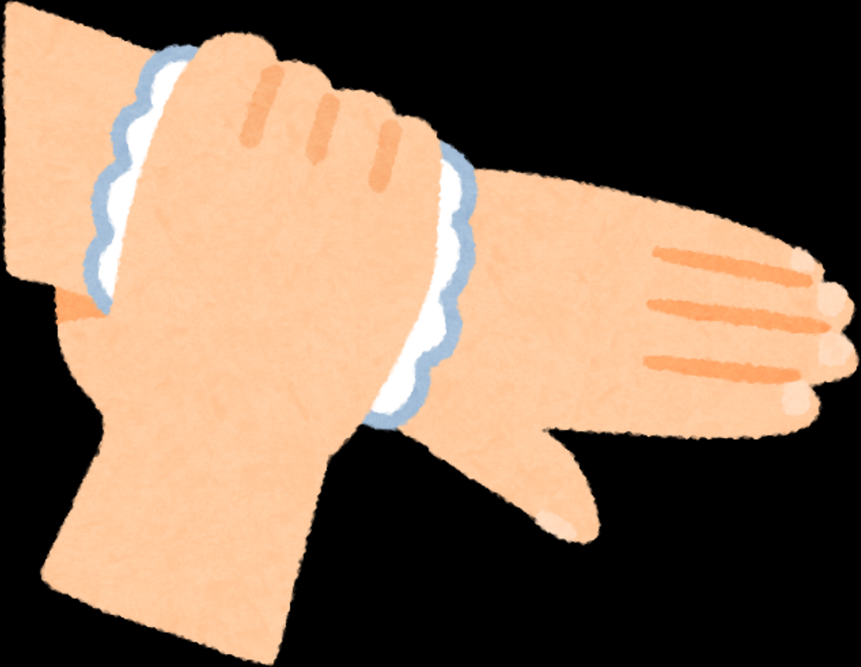
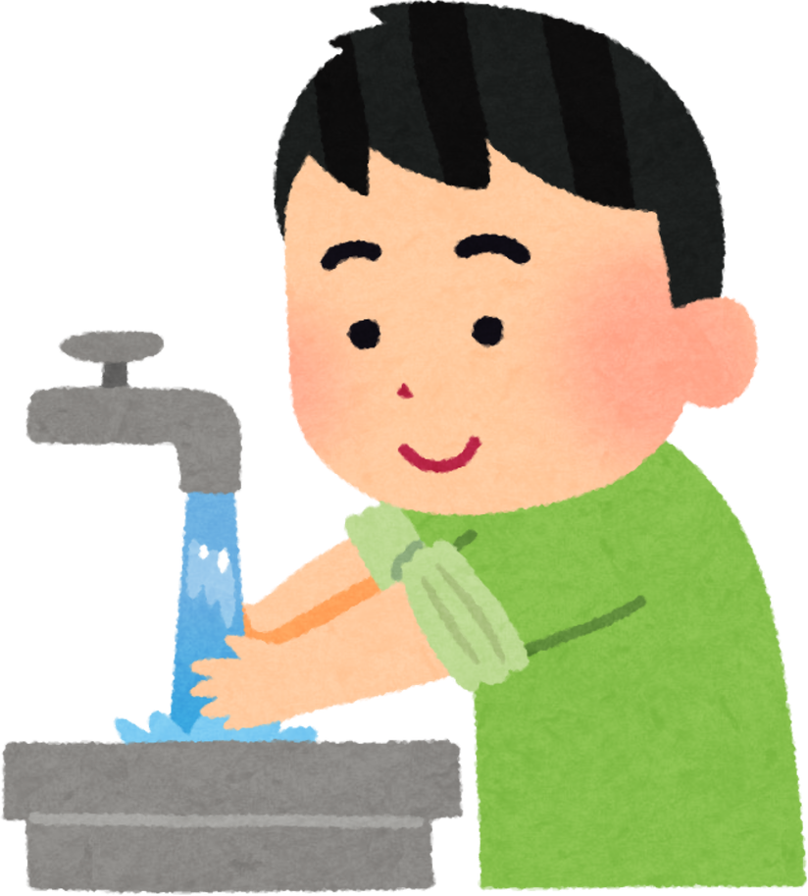
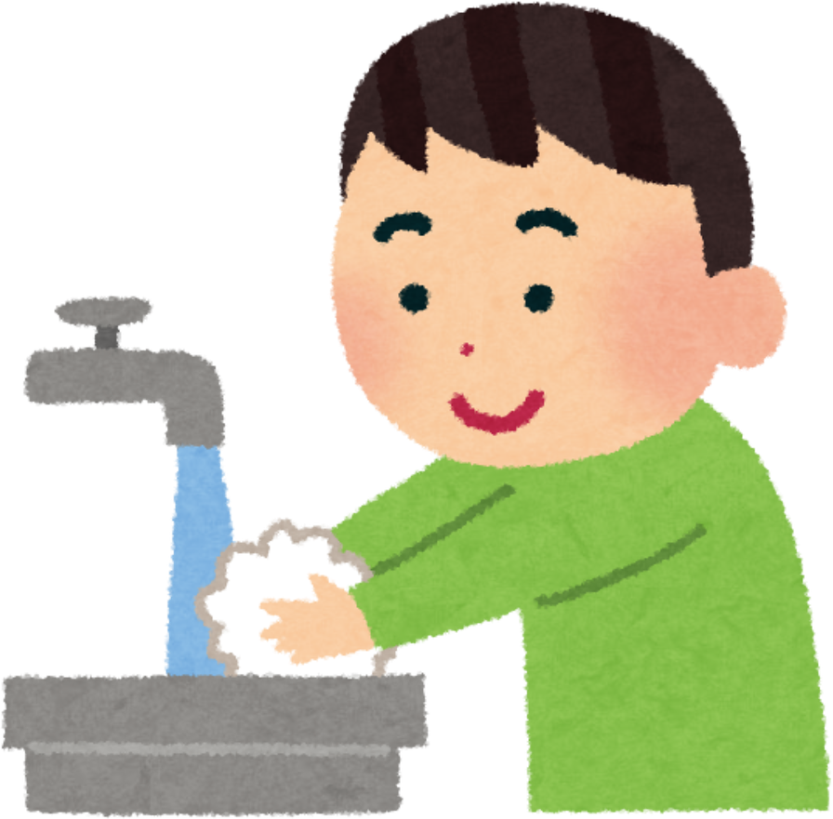
Caring for My Body and My Health
Clean Hands, Healthy Heart
for 4th grade

Slide 2

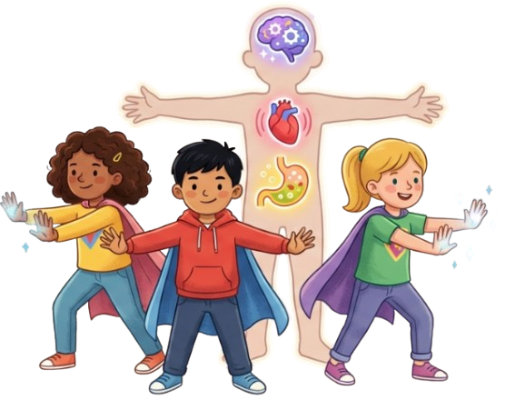
Welcome to a journey inside YOU! Today we will discover the incredible team that works inside your body, meet invisible enemies, and learn how to maintain your strength

Slide 3
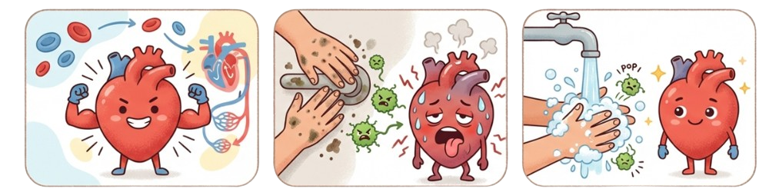
A Tale of the Busy Heart
There was one heart that worked day and night to send blood throughout the body
One day invisible germs crept in through dirty hands. The body got sick, and the poor heart had to work twice as hard!
But then... Dance! The child washed his hands. The germs disappeared and the heart smiled again.
Your habits help your heart rest!

Slide 4
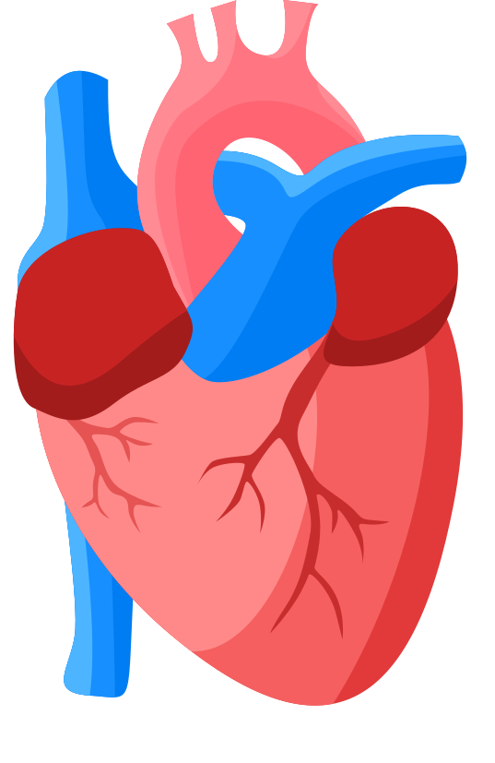
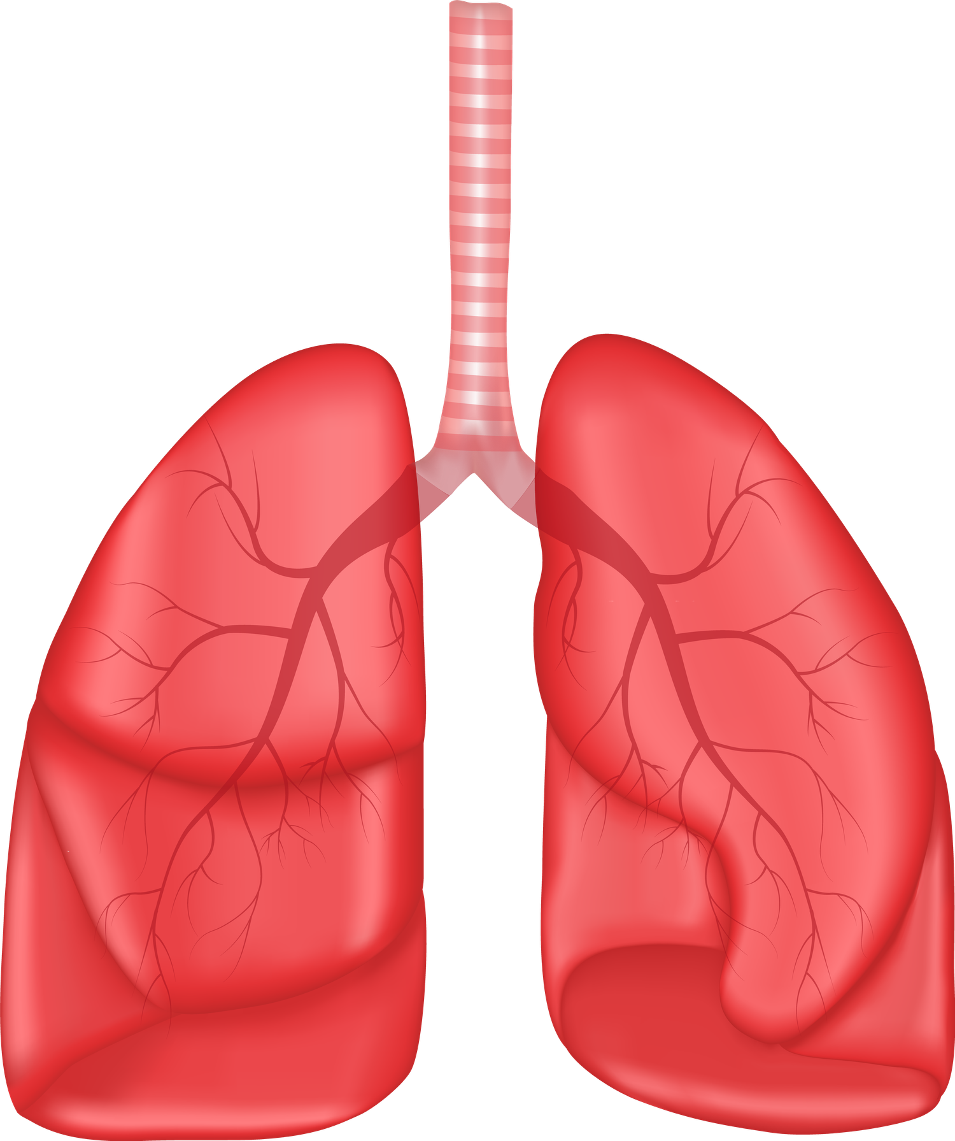
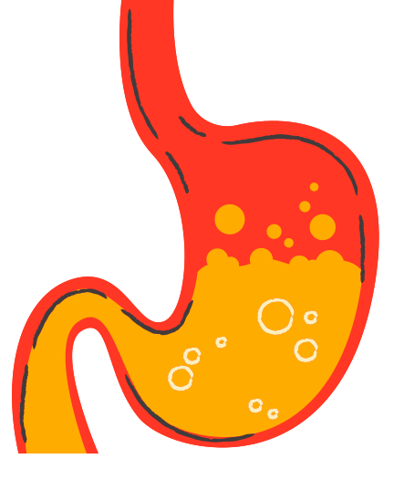
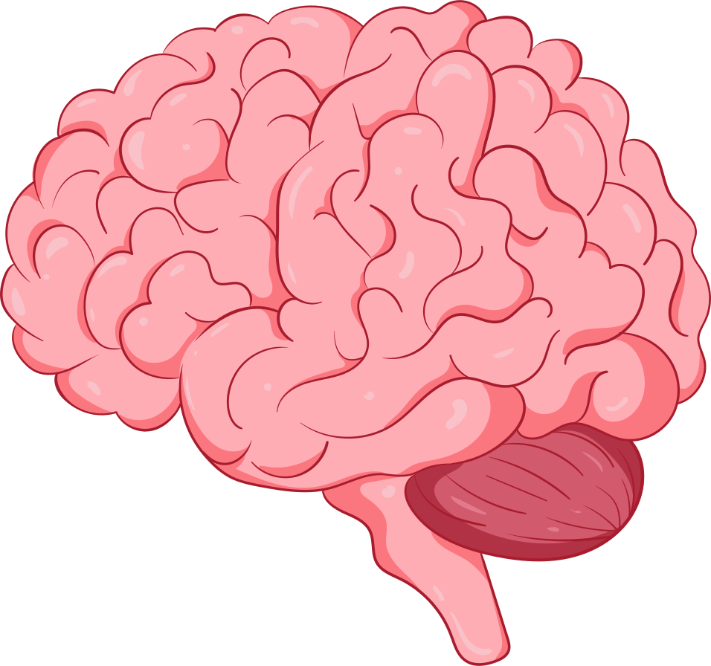
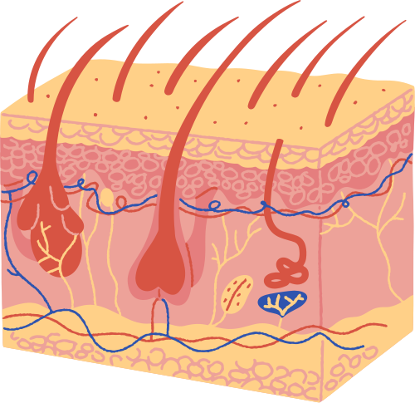
Meet the Body Super Team
The heart
Lungs
The stomach
The brain
The skin
Your body is like a bustling city, and these are the main workers

Slide 5
The Engine: Your Heart
What does it do?
The heart is a strong muscle that acts like a pump. It pushes blood, carrying oxygen and nutrients, to every corner of your body.
How to help him?
When you are sick, your heart beats faster and works harder to fight the illness. Cleanliness helps the heart stay calm and strong.

Slide 6
The Respiratory System: Your Lungs
What do they do?
The lungs breathe in fresh oxygen for energy and exhale the air we don't need. They give you the strength to run and play.
How to help them?
Germs like to travel through the air. Cover your mouth when you cough or sneeze to protect your lungs and your friends.

Slide 7
The Energy Factory: Your Stomach
What does he do?
The stomach breaks down food, turning the sandwich into the energy you need to grow and learn.
How to help him?
Imagine pouring mud into the gas tank of a car! If you eat with dirty hands, germs enter your stomach and cause pain. Wash before eating so that the fuel is clean

Slide 8
The Captain: Your brain
What does he do?
The brain controls everything - your thoughts, movements, and feelings. It helps you make good decisions.
How to help him?
When the body is fighting germs, it's hard for the Captain to focus. Being healthy means learning easier and playing better.

Slide 9
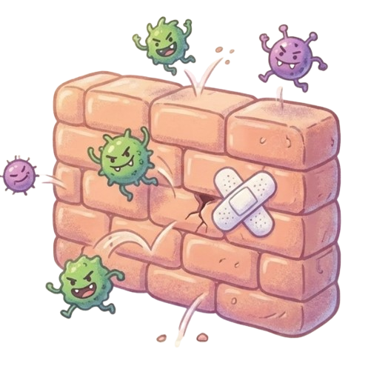
The Shield: Your Skin
What is she doing?
The skin is the first line of defense.
It's a waterproof suit that keeps the good stuff in and the bad stuff (like germs) out.
How to help her?
Scratches or dirt can make holes in the shield.
Keeping the skin clean repairs the armor and keeps invaders away.

Slide 10
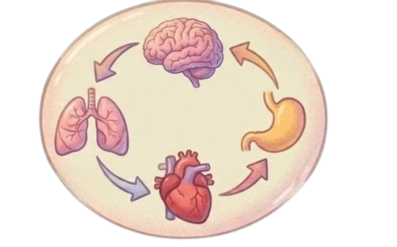
How it's all connected
No body works alone
Breathing helps the blood carry oxygen.
Blood carries energy from the stomach to the brain.
The skin protects everything inside so the heart can work.
Because of a small germ on the hand, the whole body can feel weak.

Slide 11

What are microbes?
Microbes are tiny living things so small that you can't see them without a microscope. They're not bad on purpose, but when they enter the body, they multiply and cause illness (like a cold, the flu, or a stomachache).
Where are they hiding:
On doorknobs, pencils and... your hands!

Slide 12
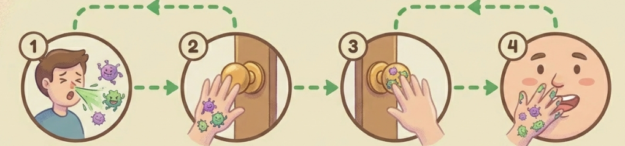
Microbes don't have legs, but they travel by:
Touch: Dirty hands touch the eyes, nose, or mouth.
Air: Sneezing or coughing without covering.
Sharing: Using common dirty objects or food.
Warning: Your hands are the "bus" that germs use to enter your body.

Slide 13
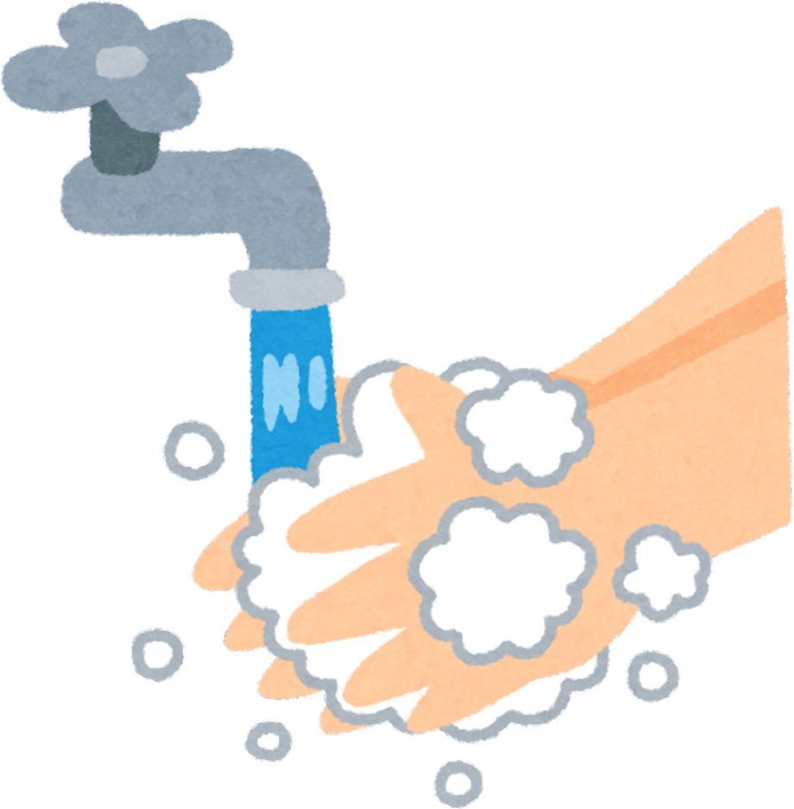
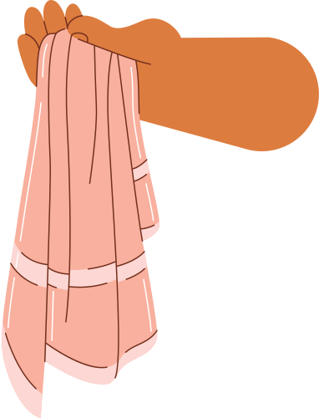
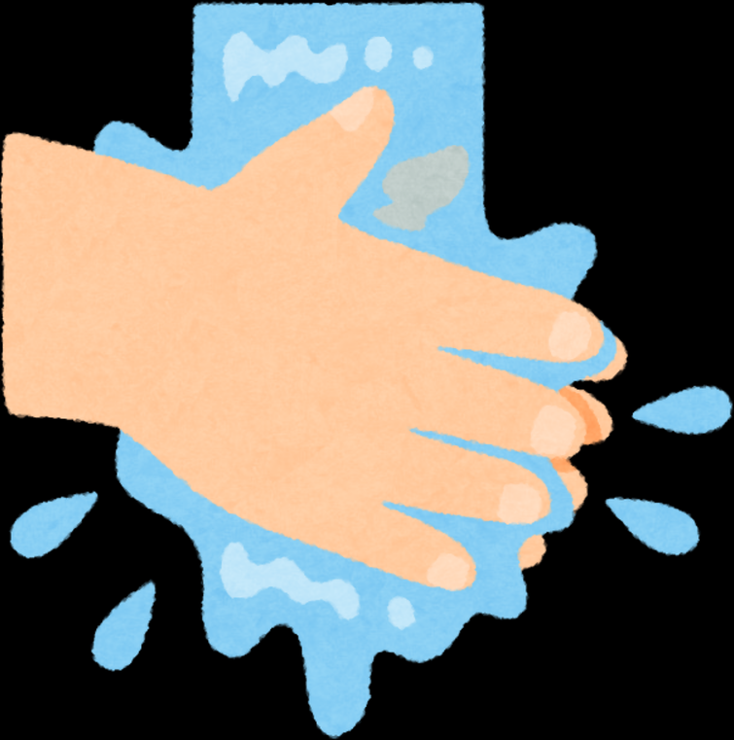
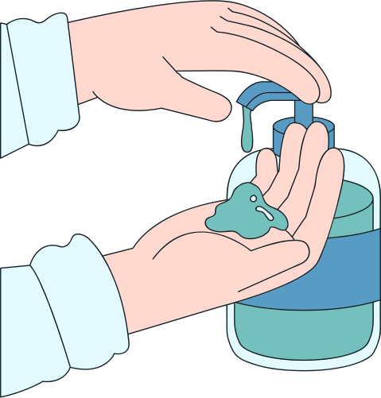
The best protection - hygiene

Slide 14
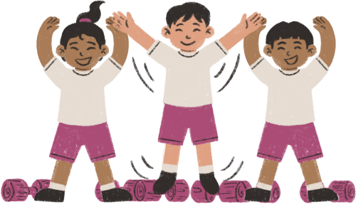
Now, a quick exercise.
You need to stand up and repeat the steps shown in the video. This will give you a little distraction and help you remember all the steps for proper hand washing.

Slide 15


Slide 16
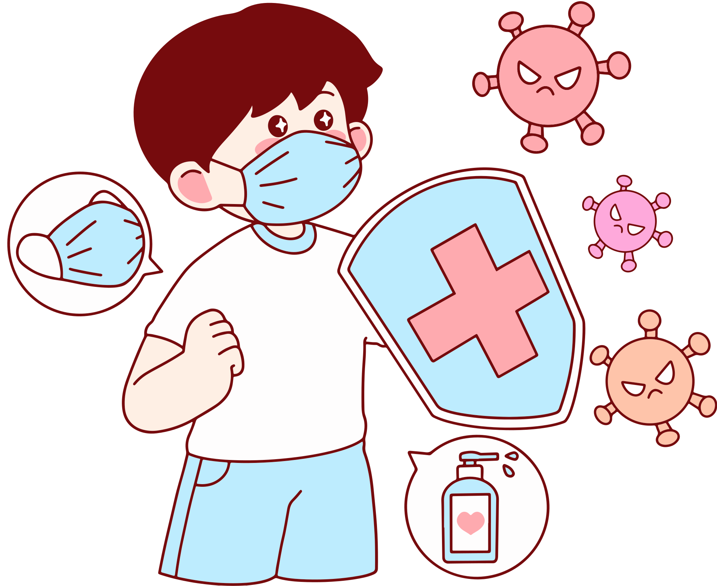
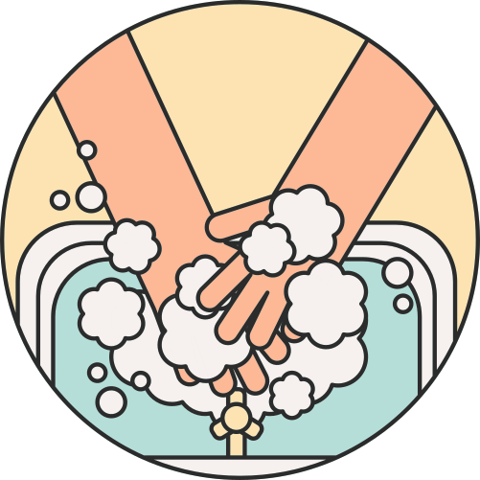

Caring for life is a responsibility
Health is a precious gift. When you are clean, you don't just protect yourself - you protect your classmates, your family, and your community.
Your promise: "My body is healthy when I take care of it. One habit I will follow every day is washing my hands to help my busy heart."

Slide 17

And now... a game where we'll test your listening skills and what you remembered. It'll be fun!

Slide 18

for your attention! Take care and stay healthy.

