Slide 1
The Strength of the Heart – Choosing Virtue Over Vice
FAIRY TALES WITH A MORAL

Slide 2

Fairy Tale “The Two Seeds”
Story
Two seeds lay in the same soil.
The first seed said, “I want to grow strong and share shade and fruit.”
The second seed whispered, “I hope the other seed fails so I can be the only one.”
The first seed grew patiently, even during storms.
The second seed focused only on envy and never grew deep roots.
When the sun became hot, the strong plant offered shade to others.
The weak one dried out.

Slide 3
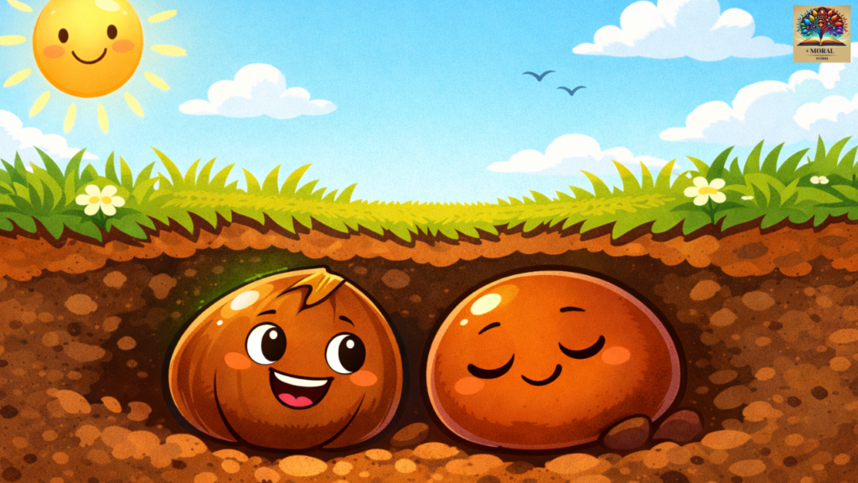
Discussion Questions
Which seed showed virtue?
What vice stopped the second seed from growing?
How do our intentions shape our future?
Can envy hurt the person who feels it?

Slide 4
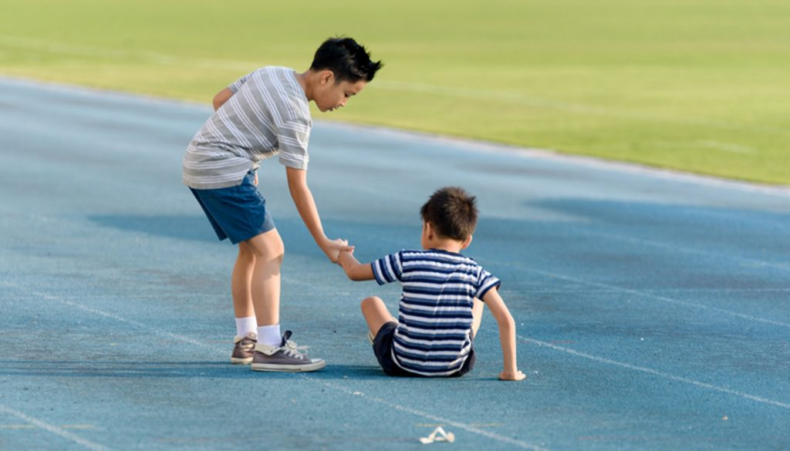
CORE CONCEPTS – THEORY
Compassion
Forgiveness
Envy vs. Generosity
Virtue and Vice

Slide 5
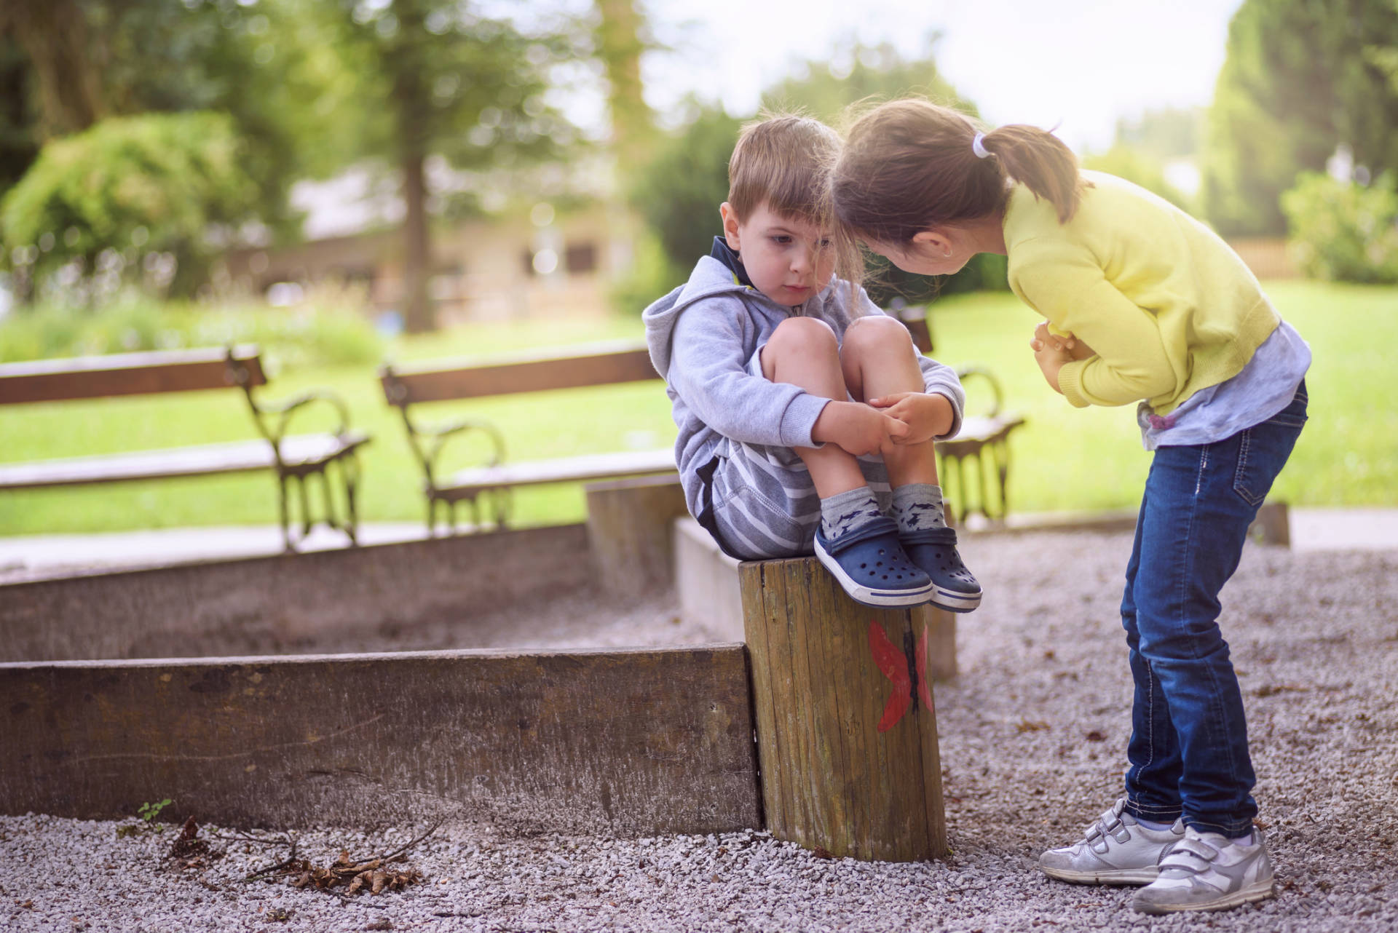
Compassion
Compassion means noticing another person’s pain and wanting to help.
It goes beyond feeling sorry, it leads to action.

Slide 6
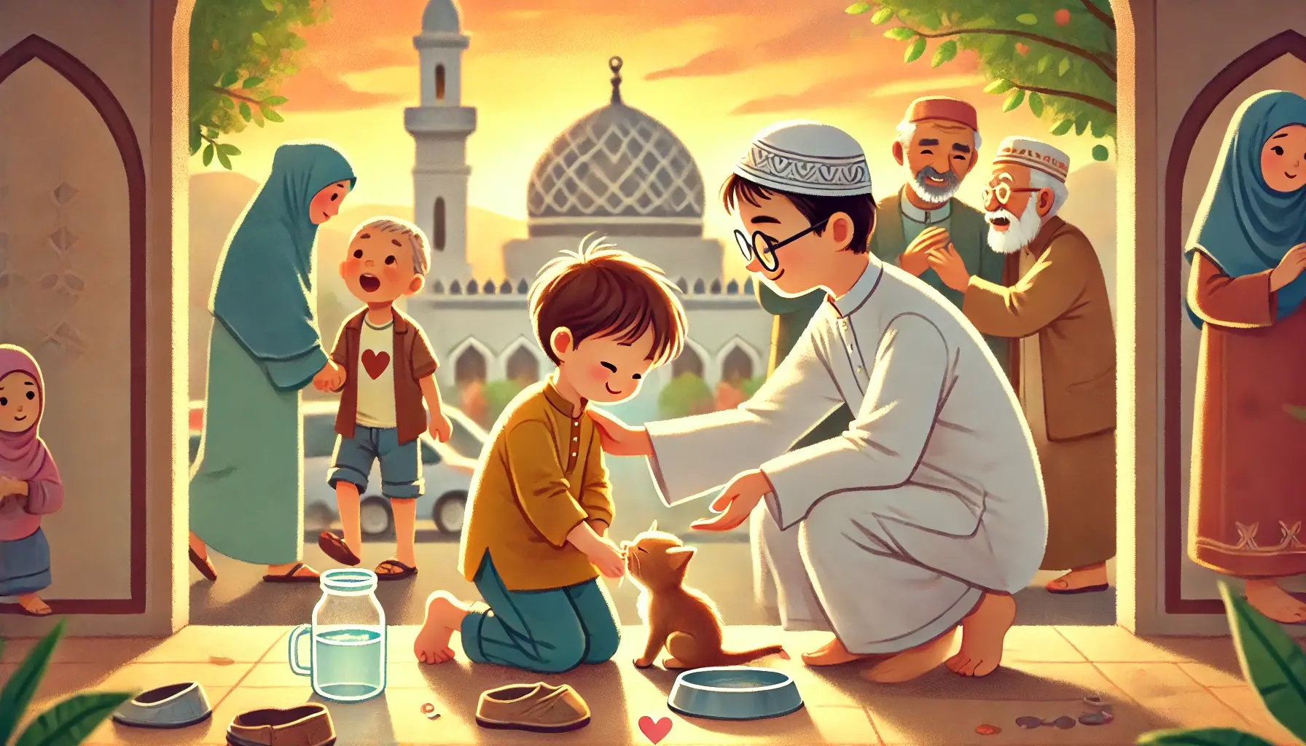
Islamic connection
Rahma (mercy) is a central value in Islam and a universal human virtue.

Slide 7

Forgiveness
Forgiveness means letting go of anger and choosing peace instead of revenge.
It does not mean forgetting harm, but choosing not to harm back.

Slide 8
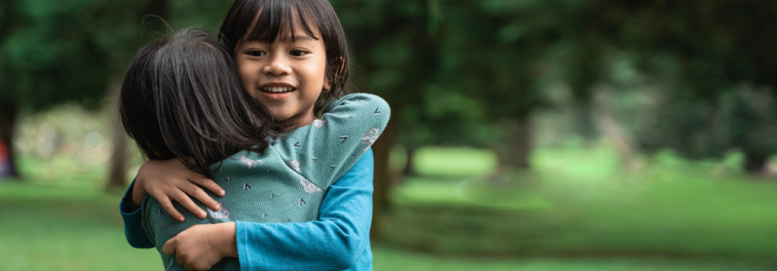
Islamic connection
Afw (forgiveness) is praised as a sign of strength and wisdom.

Slide 9

Envy vs. Generosity
Envy is feeling upset because someone else has something good.

Slide 10
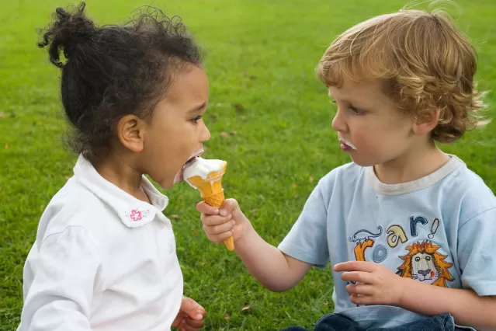
Envy vs. Generosity
Generosity is feeling happy for others and sharing what we can.

Slide 11
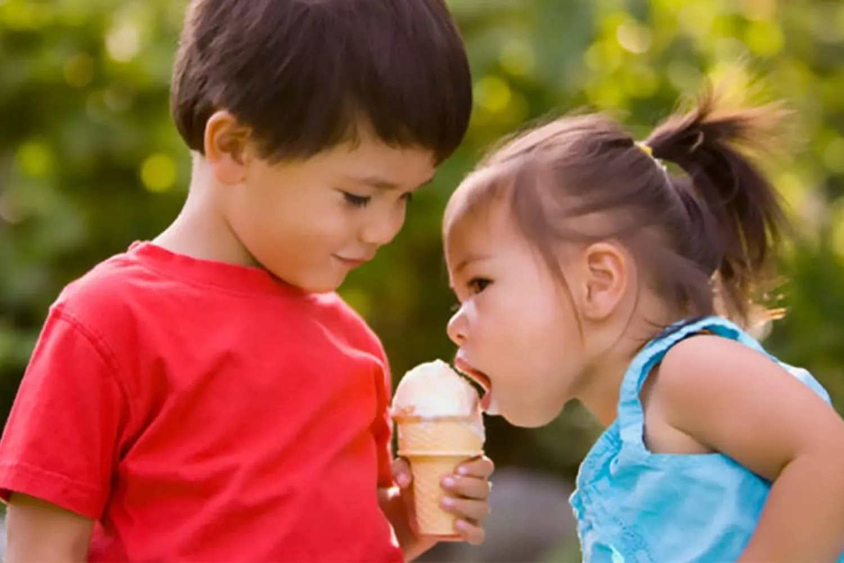
Islamic connection
Hasad (envy) harms the heart, while sadaqah (giving) purifies it.

Slide 12

Virtue and Vice
Virtue: habits that build good character (kindness, patience, honesty).
Virtue grows with practice.

Slide 13

Virtue and Vice
Vice: habits that harm the self and others (envy, cruelty, pride).
Vice grows when ignored.

Slide 14
Why These Values Matter
• They help solve conflicts peacefully
• They strengthen friendships and communities
• They support emotional well-being
• They prepare students to be responsible citizens in diverse societies

Slide 15

Thank you for your attention!
“The only way to have a friend is to be one.”
— Ralph Waldo Emerson

