Slide 1

Lesson plan : Fairy tales with a lesson "What Is Right? – Telling Good from Evil and Truth from Lies"

Slide 2
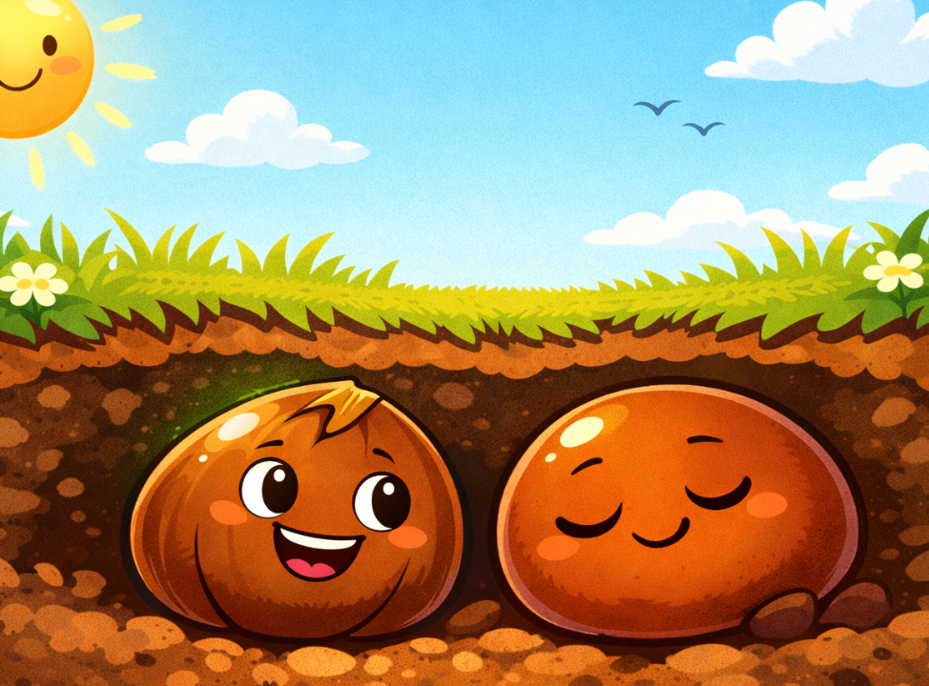
Introduction
The Parable of the Two Seeds
Two tiny seeds lay side by side in the ground.

Slide 3

The first seed said
“I want to grow! I’ll send my roots deep into the earth, stretch my leaves to the sun, and become a strong plant.”

Slide 4
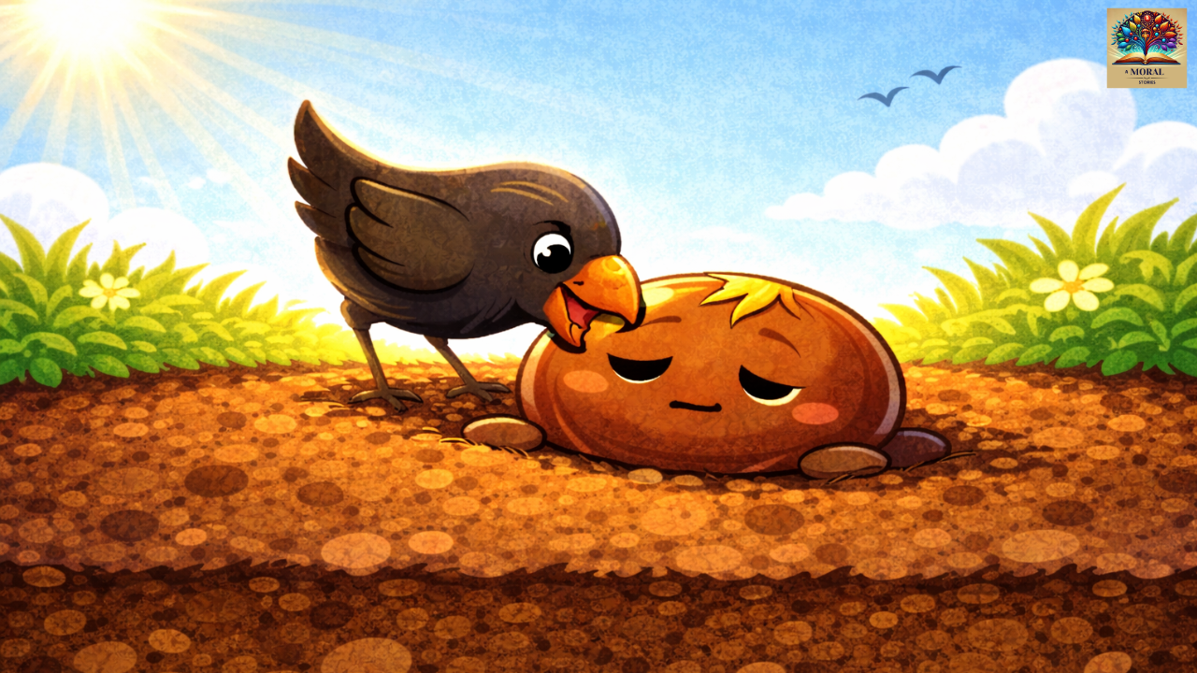
The second seed said
“But what if it’s cold? What if something eats me? What if I don’t succeed? It’s safer to stay buried.”

Slide 5

Time passed. The first seed grew into a beautiful plant. The second seed stayed underground—forgotten.

Slide 6


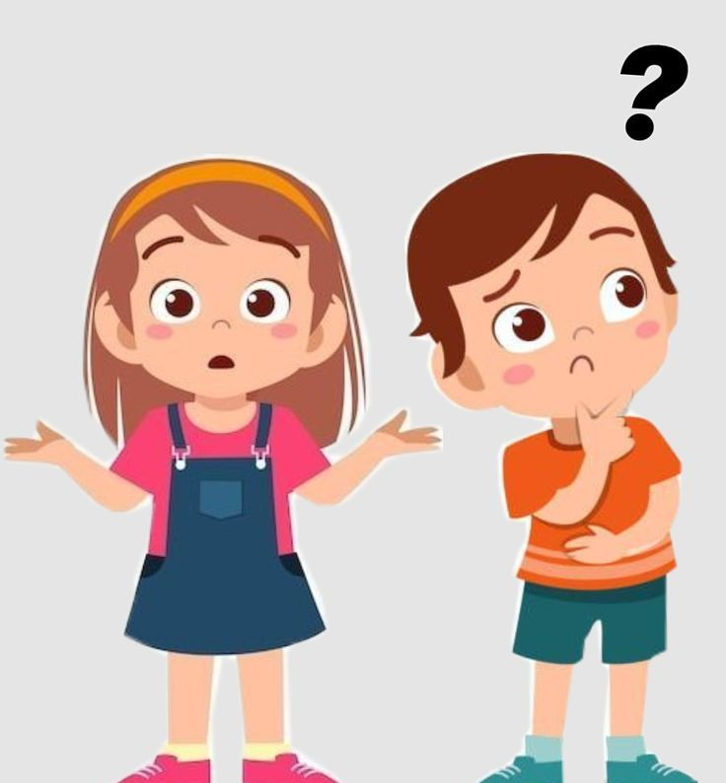

Discussion Questions:
Which seed made the better choice?
Why is it sometimes
hard to do what’s right?

Slide 7
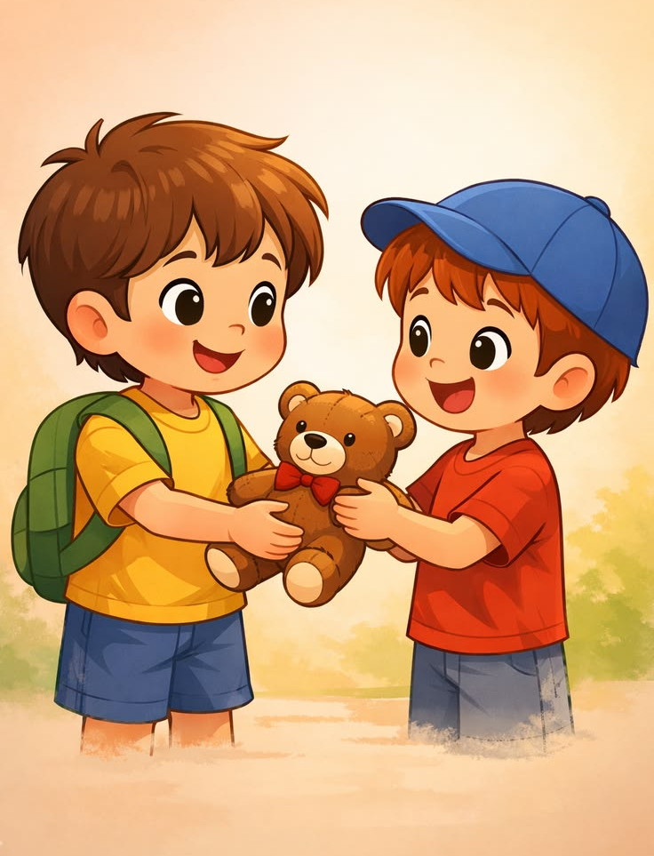
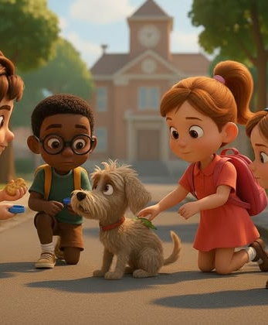
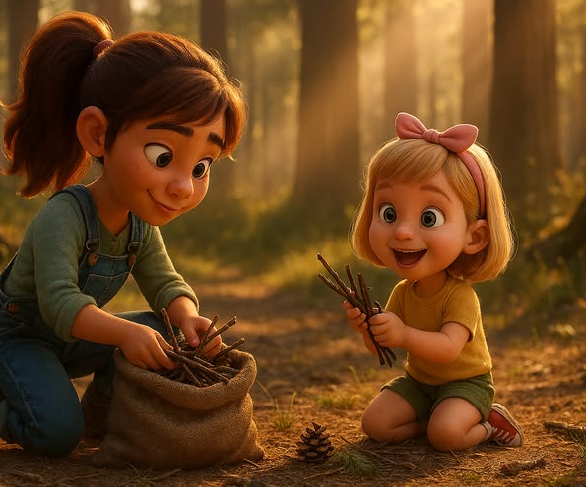
Transition:
“Like the seeds, we make choices every day - whether to be honest, brave, kind, or to hide from what’s right. Today, we’ll learn how to know what’s good and true.”

Slide 8


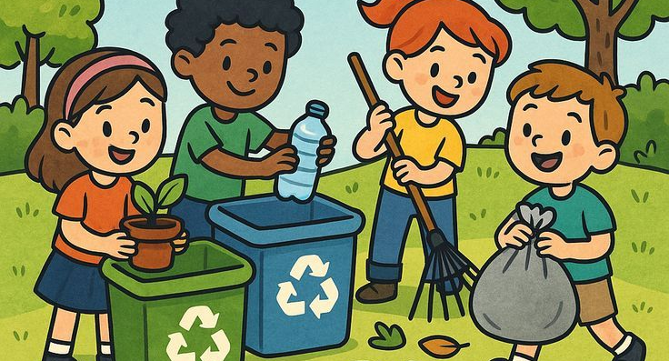
What Is Good?
Good means actions that help, care, support, and protect. It includes kindness, sharing, being honest, and helping others.

Slide 9

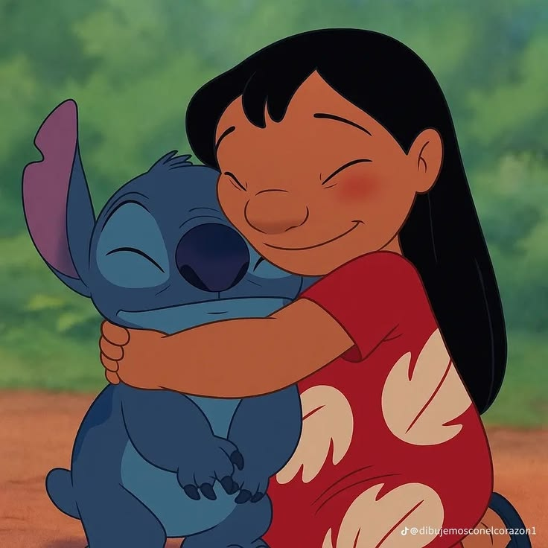
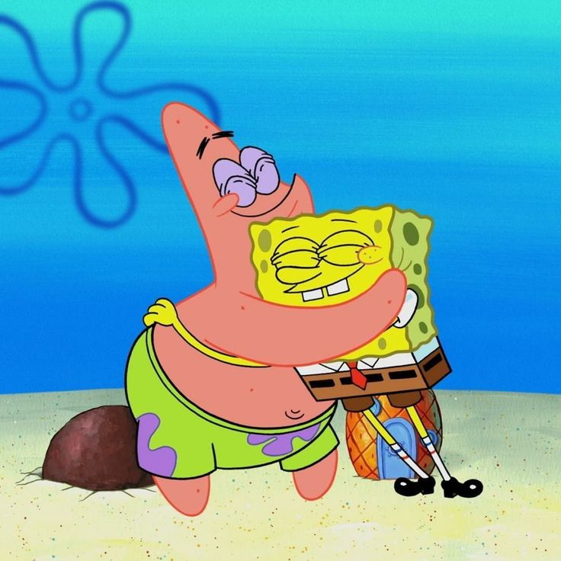
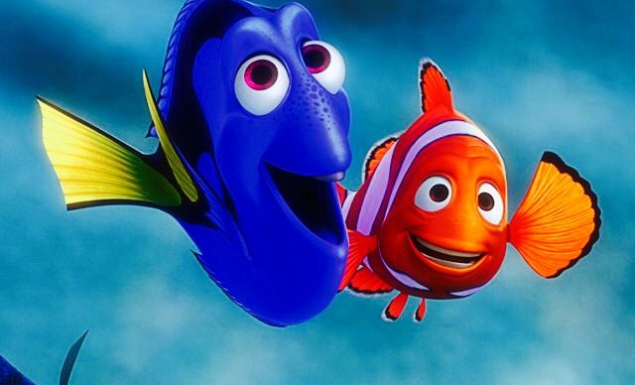
Examples of Good
Helping someone who dropped their books.
Inviting someone new to play.
Saying “I’m sorry” when you’ve made a mistake.

Slide 10

What Is Evil?
Evil means hurting others through actions or words. It includes bullying, lying, stealing, mocking, or being cruel.

Slide 11
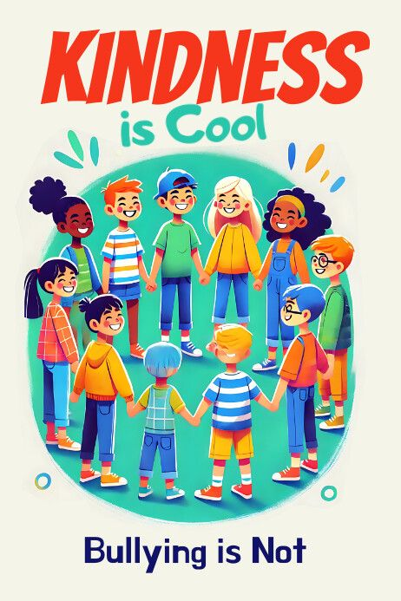
Examples of Evill
o Laughing at someone who’s different.
o Hiding something that isn’t yours.
o Saying mean things when angry.

Slide 12
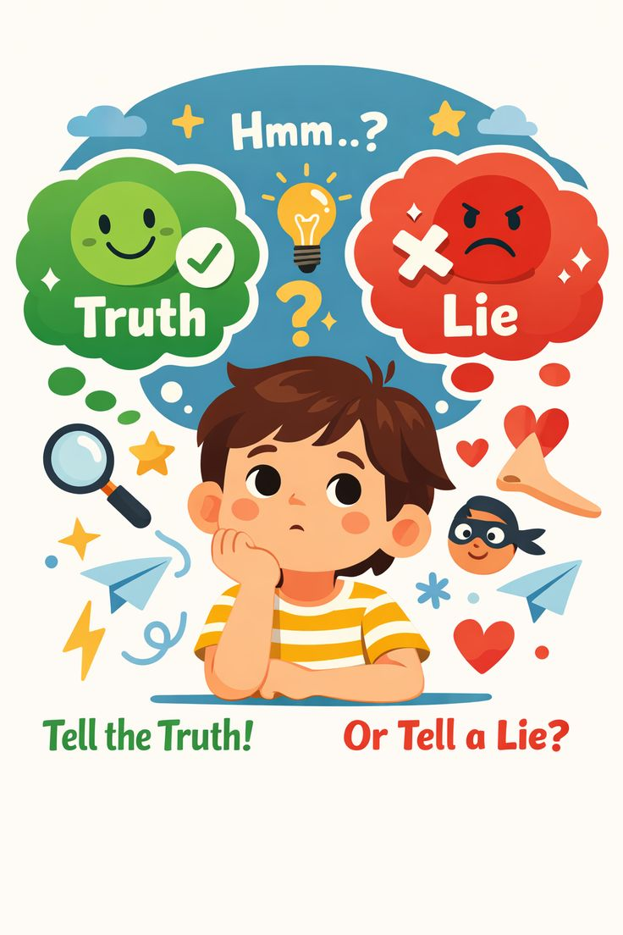


What Is Truth?
Truth means saying what really happened. Even when it’s hard, being truthful shows courage and respect.
Examples:
o Admitting a mistake.
o Telling an adult if someone is being treated badly.
o Not exaggerating or making up stories.

Slide 13

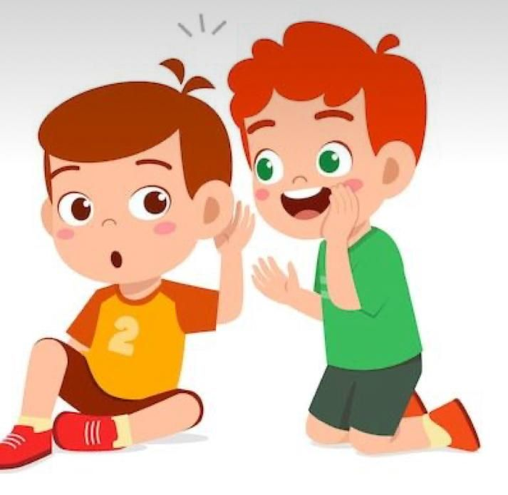
What Is a Lie?
A lie is when you hide or invent something on purpose. Lies may seem small, but they often grow into bigger problems.
Examples:
o Blaming someone else for something you did.
o Pretending you completed homework when you didn’t.
o Hiding the truth to avoid punishment.

Slide 14
GAME : THINK AND STAND
Teacher activity: Instructions:
Teacher reads a short situation aloud. Students stand up if they believe the action is good or true. Students stay seated if they believe the action is evil or a lie.
Examples:
1. I helped my friend clean up after lunch.
2. I said I wasn’t the one who broke the toy, even though I was.
3. I shared my snack with someone who forgot theirs.
4. I blamed my sibling so I wouldn’t get in trouble.

Slide 15

THANK YOU FOR ATTENTION !
We live to do good to other people. For example, I live only for that. And other people, I wonder what they live for.

