Slide 1
Me and the society. respecting civic property, rights and responsibilities.

Slide 2
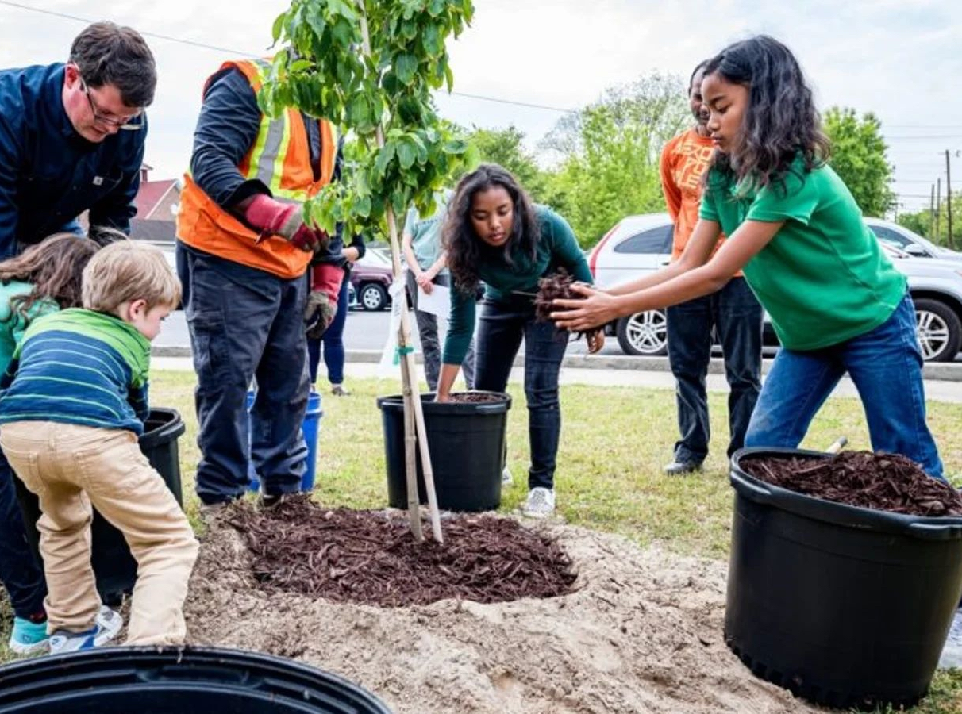
What we will learn today?
Lesson for acquiring foundational civic and social knowledge:
- Understanding public (civic) property
- Learning basic rights and responsibilities
- Forming respectful attitudes toward community life
- Developing cooperation skills

Slide 3
Our Civic Values
1. RESPECT- for people and property
2. RESPONSIBILITY- taking care of what we share
3. COOPERATION- working together
4. SHARED RULES- following community guidelines

Slide 4
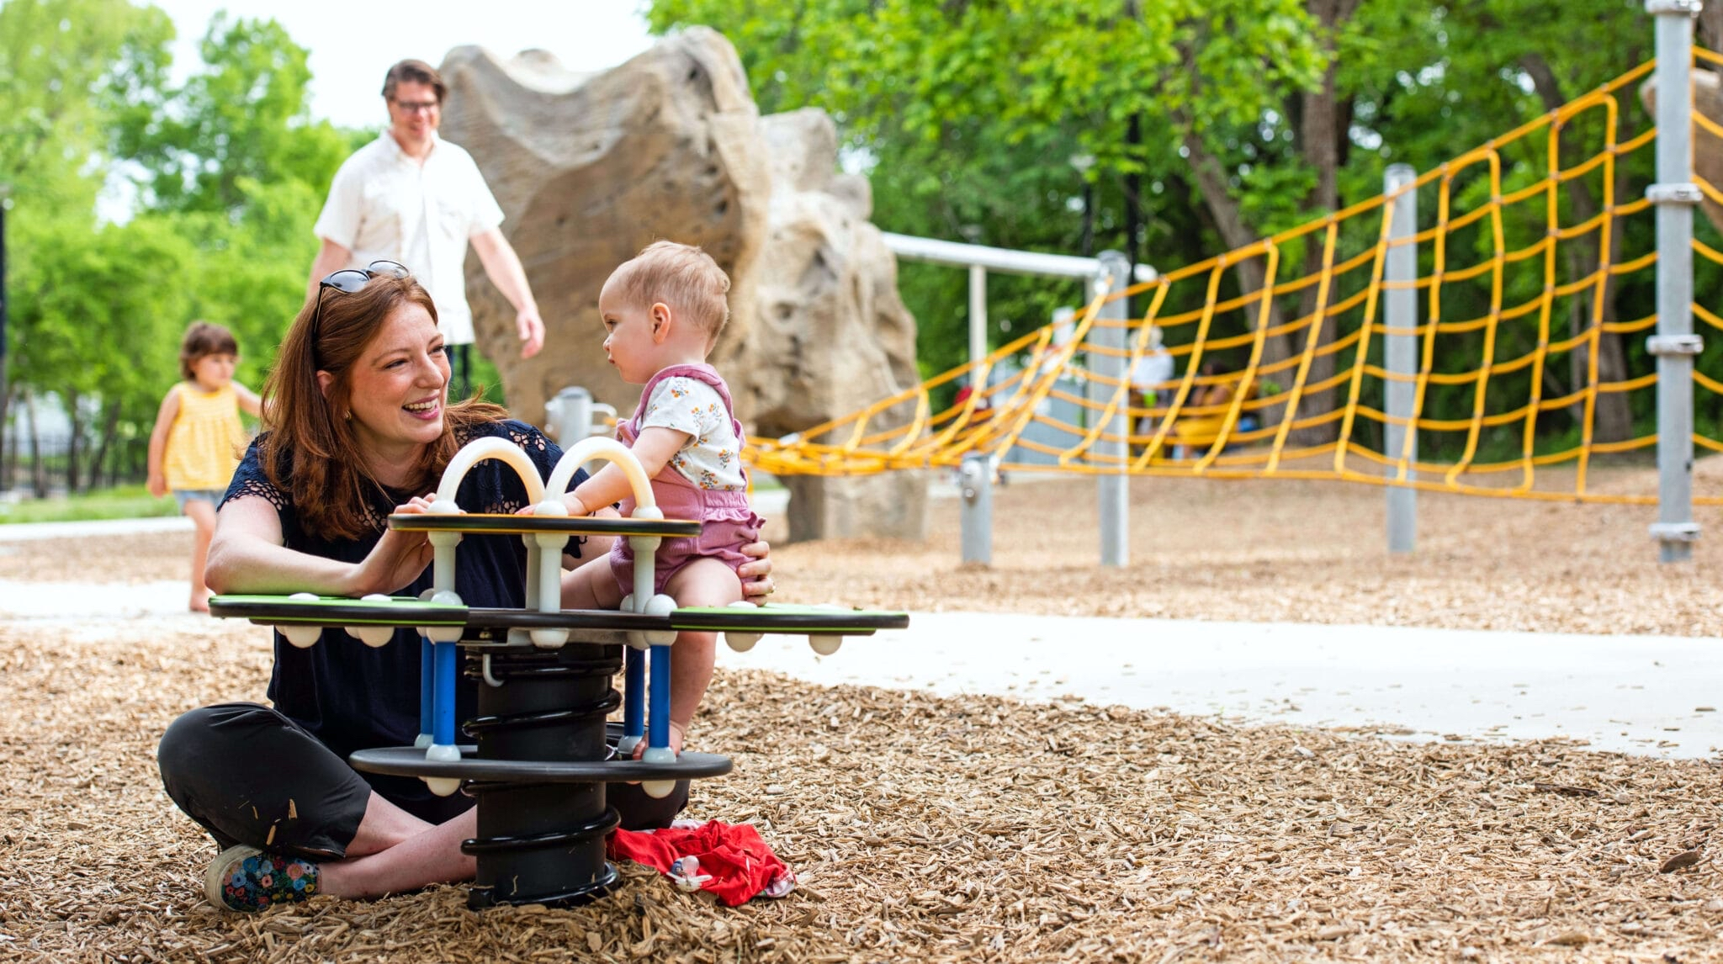
What is public property?
Public property belongs to everyone in our community:
- Parks and playgrounds
- Schools and libraries
- Streets and sidewalks
- Public buildings

Slide 5
Our rights
✓Right to use public spaces
✓ Right to play in parks
✓ Right to learn in school
✓ Right to be safe
✓ Right to be respected

Slide 6
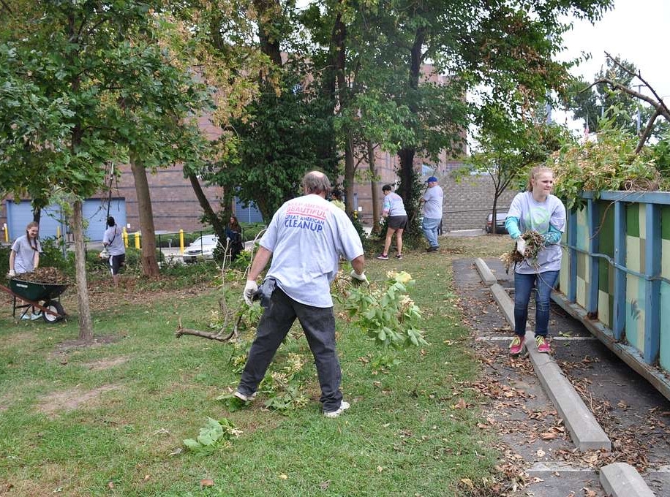
Our responsibilities
✓ Respect public property
✓ Keep public spaces clean
✓ Follow the rules
✓ Be kind to others
✓ Help take care of shared spaces

Slide 7
Respecting public property.
How?
🚫 Don't damage or break things
Put trash in bins
🎨 Don't draw on walls or benches
🌳 Take care of plants and trees
Share equipment with others

Slide 8
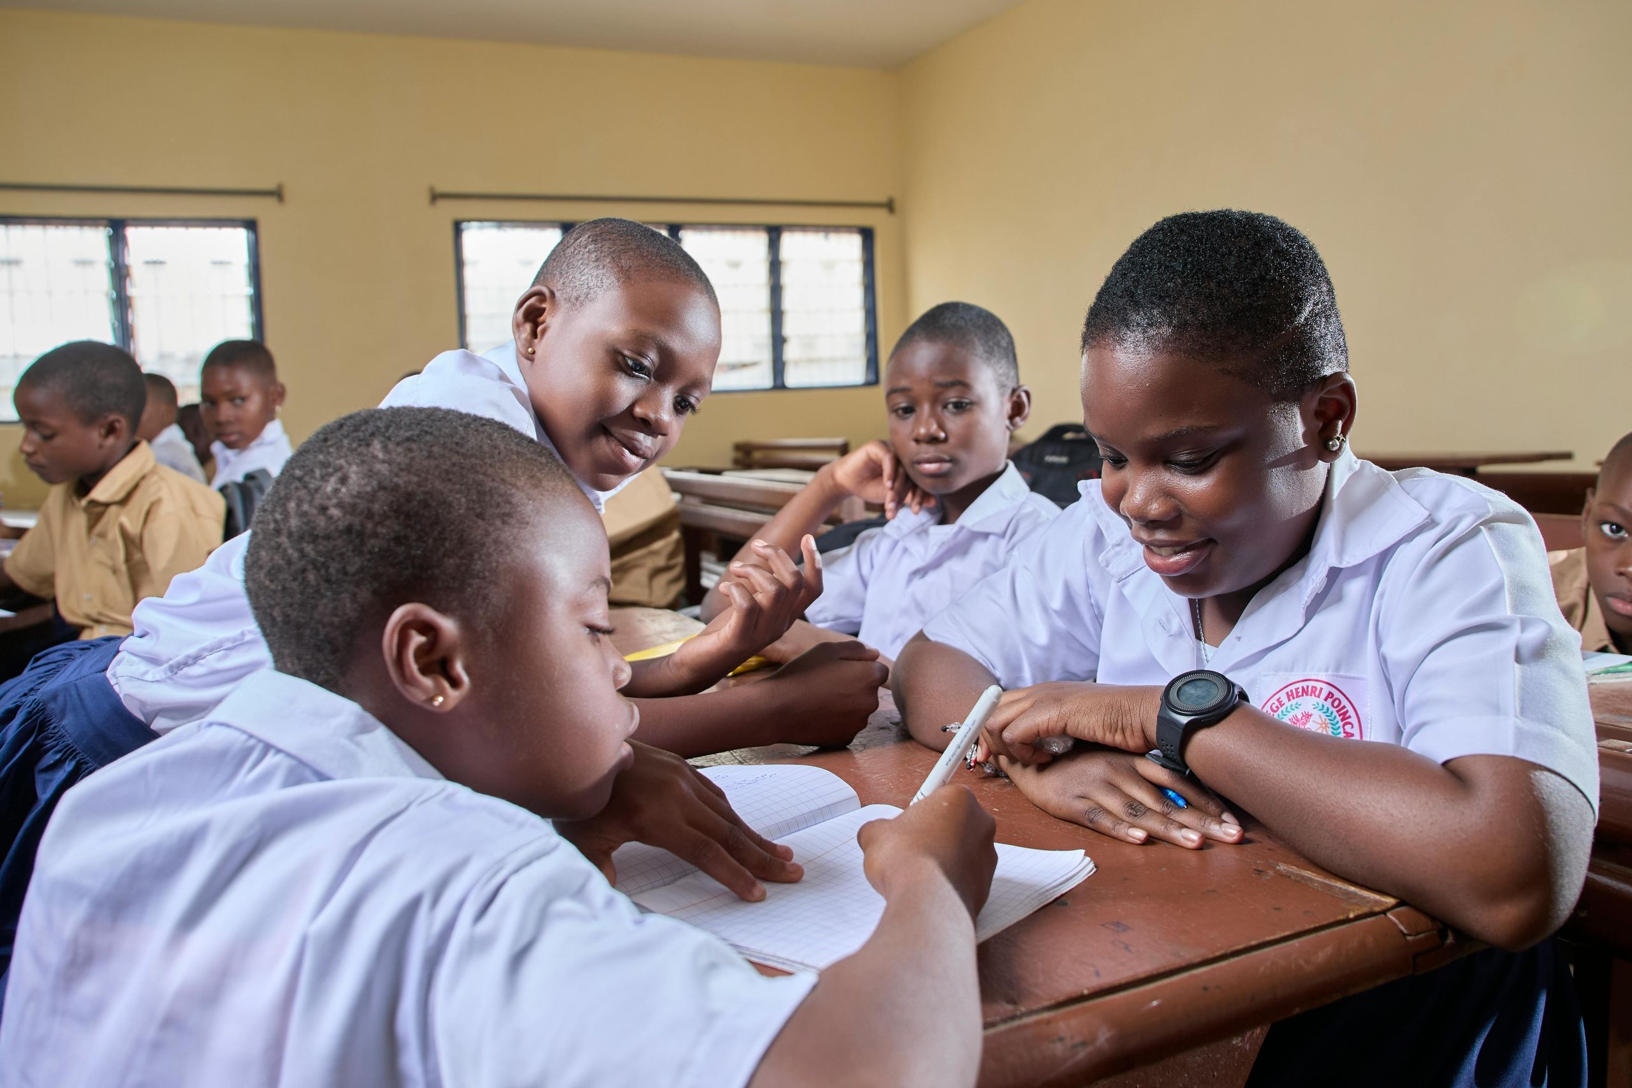
Working together
(cooperation)
Cooperation makes our community better!
When we cooperate:
- We help each other
- We share fairly
- We solve problems together
- We make our community a better place

Slide 9
Classrooms rules.
Our classroom and community rules.
1. Be respectful
2. Be responsible
3. Be cooperative
4. Be safe
5. Be kind

Slide 10
LET’S PRACTICE!
Activity time
Today we will:
- Discuss examples of public property
- Draw pictures showing respect
- Role-play community situations
- Create our class respect pledge
REMEMBER!
💚 Public property belongs to all of us
💚 We have rights AND responsibilities
💚 Respect and cooperation make our community better
💚 Every small action counts!

Slide 11
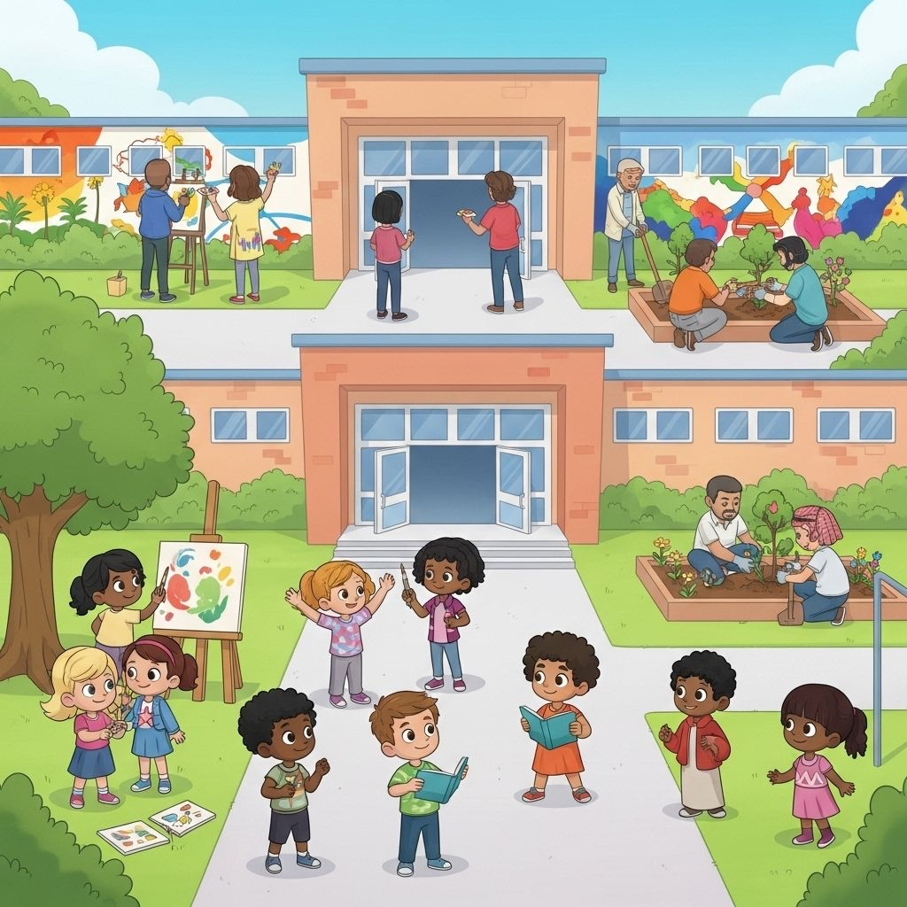
Together We Make Our Community Better!

