Slide 1

Me and the world
Countries, languages ​​and landmarks

Slide 2
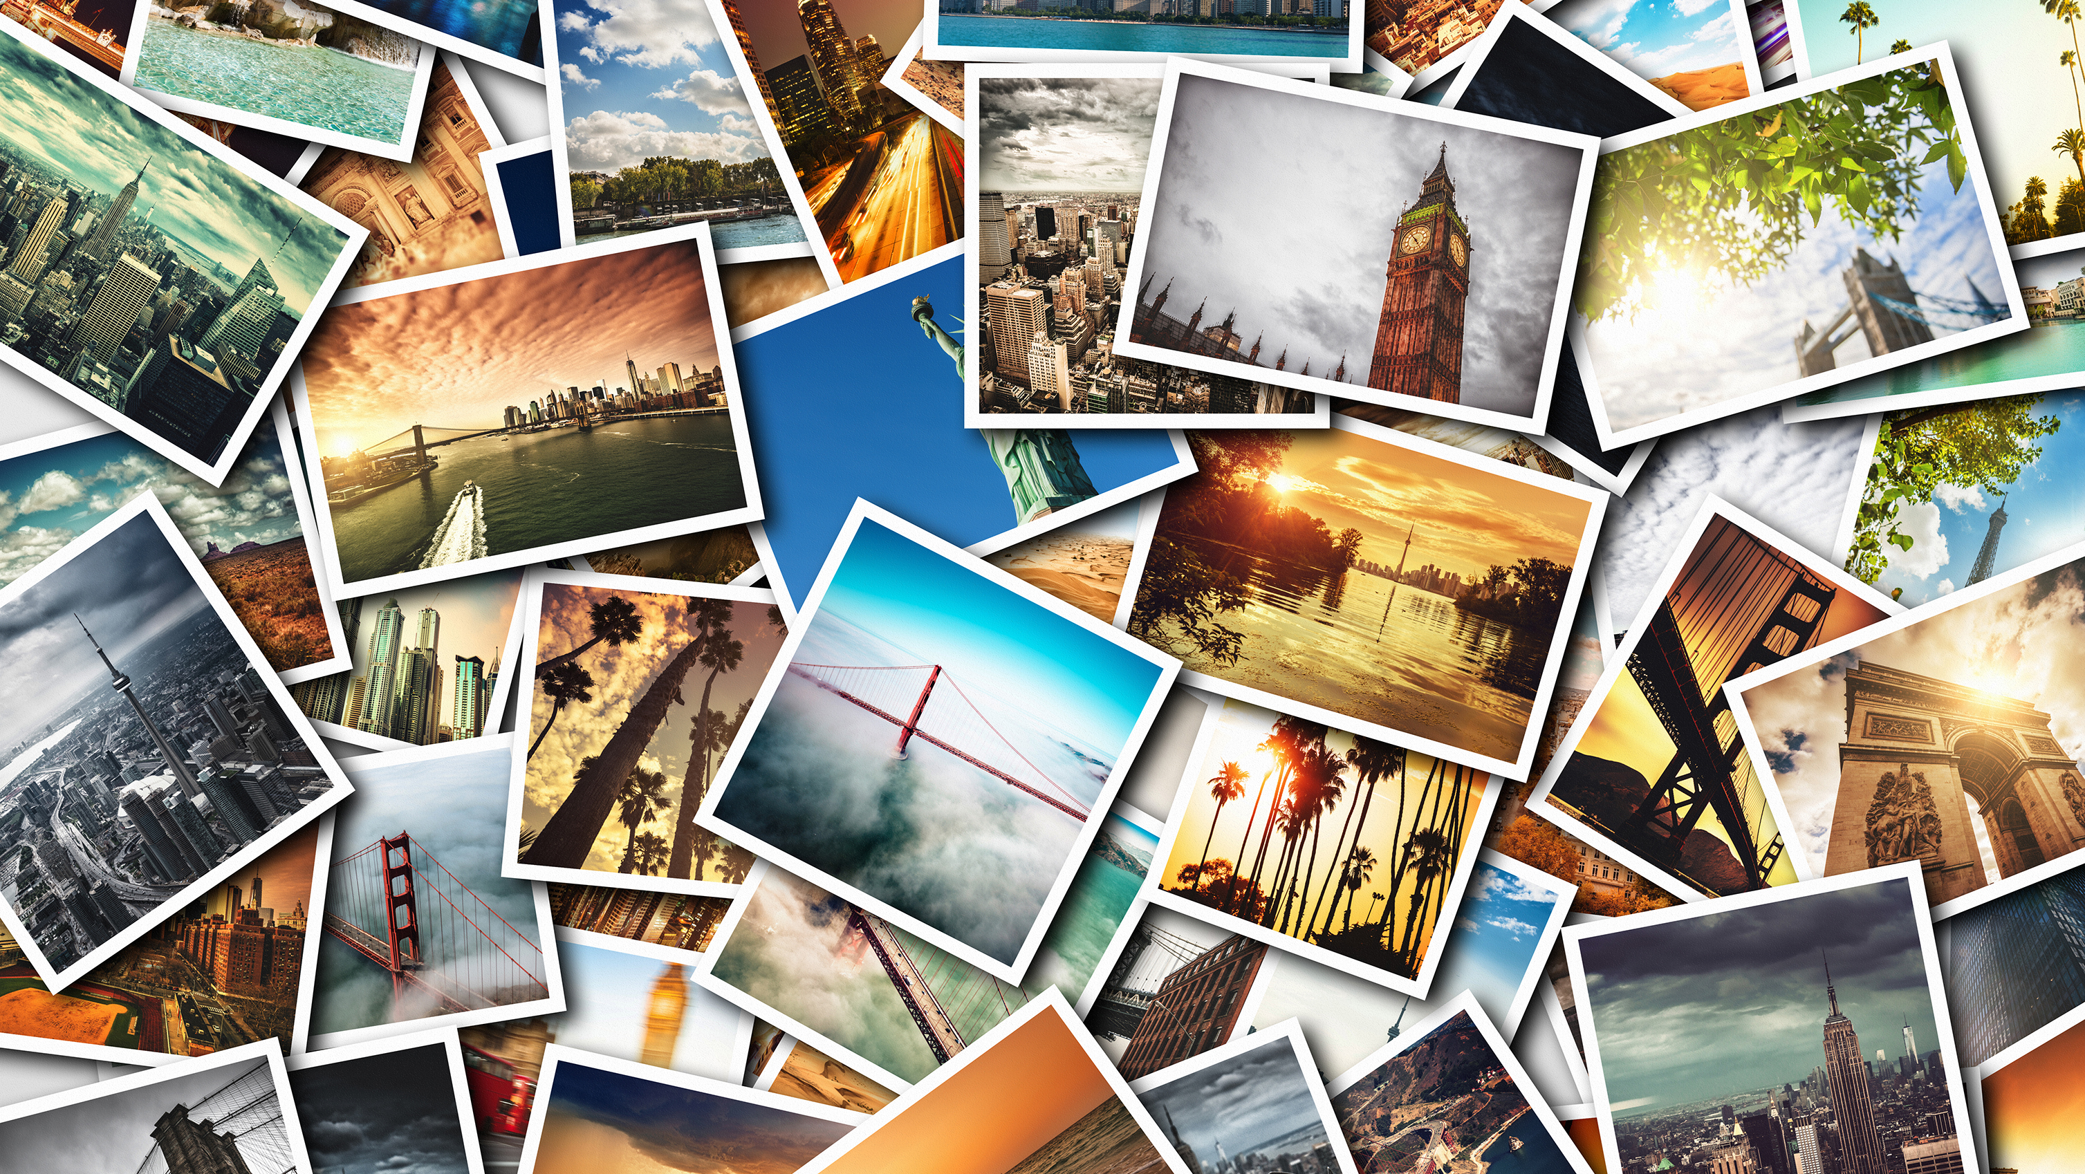

Slide 3
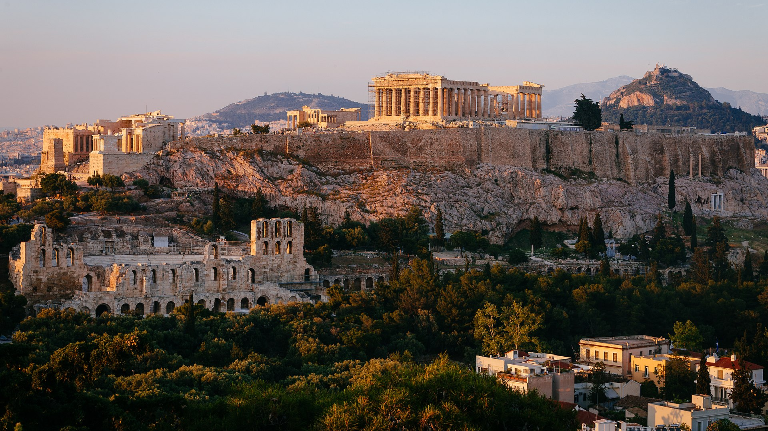
Greece – Acropolis of Athens

Slide 4
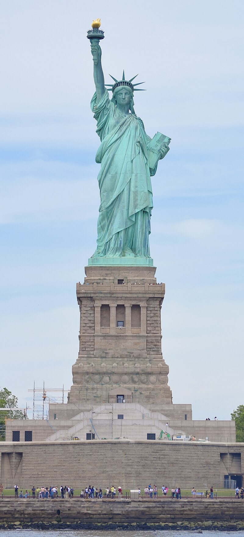
United States –
Statue of Liberty

Slide 5
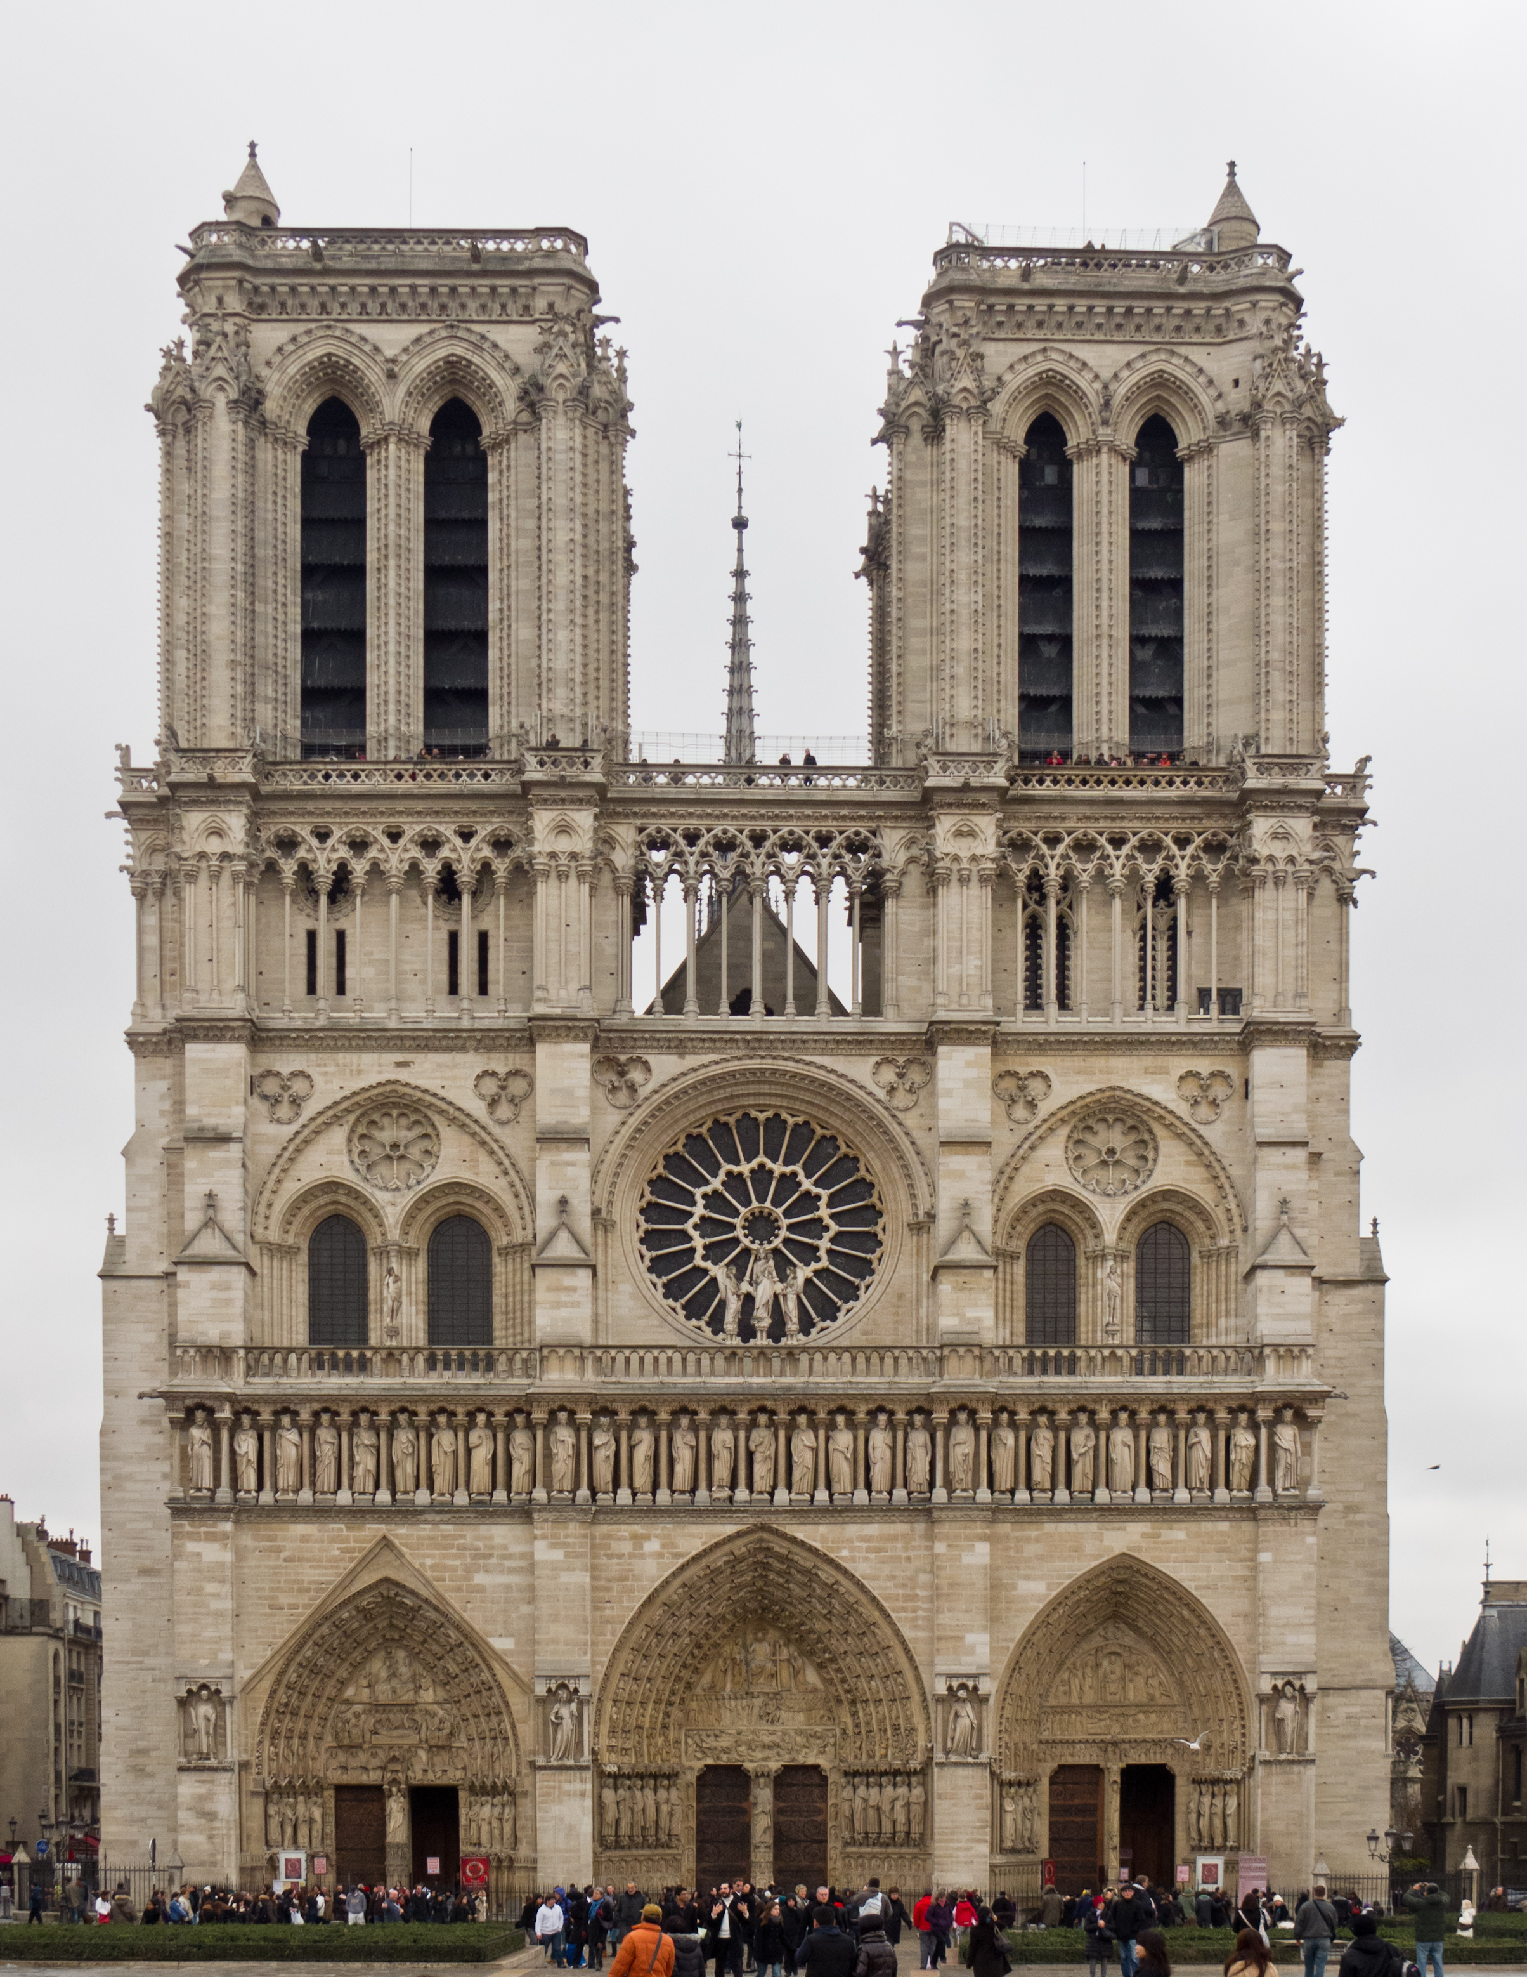
France –
Notre Dame Cathedral

Slide 6
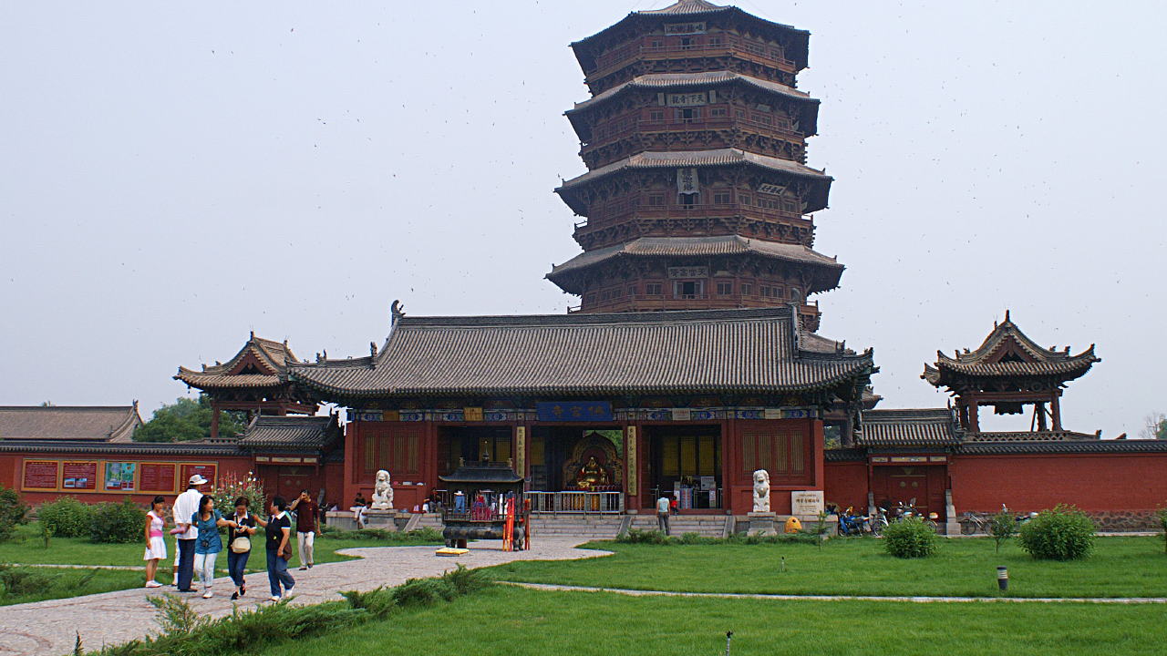
China – Fogong Temple Pagoda

Slide 7
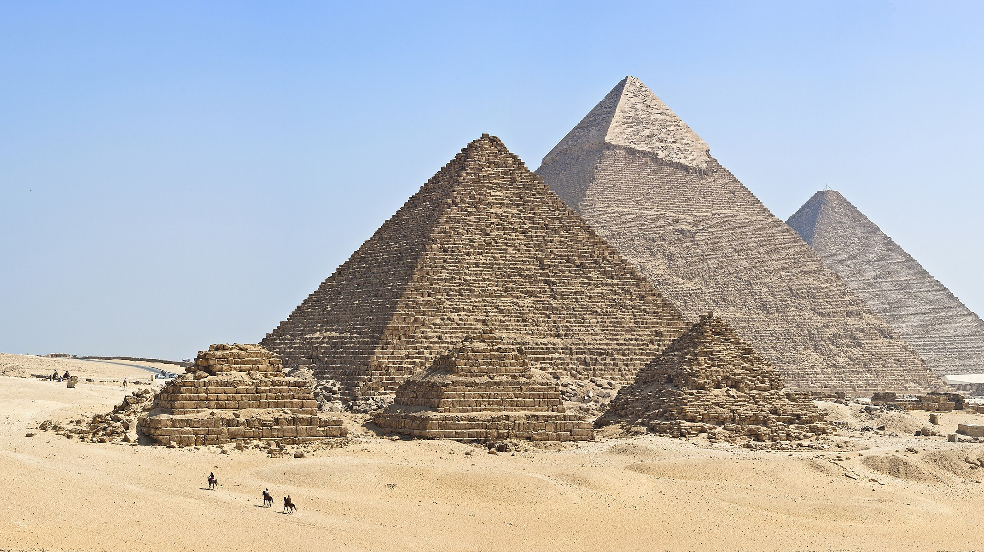
Egypt – Pyramids of Giza

Slide 8
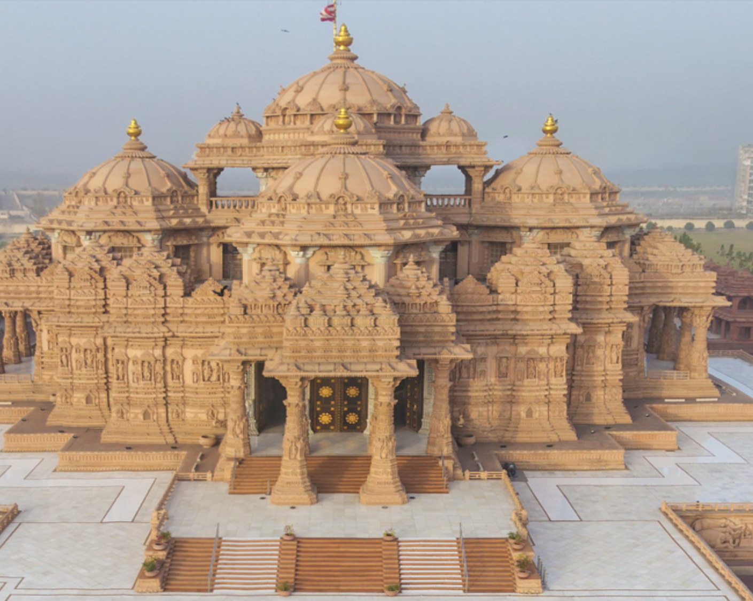
India – Swaminarayan Akshardham Temple

Slide 9
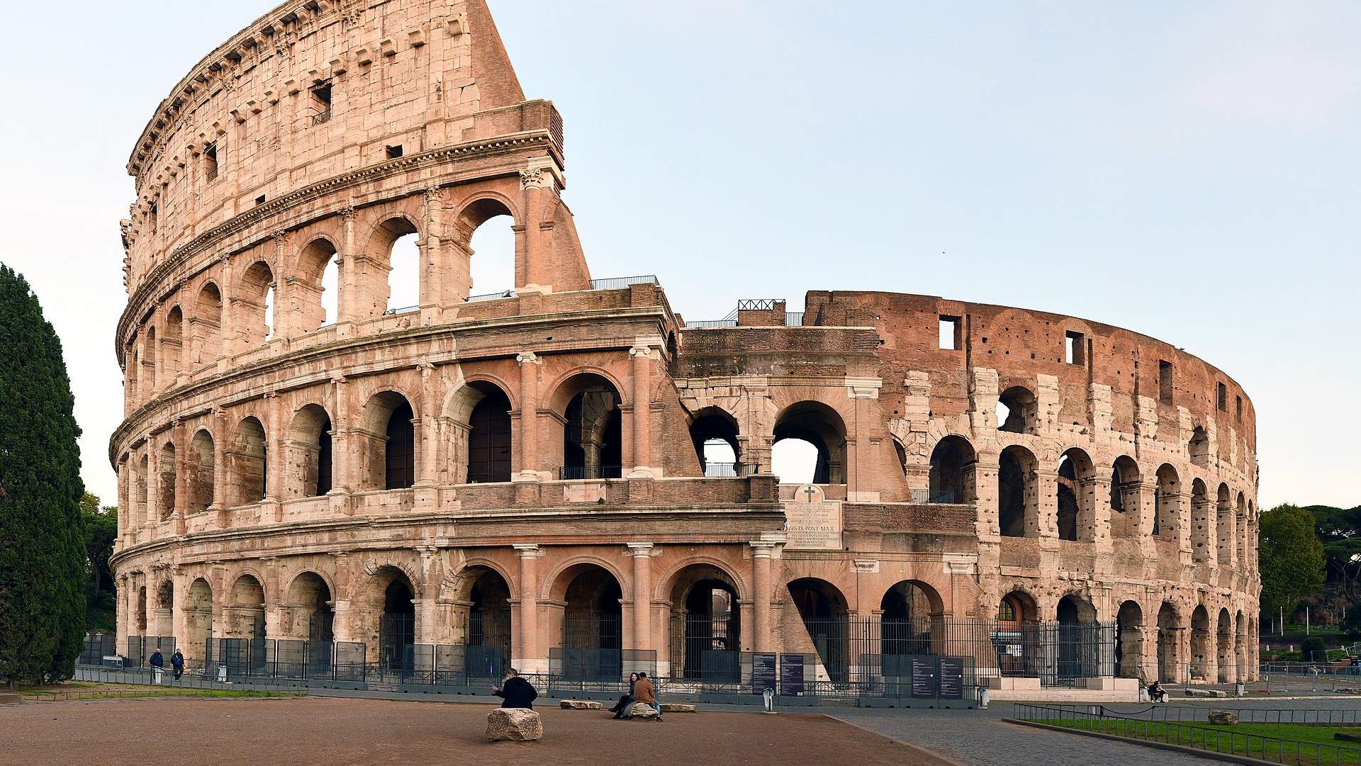
Italy – Colosseum

Slide 10
Sources
Athens Acropolis, Photo by Alexander Popkov (engineerontour.com) - Own work, CC BY-SA 4.0, https://commons.wikimedia.org/w/index.php?curid=82702614
Statue of Liberty, Photo by AskALotl - Own work, CC0, https://commons.wikimedia.org/w/index.php?curid=149005856
Cathedral of Notre-Dame, Photo by Carlos Delgado, CC BY-SA 3.0, https://commons.wikimedia.org/w/index.php?curid=18462170
Pagoda of Fogong Temple, Photo by Peellden - Own work, CC BY 3.0, https://commons.wikimedia.org/w/index.php?curid=2839143
Pyramids of Giza, Photo by KennyOMG - Own work, CC BY-SA 4.0, https://commons.wikimedia.org/w/index.php?curid=40998161
Swaminarayan Akshardham Temple, Photo from: /https://www.travelogyindia.com/blog/list-of-famous-temples-in-india/, Photo
Colosseo, Photo by FeaturedPics - Own work, CC BY-SA 4.0, https://commons.wikimedia.org/w/index.php?curid=95579199

