Slide 1
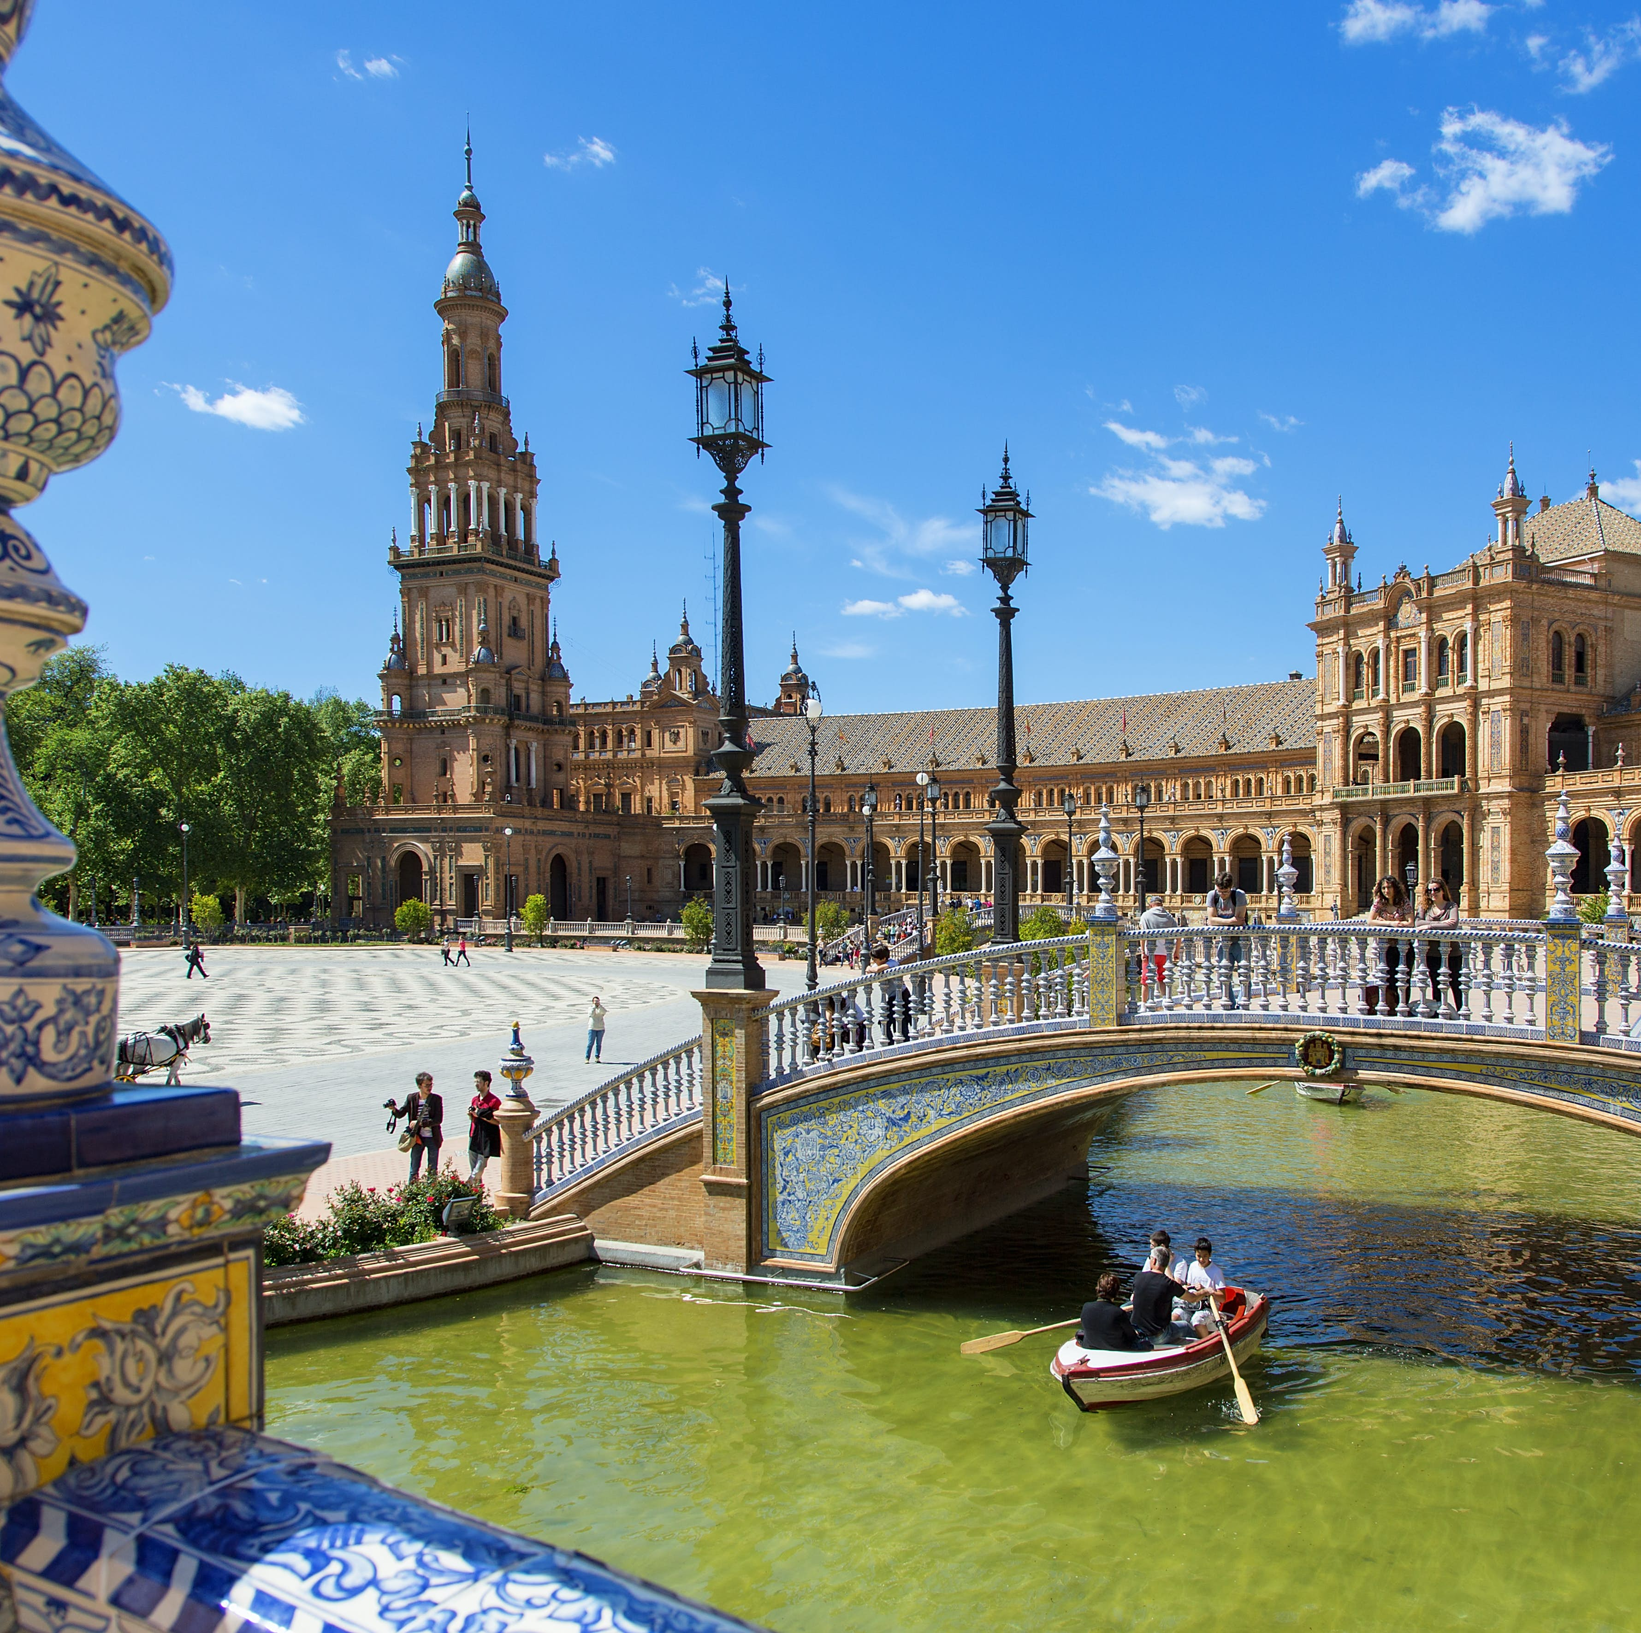
SPAIN
STRUCTURE
Spain's entry to EU,NATO,Schengen area
Spain's profile and basic characteristic
Spain's priorities/policy
Euroscepticism in Spain
Current challenges(Ukraine and Russian War, COVID-19 pandemic and Eurozone crisis
Joanna Karageorgopoulou

Slide 2
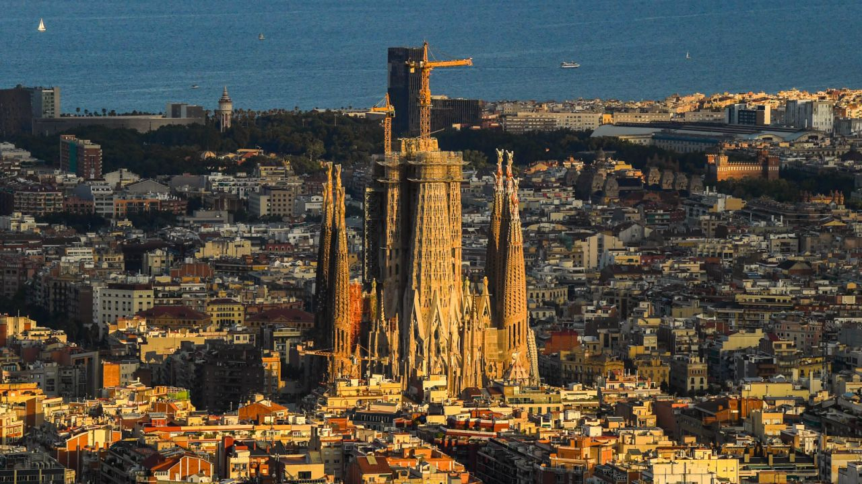
SPAIN
SPAIN’S REQUEST FOR JOIN THE EUROPEAN UNION
First of all, Spain requested accession was on 26.7.1977 after the arrival of democracy but Spain is a member state of European Union since 1.1.1986.The main reason why Spain wanted to join the European Union was the fact that democracy had just been set up and it needed to be recognized by Europe. Spain was aware of how much support it needed in order to establish democracy and be political, economic and social stable. Another reason is the desire of Spain to connect with the Single Market Project (3rd Enlargement) and provide its citizens with international services and enjoy products from all over the world. In addition Spain is a member of NATO from 1982 and Spain’s participation in Schengen was achieved on 1995 and joined eurozone in 1999.

Slide 3
MY COUNTRY’S PROFILE AND BASIC CHARACTERISTICS
1)SIZE
Spain is the biggest country in South Europe and the fourth-most populous European Union member-state. Spain plays an important role in EU due to its population(47.1 million).Size is a factor with essential impact on country’s EU policy as when bigger countries disagree this can have more impact on decisions and have more power on Eu’s achievements.
2)PLACE ON THE MAP/GEOGRAPHY
One more factor which can shape Spain’s foreign policy is its borders and place on the map. More precisely, Spain’s boundaries are the Mediterranea sea and the Atlantic ocean important in order to build a strong economy due to it’s trade flows.

Slide 4
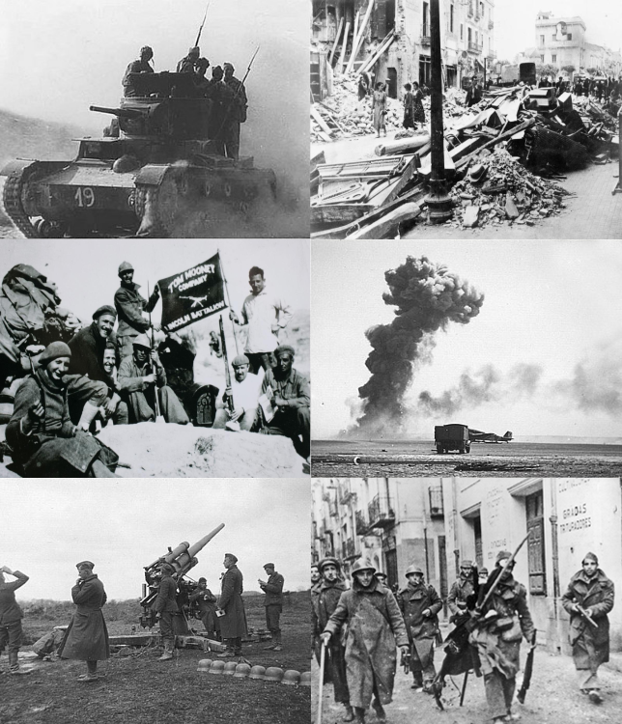
3)HISTORY
Important historical key that characterizes Spain’s historical traumas are the following.
Spain’s modern history was marked by the bitter civil war 1936-1939.
20th century was a turbulent time for Spain as Spanish civil war was a war between the Republicans and Nationalists with the dictator Francisco Franco who had the support from nazi Germany and Italy. So the results from this struggle between dictatorship and republican democracy was the victory of Nationalists. In addition franco’s dictatorship lasted for 36 years and franco’s ideologies were the following three: traditionalism, anti-communism and catholic religion.
Another significant highlight of Spain’s history is the transition to democracy .Spain’s transition to democracy began after the death of dictator Francisco Franco in 1975 but there are some opposite opinions about the exactly date of transition. At it’s latest we all accept the fact that Spain’s transition to democracy was completed after the victory of the Spanish socialist worker’s party in 1982 general elections.
Spain adopt euro in 2002

Slide 5
SPAIN’S ECONOMY
Spain is an advanced capitalism economy and the world’s sixteenth-largest economy by nominal GDP.The most important sectors of Spain’s economy in 2020 by researches are public administration-human health and social work activities(20.5%), transportation and food services(19.7%) and industrial production growth rate is 4.03%.Spain is a very strong and progressive economy but unemployment rate still exist and it has been increased so Spain suffers from unemployment rates being at record levels.
Unemployment rate in 2022 was 12.9% and especially during coronavirus pandemic many youth people lost their jobs or they weren’t able to find.
Before pandemic Spain had more than 120 million tourists but after the previous number was dropped to 100million.
International financial crisis of 2007-2008 had a crucial impact on Spain especially after Spain’s entry to EU which is connected also with the development of single market in EU that improve Spain’s economy by offering to all the member states of EU the opportunity to transfer their products ,to enhance most good services to make more easy and effective the communication between EU’s countries and the transport in order for Spanish citizens be able to study, work and live to another EU’s member state. About 2008-2014 started in Spain a financial crisis known as The Great Recession in Spain. The main cause of this crisis was housing bubble. During the economic downtown Spain reduced imports and increased exports but also unemployment rate at the height of this crisis was around 25%.
After general financial crisis Spain from 2014-2015 started to recovery.

Slide 6
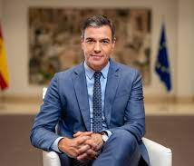
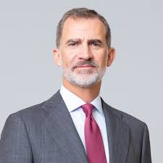
SPAIN’S GOVERNMENT AND CURRENT POLITICAL SITUATION
Spain’s 2023 general election was held on 23 of July and the results are the following: People's Party made big gains and secured the most votes so is on the top in comparison to 2019 general election’s results in which Socialist Worker’s Party had win .
Spain is a multy-party country and the next election will be held on Sunday 22 August 2027
Spain has its own monarch as the head of state. Spain’s form of government is a constitutional monarchy with head of state the King Filipe Vi with power and a symbolic role who also express his opinions about issues to prime minister ,head of government Pedro Sanchez that discuss on their weekly meetings .
A new government has been formed in Spain, led by the Socialist Worker's Party and Pedro Sanchez in alliance with Sumar. According to current news the Socialist Leader will form a minority administration with the far-left Sumar coalition. Some days ago Pedro Sanchez on Friday 17 of November is expected to be sworn in by Spain’s King Felipe VI and mention to him the names of the minister he would like to have.

Slide 7
SPAIN'S POLITICAL PARTIES
Spain has a multy-party system at both the national and regional level, the major parties nationwide being the People's Party(PP), the Spanish Socialist Worker's Party(PSOE), Vox(VOX) , Sumar(SMR) and Podemos which is a left-wing populist political party and in the last election, Podemos joined Sumar(which is the 4th significant political force)
People's Party: Centre-right party ,conservatism and Christian democracy(ideology).
Leader: Alberto Nunez Feijoo
Spanish Socialist Worker's Party: Centre-left social democratic ,social democracy(ideology).Leader: Pedro Sanchez
VOX: a right-wing and to far-right. Ideologies: social and national conservatism, economic liberalism and centralism. Leader: Sandiago Abascal. Founded in 2013

Slide 8
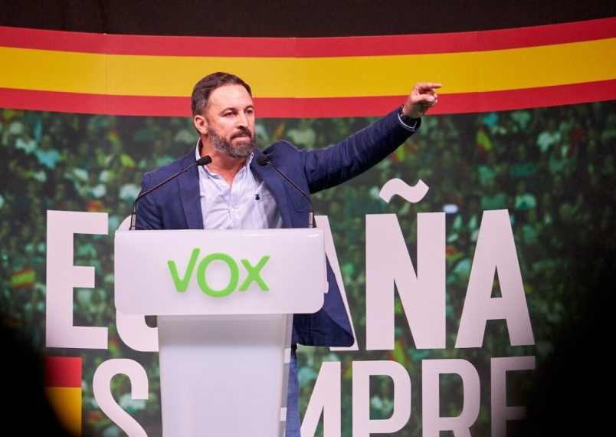
MORE DETAILS ABOUT VOX
Vox(from the Latin: voice)
A national conservative political party in Spain
Entered the Spanish parliament for the first time after winning seats in April 2019 general election.
Opposition to COVID-19 measures. At the begging of 2020,during the global COVID-19 pandemic, Vox called for travel restrictions between China and Spain and then Italy and Spain .That position found no support among other parties and it was criticized as xenophobic policy.

Slide 9
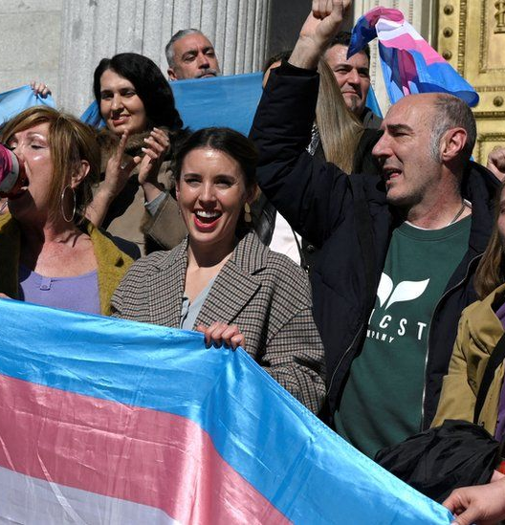
SPAIN’S PRIORITIES AND CONTRIBUTION TO EU
Spain focus a lot to it’s European policy in order to deal with foreign affairs. So some of the examples that characterize Spain’s European policy are the following:
1) Spain is a country full committed to human rights . Spain works to defend women and girl rights, to promote gender equality and the rights to people with disabilities . Spain wants not only for it’s country but also for the EU to provide both men and women same opportunities and rights and to promote justice ,peace ,liberty and balance to international relations among EU’s member states.
2) Spain thinks that cooperation with the other countries is the key to prevent poverty , reduce the number of crimes and negotiate to avoid unlawful migration flows. So as a result Spain invest in international cooperation for development.

Slide 10
Spain has been a net beneficiary member from 2007-2014 but also is a net contributor to EU's budget form 2014​.
3) Another Spain’s priority is the fight against disinformation . Nowadays we are all becoming aware of the fact that more and more people use the internet and social media but sometimes this can have a negative impact on public communication and general on social network . Fake and false news can be a dangerous threat to freedom and democracy.
4) Spain supports the most the EU to ensure and promote greater social and economic justice in order to become a more competitive economy . Spain wants Europe to develop more and be more capable of finding solutions to the problems which appear every day . Spain plays a significant role to EU’s progress .
5) Moreover Spain is devoted to green transition and environmental adaptation . More specifically , Spain’s climate is a factor that can also influence it’s foreign policy and it can explain why Spain in order to contribute to Europe’s future is making important efforts to reduce people’s demand for electricity about the concerns of global warming . We need to take care of our planet and to protect the environment from climate change which can cause crucial impacts such as natural disasters.

Slide 11
EUROSCEPTICISM IN SPAIN.CAN WE TALK ABOUT HARD OR SOFT EUROSCEPTICISM?
Spain presents soft Euroscepticism
Opinions have been changed after the entry of Spain in EU ,continue with Spain's transition to democracy until now
1992 'Maastricht Treaty' was a significant point for Spain's position to euroscepticism . First symptoms were presented among political parties.
Spain's parties supported the EU policy and until now believe that national Spanish policy and European policy can be combined in order to provide a more stable policy.
A complexity in the political parties does not mean that Spain want to face the future outside the EU.

Slide 12
Spain's results from Eurobarometer in spring
May-June 2023 Eurobarometer results on public opinion
44% believe that things are going to wrong direction in EU
38% believe that things are going to right direction in EU
6% neither of these two directions and
12% no opinion about EU's direction.

Slide 13
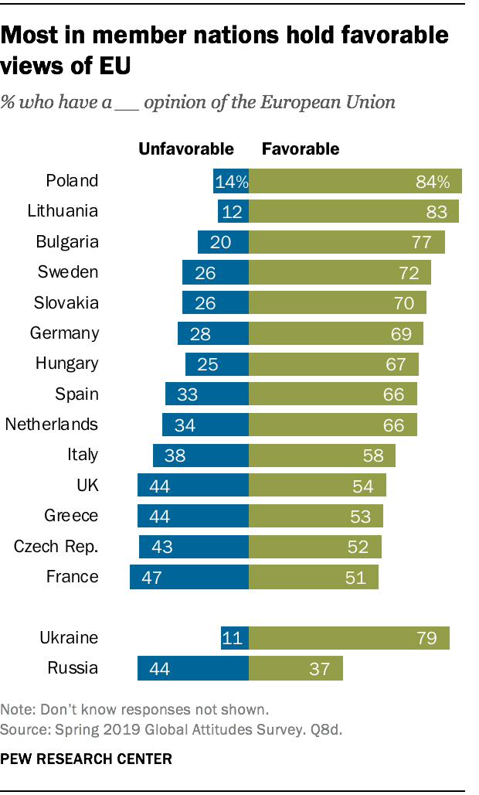
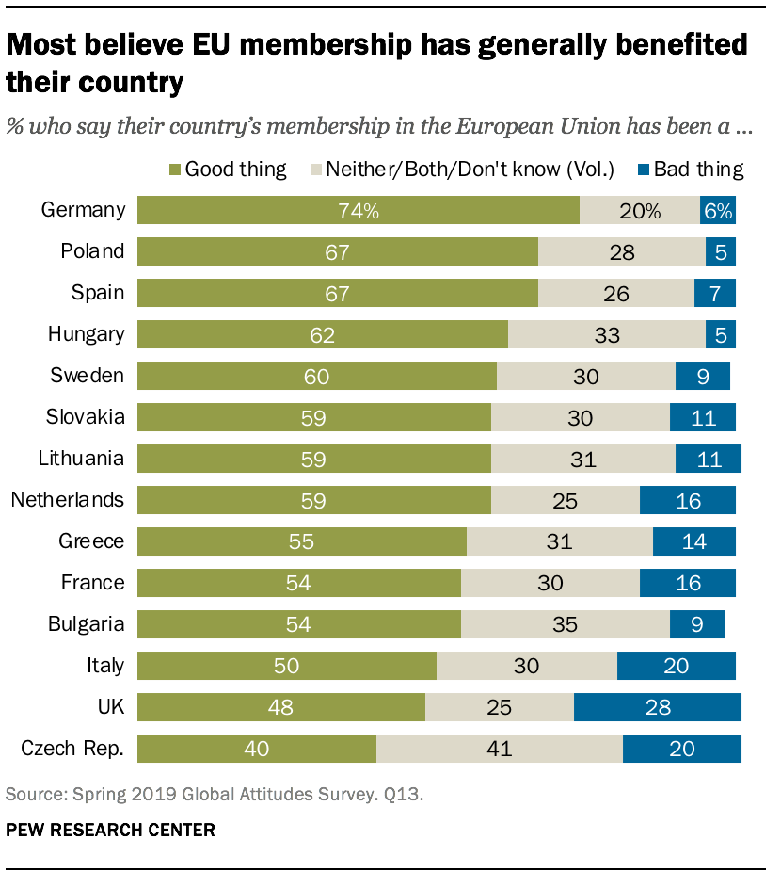
VOX(political party) and euroscepticism
Vox holds a Eurosceptic view of the EU, arguing that Sapin should make no sovereignty concessions to the EU, because according to the Constitution of Spain national sovereignty is vested in the Spanish people, from whom emanate the powers of the state.
Spain's view about EU
Unfavorable:33%
Favorable:66%
Spain's public opinion on membership in EU(is a good thing or bad)
Good thing:67%
Bad thing:7%

Slide 14
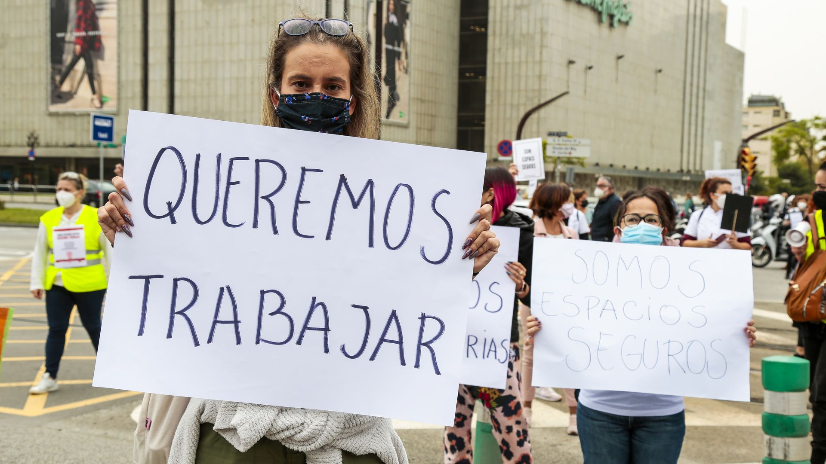
CHALLENGES AND SPAIN
1)CORONAVIRUS PANDEMIC
Coronavirus pandemic was a disaster for some of EU's countries but especially for Spain , which was the most affected country form CIVID-19.This fact can be proved by the results which International Health Organization presented during this crucial pandemic and showed that Spain presented the highest infection rate and death rate. In addition, Spain was a country which responded too late to coronavirus pandemic. Why this happened? The reason that can explain this was the lack of preparation and the lack of dialogue among the political parties which had different opinions about the solution .Also it was an even harder case for Spanish government to decide for how they will deal with this pandemic because of the fact that Spain is a well-known country for its socialization and big population(two factors which had a major impact on Spanish government response to COVID-19.The consequences from this pandemic were devastating for the economy, and to combat with COVID-19 Spanish government implement mobility restrictions measures and social distance. The first confirmed case was reported on 31 January 2020.

Slide 15
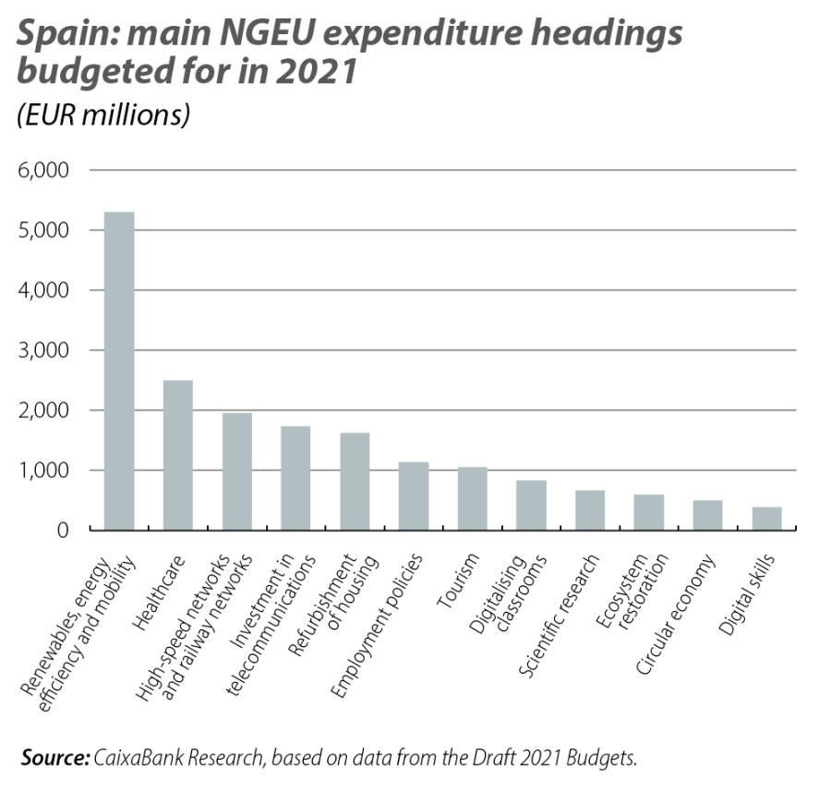
HOW SPAIN DEAL WITH THE SERIOUS SOCIAL AND ECONOMICAL IMPACTS FROM COVID-19
With the Next Generation recovery plan which helps Spain to overcome the devasting impacts on energy, services, industries and general economy
One of the main recipients with 160€ billion
This plan offers a golden opportunity for an effective economy and between 2021 and 2026 Next Generation Plan offers 140 billion euros.

Slide 16
CHALLENGES AND SPAIN
2)Ukraine and Russian War
Spain is a member state of EU which fully support Ukraine as these two countries have a very strong relation and that's why Spain keeps a favorable position on Ukraine decision to apply for accession to the EU on February of 2022 .A current action that captured the relation between Ukraine and Spain is that on 5/10/2023 Spanish Prime Minister Pedro Sanchez meet Ukraine's head of government Zelensky and for one more time how much financial and military support Ukraine.
Spain guarantees the first aid package from the World Bank to Ukraine with 100 millions euros, in order to improve access in health services and help Ukraine to start recovery form the Russian's damages.
About energy crisis Spanish government has made efforts to reduce the national demand for electricity. In order to help more the vulnerable people as the energy Prises have been increased, Spanish government implement the measure of the reduction of tax on electrisity.

Slide 17
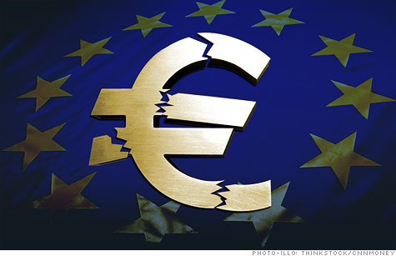
EUROZONE CRISIS(3rd challenge)
Crucial impacts on Spain's strong economy, increased national debt and unemployment rate and bankruptcies of major companies.
Three scenarios for Spain:1)exit from eurozone 2)intervention(European loan) 3)muddling through
Despite of its strong economy, Spain needed the cooperation with Europe in order to come out of the crisis.
Spain received a bank bailout (not a sovereign bailout like Greece) from the EU/IMF during the crisis.
Should Spain leave or stay in Eurozone?
30% of public opinion said that euro has been bad for the economy ,but want to continue using it.
UNEMPLOYMENT RATE DURING THE EUROZONE CRISIS
2008-9.60% 2010-19.84% 2013-26.94% 2016-21% 2020-14.71%
2009-17.24% 2011-21.08% 2014-25.93% 2018-16.74% 2023-11.84%

Slide 18
Sources Used
BBC news for Spain/information about Spain's profile
https://www.bbc.com/news/world-europe-17941641
Spain's priorites,foreign policy,Prime Minister's actions
https://www.lamoncloa.gob.es/lang/en/presidente/biografia/Paginas/index.aspx
Euroscepticism
An article by Antonia Maria Ruiz Jimenez
https://www.academia.edu/7773468/Spain_Euroscepticism_in_a_Pro_European_Country
https://europa.eu/eurobarometer/surveys/detail/3052
Challenges for Spain
Artcile by Charlles Powell and Garlota Garcia Encina
https://www.realinstitutoelcano.org/en/analyses/spanish-responses-to-russias-invasion-of-ukraine/
Researchs for the consequences of coronavirus pandemic in Spain from National Institutes of Health (.gov)
https://www.ncbi.nlm.nih.gov/pmc/articles/PMC7753436/
https://www.realinstitutoelcano.org/en/
https://www.europarl.europa.eu/thinktank/en/document/EPRS_BRI(2022)698878
https://www.caixabankresearch.com/sites/default/files/content/file/2021/11/15/34455/im11_21-07-ee-focus-5-en.pdf
https://www.ine.es/
https://www.politico.eu/

