Slide 1

SLOVENIA
AND THE EU
Presentación realizada por Patricia Pérez

Slide 2

INDEX
  Profile of the country
  Brief History
  When and Why did Slovenia join the EU?
  What kind of Europe does Slovenia seek?
  Croatian-Slovenian border issue & Croatian accession negotiation to the EU
  Crisis: Refugee Crisis & The Russian-Ukraine War
  Euroscepticism

Slide 3
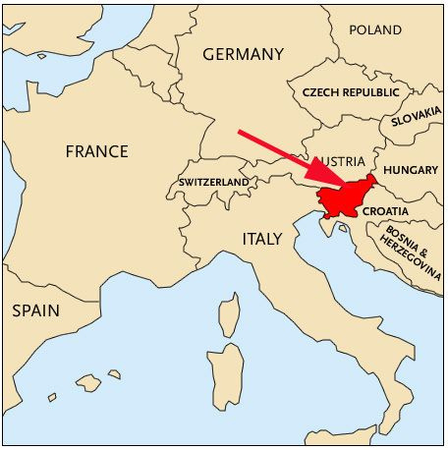
PROFILE OF SLOVENIA
Location:
Size:
Inhabitants:
Capital city:
Language:
Religion:
Currency:
Political system:
20.273km2
2.1M
Ljubljana
Slovenian ( + Hungarian & Italian)
Catholics,…
€, 2007 (previously, tolar)
Parliamentary Democratic Republic
with a proportional electoral system

Slide 4
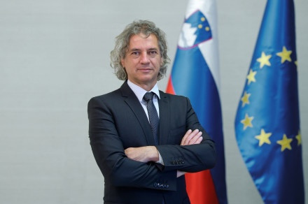
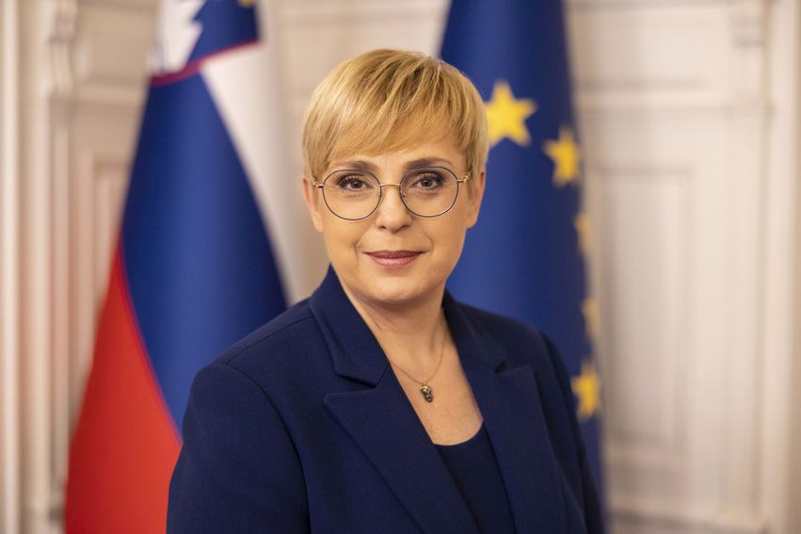



Prime Minister: President of the Republic:
Robert Golob Nataša Pirc Musar
Green social liberal political party
(“Freedom Movement”)

Slide 5


BRIEF HISTORY
1929
Kingdom of Serbs,
Croats and Slovenes
Independence of Slovenia
(+Constitution)
Austro-Hungarian
Empire
Yugoslavia
WWII: occupied
After the War:
Yugoslavia = federal communist state
(Slovenia = one of its constituent republics)
of name
1918
1991
1992: Recognized by the EU

Slide 6
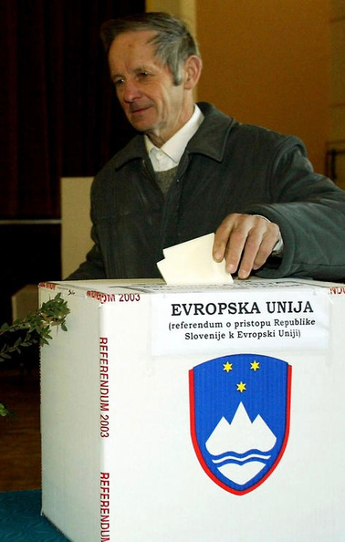
WHEN DID SLOVENIA JOINED THE EU?
Formal application: June 10, 1996
Europe Agreement: June 10, 1996
Member since: May 1 2004
Fifth and largest Enlargement —> “Fast track” group
Referendum: March 23, 2003
(89.61% voting for EU membership)

Slide 7

WHY DID SLOVENIA JOINED THE EU?
  Economic strategy
  IDENTITY: Slovenia identified with Europe
  Crucial step —> INDEPENDENCE : affirmation in the international arena
Triple transition
Democracy — Free market — Independence

Slide 8
WHAT EUROPE DOES SLOVENIA SEEK?
  EUROZONE: January 1, 2007
  SCHENGEN ZONE: December 21, 2007
  EU ENLARGEMENT: extending the EU to the Western Balkans
  EU BUDGET: Net beneficiary
  SECURITY & DEFENSE: NATO and EU frameworks
“MORE” EUROPE

Slide 9
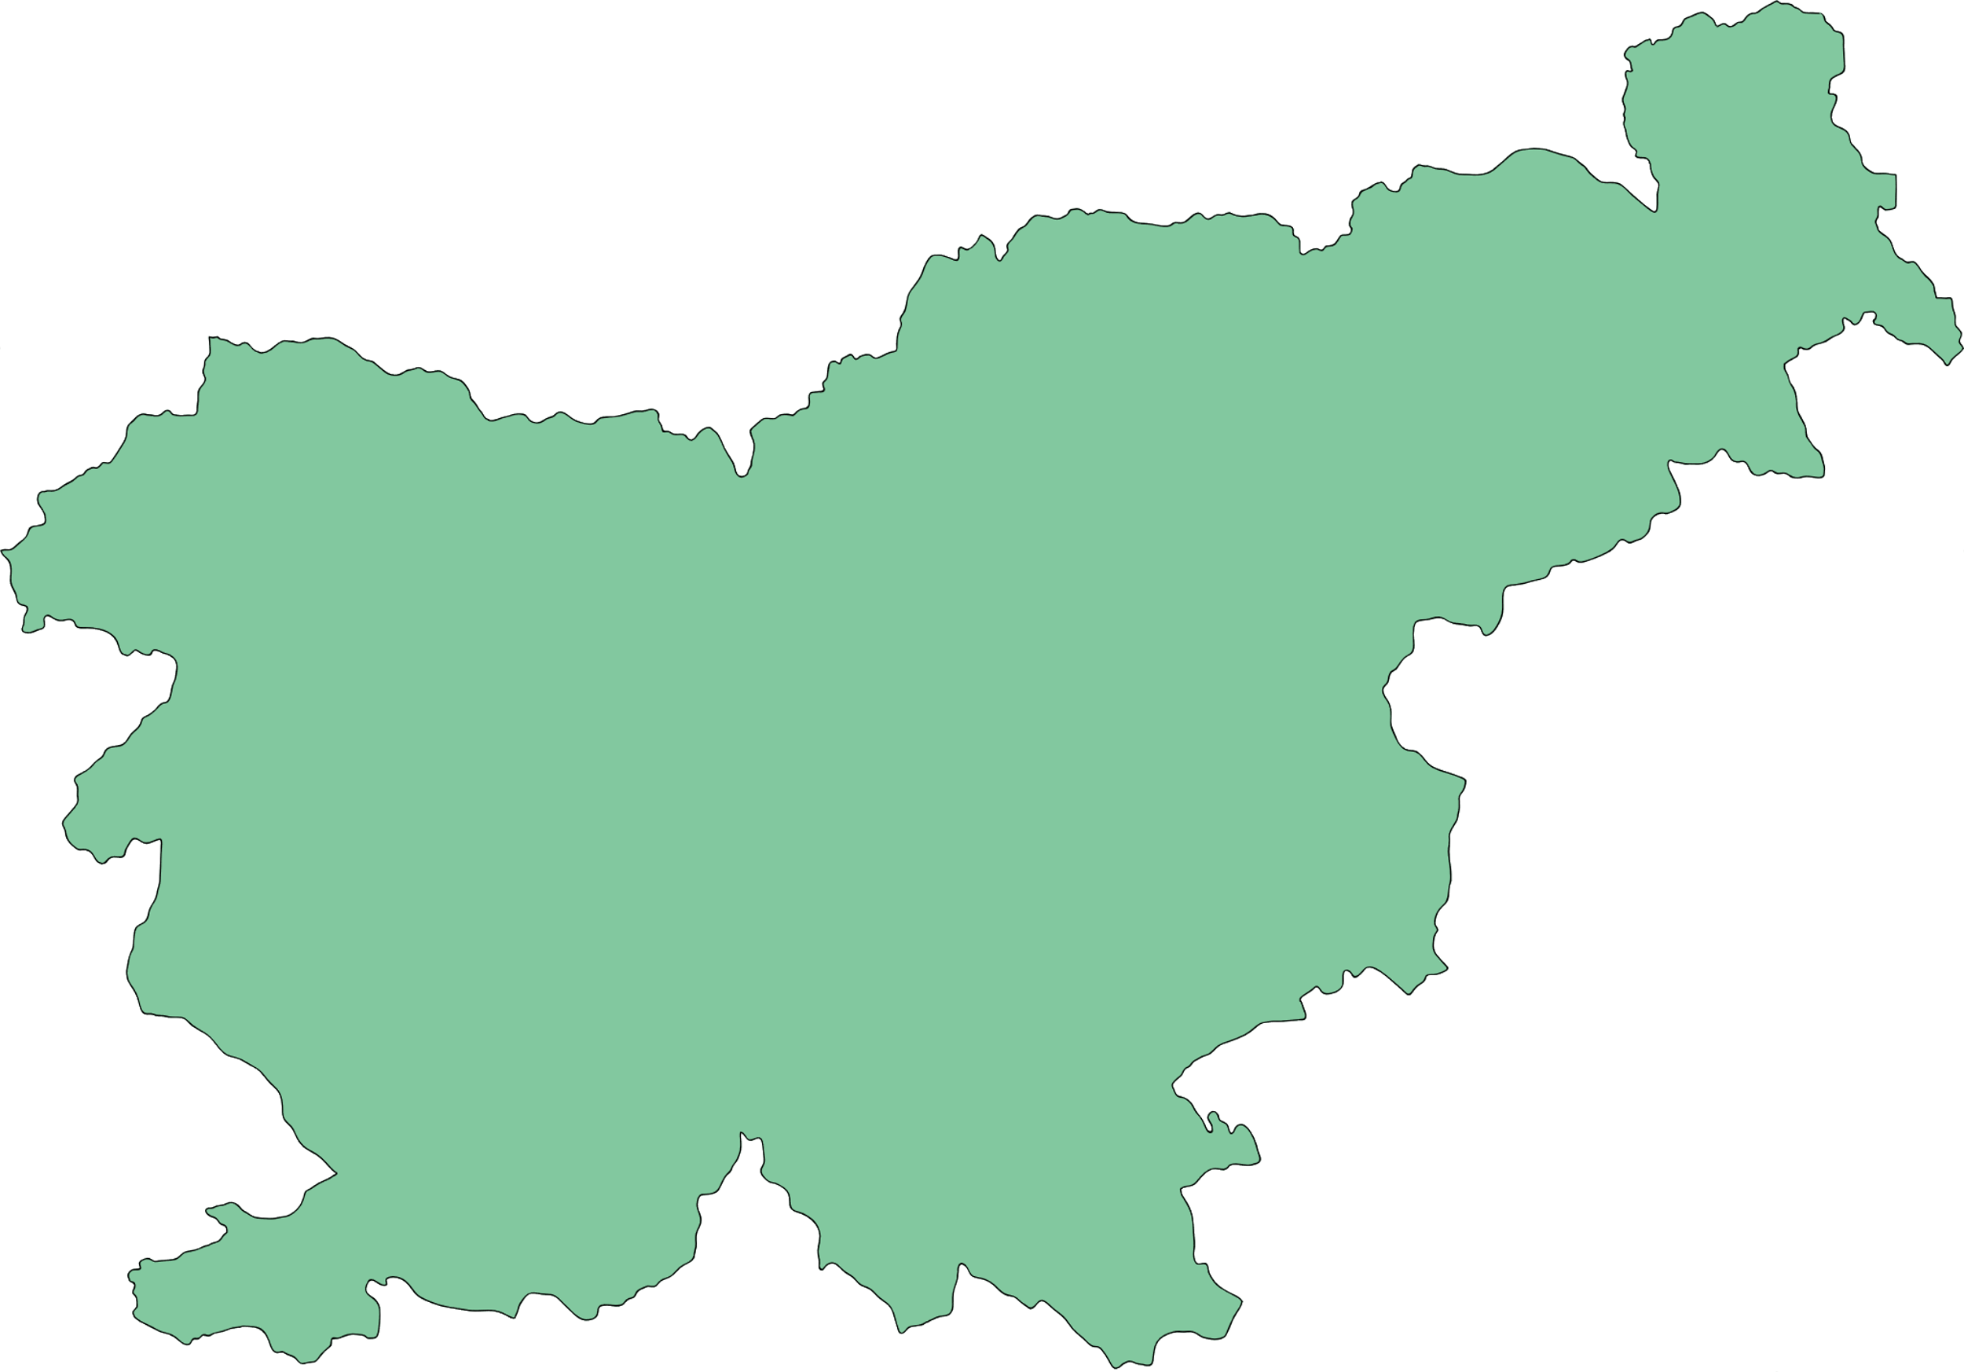
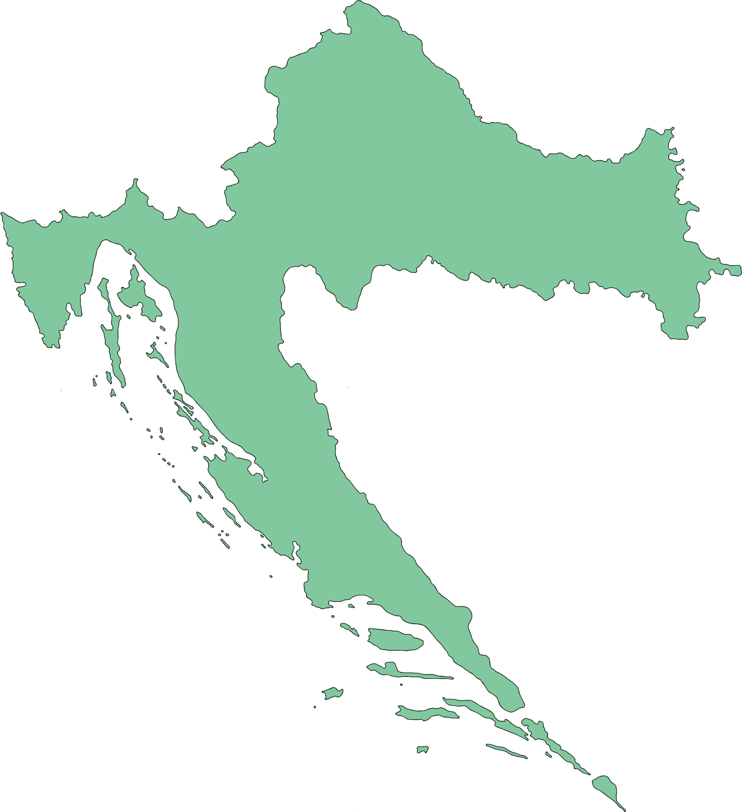
CROATIAN-SLOVENIAN BORDER ISSUE & CROATIAN ACCESSION NEGOTIATION TO THE EU
Since: the dissolution of Yugoslavia
Slovenia attempted to use the accession negotiation as a lever to settle the border issue —> blocked of Croatia’s membership negotiations.
Solution:
  separate one issue from the other
  present the case to the ICJ: Arbitration

Slide 10
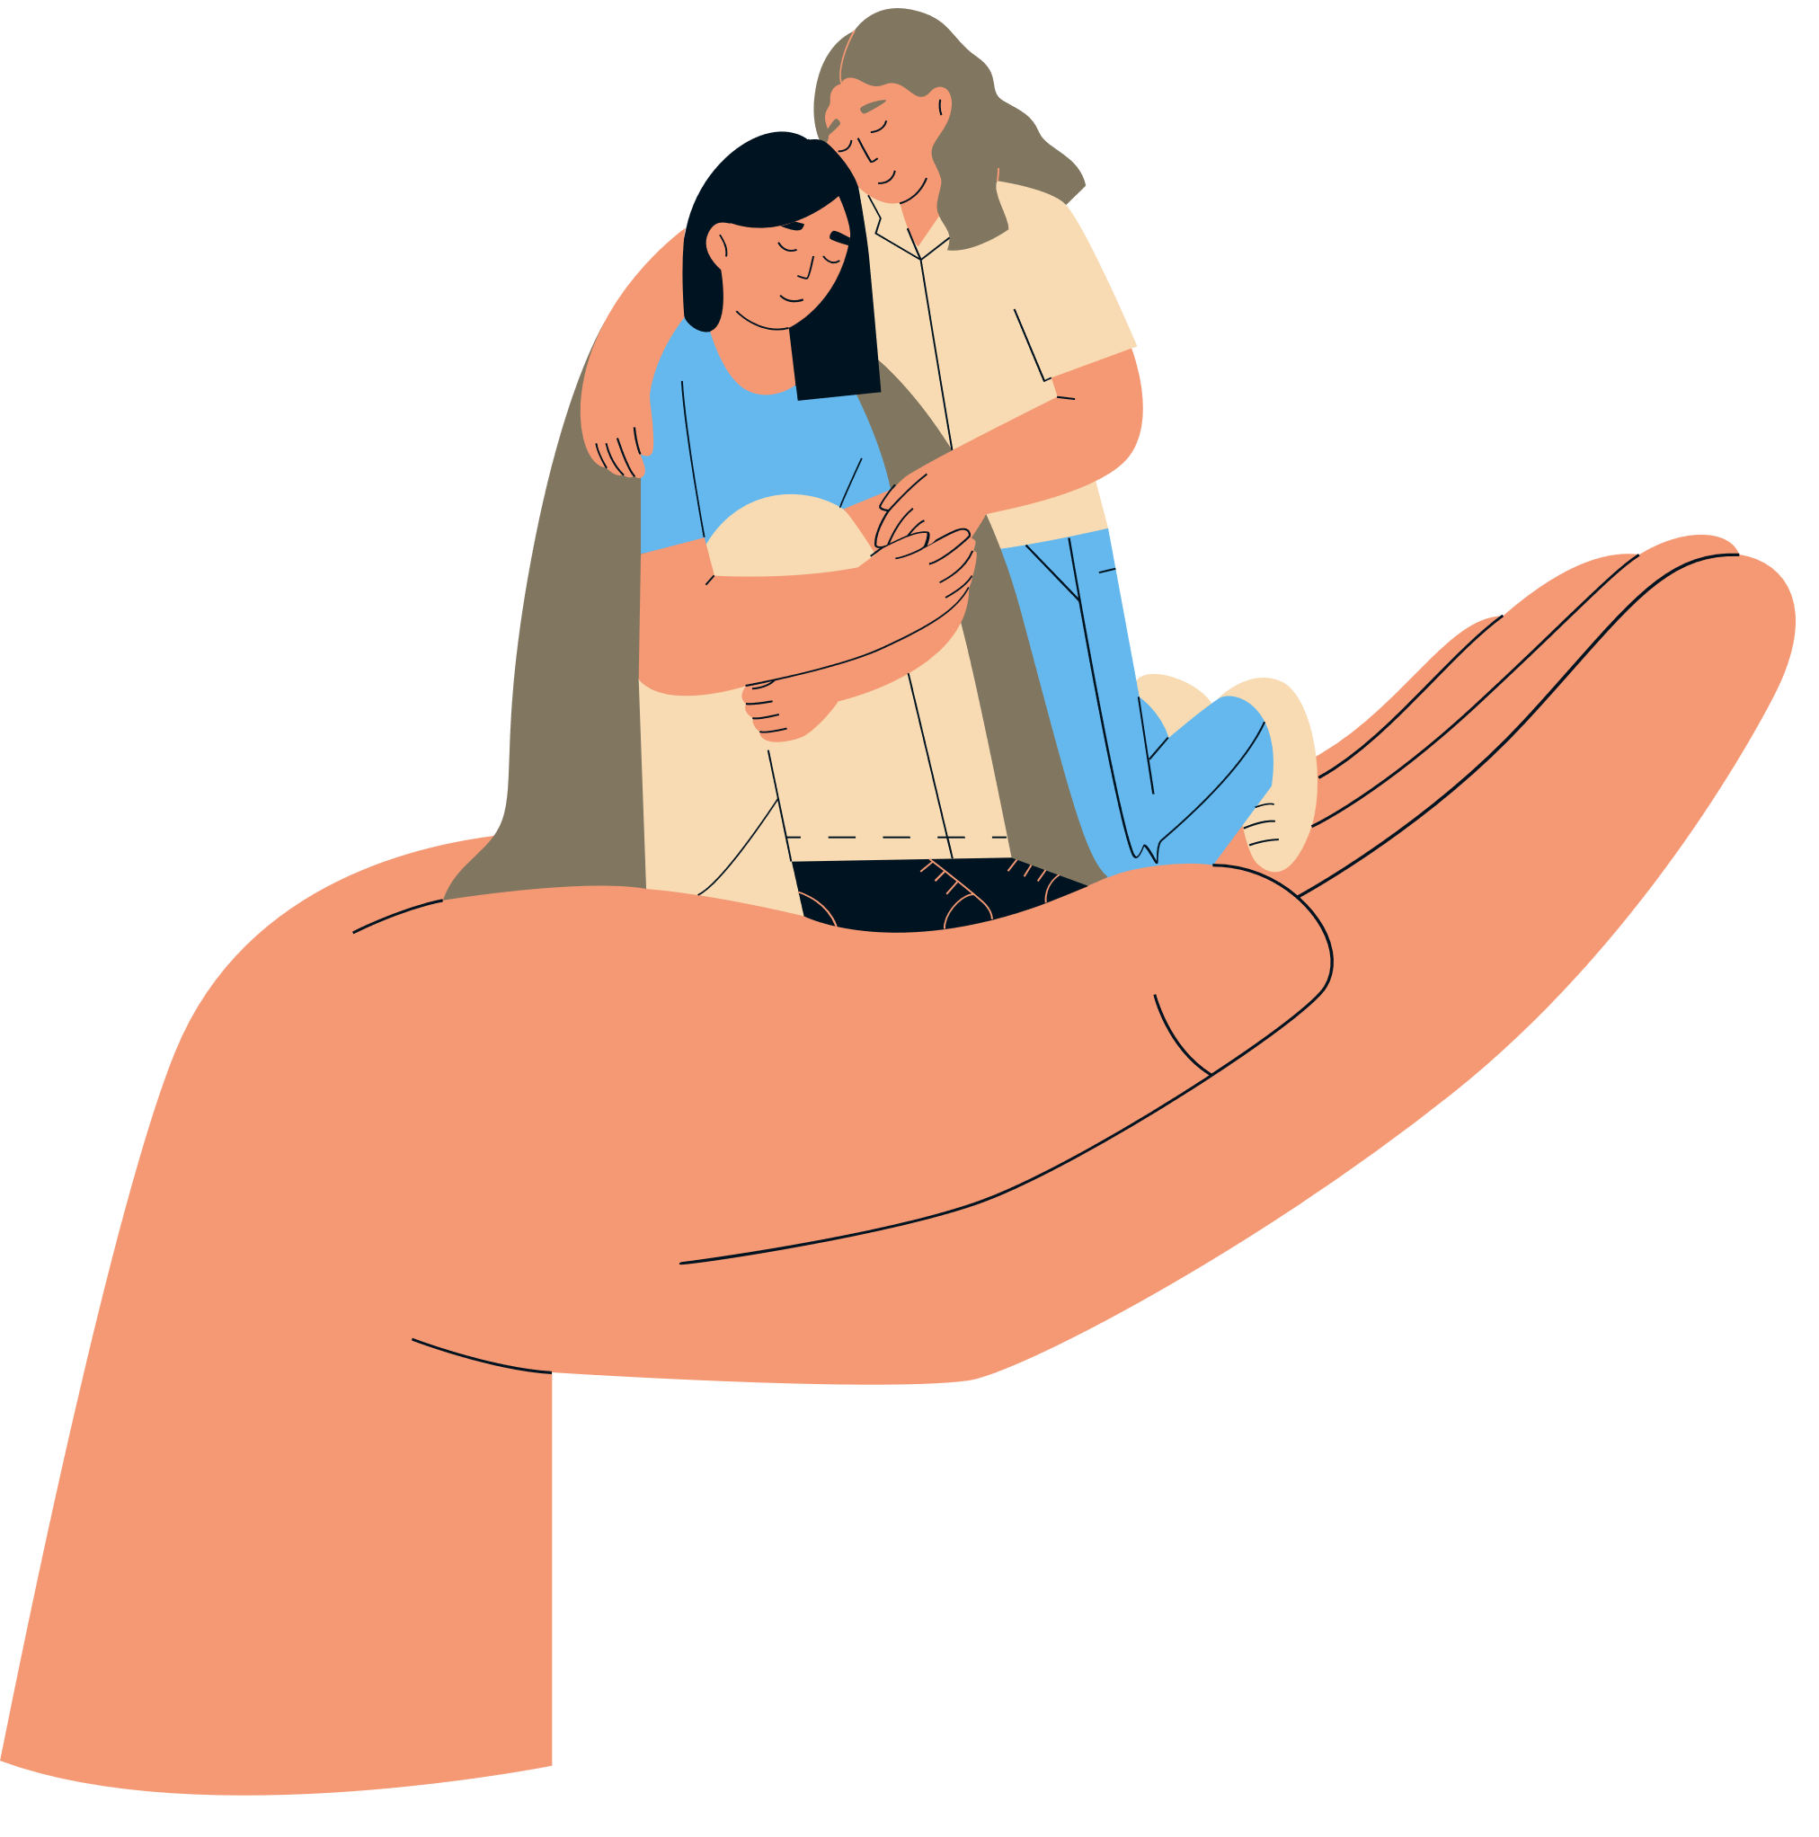
REFUGEE CRISIS
Sloven﻿ia = TRANSIT COUNTRY for asylum
An ideal state for refugees (being a member of the EU and Schengen Area)
2015 and 2016: sizable increase in refugees (mostly from the Syrian War)
2021: “No more “Refugees welcome””, Slovenian minister. The EU must seal borders.
June 2022, new government would remove a fence built in 2015 on its border with Croatia.
Temporary protection for Ukraine refugees.

Slide 11
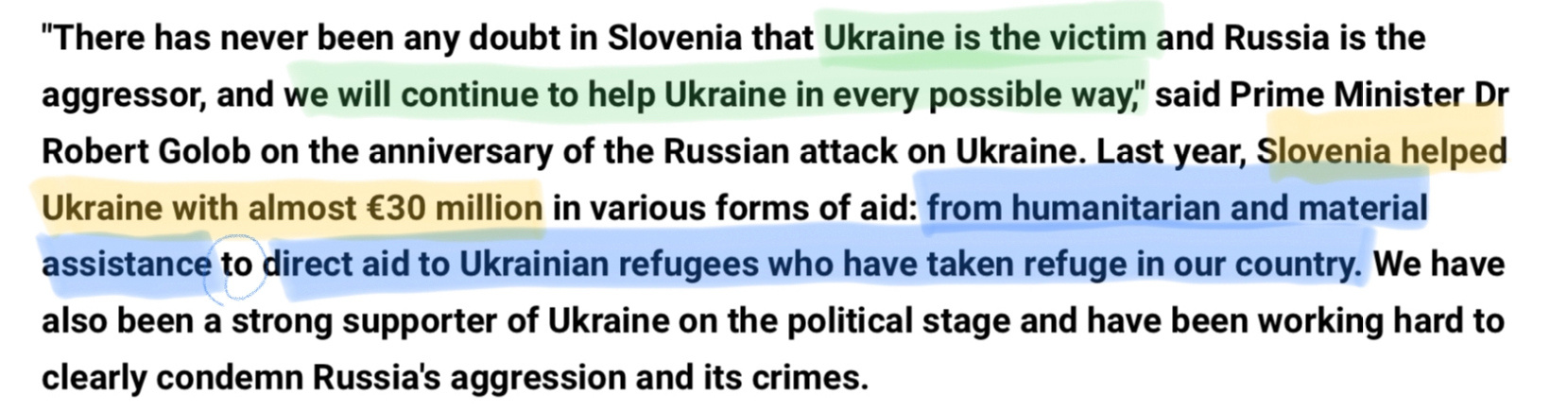
THE RUSSIAN-UKRAINE WAR CRISIS

Slide 12
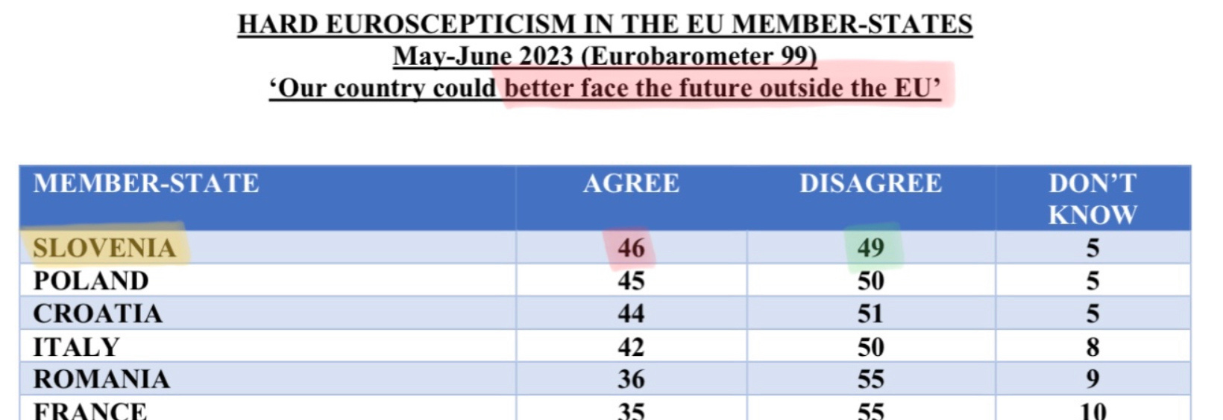
HARD EUROSCEPTICISM

Slide 13
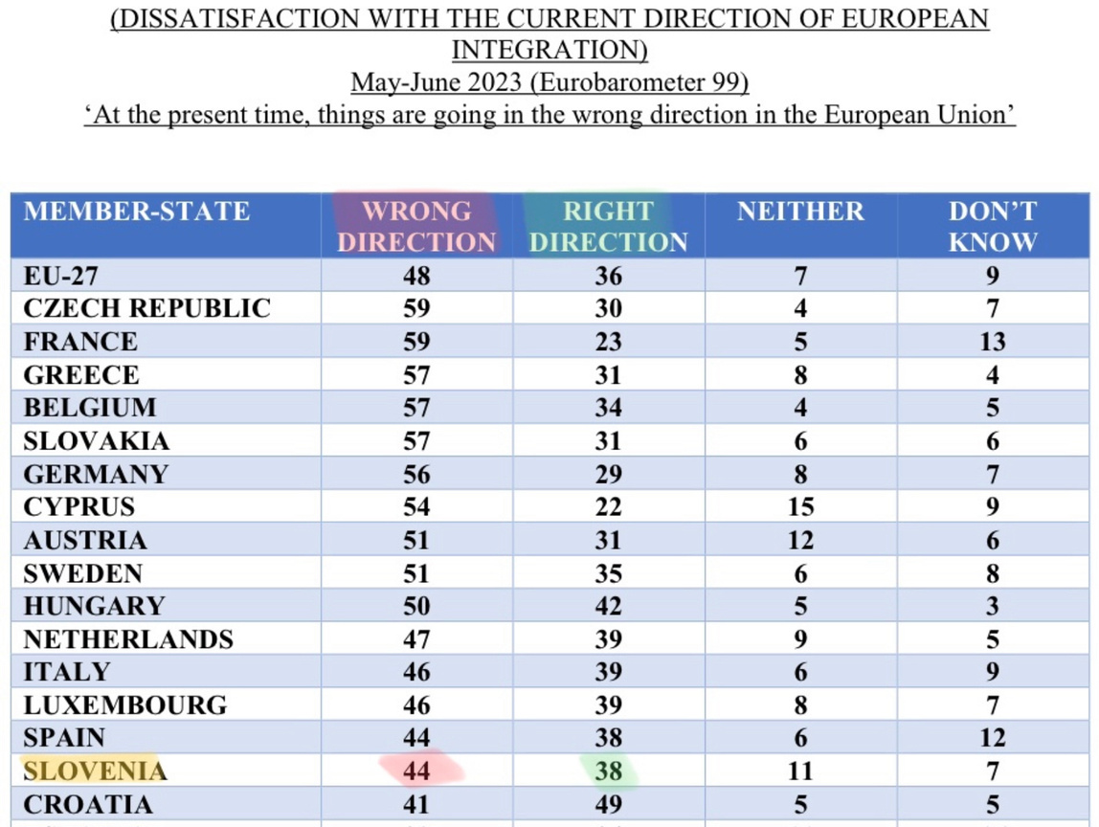
SOFT EUROSCEPTICISM

Slide 14

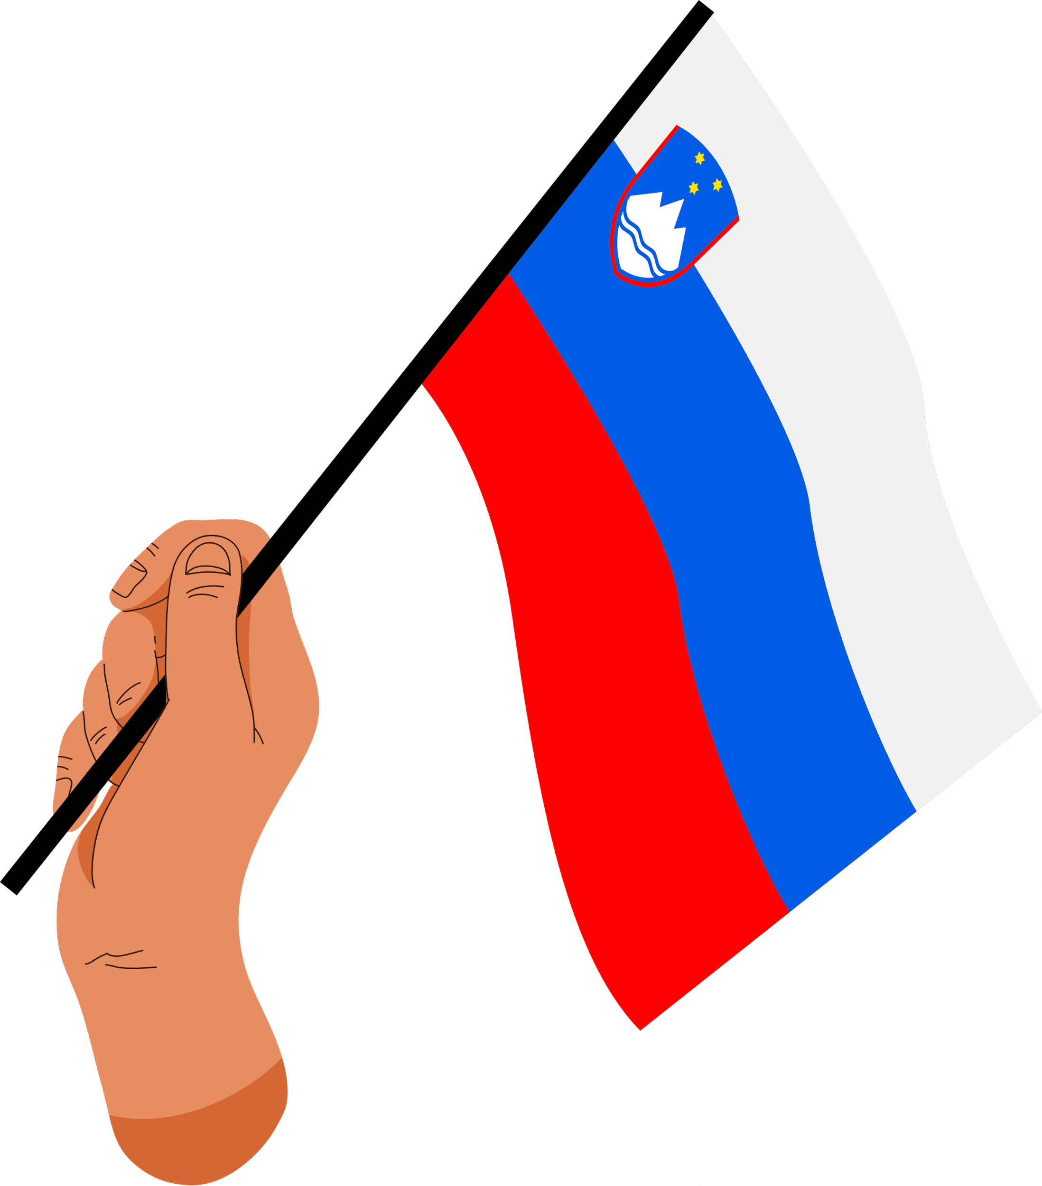
THANK YOU
DO YOU HAVE ANY QUESTIONS?

