Slide 1
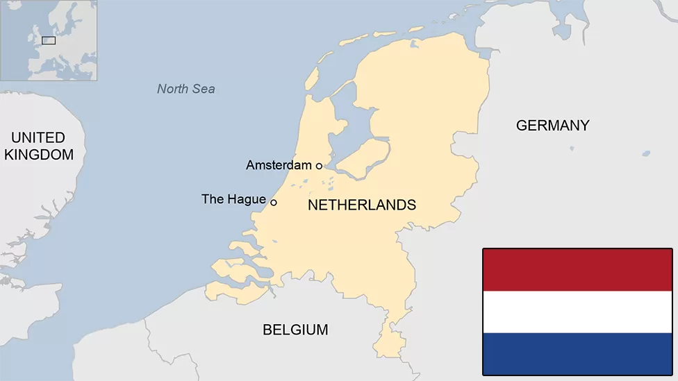
THE NETHERLANDS
THE NETHERLANDS
THE EUROPEAN POLITICY IN THE EU
COURSE:THE EUROPEAN POLICIES OF THE EU MEMBER-STATES
MARKELA LILE
DEPARTMENT OF POLITICAL SCIENCE AND PUBLIC ADMINISTRATION, UNIVERSITY OF ATHENS

Slide 2
1. BASIC INFORMATION
2. HISTORY
3. POLITICAL SYSTEM
4. POLITICAL PARTIES-ELECTIONS
5. THE NETHERLANDS AND THE EU i)place on map ii) economy iii)Euroscepticism
6. FRUGAL FOUR
7. BREXIT
8. UKRAINE-RUSSIA WAR

Slide 3
BASIC INFORMATION
CAPITAL CITY: Amsterdam
SEAT OF THE GOVERNMENT: The Hague
POPULATION: 17.9M
POLITICAL SYSTEM: Constitutional monarchy
PRIME MINISTER: Mark Rutte(since 2010)
THE KING: Willem-Alexander of the Netherlands

Slide 4
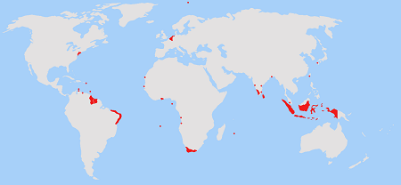
HISTORY: THE DUTCH EMPIRE

Slide 5
THE COLONIES
The Dutch Empire was a colonial empire controlled by the Netherlands.
The Dutch Empire consisted of both settler colonies, in which Dutch people moved overseas and began new lives (while also suppressing indigenous people), as well as commercial colonies that consisted of trading posts in distant regions.
The Dutch East India Company was a major institution in the Dutch colonial empire; it controlled Dutch colonies in the Indian and Pacific Oceans.
ASIA
INDONESIA( DUTCH EAST AND WEST INDIA COMPANY)
DUTCH CEYLON(SRI LANKA)
FORMOSA(TAIWAN)
DESHIMA
NEW HOLLAND
IRAN
PAKISTAN
SOUTH AFRICA
THE AMERICAS-> NEW NETHERLANDS, DUTCH WEST INDIES ETC
EUROPE

Slide 6
.
THE DUTCH POLITICAL SYSTEM IN AN NUTSHELL

Slide 7
CONSTITUTIONAL MONARCHY
The Netherlands is a Constitutional Monarchy. Τhis means that the Dutch monarch’s powers are regulated by the Constitution.

Slide 8
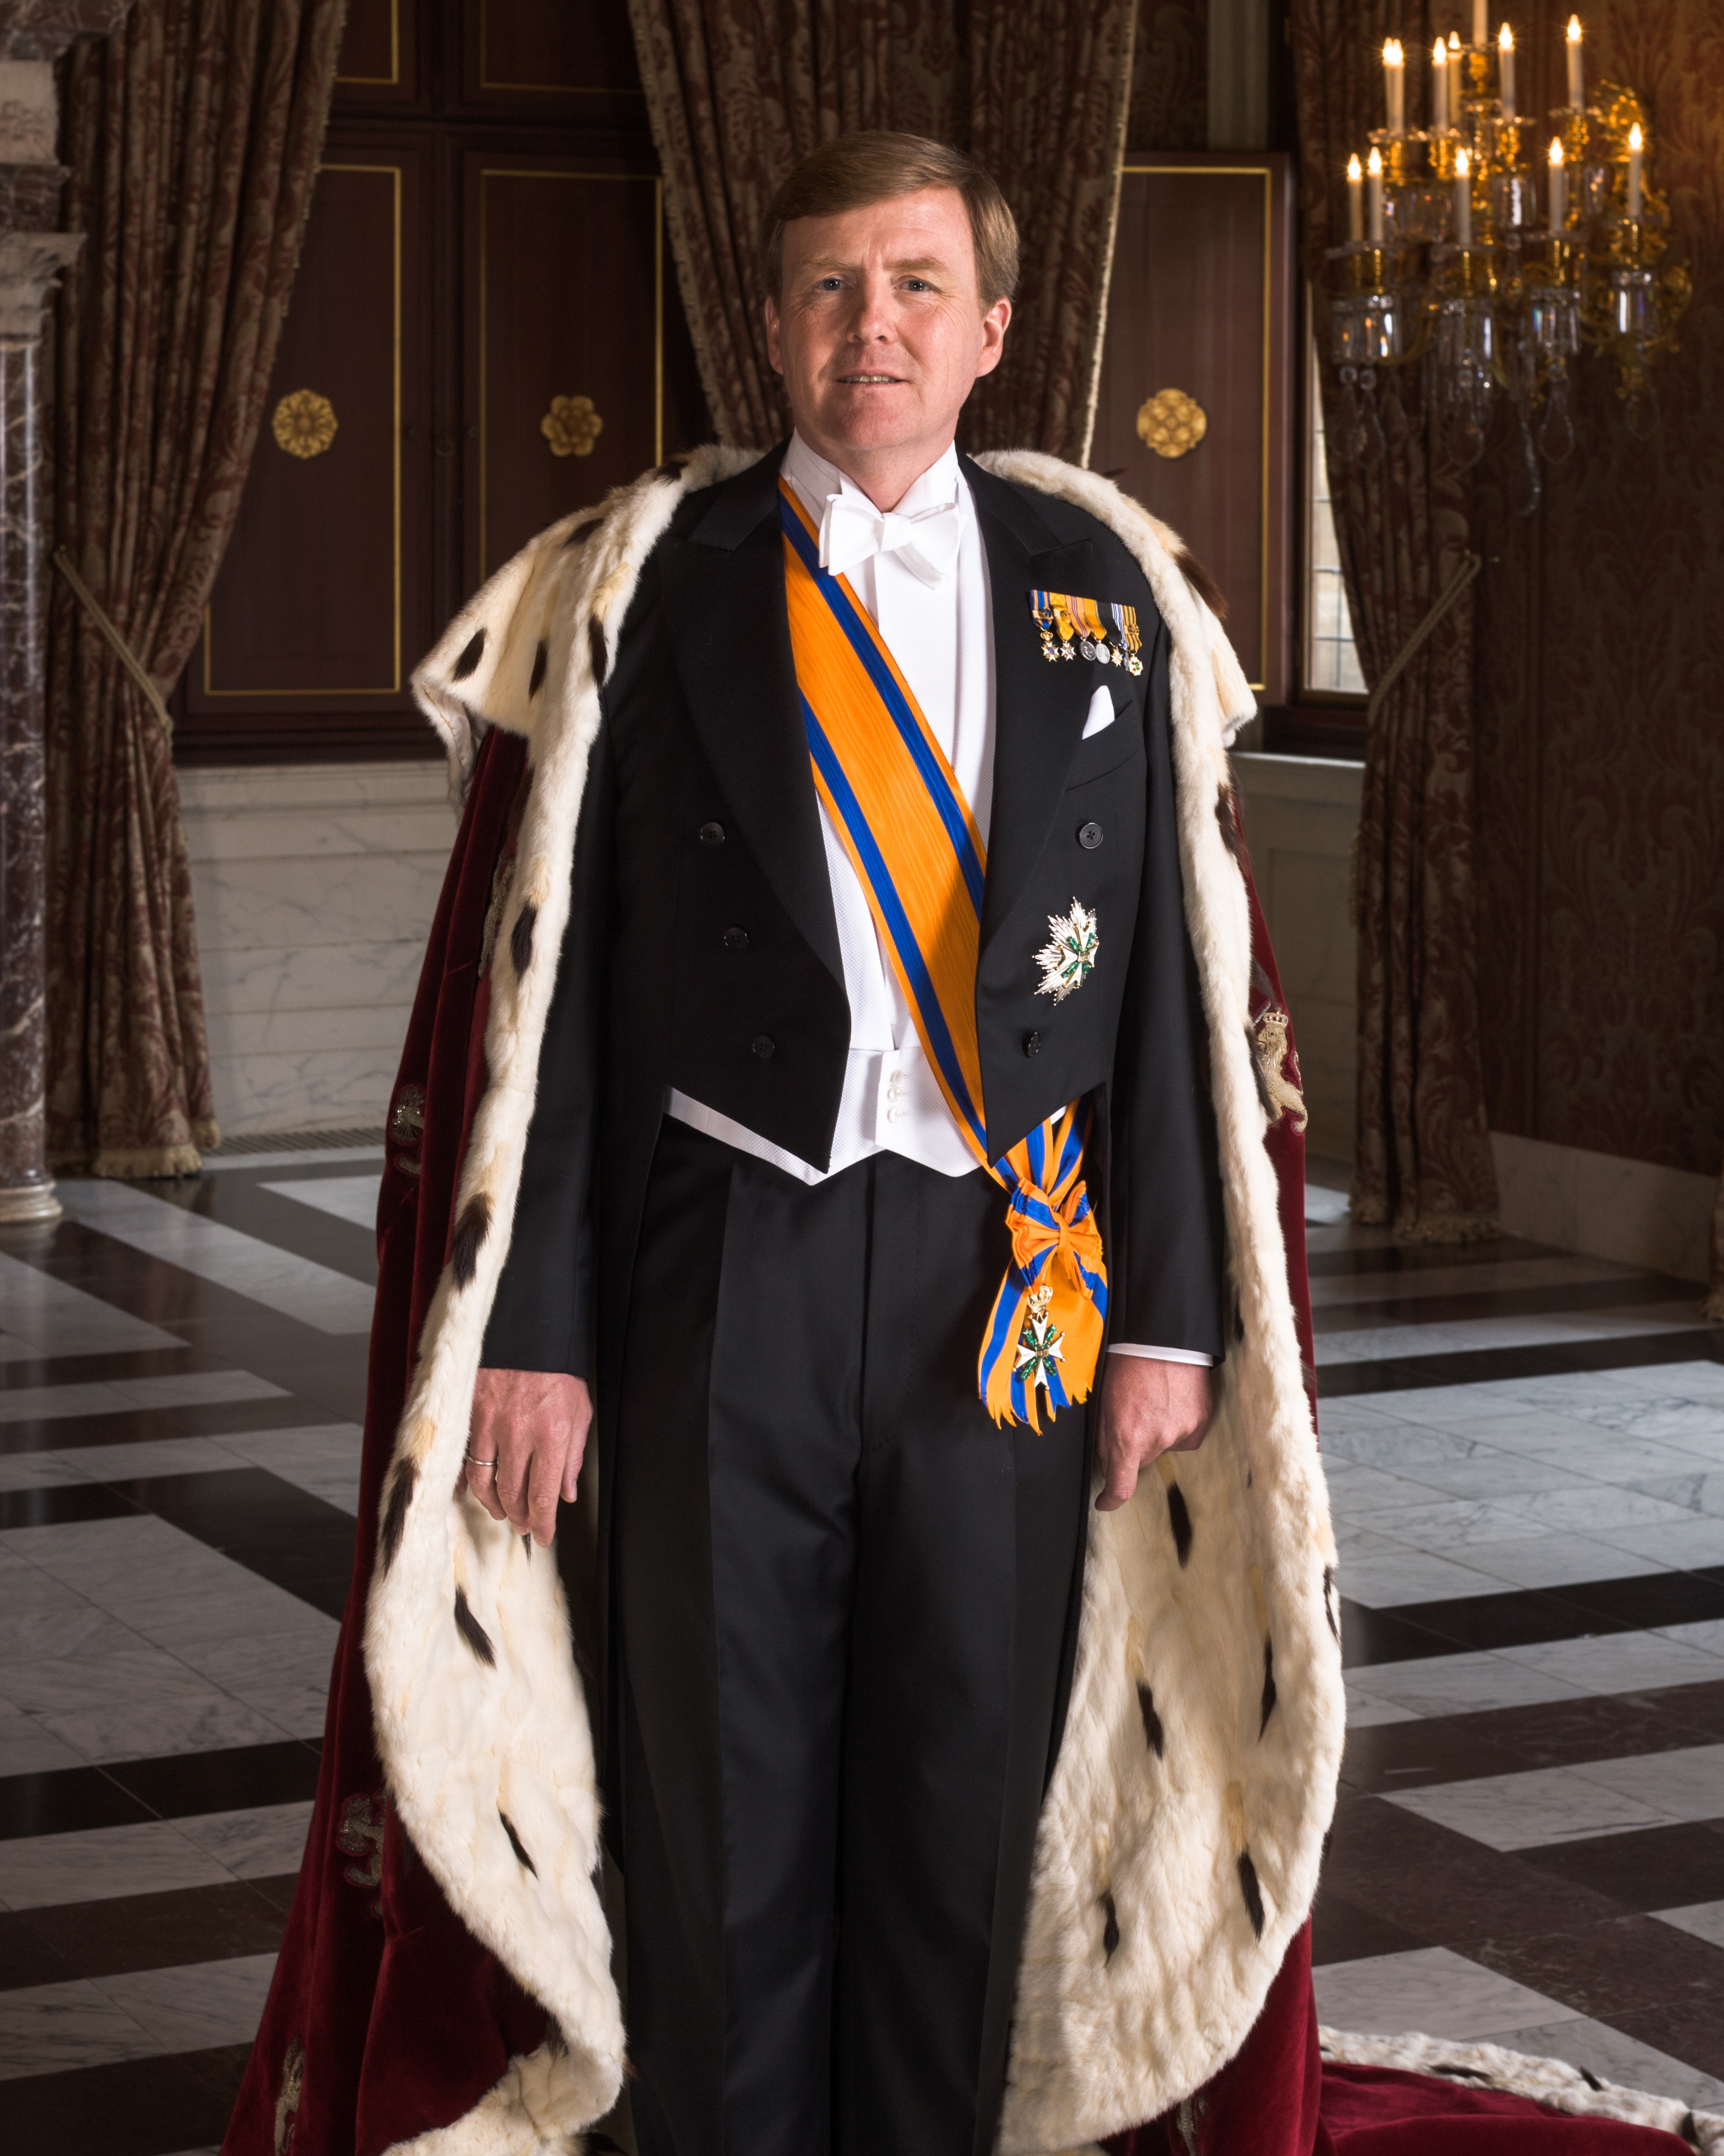
THE KING OF THE NETHERLANDS
King Willem-Alexander

Slide 9
DUTCH POLITICAL PARTIES

Slide 10
VVD (The people’s party for freedom and democracy): liberal, center-right 34 SEATS
LABOUR PARTY : social-democratic, center-left 9 SEATS
DEMOCRATS 66 (D66) : Centre, Centre-left, social liberal 24 SEATS
CDA(CHRISTIAN DEMOCRATIC APPEAL): Centre-right 14 SEATS
PVV(THE PARTY FOR FREEDOM: nationalist conservative, right populistic, anti-Islam- far-right 17 SEATS
SOCIALIST PARTY: from communism to democratic socialism, left-wing 9 SEATS
CHRISTIAN UNION: anti- abortion, euthanasia and gay marriage. 5 SEATS

Slide 11
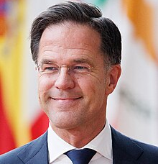
MARK RUTTE: THE PRIME MINISTER
2010: VVD won 31 seats in the house of Representative. Rutte became the first liberal prime minister to serve since Pieter Cort van der Linder in 1918 and also the youngest PM in Dutch history
2011: early collapse of the government
2012: +10 seats for VVD. Coalition agreement with the labour party.
2017: -8 seats. Big coalition with CDA, D66 and CU. Judgments about Rutte’s management to the 2017 Dutch-Turkish diplomatic incident.
2021: 34 seats. Government with D66, CDA, CU. Scandal about violating the archival law.
2 AUGUST 2022: the longest-serving Dutch prime minister.
JULY 2023: Announcement about the departure of Mark Rutte as a political leader of VVD.

Slide 12
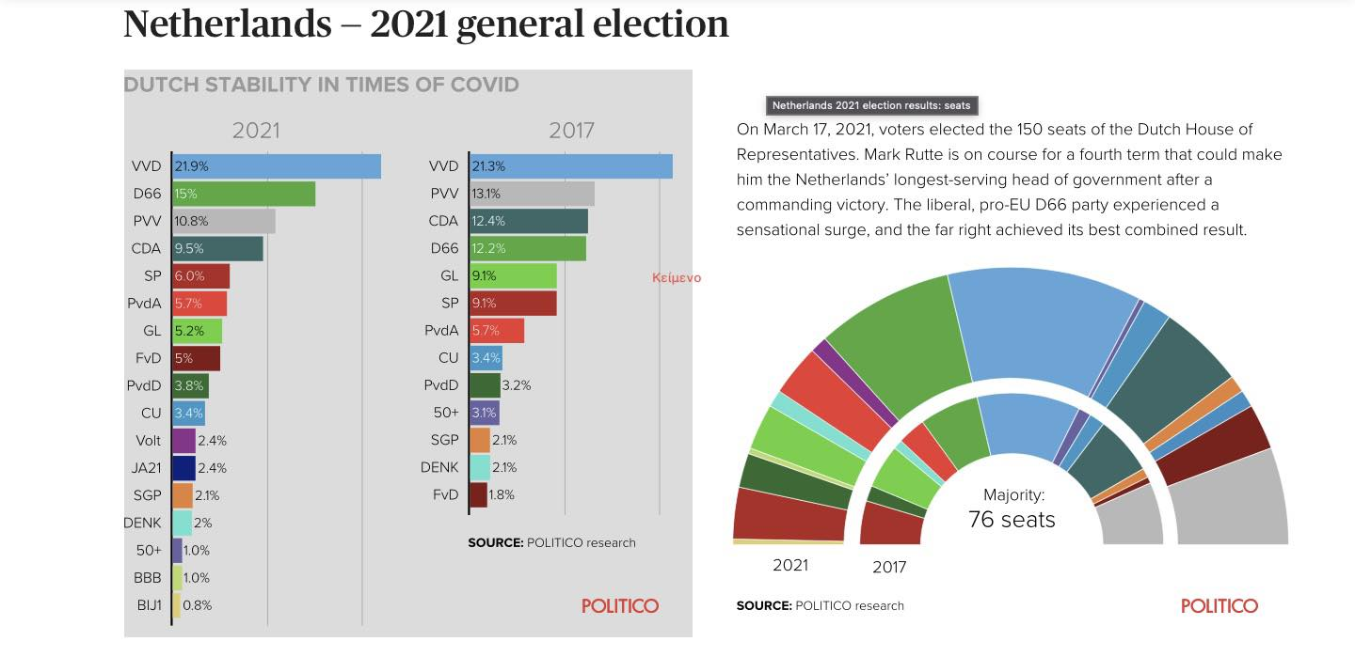
THE 2021 ELECTIONS

Slide 13
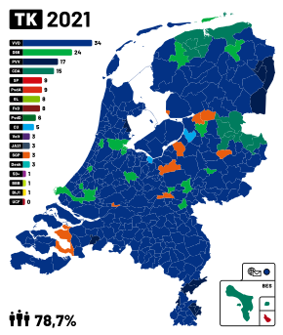
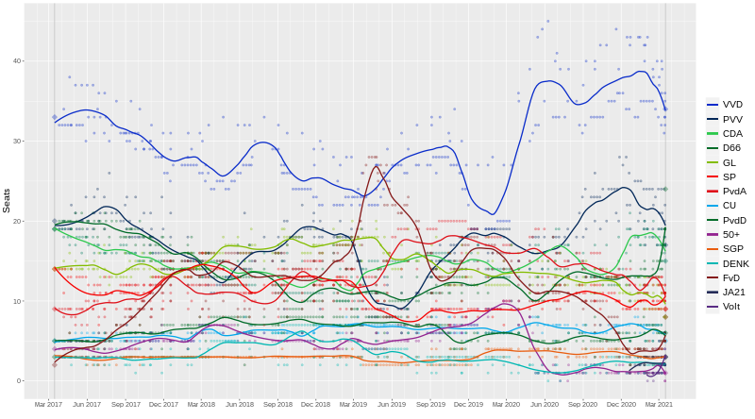
Largest political party by municipality
PREDICTIONS ABOUT THE 2023 ELECTION ON NOVEMBER

Slide 14
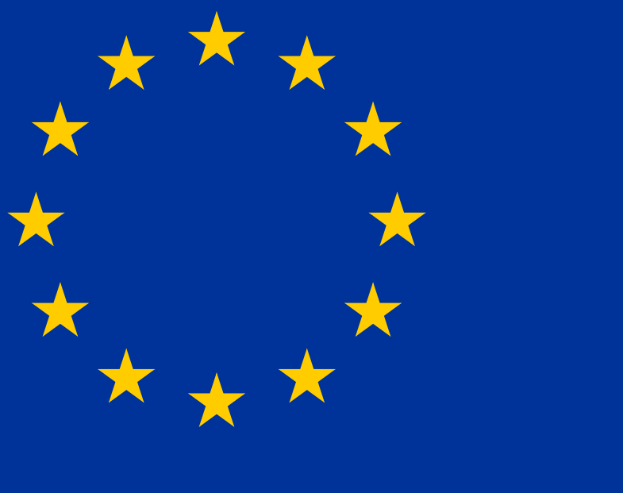
THE NETHERLANDS AND THE EU

Slide 15
BASIC EU INFORMATION
ENTRY: 1 JANUARY 1958
CURRENCY: EURO (euro-area member since 1 January 1999)
SCHENGEN AREA: 26 MARCH 1995
EUROPEAN PARLIAMENT: 29 members
LAST PRESIDENCY OF THE COUNCIL OF THE EU: JAN-JUN 2016
EU BUDGET: In 2022 the Netherlands remitted €10 billion to the EU (after deduction of the compensation for collection of import duties). The Netherlands has been a ‘net contributor’ since the mid-1990s. It pays more to the EU than it receives from it.

Slide 16
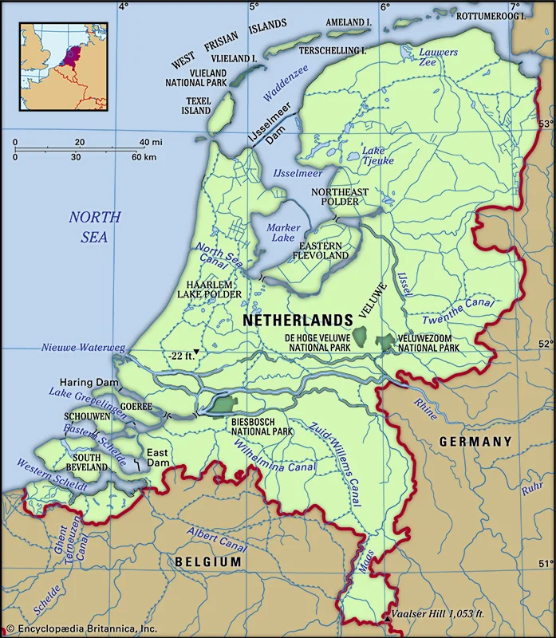
PLACE ON THE MAP

Slide 17
TRADE AND ECONOMY
Public administration, defense, education, human health, social work activities (21.7%)
1
Wholesale & retail trade, transport, accommodation, food services (20.4%)
2
Professional, scientific, technical activities; administrative and support service activities (14.7%)
3

Slide 18
EXPORTS
IN THE EU
GERMANY 23%
BELGIUM 10%
FRANCE 9%
OUTSIDE THE EU
UNITED STATES 8%
UNITED KINGDOM 4%
IMPORTS
FROM THE EU
GERMANY 15%
BELGIUM 8%
OUTSIDE THE EU
CHINA 17%
UNITED STATES 8%

Slide 19
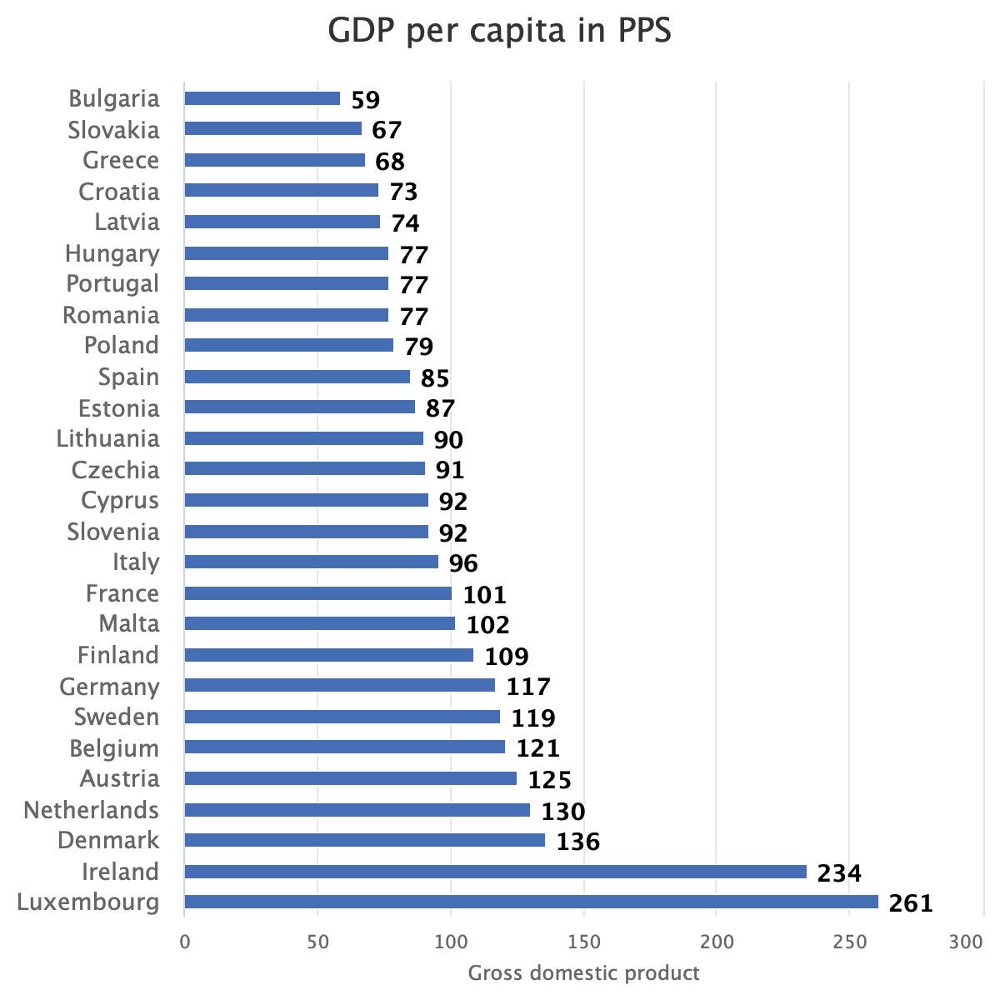
GDP: 1.3trillion
GDP RANK: 18th
GDP PER CAPITA:72,973$
BIG ECONOMY VALUE FROM:
GRONINGEN GAS FIELD
ROTTERDAM’S PORT
AMSTERDAM’S AIRPORT

Slide 20
EUROSCEPTISISM
The Netherlands have been a very pro-European country, being one of the six founding members of the European Coal and Steel Community in 1952.
2000’s: First time it became slightly Eurosceptic by rejecting the European Constitution in 2005.
PUBLIC OPINION:EUROBAROMETER-> WRONG DIRECTION:47
RIGHT DIRECTION:39 (soft Euroscepticism)
‘Our country could better face the future outside the EU?’: 14 AGREE
- 83 DISAGREE
SOME DUTCH EUROSCEPTIC PARTIES: i) Party of freedom(Eurosceptic, anti-Islamic) -> hard Eurosceptic party. It wants the Netherlands to leave the EU(WHY? money costing, cannot close the borders for immigrants)
ii) Forum for Democracy→ against the Association Agreement between the EU and Ukraine.
iii) The Socialist Party -> European co-operation is essential for climate change and international crime

Slide 21
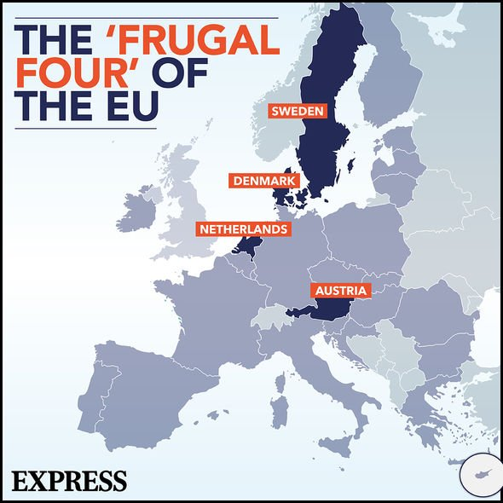
The Frugal Four is the nickname of an informal cooperation among some European countries, including Austria, Denmark, the Netherlands and Sweden. It partly evolved as a successor of the New Hanseatic League that was set up to make up for the loss of the United Kingdom in the European political arena after Brexit.
MAIN GOAL: Budget contribution-maximum 1% of the EU’s gross national income.
Initially opposed the European Recovery Ιnitiative after the pandemic.

Slide 22
FRUGAL FOUR HEADS OF GOVERNMENT 2023
NETHERLANDS
DENMARK
METTE FREDERIKSEN, PRIME MINISTER
AUSTRIA
KARL NEHAMMER,
CHANCELLOR
SWEDEN
ULF KRISTERSSON,
PRIME MINISTER
MARK RUTTE,PRIME MINISTER

Slide 23
BREXIT AND THE NETHERLANDS: UK
The UK was one of its main trading partners and tens of thousands of Dutch citizens resided, studied, or lived in the UK on the basis of their EU citizenship, and vice versa.
GOAL: EU unity-> the Netherlands mainly focused on i) citizens' rights, ii) the settlement of financial obligations, and iii) border issues, especially those between Ireland and Northern Ireland.
Total UK exports to Netherlands->£56.5 billion in the end of 2023 (an increase of 20.5% from 2022);
Total UK imports from Netherlands ->£65.7 billion in the end of 2023 (an increase of 43.9% from 2022).

Slide 24
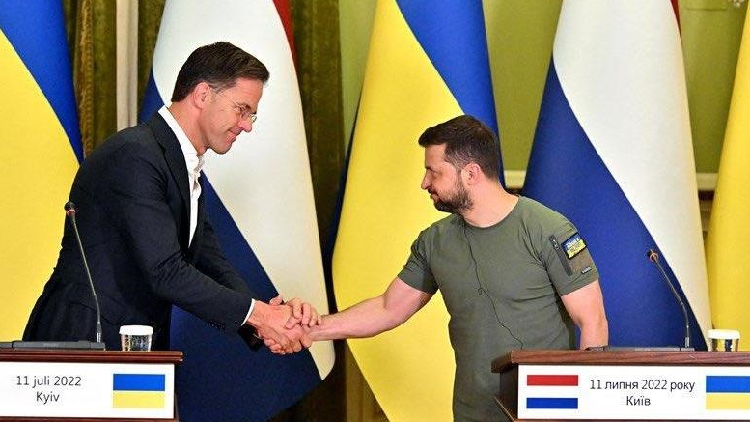
THE RUSSIAN-UKRAINIAN WAR: THE DUTCH VIEW

Slide 25
As a member of NATO, the EU and the Organization for Security and Co operation in Europe (OSCE), the Netherlands made clear the importance of diplomacy and dialogue.
The Netherlands supports EU sanctions against Russia following Russia’s attack on Ukraine. The Netherlands is also providing military goods to Ukraine.
It is providing humanitarian, economic, and military support. In fact, since the war started, the Dutch government has:
Made at least €40 million available for emergency aid for victims of the war and financially supported international humanitarian organizations;
Sent (and continues to send) medicine and aid supplies;
Supplied more than €65 million in military goods to Ukraine(heavy weaponry, armored vehicles etc)
Supported the EU-imposed sanctions against Russia.

Slide 26
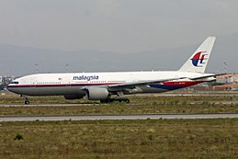
Malaysia Airlines Flight 17
Malaysia Airlines Flight 17 (MH17/MAS17) was a scheduled passenger flight from Amsterdam to Kuala Lumpur that was shot down by Russian-controlled forces on 17 July 2014, while flying over eastern Ukraine. All 283 passengers and 15 crew were killed.

Slide 27
-THE END-

