Slide 1
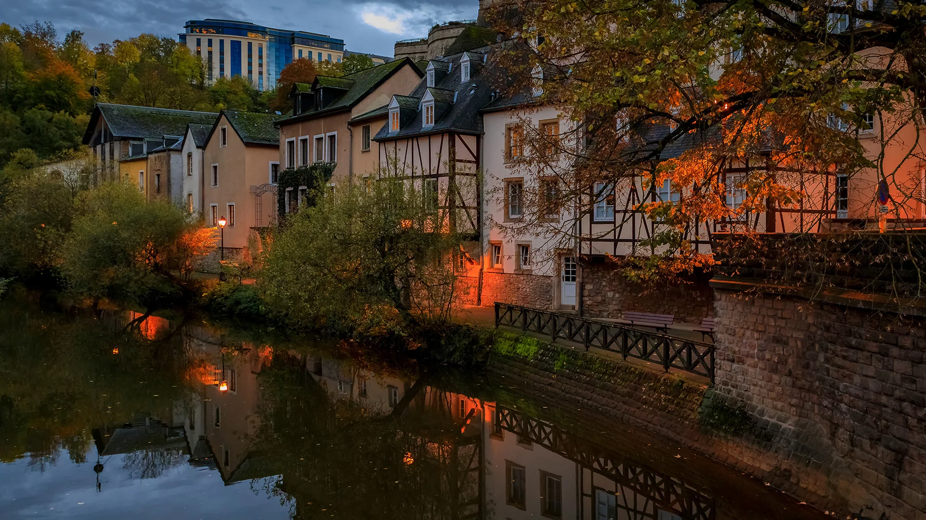
Structure
Fun facts about Luxembourg
About Luxembourg
LuxLeaks
Luxembourg in the EU
Personalities
Euroscepticism
LUXEMBOURG
David Schneider

Slide 2
Structure
Fun facts about Luxembourg
About Luxembourg
LuxLeaks
Luxembourg in the EU
Personalities
Euroscepticism
David Schneider

Slide 3
Fun fact time
How many Universities does Luxembourg have?
“Chiggeri” holds the record for the most varieties of wine commercially available – How many?
How much is the minimum wage in Luxembourg?

Slide 4
About Luxembourg
Capital: Luxembourg
Official Languages: German; French, Luxembourgish
System of Government: Democracy
EU member country since: 1958
Early member/founder of the “Schengen Area”

Slide 5
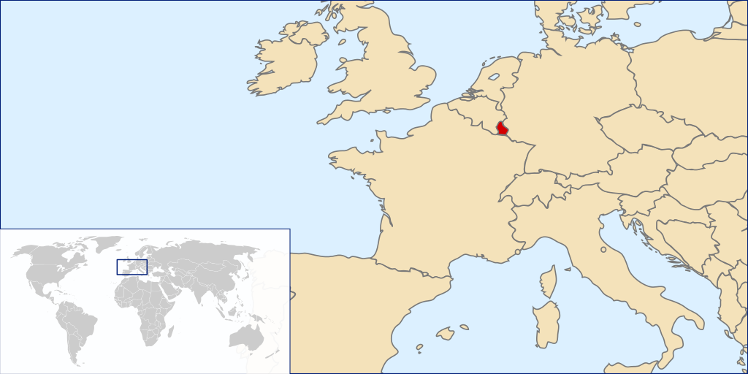
Geographic stats
Second smallest country in the EU
2.586 km² surface area
660.809 inhabitants
Pic. 1

Slide 6
Living standards
Pic. 2

Slide 7
Economy
Exports ~ 16billion$
Mostly to: Germany (25%), France (16%), Belgium (12,7%), Netherlands (6%) and Italy (4,2%)
Imports ~ 25,5billion$
Mostly from Germany (23,6%), Belgium (23,5%), France (12,2% and Netherlands (4,22%)

Slide 8
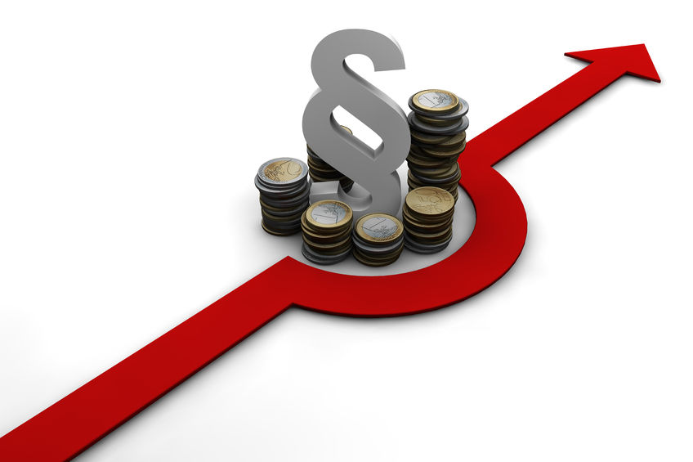
LuxLeaks
Finance scandal 2014
Investigation by the ICIJ
Public making of confidential information about Luxembourg tax rulings
300+ multinational companies involved
Pic. 3

Slide 9
Different Destinies
No multinational company was charged
Two whistleblowers got condemned in the trials
ICIJ got rewarded with the United States top journalism award
Heavy critics for Jean-Claude Juncker

Slide 10
Impact of LuxLeaks
Pierre Gramegna describes LuxLeaks as the worst attack the country ever experienced
Scandal lead to countless investigations around the world
Raised discussion about tax avoidance in Luxembourg and other countries

Slide 11
Luxembourg and the EU
Nations came together after WW II to prevent such terrible wars in the future
Schuman declaration in 1950
Pooling coal and steel production
European Coal and Steel Community (ESCS) later became the European Union
Necessity of an alliance for Luxembourg
Pic. 4

Slide 12
Luxembourg in the EU
6 members of the European Parliament from Luxembourg
Permanent representation in Brussels to ensure the countries interests and policies are pursued
Home of one of three official headquarters to the EU´s institutions
Three Presidents of the European Commission were from Luxembourg

Slide 13
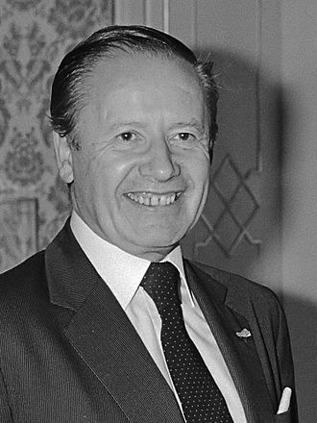
Luxembourg important personalities
Gaston Thorne
Imprisoned for several month during WW II
Engaged in resistance activities during the German occupation
Became president of the commission 1981
Accomplishments like Iberian enlargement, Single European Act
Pic. 5

Slide 14
Euroscepticism in Luxembourg
Pic. 6

Slide 15
Alternative Democratic Reform Party (ADR)
One of the few Eurosceptic parties in Luxembourg
4 seats in the national parliament
5th largest party
Critical stance towards the EU
Soft Euroscepticism
Pic. 7

Slide 16
Influence on the European Union
No seats in the European Parliament
Member of the European Conservatives and Reformists (ESC)
Anti EU-enlargement
6th largest party in the European parliament
Concerns about democratic deficit in the EU and transparency issues

Slide 17
Sources used
Facts: https://www.solosophie.com/fun-cool-weird-interesting-facts-about-luxembourg/
Geographics and Political system: https://european-union.europa.eu/principles-countries-history/country-profiles/luxembourg_en
GDP: https://capital.com/gross-domestic-product-definition
Statistics: https://europa.eu/eurobarometer/surveys/detail/3052
Economy: https://www.lloydsbanktrade.com/en/market-potential/luxembourg/trade-profile
LuxLeaks: https://en.wikipedia.org/wiki/LuxLeaks
LuxLeaks: https://blogs.law.ox.ac.uk/business-law-blog/blog/2021/07/luxleaks-scandal-and-corporate-whistleblowing-reflecting-halet-v
LuxLeaks: https://www.theguardian.com/world/2016/apr/24/luxleaks-antoine-deltour-luxembourg-tax-avoidance-pricewaterhousecoopers-trial
Luxembourg EU: https://european-union.europa.eu/principles-countries-history/history-eu/1945-59/schuman-declaration-may-1950_en
Luxembourg EU: https://european-union.europa.eu/principles-countries-history/country-profiles/luxembourg_en

Slide 18
Sources used
Robert Schuman: https://european-union.europa.eu/principles-countries-history/history-eu/1945-59/schuman-declaration-may-1950_en
Robert Schuman: https://european-union.europa.eu/principles-countries-history/history-eu/eu-pioneers/robert-schuman_en
Statistics Luxembourg in the EU: https://www.europarl.europa.eu/election-results-2019/en/luxembourg/
Euroscepticism: https://www.euractiv.com/section/eu-elections-2019/news/eu-country-briefing-luxembourg/
Euroscepticism: https://luxtoday.lu/en/knowledge/alternative-democratic-reform-party-in-luxembourg
Euroscepticism: https://en.wikipedia.org/wiki/European_Conservatives_and_Reformists

Slide 19
Images used
Background: https://www.expatica.com/lu/moving/about/facts-about-luxembourg-508539/
Picture 1: https://commons.wikimedia.org/wiki/File:Luxembourg_in_Europe.svg
Picture 2: https://european-union.europa.eu/principles-countries-history/key-facts-and-figures/life-eu_en
Picture 3: https://www.raekoeln.de/steuerhinterziehung-und-verjahrung/
Picture 4: https://en.wikipedia.org/wiki/European_Coal_and_Steel_Community
Picture 5: https://en.wikipedia.org/wiki/Gaston_Thorn#/media/File:Gaston_Thorn_(1984).jpg
Picture 6: https://www.euractiv.com/section/eu-elections-2019/news/eu-country-briefing-luxembourg/
Picture 7: https://en.wikipedia.org/wiki/Alternative_Democratic_Reform_Party#/media/File:Logo_of_the_Alternative_Democratic_Reform_Party_(2022).svg

