Slide 1
LITHUANIA IN THE EUROPEAN UNION
MARIA IOANNIDI
NKUA POLITICAL SCIENCE AND PUBLIC ADMINISTRATION

Slide 2
TABLE OF CONTENTS
SMALL BUT IMPORTANT FACTS ABOUT THE COUNTRY
LITHUANIA IN THE EU
THE GOVERNMENT
EUROSCEPTICISM
SINO-LITHUANIAN CRISIS
CONCLUSION

Slide 3
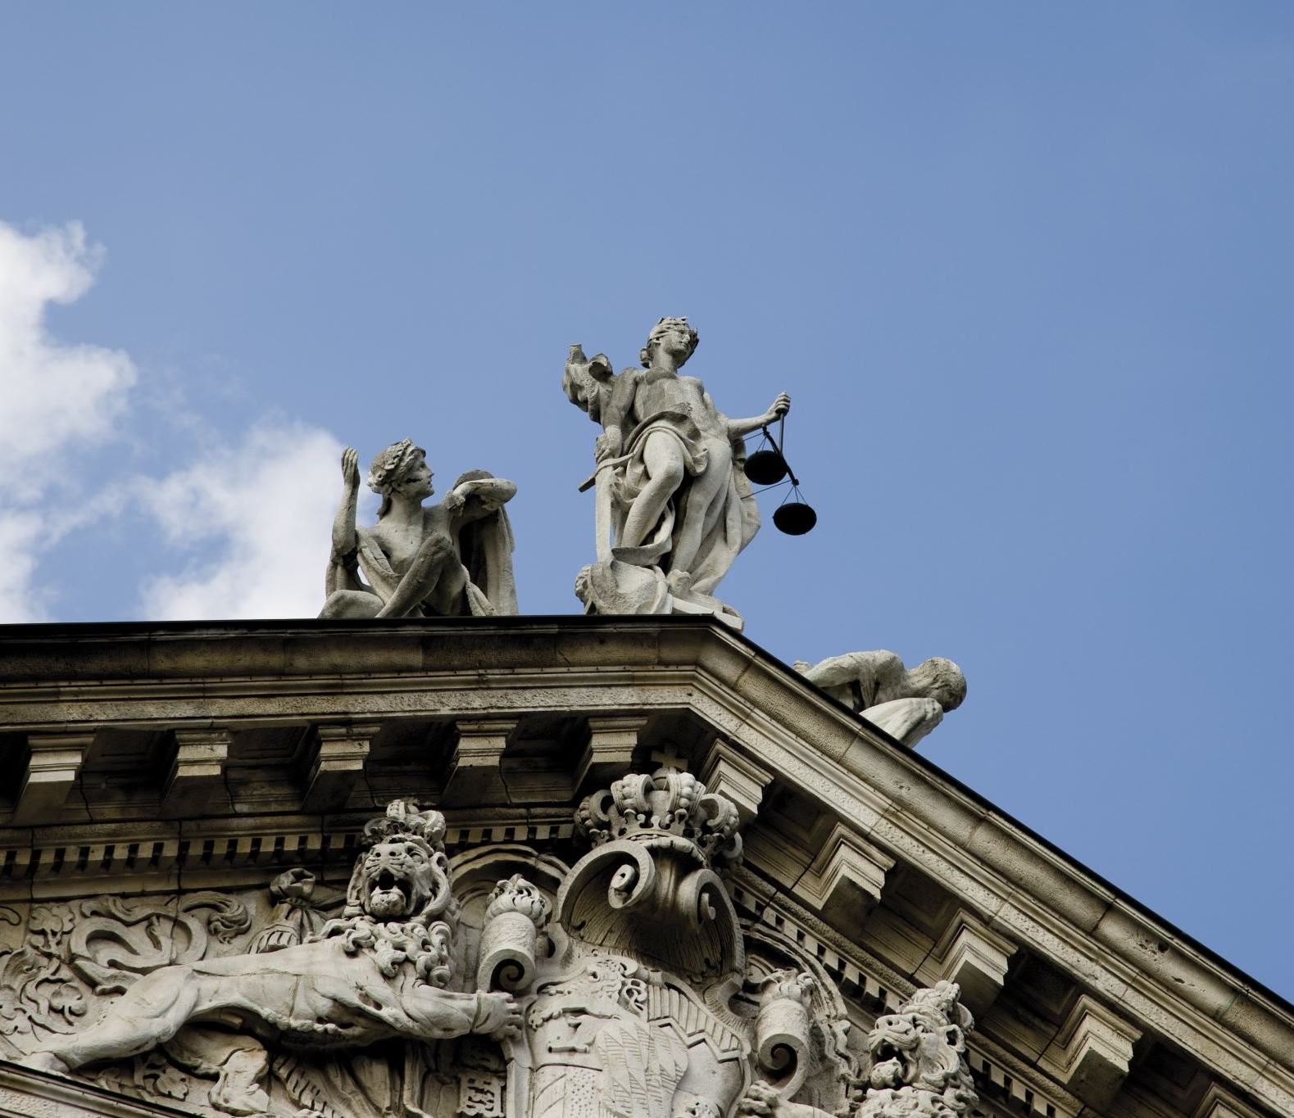
FACTS
Capital: Vilnius
Considered to be the geographical center of Europe
Population : 2,655,755 (2023 est.)
Language: Lithuanian
The largest Baltic country
Basketball tradition
Also known as Amber Capital of the world
Occupied by the Soviets and the Nazis
Gained its independence after the fall of the Soviet Union in 1990
Sensitivity about sovereignty
Migration crisis: 2021: huge wave of immigrants arrived in Lithuania, it was unprepared to face such a challenge
Many human rights were violated

Slide 4
LITHUANIA IN THE E.U.
History in the EU
- Member of the EU and NATO since May 1st 2004
- joined during the largest enlargement of the Union ( the countries were named A10)
- the negotiation process started in 1998 but the accession was delayed
- the treaty of Amsterdam and Nice were already in operation
- member of the Schengen agreement since 2007
- 19th member of Eurozone in 2015

Slide 5
LITHUANIA IN THE E.U.
ECONOMY
Transition from a centrally planned economy to a market economy through reforms such as privatization, currency reform, establishment of modern banking system and new tax system and hyperinflation policies
Relationship to the EU budget: is one of the net beneficiaries – receiver 1,7 billion
Real GDP growth rate: 5.98% (2021)
Belongs to the middle 11 countries with GDP 89% in comparison to the EU average
Exports - 53.400 dollars (2021)
Main export partners: Russia, Latvia, Germany, Poland and the United states
Imports – 50.400 dollars (2021)
Main import partners: Poland, Germany, Russia, Latvia, Netherlands

Slide 6
LITHUANIA AND RUSSIA
After the Chernobyl disaster and during the Soviet rule there was a factory built in Lithuania to provide electricity in the country economically supported by Moscow but after 1990 several million dollars were given by the EU to shut down the plant due to lack of trust in the Russians
Russia was Lithuania’s main energy source
In the last decade Lithuania promoted its energy independence from Russia, in fear of political and diplomatic pressures and potential supply disruptions
Was among many European countries that were always dependent on Russian gas imports
Lithuania tried to diversify itself by creating a terminal to import gas from other countries all around the world apart from Russia
Aims to reduce dependence on fossil fuels and develop gas import relations with neighboring countries such as Sweden and Poland.

Slide 7
LITHUANIA IN THE EU
After gaining its independence in 1990 Lithuania became one of the fastest growing economies within the European Union.
It ranks 8th in the Economic Freedom of the World
The majority of the country’s incoming investments is coming from the European Union members

Slide 8
THE GOVERNMENT
Current Constitution : applies from 1992
The Constitution aligns with the guidelines and commitments that arise from the participation in the European Union
Separation of powers: the legislative, the judicial and the executive
Parliamentary democracy
Semi- presidential system
Parliament name: Seimas- needs 2/3 majority to make decisions (except for situations concerning matters of national integrity and independence)
As of 2022 president of the Lithuanian government is Ingrida Simonyte who is also the Prime Minister

Slide 9
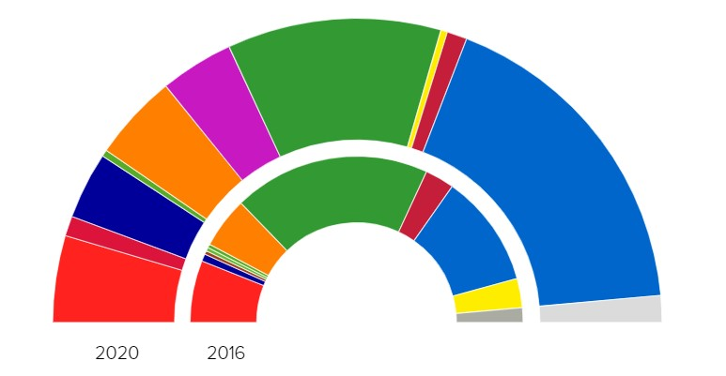
BIGGEST PARTIES IN THE GOVERNMENT IN THE 2020 ELECTIONS
TS-LKD: Homeland Union – Lithuanian Christian Democrats :light blue
Lithuanian Farmers and Greens Union : green
LSDP- Social Democratic Party of Lithuania : red
Labour Party: dark blue
Liberals' Movement: orange
Freedom party: purple
In 2020 the Homeland Union- Lithuanian Christian Democrats won the elections, led by the former Finance Minister
In the second place was a coalition between the Prime Minister at the time and The Farmers and Greens Union.

Slide 10
Voting intention since the Russian invasion in Ukraine

Slide 11
EUROSCEPTICISM IN LITHUANIA
Referendum in 2003 according to the country’s integration in the European Union
Result- was voted one of the most euro-enthusiastic countries with a 91% of YES answers, along with Slovakia with a 93.7% of euro-positive votes.
In the 2020 elections only one party supported the country’s exit from the European Union: The Lithuanian People’s Party
It’s a russophilic party, known for its hard eurosceptic policies
It has 0 seats in the Lithuanian parliament, showing the euro-friendly direction of the government.

Slide 12
Euroscepticicm
Euroscepticism hardly exists in Lithuania, because people saw the European Union as their benefactor, in hopes of becoming, after continuous decades of occupation by the Soviets, part of the Western modern world.

Slide 13
SINO-LITHUANIAN DIPLOMATIC CRISIS
2021 marked 30 years since the beginning of diplomatic relations between China and Lithuania.
On the same year Taiwan opened its representative office in Vilnious , breaching, according to China, the agreement that had been made 30 years ago in 1991 when Lithuania recognized The One China principle.
As a result, China downgraded the diplomatic relations between the two countries, asking diplomatic pressure to Lithuania.
The Lithuanian embassy in Beijing shut down
China imposed economic penalties through the ‘freezing of the bilateral trade’
Beijing blocked the Lithuanian exports to other European countries due to their Lithuanian components.
The whole crisis created serious damage to the Lithuanian economy and led to a case being formed against China by the European Union, concerning its cruel actions against Lithuania.

Slide 14
CONCLUSION
The country’s integration in the European Union turned out to be quite beneficial for the economy, the culture, the establishment of the democratic values
The participation in the union has promoted safety and security through intergovernmental cooperation

Slide 15
BIBLIOGRAPHY
European Union country profiles:
https://european-union.europa.eu/principles-countries-history/country-profiles/lithuania_en
https://lithuania.lt/key-facts-about-lithuania/
https://www.cia.gov/the-world-factbook/countries/lithuania/#introduction
History of basketball , Article written by Augustinas Zemaitis: http://www.truelithuania.com/basketball-in-lithuania-33
Lithuania in the EU: https://www.oecd.org/lithuania/RIT_HIA_Lithuania.pdf
European Committee of the Regions - https://portal.cor.europa.eu/divisionpowers/Pages/Lithuania-Introduction.aspx
Lithuanian and Russian relations : https://time.com/5754581/visaginas-nuclear-town-chernobyl/
2020 elections: https://www.politico.eu/europe-poll-of-polls/lithuania/

Slide 16
BIBLIOGRAPHY
Euroscepticism: Article: Unikaite-Jakuntaviciene, I.(2014). Eurosceptics in Lithuania: On the Margins of Politics? https://www.ssoar.info/ssoar/bitstream/handle/document/40307/ssoar-eqpam-2014-4-unikaite-jakuntaviciene-Eurosceptics_in_Lithuania_On_the.pdf?sequence=1&isAllowed=y&lnkname=ssoar-eqpam-2014-4-unikaite-jakuntaviciene-Eurosceptics_in_Lithuania_On_the.pdf
Poll on euroscepticism:
https://theconversation.com/eu-election-presidential-poll-adds-intrigue-to-lithuanian-vote-26601
Article on the Sino- Lithuanian crisis by Konstantinas Andrijauskas https://www.ifri.org/sites/default/files/atoms/files/andrijauskas_sino_lithuanian_crisis_2022.pdf
Sino-Lithuanian crisis- Chinese Journal of International Law, Volume 21, Issue 3, September 2022 https://academic.oup.com/chinesejil/article-abstract/21/3/631/6847134?redirectedFrom=fulltext
Picture of the Seimas: https://en.wikipedia.org/wiki/Seimas

