Slide 1
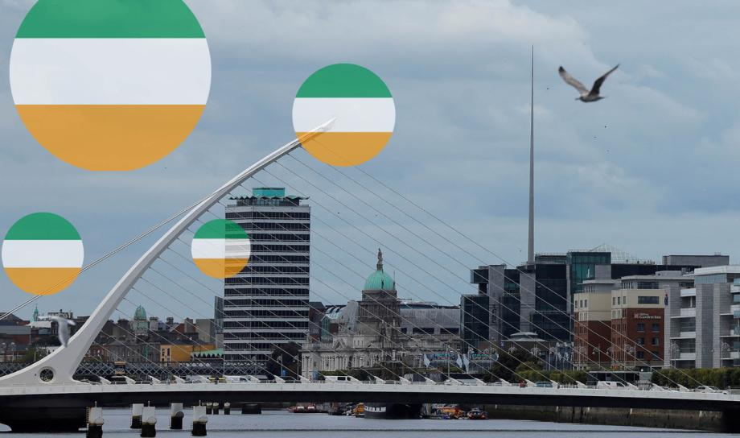
705 European Policies
Associate Professor Susannah Verney
The Polarity of Ireland
by Eleni Exarchou
“He who only tries to understand Ireland will not even understand Ireland.”
Anonymous

Slide 2
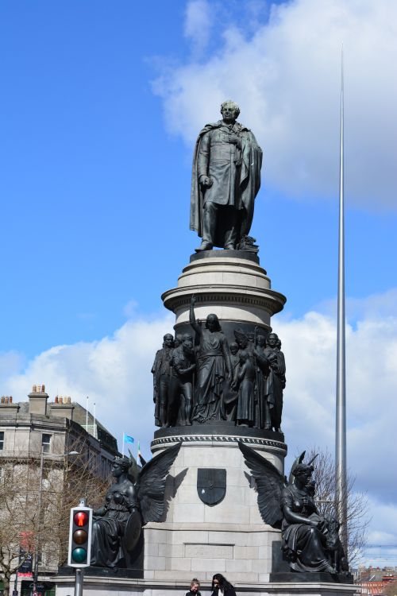
Ireland
Table of Contents
Introduction to Ireland
Ireland is a small island/country located in the far northwestern corner of Europe and of the European Union.
Originally dependant of the UK, the country earned its independence on December 1921 and for the past century has faced challenge after challenge triumphantly, proving itself a formidable force on the world stage.
After just 50 years of being an EU member-state (1st Enlargement,1973) Ireland is commonly referred to as “An example of how to succeed through the EU”.
Introduction to Ireland
ID of Ireland
Irish history of the 20th and 21st century
Economy of Ireland
Brexit
Covid-19
Russia-Ukraine War
Conclusion
Bibliography
O'Connell Monument

Slide 3
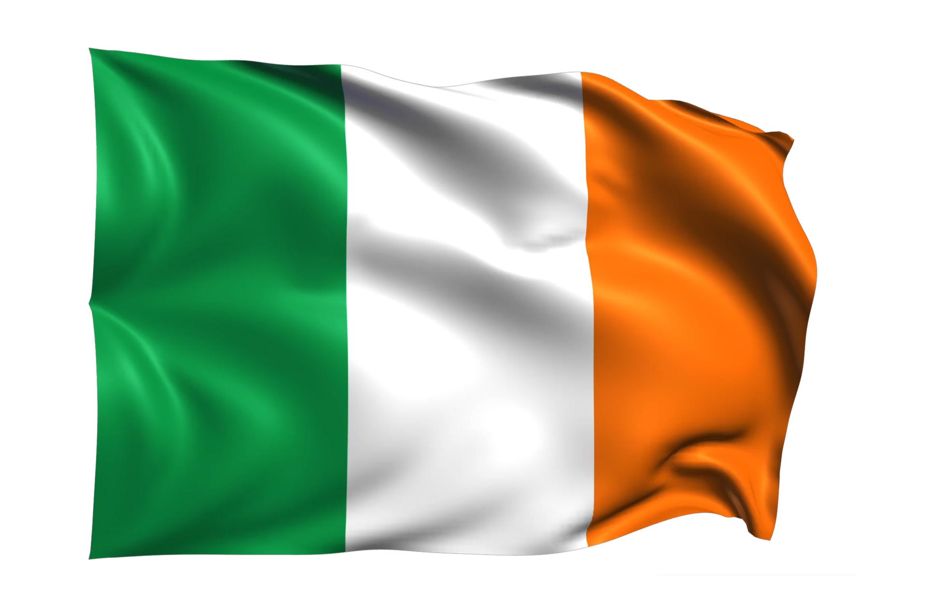
ID of Ireland: Factors shaping it’s policy
Population: 5.2 million, 1.2% of the total EU population.
Capital: Dublin, Official language: English, Irish.
Currency: Euro (Euro-area member since 1 January 1999).
Schengen: Ireland has negotiated an opt-out from Schengen area.
NATO: One of the five EU member-states that are not full time NATO members.
The Republic of Ireland follows a parliamentary and representative democratic system.
President: Michael D Higgins
Prime Minister: Leo Varadkar
International Law: it accepts ICJ jurisdiction and EU law takes precedence over its own Constitution.
Any amendment to the constitution must be done by way of referendum, approved by both Houses of the Oireachtas (parliament).

Slide 4
Irish History in the 20th Century
1921 - Post-ceasefire negotiations lead to the signing of Anglo-Irish Treaty on the 6th of December.
1922 - The Irish Free State comes officially into existence after exactly one year of Civil war that raged on in response to the parliament's decisions.
1939 - Outbreak of WWII. Country remains neutral, but many Irish citizens join the Allied forces.
1949 - The Republic of Ireland leaves the British Commonwealth.
1973 - Ireland joined the EEC. Violence in Northern Ireland intensifies. Relations between Ireland and Britain are strained.
Early 1980s - Ireland faces severe economic problems, with rising debt and unemployment. Three elections are held in the space of less than two years.
“Ireland – EU Member Country Profile.” European Union, european-union.europa.eu/principles-countries-history/country-profiles/ireland_en. Accessed 7 Oct. 2023.

Slide 5
Irish History in the 21st Century
1991 - Ireland signs the Treaty on European Union at Maastricht and receives a guarantee that its anti-abortion law will not be affected.
1998 - Good Friday Agreement. It was the acknowledgement that the people wanted a united Ireland while maintaining their respective borders by way of referandum.
1990s-2000s - Rapid economic growth earns Ireland reputation of "the Celtic Tiger".
2002 January - Euro replaces punt as national currency.
2006 - Government launches a 20-year strategy to create a bilingual, Irish- and English-speaking society.
2008 - Global financial crisis hits Ireland hard. Unemployment reaches 11% in 2009 and 100,000 people protest in Dublin at the handling of the crisis. In 2010 Ireland agrees a bailout with the EU and IMF.
“Ireland – EU Member Country Profile.” European Union, european-union.europa.eu/principles-countries-history/country-profiles/ireland_en. Accessed 7 Oct. 2023.

Slide 6
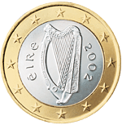
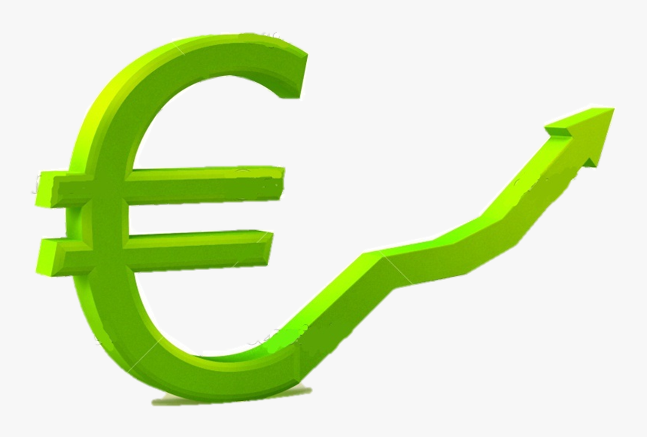
Economy - Statistics
Budget
revenues: $99.784 billion (2019 est.)
expenditures: $97.713 billion (2019 est.)
Budget surplus (+) or deficit (-)
-0.3% (of GDP) (2017 est.)
Debt - external
$2.829 trillion (2019 est.)
$2.759 trillion (2018 est.)
44.7 million € of National GDP(2022 est.)
Unemployment
4.5% of EU-27 average(2022)
4.3% (2023)
8.5% 5 year average(2014-2018)
Military Expenditures
0.3% of GDP (2022)
Tax Minimisation
12.5% (corporate tax haven)
National GDP
426.3 million€ (2021)
5.0% annual growth rate
Purchasing power
233% avg. GDP per capita
Debt-to-GDP ratio
Decreased: 44.7%(2022)
40.4%(2023)
Projected 38.3%(2024)
Irish Euro Coin

Slide 7
Ireland and the EEC: Early steps
During the first two chapters of European Integration (May 1950 and 1957) Ireland was both preoccupied and not invited by the six founding members.
1959 - Prime Minister Seán Lemass of Fianna Fáil took office and made membership to the ECC a key foreign policy consideration, believing it would benefit irish economy tremendously.
Ireland applied for full membership of the EEC on 31 July 1961.
On 14 January 1963 French President General de Gaulle casted doubts over Britain’s suitability for EEC membership and vetoed London’s application. Ireland’s EEC application was within the collateral damage of de Gaulle’s ‘Non’.
Following General de Gaulle’s resignation of office (28 April 1969) the notion of community enlargement became a possibility.
Minister of External Affairs Hillary in April 1970 published a White Paper,Membership of the European Communities – Implications for Ireland.

Slide 8
Economy - Becoming the Celtic Tiger
Ireland has a long history of economic hardships from the Potato Famine (1845-1852) to more recently an economic downfall (1950s-1973), 2008 economic collapse (international bailout)etc.
Important weakness of the irish economy was it’s “over-dependance” on the economy of the UK which at the time was performing equally slow in growth.
As well as recurring payment crises and the rise of the phenomenon of “delayed liberalisation”.
Post-war and the “Golden Age” of Europe was met by an underperforming and set in it’s ways, Ireland.
1960s Ireland starts selling goods as a whole to the then EEC and to EFTA (through UK).
Lemass’s export-led policy that catapulted irish economy to an extraordinary “over-performance” and it’s important consequences.
Through the EU membership and Single market programme in the 1980s by the 1990s Ireland could finally experience the full spectrum of it’s hard fought independence.

Slide 9
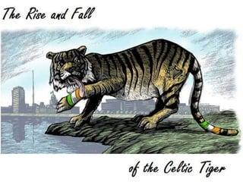
Economy - EU/Eurozone Dependance
38.7% EU share in total exports (2021).
38.1% EU share in total imports (2021).
Exports (Goods and Services): 134.4% of GDP(2021).
Imports: 95% of GDP(2021).
Ireland became a net contributor in 2014.
From 1973-2018 Ireland has received over 40 billion€ in funds.
European Social Fund(ESF): funding from the European Commission to eliminate unemployment, to further competitiveness in the entrepreneurship market and to promote economic growth.
18 November 2014: 400 million€ for seven years.
2021: European Commision Fund designated for the mitigation of the impending impact of Brexit: 920 million € in funds.
Notes:
yrski75dktfpg89gt07tg

Slide 10
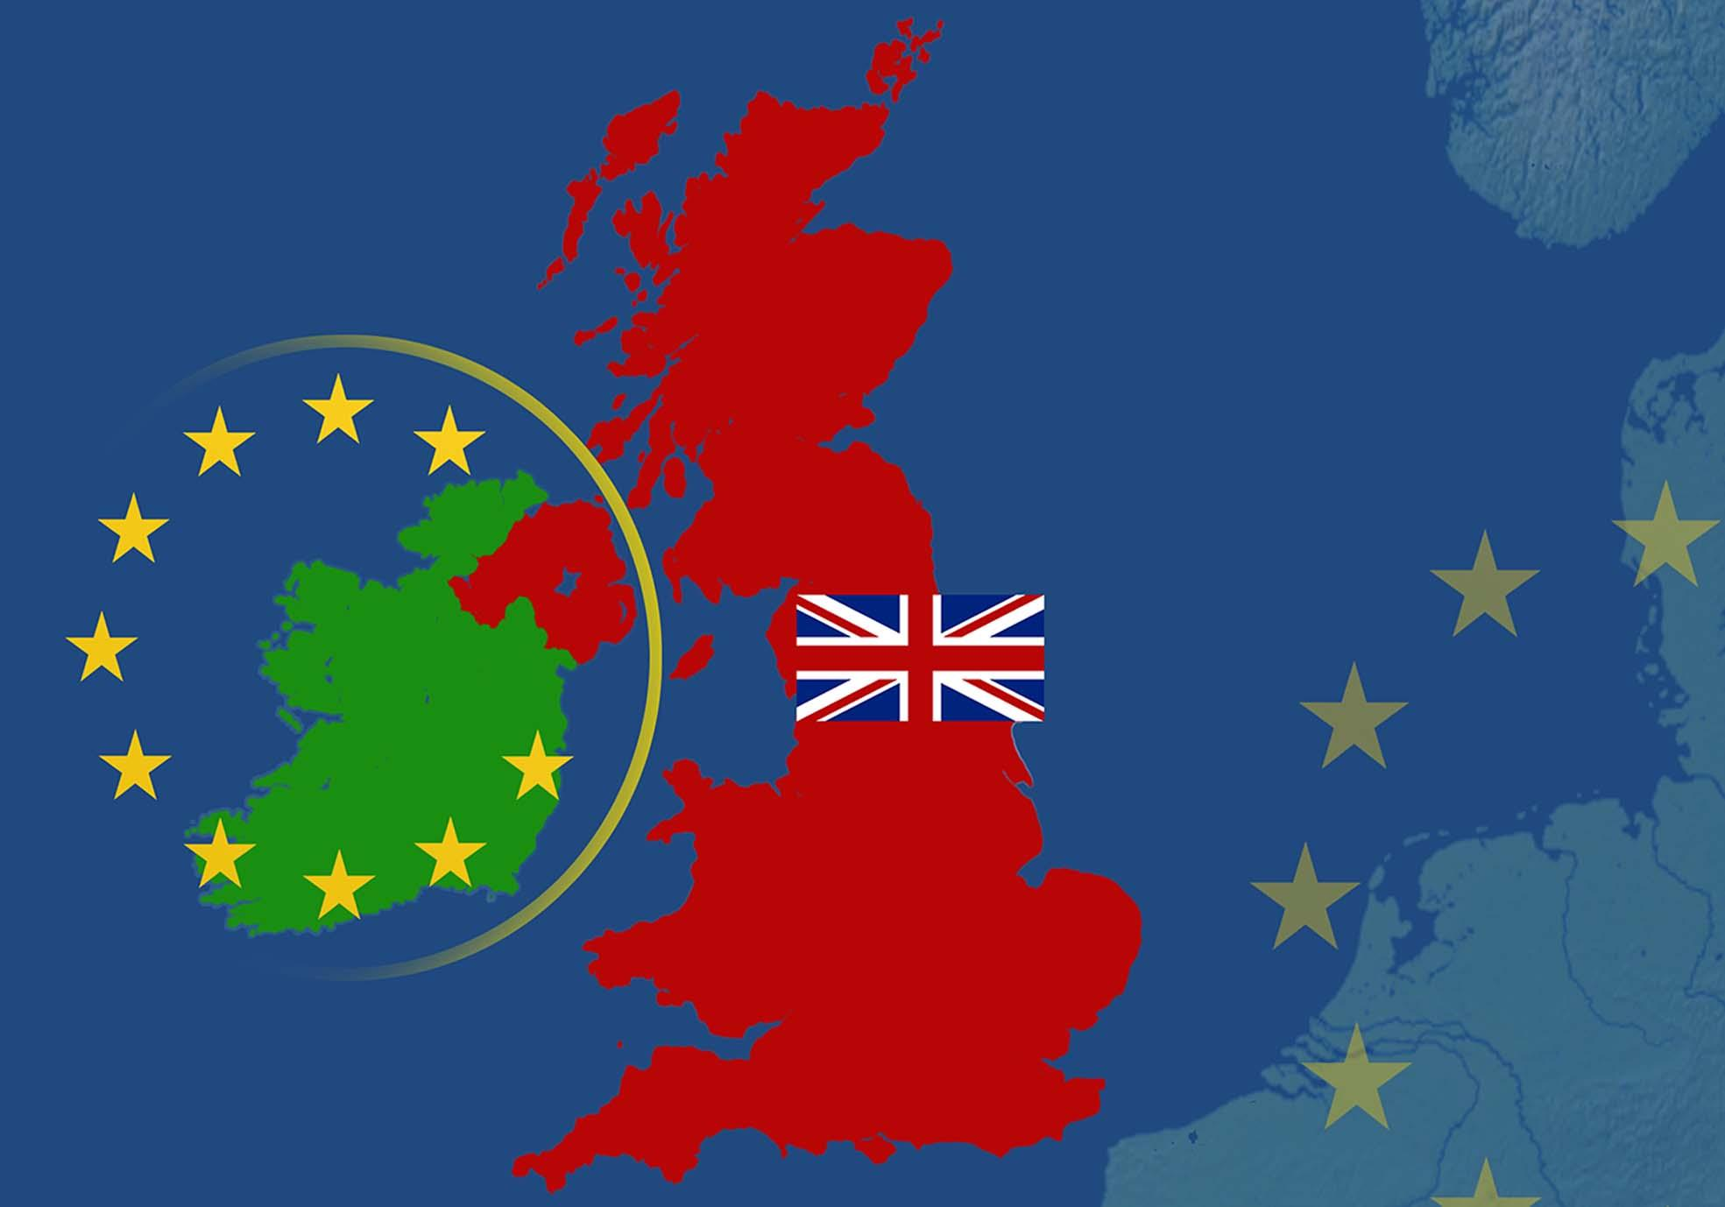
Brexit
Protocol on Ireland/Northern Ireland: a binding part of the Withdrawal Agreement, a complex system created to ensure that Northern Ireland could still benefit from access to the single market through the exchange of goods while remaining part of the UK customs territory.
Windsor Framework: formally addresses the practical difficulties faced from the implementation of the protocol, creating friction between EU & UK trade a by product of Brexit itself.
Brexit Adjustment Reserve: 5.37 billion in funding designated to assist member-states worst affected by the exit of the UK from the union.
UK-EU Trade and Cooperation Agreement: one of four similar treaties that outline any relations between both parties EU & UK. Includes a new Free Trade Agreement, Commitments on climate change, social and labor rights and tax transparency and Framework for judicial cooperation and joint management of fish stock in EU & UK waters.

Slide 11
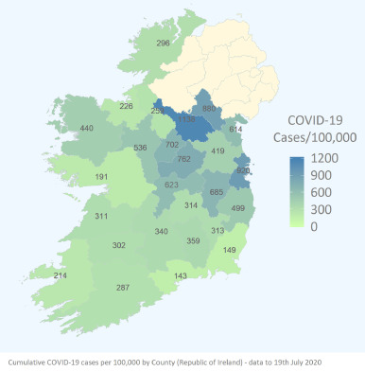
Covid-19
NPHET( National Public Health Emergency Team): a team of 30 medical, science and health professionals invoked January 2020 with the purpose of actively dealing with the covid-19 virus.
9.249 deaths in 1.7 million cases reported to the WHO(as of 12/10/23).
In the early stages the response focused on Hospital-related issues.
Public Health Advice was the most productive preventative measure.
A phenomenon was made apparent that the number of cases dropped significantly in rural and less residencial less urban areas.
https://www.sciencedirect.com/science/article/pii/S2211883720300952

Slide 12
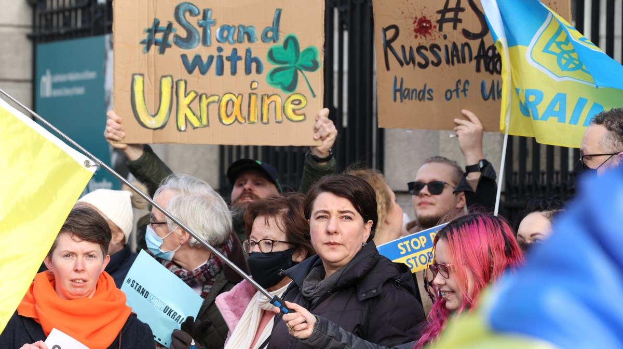
Russia-Ukraine War
Ireland is a military neutral country.
One of 5 EU members that are not NATO members
(Partnership for peace)
China, France, Russia, the US and the UK need to convene and issue an approval if the country wants to deploy a number of soldiers larger that 12.
“Triple lock” system which includes a resolution from the UN security council.
Ireland is against Russia’s full- scale invasion of Ukraine politically and in active measures along with most of its fellow EU members.
In non lethal military assistance Ireland has provided €122 million in fuel,food, medical equipment and protective gear.
Mission of the European Union: specialized training of Ukrainian soldiers, 30 members of the IDF (Irish Defence Forces) were authorized.
Regardless of the high eurobarometer statistics about financial measures (75%) and welcoming the people fleeing the war (86%), public debate over the country’s continued neutrality and it’s military responsiveness.
June 22nd 2023: The Government called for a Consultative Forum to promote understanding and to discuss a wide rage of issues.

Slide 13
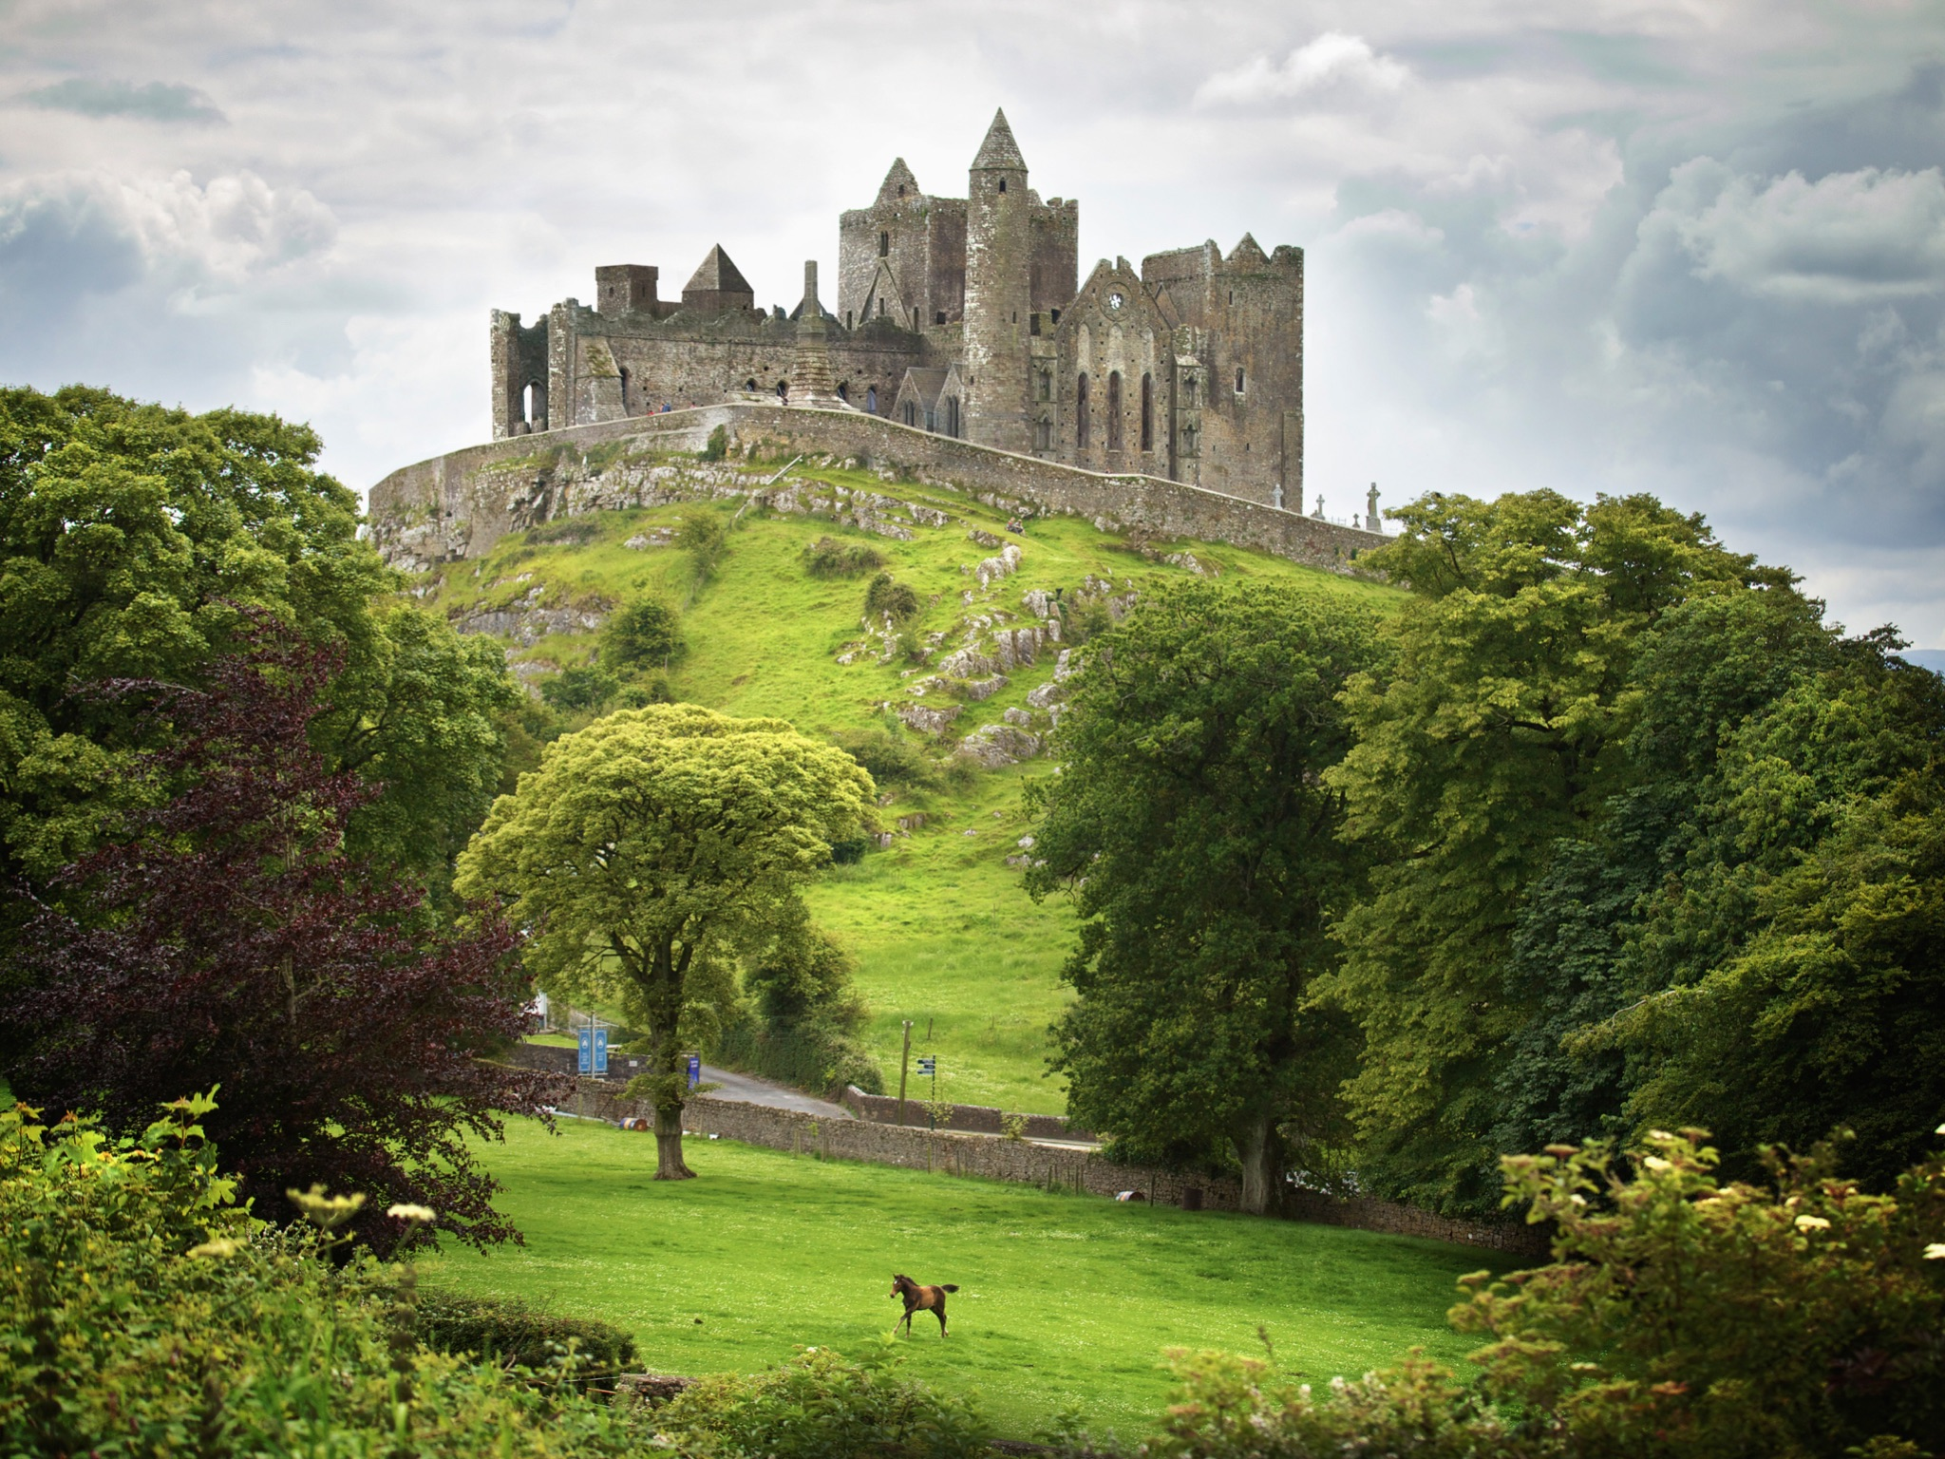
Conclusion
Ireland’s European Union policy is influenced by its economic standards and entrepreneurial efforts.
The country is no longer bound by it’s small size and close border with the UK.
It has faced some controversy over it’s support of Ukraine in the conflict.
Ireland is generally thought to be a economically crippled nation that relies on the help of it’s EU allies and faces many challenges.
In more recent times this EU member state has flourished and became not only financially stable but a shining example of the contributions and the benefits of EU membership.
Thus,showcasing its polarity.

Slide 14
Bibliography
“Ireland – EU Member Country Profile.” European Union,european-union.europa.eu/principles-countries-history/country-profiles/ireland_en. Accessed 7 Oct. 2023.
“Ireland – EU Member Country Profile.” European Union, european-union.europa.eu/principles-countries-history/country-profiles/ireland_en. Accessed 7 Oct. 2023.
“Explore All Countries- Ireland .” Central Intelligence Agency, Central Intelligence Agency, 3 Oct. 2023, www.cia.gov/the-world-factbook/countries/ireland/#government.
“The Impact of Brexit on Ireland.” Representation in Ireland, ireland.representation.ec.europa.eu/strategy-and-priorities/key-eu-policies-ireland/impact-brexit-ireland_en. Accessed 7 Oct. 2023.
Brendan Kennelly, Mike O'Callaghan, Diarmuid Coughlan, John Cullinan, Edel Doherty, Liam Glynn, Eoin Moloney, Michelle Queally,The COVID-19 pandemic in Ireland: An overview of the health service and economic policy response,Health Policy and Technology,Volume 9, Issue 4,2020,Pages 419-429,ISSN 2211-8837 (https://www.sciencedirect.com/science/article/pii/S2211883720300952).
Dinan, Professor of European Public Policy at George Mason University, Desmond, et al. “Ireland and the Art of Small-State-Ism.” EUROPP, 30 May 2023, blogs.lse.ac.uk/europpblog/2023/05/30/ireland-and-the-art-of-small-state-ism/.
DUFFY, MUIREANN. “Irish GDP Increases by over 9% with Strong Post-Pandemic Rebound.” BreakingNews.Ie, 14 July 2023, www.breakingnews.ie/ireland/irish-gdp-increases-by-over-9-with-strong-post-pandemic-rebound-1502239.html
European Economic Forecast - Economy and Finance, economy-finance.ec.europa.eu/system/files/2023-05/ip200_en_1.pdf. Accessed 16 Oct. 2023.
Birchard, Rosie. “Ireland Rethinks Neutrality in Wake of Ukraine War – DW – 04/15/2023.” Dw.Com, Deutsche Welle, 15 Apr. 2023, www.dw.com/en/ireland-rethinks-neutrality-in-wake-of-ukraine-war/a-65330418.
Commission, European. “Standard Eurobarometer 99 - Spring 2023.” Eurobarometer, europa.eu/eurobarometer/surveys/detail/3052. Accessed 7 Oct. 2023.

Slide 15
Go raibh maith agat!
(in Irish Gaelic)

