Slide 1
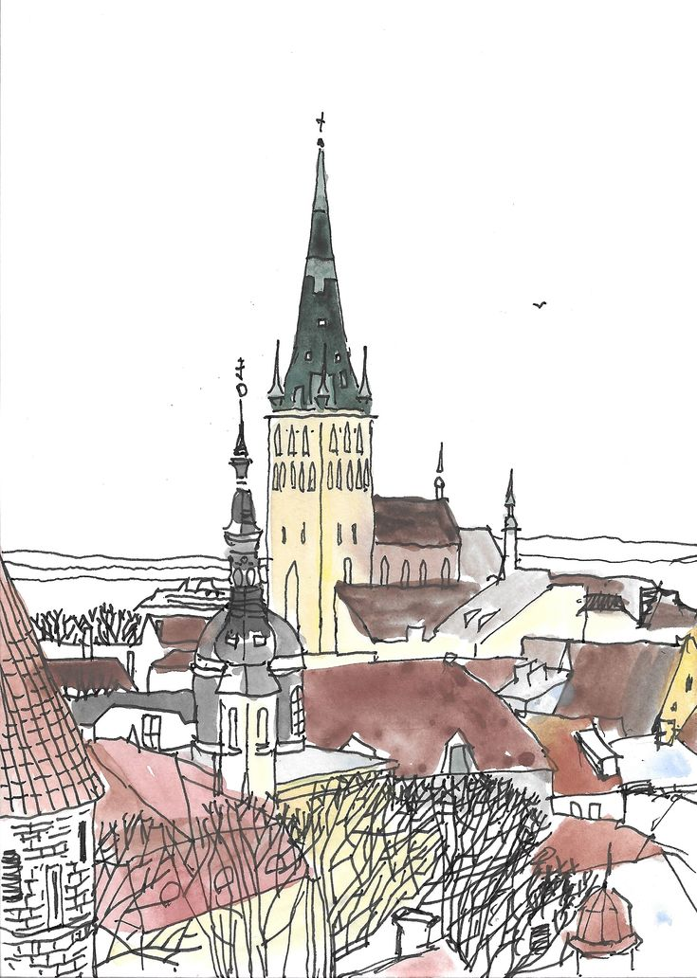
Estonia
THE EUROPEAN POLICIES OF THE EU MEMBER-STATES
UNIVERSITY OF ATHENS
STELLA SPANOU

Slide 2
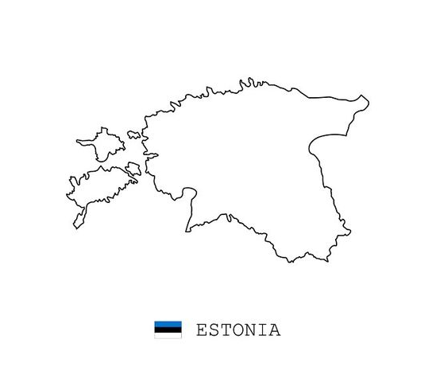
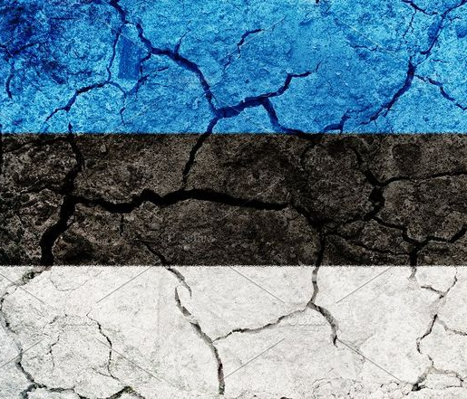
STRUCTURE ESTONIA PRESENTATION
PROFILE OF ESTONIA
ECONOMY
ESTONIA AND EUROPE
EUROSCEPTICISM
RECENT CHALLENGES

Slide 3
PROFILE OF ESTONIA basic facts
Capital: Tallinn
Official Language: Estonian
EU member country since 1 May 2004
Schengen Area member since 21 December 2007
Currency: euro. Euro area member since 1 January 2011
Surface area: 43.110 square kilometers
Population: 1.3 million ( over 1/3 of the population lives in Tallinn )

Slide 4
Republic of estonia profile
Parliamentary democracy
Head of state: President Alar Karis since 31st August 2021(elected every 5 years)
Head of government: Prime Minister Kaja Kallas since January 26th, 2021.
Parliament : 101 members, elections every 4 years
The country is divided into 15 counties and 79 municipalities.

Slide 5
Profile of estonia geography and terrain
Location: Eastern Europe, bordering the Baltic Sea and the Gulf of Finland, between Latvia and Russia
Coastline: 3.794 km
It has 1.524 islands
Natural resources: oil shale, peat, rare earth elements, phosphorite, clay, limestone, sand, dolomite, arable land, sea mud

Slide 6
Estonia: history
1710
Estonia is occupied by Russia
1918
Estonia becomes an independent state
1920
1940
Estonia is annexed by the Soviet Union. “Sovietization” and repression of political dissidents, interrupted only by the German occupation of 1941 to 1944. The Communist Party of Estonia rules the country until the 1980s
1988
Resurgence of Estonian national feeling (policy of relaxation being carried out in the USSR by Gorbachev). New political groups come into being
1990
As leaders of the anti-Soviet movement, these parties come into power
Estonia becomes internationally recognised

Slide 7
Estonia: History
1991
Estonia declares its independence (recognition by the Soviet authorities a few months later)
1994
The last Russian troops leave the country
1997
Estonia rejects the Russian proposal guaranteeing the country’s security. Preferring a close relationship with the West since its independence, Estonia seeks to join NATO and the European Union
2004
Estonia joins NATO and the European Union
2006
Toomas Hendrik Ilves, Social Democrat, becomes Head of State
2007
Estonia joined the Schengen area

Slide 8
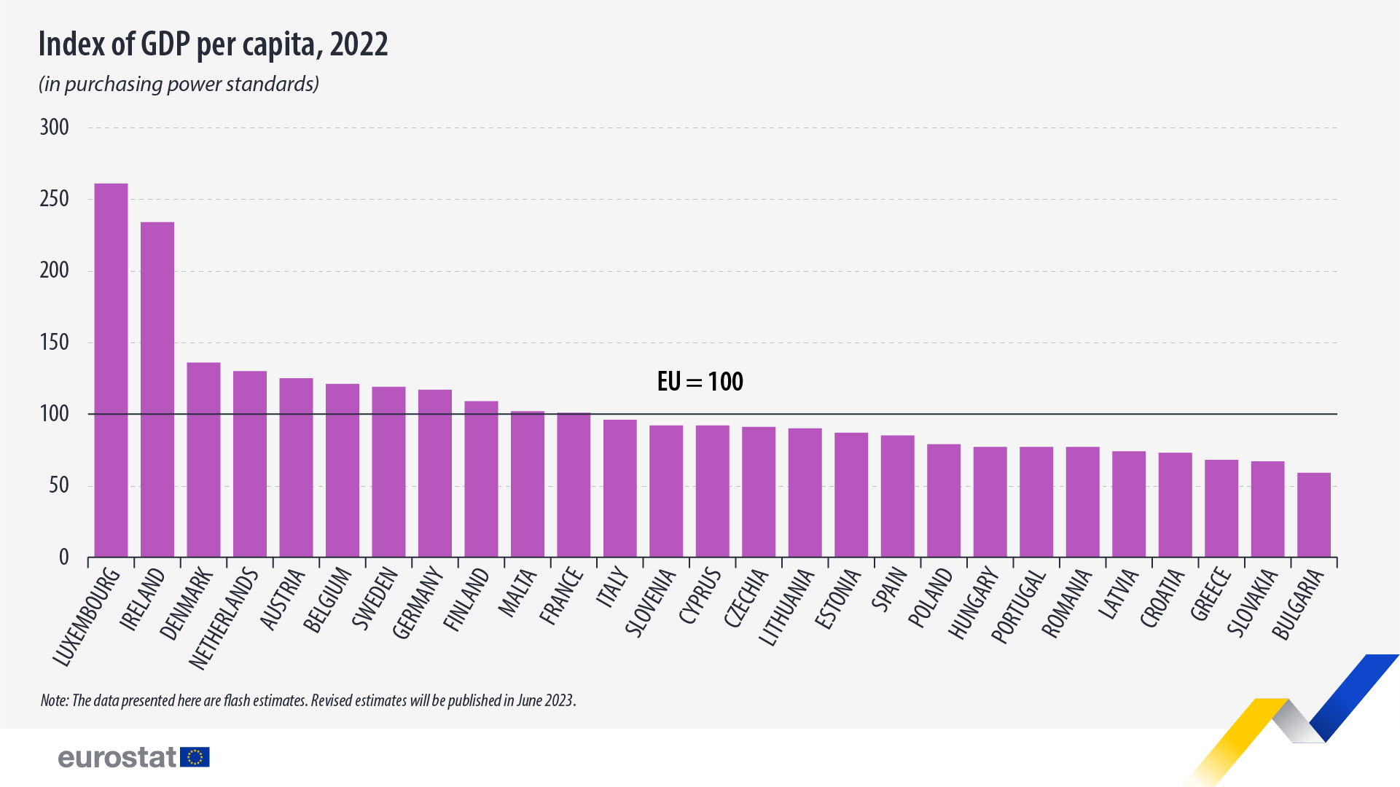
Estonia: ECONOMY
GDP growth in 2023: -2,6%
Expected to reach 1,9% in 2024
Inflation: 9,4% ( 2023 )
Unemployment: 5,6% (2022)
GDP: 36B€
GDP per capita in PPS 87 (17th in the EU)

Slide 9
Estonia: economy
Exports: 66% to EU Member States (Finland 16%, Sweden 10% and Latvia 9%)
Imports: 75% come from EU Member States (Finland 13%, Germany 10% and Latvia and Lithuania 9%)
At the end of 2022, the government debt-to-GDP ratio ranged from 18.4 % in Estonia ( lowest ratio in the EU ) to 172.6 % in Greece
Broadcasting equipment
Car tar oil
Refined petroleum
Cars
Prefabricated buildings
Refined petroleum
Cars
Coal tar oil
Electricity
Sawn wood

Slide 10
Estonia AND the eu
Estonia had been occupied by the Soviet Union for a long time
EU member in 2004 after 6 years of accession negotiations (along with Latvia, Lithuania, Poland, Hungary, Czech Republic, Slovakia, Slovenia, Malta, Cyprus)
2011: euro
2007: Schengen visa area
In the second half of 2017 Estonia held the presidency of the Council of the European Union.
EU COHESION POLICY: 3.5B€ for Estonia's economic and social development and green transition (2021-2027)

Slide 11
Estonia and europe: enlargment
Supports enlargement policy , strict but fair conditions for enlargement, and for countries that have made progress to have the opportunity to move forward in the enlargement process
Estonia’s European Union policy priorities 2023–2025: ''enlargement is now more geostrategically important than ever"
Supports
Ukraine,
Georgia
Moldova
Western Balkan countries' EU perspective

Slide 12
Estonia and europe: euroscepticism
European Union membership seen as an alternative to the influence of Russian Federation
2023 elections: EKRE in 2nd place but not included in coalition
government.
2022 annual population survey:
86% supported the
EU membership
May-June 2023 Eurobarometer survey: 68% disagree that the country could better face the future outside of the EU
Same survey: 39% think that at the present time, things are going in wrong direction in the European Union.
Eurobarometer Survey
June 2023: ' the EU has the tools to defend economic interests in the global economy?' 26th place

Slide 13
60% of Estonians that participated in this Standard Eurobarometer survey conducted in June 2023 , totally agree that the EU has the tools to defend its economic interests in the global economy.
ESTONIA AND THE EU: EUROSCEPTICISM

Slide 14
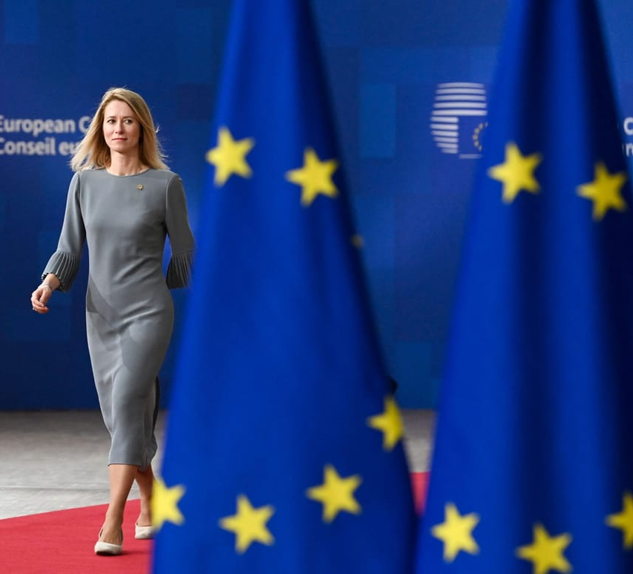
Estonia and the eu- 2023 elections
VICTORY OF THE REFORM PARTY: 31,2%
A center-right PARTY
PRO- EU
Kaja Kallas: most voted individual candidate in an Estonian parliamentary election.

Slide 15
Estonia and the eu - 2023 elections
2nd.EKRE: 16,1%
3rd.Center: 15,3%
4th.Eesti 200: 13,3%
5th.SDE: 9,3%
6th.Isamaa: 8,2%
Reform Party, Estonia 200 and SDE: COALITION GOVERNMENT

Slide 16
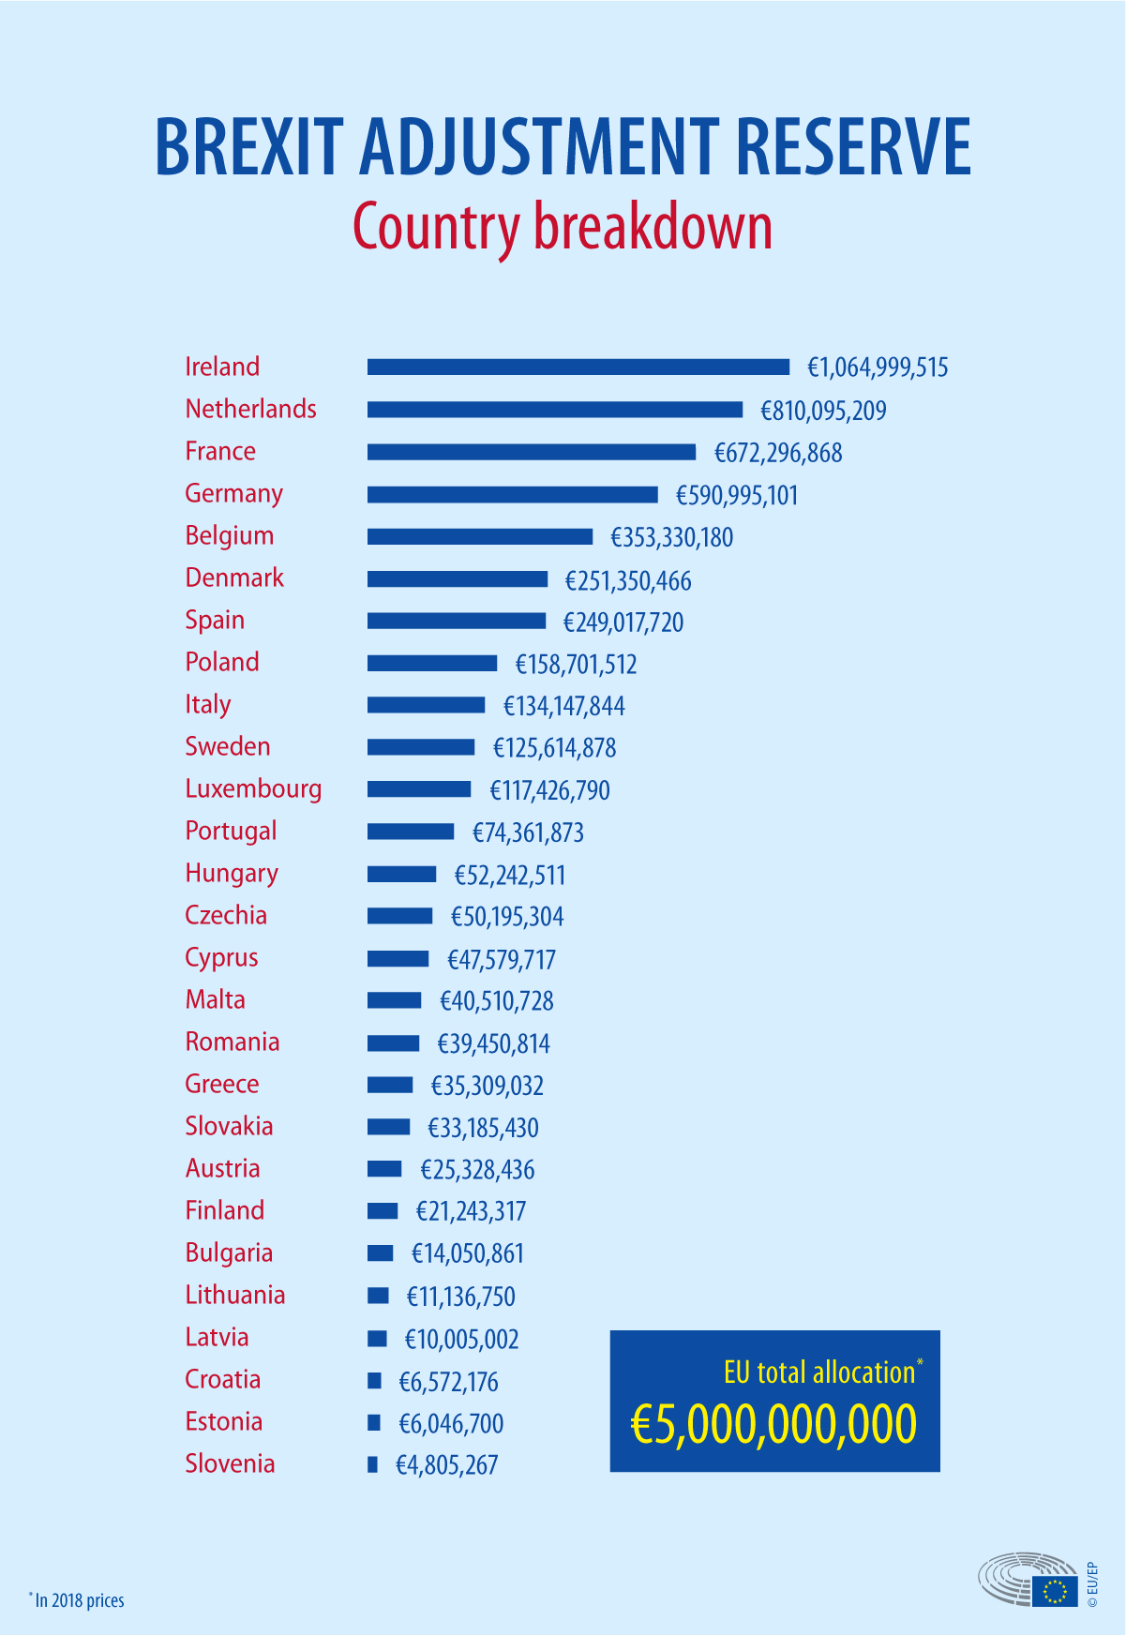
Estonia and the eu: brexit
Brexit affected directly Estonia's presidency of the Council of the EU
It took place in the 2nd SEMESTER OF 2017 RATHER THAN IN 2018
It affected Estonia's presidency priorities as it played a more relevant role in the initial stages of the Brexit negotiations
6M € to Estonia as part of the 5B€ fund of the Brexit Adjustment reserve ( aimed to help the EU countries adapt to the changes)

Slide 17
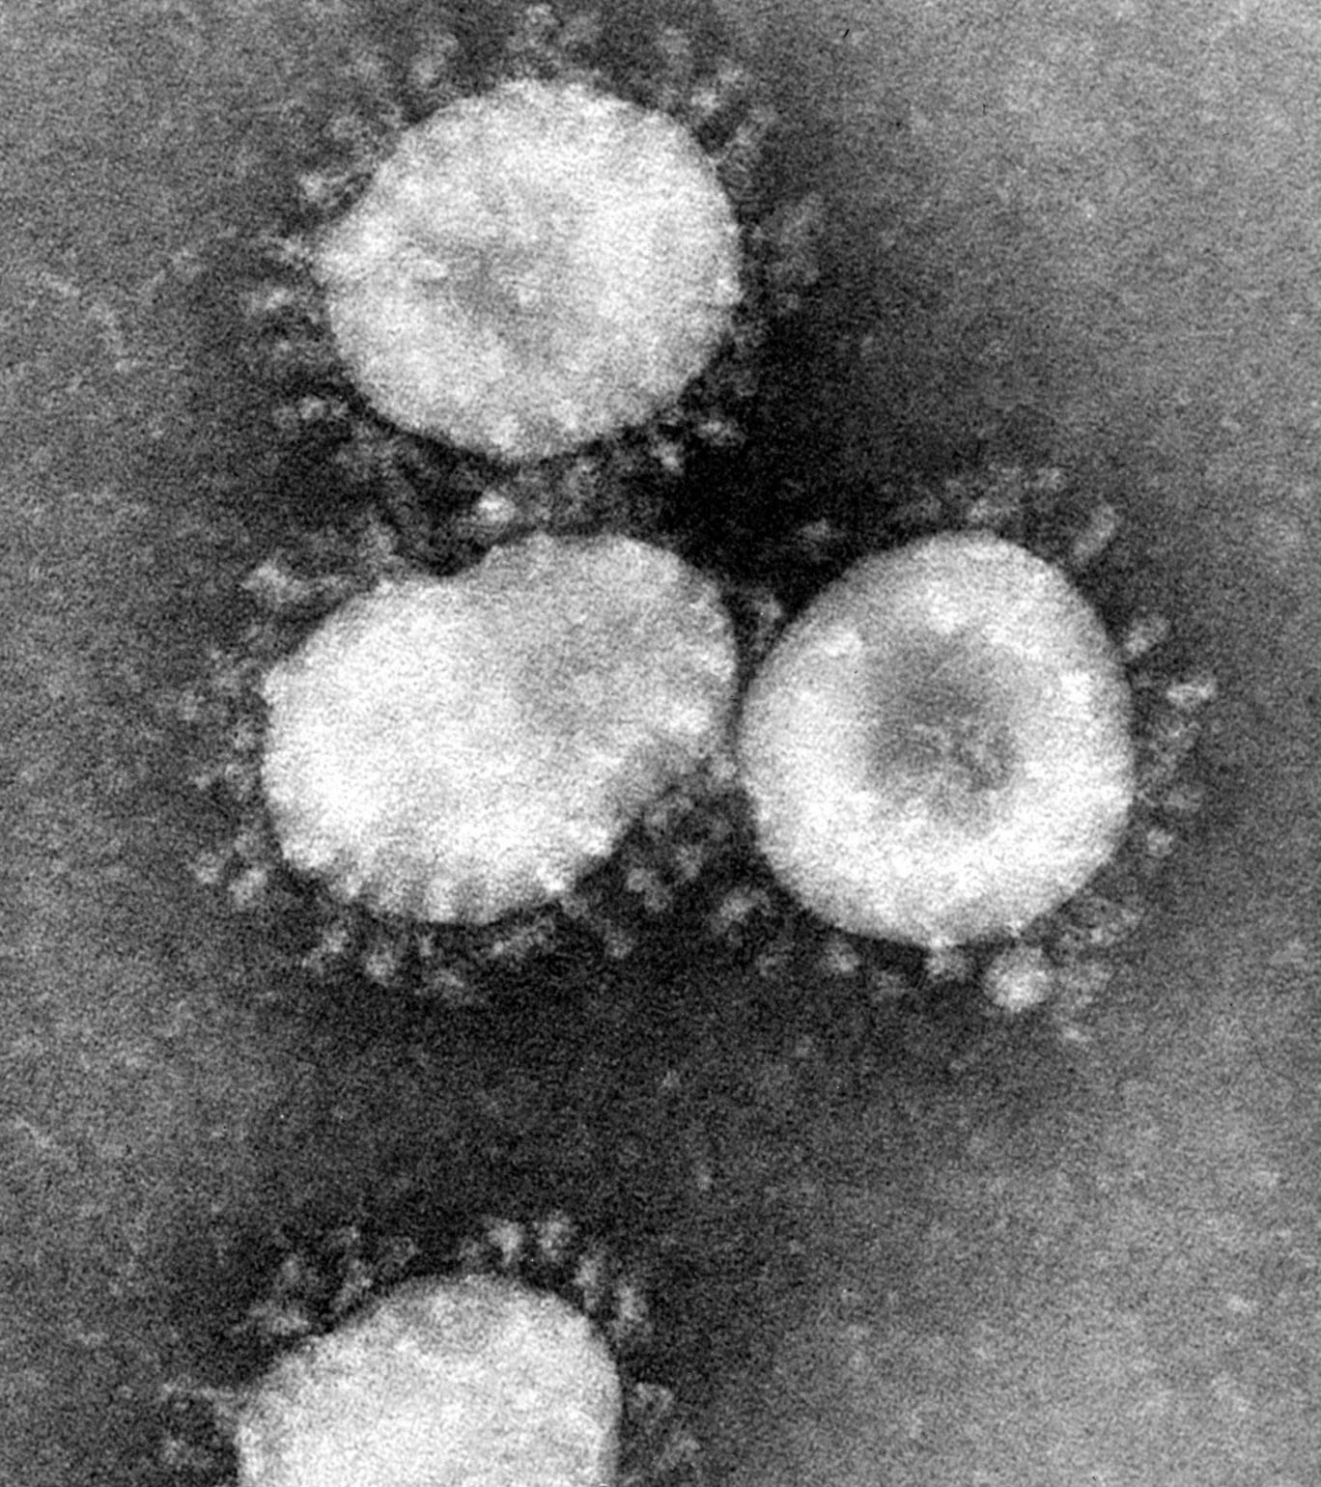
ESTONIA: RECENT CHALLENGES
COVID 19
Excellent education and health care policy response
Less effective social welfare policy response and international
cooperation
In march 2020 Estonia's level of panic was ranked 3/10 ( France: 7/10)
Might have been the best prepared nation
Economy , government , services were ALL BOUND TO TECHNOLOGY

Slide 18
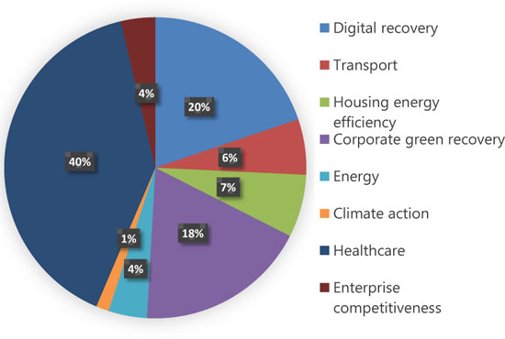
RECOVERY AND RESILIANCE PLAN 2021-2027 FUNDED BY THE EU
STRONG RECOVERY FROM THE COVID-19 PANDEMIC
updated in June 2023:
reform and investments that address
REPowerEU objectives
( which was launched
to save energy and diversify the EU’s energy
Supplies after Russia's invasion of Ukraine)
982.5 M€

Slide 19
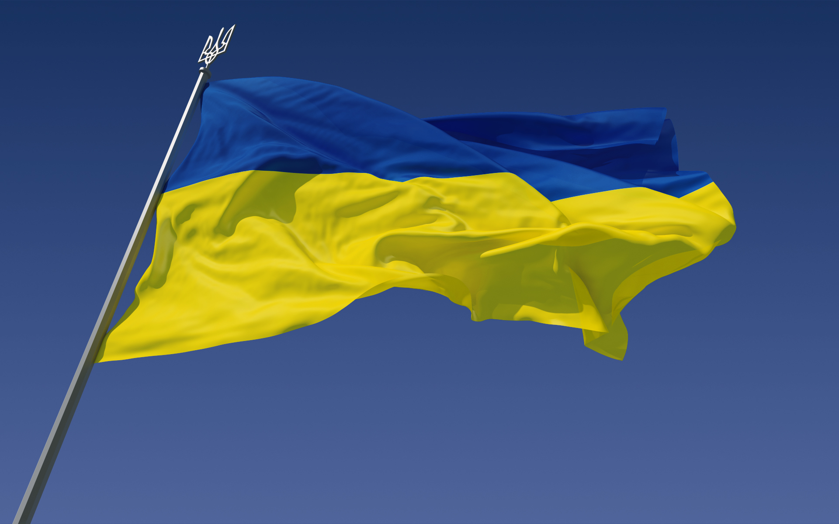
Estonia: recent challenges RUSSIA-UKRAINE WAR
One of the first countries to aid Ukraine
semi-automatic rifles
sniper rifles
sights
binoculars
ammunition
individual and special equipment
patrol boats
thermal cameras
medical equipment
Prime Minister Kaja Kallas is one of Europe's most outspoken supporters of Ukraine
ESTONIA READY TO BECOME NET CONTRIBUTOR AND LOSE FUNDING IF UKRAINE JOINS THE EU
DEFENCE ASSISTANCE TO UKRAINE: 400MIL€

Slide 20
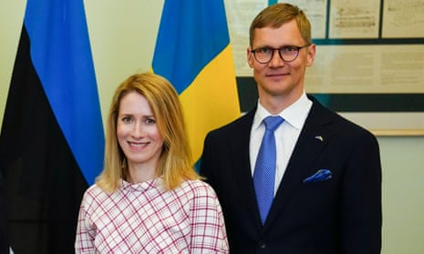
ESTONIA: RECENT CHALLENGES russian-ties scandal
Kallas’ husband Arvo Hallik owns
a quarter of the shares of a logistics company Stark Logistics
Star Logistics transports goods to and from Russia
Kallas lent 350,000 euros to her husband's business
According to her, the money has since been repaid
and her husband is now letting go of his share in the company
Kallas denied wrongdoing on the part of herself or her husband
Kallas refused to resign in September 2023,
calling the controversy a "witch-hunt" by political opponents
Reform Party reelected Prime Minister Kaja Kallas as its chairperson on Saturday, November 18

Slide 21
sources
Facts and figures on life in the European Union | european-union.europa.eu
Tallinn, Estonia | earth.esa.int
Google Earth Tallinn Map : Map Index | nationsonline.org
The world factbook : estonia | cia.gov
Estonia | strasbourg-europe.eu
Country Profiles: Estonia | european-union.europa.eu
Economic forecast,Estonia | economy-finance.ec.europa.eu
Government finance statistics | eurostat
Press corner: Eu Cohesion Policy: €3.5 billion PA with Estonia | ec.europa.eu
Estonia in the European Union | Republic of Estonia - Ministry of Foreign Affairs
Estonia’s EU policy priorities for 2023-2025 | Republic of Estonia - Government
Estonia and the European Union | Oxford University Press | research gate.net
EUROSCEPTICISM IN THE BALTIC STATES: Uncovering Issues, People and Stereotypes | Latvian Institute of International Affairs
Balancing Between Solidarity and Responsibility: Estonia in the EU, Refugee Crisis | Journal on Baltic Security 1(2):28-61 | research gate
Report: EU crisis response in tackling Covid-19 Views from the member states | European Policy Institutes Network | clingedael.org
Coalition Agreement 2023-2027 | valitsus.ee

Slide 22
Sources
Reform party takes landslide win in 2023: riigikogu elections | news.err.ee
The rise of the right wind populists in Estonia | fpri.org
Estonian Center Party | wikipedia.org
Standard Eurobarometer Survey - Spring 2023 | europa.eu
Advanced Search: Estonia | europarl.europa.eu
Republic of Estonia: 2021 Article IV Consultation | elibrary.imf.org
Estonia sent first nearly 240M in recovery and resilience facility funds | news.rr.ee
Estonia’s recovery and resilience plan | comission.europa.eu
Why Estonia was poised to handle how a pandemic would change everything | newyorker.com
Sustainable Governance in the context of the COVID-19 Crisis : Estonia report | sgi-network.org
Estonia’s aid: Ukraine | Ministry of Foreign Affairs of the Republic of Estonia
Comment: Why Estonia is worried about the war in Ukraine | press office of Newcastle University
Russia- ties scandal rocks Estonia | lrt.it
Country report- Estonia | 2020 | bridgenetwork.eu
How the eu will help mitigate the impact of brexit | europarl.europa.eu

