Slide 1
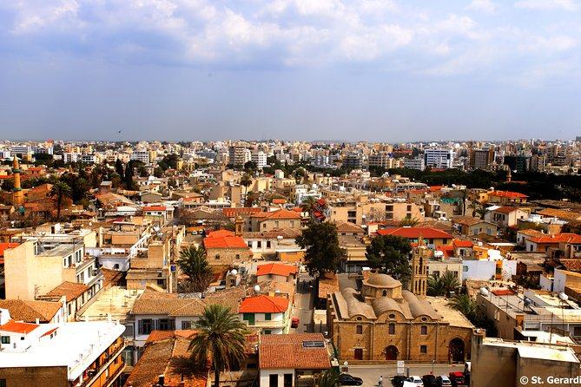
CYPRUS
PRESENTATION

Slide 2

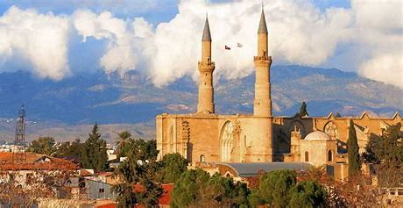

TABLE OF CONTENTS
  KEY DATAS
  HISTORY
  ECONOMY
  POLITICS
  RELATIONS WITH EU
  CRISIS
    Economic
    Russia/Ukraine war

Slide 3
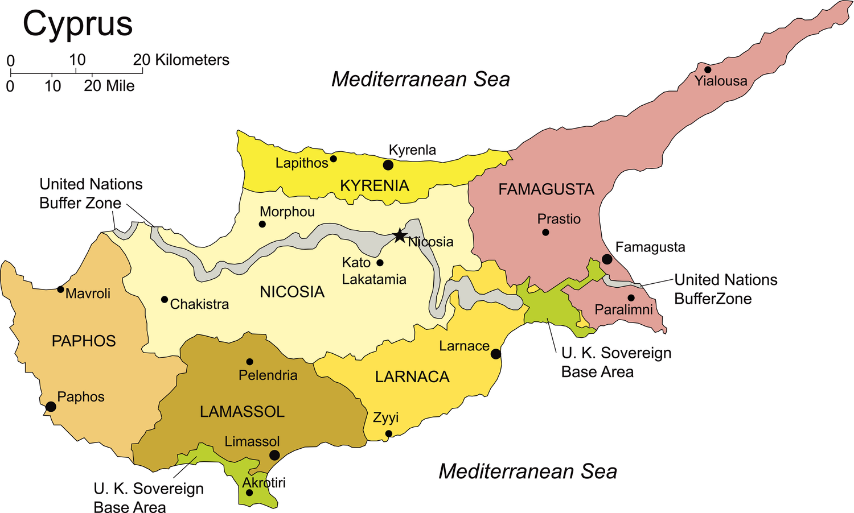
KEY DATAS
stagflation
  Capital : Nicosia
  Area : 9 253 Km2
  Population : 900 000 hab
  Languages spoken : Greek Turkish
  Administrative division :
    6 districts
    33 towns
    85 municipalities
  HDI : 0,896 (2021)
  GDP : 21, 55 billions euros
  Political system : presidential republic
  Head of government : Níkos Christodoulídes since february of 2023
  Next elections : parliamentary elections in 2026 and presidentials in 2028.
  Date of entry in the EU : 2004

Slide 4


I. HISTORY
“For centuries, the island's geographical location gave rise to constant rivalry between the powers that wanted to secure possession of it.”
1974 : Island division
The military in power in Greece organised a coup d'état against Cypriot President Makarios. Turkish troops landed in the north of the island to protect the interests of the Turkish community.
Conquered by the Franks in 1192, it then fell to the Venetians in 1489, the Ottoman Turks in 1571 and the British in 1878 (until 1960).
Known for its copper, Cyprus is at the crossroads of important trade routes.
2008 : Ledra street, a pedestrian and shopping street in Old Nicosia that had been cut in two by a wall, was reopened after 40 years.
Antiquity
XII-XVI
XVII-XIX
XX
XXI
Over the centuries, it assimilated different cultures : Mycenaean, Phoenician, Greek, Roman, Byzantine...
Proclamation of Cyprus's independence on 16 August 1960
2004 : Rejection of the United Nations plan for the reunification of the island. Cyprus enters the European Union divided.
Christmas 1963 : Intervention by UN forces following an increase in tensions between Greek and Turks Cypriots.

Slide 5

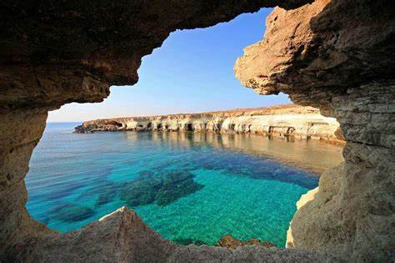
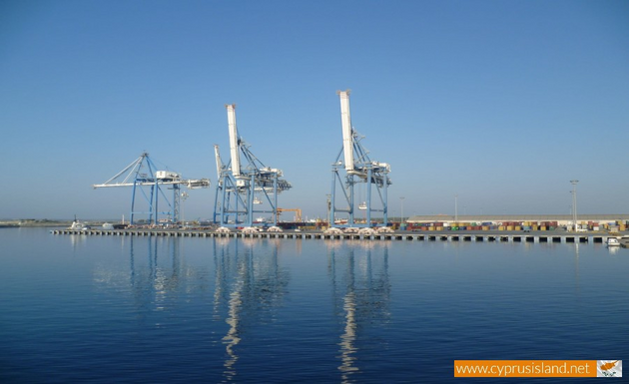

II. ECONOMY
GDP : 21,55 billions euros (2020)
Inflation : 6,8 % (2023)
Growth : 1,3 % (T3 2022)
Unemployment : 7,7 (2022)
Public debt : 91,6 % (T3 2022)
SERVICES
TOURISM
Merchant navy
TAX ENVIRONMENT
Finally, it can be said that the country's economy is largely based on the tertiary sector, which employs around 80% of the population.
Although still a tourist destination, the country has lost much of its competitiveness.
Dynamic sector, accounting for almost 5% of GDP and 60% of trade with European Union countries.
The country offers a favourable tax environment.

Slide 6
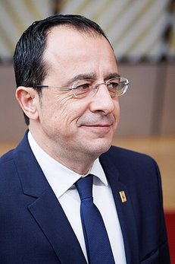
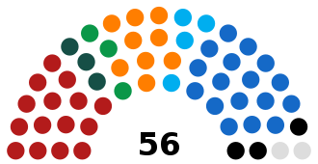
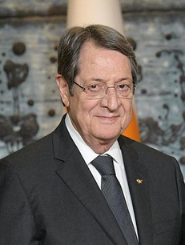
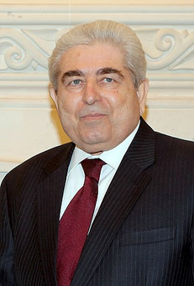
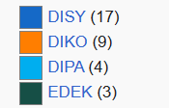
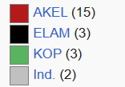
III. POLITICS
Presidents
Níkos Christodoulídes :
  elected on 12 February 2023 with almost 52% of the vote, ahead of his rival Andréas Mavroyiánnis.
  "Independent"
  He had received the support of former president Níkos Anastasiádis
Cyprus is a presidential republic in which the president is both head of state and head of government. Its unicameral parliament is elected every five years.
Parliament
Níkos Anastasiádis :
  Had served 2 presidential terms 2013-2023
  member of the conservative Democratic Rally (DISY)
Dimítris Christofias :
  President from 2008 to 2013
  Member of the communist AKEL party
  First and only head of state to be a member of a communist party within the European Union.
  The end of his mandate was marked by a serious crisis in the Cypriot financial sector.
Government
Opposition

Slide 7

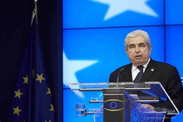

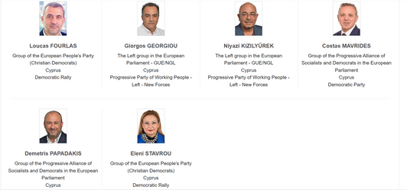
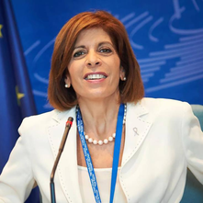

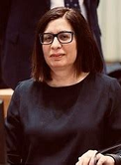
IV. RELATIONS WITH EU
Cyprus' process of integration into the European Union
Representation of Cyprus in the European political institutions :
2008 : Adoption of the euro, but no entry into the Schengen area due to the presence of Turkish armed forces in the northern part of the island.
2004 : Cyprus joins the EU. Even though the island is divided, the entire population has the title of European citizen. However, European legislation only applies to the southern part of the island.
1990 : Application for membership with an obligation of reconciliation. But the Turkish Cypriots refuse to take part in the negotiations.
1972 : Association agreement between the bicommunal government and the European Economic Community.
Cyprus held the Presidency of the Council of the European Union in 2012
Cyprus has 6 Members of the European Parliament
The European Commissioner appointed by Cyprus is Stélla Kyriakides and she is responsible for Health within the von der Leyen Commission (2019-2024).
Cyprus also has 5 representatives on the European Economic and Social Committee and the European Committee of the Regions.
Cyprus also communicates with the European institutions through its permanent representation in Brussels : Ambassador Christina Rafti

Slide 8
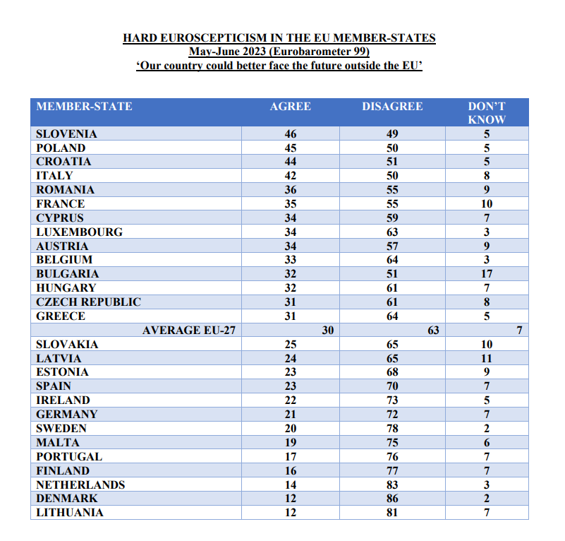
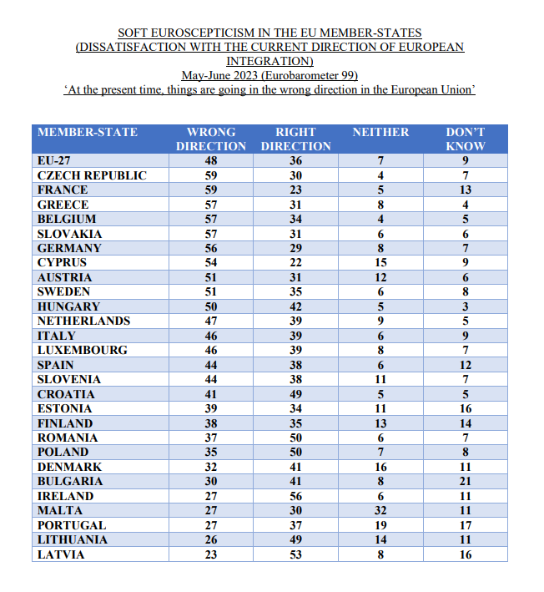
IV. RELATIONS WITH EU

Slide 9
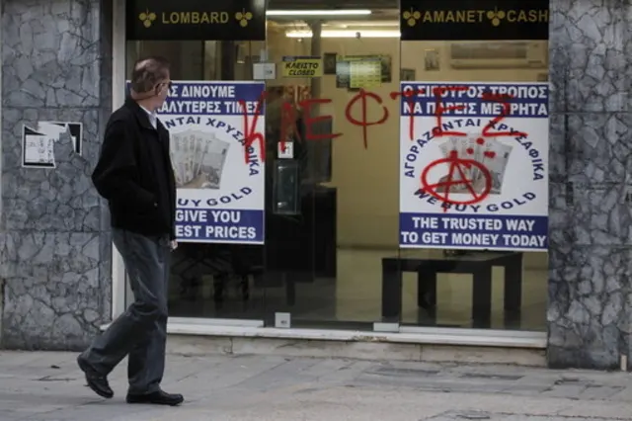
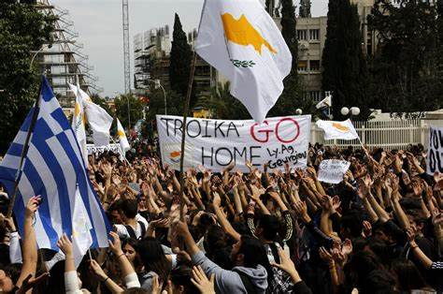
V. CYPRUS THROUGH CRISIS
Zoom : Economic Crisis of 2012-2023
=> The Cypriot financial crisis of 2012-2013 was an economic crisis that affected Cyprus' financial sector after partial defaults on Greek public debt in 2011 and 2012, along with a high deficit rate for the state, which saw its financial rating plummet.
  Beginning of the year 2012 : Russian loan of 2 millions
  15 march of 2013 :
1st EU financial rescue plan
    10 millions
    Taxation of bank deposits
=> rejected by Cypriot parliament
  25 march of 2013 :
2nd EU financial rescue plan
    23 millions
    draconian conditions
      Dismantling Laiki bank
      taxation of 30/40% of the bank accounts of individuals over 100, 000 euros
=> imposed on Nicosia

Slide 10
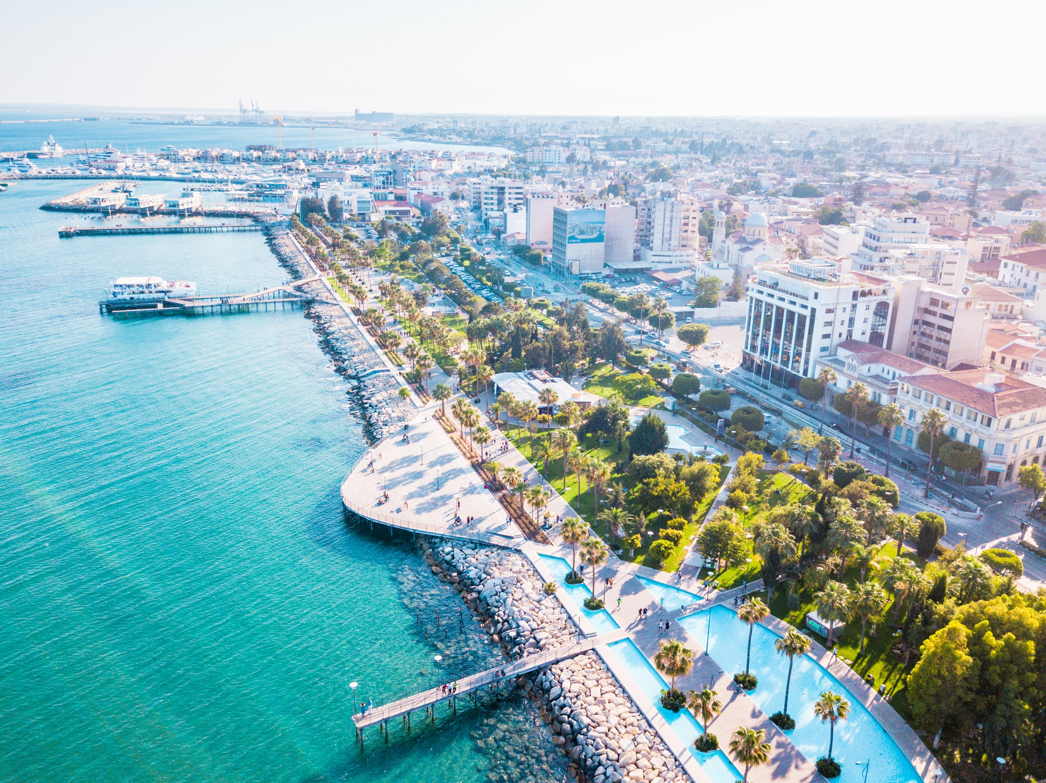

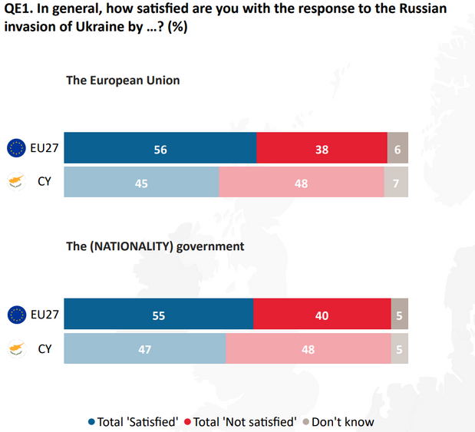
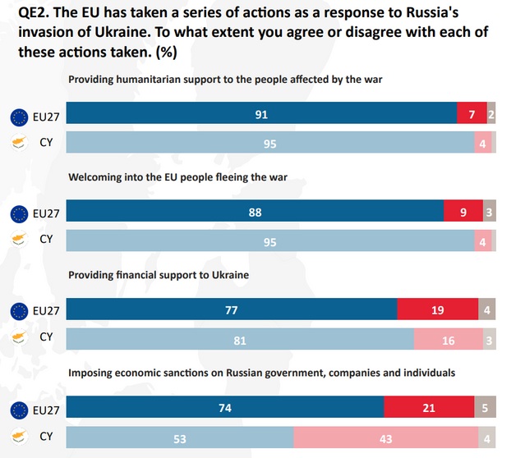
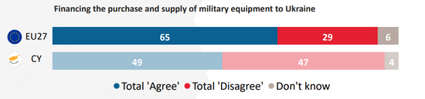
V. CYPRUS THROUGH CRISIS
Zoom : Russia-Ukraine war
  In 2020 the island has delivered passeports to Russian oligarchs
  Limassol, the financial capital :
    Nicknamed “the little Moscow”
    17% of the population is Russian speaking.
  Financial sanctions imposed by the EU to these billionairs

Slide 11

thank you for listening

